Slide 1
Classification of Questions
Petr Lorenc 2017
FIT CTU Prague
12.5.2017

Slide 2
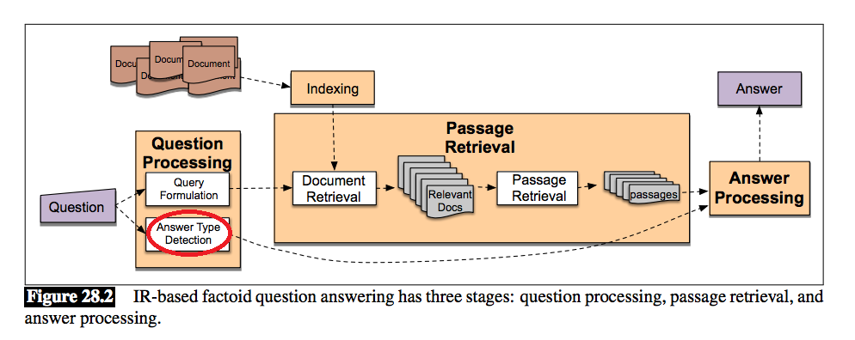
Why ?

Slide 3
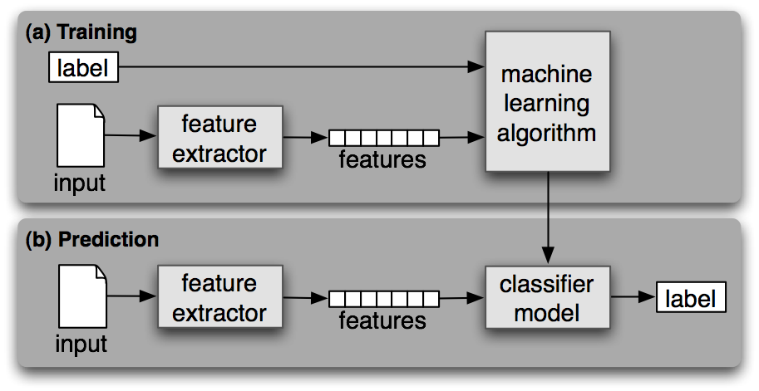
How?

Slide 4
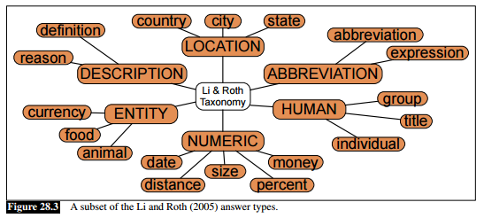
Representation of data
Tf-Idf
Bi-grams + Tf-Idf
Vector representation (with/without scale normalization)
Word2Vec
Glove
Doc2Vec
FastText

Slide 5
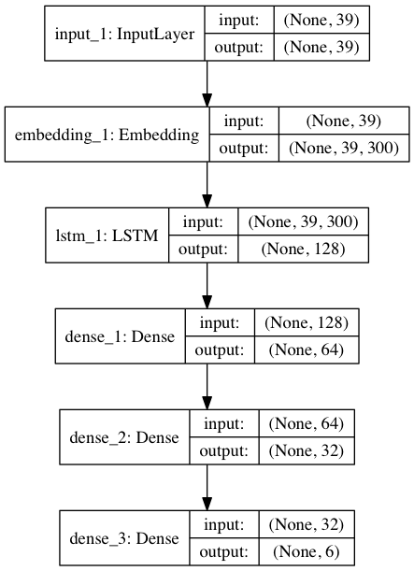
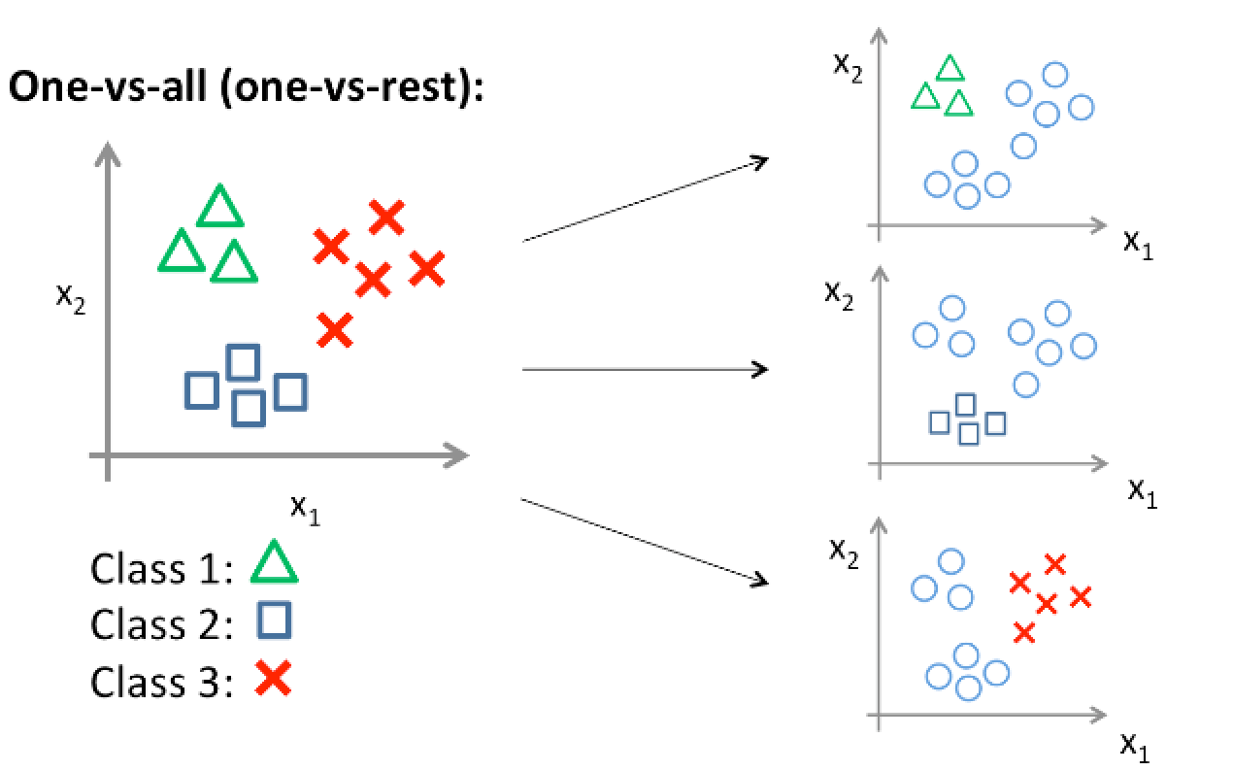
Algorithms
Naive Bayes
SVM (+ bigrams) - 83%
kNN
Neural network
LSTM - 89 %
CNN
LSTM + CNN

Slide 6
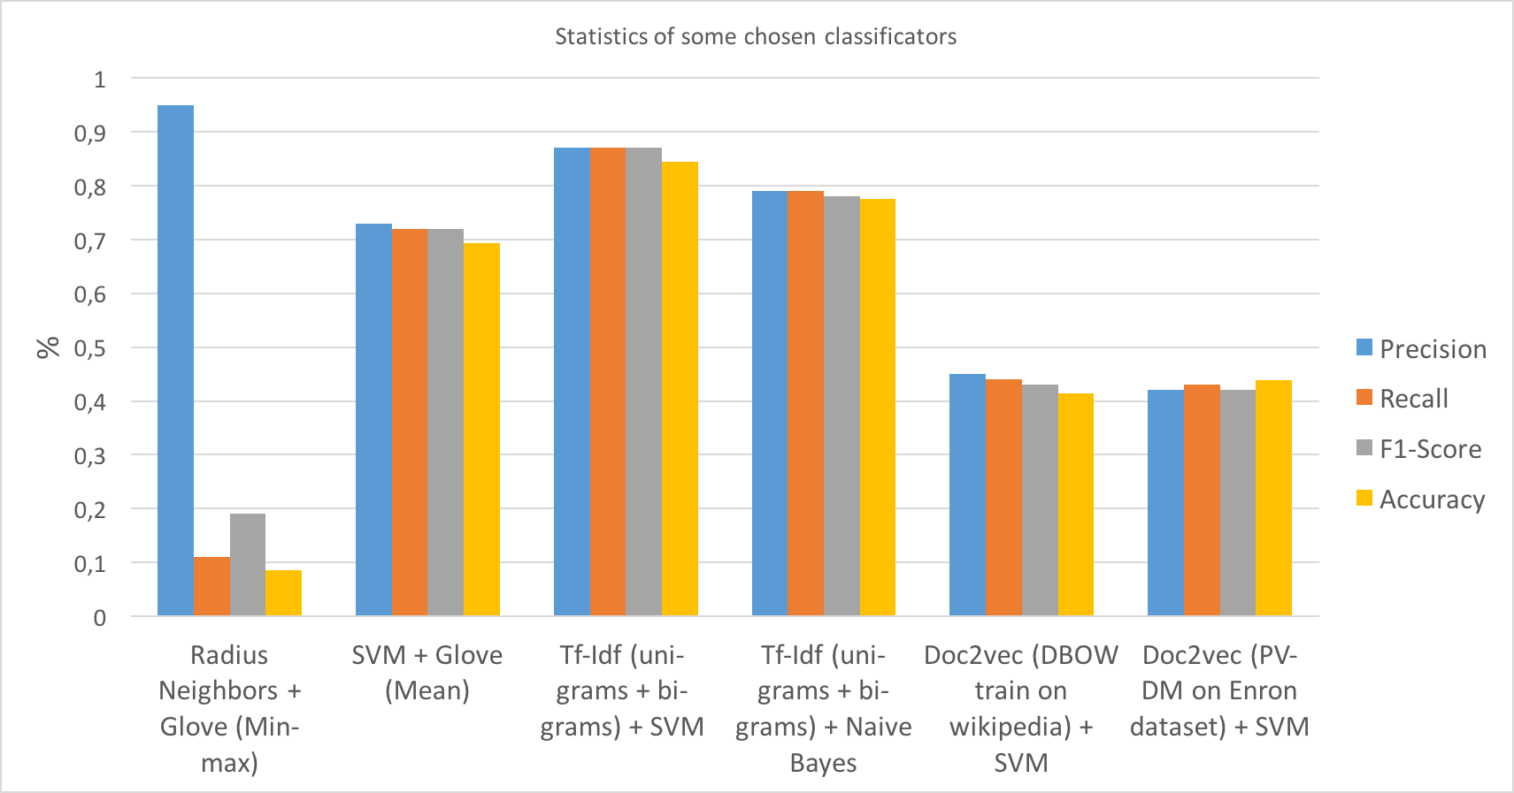
Results

Slide 7
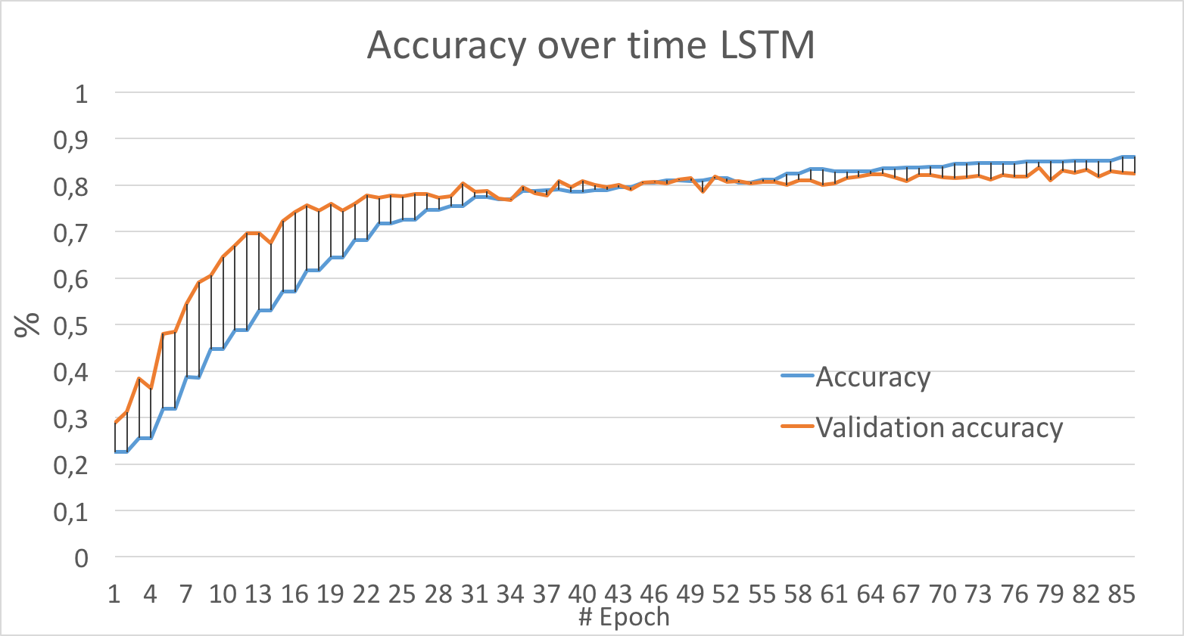
Results

Slide 8
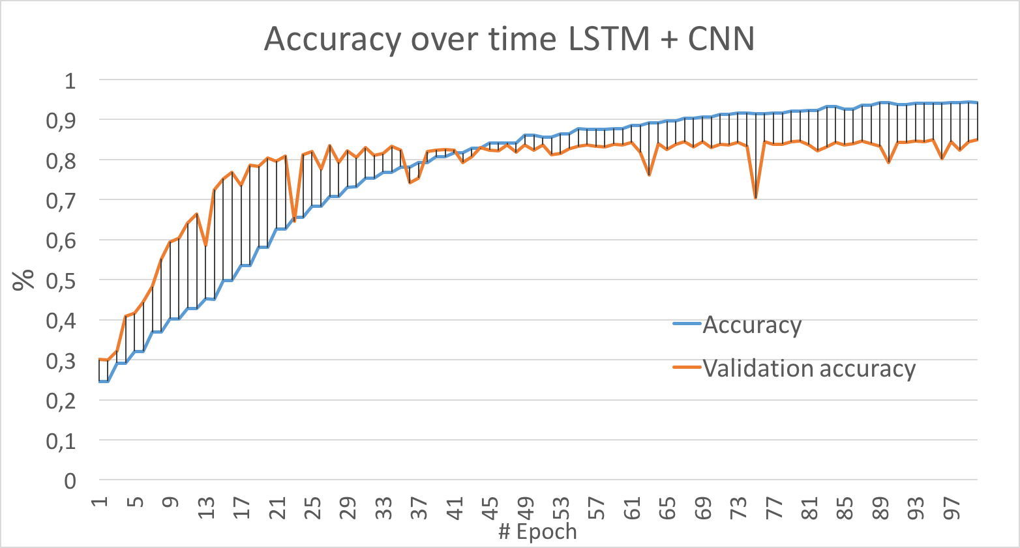
Results

Slide 9
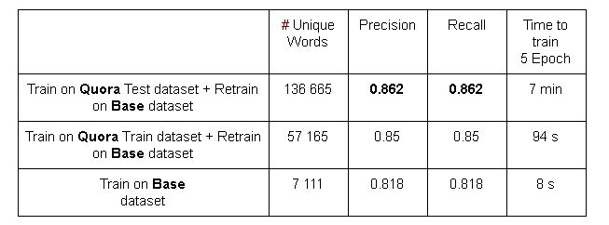
Results
FastText is library from Facebook, which has build-in function to classify text (based on train data), it also provide similar functionality like word2vec

Slide 10



Reference
Frameworks
Code
https://web.stanford.edu/ jurafsky/slp3/28.pdf
Available at: https://github.com/petrLorenc/EmailReply
Report at: https://github.com/petrLorenc/EmailReply/blob/master/report.pdf

