Slide 1
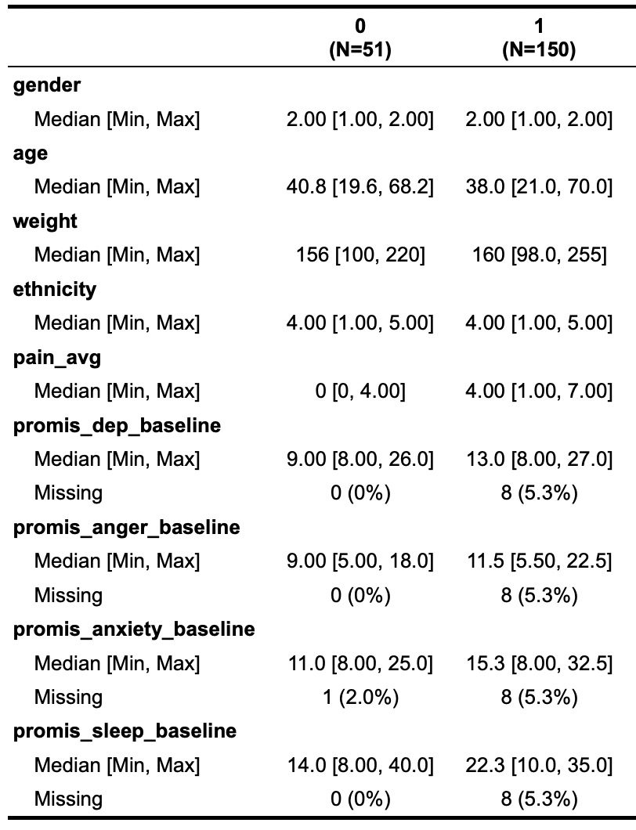
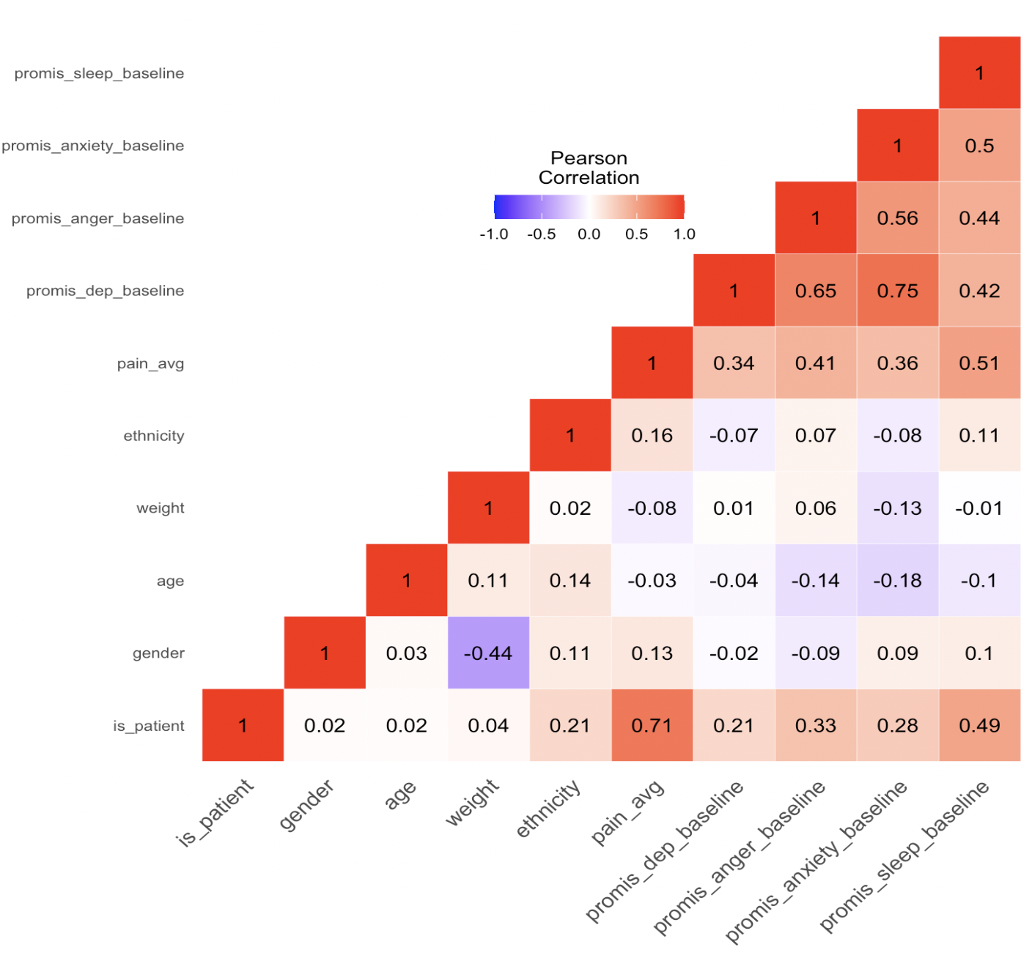

Slide 2
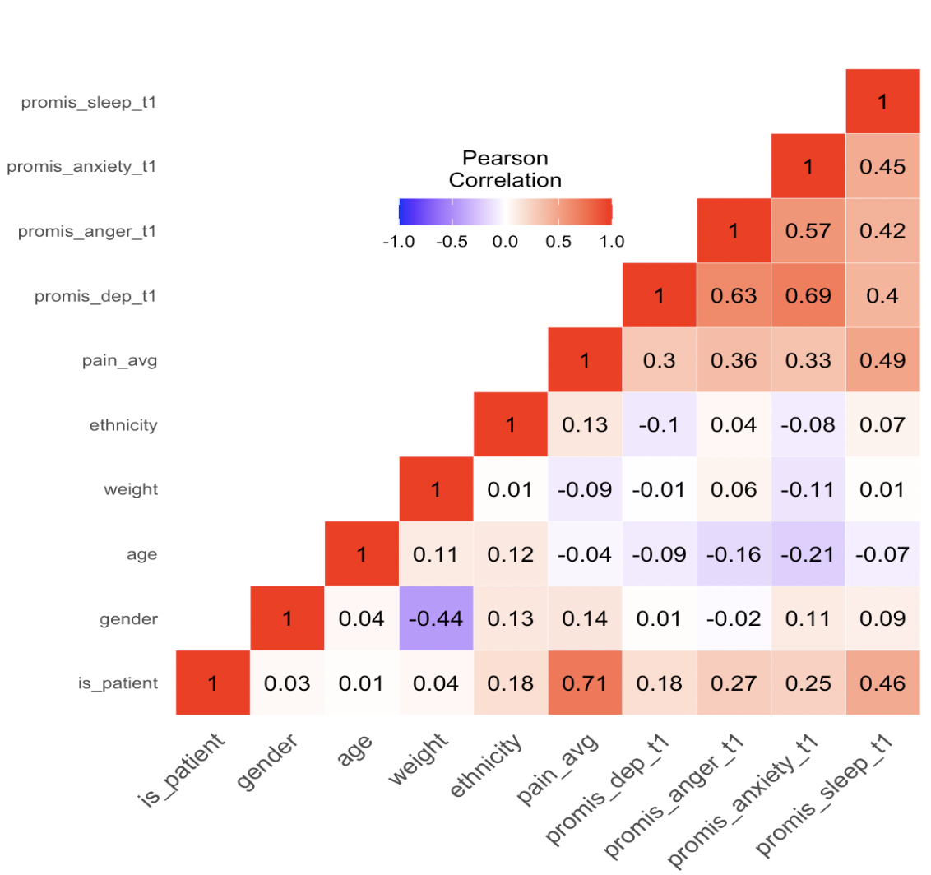
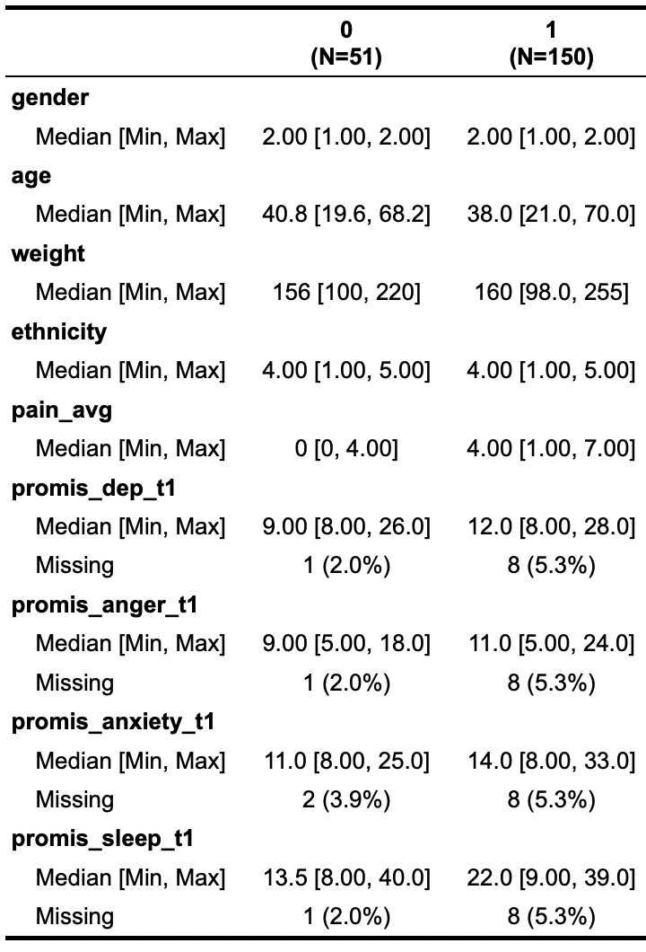
Using T1 instead of baseline (CBP) and healthies_measures.mat instead of metadata in brainpathway

Slide 3
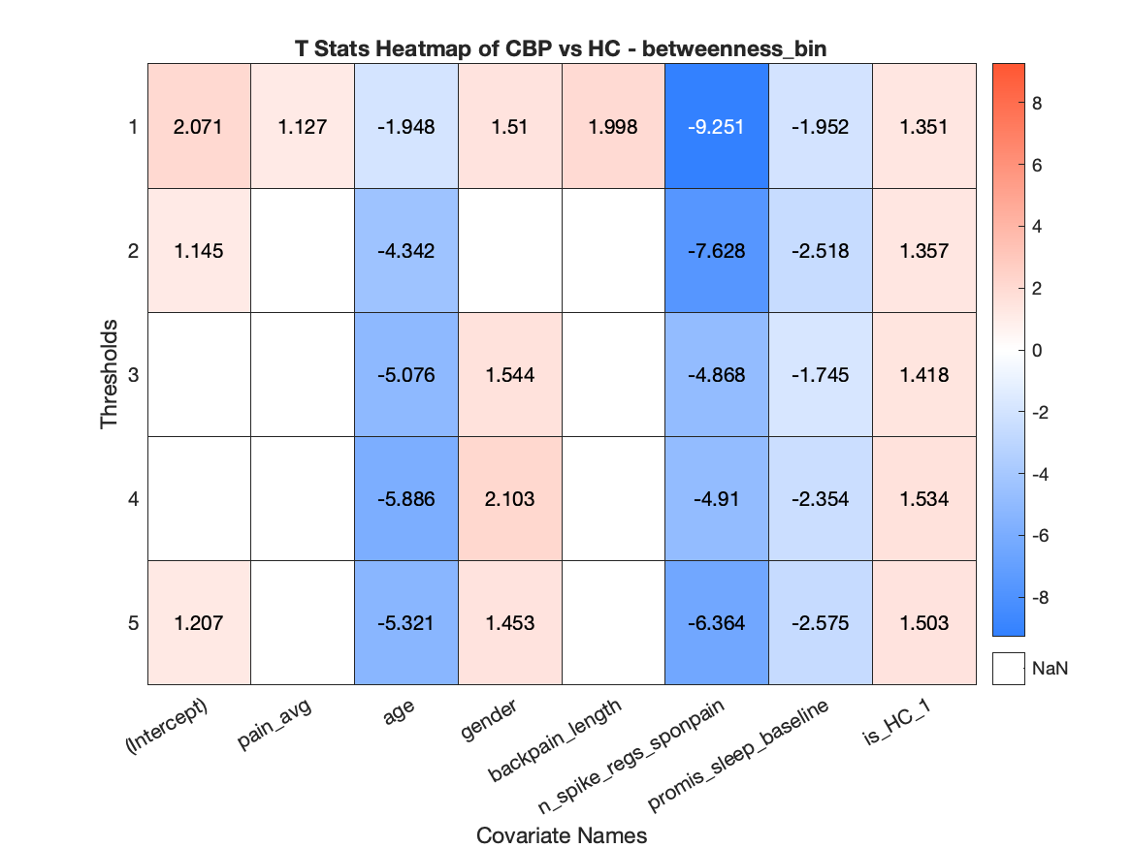
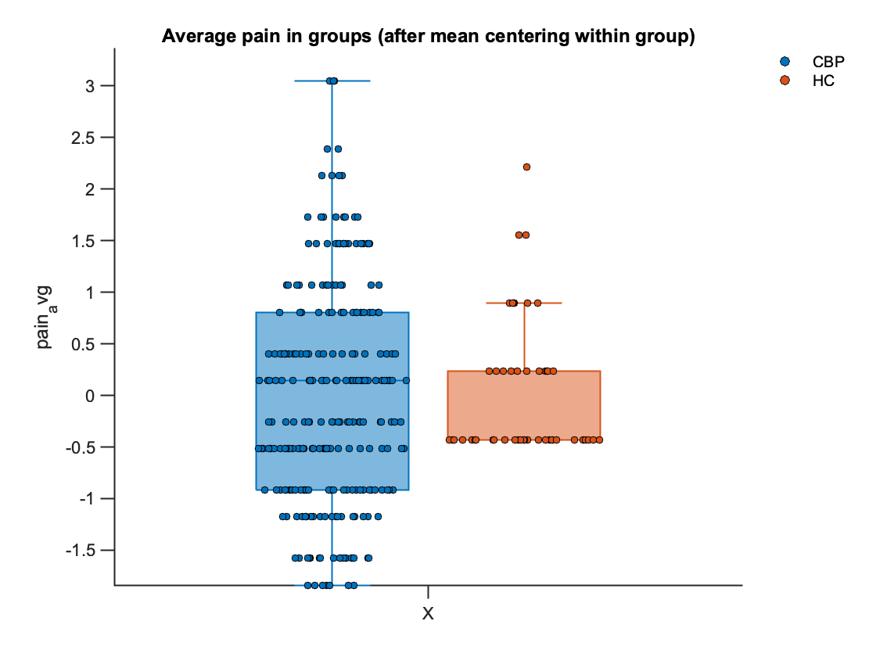
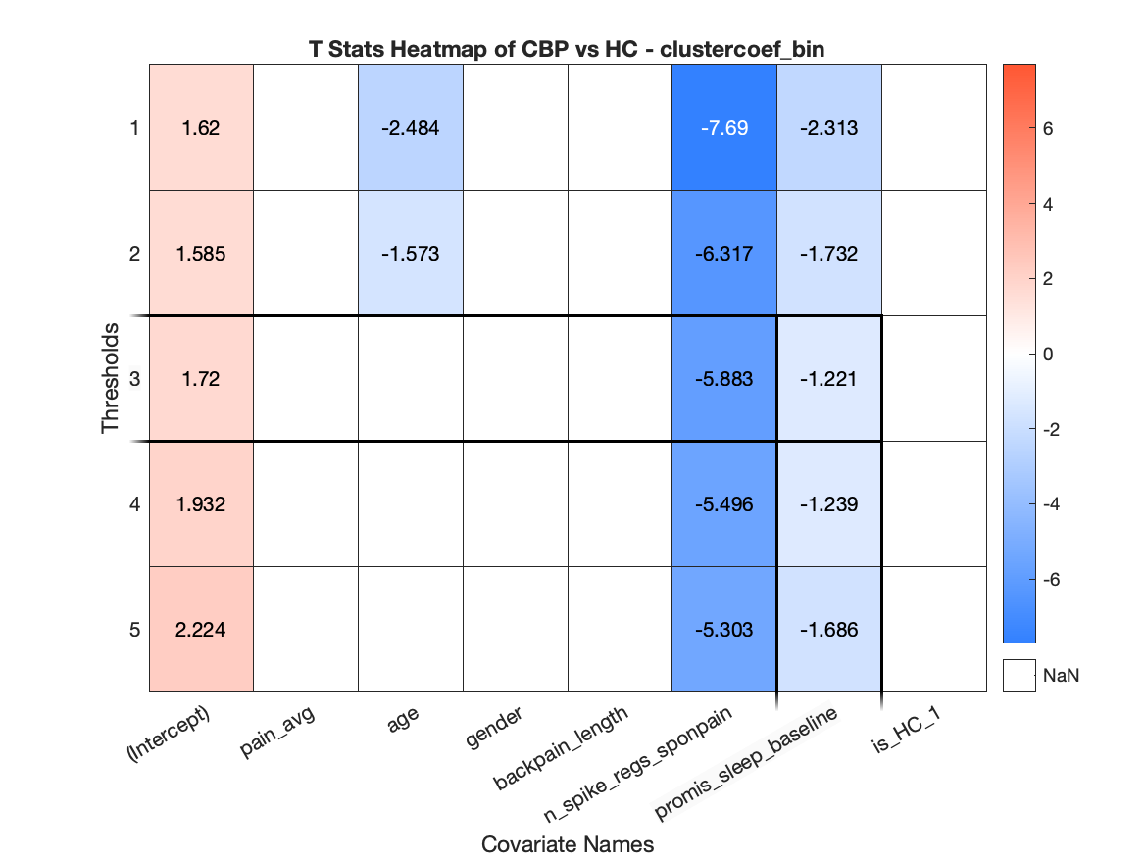
HDI LMMs
Pain average & promis_sleep_baseline mean-centred before standardising

Slide 4
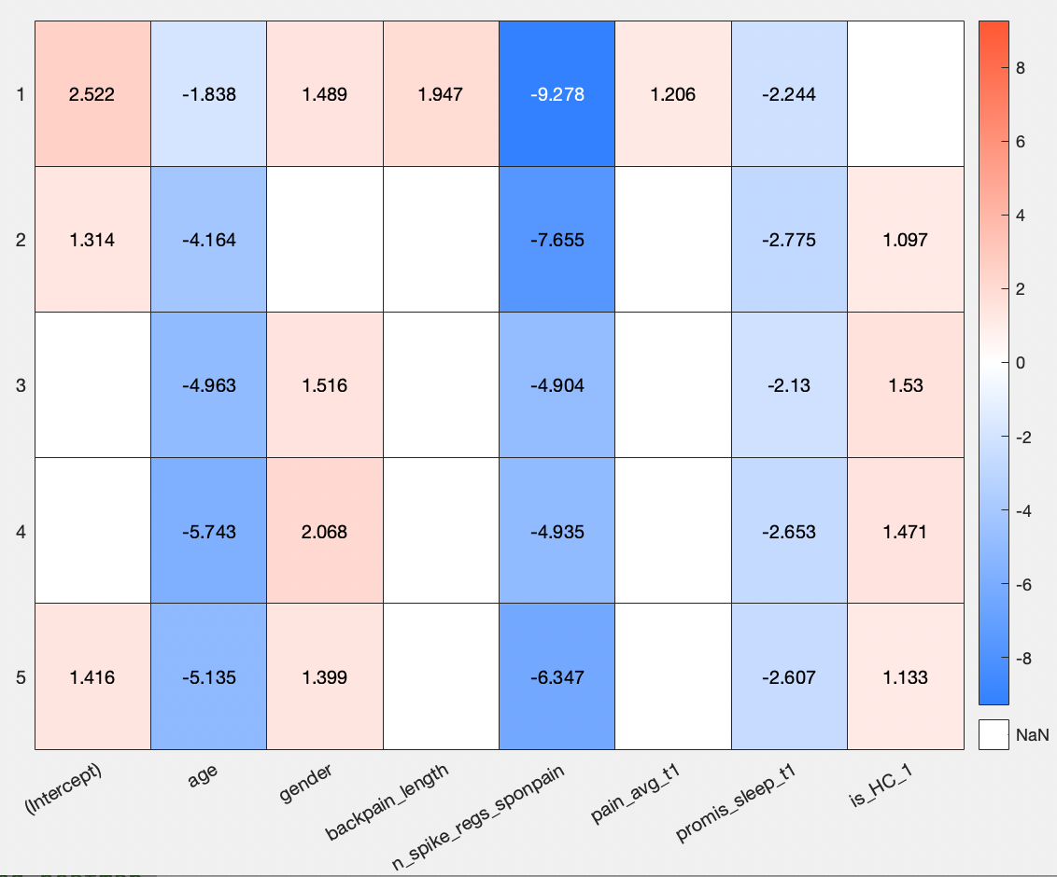
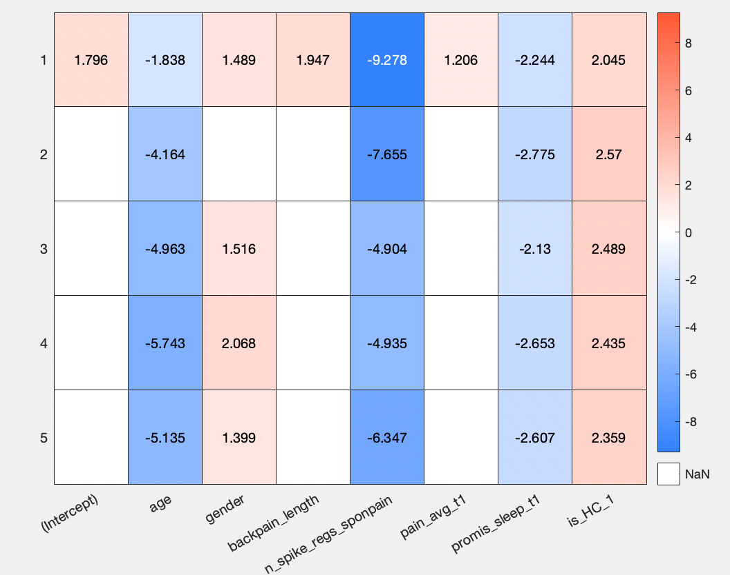
Mean centred: backpain_length, promis_sleep, pain_avg
Head motion NOT mean-centred
Mean centred: backpain_length, promis_sleep, pain_avg, head motion is mean-centred

