Slide 1


Embedded Systems
ENGS 28
Day 1: Blinky

Slide 2
Embedded
Systems
Peyton
Gent
Thor
Oliver
Napu
Alex
JP
Andrew
Nina
Tiffany
Teaen
Jeff
Molly
Soleil
Meiirzhan
Ollie
Starlone
Papa
Chase
Ryan
Owen
Holden
Stefan
Konstantinos
Jaden
Alkins
ENGS 28
Day 1: Blinky
Simrah
Leah
Claire
Renata
Hope
Brianna
Rachel
Maya

Slide 3
What questions do you have about the course?
What is the level of difficulty of C for this course?
If someone does not feel confident enough in coding, though open to learn, is that a problem in this course?
Will we have a practice quiz before the first quiz so we can know the format?

Slide 4
If you could automate anything in your dorm room…
Roll my chair back into position after every use
Flip pages in a book without me having to pull out my arms from under covers
Window shades to open and close with sunlight/sunset or on a timer
Turn each of my lamps on and off via remote control from my bed
Heating system in our house to run on a timer
Dorm room cleaning
Windows opening when it gets too hot in my room
Lights turning on 10 minutes before alarm goes off
Putting my shoes away onto a shoe rack from by the door
Making my bed
Laundry folding
Clean salt off my shoes

Slide 5
What do you need to build some of these great ideas?
Notes:
Moved to discussion forum before class.
Think for a minute, discuss with neighbor, then share out. - processor, sensor, actuator, tools: group student answers into these categories without labelling them (on whiteboard)

Slide 6
What do you need to build some of these great ideas?
Light sensor
Temperature sensor
Motion sensor
Weather tracker
"Shoe sensor"
Camera (is the bed made?)
Motor
Switch
Heating
Cooling
Pressurized air
Robotic arm
Relay
Self-driving vacuum
Deciding what action to take based on measurement
Time keeping
…

Slide 7

Notes:
https://www.youtubeeducation.com/watch?v=EGSyw2dHhrc

Slide 8
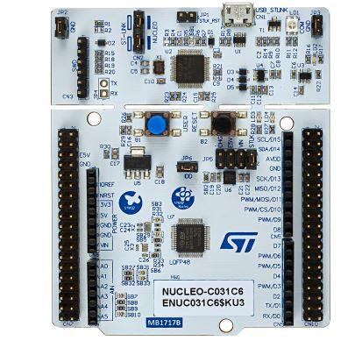
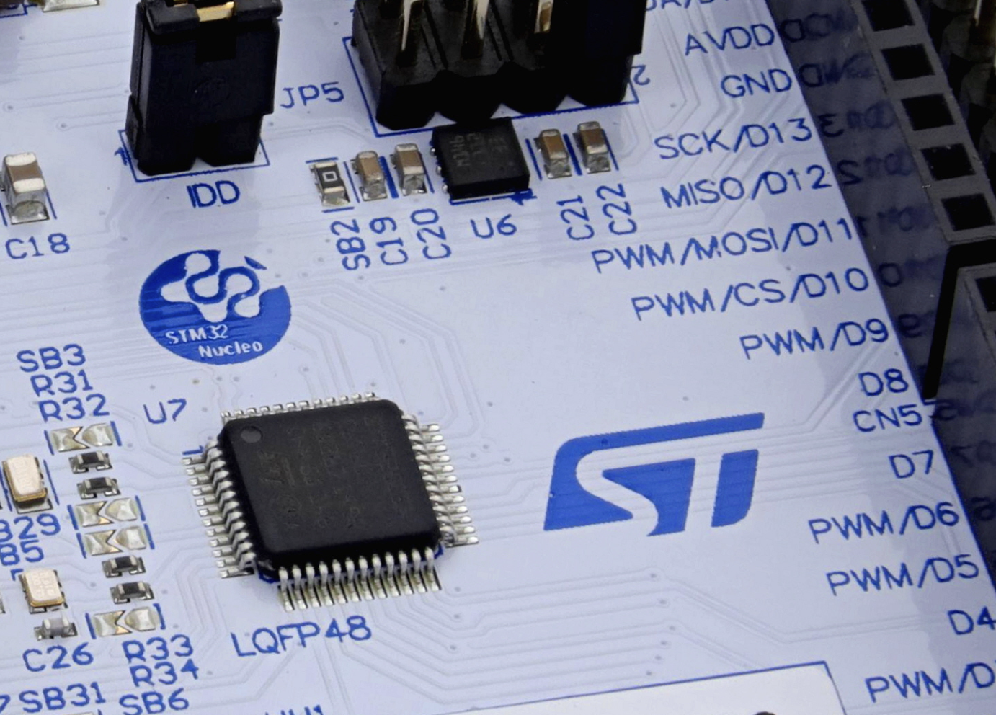
STM32 Nucleo-64 board
In this class we use the STM32 Nucleo-64 board.
The main processor chip is the STM32C031C6 microcontroller based on the Arm® Cortex®-M0+ processor.
Our main goal is to work with the STM32C031C6.
The Nucleo board is a convenient way for us to access the chip.
Microcontroller pins are connected to header pins (where we plug things in).
STM32C031C6 microcontroller
Notes:
Hand out Arduinos. Video has details.

Slide 9
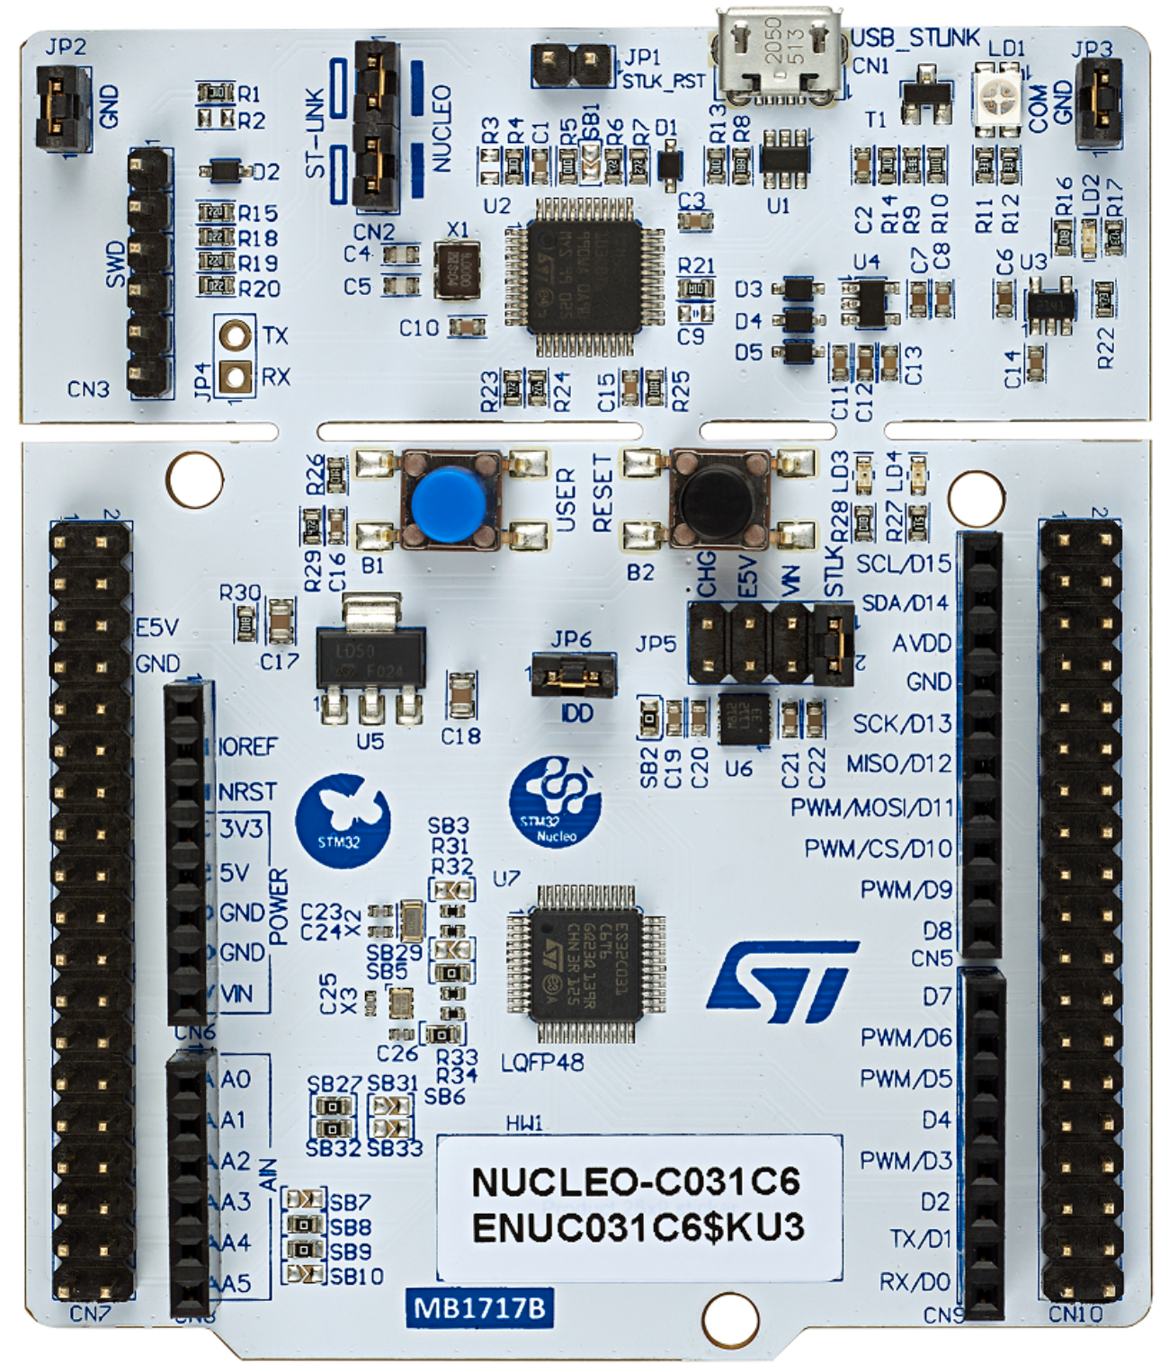
STM32 Nucleo-64 board
USB interface
PowerLED
Reset button
User LED
User button
Crystal oscillator 32 kHz
Morpho connector
Digital I/O header
Power and ground header
External power and ground
Crystal oscillator 48 MHz
STM32C031C6 microcontroller
Analog input header
Notes:
The 32kHz crystal oscillator is primarily used to provide a precise, low-power clock signal for the real-time clock RTC module (which requires a highly accurate and low-power clock source to maintain time and date even when the main system is in low-power or sleep modes), enabling accurate timekeeping and efficient time-triggered operations while keeping the overall power consumption of the system as low as possible.

Slide 10
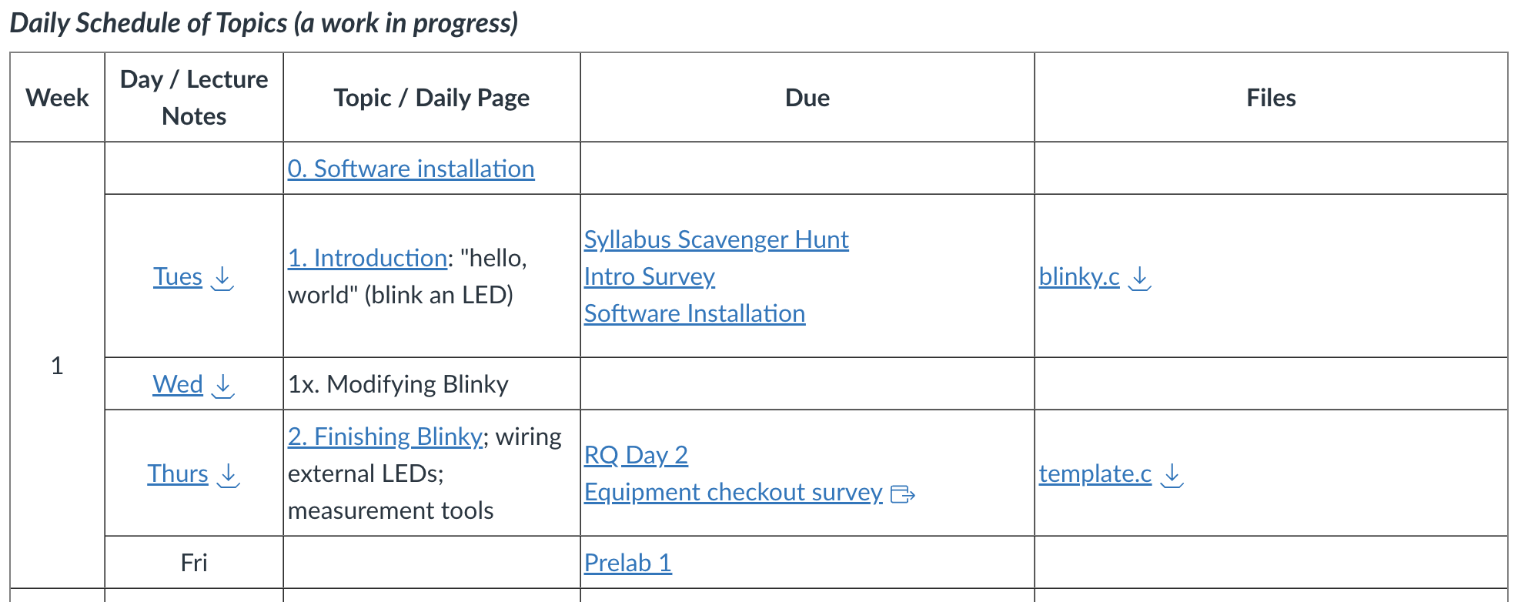
Install Necessary Software on your Computer
Prior to today’s class, you were instructed to install the STM32 Cube IDE, which we use to program the STM32C031C6 microcontroller. You must have that software installed before you can go any farther.
If you do not have the software installed at this point please raise your hand so that someone can help.

Slide 11
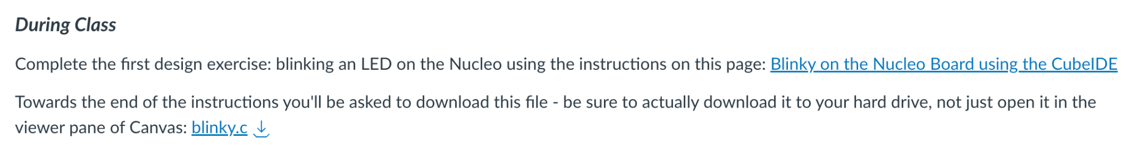
Blink an LED
This is the “hello, world” of embedded system programming. Follow the instructions on the Canvas page. If you get stuck simply ask one of the instructors / LFs for help.
Once you have it running, we’ll talk about how the program works.

Slide 12
How does the program blink the LED?
Hardware: Pin 16 of the MCU is wired to the LED and also to header pin D13.
Software: Program alternately writes ‘1’ and ‘0’ to Pin 16 (addressed via bit 5 of Port A).
Hardware: Pin 16’s voltage alternates HIGH and LOW, driving current on and off through the LED.
LED at header pin D13
wired to
STM32C0 pin 16
14
1
16
28
Notes:
The GPIO system of the STM32 is designed around ports and bits rather than physical pin numbers. Each port (like PORT A) is a 16-bit register, where each bit controls one specific pin’s state (high or low). For example, PORT A, Bit 5 controls pin PA5. By referencing pins through their port and bit, the software becomes more portable across different package variants of the STM32C031 (or other STM32 microcontrollers), which may assign different physical pins to the same logical GPIO. STM32 documentation uses the port/bit nomenclature (e.g., PA5) for clarity and consistency. Pin 16 on your specific package happens to be PA5, but the physical pin number depends on the microcontroller’s package type (e.g., LQFP vs. QFN).

Slide 13
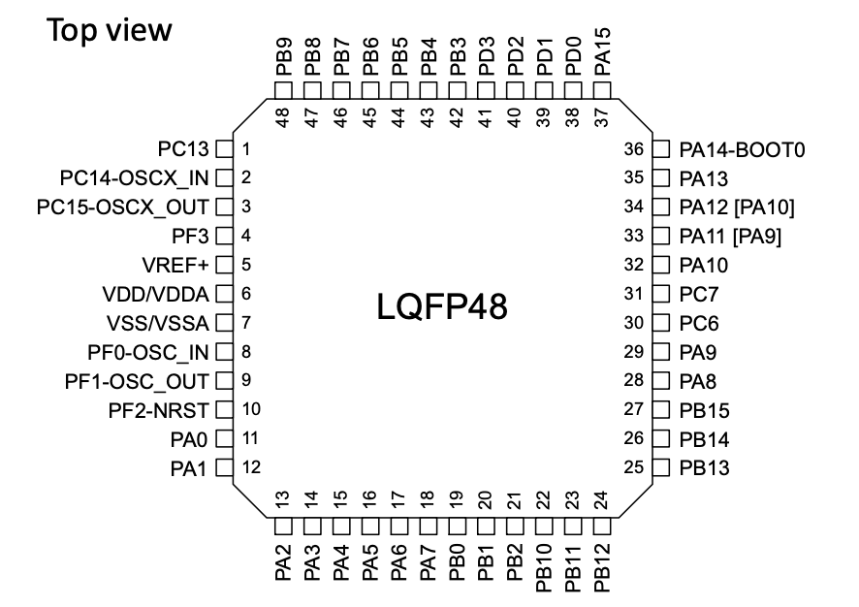
The Microprocessor STM32C031C6
The STM32C031C6 has 48 pins
The pins are organized into 3 ports: A, B, C.
Each port has 16 pins.
14

Slide 14
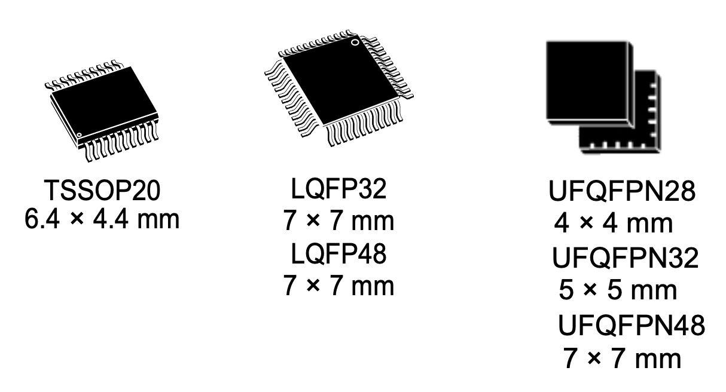
What's with all the different names?
Arduino header pin D13 versus STM32C031C6 pin 16 versus bit 5 of I/O Port A?
STM32 GPIOs are organized by ports (A, B, C, …), not by physical pin numbers
Each port is a 16-bit register
Each bit controls one pin (HIGH or LOW)
Example:
PA5 = Port A, Bit 5
Writing to bit 5 of GPIOA controls PA5
Why this matters
Physical pin numbers depend on the chip package (LQFP, QFN, …)
Port/bit names stay the same
STM32 documentation and code always use PA5, PB3, etc.
Notes:
The GPIO system of the STM32 is designed around ports and bits rather than physical pin numbers. Each port (like PORT A) is a 16-bit register, where each bit controls one specific pin’s state (high or low). For example, PORT A, Bit 5 controls pin PA5. By referencing pins through their port and bit, the software becomes more portable across different package variants of the STM32C031 (or other STM32 microcontrollers), which may assign different physical pins to the same logical GPIO. STM32 documentation uses the port/bit nomenclature (e.g., PA5) for clarity and consistency. Pin 16 on your specific package happens to be PA5, but the physical pin number depends on the microcontroller’s package type (e.g., LQFP vs. QFN).

Slide 15
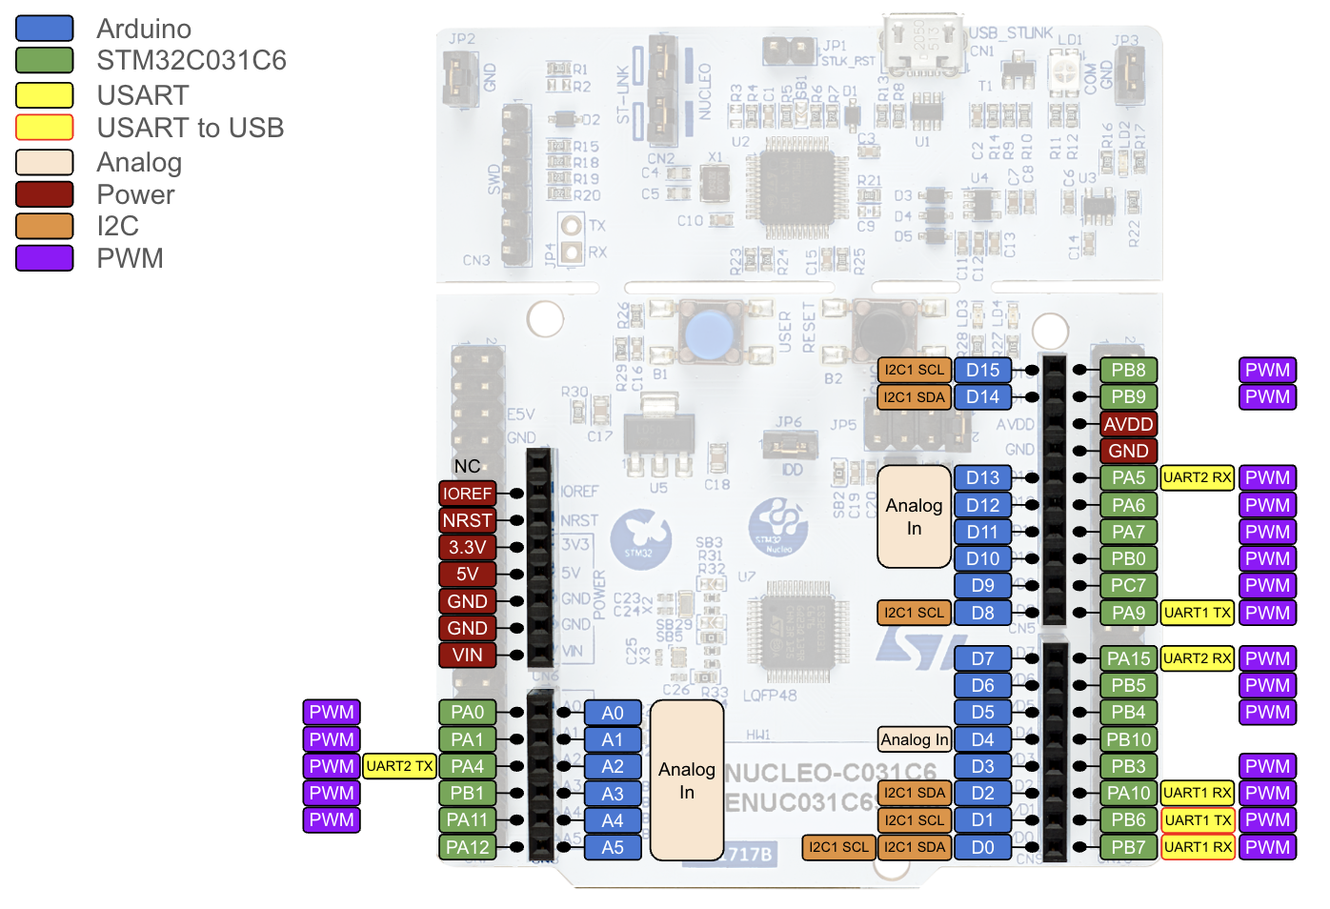
What’s where on the Nucleo board?
LED at header pin D13,
STM32C0 pin 16,
PA5: Port A, bit 5

Slide 16
Nucleo Digital I/O
The STM32C031C6 microcontroller (MCU) has 48 pins.
Of these, 45 pins that can be connected to other devices (LEDs, buttons, motors, etc).
Only 22 of these lines are programmable on the Arduino header pins. (11 on port A, 10 on port B, 1 on port C).
All of the I/O pins are wired to the ST Morpho headers adjacent to the Arduino header (but we won't be using these).
We'll only use the I/O pins on the Arduino headers. BUT: we won't be programming in the Arduino language, so we won't be using the Arduino pin numbers in programming.
Rather, we'll address pins via their port (letter A, B, C) and bit number within that port (between 0 and 15).

Slide 17
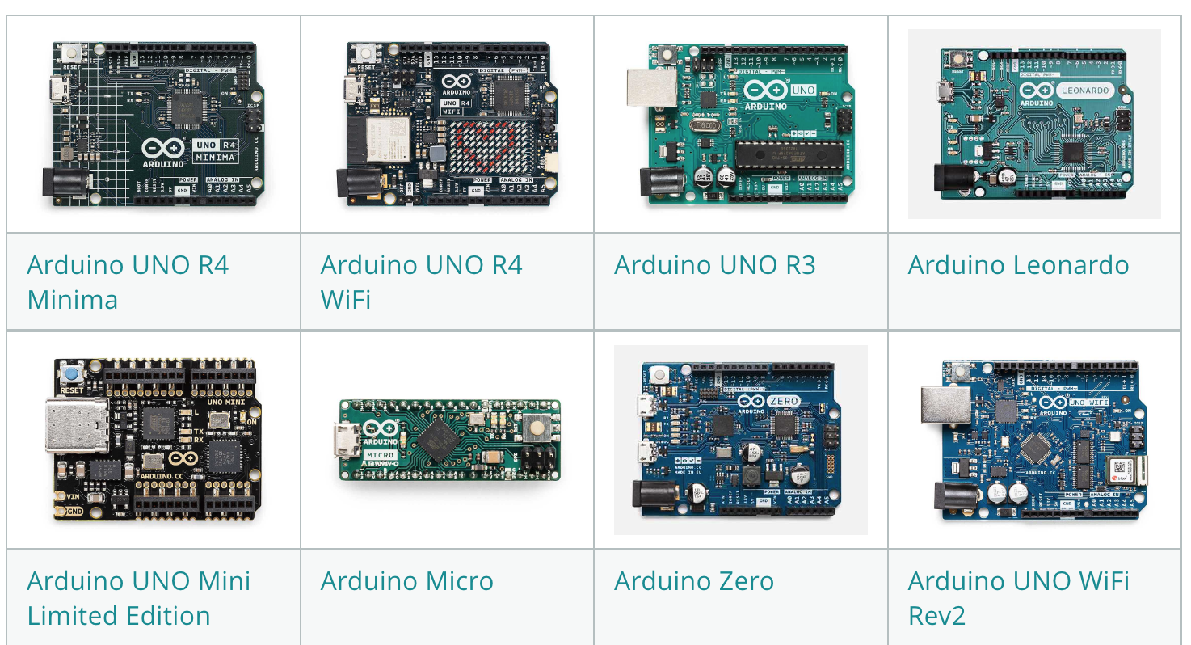
What is "Arduino"?
Arduino is an Italian company.
Arduino makes numerous low-cost boards with different processors, dimensions, input/output pins, and other features (including wireless), but a common programming model and development environment.
Hardware and software are open source, huge user community. Other companies make Arduino-compatible boards.
The Arduino headers on our Nucleo board are Arduino-compatible.

Slide 18
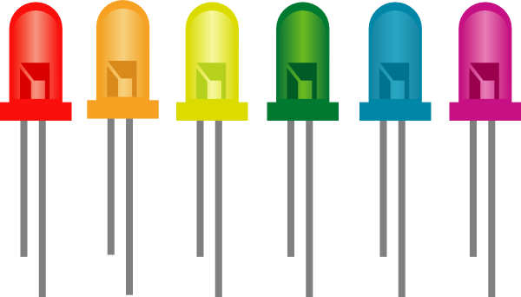
Software: What steps are required to blink the LED?
Recall: on-board LED is connected to bit 5 of port A.
Enable the clock for the GPIO port A.
Program pin 5 of port A to be an OUTput (to drive something on the board) versus INput (to detect a signal coming from the board).
Write a ‘1’ to the pin (“set”) to drive its voltage HIGH (turn the LED on).
Write a ‘0’ to the pin (“clear”) to drive its voltage LOW (turn the LED off).
Each pin of port A is addressed as one bit in a 16-bit number:
General Purpose Input/Output
Bit 15 | Bit 14 | … | Bit 8 | Bit 7 | Bit 6 | Bit 5 | Bit 4 | Bit 3 | Bit 2 | Bit 1 | Bit 0

Slide 19
Source code: blinky.c
The four steps are shown in red.
#include "stm32C0xx.h" // All the port definitions are here
// Bit 0 of RCC_IOPENR enables clock for GPIOA
#define GPIOAEN (1U<<0) // 0b 0000 … 0000 0001 (32-bit)
// Bit 5 of Port A is wired to the LED
#define LED_PIN (1U<<5) // 0b 0000 … 0001 0000
int main(void) {
RCC->IOPENR |= GPIOAEN; // 1. Enable clock access to GPIOA
GPIOA->MODER |= (1U<<10); // 2. Configure PA5 (Port A, bit 5)
GPIOA->MODER &= ~(1U<<11); // as output pin
while(1) {
GPIOA->ODR |= LED_PIN; // 3. Set bit 5 to turn LED on
for (int i=0; i<100000; i++); // kill some time
GPIOA->ODR &= ~LED_PIN; // 4. Clear bit 5 to turn LED off
for(int i = 0; i<100000; i++); // kill some time
}
return 0; // never reached
}
Notes:
Postponing what "GPIO->ODR" means -- "Just trust the syntax for now, will explain soon."

Slide 20
GPIOA->ODR |= (1U<<5);
GPIOA->ODR = "Output Data Register for GPIO Port A" is a 16-bit register: one bit for each pin to determine whether it's high (1) or low (0).
(1U<<5) = 0b 0000 0000 0000 0000 0000 0000 0010 0000
GPIOA->ODR:
bit 5
data for pin 15
data for pin 5
data for pin 0
Bit 15 | Bit 14 | … | Bit 8 | Bit 7 | Bit 6 | Bit 5 | Bit 4 | Bit 3 | Bit 2 | Bit 1 | Bit 0
In order to turn our LED on we need to write a '1' to bit 5 of GPIO->ODR.
Bit 15 | Bit 14 | … | Bit 8 | Bit 7 | Bit 6 | Bit 5 1 | Bit 4 | Bit 3 | Bit 2 | Bit 1 | Bit 0
How does GPIOA->ODR |= (1U<<5); … accomplish this???

Slide 21
The binary number 0b 0000 0000 0000 0000 0000 0000 0010 0000
ODR is a 16-bit register, so no need for the extra upfront zeros.
We could simply write GPIOA->ODR = 0b0000000000100000;
This sets all bits to '0', except for bit 5, which is set to '1'.
Not good style (what if some other device were already connected elsewhere?), but let's ignore that issue temporarily.
We could also write GPIOA->ODR = 32; or GPIOA->ODR = 0x20;
None of these are very readable, which could lead to difficult debugging.
Better: GPIOA->ODR = (1U << 5);
Still better: #define LED_PIN (1U<<5) to avoid the “magic number” in your code, then write GPIOA->ODR = LED_PIN;
The definition for GPIOA->ODR lives in a header file, "stm32C0xx.h" (we'll look into that later.)
The 'U' ensures that the 1 is represented in the 'unsigned integer' data type which is a 32 bit number on our platform
Shift a '1' to the left (in binary) by 5 slots.
0 | … | 0 | 0 | 0 | 0 | 0 | 0 | 0 | 1
0 | … | 0 | 0 | 1 | 0 | 0 | 0 | 0 | 0
Notes:
If you don't really remember binary and hexadecimal numbers, no worries. You'll be watching a video reviewing all this for next class.

Slide 22
Setting bit 5 in GPIOA->ODR without changing other bits
Suppose GPIOA->ODR already has some bits set, for example:
We want to set bit 5 without changing the other bits. Use the logical bitwise "OR" operation, |.
Bit 15 1 | Bit 14 0 | … | Bit 6 1 | Bit 5 0 | Bit 4 1 | Bit 3 1 | Bit 2 0 | Bit 1 1 | Bit 0 0
GPIOA->ODR:
| | 0 | 1
0 | 0 | 1
1 | 1 | 1
Logical OR truth table
GPIOA->ODR = GPIOA->ODR | (1U << 5); accomplishes what we want:
1 | 0 | … | 1 | 0 | 1 | 1 | 0 | 1 | 0
Bitwise OR
1 | 0 | … | 1 | 1 | 1 | 1 | 0 | 1 | 0
0 | 0 | … | 0 | 1 | 0 | 0 | 0 | 0 | 0
Alternative: GPIOA->ODR |= (1U << 5);

Slide 23
So GPIOA->ODR |= LED_PIN; turns the LED on.
(...)
#define LED_PIN (1U<<5) // 0b 0000 … 0010 0000
int main(void) {
RCC->IOPENR |= GPIOAEN; // 1. Enable clock access to GPIOA
GPIOA->MODER |= (1U<<10); // 2. Configure PA5 (Port A, bit 5)
GPIOA->MODER &= ~(1U<<11); // as output pin
while(1) {
GPIOA->ODR |= LED_PIN; // 3. Set bit 5 to turn LED on
for (int i=0; i<100000; i++); // kill some time
GPIOA->ODR &= ~LED_PIN; // 4. Clear bit 5 to turn LED off
for(int i = 0; i<100000; i++); // kill some time
}
return 0; // never reached
}

Slide 24
What does GPIOA->ODR &= ~LED_PIN; do?
(...)
#define LED_PIN (1U<<5) // 0b 0000 … 0010 0000
int main(void) {
RCC->IOPENR |= GPIOAEN; // 1. Enable clock access to GPIOA
GPIOA->MODER |= (1U<<10); // 2. Configure PA5 (Port A, bit 5)
GPIOA->MODER &= ~(1U<<11); // as output pin
while(1) {
GPIOA->ODR |= LED_PIN; // 3. Set bit 5 to turn LED on
for (int i=0; i<100000; i++); // kill some time
GPIOA->ODR &= ~LED_PIN; // 4. Clear bit 5 to turn LED off
for(int i = 0; i<100000; i++); // kill some time
}
return 0; // never reached
}

Slide 25
Clearing bit 5 in GPIOA->ODR without changing other bits
Suppose GPIOA->ODR already has some bits set, for example:
We want to clear bit 5 without changing the other bits. Flip each bit in (1U<<5) and use the logical bitwise "AND" operation, &.
Bit 15 1 | Bit 14 0 | … | Bit 6 1 | Bit 5 1 | Bit 4 1 | Bit 3 1 | Bit 2 0 | Bit 1 1 | Bit 0 0
GPIOA->ODR:
& | 0 | 1
0 | 0 | 0
1 | 0 | 1
Logical AND truth table
GPIOA->ODR &= ~(1U << 5); accomplishes what we want:
1 | 0 | … | 1 | 1 | 1 | 1 | 0 | 1 | 0
Bitwise AND
Bitwise NOT
0 | 0 | … | 0 | 1 | 0 | 0 | 0 | 0 | 0
1 | 1 | … | 1 | 0 | 1 | 1 | 1 | 1 | 1
1 | 0 | … | 1 | 0 | 1 | 1 | 0 | 1 | 0

Slide 26
So GPIOA->ODR &= ~LED_PIN; turns the LED off.
(...)
#define LED_PIN (1U<<5) // 0b 0000 … 0001 0000
int main(void) {
RCC->IOPENR |= GPIOAEN; // 1. Enable clock access to GPIOA
GPIOA->MODER |= (1U<<10); // 2. Configure PA5 (Port A, bit 5)
GPIOA->MODER &= ~(1U<<11); // as output pin
while(1) {
GPIOA->ODR |= LED_PIN; // 3. Set bit 5 to turn LED on
for (int i=0; i<100000; i++); // kill some time
GPIOA->ODR &= ~LED_PIN; // 4. Clear bit 5 to turn LED off
for(int i = 0; i<100000; i++); // kill some time
}
return 0; // never reached
}

Slide 27
What does GPIOA->MODER do?
(...)
#define LED_PIN (1U<<5) // 0b 0000 … 0001 0000
int main(void) {
RCC->IOPENR |= GPIOAEN; // 1. Enable clock access to GPIOA
GPIOA->MODER |= (1U<<10); // 2. Configure PA5 (Port A, bit 5)
GPIOA->MODER &= ~(1U<<11); // as output pin
while(1) {
GPIOA->ODR |= LED_PIN; // 3. Set bit 5 to turn LED on
for (int i=0; i<100000; i++); // kill some time
GPIOA->ODR &= ~LED_PIN; // 4. Clear bit 5 to turn LED off
for(int i = 0; i<100000; i++); // kill some time
}
return 0; // never reached
}

Slide 28
GPIOA->MODER |= (1U<<10); GPIOA->MODER &= ~(1U<<11);
GPIOA->MODER = "Mode Register for GPIO Port A", contains 32 bits: two for each pin to determine its mode: Output, input, analog I/O, etc
(1U<<10) = 0b 0000 0000 0000 0000 0000 0100 0000 0000
(1U<<11) = 0b 0000 0000 0000 0000 0000 1000 0000 0000
GPIOA->MODER:
bit 10
bit 11
configure pin 15
configure pin 5
configure pin 0
Bit 31 | Bit 30 | … | Bit 13 | Bit 12 | Bit 11 | Bit 10 | Bit 9 | … | Bit 2 | Bit 1 | Bit 0
In order to configure our pin as output, write a '01' into its two bits, so '1' to bit 10 and '0' to bit 11.
Bit 31 | Bit 30 | … | Bit 13 | Bit 12 | Bit 11 0 | Bit 10 1 | Bit 9 | … | Bit 2 | Bit 1 | Bit 0
GPIOA->MODER &= ~(1U<<11);
GPIOA->MODER |= (1U<<10);

Slide 29
And finally: RCC->IOPENR |= GPIOAEN;
(...)
#define GPIOAEN (1U<<0) // 0b 0000 … 0000 0001 (32-bit)
(...)
int main(void) {
RCC->IOPENR |= GPIOAEN; // 1. Enable clock access to GPIOA
GPIOA->MODER |= (1U<<10); // 2. Configure PA5 (Port A, bit 5)
GPIOA->MODER &= ~(1U<<11); // as output pin
while(1) {
GPIOA->ODR |= LED_PIN; // 3. Set bit 5 to turn LED on
for (int i=0; i<100000; i++); // kill some time
GPIOA->ODR &= ~LED_PIN; // 4. Clear bit 5 to turn LED off
for(int i = 0; i<100000; i++); // kill some time
}
return 0; // never reached
}

Slide 30
And finally: RCC->IOPENR |= (1U<<0);
By default, the clock to peripherals (of which GPIOA is one) is turned off to save power.
You can't read from or write to a GPIO pin without the clock being active.
RCC->IOPENR = "I/O Port Clock Enable Register of the Reset and Clock Control (RCC) system".
It's a 32-bit register that enables (1) or disables (0) the clock for GPIOx (x = A, B, C, D, or F):
Port D
Port B
Port F
Port C
Port A
Bit 31 | Bit 30 | … | Bit 8 | Bit 7 | Bit 6 | Bit 5 | Bit 4 | Bit 3 | Bit 2 | Bit 1 | Bit 0 1

Slide 31
We now understand blinky.c!
#include "stm32C0xx.h" // All the port definitions are here
// Bit 0 of RCC->IOPENR enables clock for GPIOA
#define GPIOAEN (1U<<0) // 0b 0000 … 0000 0001 (32-bit)
// Bit 5 of Port A is wired to the LED
#define LED_PIN (1U<<5) // 0b 0000 … 0001 0000
int main(void) {
RCC->IOPENR |= GPIOAEN; // 1. Enable clock access to GPIOA
GPIOA->MODER |= (1U<<10); // 2. Configure PA5 (Port A, bit 5)
GPIOA->MODER &= ~(1U<<11); // as output pin
while(1) {
GPIOA->ODR |= LED_PIN; // 3. Set bit 5 to turn LED on
for (int i=0; i<100000; i++); // kill some time
GPIOA->ODR &= ~LED_PIN; // 4. Clear bit 5 to turn LED off
for(int i = 0; i<100000; i++); // kill some time
}
return 0; // never reached
}

Slide 32
Summary: "Bit Twiddling"
To set bit n in the binary number NUM:
NUM |= (1 << n);
To clear bit n in the binary number NUM:
NUM &= ~(1 << n);
To toggle bit n in the binary number NUM:
NUM ^= (1 << n);
(1 << n) and ~(1 << n) are called bit masks. Bit twiddling consists of using AND, OR, or XOR with an appropriate bit mask.

Slide 33
Bonus operations
These expressions check if bit n in the binary number NUM is ‘0’ or ‘1’:
(NUM & (1 << n)) == 0
(NUM & (1 << n)) != 0
How do they work?

Slide 34
What else could you do by turning a pin on and off?
What if you could turn more than one pin on and off?

Slide 35
Homework for tomorrow: Modify the Blinky Code
Think about the blinky.c code and how you would modify it to make the LED blink faster / slower / on longer / etc. Make notes for tomorrow's class.
Next, think about the following:
How would you modify blinky.c to make the blink rate steadily increase from slow to fast, then repeat? Write out your code on paper.
Use your best C programming style to make the code clean and readable. See Canvas page "Coding Style" (Online Resources -> Coding standards -> style guide for ENGS 28)
Bring your hand written code to class tomorrow.

Slide 36
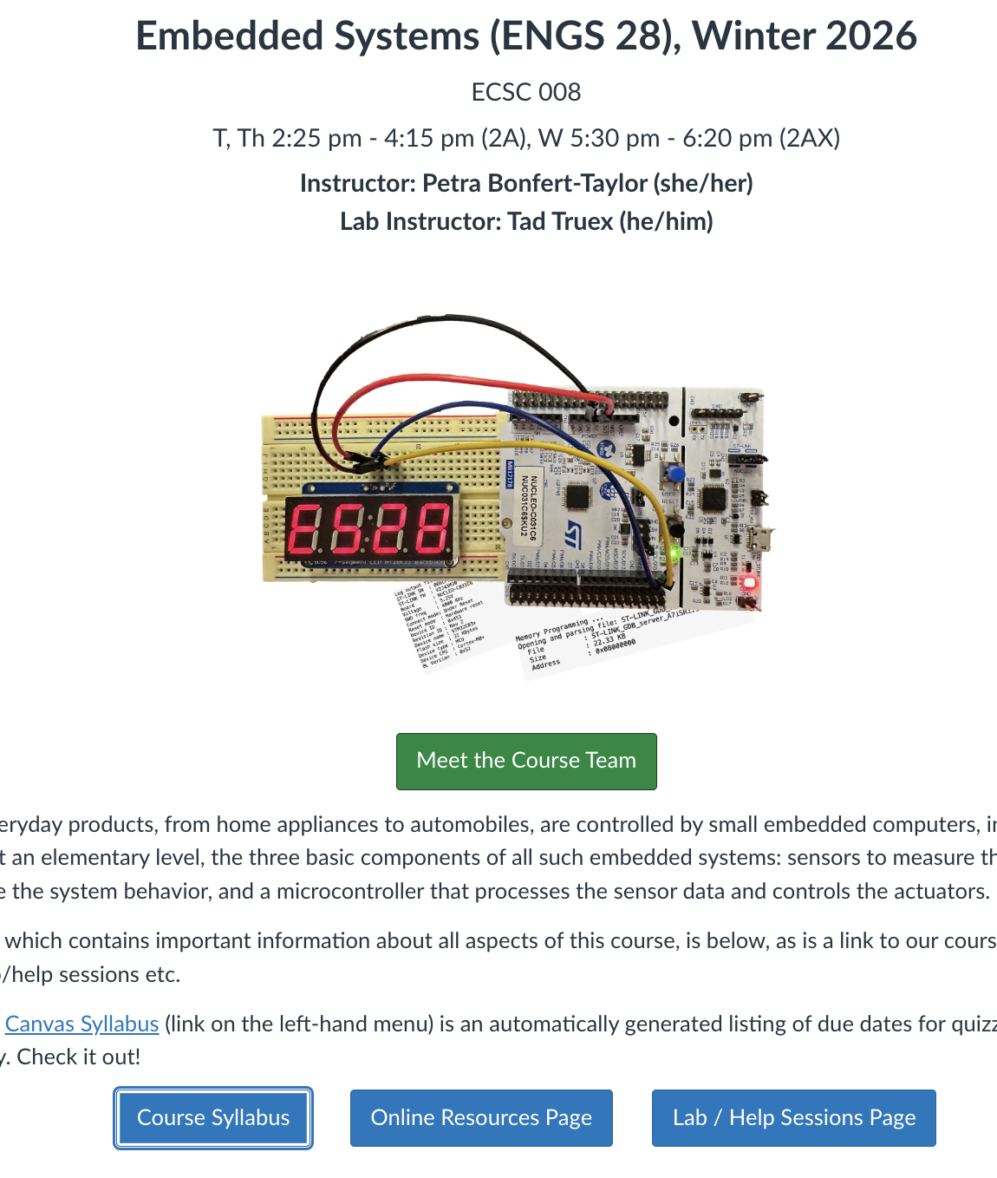
Yes, we'll be using all x-hours for class.
We are all here to help!!!!!
Help sessions start today!
Need a C-programming refresher?

