Slide 1


Embedded Systems
ENGS 28
Day 1x: Modifying Blinky

Slide 2
Embedded
Systems
Peyton
Gent
Thor
Oliver
Napu
Alex
JP
Andrew
Nina
Tiffany
Teaen
Jeff
Molly
Soleil
Meiirzhan
Ollie
Starlone
Papa
Chase
Ryan
Owen
Holden
Stefan
Konstantinos
Aikins
ENGS 28
Day 1x: Modifying Blinky
Simrah
Leah
Claire
Renata
Hope
Brianna
Rachel
Maya

Slide 3
Agenda for Today
Quick Review of Canvas and Course
Practice Bitwise Operations
Homework Code Review
Working with multiple source files in a project
Equipment distribution and check-out survey

Slide 4
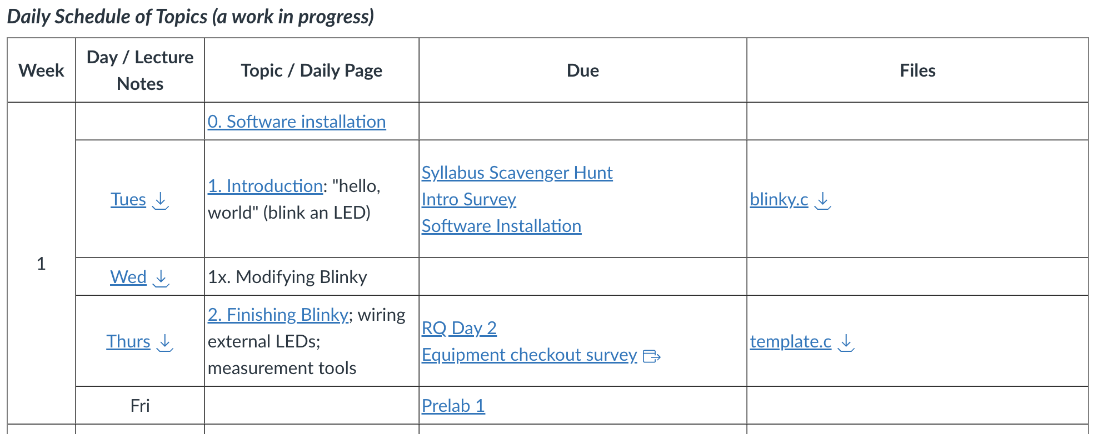
This Week on Canvas
today

Slide 5
Practice bitwise operations (8-bit here for practice)
What is (1 << 4)?
Now (0b00111001 << 3)?
(0b00111001 >> 2)?
(0b00111001 << 3) | (0b00111001 >> 2)?
(0b00111001 << 3) & (0b00111001 >> 2)?
(0b00111001 << 3) ^ (0b00111001 >> 2)?

Slide 6
More practice:
How do you clear bit 5 in 0b00101101?
How do you create the number 0b11111011?
0 | 0 | 1 | 0 | 1 | 1 | 0 | 1
&
=
0 | 0 | 0 | 0 | 1 | 1 | 0 | 1

Slide 7
Summary: "Bit Twiddling"
To set bit n in the binary number NUM:
NUM |= (1 << n);
To clear bit n in the binary number NUM:
NUM &= ~(1 << n);
To toggle bit n in the binary number NUM:
NUM ^= (1 << n);
(1 << n) and ~(1 << n) are called bit masks. Bit twiddling consists of using AND, OR, or XOR with an appropriate bit mask.

Slide 8
Bonus operations
These expressions check if bit n in the binary number NUM is ‘0’ or ‘1’:
(NUM & (1 << n)) == 0
(NUM & (1 << n)) != 0
How do they work?
Hint: What are the possible (decimal) values, (NUM & (1 << n)) can take?

Slide 9
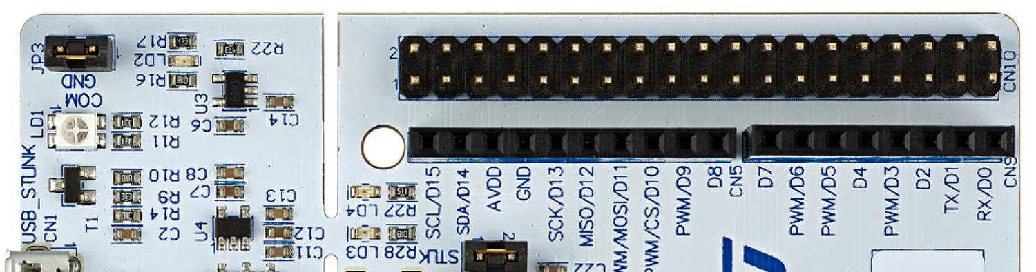
Yesterday: blinky.c
LED at header pin D13 wired to
STM32C0 pin 16 (Port A, bit 5)
#include "stm32C0xx.h" // All the port definitions are here
// Bit 0 of RCC->IOPENR enables clock for GPIOA
#define GPIOAEN (1U<<0) // 0b 0000 … 0000 0001 (32-bit)
// Bit 5 of Port A is wired to the LED
#define LED_PIN (1U<<5) // 0b 0000 … 0010 0000
int main(void) {
RCC->IOPENR |= GPIOAEN; // 1. Enable clock access to GPIOA
GPIOA->MODER |= (1U<<10); // 2. Configure PA5 (Port A, bit 5)
GPIOA->MODER &= ~(1U<<11); // as output pin
while(1) {
GPIOA->ODR |= LED_PIN; // 3. Set set bit 5 to turn LED on
for (int i=0; i<100000; i++); // kill some time
GPIOA->ODR &= ~LED_PIN; // 4. Clear bit 5 to turn LED off
for(int i = 0; i<100000; i++); // kill some time
}
return 0; // never reached
}
An infinite loop??

Slide 10
Homework
Modify blinky.c:
Modify the blinky.c code to make the LED blink faster / slower / on longer / etc.
Make the blink rate steadily increase from slow to fast, then repeat.
Use your best C programming style to make the code clean and readable. See Canvas page "Coding Style" (Online Resources -> Coding standards -> style guide for ENGS 28)

Slide 11
Modify the blinky.c code to make the LED blink faster / slower / on longer / etc.
At your table, discuss the modifications you thought about making to change the blink behavior of the LED.
Change the code in blinky.c to make the LED blink faster / slower / on longer then off, etc
Make sure everyone at your table has these modifications working.

Slide 12
Code Review: Make the blink rate steadily increase from slow to fast, then repeat.
Share your hand written code within your group.
Can you read, understand, and explain your partners’ codes? (This is called "code review" — good for catching bugs!)
Decide which strategy you'd like to implement.
Notes:
One of the top 5 things to do improve embedded systems design flow b/c code reviews catch bugs.

Slide 13
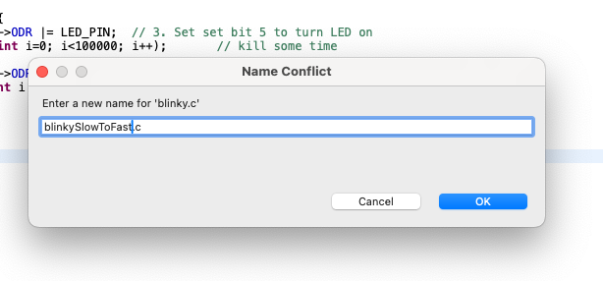
Give it a try: blinkySlowToFast.c
Make a copy of blinky.c by right-clicking on blinky.c inside the IDE and selecting "copy"
Right-click on the src folder icon in the Blinky project and select "paste".
In the popup enter the new filename blinkySlowToFast.c, click OK.
Open this new file by double-clicking on it. Make your edits in this new file.

Slide 14
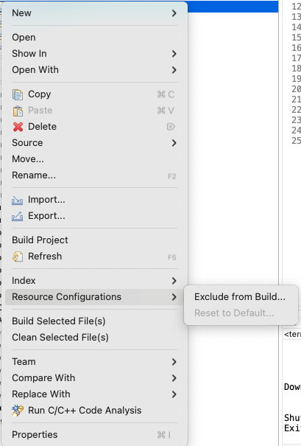
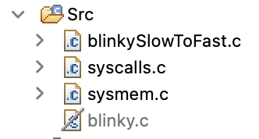
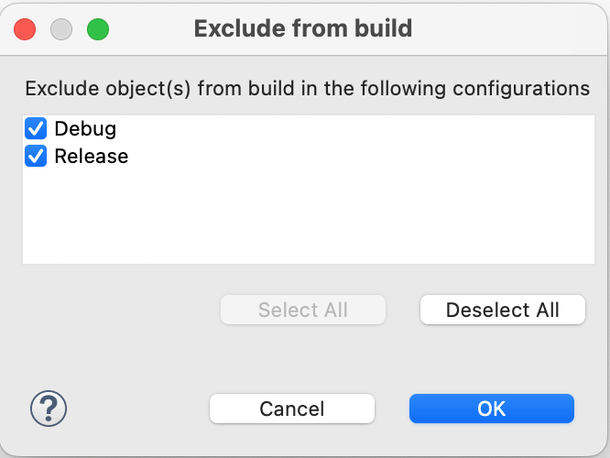
Tell the compiler which blinky to use
Right-click on blinky.c, go to Resource Configurations and select Exclude from Build.
In the Exclude from build popup, click Select All and then OK.
In your Src folder you can now see that blinky.c will not be used to build the project.
Note: In order to successfully build your project you need to ensure that you have exactly one file with a main() function.

Slide 15
blinkySlowToFast.c - Sample Solution
#include "stm32C0xx.h" // All the port definitions are here
#define GPIOAEN (1U<<0) // bit 0 enables clock for GPIOA
#define LED_PIN (1U<<5) // Bit 5 of Port A is wired to the LED
#define MIN_WAIT 100000
#define N 10
int main(void) {
RCC->IOPENR |= GPIOAEN; // 1. Enable clock access to GPIOA
GPIOA->MODER |= (1U<<10); // 2. Configure PA5 (Port A, bit 5)
GPIOA->MODER &= ~(1U<<11); // as output pin
while(1) {
for(int i = N; i > 0; i--) {
GPIOA->ODR |= LED_PIN; // 3. Set set bit 5 to turn LED on
for (int j=0; j<MIN_WAIT; j++); // kill some time
GPIOA->ODR &= ~LED_PIN; // 4. Clear bit 5 to turn LED off
for(int k = 0; k <= i; k++) {
for(int j = 0; j<MIN_WAIT; j++); // kill some time
}
}
}
return 0; // never reached
}

Slide 16

AI Use in ENGS 28
AI tools are likely to have an impact on your career and work as an engineer.
In ENGS 28, we will be approaching AI tools with a posture of critical exploration and cautious engagement.
Guiding principle: tools must be used in the spirit of the assignment to enhance your learning and not a crutch to shortcut your learning.
shortcut
Productive struggle deepens learning

Slide 17
AI Use in ENGS 28
You are free to use the HiTA tool, integrated in Canvas, to get help with the assignments in this course. Please do not use any other GenAI tools unless explicitly invited to do so.
The HiTA tool has been trained on our course materials and can tailor responses accordingly. It was also specifically designed and prompted not to provide direct homework solutions.
What matters most:
Before asking for help, engage in that productive struggle!
Use HiTA in combination with your critical thinking skills. Don’t simply accept the answer–probe it, question it, ask for more explanation if it is still unclear.
Analyze whether the tool's output is correct! It's just a language model, after all.

Slide 18
AI Use in ENGS 28
We will treat GenAI tools similarly to other resources you use. This means you MUST follow these four points:
Give notice that you used the AI tool and how you used it in the comments of your code and your lab report.
If you are basing your work on generated code, rigorously test and alter the program to suit the assignment and your understanding.
You must understand any code you submit and be prepared to explain it to us.
All comments in your code should be your own words.

Slide 19
Equipment Check-Out
Please be sure to register your equipment via our check-out survey:

