Slide 1


Embedded Systems
ENGS 28
Day 2: Finishing Blinky

Slide 2
Agenda for Today
Going deeper into how Blinky works:
How is the LED connected to the microcontroller?
How does a microcontroller output pin work?
How does the computer program change the state of the pin?
Implement Blinky for external LEDs, measure voltage and current and compare with the data sheets.
Start Lab 1: Various experiments with LEDs and the microcontroller

Slide 3
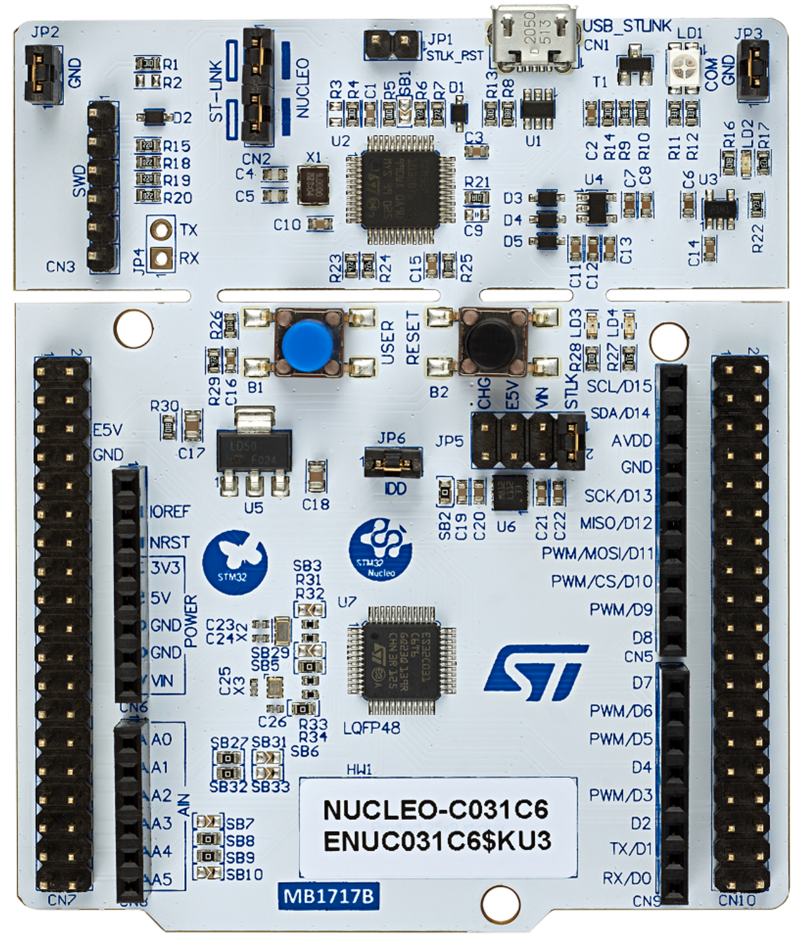
blinky.c
LED at header pin D13 wired to
STM32C0 pin 16 (Port A, bit 5)
#include "stm32C0xx.h" // All the port definitions are here
// Bit 0 of RCC->IOPENR enables clock for GPIOA
#define GPIOAEN (1U<<0) // 0b 0000 … 0000 0001 (32-bit)
// Bit 5 of Port A is wired to the LED
#define LED_PIN (1U<<5) // 0b 0000 … 0001 0000
int main(void) {
RCC->IOPENR |= GPIOAEN; // 1. Enable clock access to GPIOA
GPIOA->MODER |= (1U<<10); // 2. Configure PA5 (Port A, bit 5)
GPIOA->MODER &= ~(1U<<11); // as output pin
while(1) {
GPIOA->ODR |= LED_PIN; // 3. Set set bit 5 to turn LED on
for (int i=0; i<100000; i++); // kill some time
GPIOA->ODR &= ~LED_PIN; // 4. Clear bit 5 to turn LED off
for(int i = 0; i<100000; i++); // kill some time
}
return 0; // never reached
}

Slide 4
Going deeper into how Blinky works

Slide 5
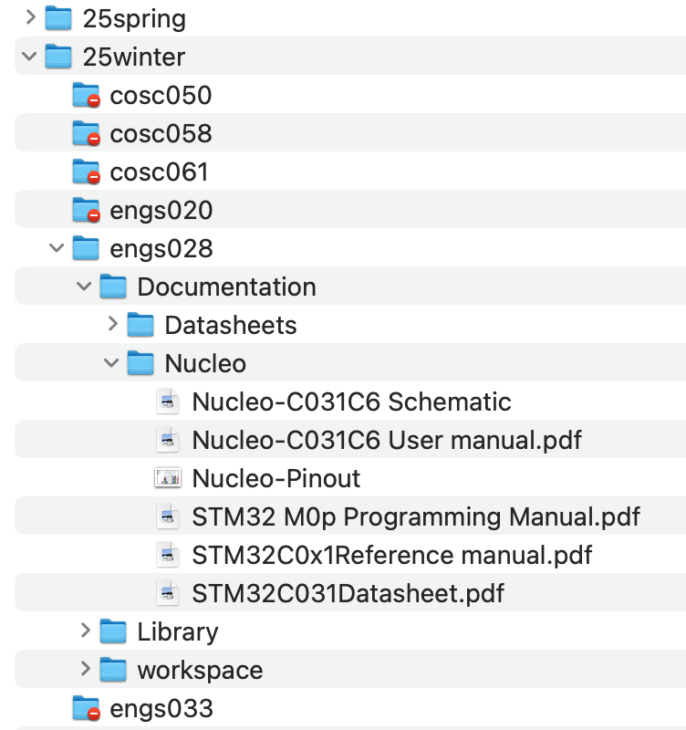
Hardware: How is the LED connected to the microcontroller?
6
6
Thayer Shares: Courses
Notes:
Don't let this scare you away - I'll show you what parts to look at.

Slide 6
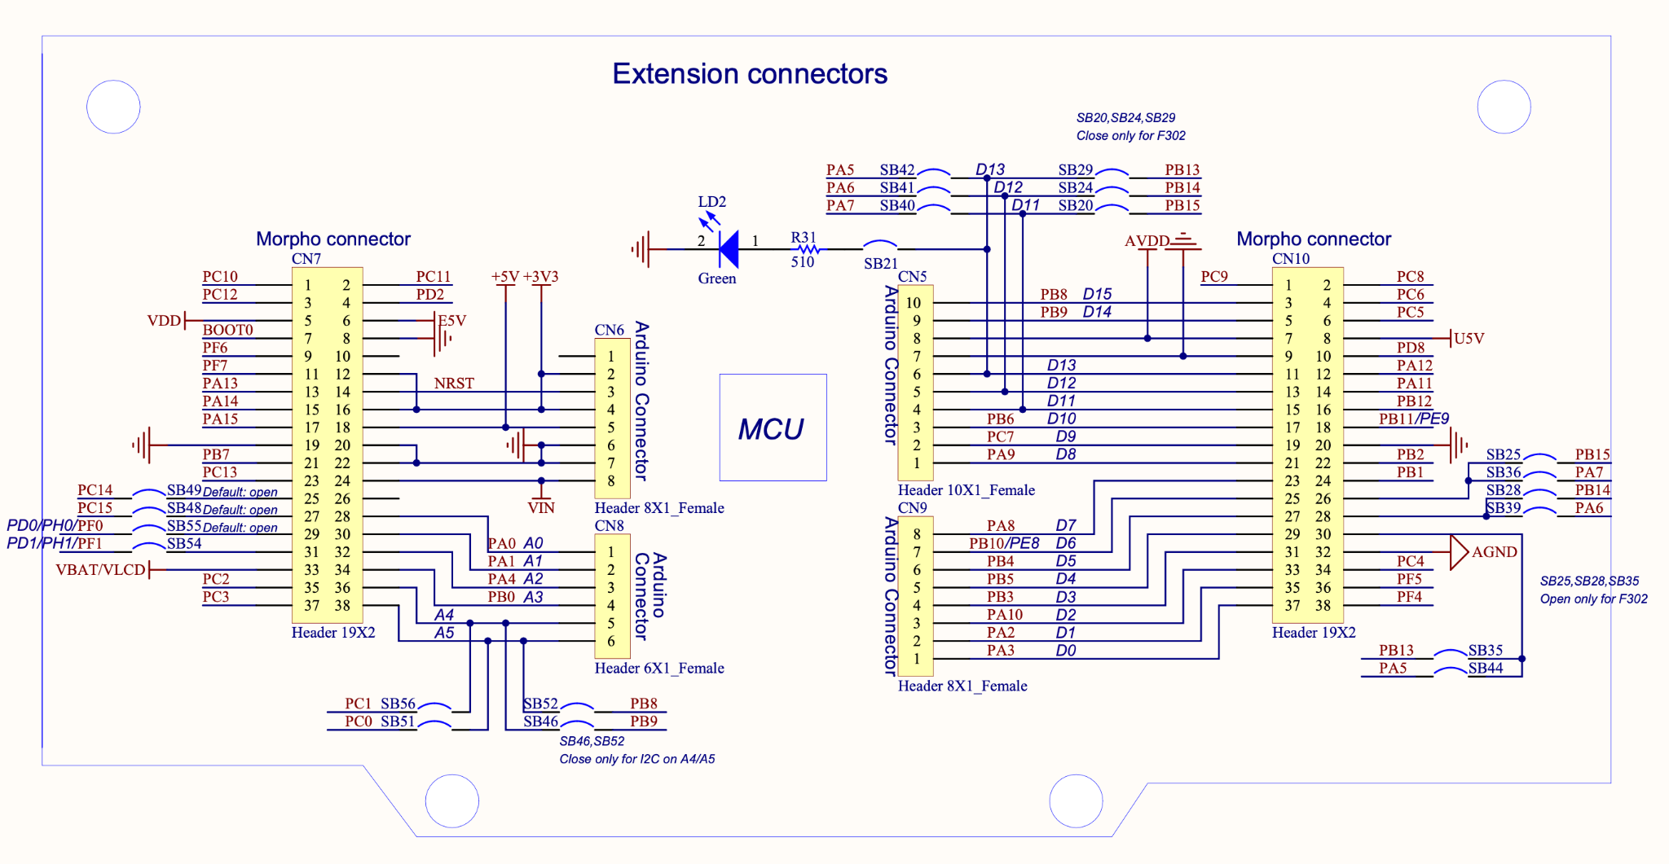
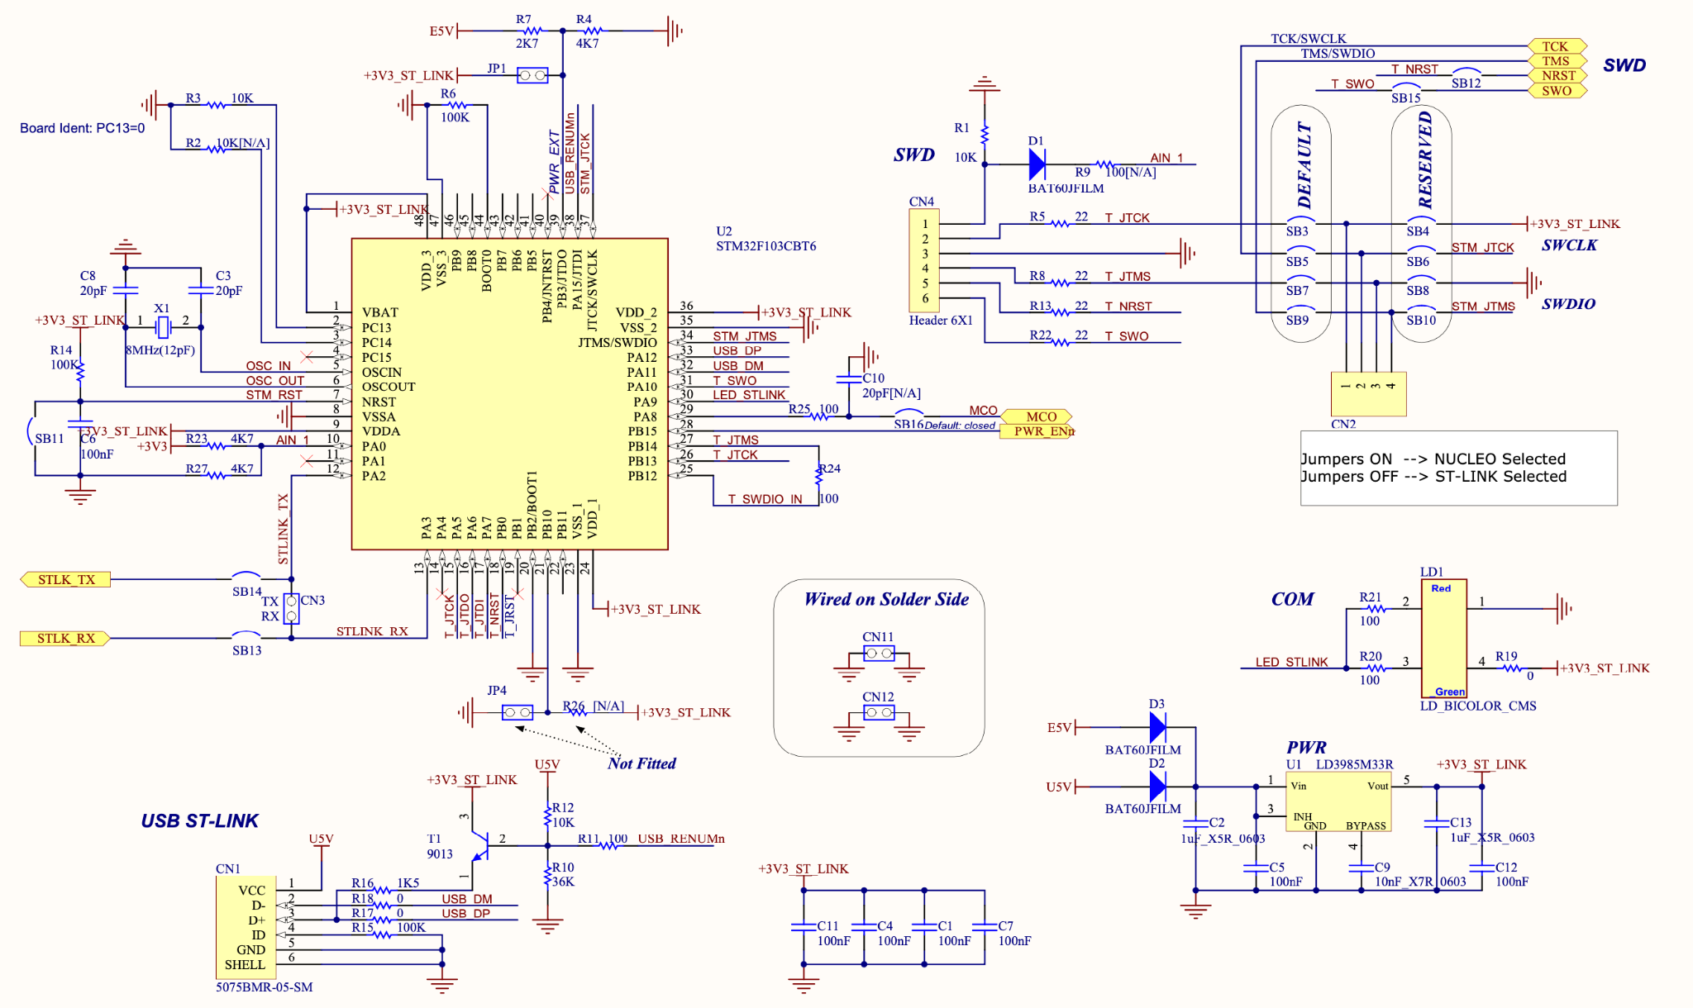
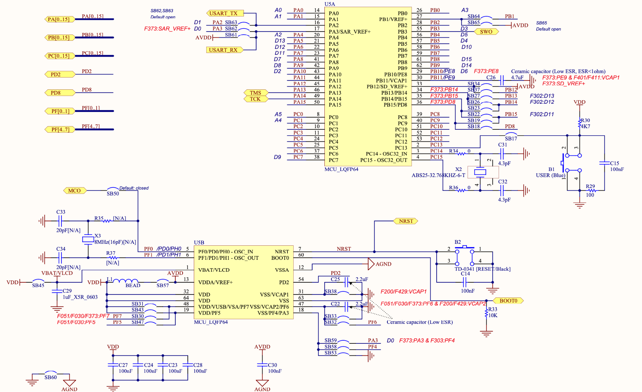
Hardware: How is the LED connected to the microcontroller?
STM32 Nucleo 64 Schematic
Notes:
Don't let this scare you away - I'll show you what parts to look at.

Slide 7
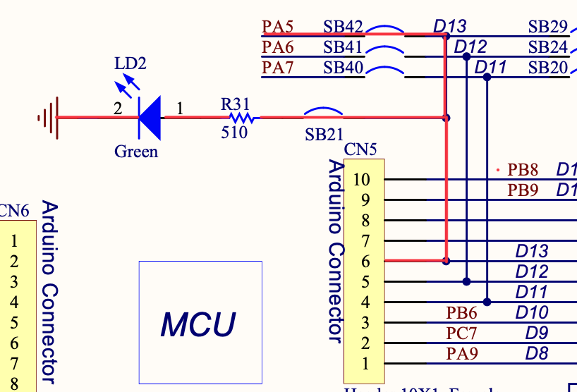
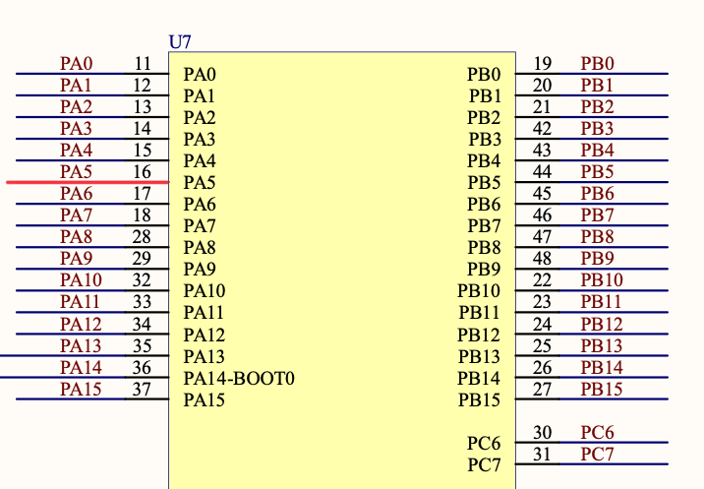
Hardware: How is the LED connected to the microcontroller?
LED is driven by
signal on PA5
(detail of Nucleo schematic)
STM32C031C6
Bit 5 of I/O Port A of the STM32C031C6 is connected to the LED and Arduino header pin 13.
Notes:
Bottom right picture shows that Port A, bit 5 connected to Pin 16 on microcontroller; that signal also has the name SCK and goes to Arduino pin 13, as you can see from the top left schematic picture since the name PA5 appears there also. Whenever you see two wires with the same name they are connected.
SCK = serial clock - only used here since that's how the pin is labelled.

Slide 8
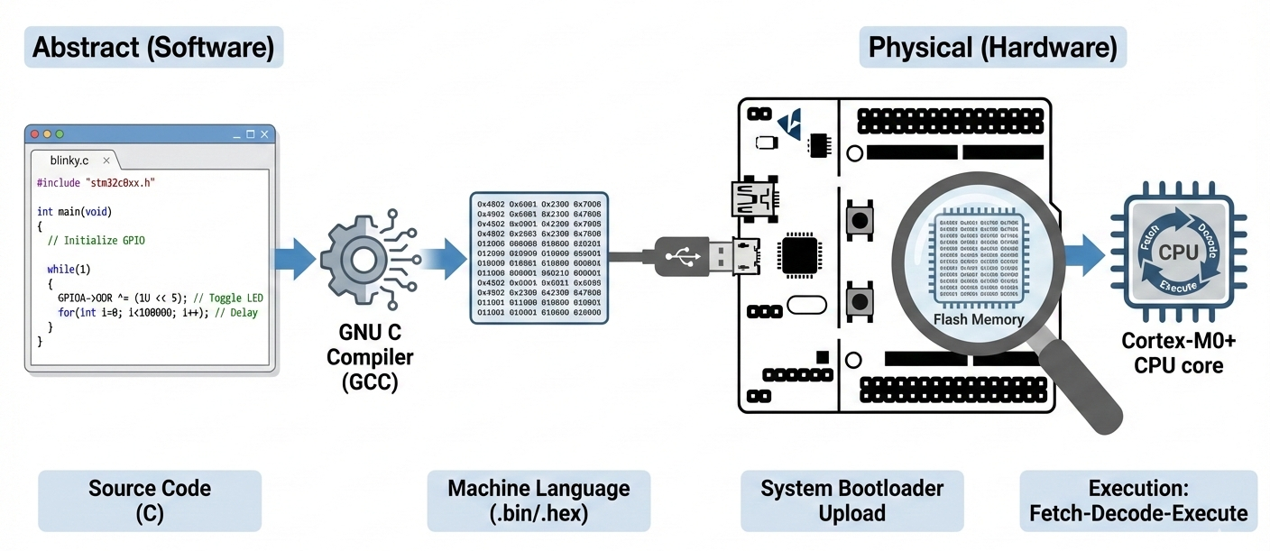
How does the microcontroller run a program?
Compiler (GNU C) translates C code into machine language instructions.
Machine code is uploaded (system bootloader) to the processor’s flash memory.
Microcontroller’s processor executes the machine language instructions.
We need to dig inside the microcontroller
Architecture: how the processor is built
Instruction set: what the processor can do

Slide 9

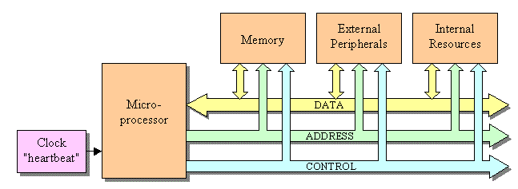
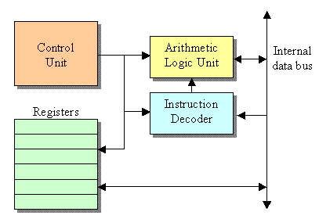
Microprocessor Architecture At a Glance
Program Instructions
Memory
Data
Flash
RAM
Memory-mapped I/O
GPIO Registers
32 wires
32 wires
Every line of C code ultimately manipulates registers and memory shown here.
C code → CPU executes instructions → Register write
→ Memory-mapped GPIO → Pin voltage changes → LED

Slide 10
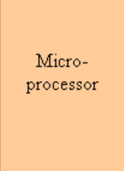
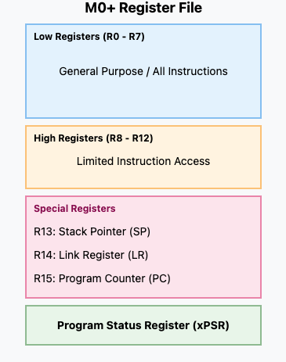
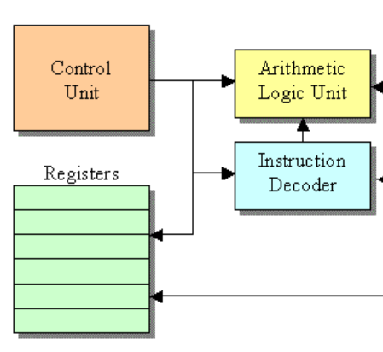
The CPU’s "Scratchpad": M0+ Registers
Microprocessor

Slide 11
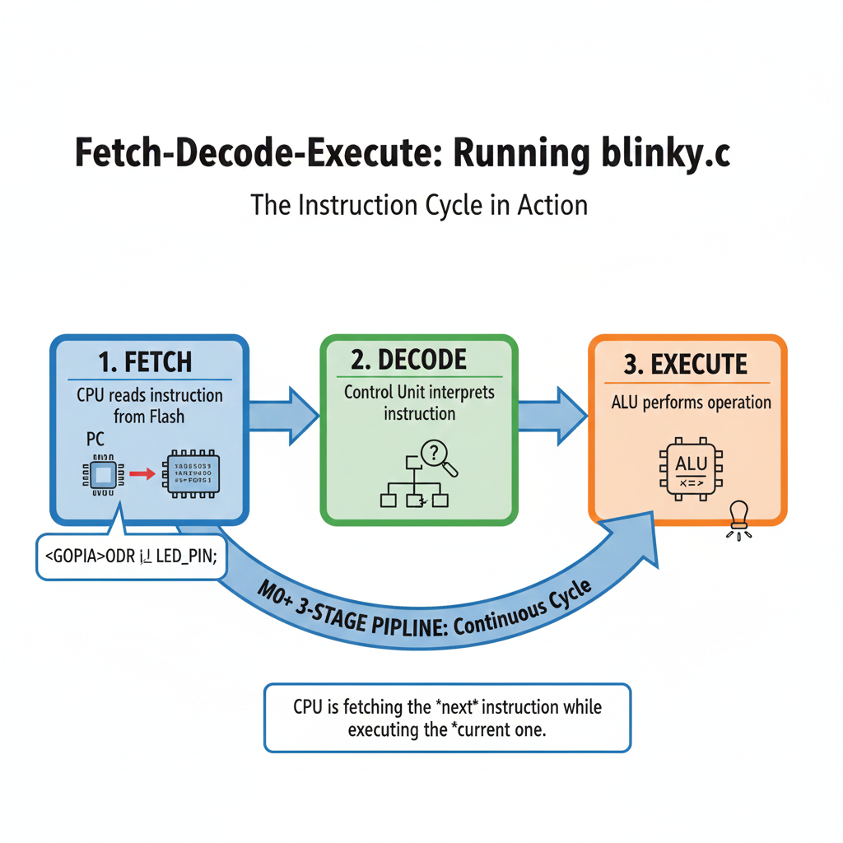
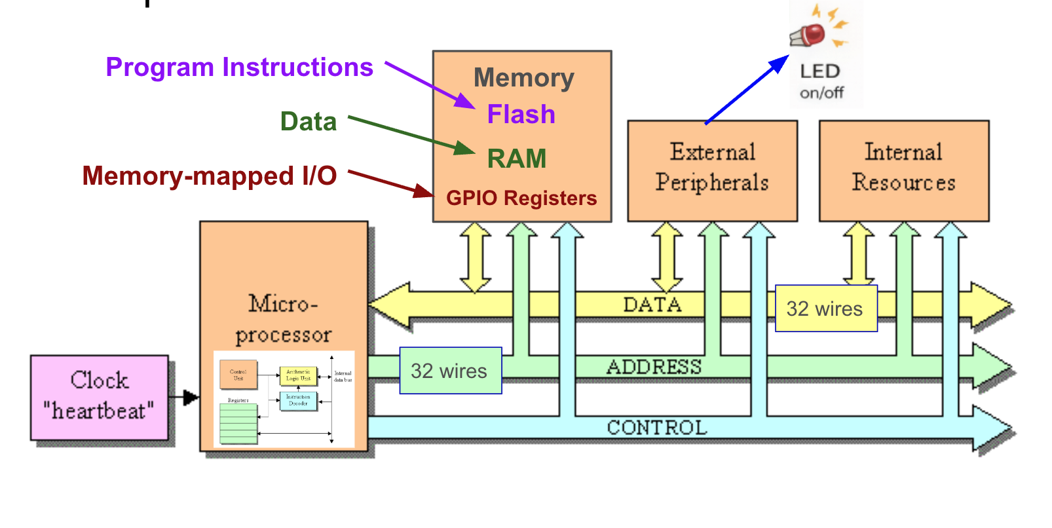
Instruction Fetch-Decode-Execute Cycle
GPIO->ODR |= LED_PIN;
Notes:
Explain Fetch-Execute cycle here
Program lives in the flash memory. Line after line of machine instruction in successive memory locations.
The program counter points to where you are in the execution sequence of these instructions.
The instruction that the program pointer points to is copied into the instruction register - a bit of storage used to hold the instruction that comes out of the program memory. The instruction register is part of the processor’s internal control logic and is not explicitly named or user-accessible like general-purpose registers (e.g., R0-R15).
Instruction is decoded to tell the processor what to do (move data, add data, etc); pieces in the instruction byte also tells the processor where to find the operands for the instruction. General purpose register? Main data memory?
Then program counter increments and we start again.

Slide 12
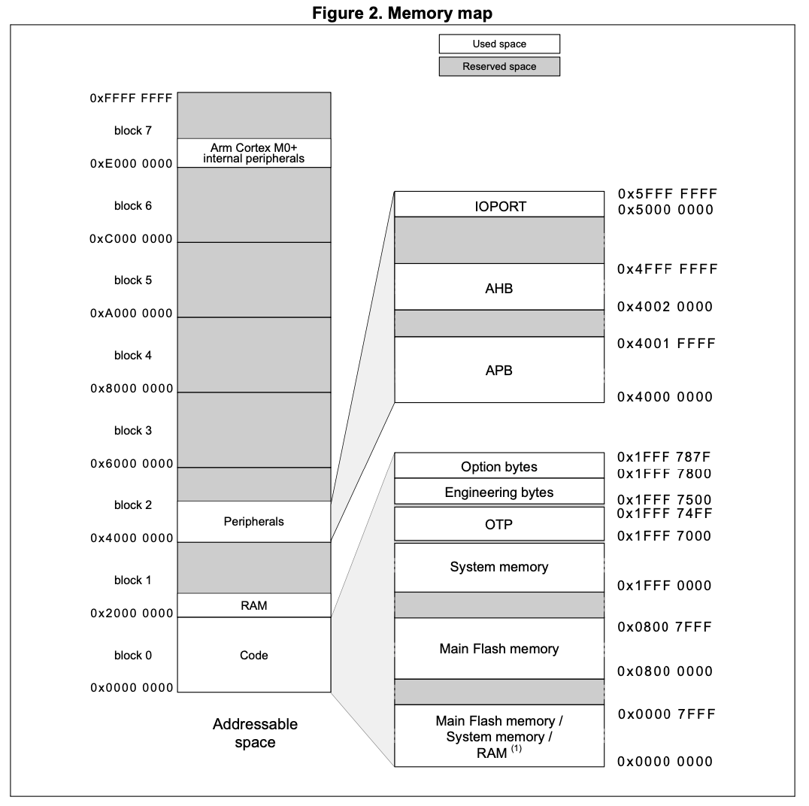
Memory Organization for our chip
I/O is "memory-mapped", so controlled through registers in memory.
GPIO->ODR |= LED_PIN;
Program code and data lives here

Slide 13
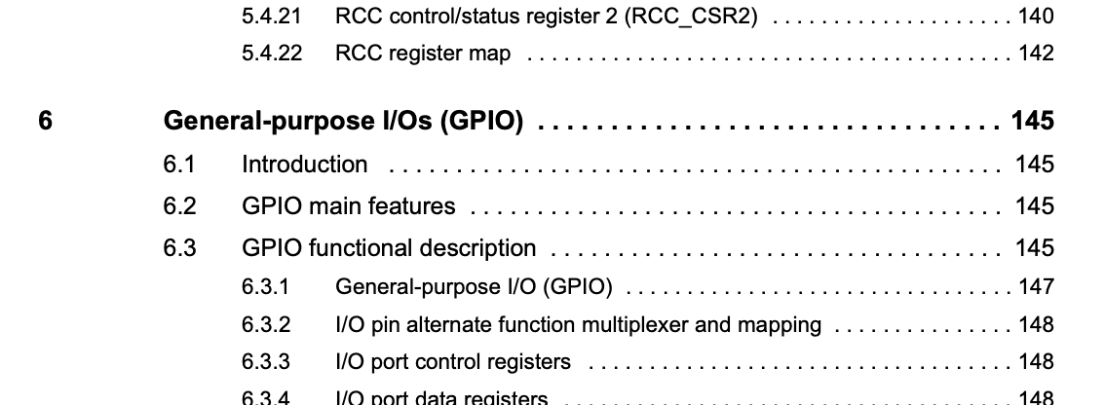
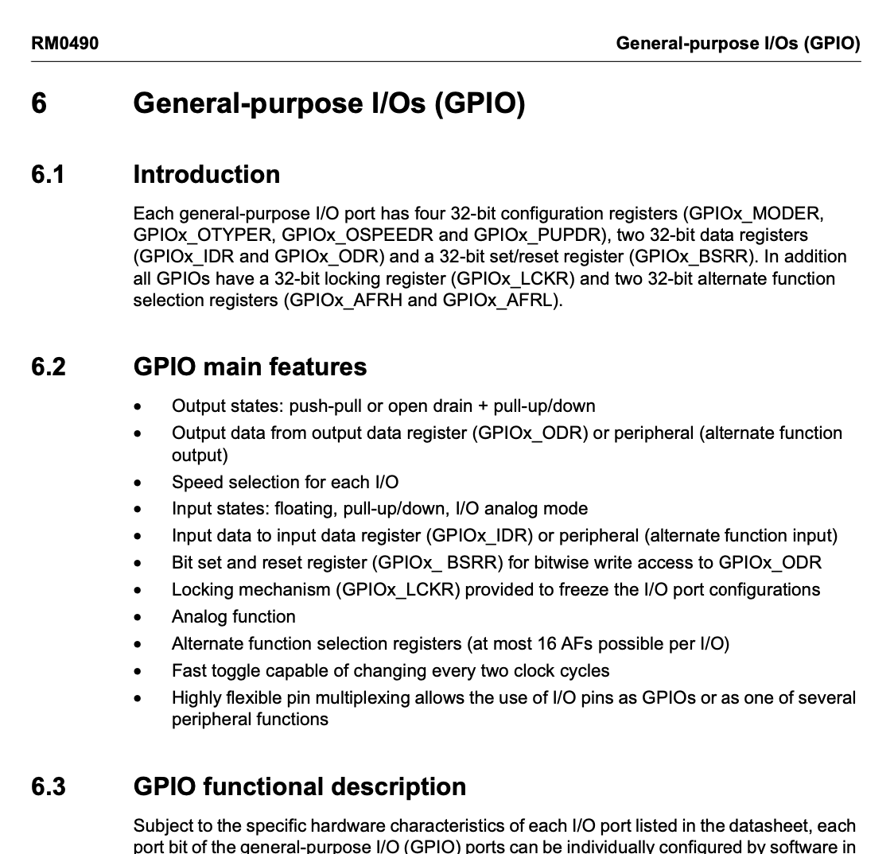
How does a microcontroller output pin work?
Thayer Shares: Courses
6
6
Notes:
The pair of output transistors can be used in three ways.
In “push-pull” mode, either the PMOS transistor is ON and the NMOS transistor is OFF, which drives the output HIGH, or vice-versa, which drives the output LOW.
In “open-drain” mode, the PMOS transistor is always off. There must be an external connection of the I/O pin to a positive supply to drive a load. An open-drain output might used if the load needs a higher supply voltage than the chip uses. (Another way would be to use an external driver transistor, like an H-bridge, driven by a push-pull output pin.)
In “Hi-Z” mode, both the PMOS and NMOS can be turned off, which effectively disconnects the I/O pin from the external circuit. These are (implicitly) used in I2C, where we have multiple devices connected to the same bus.
The box labeled Output Control must have a NOT function inside so that a ‘0’ in the Output Data Register drives the output pin LOW, and vice-versa. Easy to do, since the Output Control box is also managing the choice of push-pull, open-drain, and Hi-Z.

Slide 14
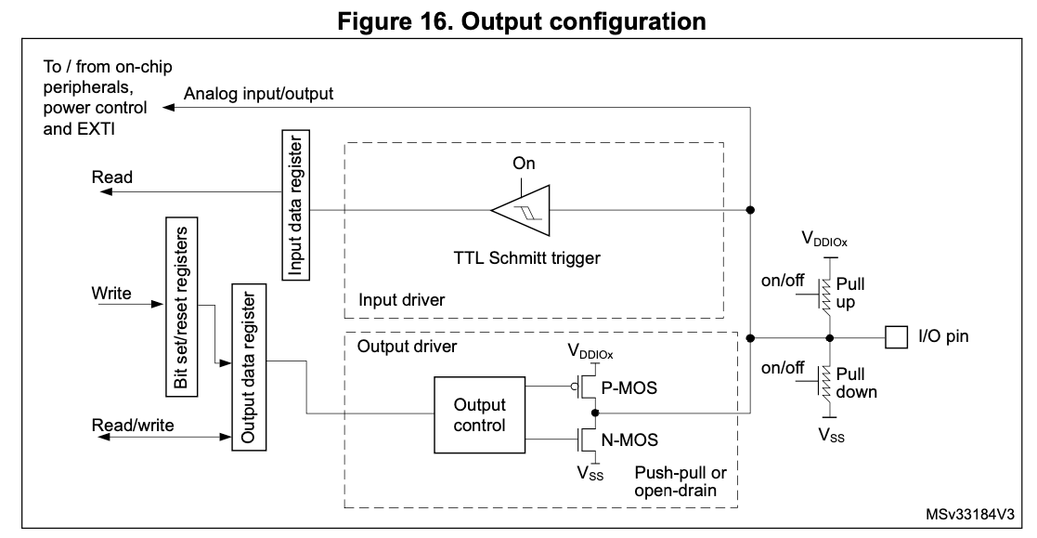
How does a microcontroller output pin work?
Using Port A, for example.
GPIOA->MODER determines input versus output mode, amongst others.
To LED
GPIOA->ODR
"In push pull mode, a 0 in the ODR register will drive the output low, while a 1 will drive it high."
Notes:
The pair of output transistors can be used in three ways.
In “push-pull” mode, either the PMOS transistor is ON and the NMOS transistor is OFF, which drives the output HIGH, or vice-versa, which drives the output LOW.
In “open-drain” mode, the PMOS transistor is always off. There must be an external connection of the I/O pin to a positive supply to drive a load. An open-drain output might used if the load needs a higher supply voltage than the chip uses. (Another way would be to use an external driver transistor, like an H-bridge, driven by a push-pull output pin.)
In “Hi-Z” mode, both the PMOS and NMOS can be turned off, which effectively disconnects the I/O pin from the external circuit. These are (implicitly) used in I2C, where we have multiple devices connected to the same bus.
The box labeled Output Control must have a NOT function inside so that a ‘0’ in the Output Data Register drives the output pin LOW, and vice-versa. Easy to do, since the Output Control box is also managing the choice of push-pull, open-drain, and Hi-Z.

Slide 15
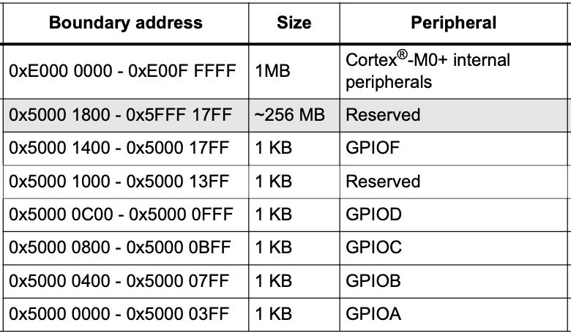
Where is the Output Data Register for GPIOA in Memory?
When your program writes data to memory location 0x5000 0014:
Processor puts data on the data bus, address on the address bus and a write signal on the control bus
Only register with address 0x5000 0014 activates and receives the data on the data bus
Since that address corresponds to a hardware register, the write changes the peripheral’s state instead of RAM
Offset | Register name
0x00 | GPIOx_MODER
0x04 | GPIOx_OTYPER
0x08 | GPIOx_OSPEEDR
0x0C | GPIOx_PUPDR
0x10 | GPIOx_IDR
0x14 | GPIOx_ODR
0x18 | GPIOx_BSRR
0x1C | GPIOx_LCKR
0x20 | GPIOx_AFRL
0x24 | GPIOx_AFRH
0x28 | GPIOx_BRR
GPIOA->ODR address: 0x5000 0000 + 0x14 = 0x5000 0014
Notes:
When your program writes to memory location 0x5000 0014, the information it wants to store in that register is put onto the processor's data bus and the 0x5000 0014 address activates the register so that it will receive the data on the data bus and store it in the register. None of the other registers attached to the data bus have this address, so they will not store the information coming on the bus.

Slide 16
GPIOA->ODR address: 0x5000 0000 + 0x14 = 0x5000 0014
Inside stm32c031xx.h:
Offset | Register name
0x00 | GPIOx_MODER
0x04 | GPIOx_OTYPER
0x08 | GPIOx_OSPEEDR
0x0C | GPIOx_PUPDR
0x10 | GPIOx_IDR
0x14 | GPIOx_ODR
0x18 | GPIOx_BSRR
0x1C | GPIOx_LCKR
0x20 | GPIOx_AFRL
0x24 | GPIOx_AFRH
0x28 | GPIOx_BRR
typedef struct
{
__IO uint32_t MODER; /* Address offset: 0x00 */
__IO uint32_t OTYPER; /* Address offset: 0x04 */
__IO uint32_t OSPEEDR;/* Address offset: 0x08 */
__IO uint32_t PUPDR; /* Address offset: 0x0C */
__IO uint32_t IDR; /* Address offset: 0x10 */
__IO uint32_t ODR; /* Address offset: 0x14 */
__IO uint32_t BSRR; /* Address offset: 0x18 */
__IO uint32_t LCKR; /* Address offset: 0x1C */
__IO uint32_t AFR[2]; /* Address offset: 0x20-0x24 */
__IO uint32_t BRR; /* Address offset: 0x28 */
} GPIO_TypeDef;
(...)
#define IOPORT_BASE (0x50000000UL)
#define GPIOA_BASE (IOPORT_BASE + 0x00000000UL)
#define GPIOB_BASE (IOPORT_BASE + 0x00000400UL)
(...)
#define GPIOA ((GPIO_TypeDef *) GPIOA_BASE)
(...)
GPIOA is a pointer to address 0x5000 00000.
"->" dereferences (goes to that address)
GPIOA->ODR is the member ODR of the structure of type GPIO_TypeDef, stored at 0x5000 0000.
The address of this member is 0x5000 000 + 0x14.
Notes:
All the GPIO ports have the same registers, and using the struct simplifies programming by allowing you to use the same names across all the ports. Also, observe how the offsets step up by four. ("Why is this"?)

Slide 17
Time to build something

Slide 18
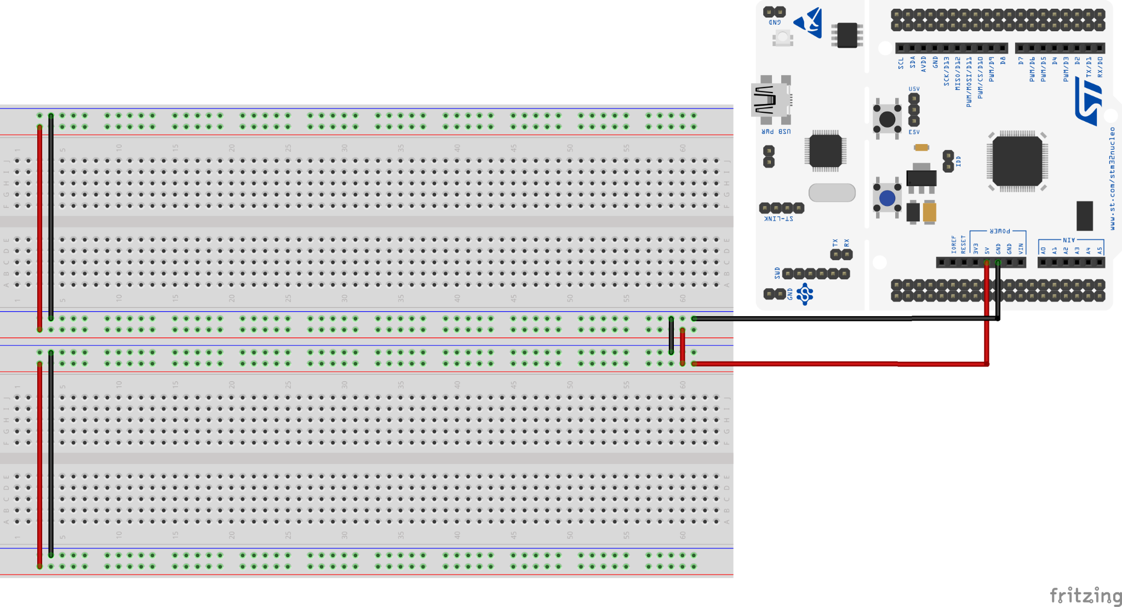
Basic Nucleo-Breadboard connection
Your breadboard has been pre-wired for power and ground. Leave these wires in place all term. Connect your Nucleo as shown in the picture below.

Slide 19
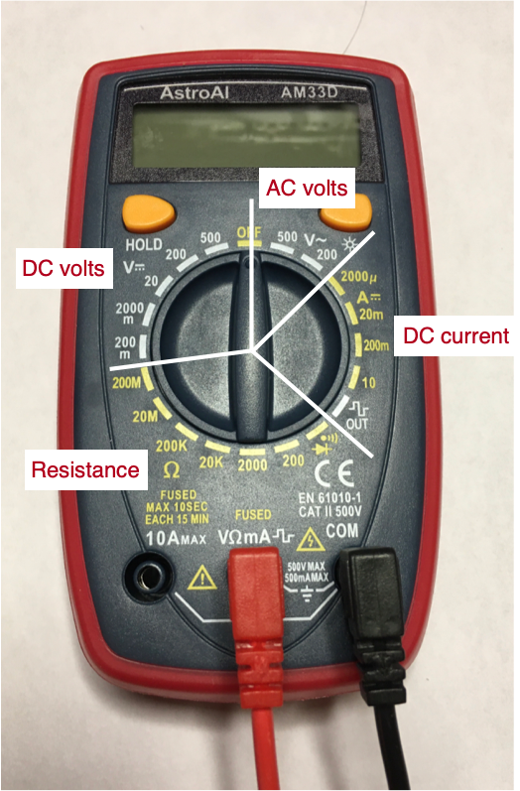
Digital multimeter (DMM)
Good for measuring voltage, current, and resistance.
It is not “auto-ranging”. Use the dial to select type of measurement and the expected range of values.
Setup: Plug the black probe into COM and the red probe into VΩmA.
Best Practice: Always set the dial before touching the probes to the circuit to avoid blowing a fuse.
Watch the video (linked from daily page).
Notes:
Can be used to measure DC volts, resistance in ohms, DC current and AC volts. Plug in the probes at the bottom as in the picture.

Slide 20
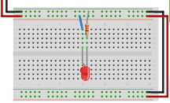
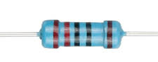

Wire up an LED on the breadboard (red or green)
Let's make an "external" LED blink, one that is on your breadboard rather than the Nucleo board.
Pick a red or green LED (agree with your table, so both colors are used).
Pick the 220 ohm resistor from your kit. The color code for 220 ohms is red-red-black-black (5 bands).
Measure the resistance with your DMM to confirm its value is within 1% of 220.
Build the circuit shown to the right. Use a jumper, as shown, between the power rail and the LED. While wiring, unplug your Nucleo from your computer or any other source of power.
Current flow
https://www.switchelectronics.co.uk/blog/post/ledpolarity.html
Notes:
An LED has an anode and a cathode terminal. Current can only flow through one way and illuminate the LED. The anode wire is longer than the cathode wire, unless they have already been shortened. The other way to tell is the flat part on the case which is near the cathode wire.

Slide 21
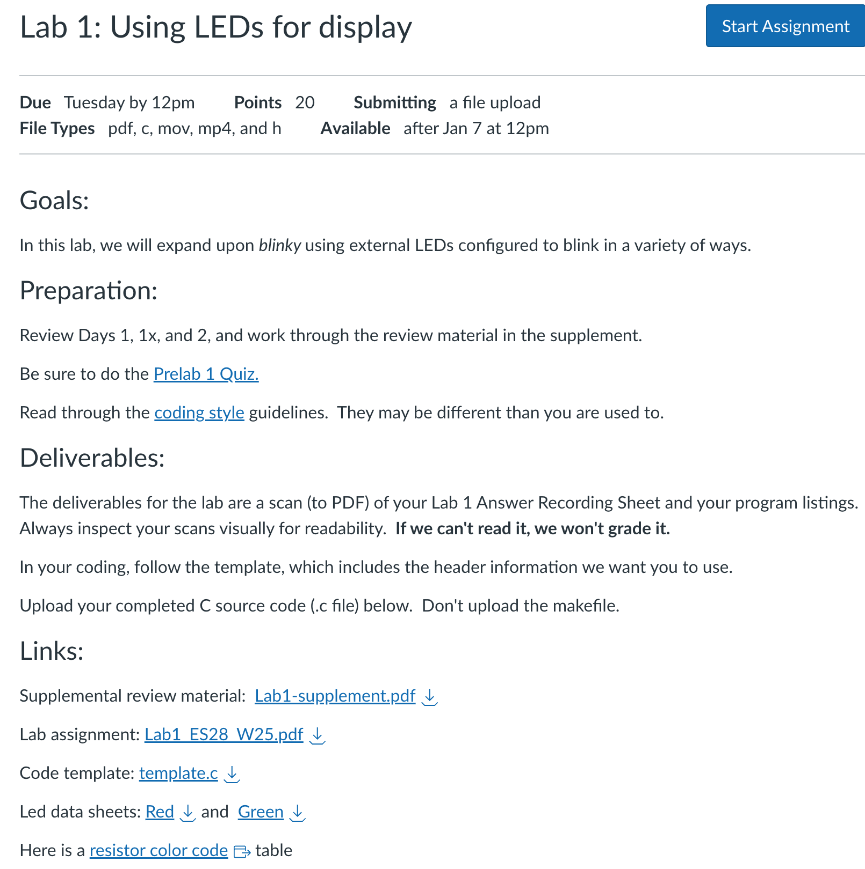
Measurements
Check your wiring, then power the board. Make sure the LED is on. If not, check your wiring (is the LED in backwards?).
Measure the three voltages: Vcc (power to ground), V_{F} (anode to cathode), and V_{R} (cathode to ground). Confirm that Vcc = V_{F} + V_{R}.
Using Ohm’s Law, what is the current I_{F} flowing through the LED?
Look up V_{F} on the LED data sheet and compare with your measurement.
Compare V_{F} of red and green LEDs with your partners.
Current flow
Notes:
This is part of your lab!

Slide 22
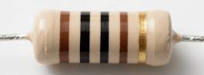
More measurements
Select a 1000 ohm (1K) resistor from your kit (brown-black-black-brown, 5 bands).
Measure its resistance with the multimeter. Is the measured resistance within 1% of 1000 ohms?
Power off the board, replace the 220 ohm resistor with a 1000 ohm (1K) resistor.
Power up the board and repeat the measurements. Vcc, V_{F}, V_{R}, I_{F}
Compare voltages, currents and brightnesses for the two resistors.
Current flow
Notes:
5th band is tolerance - brown for 1%, red for 2%, etc

Slide 23
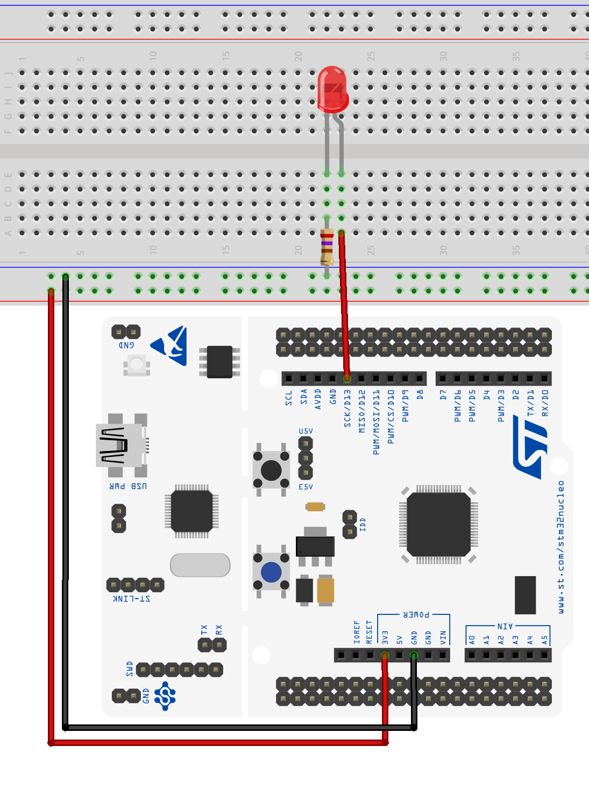
Wire up an LED on the breadboard
Let's make an "external" LED blink, one that is on your breadboard rather than the Nucloe board.
Unplug the Nucleo from your computer or any other source of power. Build the circuit shown to the right. Again, use the 220 ohm resistor.
“Pin D13” (Port A, Bit 5), will be the voltage source now. Make sure the anode (+) lead is connected to pin 13, and the cathode (–) lead is connected to ground, through the 220 ohm resistor.
Current flow

Slide 24
Wire up an LED on the breadboard
Double-check: Make sure the LED is wired with the correct polarity.
Re-connect your Nucleo to your computer.
As soon as the board has power, the previously flashed Blinky program will automatically start running.
You should see the LED on the breadboard blink along with the on-board LED.
If it doesn’t blink, check again that your LED is wired correctly.

Slide 25
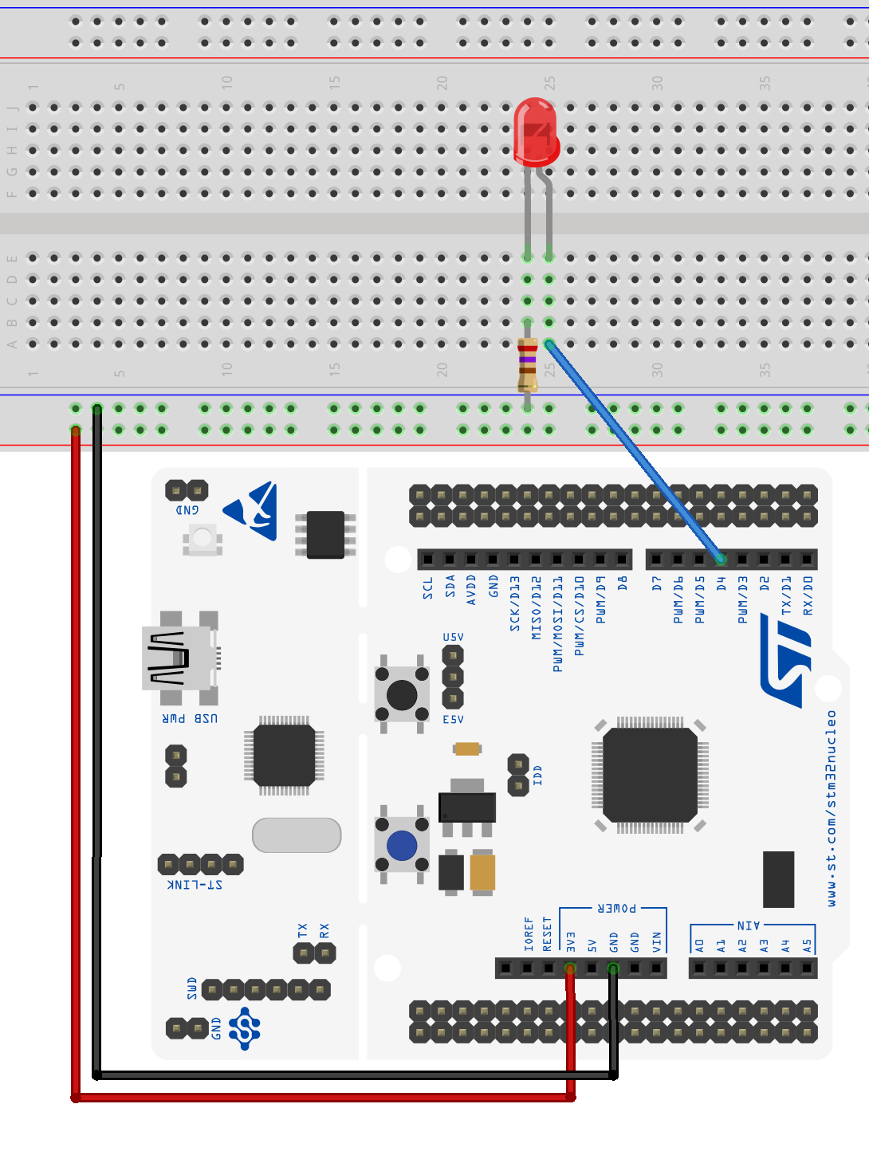
Small modification
Make a copy of blinky.c inside your Blinky project and name the new file "blinkyD4.c". Modify the resource configuration so that blinkyD4.c is the only file with a main() function that is active in your project.
Move the anode wire from pin D13 (Port A, Bit 5) to pin D4, as shown.
Modify blinkyD4.c so that the LED on the breadboard blinks. (The onboard LED will no longer blink.)

Slide 26
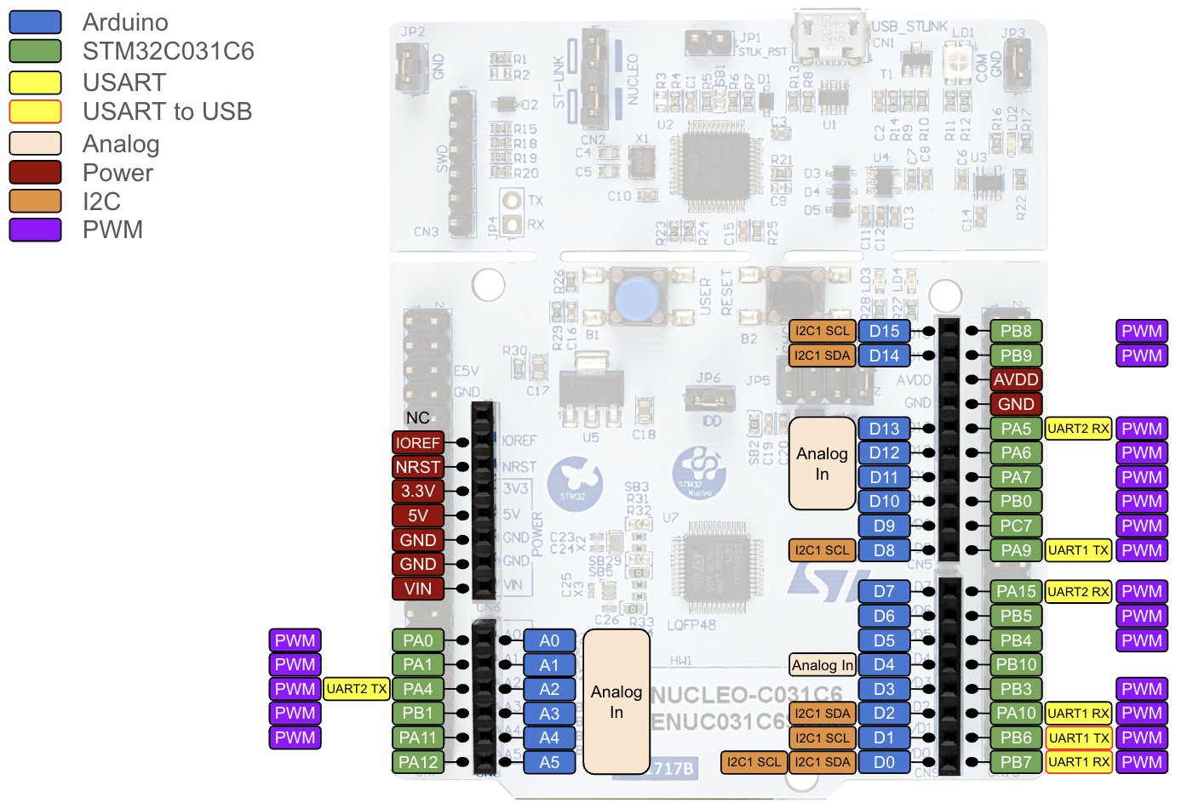
This pinout might come in handy…

Slide 27
Hints
Previously, we were blinking Arduino header pin D13, with meant we had to program port A, pin 5.
Look at the Pinout on the previous slide and determine the port and pin you have to program in order to use Arduino header pin D4.
Mark every place in our previous blinky.c that referenced port A.
Mark every place in our previous blinky.c that referenced pin 5.
Notes:
D4 is Port B, pin 10.

Slide 28
blinky.c
#include "stm32C0xx.h" // All the port definitions are here
// Bit 0 of RCC->IOPENR enables clock for GPIOA
#define GPIOAEN (1U<<0) // 0b 0000 … 0000 0001 (32-bit)
// Bit 5 of Port A is wired to the LED
#define LED_PIN (1U<<5) // 0b 0000 … 0001 0000
int main(void) {
RCC->IOPENR |= GPIOAEN; // 1. Enable clock access to GPIOA
GPIOA->MODER |= (1U<<10); // 2. Configure PA5 (Port A, bit 5)
GPIOA->MODER &= ~(1U<<11); // as output pin
while(1) {
GPIOA->ODR |= LED_PIN; // 3. Set set bit 5 to turn LED on
for (int i=0; i<100000; i++); // kill some time
GPIOA->ODR &= ~LED_PIN; // 4. Clear bit 5 to turn LED off
for(int i = 0; i<100000; i++); // kill some time
}
return 0; // never reached
}

Slide 29
blinky.c
#include "stm32C0xx.h" // All the port definitions are here
// Bit 0 of RCC->IOPENR enables clock for GPIOA
#define GPIOAEN (1U<<0) // 0b 0000 … 0000 0001 (32-bit)
// Bit 5 of Port A is wired to the LED
#define LED_PIN (1U<<5) // 0b 0000 … 0001 0000
int main(void) {
RCC->IOPENR |= GPIOAEN; // 1. Enable clock access to GPIOA
GPIOA->MODER |= (1U<<10); // 2. Configure PA5 (Port A, bit 5)
GPIOA->MODER &= ~(1U<<11); // as output pin
while(1) {
GPIOA->ODR |= LED_PIN; // 3. Set set bit 5 to turn LED on
for (int i=0; i<100000; i++); // kill some time
GPIOA->ODR &= ~LED_PIN; // 4. Clear bit 5 to turn LED off
for(int i = 0; i<100000; i++); // kill some time
}
return 0; // never reached
}

Slide 30
How do we enable clock access to GPIOB?
Recall:
By default, the clock to peripherals (of which GPIOB is one) is turned off to save power.
You can't read from or write to a GPIO pin without the clock being active.
RCC->IOPENR = "I/O Port Clock Enable Register of the Reset and Clock Control (RCC) system".
It's a 32-bit register that enables (1) or disables (0) the clock for GPIOx (x = A, B, C, D, or F):
Port D
Port B
Port F
Port C
Port A
Bit 31 | Bit 30 | … | Bit 8 | Bit 7 | Bit 6 | Bit 5 | Bit 4 | Bit 3 | Bit 2 | Bit 1 1 | Bit 0

Slide 31
How do we set the MODER? Recall:
Each GPIO Port has a 32-bit MODER. It has two bits for each pin to determine its mode: Output, input, analog I/O, etc
Bits 0 and 1 configure pin 0, bits 2 and 3 configure pin 1, … bits 30 and 31 configure pin 15.
Which bits configure pin 10?
In order to configure our pin as output, write a '01' into its two bits.
In blinky.c, in order to configure pin 5 of port A as output, we wrote a '01' into its two bits, bits 10 and 11:
Bit 31 | Bit 30 | … | Bit 13 | Bit 12 | Bit 11 0 | Bit 10 1 | Bit 9 | … | Bit 2 | Bit 1 | Bit 0
GPIOA->MODER &= ~(1U<<11);
GPIOA->MODER |= (1U<<10);
What makes pin 10 of port B into an output pin?
Notes:
Bits 20 and 21 configure pin 10

Slide 32
Solution
#include "stm32C0xx.h" // All the port definitions are here
// Bit 1 of RCC->IOPENR enables clock for GPIOB
#define GPIOBEN (1U<<1) // 0b 0000 … 0000 0010 (32-bit)
// Bit 10 of Port B is wired to the LED
#define LED_PIN (1U<<10) // 0b 0000 ... 0100 0000 0000
int main(void) {
RCC->IOPENR |= GPIOBEN; // 1. Enable clock access to GPIOB
GPIOB->MODER |= (1U<<20); // 2. Configure PB10 (Port B, bit 10)
GPIOB->MODER &= ~(1U<<21); // as output pin
while(1) {
GPIOB->ODR |= LED_PIN; // 3. Set bit 10 to turn LED on
for (int i=0; i<100000; i++); // kill some time
GPIOB->ODR &= ~LED_PIN; // 4. Clear bit 10 to turn LED off
for(int i = 0; i<100000; i++); // kill some time
}
return 0; // never reached
}

Slide 33
About that delaying for-loop…
How much time are we really killing with this loop?
for (int i=0; i<100000; i++); // kill some time
Wouldn't it be great to specify the number of milliseconds we wish to wait?
Introducing delay_ms():
We coded a function "delay_ms()" with code located inside sysinit.c (which is one of the files currently in your mylib folder). You'll be able to understand the code inside the function later but feel free to take a look anyway!
From now on: Instead of #include "stm32C0xx.h" at the start of your code:
Use #include "ES28.h" at the start of your code.
This will ensure that you have the prototype for delay_ms() (remember that C requires those?) included in your code.

Slide 34
Example: blinky.c using delay_ms():
#include "ES28.h"
// Bit 0 of RCC->IOPENR enables clock for GPIOA
#define GPIOAEN (1U<<0) // 0b 0000 … 0000 0001 (32-bit)
// Bit 5 of Port A is wired to the LED
#define LED_PIN (1U<<5) // 0b 0000 … 0001 0000
int main(void) {
RCC->IOPENR |= GPIOAEN; // 1. Enable clock access to GPIOA
GPIOA->MODER |= (1U<<10); // 2. Configure PA5 (Port A, bit 5)
GPIOA->MODER &= ~(1U<<11); // as output pin
while(1) {
GPIOA->ODR |= LED_PIN; // 3. Set set bit 5 to turn LED on
delay_ms(1000); // kill some time
GPIOA->ODR &= ~LED_PIN; // 4. Clear bit 5 to turn LED off
delay_ms(500); // kill some time
}
return 0; // never reached
}

Slide 35
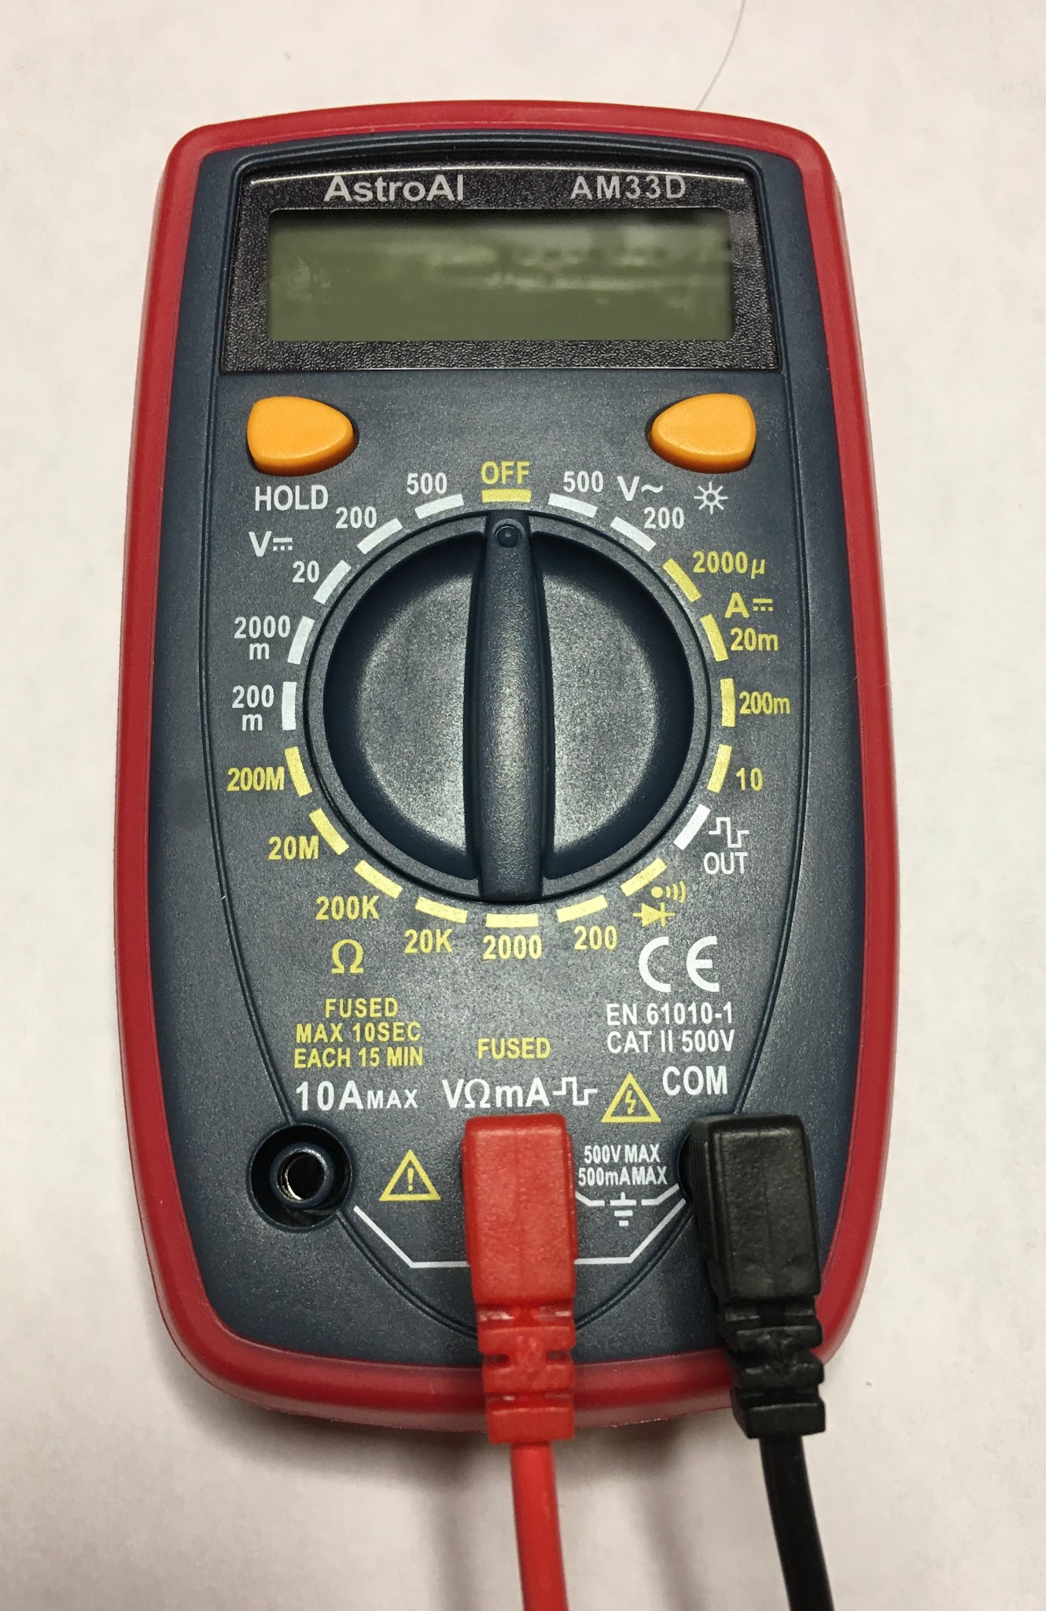
Slow down LED blinking, observe with multimeter
Modify your blinky.c program so that the blink rate is quite slow, about 2 sec on, 2 sec off.
Use the multimeter to measure the pin voltage.
Plug the black (negative) probe into the COM port, and plug the red (positive) probe into the V𝜴mA port.
Turn dial to the left to select the 0-20VDC range.
Read voltage on the display. How do the HIGH and LOW voltages compare with V_{OH} and V_{OL} specified in the microcontroller datasheet (stm32c031c6.pdf, table 51, page 69)?
Turn the dial back to OFF when you’re finished.
3
4
2
1

Slide 36
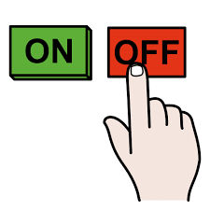



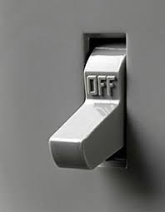

ALWAYS TURN OFF YOUR DIGITAL MULTIMETER WHEN FINISHED MEASURING

Slide 37
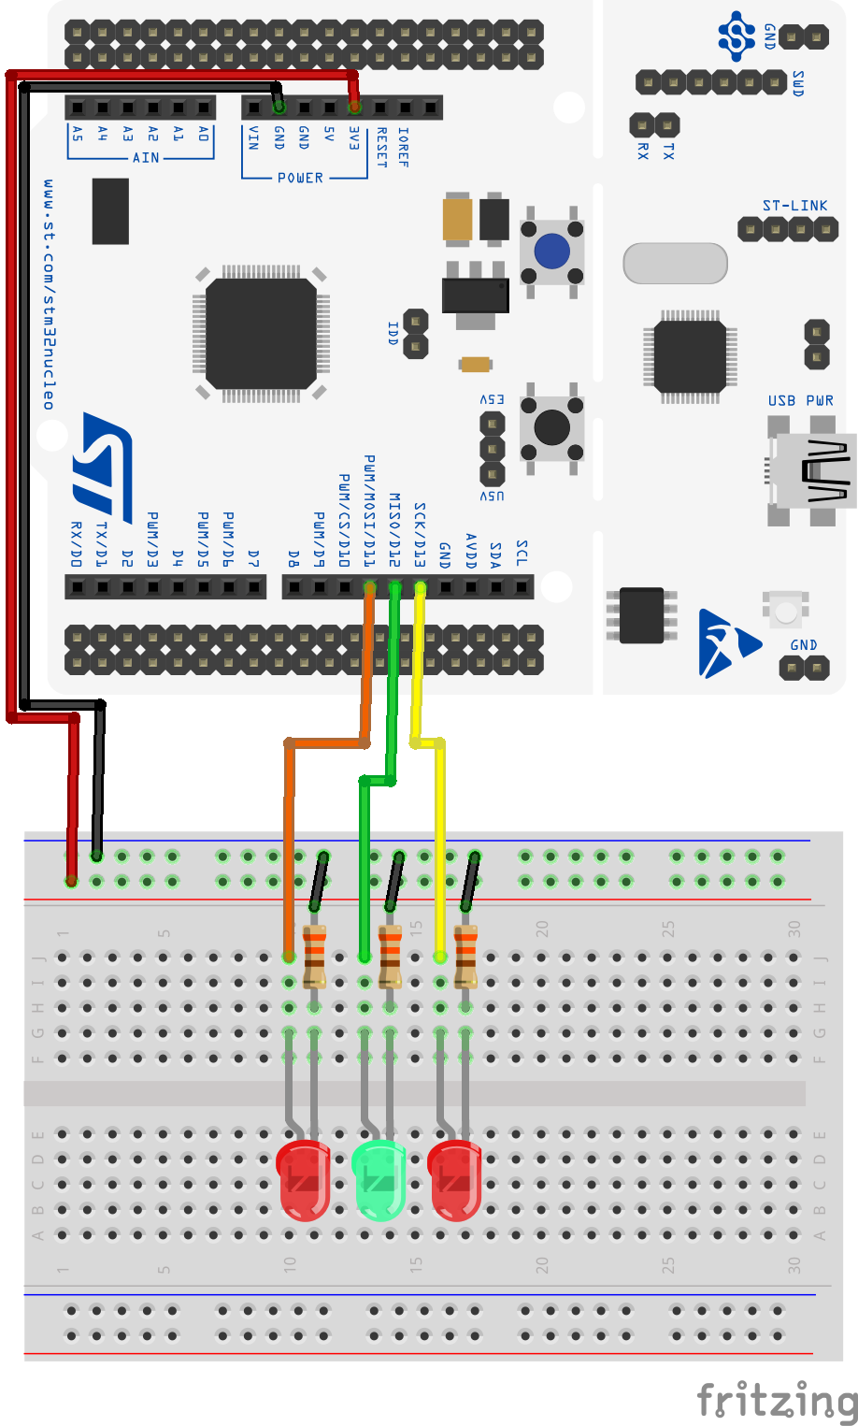
Larger modification (Lab 1)
Wire up three LEDs, as shown. Use both red and green, and the 220 ohm resistors.
blinkySIM.c: blink all three LEDs simultaneously.
blinkySEQ.c: blink the LEDs sequentially, so only one LED is lit at a time.
blinkyCNT.c: blink the LEDs in a binary code: 000, 001, 010,...111, 000...
For the labs we'll always have you work in a new project. The next slide explains how to do so.

Slide 38
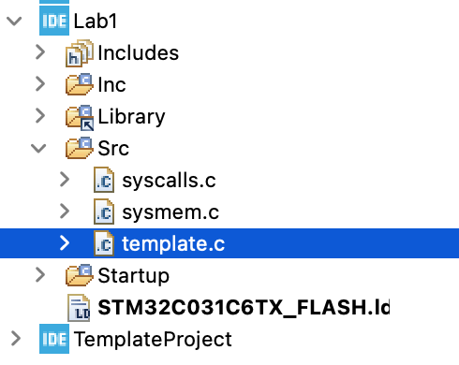
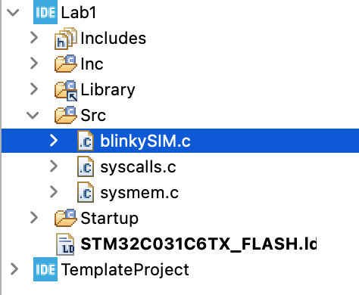
Start a new "Lab1" project
Make a copy of your TemplateProject and name it "Lab1". This creates an entirely new project for you.
Download “template.c” from Canvas and place it into the Src folder in your Lab1 project. Rename this file blinkySIM.c. This is where you'll work on blinkySim.
The easiest way to get template.c from your downloads folder into your Lab1 Src folder is to use copy+paste. Copy the file in your downloads folder, then go to your IDE and hit paste on the Src folder in Lab1.
Do not try to use your computer's file manager to drag the file into the correct location: the IDE won't be happy with you. I promise. Tried it.

Slide 39
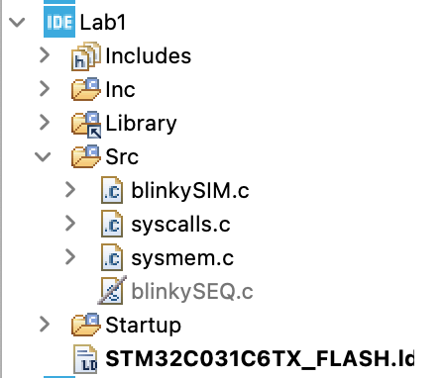
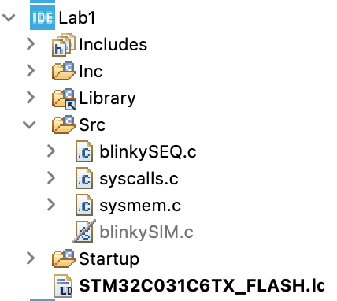
blinkySIM -> blinkySEQ
Once you got blinkySim working, copy blinkySim.c and name the copy blinkySEQ.c - it'll also live inside your Lab1 Src folder.
Use the same strategy we used in class yesterday to exclude / include files from the build configuration so that your Src directory always contains exactly one active file with a main() function in it.

Slide 40
Notes for code development
Use a consistent naming convention:
ALLCAPS (ALL_CAPS) for constants (#define)
CamelCase (camelCase) or snake_case for multi-word variable names
Build and test incrementally. For example, for blinkySIM.c,
One LED already works.
Add a second LED to a second port bit, and make them both blink.
Add the third LED
Keep track of your changes, document (comment) as you go.

Slide 41
template.c file example
/* Name: Petra BT
* Assignment: Engs 28 26W, Lab 1
*
* Program name: blinkySim.c
* Date created: 9 Jan 2026
* Description: Blink three LEDs on the breadboard
*
* Dependencies: (what other source files are required)
* (N/A)
*
* I/O pins: (what ports are used, and what are they wired to?)
* PA 5, 6, 7: Output, external LEDs on breadboard
*
* Revisions: (use this to track the evolution of your program)
* Based on the original blinky.c
*
*/

Slide 42
template.c file (2)
/* INCLUDE FILES */
#include "ES28.h"
/* FUNCTIONS */
/* Declare user-defined functions here (unless you have put the declarations in
* their own #include file) */
/* CONSTANTS */
/* #define your constants here */
#define LED_ON_TIME 100 // milliseconds
#define LED_OFF_TIME 200
/* CODE */
int main(void)
{
// Setup code (run once) goes here:
// Main code (runs in an infinite loop) goes here:
while(1) {
}
return 0; /* never reached */
}
/* Code for your user-defined functions go here, if not in their own source files. */

Slide 43
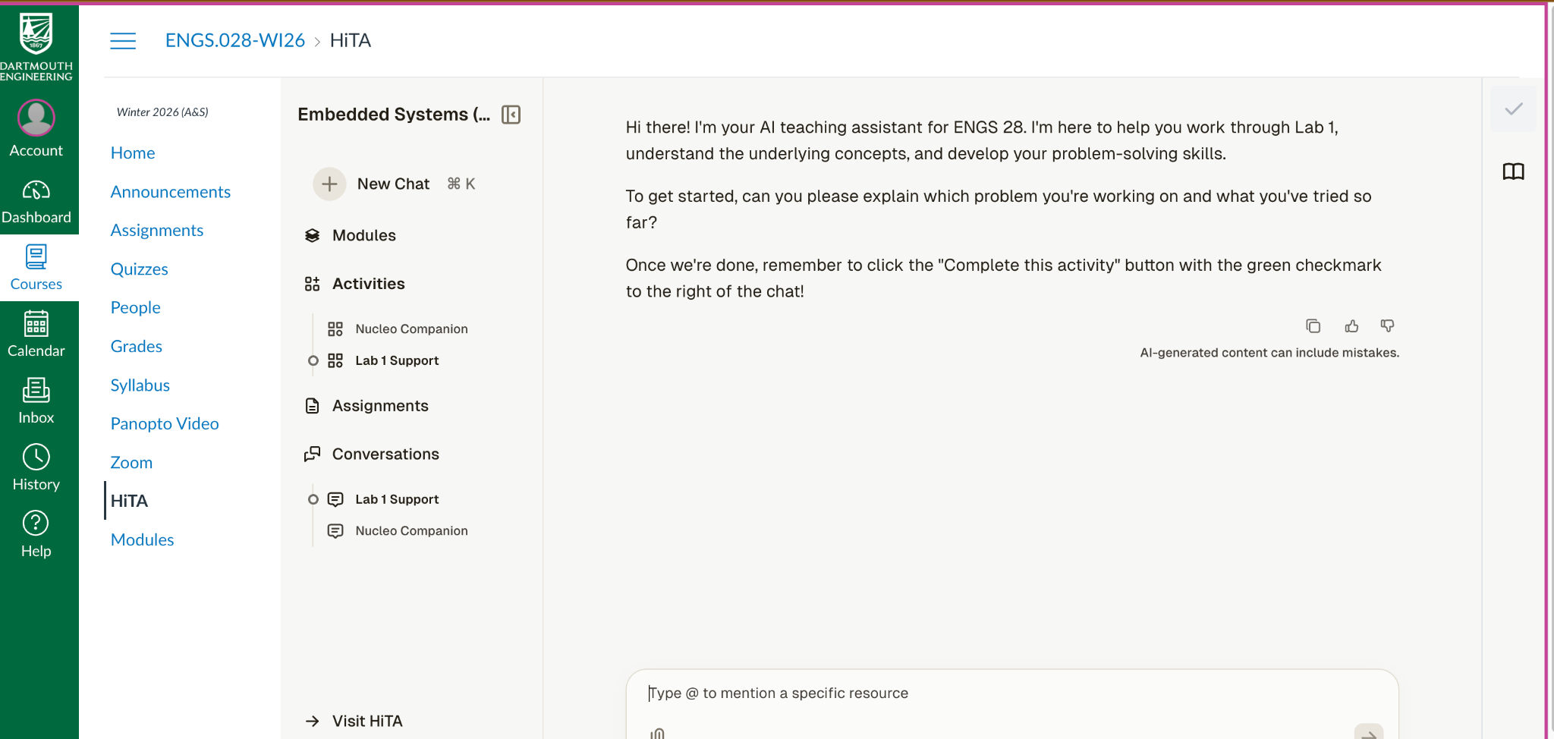
HiTA Lab 1 Support

Slide 44
Solution blinkySIM.c: blink all three LEDs simultaneously
#include "ES28.h"
#define GPIOAEN (1U<<0) // bit 0 enables clock for GPIOA
// LEDs on D13, D12, D11 (PA 5, 6, 7)
#define LED_PIN1 (1U<<5) // Bit 5 of Port A is wired to the LED1
#define LED_PIN2 (1U<<6) // Bit 6 of Port A is wired to the LED2
#define LED_PIN3 (1U<<7) // Bit 6 of Port A is wired to the LED3
#define LED_ALL (LED_PIN1 | LED_PIN2 | LED_PIN3)
int main(void) {
RCC->IOPENR |= GPIOAEN; // 1. Enable clock access to GPIOA
// 2. Configure PA5, 6, 7 as output pin
GPIOA->MODER |= (1U<<10) | (1U<<12) | (1U<< 14);
GPIOA->MODER &= ~(1U<<11) & ~(1U<<13) & ~(1U<<15);
while(1) {
GPIOA->ODR |= LED_ALL; // 3. turn LEDs on
delay_ms(1000); // kill some time
GPIOA->ODR &= ~LED_ALL; // 4. turn LEDs off
delay_ms(500); // kill some time
}
return 0; // never reached
}

Slide 45
Solution blinkySEQ.c: create a "running light"
#include "ES28.h" // All the port definitions are here
#define GPIOAEN (1U<<0) // bit 0 enables clock for GPIOA
// LEDs on D13, D12, D11 (PA 5, 6, 7)
#define LED_PIN1 (1U<<5) // Bit 5 of Port A is wired to the LED1
#define LED_PIN2 (1U<<6) // Bit 6 of Port A is wired to the LED2
#define LED_PIN3 (1U<<7) // Bit 6 of Port A is wired to the LED3
int main(void) {
RCC->IOPENR |= GPIOAEN; // 1. Enable clock access to GPIOA
// 2. Configure PA5, 6, 7 as output pin
GPIOA->MODER |= (1U<<10) | (1U<<12) | (1U<< 14);
GPIOA->MODER &= ~(1U<<11) & ~(1U<<13) & ~(1U<<15);
while(1) {
GPIOA->ODR = (GPIOA->ODR & ~LED_PIN3) | LED_PIN1; // switch to LED1
delay_ms(1000); // kill some time
GPIOA->ODR = (GPIOA->ODR & ~LED_PIN1) | LED_PIN2; // switch to LED2
delay_ms(1000); // kill some time
GPIOA->ODR = (GPIOA->ODR & ~LED_PIN2) | LED_PIN3; // switch to LED3
delay_ms(1000); // kill some time
}
return 0; // never reached
}

Slide 46
Solution blinkyCNT.c: create a counter
#include "ES28.h" // All the port definitions are here
#define GPIOAEN (1U<<0) // bit 0 enables clock for GPIOA
// LEDs on D13, D12, D11 (PA 5, 6, 7)
#define LED1_BIT 5
#define LED_PIN1 (1U<<LED1_BIT) // Bit 5 of Port A is wired to the LED1
#define LED_PIN2 (1U<<(LED1_BIT+1)) // Bit 6 of Port A is wired to the LED2
#define LED_PIN3 (1U<<(LED1_BIT+2)) // Bit 6 of Port A is wired to the LED3
#define LED_ALL (LED_PIN1 | LED_PIN2 | LED_PIN3)
int main(void) {
RCC->IOPENR |= GPIOAEN; // Enable clock access to GPIOA
// Configure PA5, 6, 7 as output pin
GPIOA->MODER |= (1U<<10) | (1U<<12) | (1U<< 14);
GPIOA->MODER &= ~(1U<<11) & ~(1U<<13) & ~(1U<<15);
while(1) {
for (unsigned count = 0; count<8; count++){
GPIOA->ODR &= ~(LED_ALL); //turn all LEDs off
GPIOA->ODR |= count<<LED1_BIT;
delay_ms(1000); // kill some time
}
}
return 0; // never reached
}

