Slide 1


Engs 28
Embedded Systems
Day 3

Slide 2
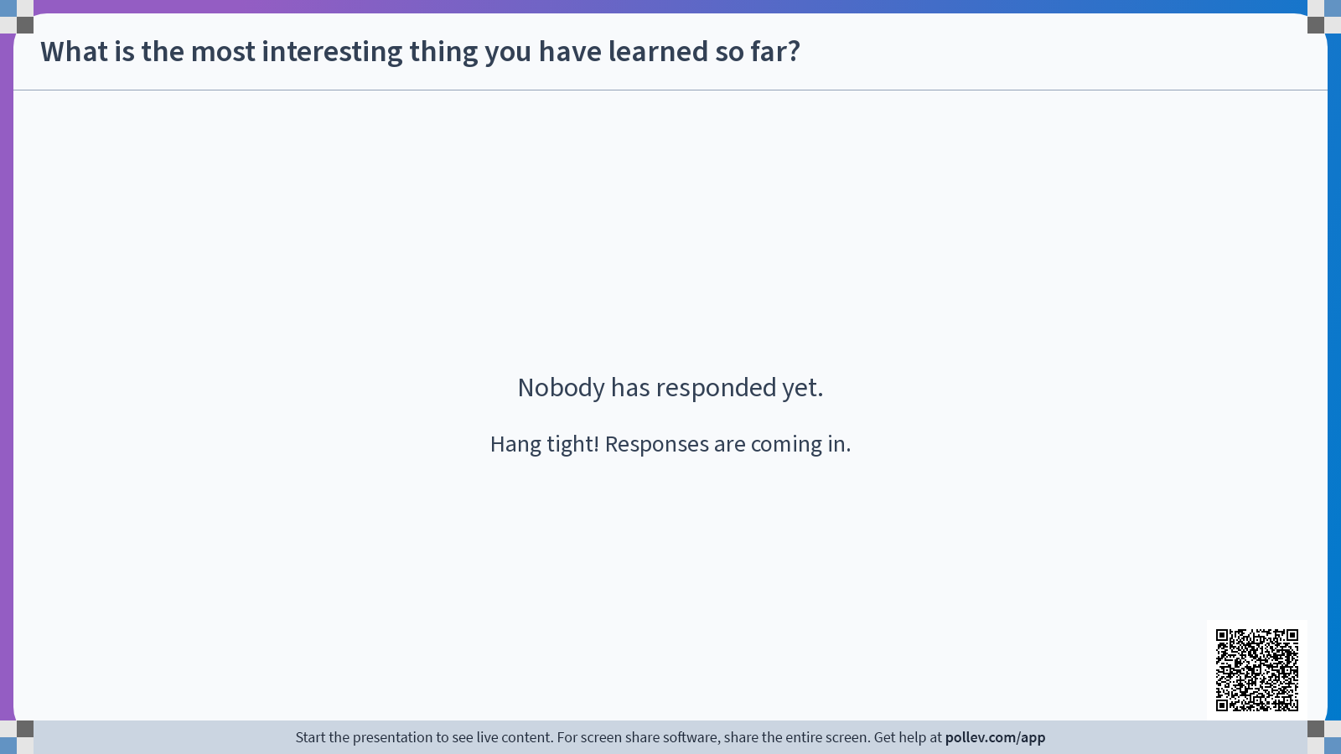

Slide 3
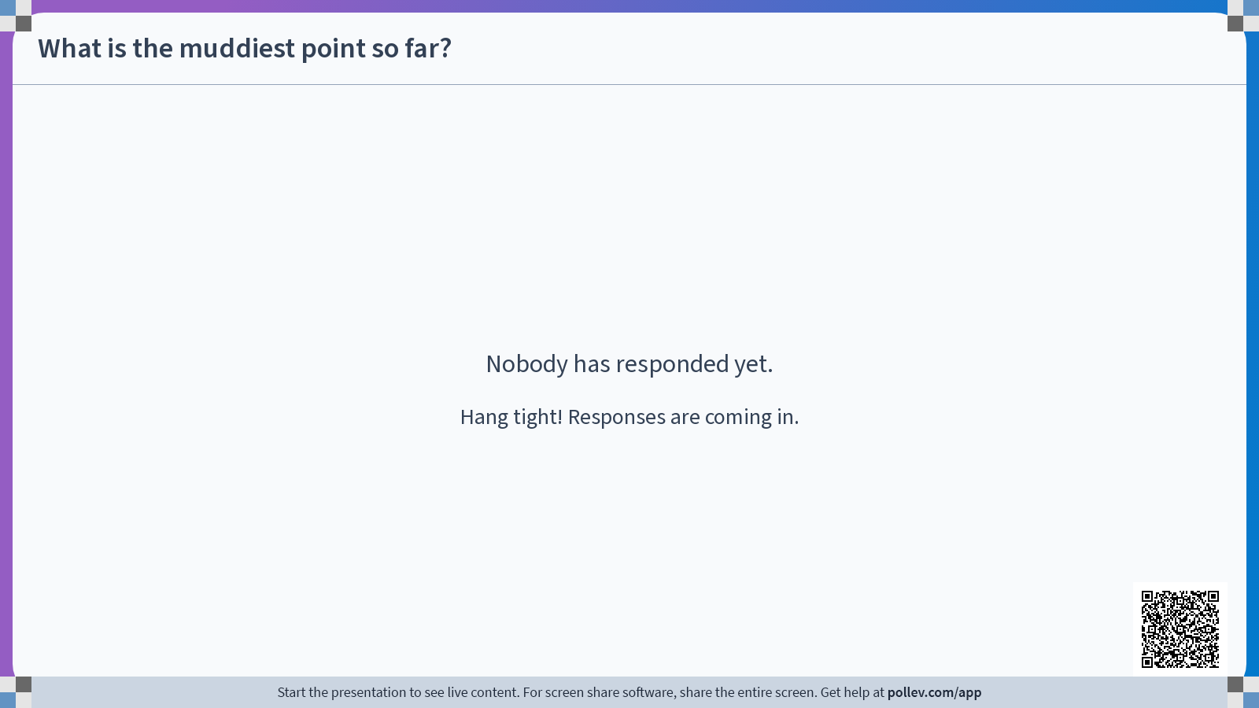

Slide 4
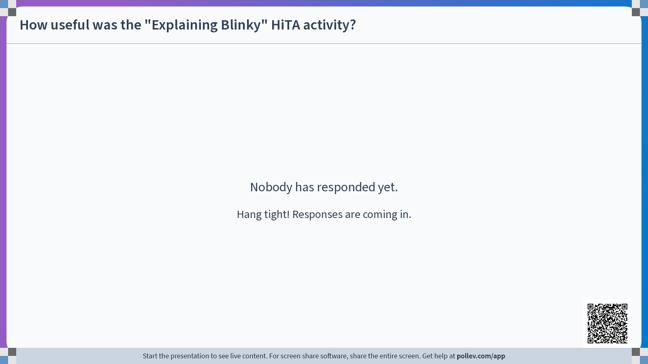

Slide 5
Reminder: Late Lab Assignment Policy
Each student has an account of 2 late days to be used at their discretion for lab assignments. If you wish to use one of your late days for a lab assignment, please indicate you are doing so in a submission comment.
If you use a late day for your lab assignment and submit within 24 hours of the original deadline you will not be penalized for your late submission. Otherwise:
Late lab assignments will be accepted for up to two days after they are due (with due date modified based on number of used late days) at the cost of a 10% penalty per day.
After two days beyond the deadline lab assignments will not be accepted for credit.

Slide 6
Another Reminder: Labs and the Honor Code
You will work alone on the labs unless we specifically say otherwise.
Interaction, to a certain degree, among class members is encouraged when learning new things. But, as you write and debug your programs, be careful that in your conversations you are exchanging ideas, not code, and that the work you turn in is your own. Do not copy any portion of someone else’s computer code or provide code to someone else. Copying another person’s work — including reusing a design posted online or written by a student in another course — is a violation of the Honor Principle and will have serious consequences.
Always cite your lab and study partners by giving their names on your papers, just as you would acknowledge any other source (such as a book or article) outside the usual course readings.

Slide 7
A Third Reminder: AI Use in ENGS 28
You are free to use the HiTA tool, integrated in Canvas, to get help with the assignments in this course. Please do not use any other GenAI tools unless explicitly invited to do so.
We will treat GenAI tools similarly to other resources you use. This means you MUST follow these four points:
Give notice that you used the AI tool and how you used it in the comments of your code and your lab report.
If you are basing your work on generated code, rigorously test and alter the program to suit the assignment and your understanding.
You must understand any code you submit and be prepared to explain it to us.
All comments in your code should be your own words.

Slide 8
Agenda
Code Review for Lab 1 code blinkyCNT.c
Using the AD2’s oscilloscope
Using a pushbutton switch

Slide 9
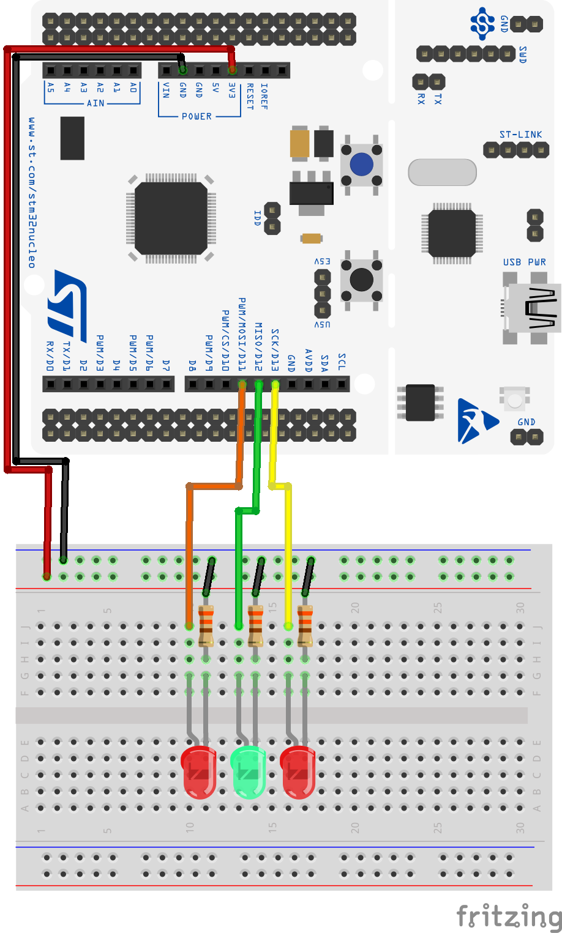
Lab 1
Wire up three LEDs, as shown. Use both red and green.
blinkySIM.c: blink all three LEDs simultaneously.
blinkySEQ.c: blink the LEDs sequentially, so only one LED is lit at a time.
blinkyCNT.c: blink the LEDs in a binary code: 000, 001, 010,...111, 000...

Slide 10
Code Review
Share blinkyCNT.c in your group.
Read, explain, understand your partners’ code.

Slide 11
Solution blinkySIM.c: blink all three LEDs simultaneously
#include "ES28.h"
#define GPIOAEN (1U<<0) // bit 0 enables clock for GPIOA
// LEDs on D13, D12, D11 (PA 5, 6, 7)
#define LED_PIN1 (1U<<5) // Bit 5 of Port A is wired to the LED1
#define LED_PIN2 (1U<<6) // Bit 6 of Port A is wired to the LED2
#define LED_PIN3 (1U<<7) // Bit 6 of Port A is wired to the LED3
#define LED_ALL (LED_PIN1 | LED_PIN2 | LED_PIN3)
int main(void) {
RCC->IOPENR |= GPIOAEN; // 1. Enable clock access to GPIOA
// 2. Configure PA5, 6, 7 as output pin
GPIOA->MODER |= (1U<<10) | (1U<<12) | (1U<< 14);
GPIOA->MODER &= ~(1U<<11) & ~(1U<<13) & ~(1U<<15);
while(1) {
GPIOA->ODR |= LED_ALL; // 3. turn LEDs on
delay_ms(500); // kill some time
GPIOA->ODR &= ~LED_ALL; // 4. turn LEDs off
delay_ms(500); // kill some time
}
return 0; // never reached
}

Slide 12
Solution blinkySEQ.c: create a "running light"
#include "ES28.h"
#define GPIOAEN (1U<<0) // bit 0 enables clock for GPIOA
// LEDs on D13, D12, D11 (PA 5, 6, 7)
#define LED_PIN1 (1U<<5) // Bit 5 of Port A is wired to the LED1
#define LED_PIN2 (1U<<6) // Bit 6 of Port A is wired to the LED2
#define LED_PIN3 (1U<<7) // Bit 6 of Port A is wired to the LED3
int main(void) {
RCC->IOPENR |= GPIOAEN; // 1. Enable clock access to GPIOA
// 2. Configure PA5, 6, 7 as output pin
GPIOA->MODER |= (1U<<10) | (1U<<12) | (1U<< 14);
GPIOA->MODER &= ~(1U<<11) & ~(1U<<13) & ~(1U<<15);
while(1) {
GPIOA->ODR = (GPIOA->ODR & ~LED_PIN3) | LED_PIN1; // switch to LED1
delay_ms(500); // kill some time
GPIOA->ODR = (GPIOA->ODR & ~LED_PIN1) | LED_PIN2; // switch to LED2
delay_ms(500); // kill some time
GPIOA->ODR = (GPIOA->ODR & ~LED_PIN2) | LED_PIN3; // switch to LED3
delay_ms(500); // kill some time
}
return 0; // never reached
}

Slide 13
blinkyCNT.c
To turn an individual output bit n of Port x on and off:
GPIOx->ODR |= (1U << n);
GPIOx->ODR &= ~(1U << n);
How to turn multiple bits on and off? In particular, how do you display the binary count?
count
… | Bit 6 | Bit 5 | Bit 4 | Bit 3 | Bit 2 d | Bit 1 d | Bit 0 d
GPIOA->ODR
Bit 15 | Bit 14 | … | Bit 8 | Bit 7 | Bit 6 | Bit 5 | Bit 4 | Bit 3 | Bit 2 | Bit 1 | Bit 0
One possibility: Turn all bits off, then turn on those that you wish to turn on:
GPIOx->ODR &= ~( (1U << 5) | (1U << 6) | (1U << 7));
GPIOx->ODR |= (count << 5);
Note: Turning off all bits can also be accomplished this way (WHY?):
GPIOx->ODR &= ~(0x7 << 5);

Slide 14
Solution blinkyCNT.c: create a counter
#include "ES28.h"
#define GPIOAEN (1U<<0) // bit 0 enables clock for GPIOA
// LEDs on D13, D12, D11 (PA 5, 6, 7)
#define LED1_BIT 5
#define LED_PIN1 (1U<<LED1_BIT) // Bit 5 of Port A is wired to the LED1
#define LED_PIN2 (1U<<(LED1_BIT+1)) // Bit 6 of Port A is wired to the LED2
#define LED_PIN3 (1U<<(LED1_BIT+2)) // Bit 7 of Port A is wired to the LED3
#define LED_ALL (LED_PIN1 | LED_PIN2 | LED_PIN3)
int main(void) {
RCC->IOPENR |= GPIOAEN; // Enable clock access to GPIOA
// Configure PA5, 6, 7 as output pin
GPIOA->MODER |= (1U<<10) | (1U<<12) | (1U<< 14);
GPIOA->MODER &= ~(1U<<11) & ~(1U<<13) & ~(1U<<15);
while(1) {
for (unsigned count = 0; count<8; count++){
GPIOA->ODR &= ~(LED_ALL); //turn all LEDs off
GPIOA->ODR |= count<<LED1_BIT;
delay_ms(500); // kill some time
}
}
return 0; // never reached
}

Slide 15
Watching signals in time
(oscilloscope)

Slide 16
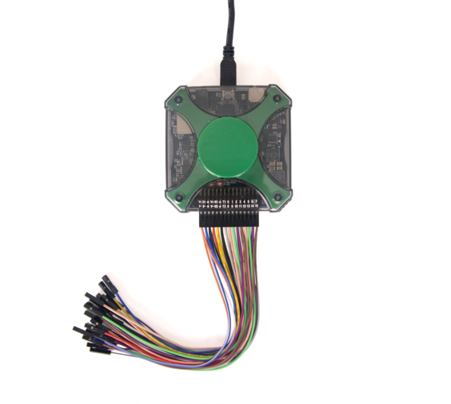
Making measurements: Analog Discovery 2
“AD2” contains oscilloscope, waveform generator, and other test tools.
USB connection to laptop
Flying leads
Input/output connectors

Slide 17
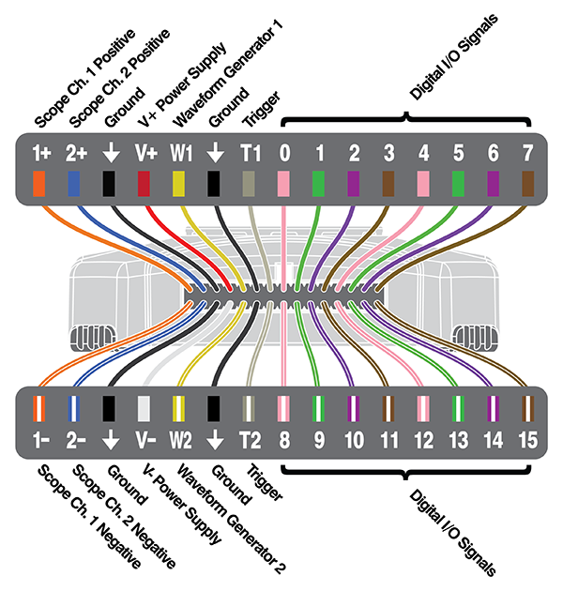
AD2 connector pinout
Use “flying leads” to connect AD2 to Nucleo and/or breadboard.
Plus leads are solid colored
Two analog
input channels
We’ll get to the other I/O channels later
Minus leads have a white stripe on them

Slide 18
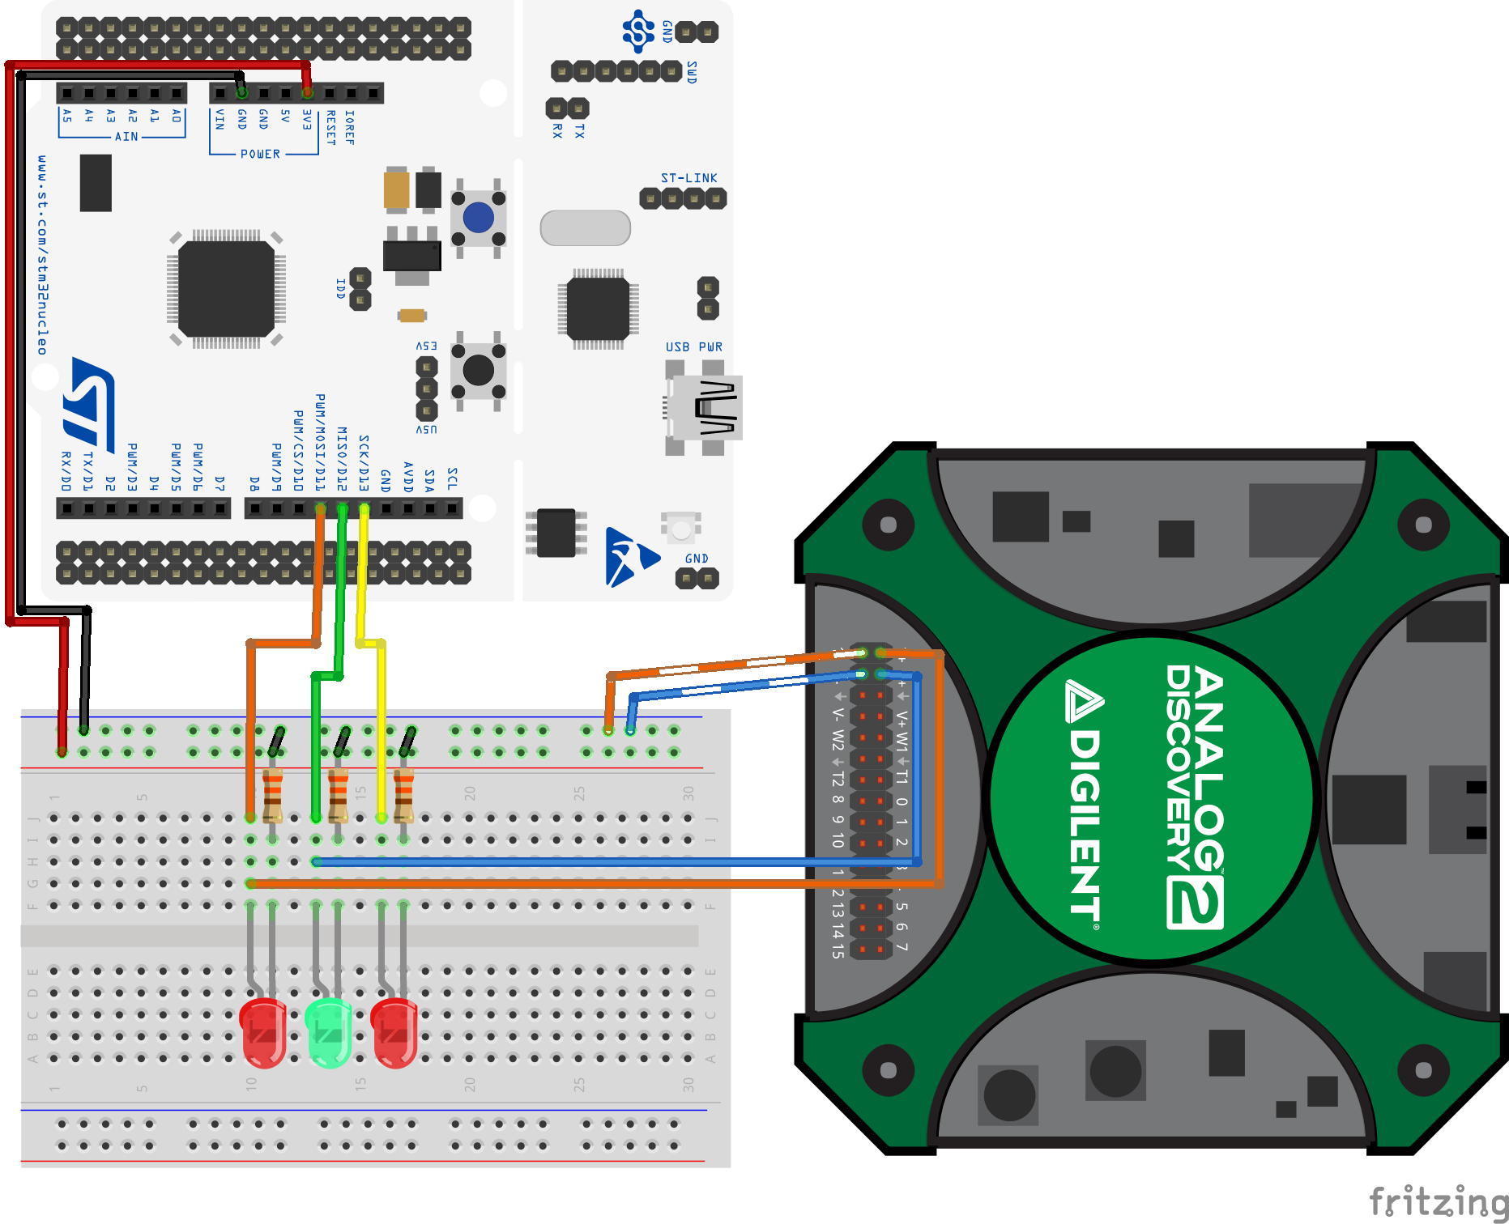
Wire the AD2 to your Lab 1 setup
Load BlinkySEQ onto your Nucleo.
Use “flying leads” to connect AD2 to your breadboard: “–” leads to ground, “+” leads to the LED anodes.

Slide 19
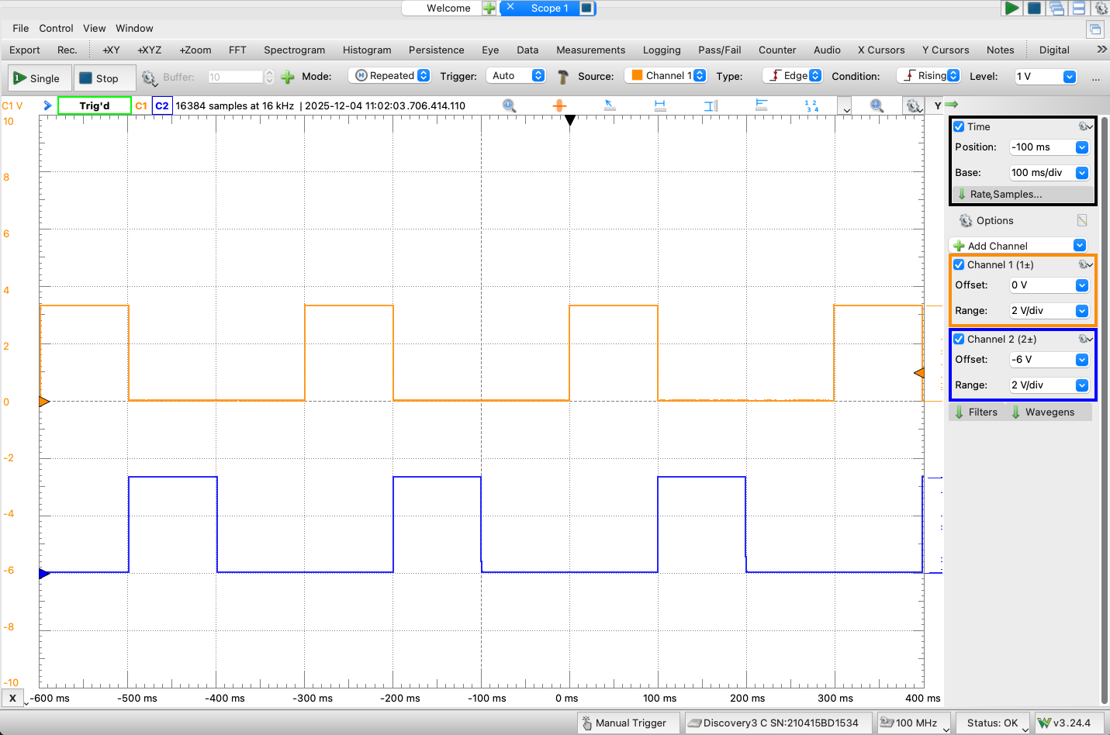
Open Waveforms, select "Scope".
Observe two channels with Waveforms
LED ON: 1 2 3 1
100ms
Notes:
The time base settings depend on your chosen LED on/off time. This picture has a delay_ms(100).

Slide 20
Waveforms Settings
Experiment with different settings for Time Base, Range, Offset, both for CH1 and CH2. Answer the following questions as a table group:
What does "Time Base" do?
What does Range do?
What does Offset do?
How do you change which channel's voltage is shown on the vertical axis?
What is the voltage on an output pin when it is high?
Save as PNG, and see what you get. (You’ll need this for labs going forward)
File->Export
Select the “Image” tab
Click "Save"
Notes:
The channel that is last enabled will determine what shows on the y-axis. You may need to check "enable labels on the plot" under "Preferences->M2K".

Slide 21
One more experiment
Edit blinkySIM.c:
Change the blink rate as follows and note the brightness of the LEDs and observe the waveform.
Now swap the lengths of on and off time; again note the brightness and the waveform.
while(1) {
GPIOA->ODR |= LED_ALL; // 3. turn LEDs on
delay_ms(1); // kill some time
GPIOA->ODR &= ~LED_ALL; // 4. turn LEDs off
delay_ms(10); // kill some time
}
while(1) {
GPIOA->ODR |= LED_ALL; // 3. turn LEDs on
delay_ms(10); // kill some time
GPIOA->ODR &= ~LED_ALL; // 4. turn LEDs off
delay_ms(1); // kill some time
}
The oscilloscope can see the on/off in the LED signal, even when your eyes cannot.
Discuss at your table why the LED brightness changes. How could this be useful?
Notes:
One looks dimmer than the other but oscilloscope shows that the voltage is the same. It's our eyes that cannot perceive the flickering.
Use case: dimming an LED!

Slide 22
Using pins for INPUT

Slide 23
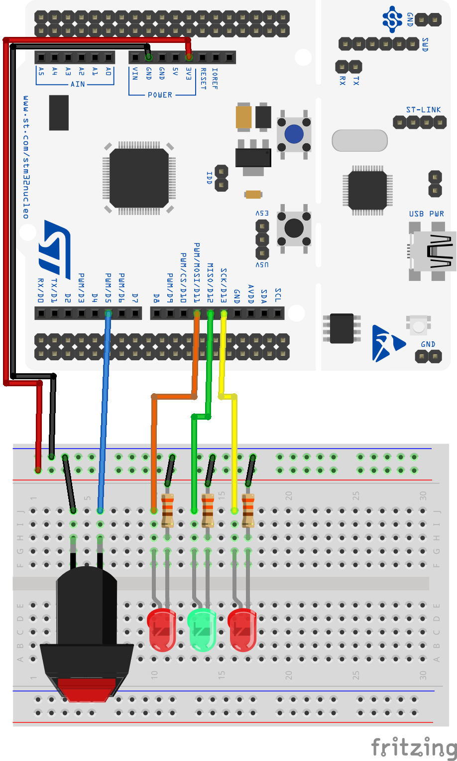
Wire up the next circuit
Add a pushbutton switch to your Lab 1 breadboard, like this.
Notes:
This button doesn't do anything! It simply connects the pin to ground when it is pushed and leaves the pin hanging randomly otherwise.

Slide 24
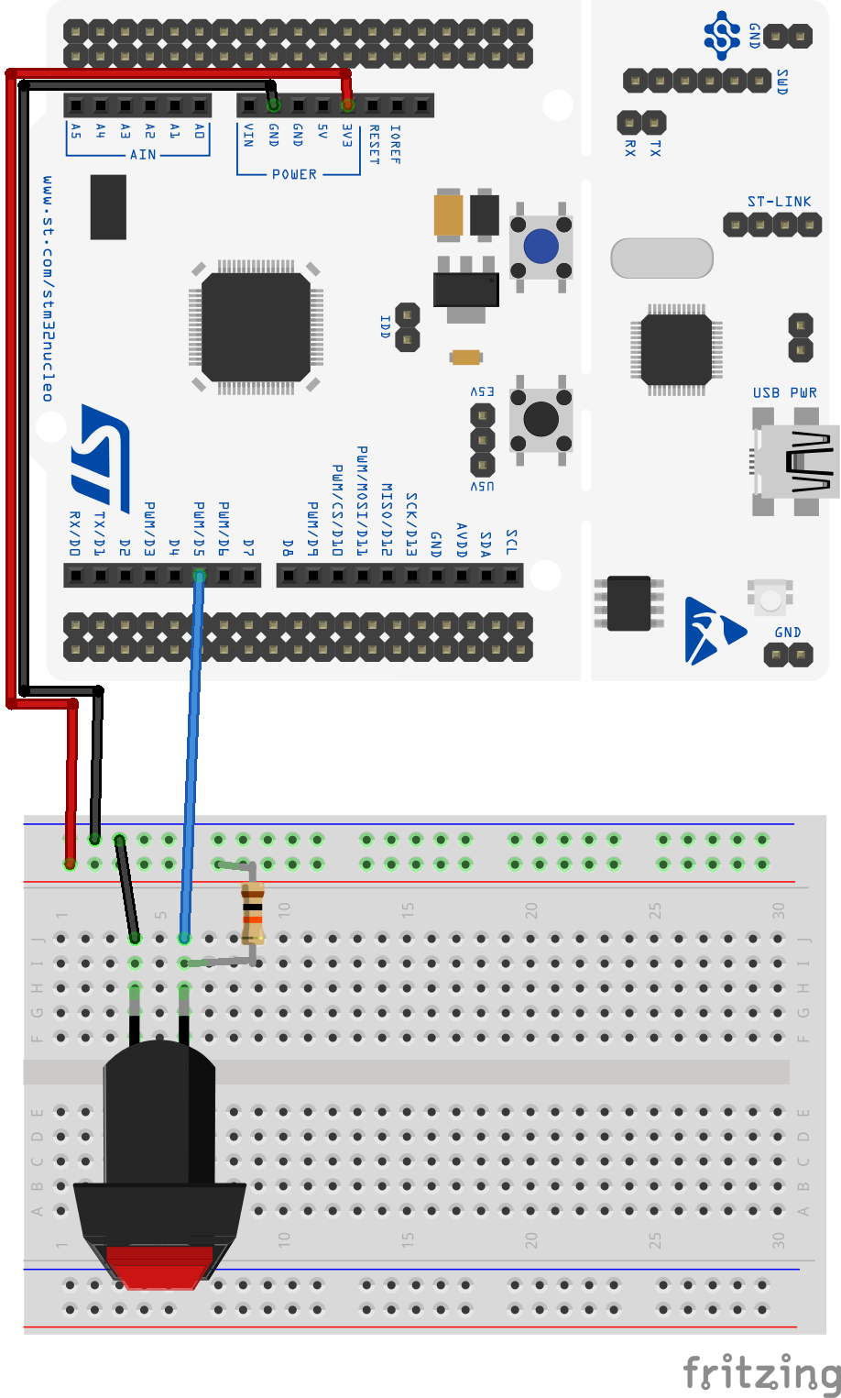
How to wire a pushbutton
A button by itself does not produce a 1 or a 0 — it simply closes a connection from the pin to ground.
“Pull the pin up” so that it is HIGH when the switch is unpressed. Two possibilities:
An external resistor (about 10K)
Enable the pin’s internal pullup resistor
Pressing the button connects the pin to ground and pulls the pin LOW. (“Low true”)

Slide 25
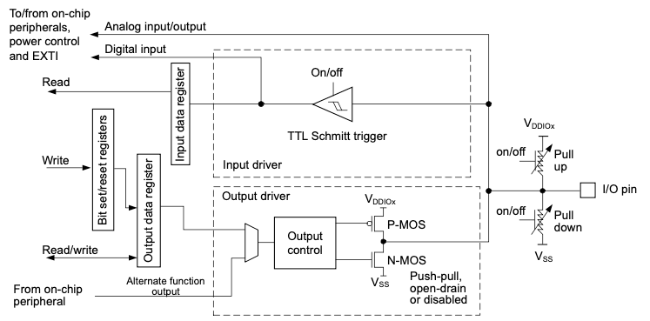
Basic structure of an I/O port bit
Read data from Pin
PIN
Write data to Pin
Internal pull-up / pull-down
Notes:
Subject to the specific hardware characteristics of each I/O port listed in the datasheet, each
port bit of the general-purpose I/O (GPIO) ports can be individually configured by software in
several modes:
• Input floating
• Input pull-up
• Input-pull-down
• Analog
• Output open-drain with pull-up or pull-down capability
• Output push-pull with pull-up or pull-down capability
• Alternate function push-pull with pull-up or pull-down capability
• Alternate function open-drain with pull-up or pull-down capability
Each I/O port bit is freely programmable, however the I/O port registers have to be
accessed as 32-bit words, half-words or bytes. The purpose of the GPIOx_BSRR and
GPIOx_BRR registers is to allow atomic read/modify accesses to any of the GPIOx_ODR
registers. In this way, there is no risk of an IRQ occurring between the read and the modify
access.

Slide 26
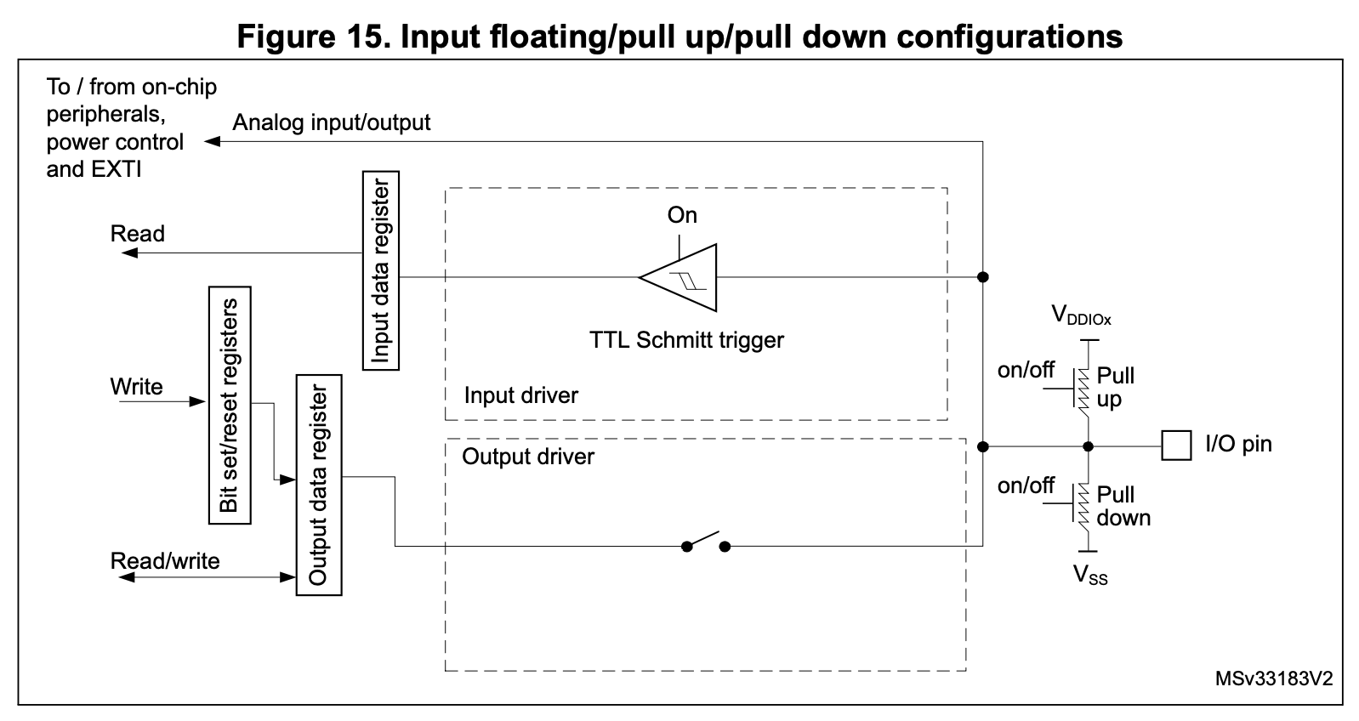
Input pin configuration
GPIOx->MODER determines input versus output mode, amongst others.
x = Port (A, B, C, D, F)
GPIOx->IDR
Internal pull-up:
GPIOx->PUPDR
From button
Notes:
Switch open: pin pulled uip
Switch closed: pin connected to ground

Slide 27
How to wire a pushbutton
Internal pullup
holds pin HIGH if switch is open.
GPIOx->IDR
Wire switch from pin to ground.
Closing switch pulls pin LOW.
Notes:
When the I/O port is programmed as input:
• The output buffer is disabled
• The Schmitt trigger input is activated
• The pull-up and pull-down resistors are activated depending on the value in the GPIOx_PUPDR register
• The data present on the I/O pin are sampled into the input data register every AHB clock cycle
• A read access to the input data register provides the I/O state

Slide 28

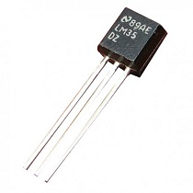
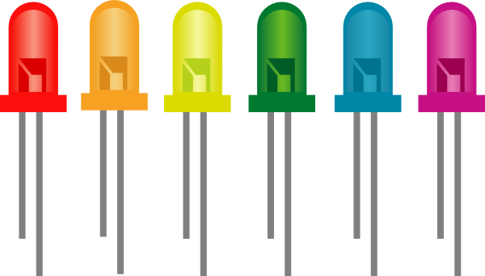
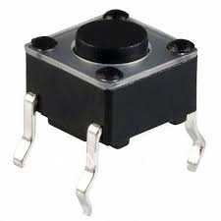
How to use a pin as INPUT
GPIOx->MODER = "Mode Register for GPIO Port x", contains 32 bits: two for each pin to determine its mode: Output, input, analog I/O, etc
Bits 2n and 2n+1 configure pin n.
configure pin 15
configure pin 6
configure pin 5
configure pin 0
Bit 31 1 | Bit 30 0 | … | Bit 13 1 | Bit 12 1 | Bit 11 0 | Bit 10 1 | Bit 9 | … | Bit 2 | Bit 1 0 | Bit 0 0
Bits | Function
00 | Input
01 | Output
10 | Alternate function
11 | Analog
In this example:
pin 0 can be used as an input pin (ex: pushbutton)
pin 5 as an output pin (ex: LED)
pin 6 as an analog pin (ex: analog temperature sensor)
pin 15 in alternate function mode (ex: control motor speed)
By default (after a reboot) all I/O lines start as inputs (00).

Slide 29
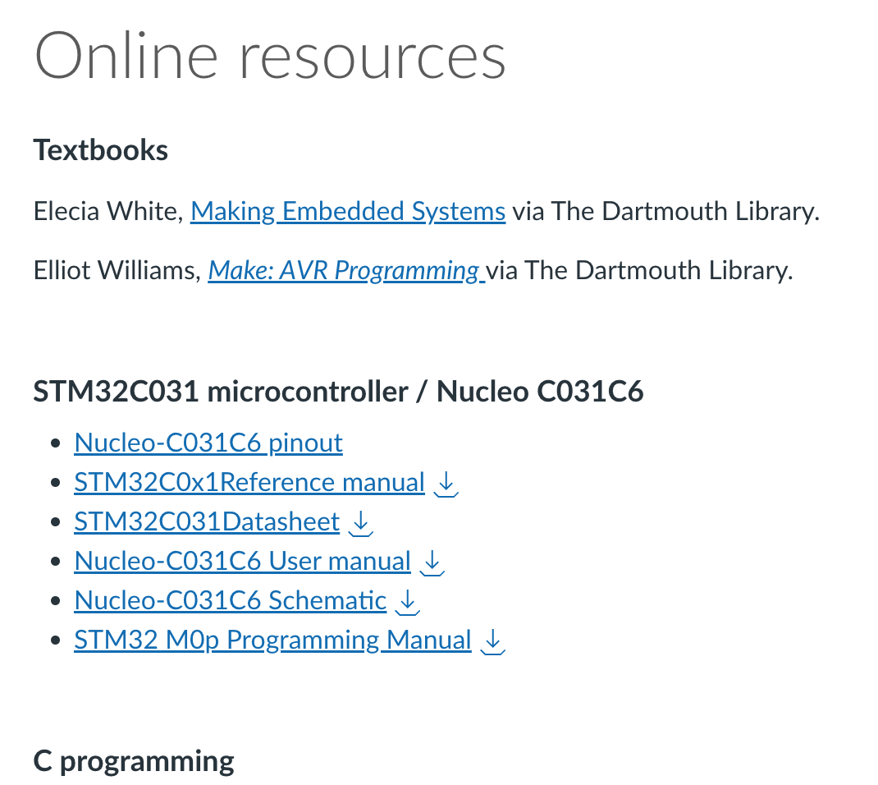
How do you know???
The Reference Manual contains all of this information!
Open the reference manual.
Scroll through the table of contents.
Find the General-purpose I/Os (GPIO) entry, follow the link to the GPIO section.
Scroll through the section and note where the images for input/output function were taken from!
Go to Section 6.4 GPIO registers
GPIOx_MODER is described in 6.4.1
Note: GPIOx_MODER is the name of the register. GPIOx->MODER is a dereferenced pointer to the memory location that is mapped to the register. To change GPIOx_MODER we write to GPIOx->MODER. So in our code we'll always use GPIOx->MODER.

Slide 30
Enabling the Internal Pullup Resistor
Each GPIO pin has an optional internal pull-up resistor associated with it.
If the pull-up is enabled, in the absence of an input signal, the input pin will be "pulled up" to a logical 1.
If an active signal is attached to the pin the pull-up has no effect.
To enable a pull-up resistor for a pin that is used as input (bits in GPIO->MODERx set to '00') we configure the corresponding GPIO port pull-up/pull-down register.
Look at the reference manual and find:
The name of the pull-up/pull-down register for GPIO port x (x=A,B,...)
How do we refer to it in code?
Which bits should we set to what values in order to configure pin 4 of port B as an input pin?

Slide 31
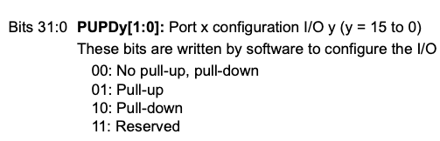
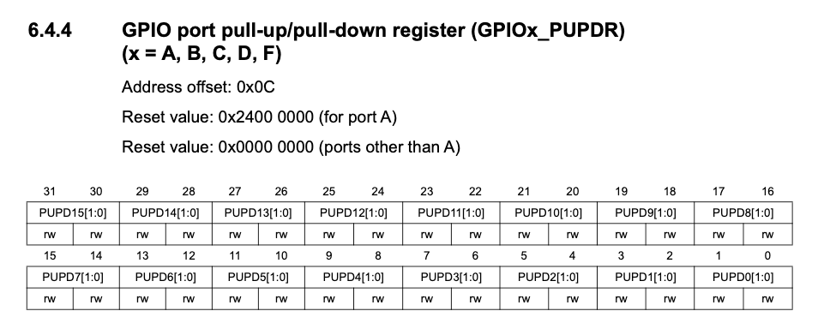
Enabling the Internal Pullup Resistor
The name of the pull-up/pull-down register for GPIO port x: GPIOx_PUPDR
How do we refer to it in code? GPIOx->PUPDR
Which bits should we set to what values in order to configure pin 4 of port B as an input pin? Bit 8 of GPIOB->PUPDR: 1 Bit 9 of GPIOB->PUPDR: 0

Slide 32
Reading the state of a pin
To read the state of pin n in PORTx (x = A, B, C, D, F):
Ensure that bits 2n and 2n+1 in GPIOx->MODER are cleared (input).
If desired, enable internal pull-up resistor by setting bits 2n and 2n+1 in GPIOx->PUPDR to 01.
Read bit n of GPIOx->IDR (input data register). Read all 16 bits in the register, perform logical AND with a bit mask to isolate pin n.
Example: Button wired to Nucleo pin D5 (PB4):
Setup: // Configure PB4 as input pin
GPIOB->MODER &= ~(1U<<8); GPIOB->MODER &= ~(1U<<9);
// (may not be necessary since this is default reset value)
// enable pull-up for PB4
GPIOB->PUPDR |= (1U<<8);
GPIOB->PUPDR &= ~(1U<<9);
Read button state: // Button on PB4 (D5)
#define BUTTON_PIN (1U<<4)
…
if ((GPIOB->IDR & BUTTON_PIN) == 0) {
// button pressed
// do stuff
} else {
// button not pressed
// do other stuff
}

Slide 33
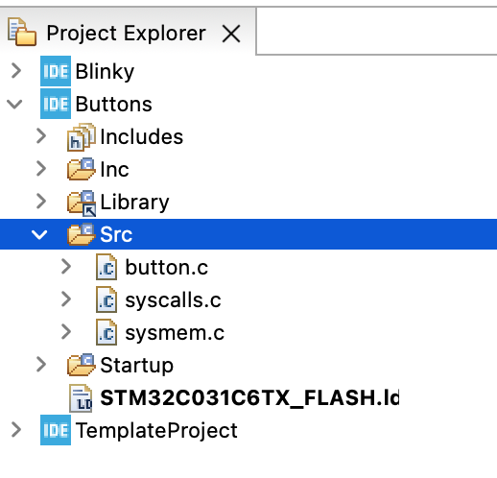
Pushbutton exercises
Create a new copy of your TemplateProject and name it "Buttons". This creates an entirely new project for you.
Download “button.c” from Canvas and place it into the Src folder in your buttons project.
This is how things should look in your Project Explorer in the IDE:

Slide 34
button.c
// Press button to light the built-in LED
#include "ES28.h" // All the port definitions are here
#define GPIOAEN (1U<<0) // Clock access to GPIOA (LED)
#define GPIOBEN (1U<<1) // Clock access to GPIOB (button)
#define LED_PIN (1U<<5) // LED on PA5 (D13)
#define BUTTON_PIN (1U<<4) // Button on PB4 (D5)
int main(void) {
RCC->IOPENR |= (GPIOAEN | GPIOBEN); // Enable clock access to GPIOA and B
GPIOA->MODER |= (1U<<10); // Configure PA5 as output pin
GPIOA->MODER &= ~(1U<<11);
GPIOB->MODER &= ~(1U<<8); // Configure PB4 as input pin
GPIOB->MODER &= ~(1U<<9); // (default is 0b11)
GPIOB->PUPDR |= (1U<<8); // enable pull-up for PB4
GPIOB->PUPDR &= ~(1U<<9); delay_ms(50); // give pull-ups time to pull up the pins
while(1) {
// Read the pin and control the LED
if ((GPIOB->IDR & BUTTON_PIN) == 0) { // button input is low-true
GPIOA->ODR |= LED_PIN; // turn LED on
} else {
GPIOA->ODR &= ~LED_PIN; // turn LED off
}
}
return 0; // never reached
}

Slide 35
Why the delay_ms() after the pull-ups?
// Press button to light the built-in LED
#include "ES28.h" // All the port definitions are here
#define GPIOAEN (1U<<0) // Clock access to GPIOA (LED)
#define GPIOBEN (1U<<1) // Clock access to GPIOB (button)
#define LED_PIN (1U<<5) // LED on PA5 (D13)
#define BUTTON_PIN (1U<<4) // Button on PB4 (D5)
int main(void) {
RCC->IOPENR |= (GPIOAEN | GPIOBEN); // Enable clock access to GPIOA and B
GPIOA->MODER |= (1U<<10); // Configure PA5 as output pin
GPIOA->MODER &= ~(1U<<11);
GPIOB->MODER &= ~(1U<<8); // Configure PB4 as input pin
GPIOB->MODER &= ~(1U<<9); // (default is 0b11)
GPIOB->PUPDR |= (1U<<8); // enable pull-up for PB4
GPIOB->PUPDR &= ~(1U<<9); delay_ms(50); // gives pull-ups time to pull up the pins
while(1) {
// Read the pin and control the LED
if ((GPIOB->IDR & BUTTON_PIN) == 0) { // button input is low-true
GPIOA->ODR |= LED_PIN; // turn LED on
…
This code takes about 1.5us to execute.
How long does the pull-up take to get to a logical 1?
Notes:
I instrumented some code to measure this delay on an oscilloscope. Ends up being about 16 instructions +/- running at ~85ns per instruction

Slide 36
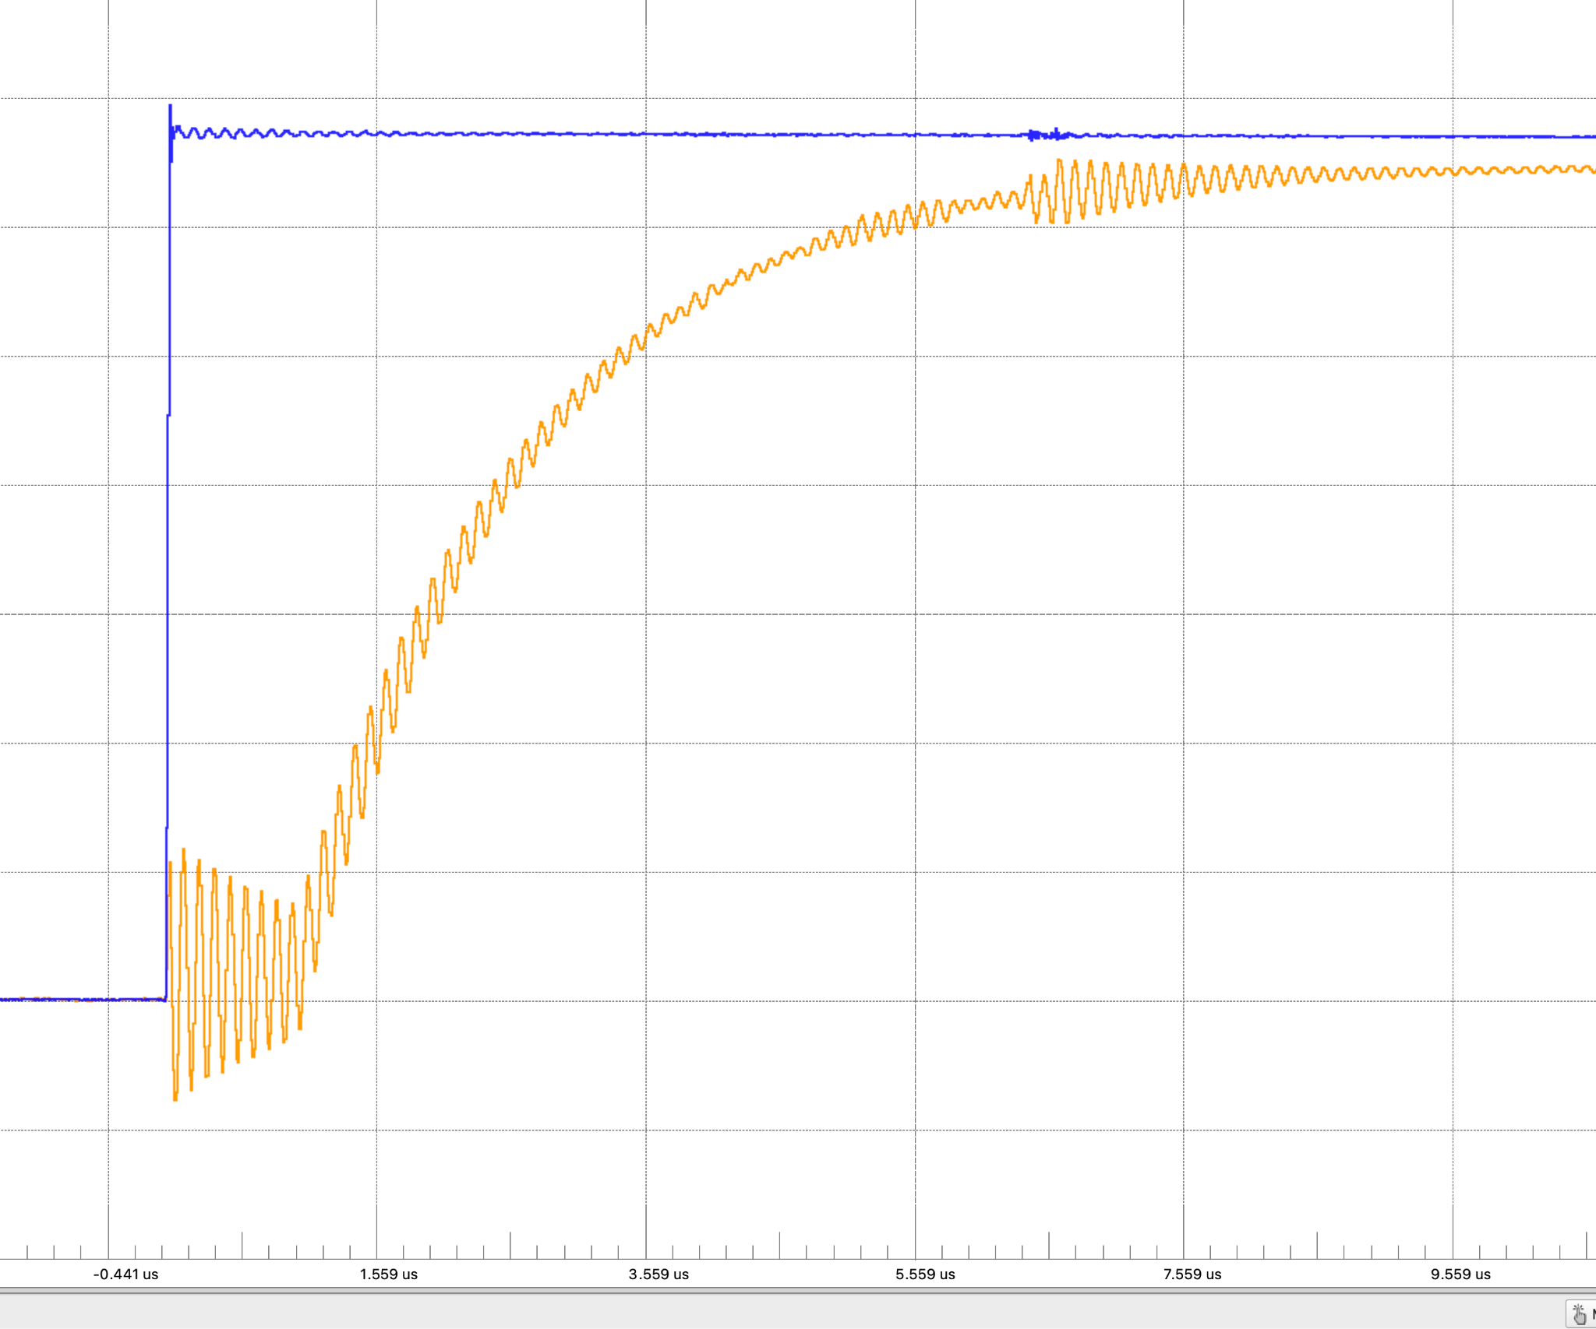
Exponential response of pull-up turning on.
~2.5us
With no external cap, the pullup takes ~2.5 us to change the state of the input.
This is enough time to sample the pin and read the old “0” value even though the button is not pushed.
Notes:
This is just the RC delay of the pullup and the intrinsic capacitance of the pin. Still slow enough to read the old value. (Note the “ringing” is at 12MHz - system clock inducing noise on the outputs!

Slide 37
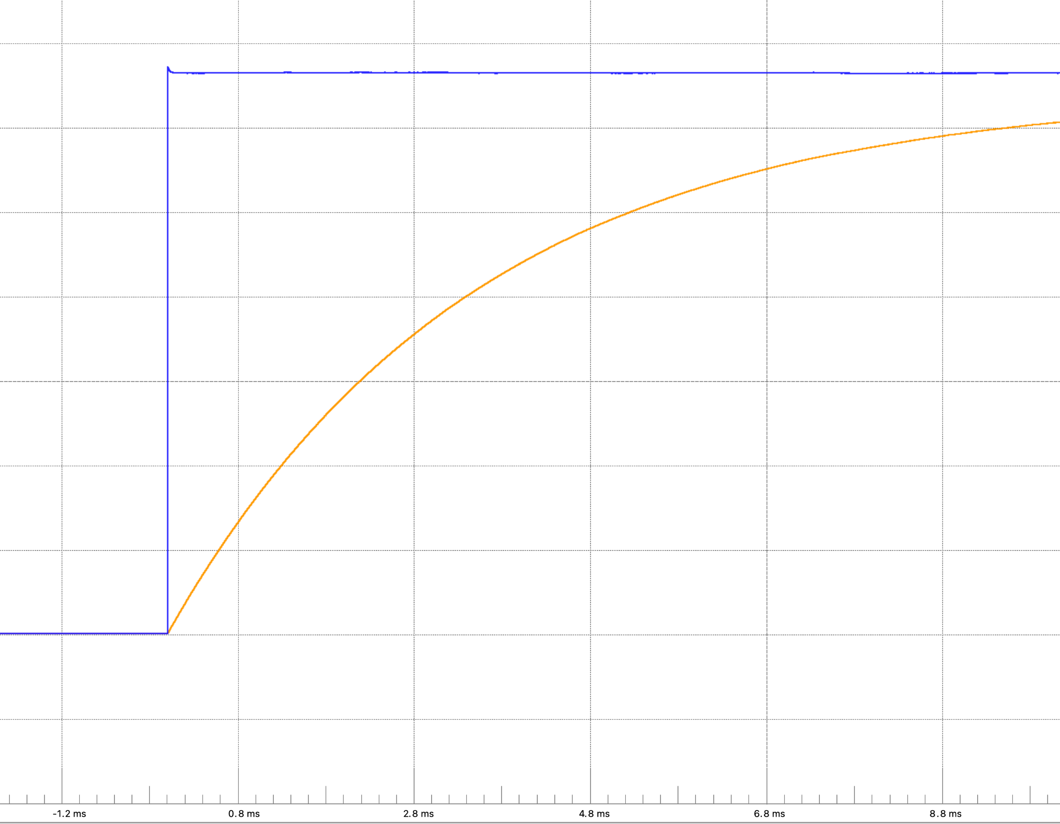
Exponential response with 0.1uF debouncing cap.
Tomorrow we'll be adding a capacitor to our setup to improve the button's behavior. This actually makes things worse when it comes to the time it takes to pull the pin up so that it reads '0' for even longer initially.
~4ms
With a debouncing capacitor, the time goes way up. This leaves even more time for the pin to read 0.
Notes:
With a .1uF cap. Smoother, but much much slower.

Slide 38
Fundamental Issue: Code executes super fast but it takes time for the pins to get to the '1' state.
In general the pins on the chip start out “0”.
Debouncing makes it take longer for the pullup to make them “1”.
How can we fix it?
Easiest:
Wait (delay_ms) 50ms before sampling any pin - add a delay after initialization.
Others:
Loop until the pin reads “1”
Start as an output, set the pin to a “1”, then switch modes and enable the pullup.
Use an external pullup.
Caution!
This will happen any time the pin is pulled down. Your code needs to account for this! Best way in “regular” code is to use a state machine. Make sure you transition from PRESSED to UNPRESSED before taking another action.

Slide 39
Pushbutton exercises
Make a copy of one of your Lab 1 programs and modify them to use the button:
blinkySEQ.c: Pressing the button turns all the LEDs on, releasing it returns to the usual sequence.
blinkyCNT.c: A button press causes the counter to pause, a second press causes it to resume.
(This is part of your Lab 2 work. You won't quite get this done right now but can get a nice headstart.)

Slide 40
Homework for Thursday
Write code (toggleLED.c) so that the on-board LED is toggled on and off via the button:
PRESS => LED goes ON
RELEASE => LED stays ON
PRESS => LED goes OFF
RELEASE => LED stays OFF
You may observe “glitches” (erratic behavior of the LED). We’ll investigate on Thursday.

