Slide 1


Engs 28
Embedded Systems
Day 3x

Slide 2
Review
On Tuesday:
Introduction to oscilloscope measurements with AD2 / Waveforms.
How to interface a pushbutton switch to an STM32C0 I/O pin.
Today:
Back to the oscilloscope
More about switches and inputs.
Need a C refresher? Check out
https://engs20book.thayer.dartmouth.edu/ENGS28Guide
(linked under "Resources" on Canvas)

Slide 3
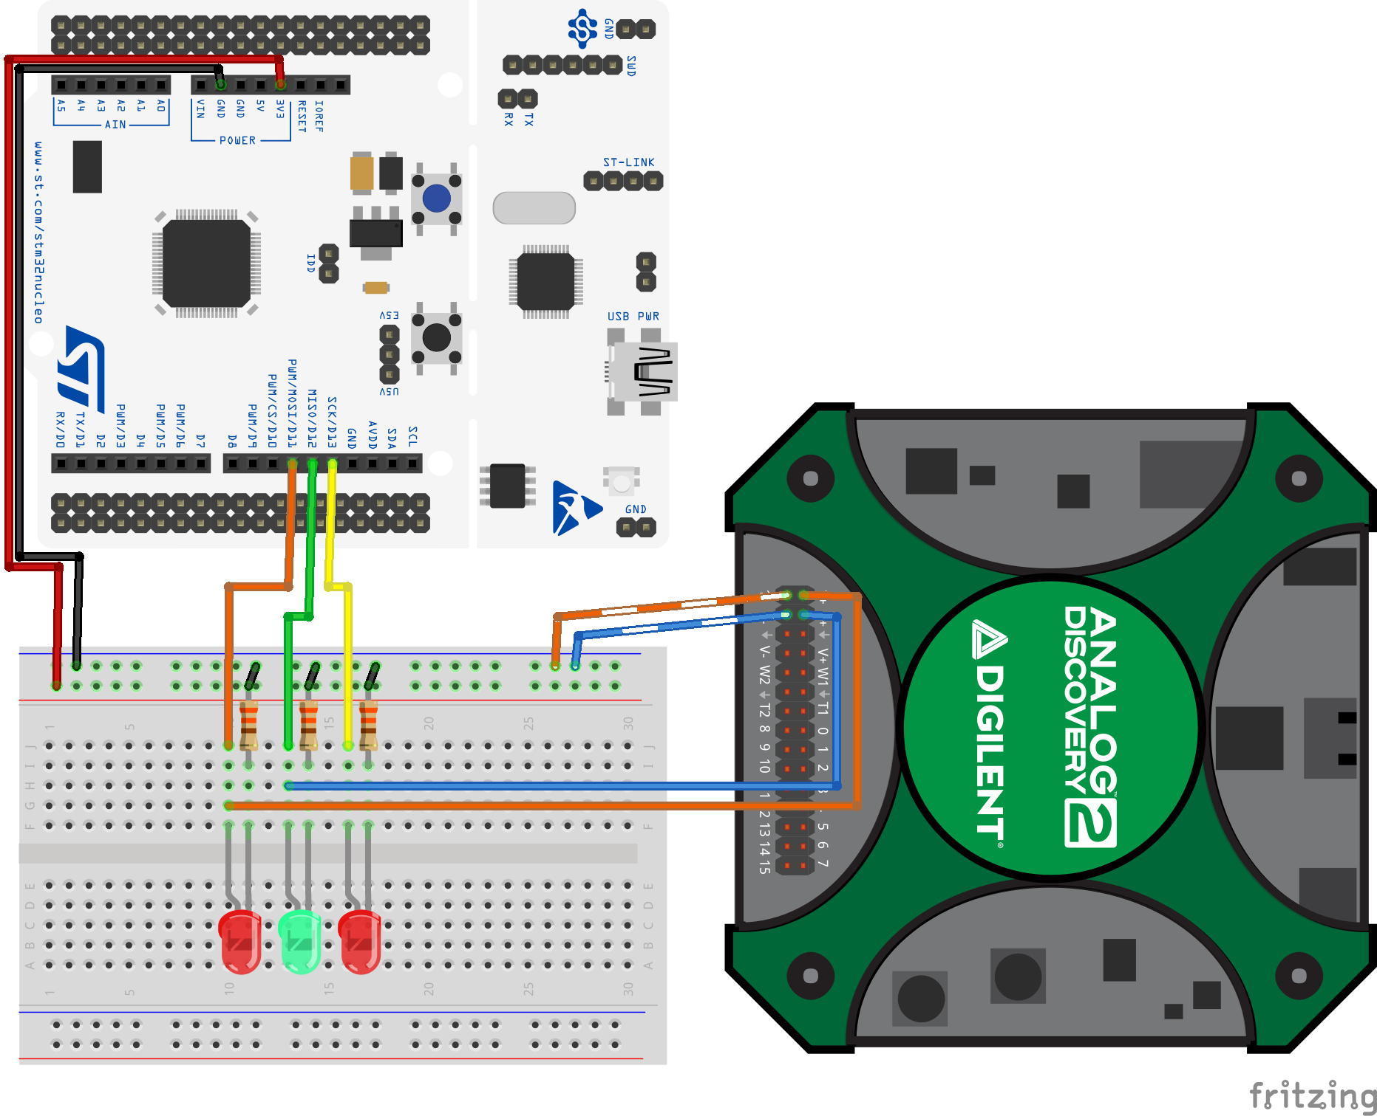
Recall: AD2 with Lab 1 setup
Load BlinkySEQ onto your Nucleo.
Use “flying leads” to connect M2K to your breadboard: “–” leads to ground, “+” leads to the LED anodes.

Slide 4
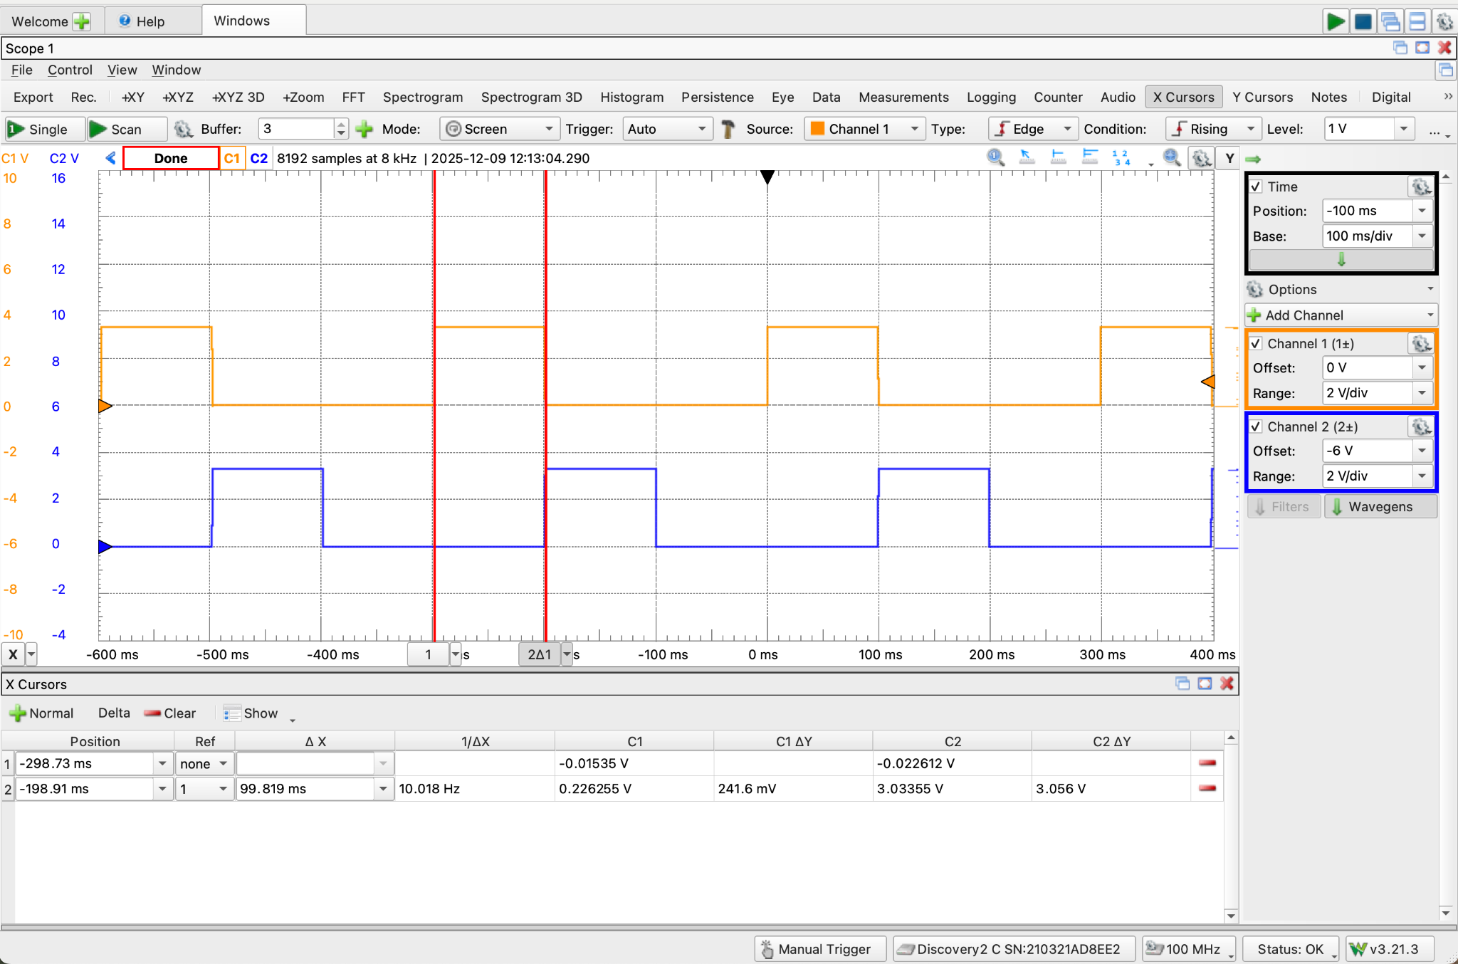
Measure Pulse Width with Cursors
1st
Click to move
2nd x2
3rd
Pulsewidth
Notes:
The time base settings depend on your chosen LED on/off time. This picture has a delay_ms(100).

Slide 5
One more experiment
Edit blinkySIM.c:
Change the blink rate as follows and note the brightness of the LEDs and the waveform on Scopy.
Now swap the lengths of on and off time; again note the brightness and the waveform.
while(1) {
GPIOA->ODR |= LED_ALL; // 3. turn LEDs on
delay_ms(1); // kill some time
GPIOA->ODR &= ~LED_ALL; // 4. turn LEDs off
delay_ms(10); // kill some time
}
while(1) {
GPIOA->ODR |= LED_ALL; // 3. turn LEDs on
delay_ms(10); // kill some time
GPIOA->ODR &= ~LED_ALL; // 4. turn LEDs off
delay_ms(1); // kill some time
}
The next slide shows the oscilloscope traces (so indeed the timing is as desired.)
Discuss at your table why the LED brightness changes. How could this be useful?
Notes:
The oscilloscope can see the on/off in the LED signal, even when your eyes cannot.
Just show this here with the next slide so students can discuss (unless you miraculously got to this on Tuesday)
One looks dimmer than the other but oscilloscope shows that the voltage is the same. It's our eyes that cannot perceive the flickering.
Use case: dimming an LED!

Slide 6
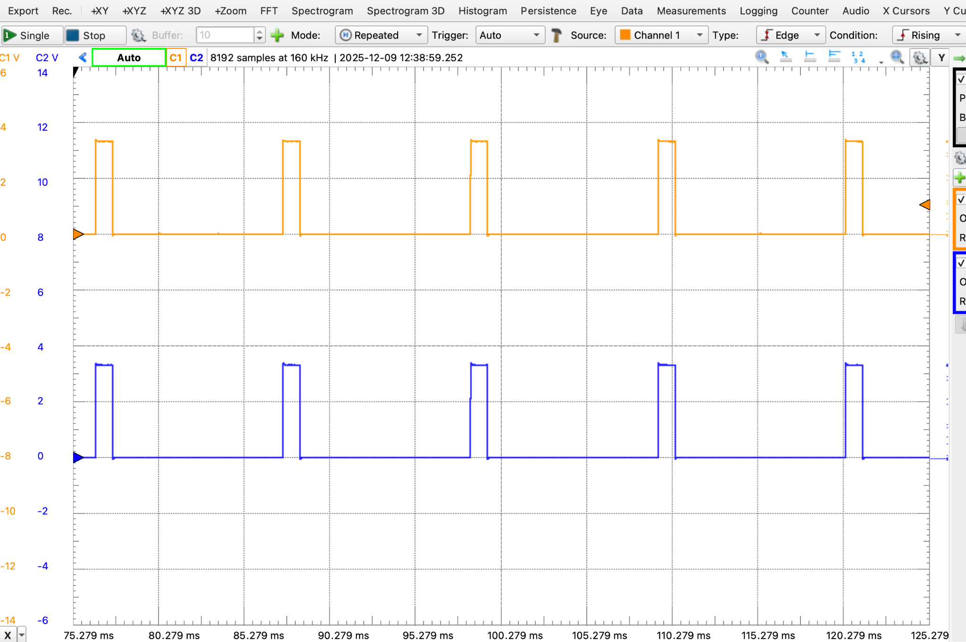
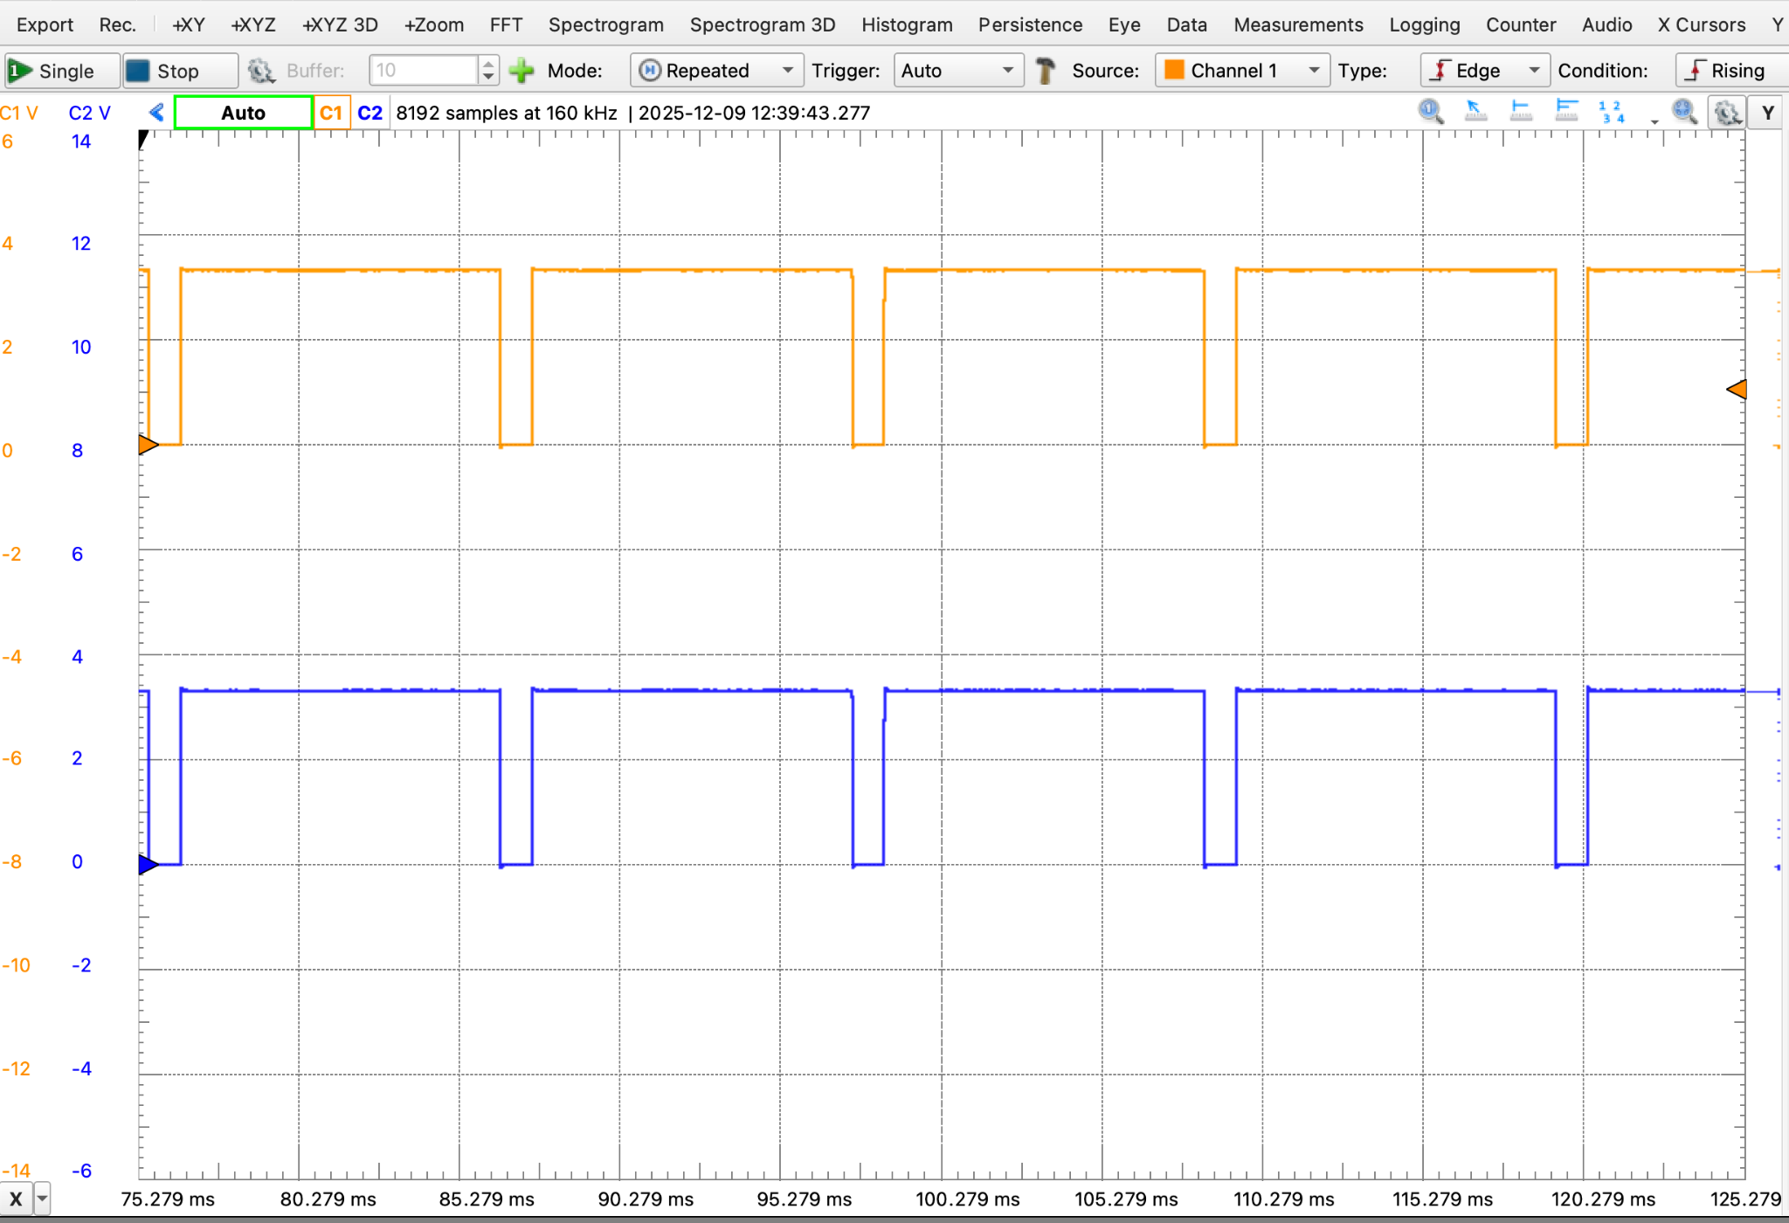
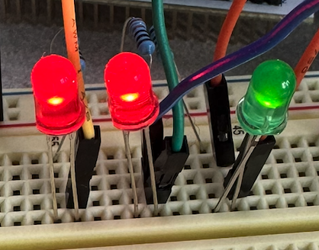
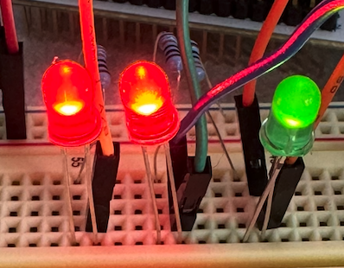
while(1) {
GPIOA->ODR |= LED_ALL; // 3. turn LEDs on
delay_ms(1); // kill some time
GPIOA->ODR &= ~LED_ALL; // 4. turn LEDs off
delay_ms(10); // kill some time
}
while(1) {
GPIOA->ODR |= LED_ALL; // 3. turn LEDs on
delay_ms(10); // kill some time
GPIOA->ODR &= ~LED_ALL; // 4. turn LEDs off
delay_ms(1); // kill some time
}

Slide 7
Back to our Button

Slide 8
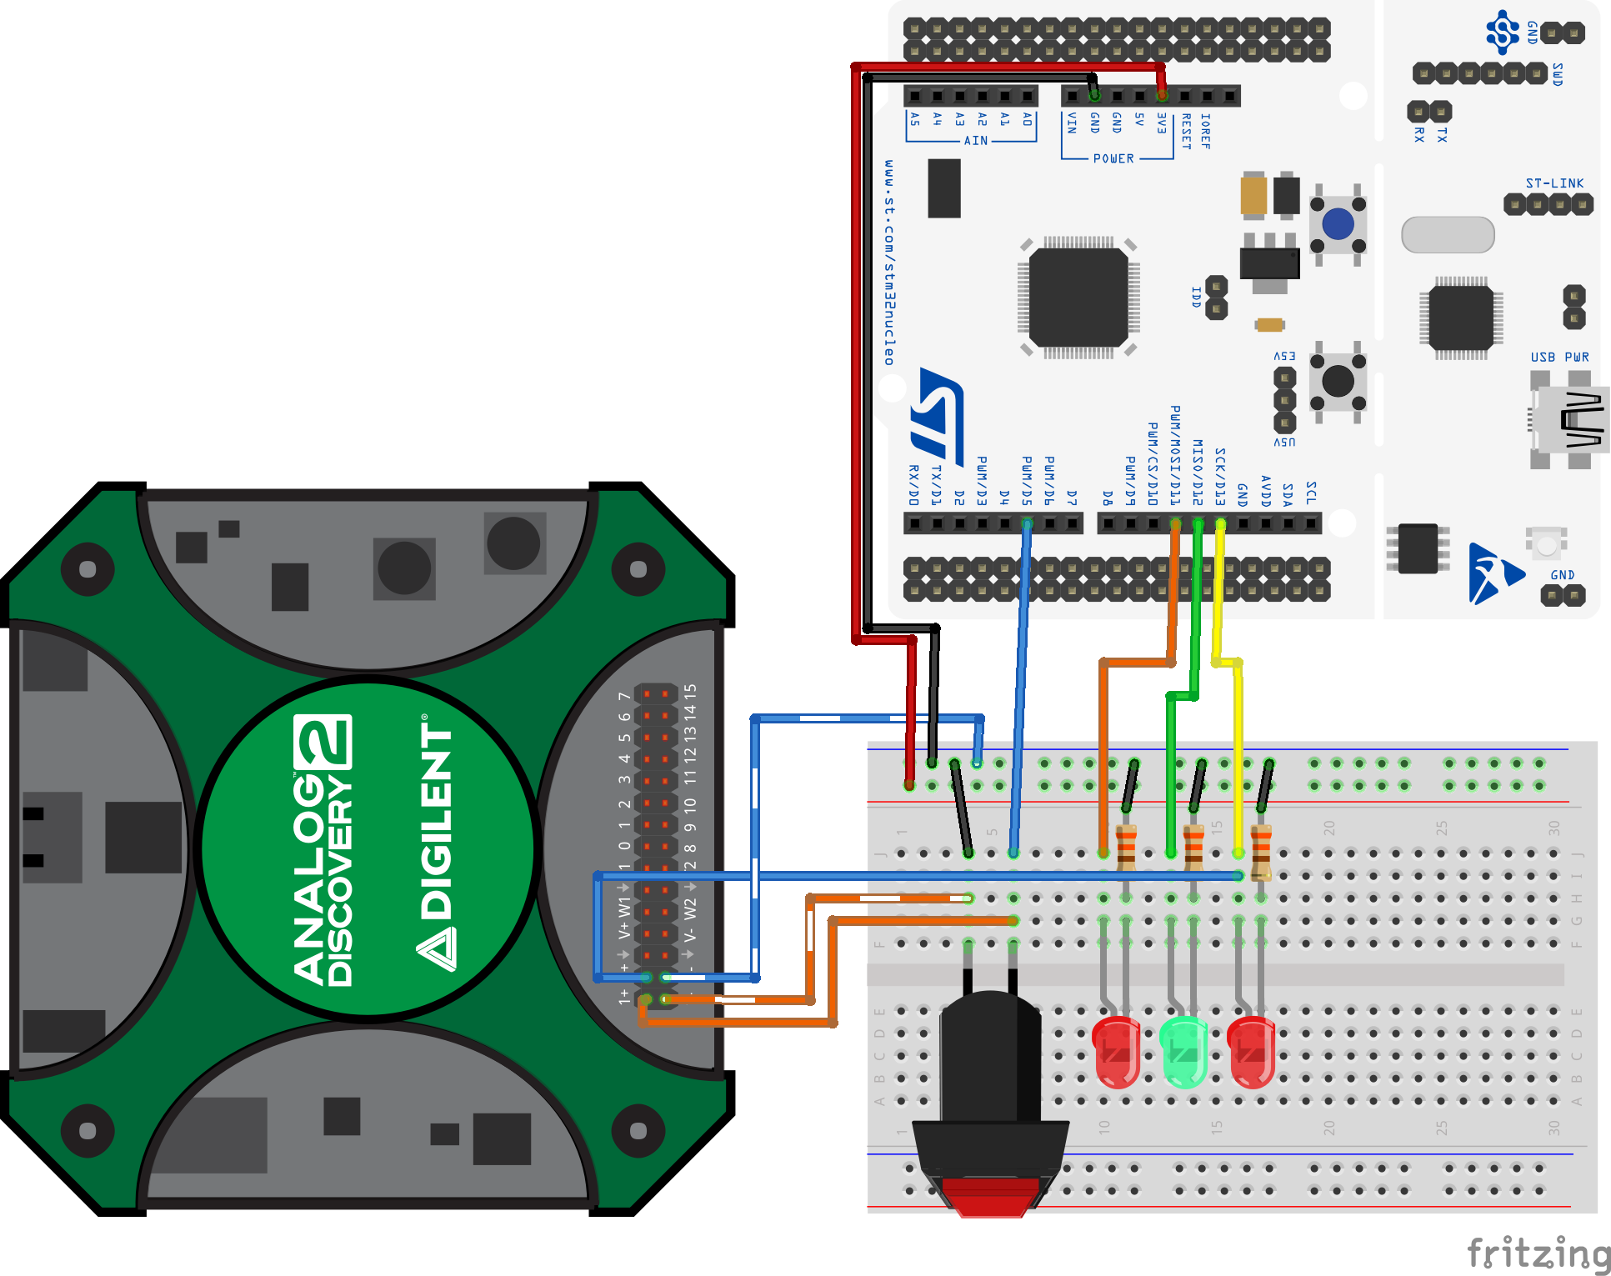
Use oscilloscope to observe button behavior (wiring)
Channel 1: Button on D5 (PB4)
Channel 2: LED on D13 (PA5)
If your "toggle" LED code is finished you can use it here. Otherwise please flash the "button" code from last class onto your Nucleo.

Slide 9
Load button.c onto your Nucleo (unless you already finished the toggle code).
#include "ES28.h" // All the port definitions are here
#define GPIOAEN (1U<<0) // Clock access to GPIOA (LED)
#define GPIOBEN (1U<<1) // Clock access to GPIOB (button)
#define LED_PIN (1U<<5) // LED on PA5 (D13)
#define BUTTON_PIN (1U<<4) // Button on PB4 (D5)
int main(void) {
RCC->IOPENR |= (GPIOAEN | GPIOBEN); // Enable clock access to GPIOA and B
GPIOA->MODER |= (1U<<10); // Configure PA5 as output pin
GPIOA->MODER &= ~(1U<<11);
GPIOB->MODER &= ~(1U<<8); // Configure PB4 as input pin
GPIOB->MODER &= ~(1U<<9); // (not necessary since this is default reset value)
GPIOB->PUPDR |= (1U<<8); // enable pull-up for PB4
GPIOB->PUPDR &= ~(1U<<9);
delay_ms(50);
while(1) {
// Read the pin and control the LED
if ((GPIOB->IDR & BUTTON_PIN) == 0) { // button input is low-true
GPIOA->ODR |= LED_PIN; // turn LED on
} else {
GPIOA->ODR &= ~LED_PIN; // turn LED off
}
}
return 0; // never reached
}

Slide 10
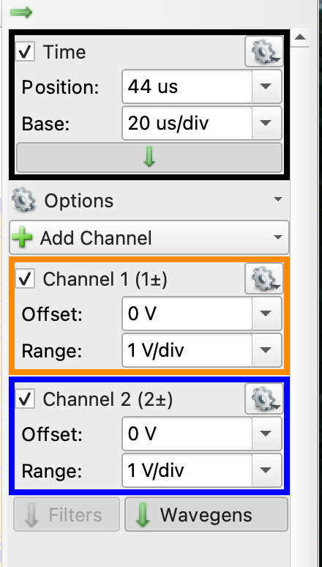
Use scope to observe button (Waveforms setup)
May need to switch this to 'auto', depending on the software version.
The ‘scope will begin an acquisition when Channel 1 (button signal) falls below 1V.
20us/div is a good start. Might need to change depending on your button
MCU sees multiple presses
Notes:
Settings for channel 1: 20 us per horizontal division and 1 V per vertical division. Same for channel 2. Then drag channel 1 down to separate the traces by putting in -4V for position.
Next, click on trigger on the trigger menu and set the trigger mode to normal. Set the condition to falling edge, so that it will trigger when the button is pushed. Trigger it on channel 1. That's what's connected to the button. As soon as it detects a button push it'll snap a picture.

Slide 11
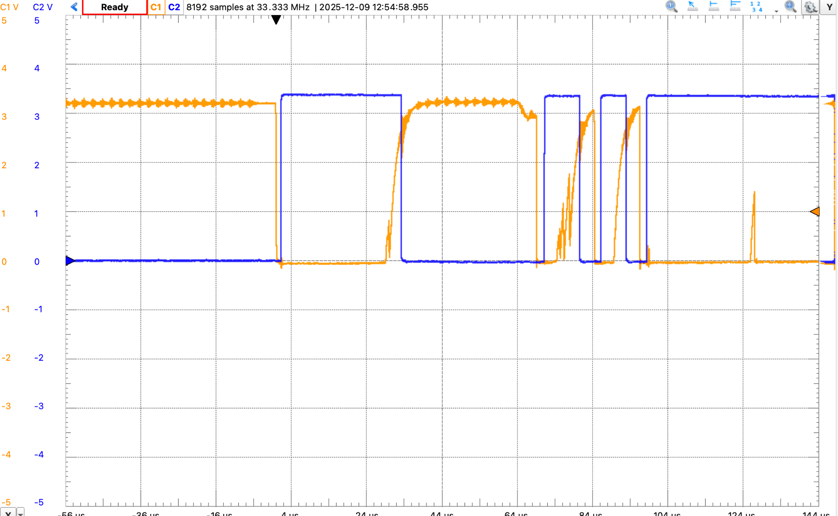
Click "Single", then press the button once to trigger.
What is happening???

Slide 12
How to “debounce” a pushbutton
The switch contacts “bounce” for a while (here, about 120µs, can be up to 10ms, depending on mechanical structure of switch) before making a solid connection.
Debouncing consists of delaying the input to the pin until the bouncing stops.
Analog (simple circuit)
Software (e.g., delay_ms)
Digital timer (Engs 31 solution)

Slide 13
Hardware or software?
Hardware (RC circuit, digital timer)
(+) Doesn’t tie up processor cycles.
(–) Requires another (tiny) component on circuit board, additional wiring
(–) Hard to revise for a different switch; design with tolerance.
Software (software delay)
(+) Flexible. Just edit code and reflash if the switch is changed.
(+) Simple. Doesn’t require additional components on the circuit board.
(–) Wastes processor cycles while waiting for the bouncing to stop.

Slide 14
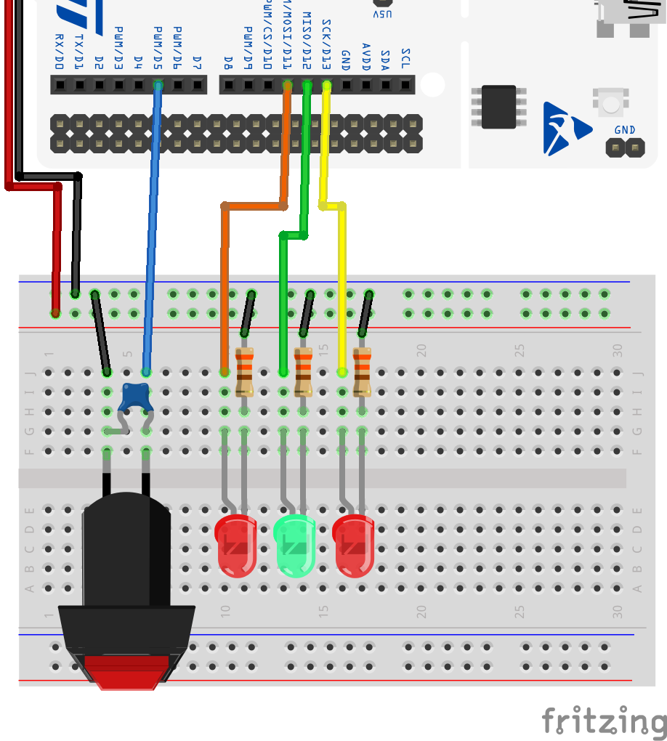
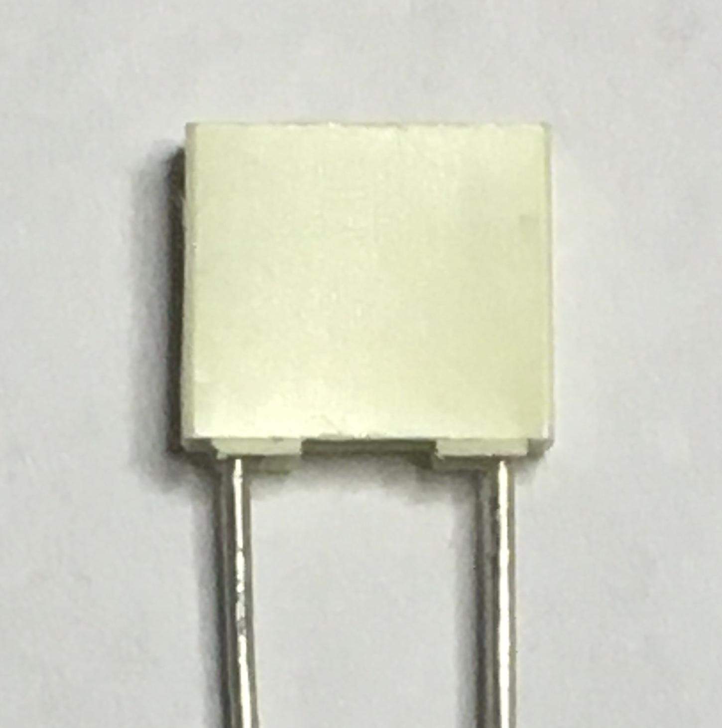
Let's try the analog solution.
Connect a 0.1µF capacitor across the switch and note the effect (we’ll see why it works soon).
How do you know which of the capacitors is 0.1µF?
Why does this work?

Slide 15
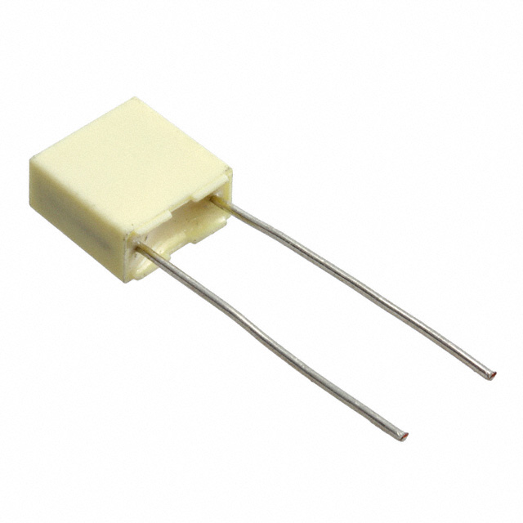
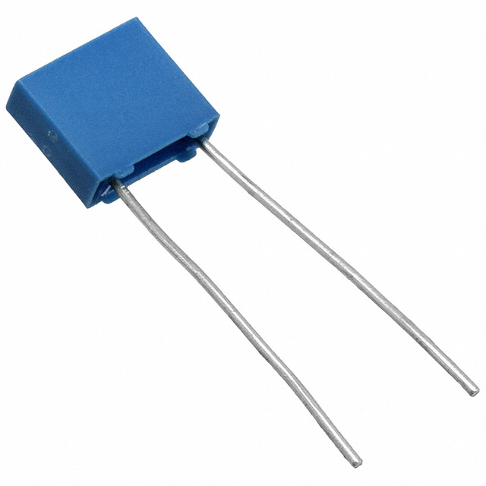
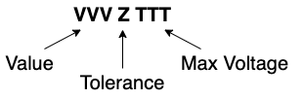
Reading Capacitor Codes
Our Metal Film Capacitors have 3 fields in their marking:
Value is 2 digits and a decimal point.
The decimal point can be an n, a p, or a dot
The default values (dot) are in microfarads.
P means Pico
N mean Nano.
Replace the letter with a decimal point and move the letter to the end:
22nJ100 => 22.0nF +/- 5% Max 100V
.15J63 => 0.15uF +/- 5% Max 63V
2n2K100 => 2.2nF +/-10% Max 100V
p22J63 => 0.22pF +/- 5% Max 63V
Tolerance is a single letter.
J means +/-5%
K means +/-10%

Slide 16
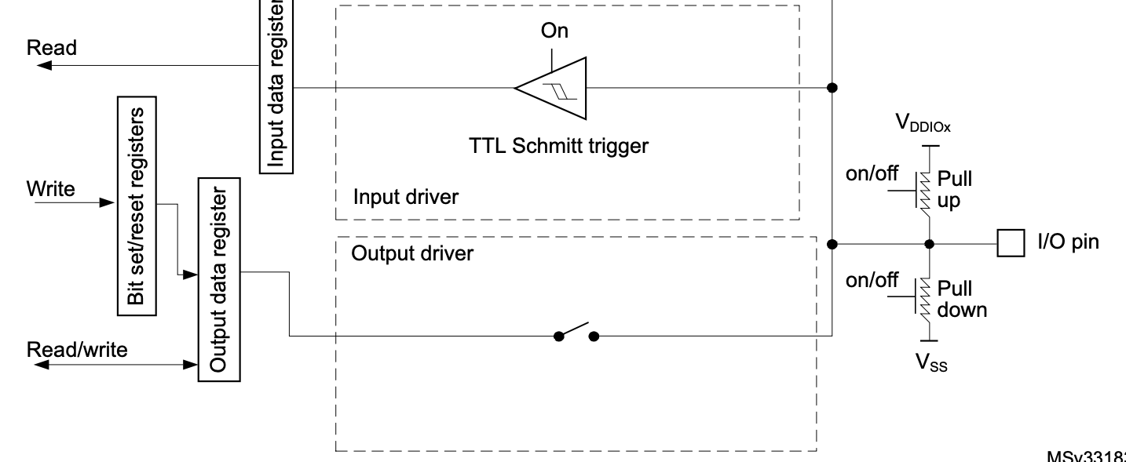
How to wire a pushbutton
GPIOx->IDR
Internal pullup charges capacitor.
Capacitor discharged by switch, recharged through Rpu
Notes:
When the I/O port is programmed as input:
• The output buffer is disabled
• The Schmitt trigger input is activated
• The pull-up and pull-down resistors are activated depending on the value in the GPIOx_PUPDR register
• The data present on the I/O pin are sampled into the input data register every AHB clock cycle
• A read access to the input data register provides the I/O state

Slide 17
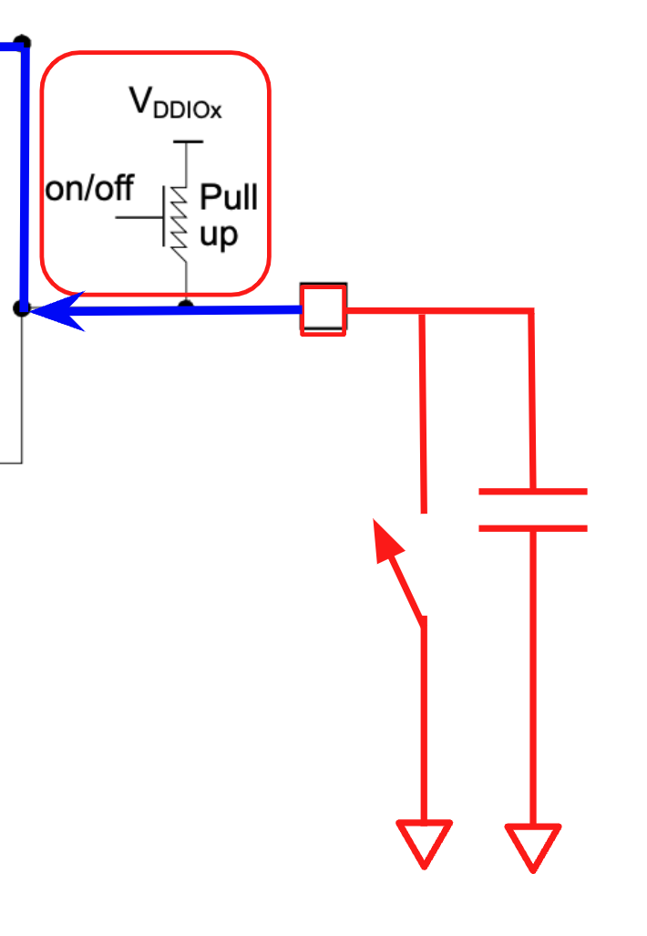
How does it work?
Remember from Phys 14: a capacitor stores electric charge.
When the switch is open, capacitor is kept charged by internal pullup Rpu.
When the switch is closed, capacitor discharges.
If the switch bounces open, capacitor recharges through pullup. Recharge time proportional to RpuC.
Discharge-charge continues until bouncing ceases.
Choose a value of C so that RpuC is sufficiently long to prevent the bounce from rising to VIH.
Quantitative design in Lab 2.
Notes:
Capacitor discharge super quick since there is no resistor in the direct line to ground when the switch is closed.
Capacitor charging depends on the values of Rpu and C.
Video of resistors blowing up: https://www.youtube.com/watch?v=JCPXckfT-6g

Slide 18
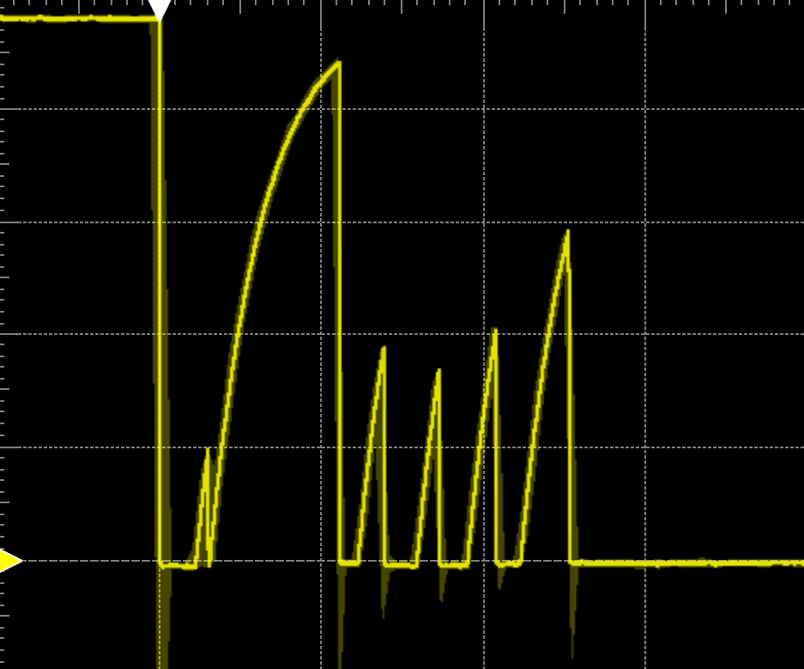
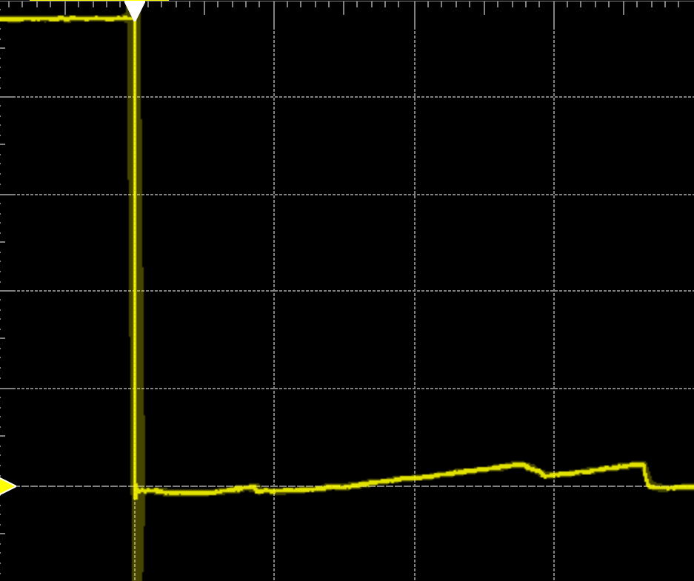
Results
Immediate drop (discharge), bounce recovers slowly, but can reach VIH
C=0.01µF
C=0.1µF
Immediate drop (discharge), bounce recovers so slowly that voltage stays below VIH

Slide 19
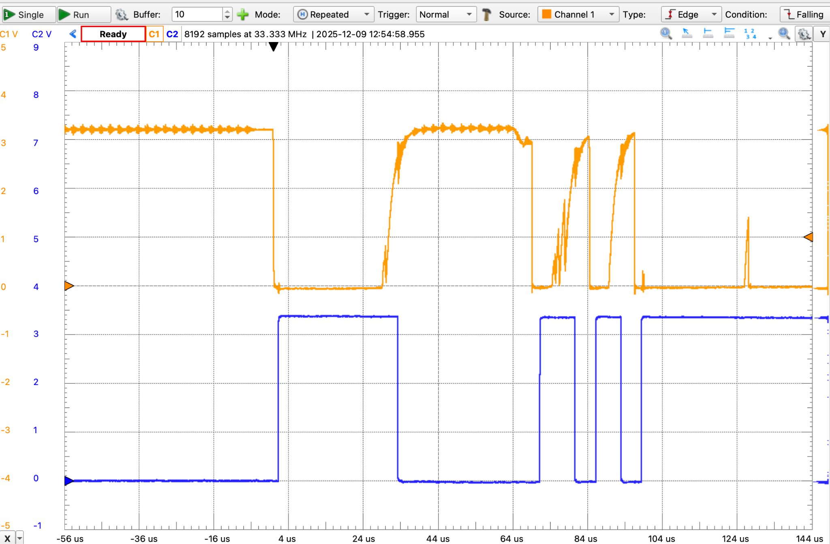
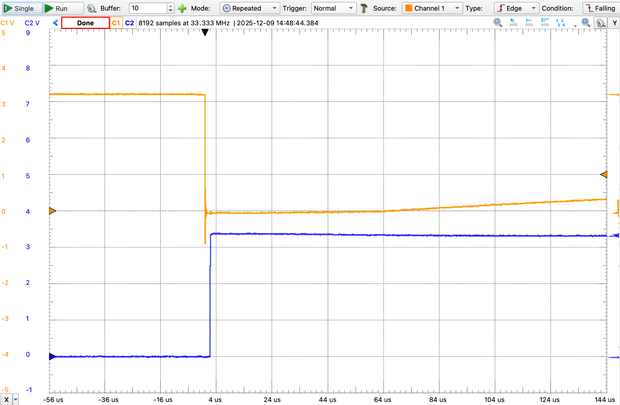
Use oscilloscope to observe glitches
Also called “switch bounce”
Without capacitor
With capacitor
switch
switch
LED
LED
MCU sees multiple presses

Slide 20
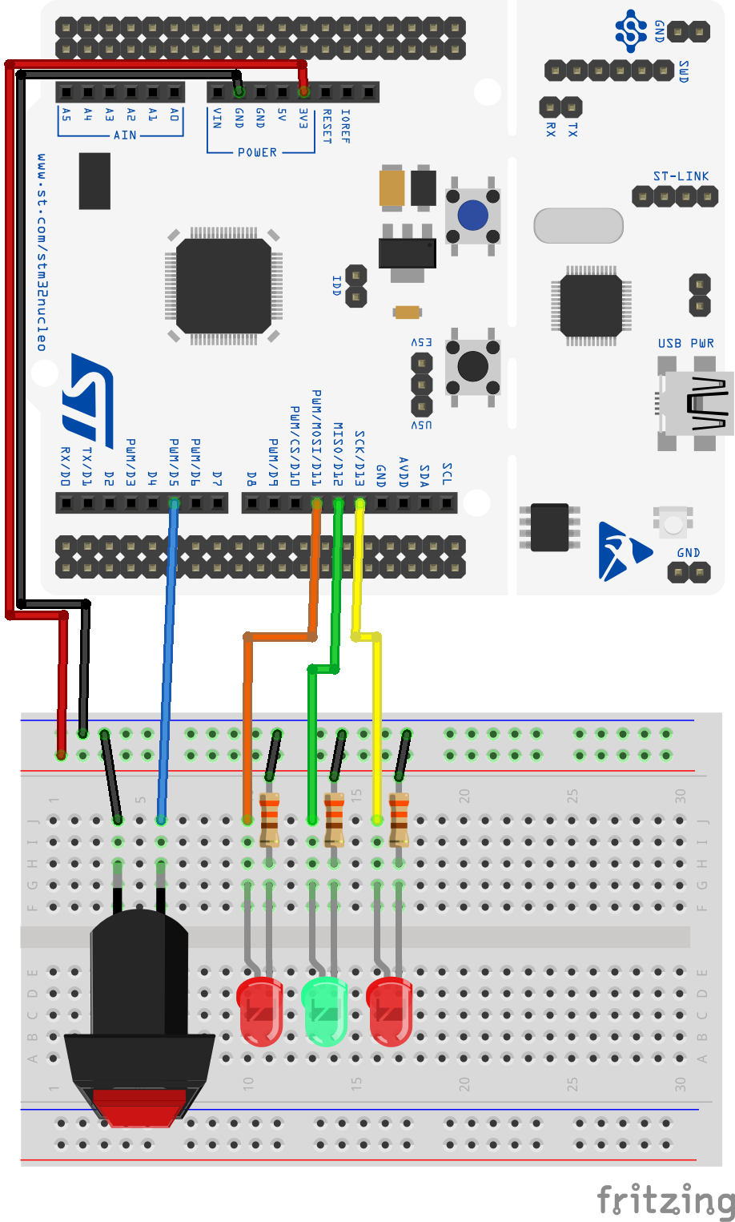
Pushbutton exercises
Make a copy of one of your Lab 1 programs and modify them to use the button:
blinkySEQ.c: Pressing the button turns all the LEDs on, releasing it returns to the usual sequence.
blinkyCNT.c: A button press causes the counter to pause, a second press causes it to resume.
(This is part of your Lab 2 work. You won't quite get this done right now but can get a nice headstart.)

Slide 21
“Polling” an input port
// MAIN EVENT LOOP
while(1) { // Every time around the loop
if ((GPIOB->IDR & BUTTON_PIN) == 0) { // Check (“poll”) the pin
GPIOA->ODR |= LED_PIN; // Then take action
} else {
GPIOA->ODR &= ~LED_PIN;
}
}
More general way: clearly separate reading the pin from acting:
uint8_t buttonPushed;
// MAIN EVENT LOOP
while(1) { // Every time around the loop
buttonPushed = ((GPIOB->IDR & BUTTON_PIN) == 0); // Poll the pin
if (buttonPushed) { // Take action
GPIOA->ODR |= LED_PIN;
} else {
GPIOA->ODR &= ~LED_PIN;
}
}

Slide 22
Example: Using button to reset a counter
#include "ES28.h" // All the port definitions are here
#define GPIOBEN (1U<<1) // Clock access to GPIOB (button)
#define BUTTON_PIN (1U<<4) // Button on PB4
(...)
int main(void) {
unsigned buttonPushed = 0;
unsigned count = 0;
RCC->IOPENR |= GPIOBEN; // Enable clock access to GPIOB
GPIOB->MODER &= ~(1U<<8); // Configure PB4 as input pin
GPIOB->MODER &= ~(1U<<9); // (not necessary since this is default reset value)
GPIOB->PUPDR |= (1U<<8); // enable pull-up for PB4
GPIOB->PUPDR &= ~(1U<<9);
(...)
while(1) {
delay_ms(500); // kill some time
buttonPushed = ((GPIOB->IDR & BUTTON_PIN) == 0); // Poll the button
if ((buttonPushed) || (count == 7)) { // Act on the button
count = 0; // Reset the counter
} else {
count++; // Increment the counter
}
/* do stuff with count, like turn on some LEDs */
}
return 0;
}

Slide 23
Now let’s talk about the homework for Thursday
Does this work (once we've debounced the switch)?
while(1) {
buttonPushed = ((GPIOB->IDR & BUTTON_PIN) == 0); // Poll the button (1 => pressed)
if ( buttonPushed ) { // Act on the button
// toggle the LED // on-->off or off-->on
}
// implicit “do nothing” if button isn’t pressed
}
Give it a try. Think about the homework code to toggle the LED whenever the button is pushed and discuss at your table. What difficulties do you observe?

Slide 24
Often you need to sense both states of the switch
unsigned buttonAlreadyPressed = 0;
while(1) {
buttonPushed = ((GPIOB->IDR & BUTTON_PIN) == 0); // Poll the button (1 => pressed)
if (buttonAlreadyPressed==0) { // Has button been pressed?
if ( buttonPushed==1 ) {
// toggle the LED // on-->off or off-->on
buttonAlreadyPressed = 1; // Mark button as pressed
}
} else { // Button is still pressed
if ( buttonPushed==0 ) { // Do nothing until button is released
buttonAlreadyPressed = 0; // Mark button as released
}
}
}

Slide 25
On Thursday
More about watching buttons, in preparation for Lab 2.
State machines.

