Slide 1


Engs 28
Embedded Systems
Day 4

Slide 2
Agenda
Announcements
Code review: Set up your Nucleo to show the LED toggle code.
State machine design pattern

Slide 3
Announcements
Labs:
Start early! Greater chance of getting 1-1 TA time on Tuesday, Wednesday, Thursday.
Signatures: try your best to get an in-person signature. Video submission should be used in an emergency only.
If something is off with your demo and at signature time it is noticed by a TA, you still have the chance to fix it. -> better chance for more points
Videos made on apple devices are difficult to view for TAs with Windows computers.
Follow the submission instructions in the lab.

Slide 4
Announcements
Quiz 1:
Available anytime between noon on Sunday, January 18, and noon on Tuesday, January 20.
Going forward, quizzes will be available on Mondays, 12:01 am-11:59 pm.
The time limit is 60 minutes. You may take the quiz in any uninterrupted one-hour period during the quiz availability.
Permitted sources: lecture and lab handouts, readings in Williams and White the Nucleo reference manual, datasheet, anything else archived on Canvas.

Slide 5
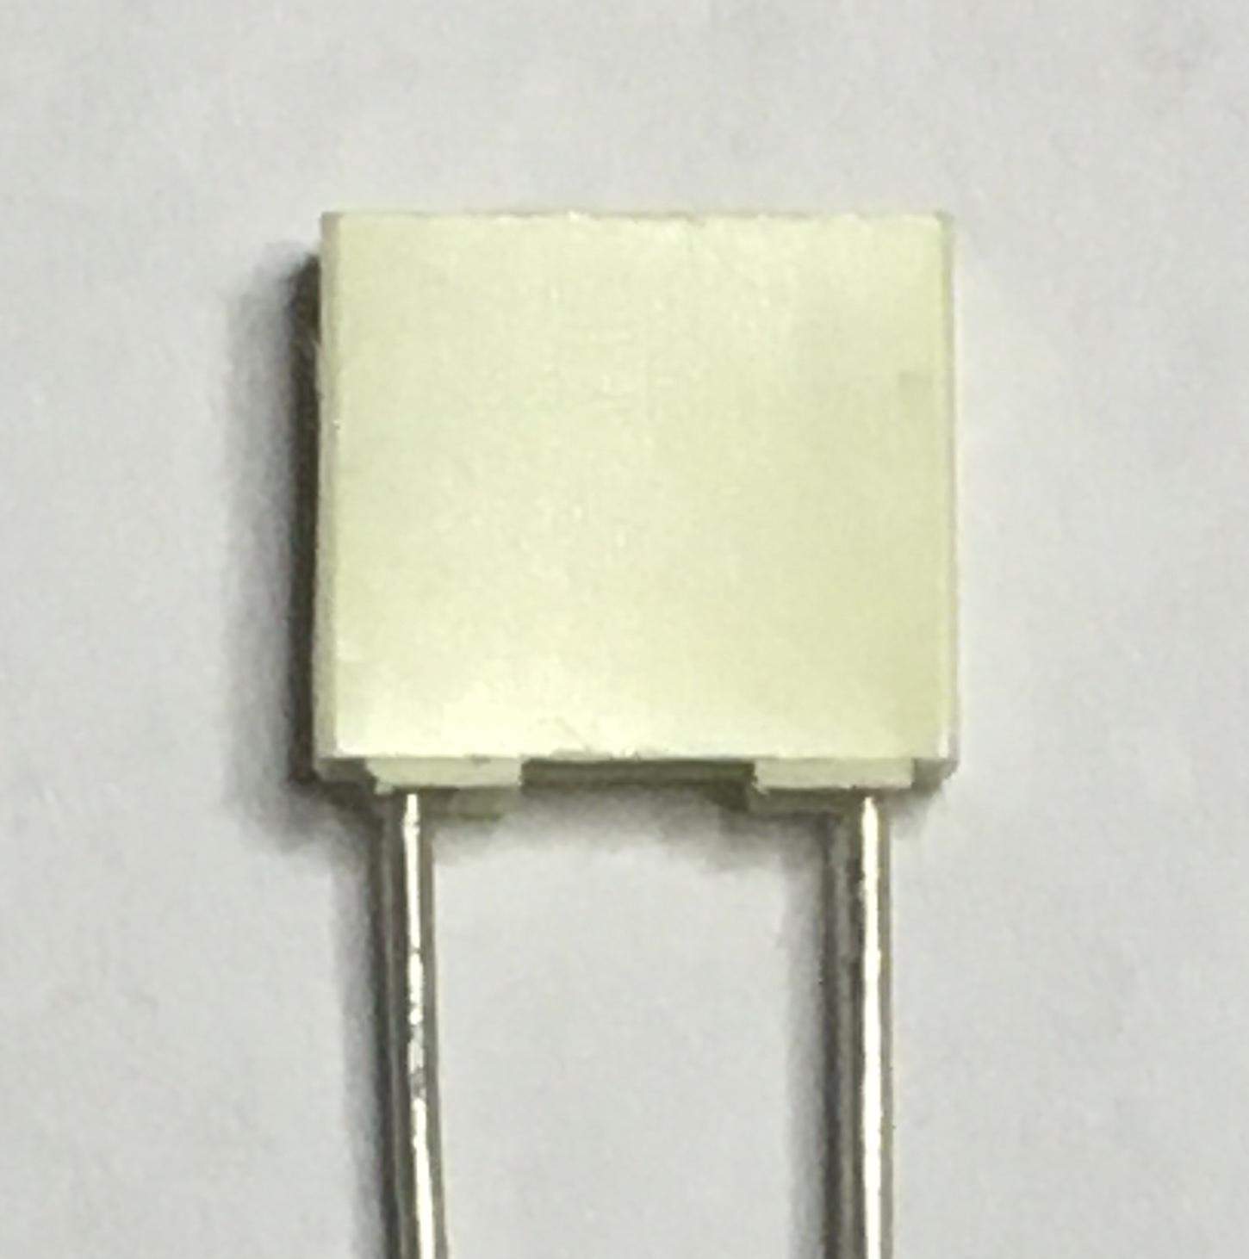
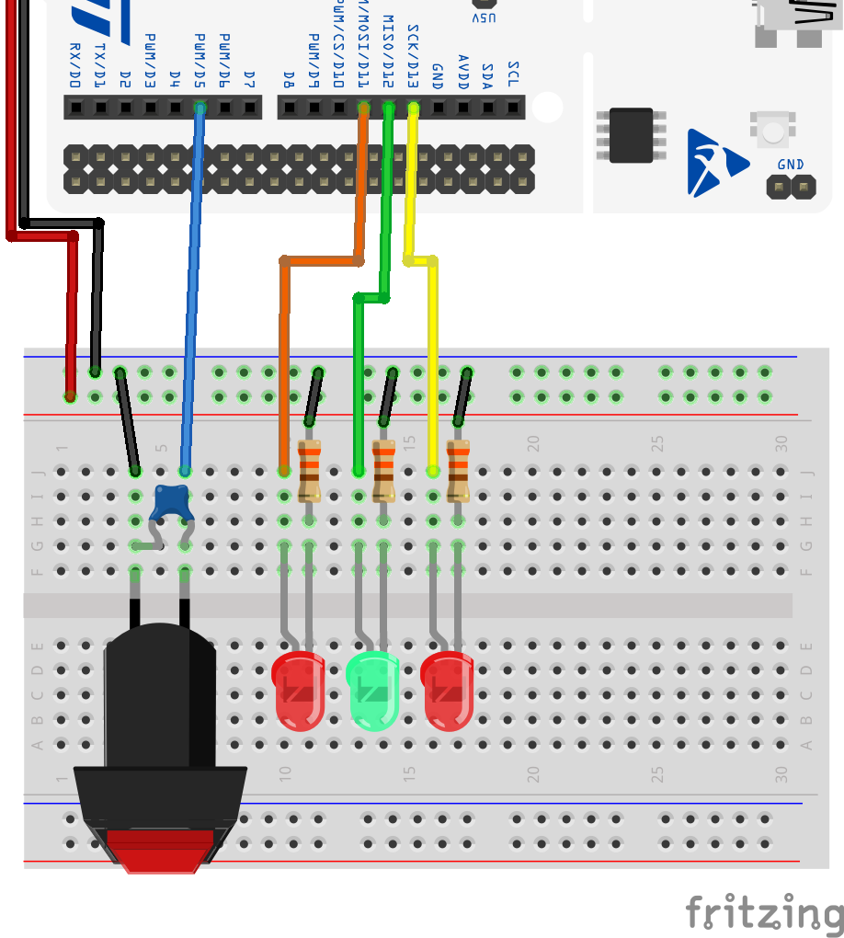
Homework
Write code (toggleLED.c) so that the on-board LED is toggled on and off via the button:
PRESS => LED goes ON
RELEASE => LED stays ON
PRESS => LED goes OFF
RELEASE => LED stays OFF
In order to prevent “glitches” (erratic behavior of the LED caused by button bounce), add a 0.15µF capacitor across the switch.

Slide 6
Code Review
Share code within your group.
Can you read, understand, and explain your partners’ codes? (This is called "code review" — good for catching bugs!)
Notes:
One of the top 5 things to do improve embedded systems design flow b/c code reviews catch bugs.

Slide 7
Control the LED - toggle - possible solution 1
#include "ES28.h" // All the port definitions are here
#define GPIOAEN (1U<<0) // Clock access to GPIOA (LED)
#define GPIOBEN (1U<<1) // Clock access to GPIOB (button)
#define LED_PIN (1U<<5) // LED on PA5 (D13)
#define BUTTON_PIN (1U<<4) // Button on PB4 (D5)
int main(void) {
unsigned buttonAlreadyPressed = 0;
unsigned buttonPushed;
RCC->IOPENR |= (GPIOAEN | GPIOBEN); // Enable clock access to GPIOA,B
GPIOA->MODER |= (1U<<10); // Configure PA5 as output pin
GPIOA->MODER &= ~(1U<<11);
GPIOB->MODER &= ~(1U<<8); // Configure PB4 as input pin
GPIOB->MODER &= ~(1U<<9); // (not necessary since this is default reset value)
GPIOB->PUPDR |= (1U<<8); // enable pull-up for PB4
GPIOB->PUPDR &= ~(1U<<9);
while(1) {
buttonPushed = ((GPIOB->IDR & BUTTON_PIN) == 0); // get state of button pin (low/high)
if (!buttonAlreadyPressed) {
if (buttonPushed) {
GPIOA->ODR ^= LED_PIN; // toggle LED
buttonAlreadyPressed = 1;
}
} else {
if (!buttonPushed) {
buttonAlreadyPressed = 0;
}
}
}
return 0; // never reached
}
Notes:
This one mirrors the state machine design.

Slide 8
Control the LED - toggle - possible solution 2
#include "ES28.h" // All the port definitions are here
#define GPIOAEN (1U<<0) // Clock access to GPIOA (LED)
#define GPIOBEN (1U<<1) // Clock access to GPIOB (button)
#define LED_PIN (1U<<5) // LED on PA5 (D13)
#define BUTTON_PIN (1U<<4) // Button on PB4 (D5)
int main(void) {
unsigned buttonAlreadyPressed = 0;
unsigned buttonPushed;
RCC->IOPENR |= (GPIOAEN | GPIOBEN); // Enable clock access to GPIOA,B
GPIOA->MODER |= (1U<<10); // Configure PA5 as output pin
GPIOA->MODER &= ~(1U<<11);
GPIOB->MODER &= ~(1U<<8); // Configure PB4 as input pin
GPIOB->MODER &= ~(1U<<9); // (not necessary since this is default reset value)
GPIOB->PUPDR |= (1U<<8); // enable pull-up for PB4
GPIOB->PUPDR &= ~(1U<<9);
while(1) {
buttonPushed = ((GPIOB->IDR & BUTTON_PIN) == 0);
if (buttonPushed) {
if (buttonAlreadyPressed==0) {
GPIOA->ODR ^= LED_PIN; // toggle LED
buttonAlreadyPressed = 1;
}
} else {
buttonAlreadyPressed = 0;
}
}
return 0; // never reached
}
Notes:
A bit more efficient but doesn't as closely mirror the state machine design that will come next.

Slide 9
State machine design pattern

Slide 10
Look again at toggling the LED with pushbutton
#include "ES28.h" // All the port definitions are here
#define GPIOAEN (1U<<0) // Clock access to GPIOA (LED)
#define GPIOBEN (1U<<1) // Clock access to GPIOB (button)
#define LED_PIN (1U<<5) // LED on PA5 (D13)
#define BUTTON_PIN (1U<<4) // Button on PB4 (D5)
int main(void) {
unsigned buttonAlreadyPressed = 0;
unsigned buttonPushed;
RCC->IOPENR |= (GPIOAEN | GPIOBEN); // Enable clock access
GPIOA->MODER |= (1U<<10); // Configure PA5 as output pin
GPIOA->MODER &= ~(1U<<11);
GPIOB->MODER &= ~(1U<<8); // Configure PB4 as input pin
GPIOB->MODER &= ~(1U<<9); // (not necessary since this is default reset value)
GPIOB->PUPDR |= (1U<<8); // enable pull-up for PB4
GPIOB->PUPDR &= ~(1U<<9);
while(1) {
buttonPushed = ((GPIOB->IDR & BUTTON_PIN) == 0);
if (!buttonAlreadyPressed) {
if (buttonPushed) {
GPIOA->ODR ^= LED_PIN;
buttonAlreadyPressed = 1;
}
} else {
if (!buttonPushed) {
buttonAlreadyPressed = 0;
}
}
}
return 0; // never reached
}
STATE: buttonAlreadyPressed
0: switch unpressed
1: switch has been pressed
EVENT: pin detected low or high
ACTION: toggle the LED
STATE TRANSITION: mark button as pressed or unpressed

Slide 11
State diagram
The button can be pressed or unpressed. But it is only when we observe a transition that we need to do anything:
Update the state
Toggle LED in transition from unpressed to pressed.
Capture behavior of system graphically
PIN is HIGH
Unpressed
(0)
STATE: buttonAlreadyPressed
0: switch unpressed
1: switch has been pressed
EVENT: PIN detected LOW or HIGH
ACTION: toggle the LED
STATE TRANSITION: mark button as pressed or unpressed
PIN is HIGH
PIN is LOW (GPIOB->IDR & BUTTON_PIN) == 0)
/ TOGGLE LED GPIOA->ODR ^= LED_PIN;
Pressed
(1)
PIN is LOW

Slide 12
Translate state diagram to C
Enumerated data type makes it easy to write code that mirrors the state diagram!
(PIN is HIGH)
typedef enum {UNPRESSED, PRESSED} state_t ;
state_t state = UNPRESSED;
...
while(1) {
buttonPushed = ((GPIOB->IDR & BUTTON_PIN) == 0);
switch(state) {
case UNPRESSED:
if (buttonPushed) {
GPIOA->ODR ^= LED_PIN;
state = PRESSED;
}
break;
case PRESSED:
if (!buttonPushed) {
state = UNPRESSED;
}
break;
}
}
Unpressed
(0)
PIN is HIGH
PIN is LOW / TOGGLE LED
Pressed
(1)
(PIN is LOW)

Slide 13
Lab 2 design challenges
Use a pushbutton to pause / resume a counter (begin with blinkyCNT.c, adapt LED-toggling state machine).
Reaction time game: Each player has a (debounced) button and a red “WIN” LED. A third (green) LED serves as the start signal.
1. Initially, the starter LED is ON, or perhaps blinking rapidly.
2. Players can press either button to start the game.
3. The starter LED “counts down” with three flashes, one second apart, then glows steadily.
4. The players press their buttons as soon as they see the starter LED become steady. The player who presses their button first wins, and their LED lights (or blinks rapidly) for a second.
5. The system returns to step 1.
Use state machine design pattern. Begin with paper design / state diagram.

Slide 14
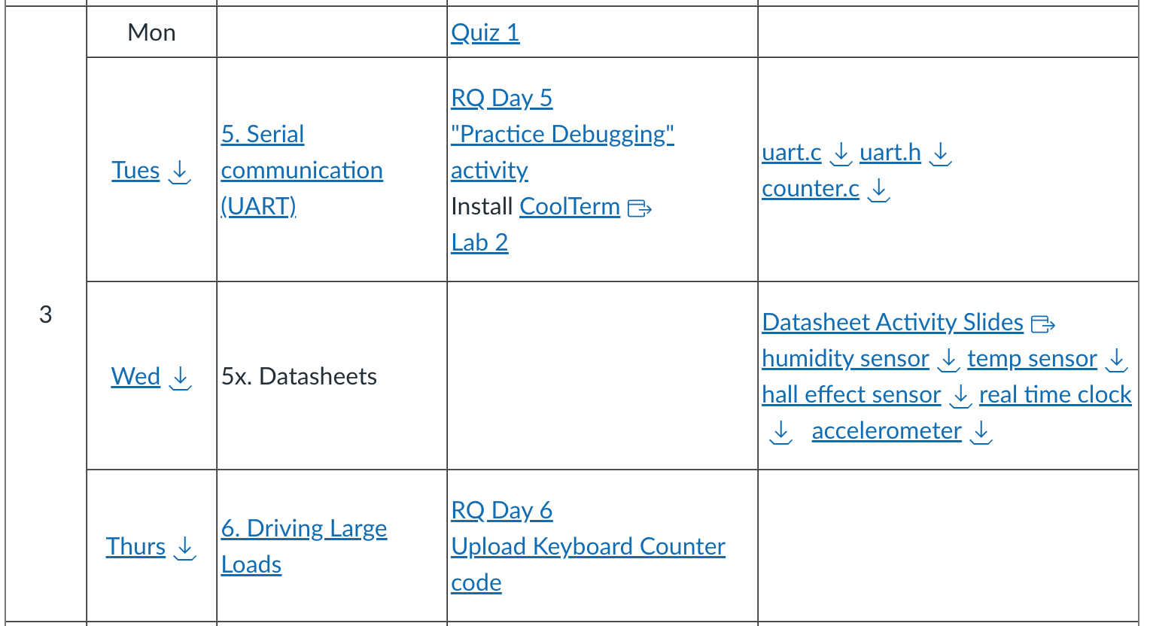
Lastly, Don't Forget:

