Slide 1


Engs 28
Embedded Systems
Day 5

Slide 2
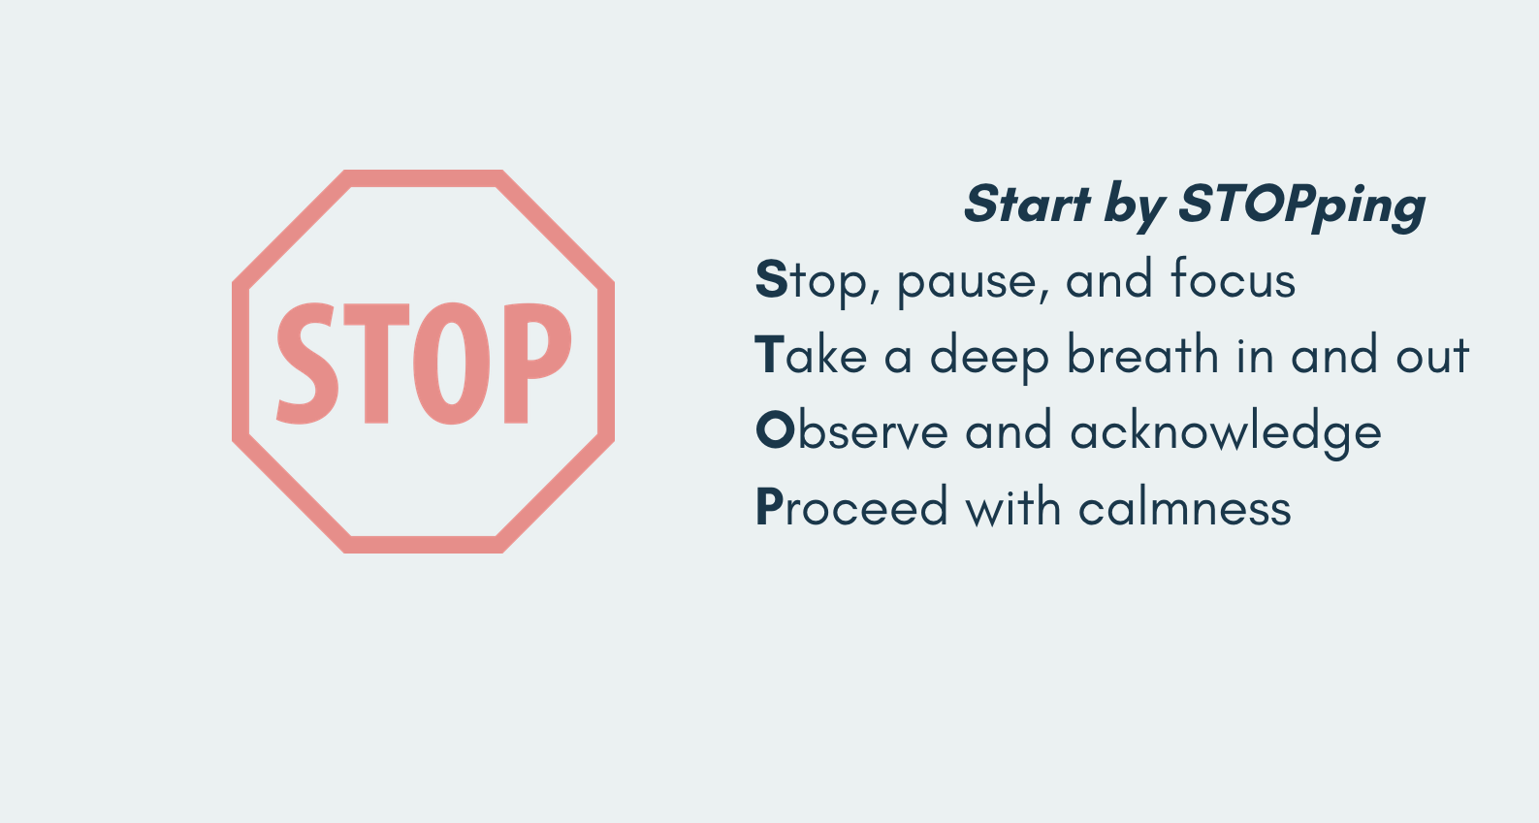

POWER OF THE PAUSE
Did you know?
Even starting class with brief mindful moments can boost academic performance and can help you feel more focused and relaxed.
https://health.cornell.edu/about/news/study-breaks-stress-busters
Notes:
benefits students AND you.

Slide 3
Lab 1 Feedback
Look at the comments in your lab.
While Lab 1 deductions are small, from now on:
Poor style will cause larger deductions.
Inefficient / redundant code will cause deductions.
Delete unused code.
Comments need to match your code.
Delete unused #defines.
Do not include unnecessary libraries.
Even if your code is working and you received a signature for it, this doesn't mean you are necessarily done.
Double-check your code.
If your code doesn't do what you showed to get your signature it's a problem.
Optimize your code.
If you submit an emergency video instead of a signature, be sure your code does what your video shows.
If we can't understand your code you'll receive a 0 and you'll have to come explain your code to us.

Slide 4
Some Q&As
Why did I get a '0' on my HiTA conversation?
If the AI determines that your understanding of the topic wasn't quite detailed enough yet, it'll grade your work as a 0.
In that case, you can learn from the AI explanations and retake the assignment.
What's a unit8_t?
It's an unsigned 8-bit integer data type, part of the stdint.h library
The "int" data type has a variable size across platforms
Why am I getting the error: uint32_t last_event_time = get_ticks(); gives error: ../Src/blinkyCNT.c:47:32: warning: implicit declaration of function 'get_ticks' [-Wimplicit-function-declaration] 47 | uint32_t last_event_time = get_ticks();
You probably forgot to #include "ES28.h"

Slide 5
Print statements (YES!)

Slide 6
Instructor Notes
Multiple students excluded syscalls.c and sysmem.c from their resource configuration, resulting in the code compiling (probably with warnings) and uploading, but nothing printing in Coolterm.

Slide 7
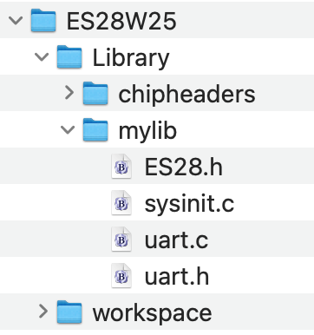
How to use print statements in your code
Finally! Diagnostic print statements (and other good things). First, the how-to, and then the explanation of how it works.
Step 1: We'll add some files to the C library for our class projects.
Remember the "mylib" folder we created during the installation process before the start of classes?
Download uart.c and uart.h from Canvas and put both into your mylib folder.
Since only your "workspace" folder is controlled by the CubeIDE (we linked mylib to your projects but that does not give the IDE control over that folder), you can simply use your computer's file manager to get the files to where you want them.
The final result should be this:

Slide 8
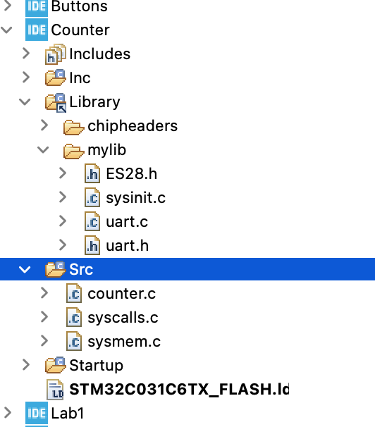
How to use print statements in your code
Step 2: Create a "Counter" project.
Create a new project "Counter" by making a copy of your TemplateProject.
Download counter.c from Canvas (table on the front page) and put it in your new project's Src folder (this is where you need to use copy+paste since the Counter project is controlled by the IDE).
The end result should be this:
Note that if you expand the linked "Library" folder as well as the mylib folder inside it you'll also see the new uart files therein.

Slide 9
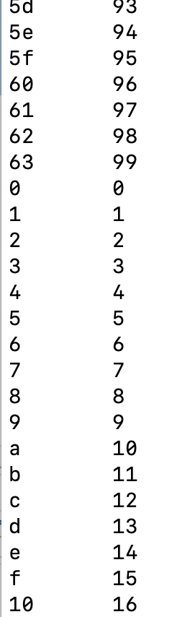
Example: Counter
WHERE WILL THE PRINTED STATEMENTS APPEAR?????
#include <stdio.h>
#include "ES28.h"
#include "uart.h"
int main(void) {
// Initialize the UART
uart2_init();
// A little message to show that the program has started
printf("Counter with serial output demo\r\n");
printf("tHex \tDecimal\r\n");
while(1) {
for (int count = 0; count<100; count++) {
printf("%x\t%d\r\n", count, count);
delay_ms(500) // slow down
}
}
}
uart.h contains function declarations (prototypes)
uart.c contain the function implementations.
Hold off on compiling and flashing. We'll get there momentarily.

Slide 10
How to use print statements in your code
Add the uart.h header file at the top of your source code: #include "uart.h" // UART initializations
Add the stdio.h header file at the top of your source code:
#include <stdio.h>
The library file stdio.c contains a "nano" version of the printf function that can be called just like regular printf(), but is more limited in the kinds of numbers it can format:
%u Unsigned decimal
%d Decimal
%x,%X Hexadecimal (“%x” uses a-f, “%X uses A-F) (up to 16 bit)
%lx 32-bit hexadecimal ("long hex")
%c Single character
%s Character string
No floats! Printing a float is complicated and uses a lot of code.

Slide 11
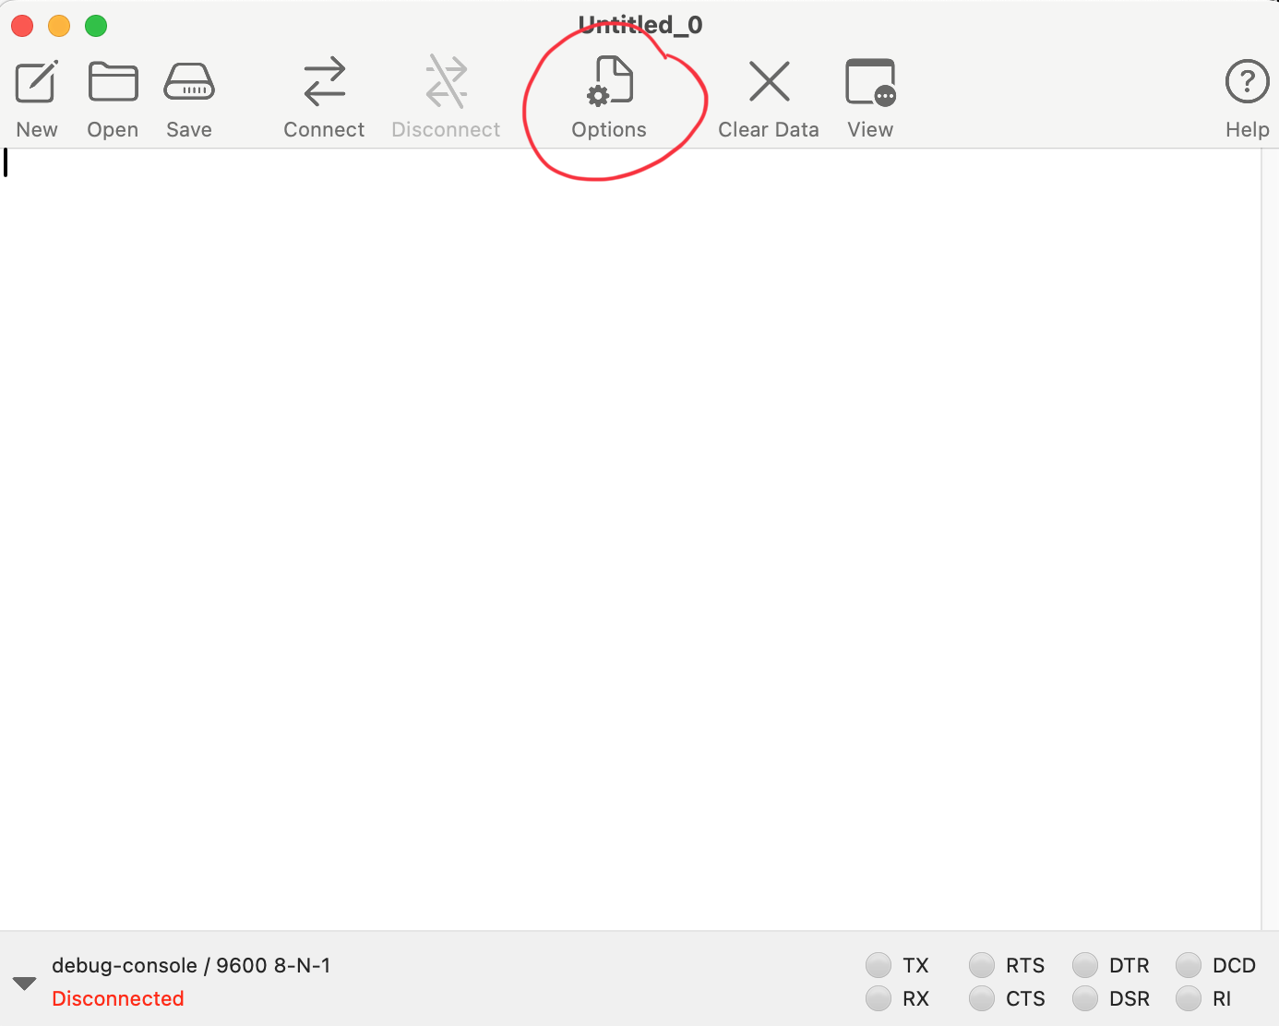
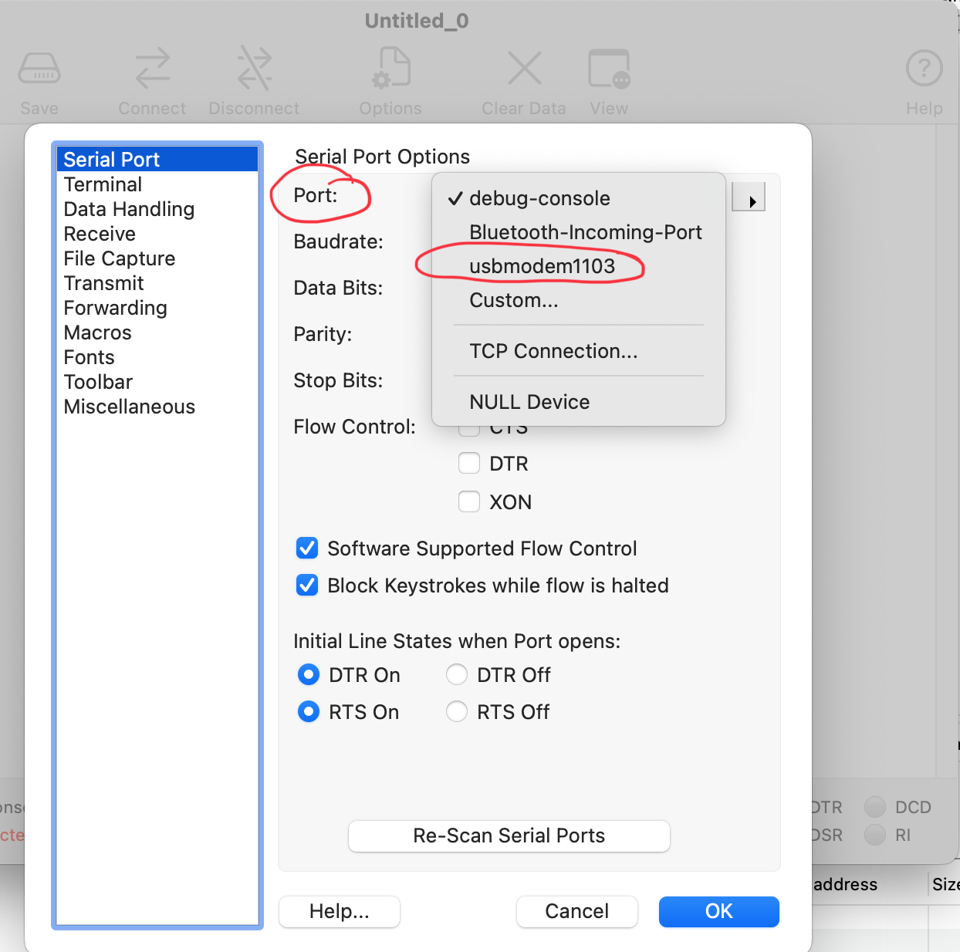
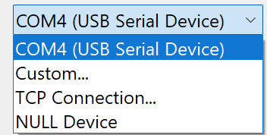
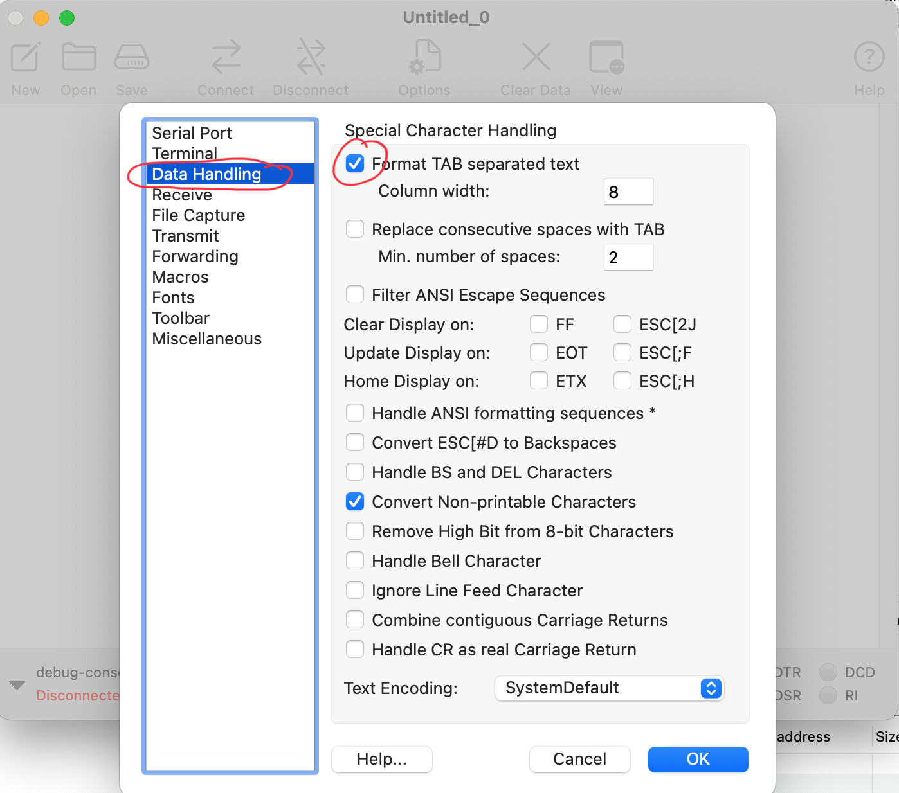

Use CoolTerm
Compile and upload to the Nucleo, as usual.
Then, open CoolTerm to create a serial connection to the Nucleo to print what it’s sending you:
In the window that opens, click "Options".
Under "Serial Port", click the drop-down for the "Port" setting and select the usb port that has your Nucleo plugged in. Unless you have other devices plugged into your computer, it is the only usb device that shows up here.
Under "Data Handling", check the "Format TAB separated text" and "Handle CR as real Carriage Return" boxes.
Click OK.

Slide 12
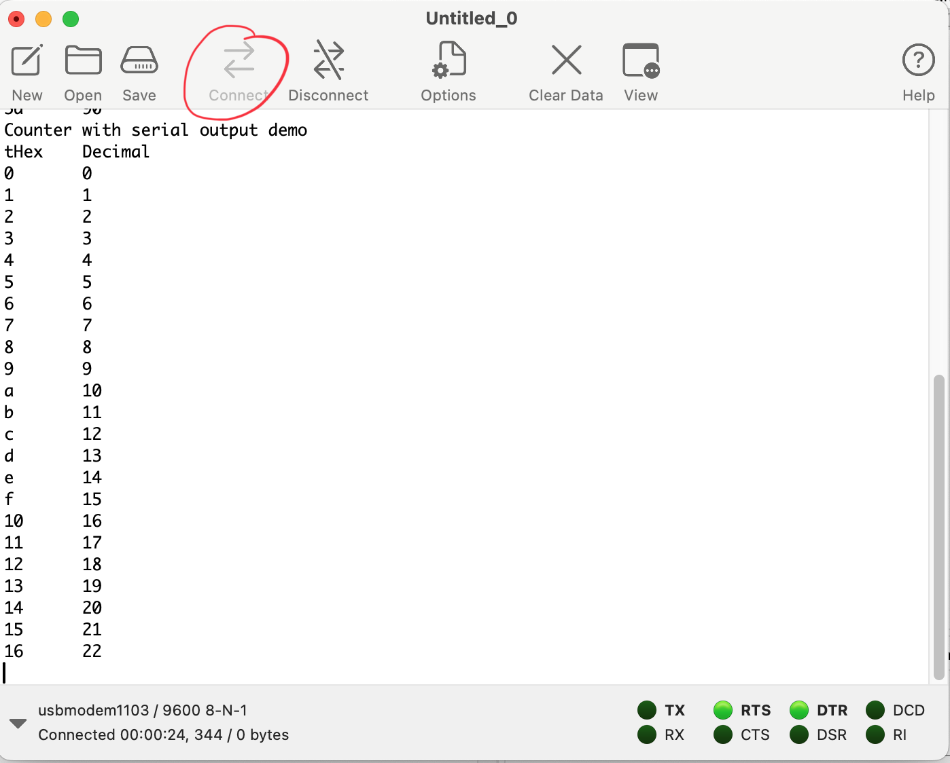
Example: Counter
Click "Connect" and watch the Nucleo count.
If you press the black Nucleo user button your program will restart and the count will start from 0.

Slide 13
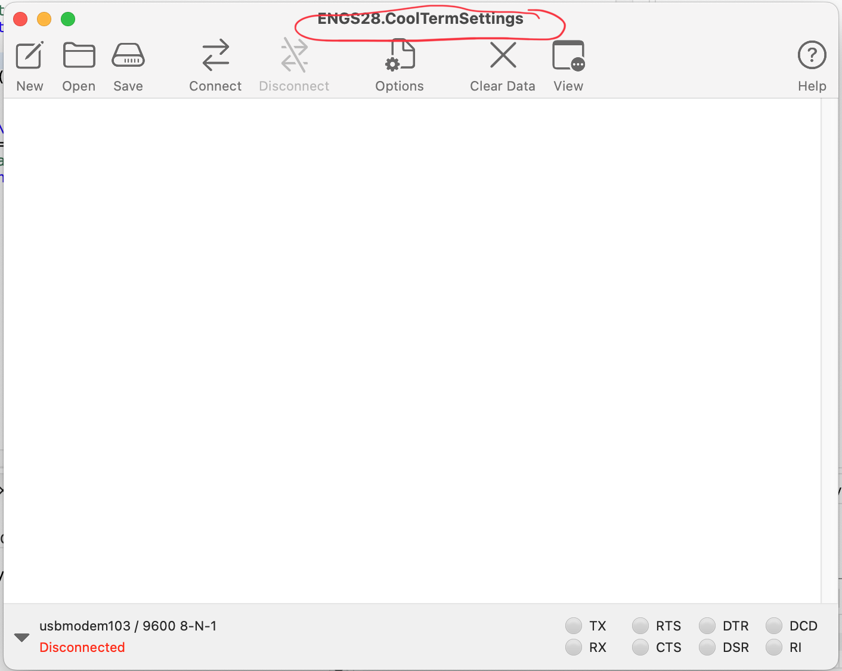
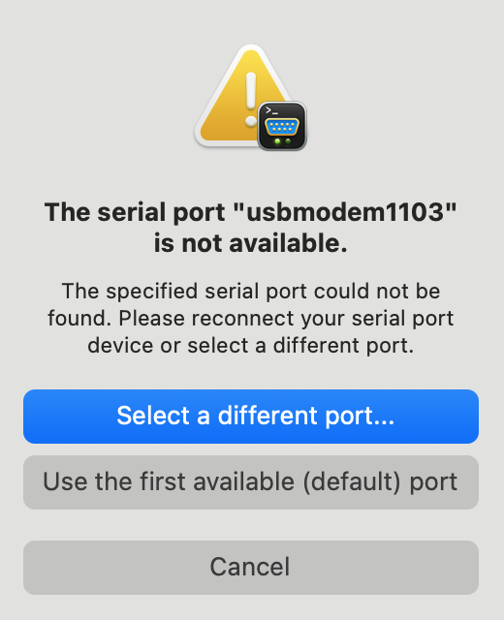
CoolTerm: Saving your Configuration
You can save your configuration using the "Save" button and then load this configuration using the "Open" button next time.
If the next time you use it you have changed your Nucleo's USB port you'll get this warning and need to select the new port:

Slide 14
Serial communications (UART)

Slide 15
Serial communication
Data usually comes in blocks of bits (bytes, words)
ASCII text (8 bits/character)
Digitized analog data (8, 12, 16, more bits per data point)
Transmit / receive all 8+ bits at once (parallel) is fast but costly
Wiring (copper is expensive)
More area on a circuit board to carry the lines
Pins on a chip, more pins = larger package = more area on a circuit board
Solution: send / receive the bits in a stream, one at a time (serial)
Solves the wiring problem, but...
Slower
USART (Universal Synchronous/Asynchronous Receive & Transmit) is one of many protocols for serial communication.

Slide 16
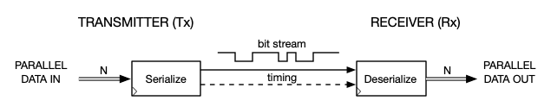
UART vs. USART?
Example: Want to transmit the letter 'E'. ASCII code for E is 69 (decimal) which is
01000101 in binary. This is the series of bits that'll be transmitted.
Decimal | Hexadecimal | Binary | Symbol
68 | 44 | 01000100 | D
69 | 45 | 01000101 | E
70 | 46 | 01000110 | F
Serial communication can be synchronous or asynchronous.
UART = Universal Asynchronous Receiver and Transmitter
USART = Universal Synchronous and Asynchronous Receiver and Transmitter
The Arm Cortex M0+ chip supports both synchronous and asynchronous communication (and much more). We'll only use the basic asynchronous mode for now.
Notes:
USART2 is the basic USART module, USART1 the full-fledged one. The basic one is more than enough for us. We use all the default settings, disabling most of the more advanced features:
Disable interrupts, FIFO mode
Word length 1 start bit, 8 data bits, 1 stop bit, oversampling by 16, parity control disabled

Slide 17
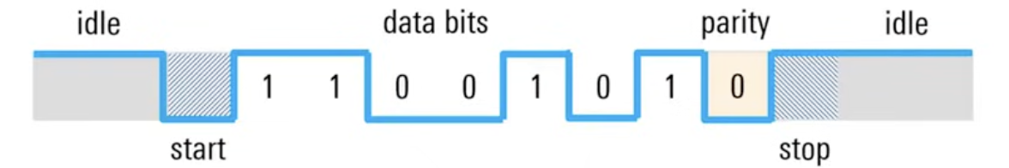
UART serial data format
T
Least significant bit sent first
Optional parity bit may be inserted between last data bit and stop bit
Typical rates are 9600 & 19200 bits/second: “9600 baud”, “19200 baud” but goes as high as 115,200 baud. Very slow, compared with “gigabit ethernet”.
Bit time T = 1/baud rate ≈ 104 µs at 9600 baud.
17.‹#›
Notes:
Engs 31 / CoSc 56 — Digital Electronics
‹#›
For UART: baud rate = bits/second since each bit transmits one symbol.
Historical note, Mars Sojourner/Pathfinder used 9600 baud for communication.
17. Serial communication

Slide 18
UART serial data format
T
IDLE
IDLE
0
0
1
1
0
1
0
0
1
1
1
START BIT (0)
d₀
(lsb)
d₁
d₂
d₃
d₄
d₅
d₆
d₇
(msb)
STOP BITS (1)
8 DATA BITS
OPTIONAL PARITY BIT MAY BE INSERTED BETWEEN d₇ AND STOP BIT
Typical rates are 9600 & 19200 bits/second: “9600 baud”, “19200 baud” but goes as high as 115,200 baud. Very slow, compared with “gigabit ethernet”.
Bit time T = 1/baud rate ≈ 104 µs at 9600 baud.
17.‹#›
Notes:
Engs 31 / CoSc 56 — Digital Electronics
‹#›
For UART: baud rate = bits/second since each bit transmits one symbol.
Historical note, Mars Sojourner/Pathfinder used 9600 baud for communication.
17. Serial communication

Slide 19
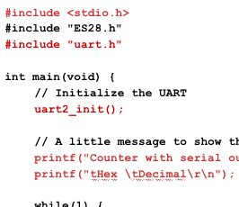
What happens when sender and receiver aren't on the same page?
Change the Baud rate in Coolterm and watch what happens when you run the counter code.
Change the Baud rate back to 9600 and ensure the counter is back to counting happily.
Now change the data bits to 6 and watch what happens.
Change the data bits back to 8 and watch the counter return to 'normal'.
Similarly, if you change stop bits, parity or other settings, the communication will fail.
Bottom line: Sender and receiver need to agree on these configurations.
All of these settings take place in uart2_init().
Today's goal: understand uart2_init() and sending/receiving data.

Slide 20
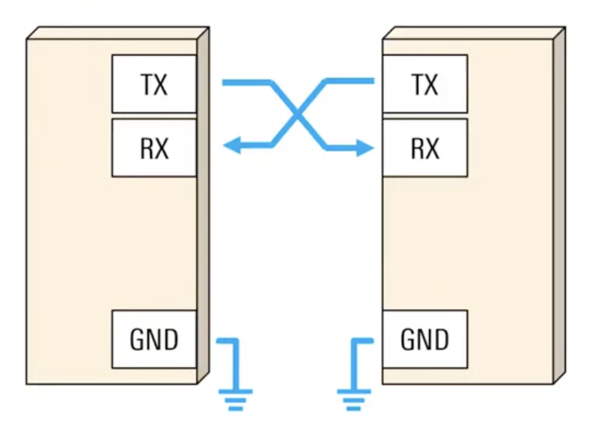
Steps to configure a UART
STM32C0 uart2
Device you are talking to
Set up the physical connection
Connect transmitter (TX) with receiver (RX) and vice versa
Configure the pins you are using for TX and RX:
Turn on the clock to their GPIO port(s)
Switch pins to the correct mode (alternate function mode)
Select the specific UART peripheral on those pins
Set up the communication essentials
Turn on the clock for the UART you are using
Set Baud rate (we'll use 9600)
Set Data bits, parity, start bits, stop bits (we'll go with the defaults)
Turn on the UART
Send / Receive data
Make sure the hardware is ready (check a status flag)
Write data to the send register / read data from the receive register

Slide 21
Setting up the physical connection
Connect transmitter (TX) with receiver (RX) and vice versa
Configure the pins you are using for TX and RX:
Turn on the clock to their GPIO port(s)
Switch pins to the correct mode (alternate function mode)
Select the specific UART peripheral on those pins

Slide 22
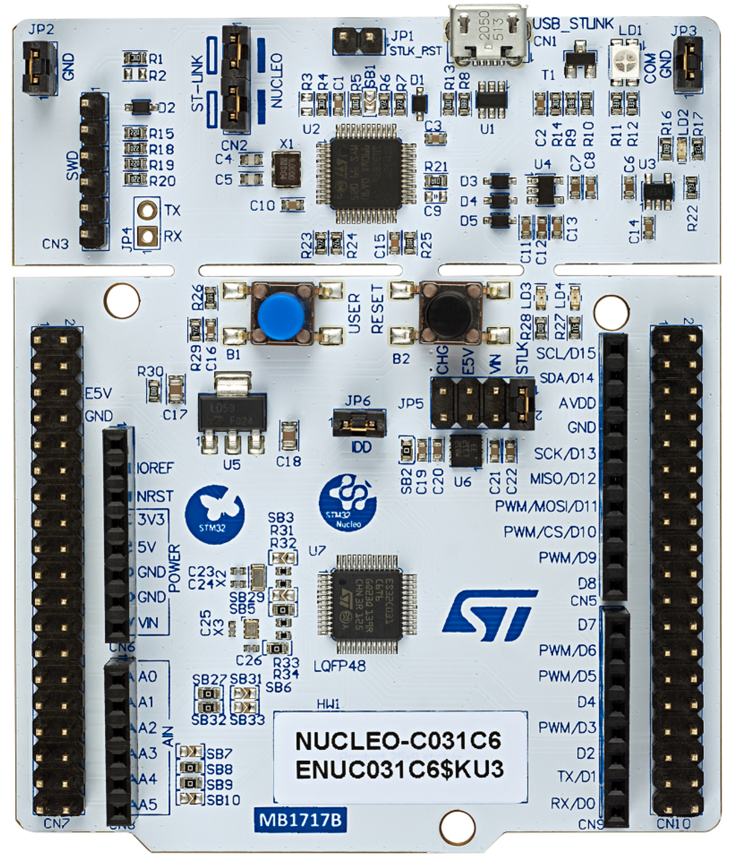
Setting up the physical connection: USB / serial conversion
USB Micro B port
Communication indicator light
Hardware: PA2 and PA3 of the STM32C0 are connected to PA2 and PA3 of the ST Link MCU.
Hardware: Two pins on the ST Link MCU are wired to the USB Micro B port
Software: The ST Link MCU handles communication with the host computer via the USB port.
to USB port
PA2
PA3
ST Link MCU
TX on PA2 RX on PA3
14
1
PA2 PA3
28
STM32C0 chip. USART2:
TX on PA2 RX on PA3

Slide 23
UART Interfaces on the STM32 Nucleo Board
The STM32C0 has two USART instances: USART1 and USART2.
USART1: Full feature set
USART2: Basic feature set (this is more than enough for us)
Both USART instances can be accessed via many different pins (on alternate function mode), but for each only one set of pins is connected via solder bridges to the ST-LINK MCU (a separate MCU on the board that handles USB communication between the Nucleo and your computer.) These are:
USART1:
TX on PB6
RX on PB7
USART2:
TX on PA2
RX on PA3
PA2 and PA3 are not accessible via the Arduino headers.
We'll use these pins for printf() statements.
Bottom line: We don't need to place any physical wires since the connections come pre-made on our board.

Slide 24
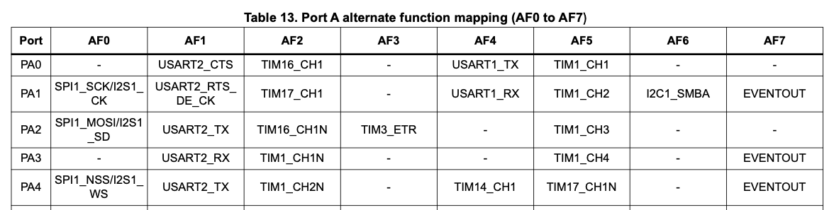
Where do you find pin numbers and such?
STM32 C0C31x User Manual

Slide 25
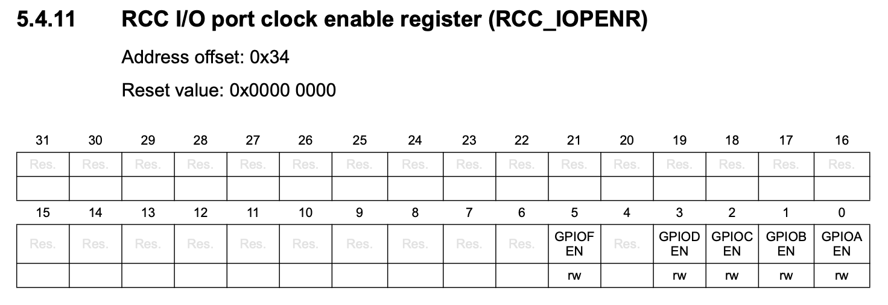
Setting Alternate Function Mode 1 for PA2 and PA3
Step 1: Enable clock access for GPIOA #define GPIOAEN (1U<<0) RCC->IOPENR |= GPIOAEN;
Shortcut: There are predefined macros!
Having to #define each bit we wish to modify is time consuming and not all that consistent.
Good news: The file stm32c031xx.h (which is one of the header files we downloaded as part of the Cube IDE installation) contains macros for all of these!
Example: Instead of #define GPIOAEN (1U<<0) RCC->IOPENR |= GPIOAEN;
we can simply write: RCC->IOPENR |= RCC_IOPENR_GPIOAEN;
How do you know the correct name to use?
Rule of thumb: REGISTERNAME_BITNAME

Slide 26
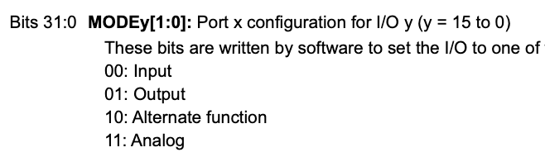
Setting Alternate Function Mode 1 for PA2 and PA3
Step 1: Enable clock access for GPIOA RCC->IOPENR |= RCC_IOPENR_GPIOAEN;
Step 2: Set port mode register GPIOA_MODER for PA2 and PA3 to Alternate Function. GPIOA->MODER &= ~GPIO_MODER_MODE2_Msk; //PA2 GPIOA->MODER |= (GPIO_ALTERNATE << GPIO_MODER_MODE2_Pos); //PA2
GPIOA->MODER &= ~GPIO_MODER_MODE3_Msk; //PA3
GPIOA->MODER |= (GPIO_ALTERNATE << GPIO_MODER_MODE3_Pos); //PA3

Slide 27
Setting Alternate Function Mode 1 for PA2 and PA3
Step 1: Enable clock access for GPIOA RCC->IOPENR |= RCC_IOPENR_GPIOAEN;
Step 2: Set port mode register GPIOA_MODER for PA2 and PA3 to Alternate Function. GPIOA->MODER &= ~GPIO_MODER_MODE2_Msk; //PA2 GPIOA->MODER |= (GPIO_ALTERNATE << GPIO_MODER_MODE2_Pos); //PA2
GPIOA->MODER &= ~GPIO_MODER_MODE3_Msk; //PA3
GPIOA->MODER |= (GPIO_ALTERNATE << GPIO_MODER_MODE3_Pos); //PA3
Step 3: Set Alternate Function Register GPIOA_AFR for PA2 and PA3 to AF1. Since each pin uses four bits here, there are actually two registers: GPIOA_AFRL for pins 0-7 and GPIOA_AFRH for pins 8-15. The first register is accessed via GPIOA->AFR[0], the second one via GPIOA->AFR[1].
GPIOA->AFR[0] &= ~GPIO_AFRL_AFSEL2_Msk; //PA2
GPIOA->AFR[0] |= GPIO_AF1 << GPIO_AFRL_AFSEL2_Pos); //PA2
GPIOA->AFR[0] &= ~GPIO_AFRL_AFSEL3_Msk; //PA3
GPIOA->AFR[0] |= GPIO_AF1 << GPIO_AFRL_AFSEL3_Pos); //PA3

Slide 28
Setting up the communication essentials
Turn on the clock for the UART you are using
Set Baud rate (we'll use 9600)
Set Data bits, parity, start bits, stop bits (we'll go with the defaults)
Turn on the UART

Slide 29
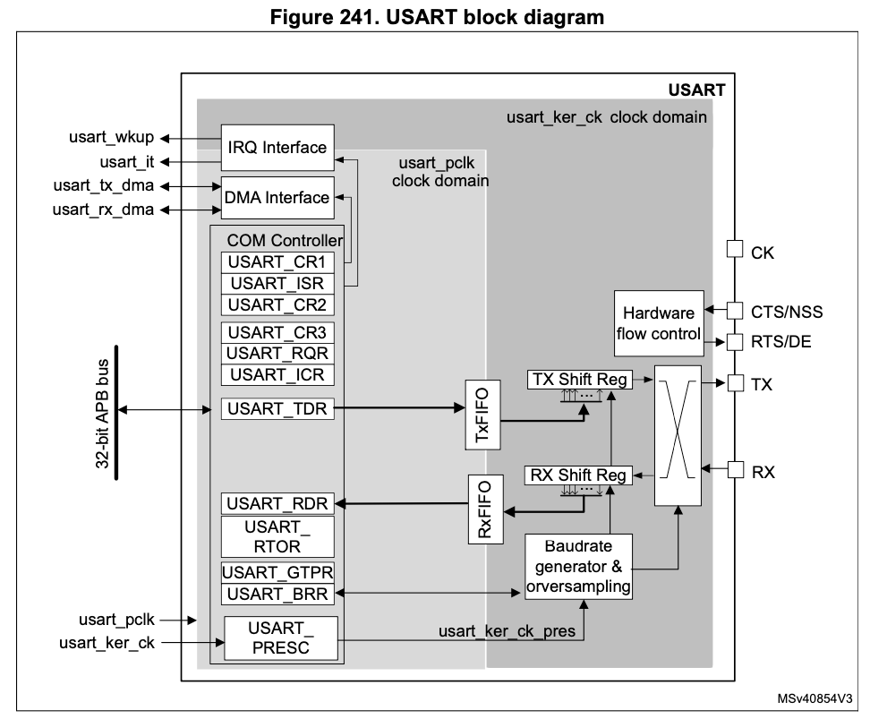
USART hardware in the STM32C0
USART control/status registers
Set operating modes, read status flags
TX shift register
Takes in 8 bits in at once (parallel)
Sends bits out one at a time (serial)
APB bus
Date is sent to the USART module via the APB (advanced peripheral bus)
Clock Generator
Not used in asynchronous mode
TX data register
Write a byte to this register to send
pins
RX data register
Retrieve a received byte here
RX shift register
Takes bits in one at a time (serial)
Sends 8 bits out at once (parallel)
USART baud rate register
Set baud rate

Slide 30
Scavenger Hunt
In the Reference manual, find the section that describes the USART registers. Find Control Register 1 and determine which bits need to be set to what values to achieve:
Function | Bit | Name | Value
Oversampling by 16
1 start bit, 8 data bits
Enable transmitter
Enable receiver
Enable USART
IF you are done early, can you figure out which register turns on the clock for devices on the APB bus?
Which bit in that register turns on the clock for USART2?
Notes:
24.8 is the section about USART registers. We are using the USART in non-FIFO mode.

Slide 31
Scavenger Hunt
In the Reference manual, find the section that describes the USART registers. Find Control Register 1 and determine which bits need to be set to what values to achieve:
Function | Bit | Name | Value
Oversampling by 16 | 15 | OVER8 | 0
1 start bit, 8 data bits | 12, 28 | M1, M0 | 00
Enable transmitter | 3 | TE | 1
Enable receiver | 2 | RE | 1
Enable USART | 0 | UE | 1
IF you are done early, can you figure out which register turns on the clock for devices on the APB bus? RCC_APBENR1
Which bit in that register turns on the clock for USART2? Bit 17 (USART2EN)
Notes:
24.8 is the section about USART registers. We are using the USART in non-FIFO mode.

Slide 32
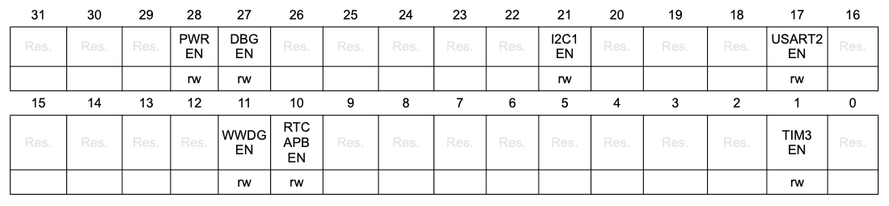
Enable Clock Access to USART
Before doing anything else we need to enable clock access to the USART module.
The USART module is on the APB bus.
So we need to turn on USART2 in RCC_APBENR1:
RCC->APBENR1 |= RCC_APBENR1_USART2EN;
RCC APB peripheral clock enable register 1 (RCC_APBENR1)

Slide 33
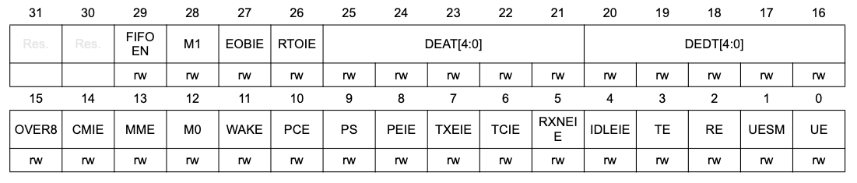
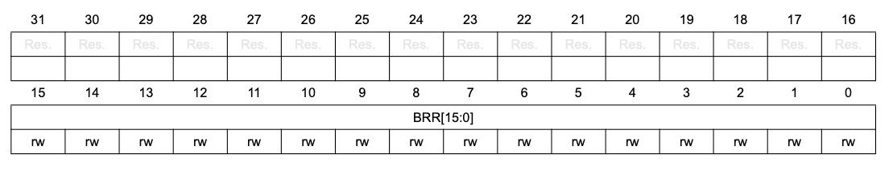
Setting up the communication essentials
USART control register 1 (USART_CR1)
Enable transmission
Enable USART
We can ignore most bits or leave them as zero.
Enable reception
USART baud rate register (USART_BRR)
Set baud rate
Notes:
And many other registers that we won't need to touch. We are using non FIFO mode.
Should we point out any kind of interrupt we may be using later?

Slide 34
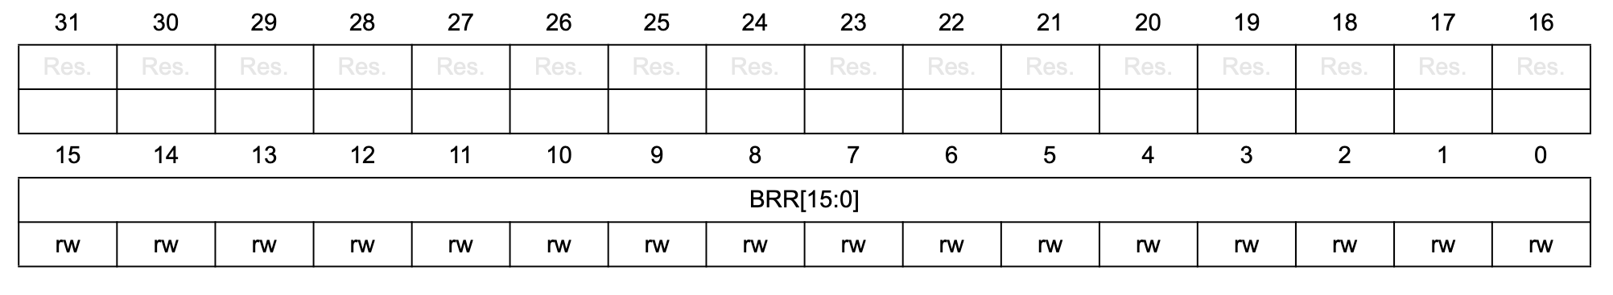
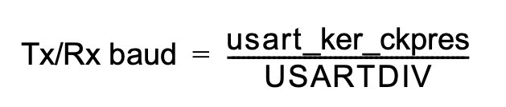
The Baud Rate Register
USART_BRR
Unused (reserved)
Determines the divisor USARTDIV for the system clock that's clocking the APB bus in order to achieve the desired baud rate.
This divisor is what's written in the Baud Rate Register.
Formula (for asynchronous mode, with oversampling by 16):
What's the number we should put into USART_BRR for a baud rate of 9600?
12 MHz (standard clock - scaled down by factor 4 from the 48 MHz oscillator)
We'll use 9600 bd.
This goes into BRR.
Notes:
12 * 10^6 / 9600 = 1250

Slide 35
The Baud Rate Register
USART_BRR
Unused (reserved)
Determines the divisor USARTDIV for the system clock that's clocking the APB bus in order to achieve the desired baud rate.
This divisor is what's written in the Baud Rate Register.
Formula (for asynchronous mode, with oversampling by 16):
What's the number we should put into USART_BRR for a baud rate of 9600?
12,000,000 / 1250 = 9600, so in code:
USART2->BRR = 1250;
12 MHz (standard clock - scaled down by factor 4 from the 48 MHz oscillator)
We'll use 9600 bd.
This goes into BRR.
Notes:
12 * 10^6 / 9600 = 1250

Slide 36
The Baud Rate Register
USART_BRR
Unused (reserved)
USART2->BRR = 1250;
This accomplishes our goal of setting the baud rate to 9600 at a processor speed of 12 MHz. But… bad style! Avoid magic numbers!
Better:
#define SYS_FREQ 12000000U // standard clock
#define APB_CLK SYS_FREQ // No additional prescaling
#define UART_BAUD_RATE 9600
USART2->BRR = (APB_CLK + (UART_BAUD_RATE/2U))/UART_BAUD_RATE;
This formula computes round(APB_CLK / UART_BAUD_RATE) (add 1/2 and truncate) - slightly nicer than plain integer division.

Slide 37
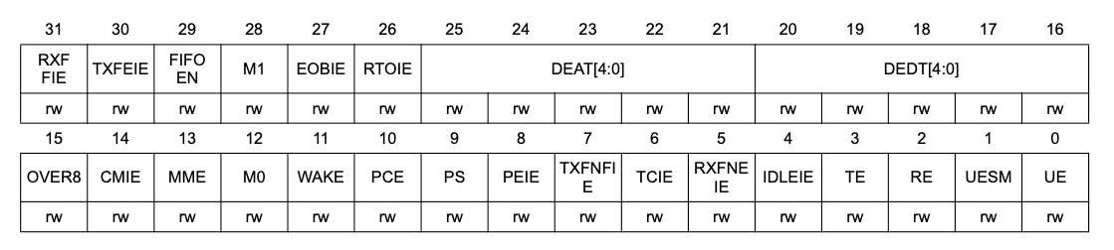
Enable Receiver and/or Transmitter
Next Initialization Step:
Now that we have the BAUD rate under control, we need to enable the receiver and/or transmitter.
USART control register 1 (USART_CR1):
USART2->CR1 = USART_CR1_RE | USART_CR1_TE;
And the very last step:
USART2->CR1 |= USART_CR1_UE;

Slide 38
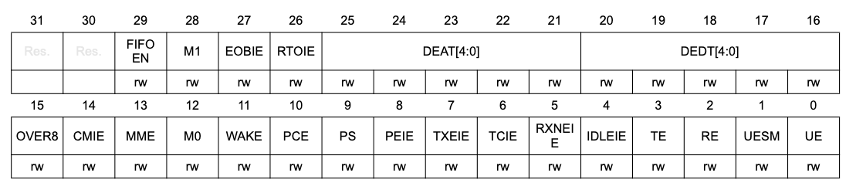

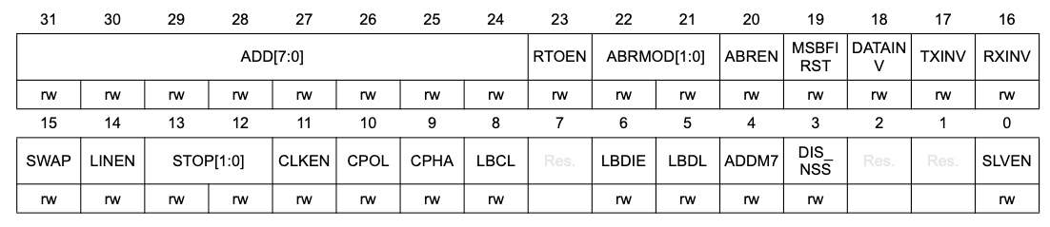
Summary: Initializations
USART control register 1 [alternate] (USART_CR1)
0 selects oversampling by 16
00 selects 1 start bit, 8 data bits
0 disables parity control
1 enables transmitter
1 enables receiver
1 enables UART
00 selects 1 stop bit
USART control register 2 (USART_CR2)

Slide 39
Summary: Initializations
Recall: To send a byte, the transmitter sends…
Start bit(s) (a zero)
Data bits (LSB first, MSB last)
Parity bits (optional for error detection - we won't be using those for now)
Stop bit(s) (a one)
By accepting the defaults in CR1 and CR2, we select:
1 Start bit
8 Data bits
1 Stop bit
No parity bits
Oversampling by 16

Slide 40
Initialization - Summary
#define SYS_FREQ 12000000U // standard clock HSISYS
#define APB_CLK SYS_FREQ // No additional prescaling
#define UART_BAUD_RATE 9600
void uart2_init(void) {
RCC->IOPENR |= RCC_IOPENR_GPIOAEN; //enable clock access to gpioa
//set PA2 (rx) mode to alternate function mode
GPIOA->MODER &= ~GPIO_MODER_MODE2_Msk);
GPIOA->MODER |= (GPIO_ALTERNATE << GPIO_MODER_MODE2_Pos);
// set PA3 (tx) mode to alternate function mode
GPIOA->MODER &= ~GPIO_MODER_MODE3_Msk);
GPIOA->MODER |= (GPIO_ALTERNATE << GPIO_MODER_MODE3_Pos);
// set PA2 alternate function type to AF01 which is mapped to UART_TX for PA2
GPIOA->AFR[0] &= ~GPIO_AFRL_AFSEL2_Msk);
GPIOA->AFR[0] |= (GPIO_AF1 << GPIO_AFRL_AFSEL2_Pos);
// set PA3 alternate function type to AF01 which is mapped to UART_RX for PA3
GPIOA->AFR[0] &= ~GPIO_AFRL_AFSEL3_Msk;
GPIOA->AFR[0] |= (GPIO_AF1 << GPIO_AFRL_AFSEL3_Pos);
RCC->APBENR1 |= RCC_APBENR1_USART2EN; // enable clock access to uart2
uart_set_baudrate(USART2, APB_CLK, UART_BAUD_RATE); // configure baudrate
USART2->CR1 = USART_CR1_RE | USART_CR1_TE; // enable transmitter and receiver
USART2->CR1 |= USART_CR1_UE; // enable uart module
}

Slide 41
Send / Receive Data
Make sure the hardware is ready (check a status flag)
Write data to the send register / read data from the receive register

Slide 42
Sending/Receiving Data
Sending is easy: Just shift bits out of the TX shift register at the baud rate.
Receiving is harder (UART): No clock to synchronize the bit stream!
IDLE
START LSB
MSB STOP
IDLE
0
0
1
1
0
1
0
0
1
1
…
Solution (clock recovery):
Sample the incoming signal at 16× the agreed-upon baud rate (oversampling)
Watch for the start bit (always a 1-0 transition)
Count 8 clocks to the middle of the start bit, shift it into the RX shift register
Sample the signal every 16 clocks after that
Also see: http://en.wikipedia.org/wiki/Universal_asynchronous_receiver/transmitter
17.‹#›
Notes:
Engs 31 / CoSc 56 — Digital Electronics
‹#›
17. Serial communication

Slide 43
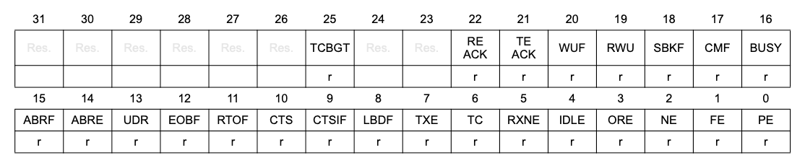
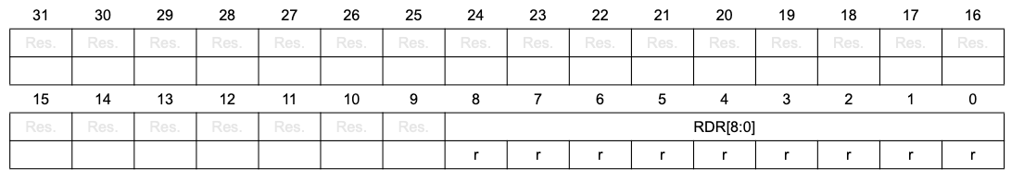
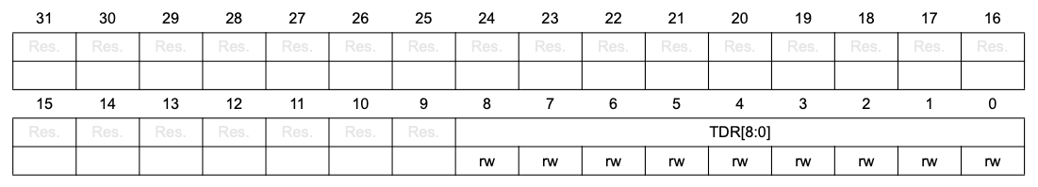
Receiving and Transmitting Data
Transmit data register empty (bit is set when USART_TDR is empty)
Read data register not empty (bit is set there is data in USART_RDR)
The hardest part is done: the rest is easy:
Check appropriate bit in USART_ISR (USART interrupt and status register) to make sure hardware is ready:
Write target byte to USART_TDR (USART transmit data register) or read byte from USART_RDR (USART receive data register).

Slide 44
Transmitting and Receiving Data
void uart2_write(int ch) {
/* Make sure the transmit data register is empty */
while(!(USART2->ISR & USART_ISR_TXE_TXFNF)){} // Block until transmitter ready
/* Write to transmit data register */
USART2->TDR = (ch & 0xFF); // restrict to 8 bit
}
int uart2_read() {
/* Make sure the receive data register is non-empty */
while(!(USART2->ISR & USART_ISR_RXNE_RXFNE)){}
/* Return data register */
return(USART2->RDR & 0xFF);
}
To see what the processor is transmitting to your computer you need to run a terminal application. The application depends on your operating system. Compile and flash your program.
These functions are blocking. The main program is made to wait until the Tx buffer is empty or the Rx buffer is full.
Open CoolTerm and load the ENGS28 settings, adjusting the Port if necessary.
Click "Connect".

Slide 45
Transmitting and Receiving Data
void uart2_write(int ch);
int uart2_read();
To transmit a string such as 'Hi' you would simply use: uart2_write('H'); uart2_write('i');
To start a new line: uart2_write(10); uart2_write(13);
To transmit (the ASCII code of) a single-digit number num: uart2_write('0' + num);
To receive (the ASCII code of) a keypress: key = uart2_read();
Dec Char Dec Char Dec Char Dec Char --------- --------- --------- ---------- 0 NUL (null) 32 SPACE 64 @ 96 ` 1 SOH (start of heading) 33 ! 65 A 97 a 2 STX (start of text) 34 " 66 B 98 b 3 ETX (end of text) 35 # 67 C 99 c 4 EOT (end of transmission) 36 $ 68 D 100 d 5 ENQ (enquiry) 37 % 69 E 101 e 6 ACK (acknowledge) 38 & 70 F 102 f 7 BEL (bell) 39 ' 71 G 103 g 8 BS (backspace) 40 ( 72 H 104 h 9 TAB (horizontal tab) 41 ) 73 I 105 i 10 LF (NL line feed, new line) 42 * 74 J 106 j 11 VT (vertical tab) 43 + 75 K 107 k 12 FF (NP form feed, new page) 44 , 76 L 108 l 13 CR (carriage return) 45 - 77 M 109 m 14 SO (shift out) 46 . 78 N 110 n 15 SI (shift in) 47 / 79 O 111 o 16 DLE (data link escape) 48 0 80 P 112 p 17 DC1 (device control 1) 49 1 81 Q 113 q 18 DC2 (device control 2) 50 2 82 R 114 r 19 DC3 (device control 3) 51 3 83 S 115 s 20 DC4 (device control 4) 52 4 84 T 116 t 21 NAK (negative acknowledge) 53 5 85 U 117 u 22 SYN (synchronous idle) 54 6 86 V 118 v 23 ETB (end of trans. block) 55 7 87 W 119 w 24 CAN (cancel) 56 8 88 X 120 x 25 EM (end of medium) 57 9 89 Y 121 y 26 SUB (substitute) 58 : 90 Z 122 z 27 ESC (escape) 59 ; 91 [ 123 { 28 FS (file separator) 60 < 92 \ 124 | 29 GS (group separator) 61 = 93 ] 125 } 30 RS (record separator) 62 > 94 ^ 126 ~ 31 US (unit separator) 63 ? 95 _ 127 DEL
See also http://www.asciitable.com/

Slide 46
Some more useful functions...
While it's nice to be able to transmit one byte at a time, we may want to print a string using a loop rather than having to print each individual character. For example:
void printString(const char myString[]) { int i = 0; while (myString[i]) { //until NUL detected
uart2_write(myString[i]); i++; } }
However, stdio.c supplies the nano printf library that allows you to use printf() with format specifiers just as you would in regular C-programming (except for floats.)
While it's possible to redirect uart2_write() and uart2_read() so as to play along with the regular stdio and printf(), this would waste a tremendous amount of memory. That's why we choose to use the nano version.

Slide 47
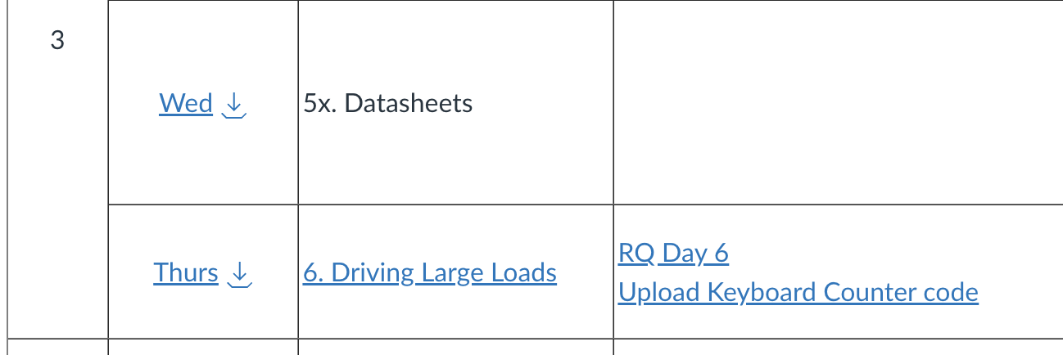
Homework for Thursday: Keyboard-Controlled Counter
Create a counter that starts at 0 and counts up by one every time 'u' or 'U' is pressed on the keyboard and down by one every time 'd' or 'D' is pressed. Other key presses should be ignored.
Counter should include negative values if you decrement below 0. Use the int8_t datatype for your counter: this is an integer that is only 8 bit wide.
Begin with the template on the next slide.
Testing:
Simple increment and decrement
Decrement below 0 to confirm negative numbers
Increment all the way to the maximum value, and beyond. What do you observe?
You will need to submit your code before class on Thursday.

Slide 48
Exercise template (adapt counter.c)
#include <stdio.h>
#include "ES28.h"
#include "uart.h"
int main(void) {
uart2_init(); // Initialize the UART
printf("Keyboard-controlled up-down counter\r\n");
while(1) {
// read a character (uart2_read()) from the keyboard
// if key is 'u' or 'U', increment the counter and print the value
// else if key is 'd' or 'D', decrement the counter and print the value
// else do nothing
}
return 0;
}
Challenge: If this is too easy for you, write this code without the use of printf(). Only use uart2_write() instead. Be sure to display negative numbers correctly.

