Slide 1


Engs 28
Embedded Systems
Day 5x

Slide 2
Pick a name for your table group!
Brainstorm a team name
Let your LF know your group name

Slide 3
Inputs and Outputs to an
Embedded System

Slide 4
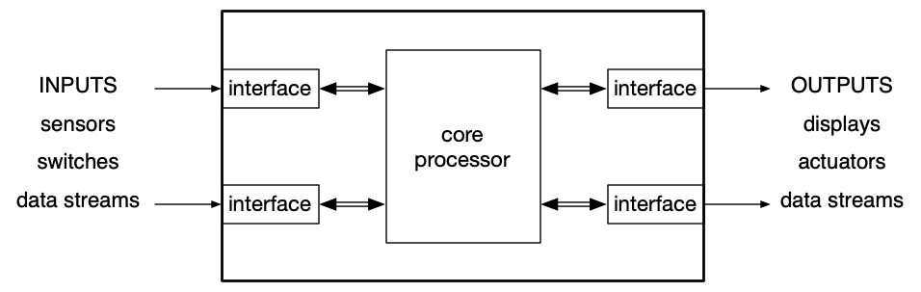
Top-level embedded system view
Notes:
Inputs measure things in the physical world. The interface converts these inputs into numbers that can be processed by the core processor. These then are converted via the right-hand interface to physical signals that are necessary to drive the output.
Already talked about switches. Data stream could be something coming in on the UART. Sensors coming up (such as temperature, force, etc)
Interface: could be UART, gpio register; inside core processor you have device drivers that get data into the processor and push it out.
Actuators could be motors; displays could be 7-segment display like at a gas pump, data stream could be UART, etc.

Slide 5
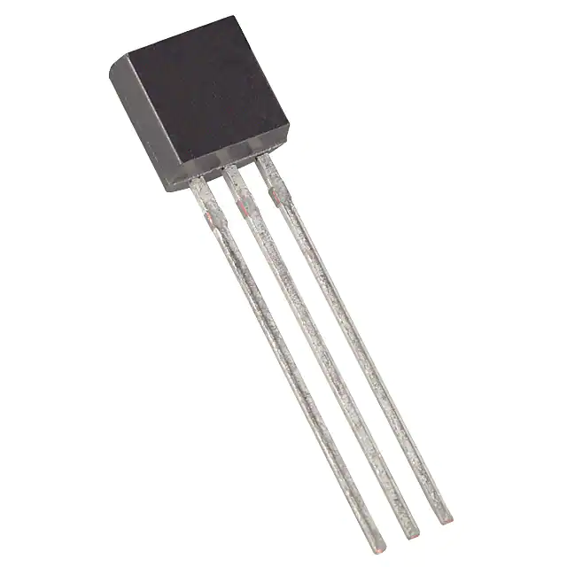
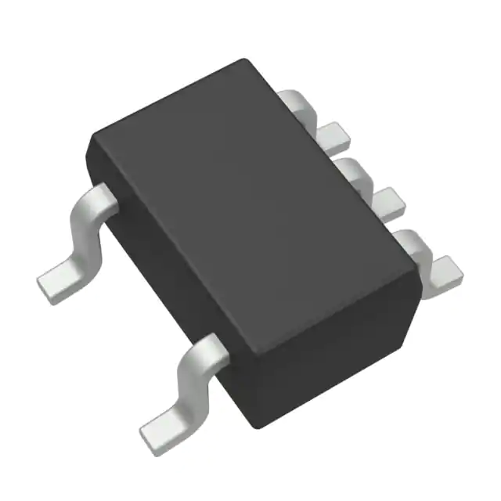
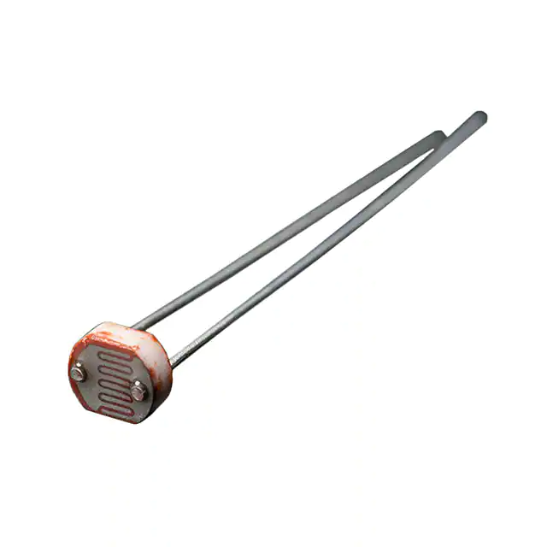
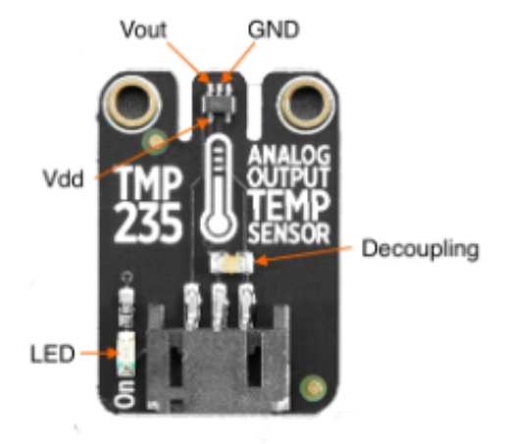
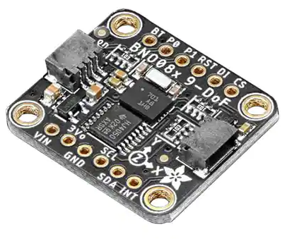
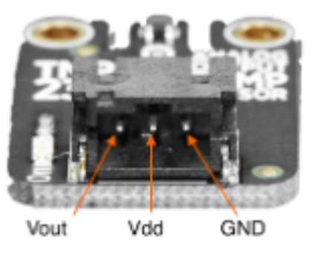
Input Component Examples
Temperature sensor tmp36
CdS photocell
Temperature sensor tmp235
Accelerometer LSM303AGR
Notes:
Don't need to know the details of how the sensor works. The datasheet gives you everything you need to know. It's your programmer's interface to the sensor.
Next week's lab (lab 4): You may have noticed while reading the datasheet that the TMP235 is packaged exclusively as a surface
mount device (SMD). Since we cannot place any SMD components on a breadboard, we are using a small
module (circuit board) which contains the TMP235, and some decoupling capacitance. It also uses a small
connector for easy access to the IO of the device (Vdd, GND, and Vout). Details of this module can be found in
Figure 1 and Figure 2. The connector is keyed, which means it can only be inserted in one orientation. In our
case, the Red wire connects to +5V, the Black wire connects to GND, and the White wire is the analog signal.

Slide 6
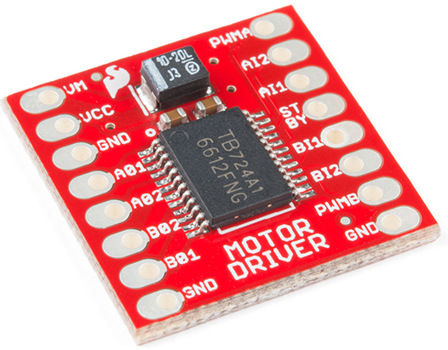
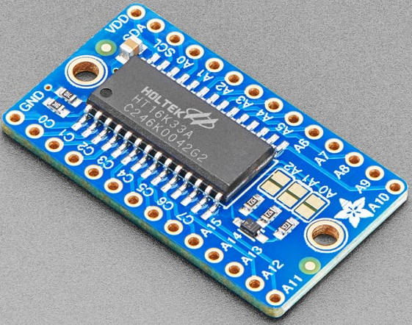
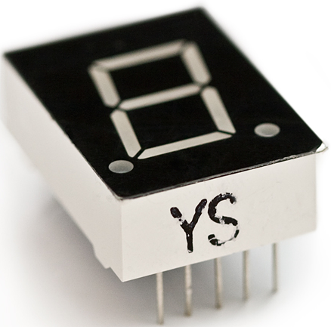
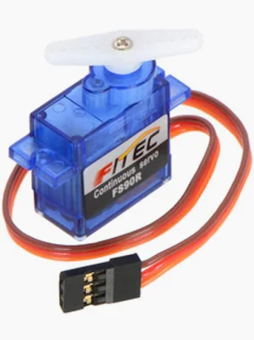
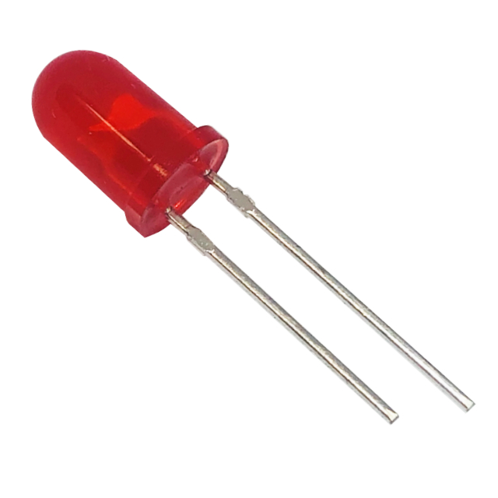
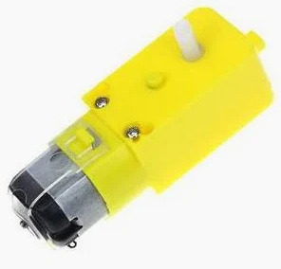
Output Component Examples
Motor Driver TB6612FNG
7-segment display YSD-160AR4B-8
LED Matrix Driver Backpack HT16K33
LED
L513SRD-C
Servomotor
DC motor

Slide 7
Typical sensor signal chain
physical
quantity
voltage
voltage
integers
World
Sensor
AFE
ADC
MCU
Sensor = Mechanism that translates one physical variable into another
AFE = Analog front end: Amplify, reduce noise (a.k.a. signal conditioning)
ADC = Analog to digital converter
MCU = Microcontroller unit (i.e., our STM32C031C6)
Many sensors are “bare” (example: thermocouple, phototransistor, force-sensitive resistor)
Often, the sensor you buy has the AFE built in (example: TMP235 temperature sensor)
Often, the sensor you buy has the AFE and the ADC built in, and a serial communication interface. (example: LSM303AGR accelerometer / magnetometer)
Usually, the MCU has an ADC built in (ours does).
Notes:
You don't just take a sensor and plug it into your microcontroller. There are some additional steps involved. That's called the sensor signal chain.
Some physical quantity you wish to measure (temperature, pressure, illumination, etc). Sensor converts the quantity to voltage. Analog front end conditions this voltage to make it compatible with the input of the analog-to-digital converter (scale, etc). ADC converts voltage to a number (voltage to 8-bit integer, voltage to 10-bit integer, etc).
How all this happens really varies. All steps happen, but where and how depends on the situation. Voltage coming out of sensor might be super feeble (for example on the order of mV) and needs to be boosted up so that it lives in the range (eg 0-3.3V) of the ADC. AFE also removes noise voltage that might be superimposed on the signal.
Bare sensor take physical quantity and make it into voltage - don't contain any AFE, etc.

Slide 8
Interfacing with Input and Output Components
Aka Reading a Data Sheet
Note: Microcontrollers, such as our STM32C031C6, also have datasheets. That's where we found the registers for the USART module!
Here, we'll focus on sensors and actuators.

Slide 9
Datasheets
Datasheets are the roadmap to a sensor or an actuator (or a chip for that matter).
Every circuit part has a data sheet (even a resistor!)
Datasheets are packed densely with information.
Datasheets can be intimidating.
Reading datasheets requires patience.
Datasheets vary between component types and manufacturers.
"In some ways, reading a datasheet is like coming into the middle of a technical conversation." (Elicia White, Embedded Software Engineer)

Slide 10
Datasheet HiTA Activity
As a table group, please complete the "Learn to read datasheets" activity in HiTA. HiTA will pick one of these datasheets for your activity:
Accelerometer
Temperature sensor
Real Time Clock
Hall Effect
Humidity sensor
After HiTA tells you which datasheet you'll be working with, open it up and display it on your projector. There are links to all datasheets on our Canvas front page.

Slide 11
Summary - Datasheets: The Hardware Side
First page typically shows at least:
Features
Description - ALWAYS READ THIS
Most parts then have:
If a pin has a star next to it or a line over the name, it means that the pin is active low.
You'll pull the pin low (0V) to activate it, rather than high (VCC)
Pinout
Electrical characteristics
Absolute maximum ratings
Packaging information
Recommended operating conditions
Some parts follow with performance characteristics, timing diagrams, example schematics.
At the end of many datasheets is packaging information (dimensions of the packages a part is available in).

Slide 12
Datasheets: Interfacing With The Component
Look for a section "Application Information" or "Theory of Operation" or "Detailed Description" or some such thing about halfway through the datasheet.
Read this section carefully.
Mark areas that may be relevant for your code.
Analog sensors will output a voltage that you'll need to interpret.
Digital sensors will communicate, via a protocol, some information that you'll need to read and interpret.
Analog actuators need to be sent a specific voltage in order to perform a specific task.
Digital actuators need to receive information, via a protocol, with instructions.
Pay particular attention to:
How to connect your component to a microcontroller
How to read its output, or send signals to it
How to calibrate it, etc.

Slide 13
Create one slide for your component
Include on your slide:
Your component's name, model number and manufacturer
A brief description of your component
How to connect your component to a microcontroller
How to communicate with your component
Anything else that seems crucial to include
Put your group's slide here.
Notes:
https://docs.google.com/presentation/d/109jjnZt3cRDWa39WyZQnE8f4yMVMaPOXCAFd1Bw1uCw/edit?usp=sharing

Slide 14
Find a Datasheet

Slide 15
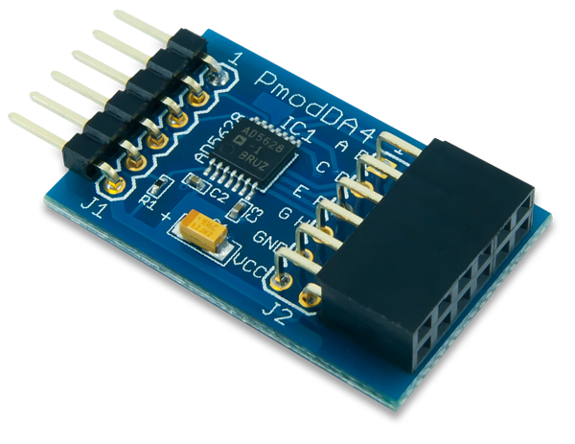
Find the datasheet for the device your table is given.
What is the absolute maximum power supply voltage (VDD or VCC) that can be applied to the part?

