Slide 1
ENGS 28
Datasheet Activity

Slide 2
Create one slide for your component
Include on your slide:
Your component's name, model number and manufacturer
A brief description of your component.
How to connect your component to a microcontroller
How to communicate with your component
Anything else that seems crucial to include

Slide 3
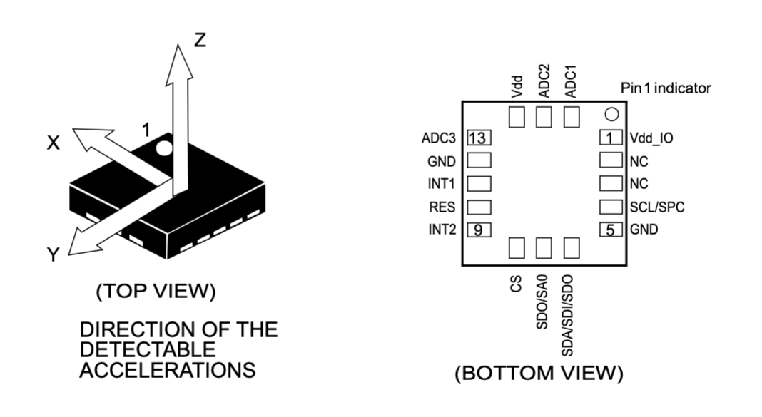
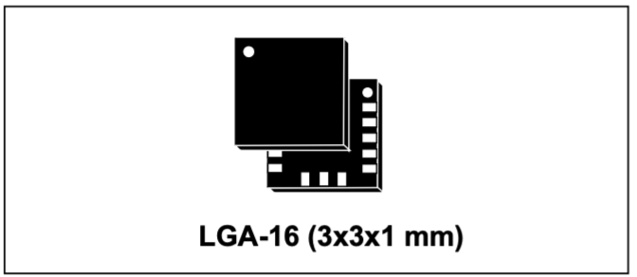
ST Microelectronics LIS3DH MEMS digital output motion sensor:
ultra-low-power high-performance 3-axis "nano" (Lab 7: accelerometer)
Brief description: I²C / SPI Linear accelerometer (x,y,z axis)
An accelerometer is a sensor that measures acceleration, which is often used to detect an object's motion, orientation, and vibration.
How to connect your component to a microcontroller:
Set up a I²C or SPI bus
How to communicate with your component: Digitally over an I²C or SPI bus
Anything else crucial: Has a self test function

Slide 4
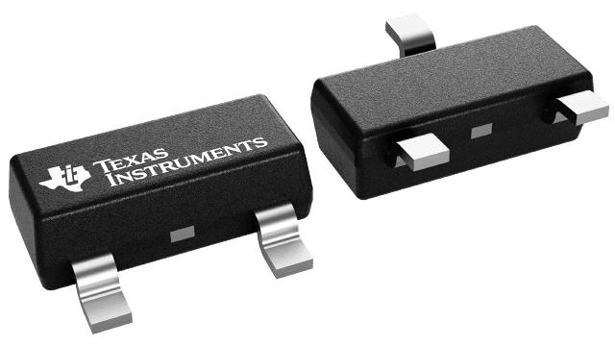
TMP23X Temperature Sensor, manufactured by Texas Instruments
A brief description of your component : Integrated circuit linear output V proportional to the temperature ( -40C - 150C). 10mV per C
How to connect your component to a microcontroller: You can connect the sensor to the ADC on the microcontroller. It might need a capacitor and resistor (for noise) depending on the ADC’s input characteristics
The output of the device is an output voltage
Anything else that seems crucial to include: Analog In Pins: A0-A5, D10-13, D4
MBRH

Slide 5
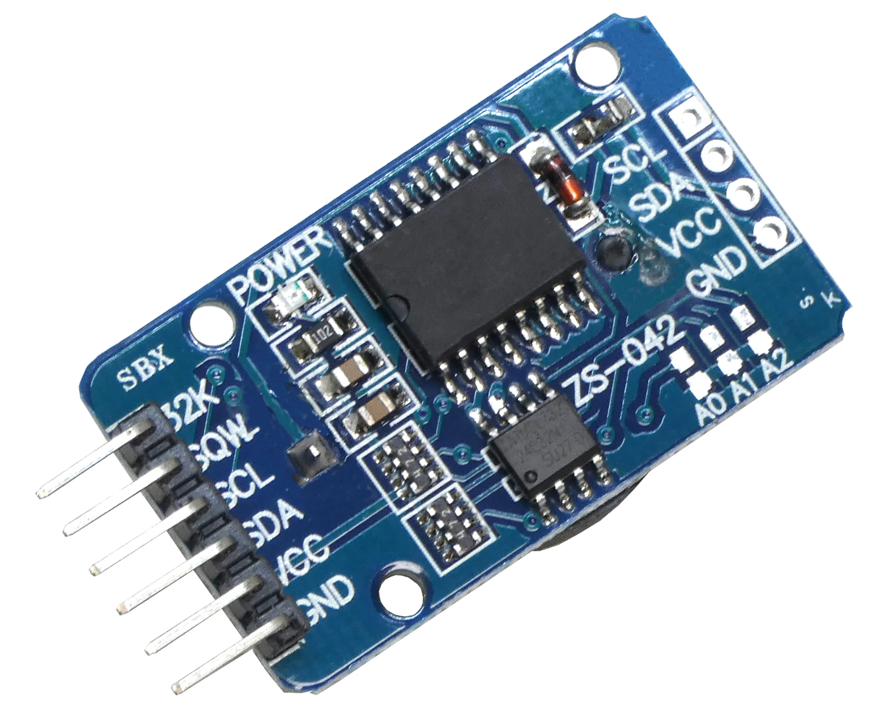
DS3231 Real Time Clock by Maxim Integrated – Team East
Has an integrated temperature compensated crystal oscillator (TCXO)
Drives the clock and makes it accurate over a long period of time
Low cost, extremely accurate I2C real-time clock
Inter-Integrated Circuit (I2C bus)
Syncs data movement for serial communication (Pin 16 SCL- serial clock input)
Requires external pullup resistor (Pin 15 SDA- serial data input/output)
Has a temperature sensor with accuracy of +/- 3 deg C

Slide 6
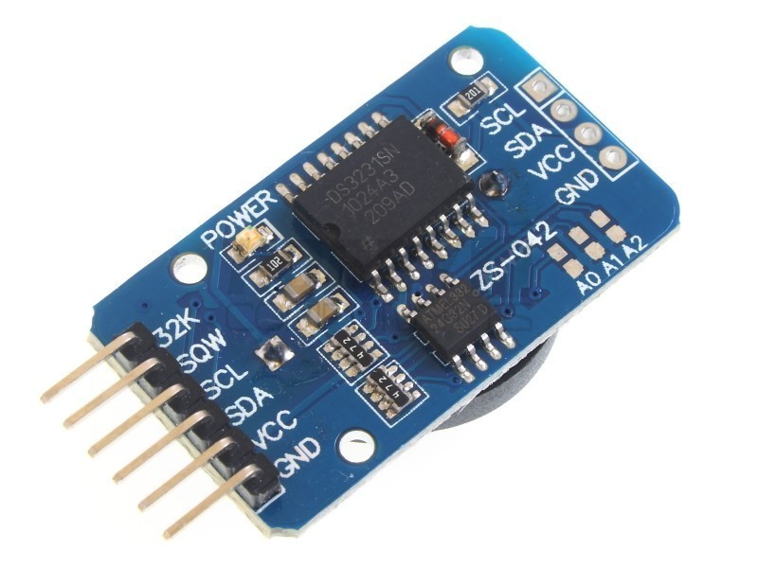
DS3231 Real Time Clock (Maxim Integrated)
ENGS 28 Table 5
Low-cost, extremely accurate real-time clock based on an integrated temperature-compensated crystal oscillator (TCXO)
Can add up to two alarms, as well as 12h vs 24h clock
Automatically handles number of days in month, and for leap years
Additionally, provides temperature information
One byte of integer information, two-complement
Two bits for fractional degrees, to nearest quarter degree
Connect with serial communication to MCU with I²C
Clock is pin 16, data is pin 15
Allows user to manually slow or speed up oscillator
However, slowing or speeding oscillator will result in dramatically reduced accuracy (up to +/- 40ppm)

Slide 7
PAPA’S BOYS
Component Name: MEMS digital output motion sensor: ultra-low-power high-performance 3-axis "nano" accelerometer
Model Number: LIS3DH
Manufacturer: life.augmented
Description of your component: Low-power high-performance accelerometer; capable of measuring accelerations with output data rates from 1 Hz to 5.3 kHz
How to connect your component to a microcontroller: Connect through the I2C and SPI serial interfaces
How to communicate with your component: With the I2C and/or SPI data busses
Can manage accelerations up to 10000 g for 0.2 ms

Slide 8
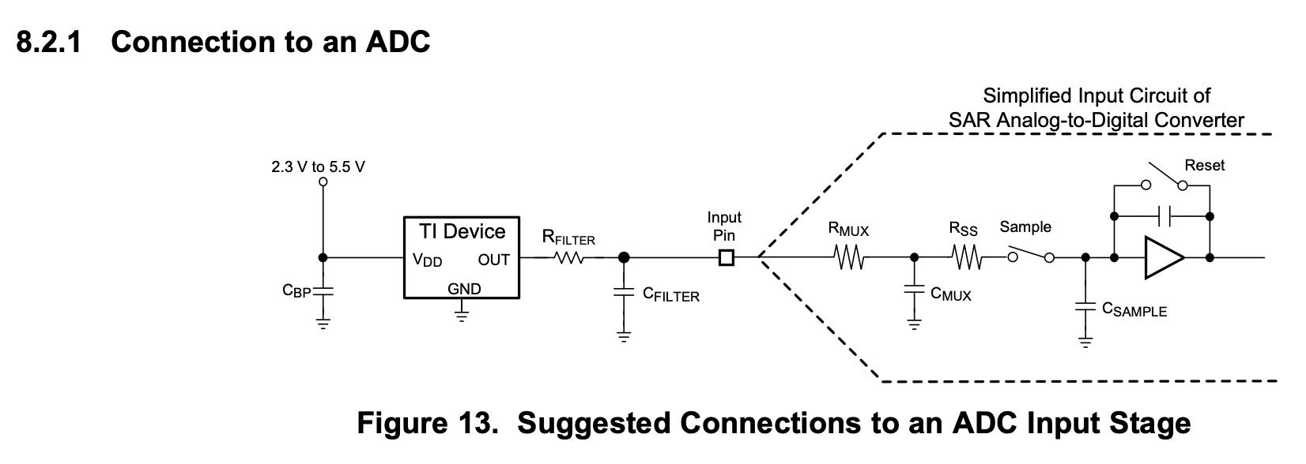
TMP23x Analog Output Temperature Sensor- Texas Instruments
International Gurus
Low-Power, High-Accuracy Analog Output Temperature Sensors
Output of voltage linearly proportional to temperature
Output of the sensor is 10mV per degrees C
Output voltage offset at 0 °C is 500 mV
Measures from -40 to 150 degrees celsius
-40 to 150 degrees celsius for the TMP 235 and -10 to 125 celsius for the TMP236

Slide 9

DS3231 Real Time Clock - Blinky Group
Description: Tracks current date and time, down to the second.
Manufacturer: Maxim Integrated
Protocol: I²C
Connect to microcontroller with serial I²C
Bonus fact: Includes internal temperature sensor and can run on internal battery in the event of power failure
Temperature-compensated crystal oscillator (TCXO

Slide 10
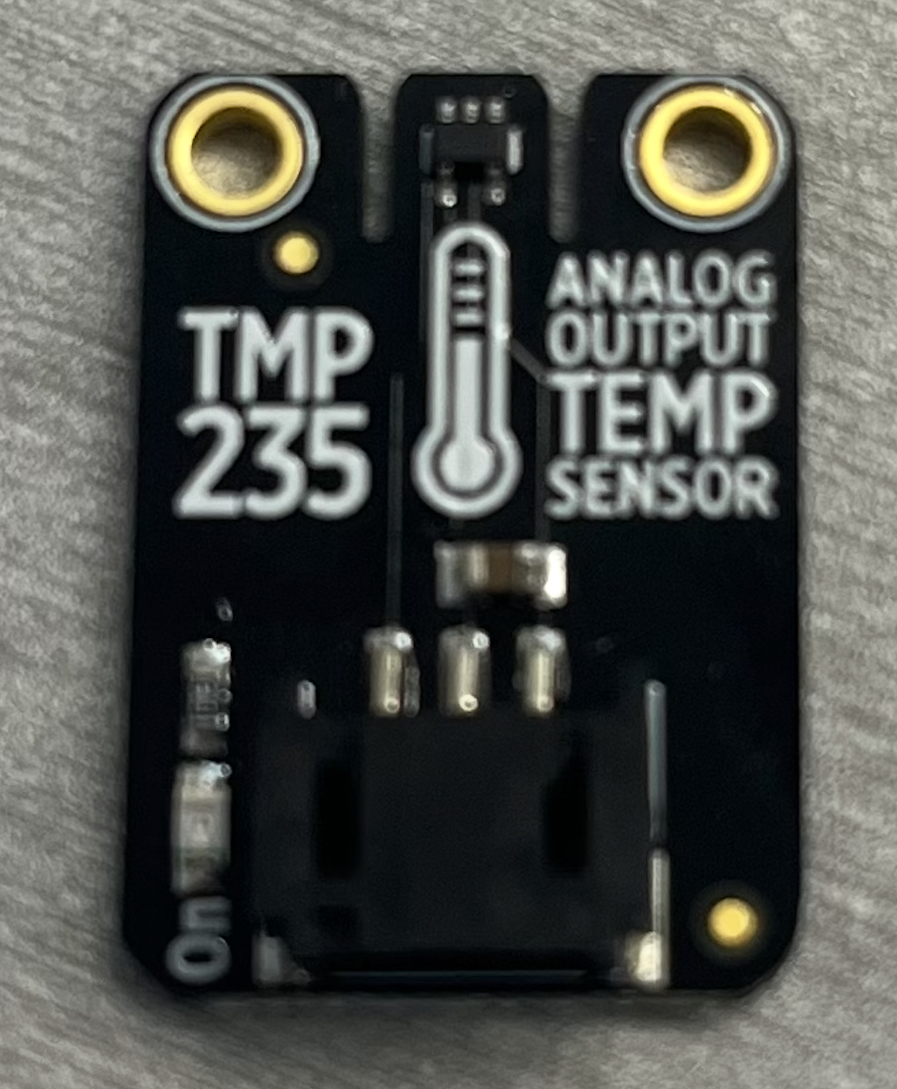
TMP23x Analog Output Temperature Sensor - Team MMOSS
Part number: TMP235/6
manufacturer: Texas Instruments
Returns an analog voltage output that is linearly proportional to the temperature sensed.
Connect pin Vdd to a power output pin on controller, pin Vout to an input pin on microcontroller, and pin GND to ground.
After passing output voltage through ADC, apply given temp/voltage relationship to output voltage to obtain actual value (10 mV/°C).

