Slide 1


Engs 28
Embedded Systems
Day 7

Slide 2
Instructor Notes
Multiple students connected their power rail to NRST instead of 3.3v (they are adjacent) The symptoms are a libusb error when trying to connect to the debugger.
One student had a corrupted project which was actually building blinky and running it (symptoms were no printouts). Discovered the issue by starting under the debugger - there is probably another way. Ultimately, I think the issue was a copy of blinky in the template project. Required some filesystem cleanup and start stop start etc of the IDE.

Slide 3
Today:
Announcements
Mid-Course Survey: Group work etc
Monday quizzes: Mondays, 12:01 am-11:59 pm
A quick note on the use of malloc()
Analog to digital conversion

Slide 4
A note on memory allocation in embedded coding
A few students used malloc() in lab 2 to allocate memory for structures in their game.
pretty standard way of doing things in ES20 but…
Embedded code generally avoids malloc(). Two (of many) reasons:
There is no “graceful” way to exit if malloc() fails (there is no OS to clean up the mess)
Embedded processors don't have any real memory management
Heap fragmentation: small RAM and alloc/free over time leads to sufficient memory existing but not so contiguously -> malloc() fails even though code ran just fine before
Memory allocation time varies -> unpredictable timing
Much more practical: to use statically allocated variables.
Notes:
Several of you used malloc to allocate memory for structures in your games. While this is a pretty standard way of doing things in ES20, embedded code generally avoids malloc for the simple reason that there is no “graceful” way to exit if the malloc fails. Couple that with the fact that there isn’t any real memory management on embedded processors and it becomes much more practical to use statically allocated variables.

Slide 5
Analog to digital conversion
How to convert voltages (from sensors) to numbers (for processing)

Slide 6
Typical sensor signal chain
physical
quantity
voltage
voltage
integers
World
Sensor
AFE
ADC
MCU
Sensor = Device that translates one physical variable into another
AFE = Analog front end: Amplify, reduce noise (a.k.a. signal conditioning)
ADC = Analog to digital converter
MCU = Microcontroller unit (i.e., our STM32C031C6)

Slide 7
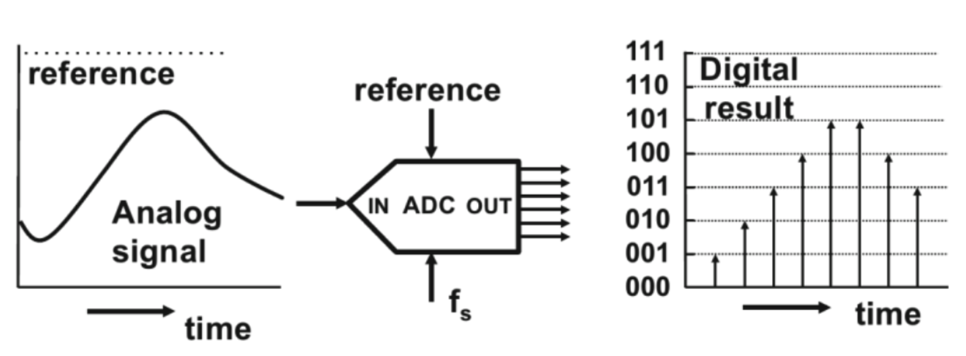
What is Analog-to-Digital Conversion?
Converts continuous analog signals into discrete digital values.
Key steps:
Sampling - capturing discrete points from an analog signal
Quantization - Assigning numerical values to sampled points
Encoding - Converting values into a digital formal
Resolution: How well can the ADC represent a voltage (what interval of voltages gets mapped to the same digital value).
Notes:
System view of the ADC.
Drawn like this as a five-sided figure. Pointy end is the analog end, where the voltage goes in. Flat end is the digital end, where a bundle of wires comes out.
Input can be 0-3.3V. Digital output is (if B = 12), a 12-bit integer. There are 2^12 voltage steps between 0 and 3.3 and the analog voltage is converted to the nearest integer to that value.
0 is converted to 0, 3.3V to 4096, others in between.
The resolution of the ADC, how well it can represent that voltage, is the stepsize, so Vmax/2^B.

Slide 8
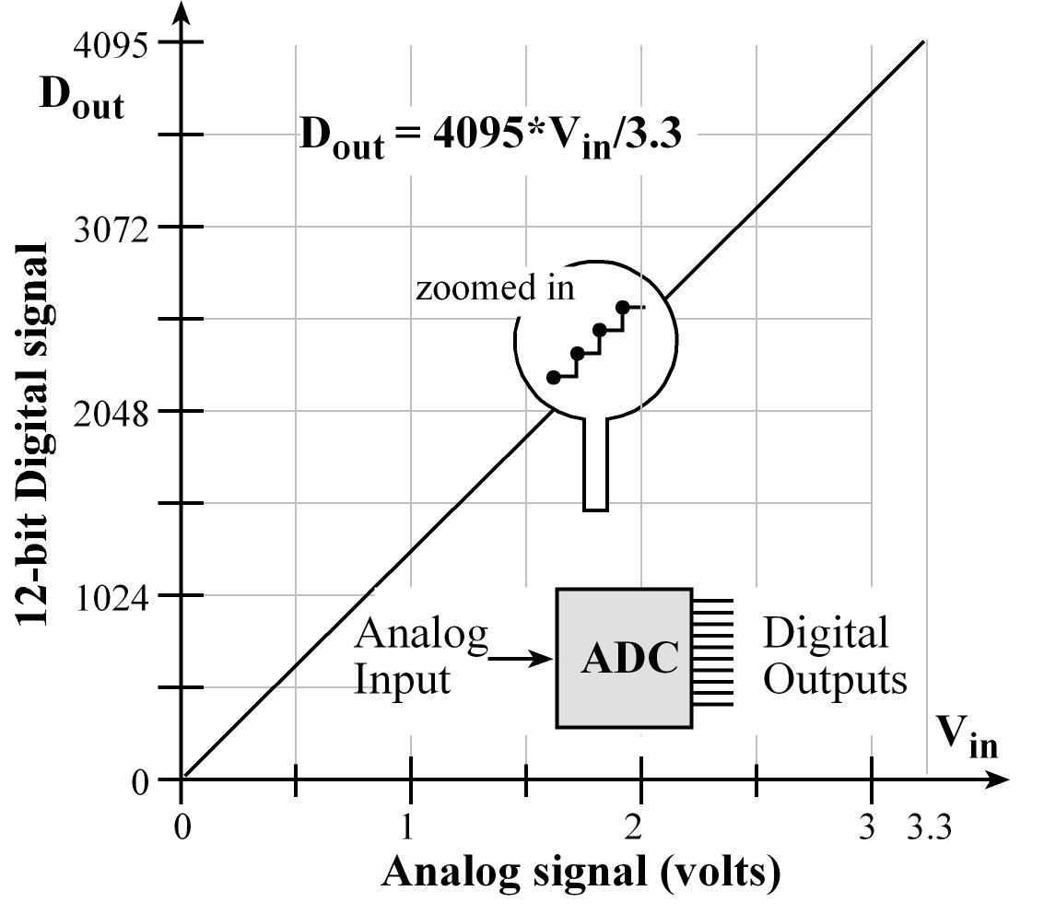
Analog-to-digital converter, system view
Bundle of B wires
D_{B-1}
Analog signal in
0 to V_{max}
ADC
B-bit integer out
0 to 2^{B} – 1
D₂
D₁
D₀
On STM32C031C6, V_{max} = 3.3V (usually)
On STM32C031C6, B = 6, 8, 10 or 12
D_{out} = floor[4096*V_{in}/3.3]
Notes:
System view of the ADC.
Drawn like this as a five-sided figure. Pointy end is the analog end, where the voltage goes in. Flat end is the digital end, where a bundle of wires comes out.
Input can be 0-3.3V. Digital output is (if B = 12), a 12-bit integer. There are 2^12 voltage steps between 0 and 3.3 and the analog voltage is converted to the nearest integer to that value.
0 is converted to 0, 3.3V to 4096, others in between.
The resolution of the ADC, how well it can represent that voltage, is the stepsize, so Vmax/2^B.

Slide 9
Analog-to-digital converter, system view
Bundle of B wires
D_{B-1}
Analog signal in
0 to V_{max}
ADC
B-bit integer out
0 to 2^{B} – 1
D₂
D₁
D₀
On STM32C031C6, V_{max} = 3.3V (usually)
On STM32C031C6, B = 6, 8, 10 or 12
Digital output of the ADC conversion of input voltage v_{in}: y = floor[ (v_{in} / V_{max}) × 2^{B} ]
= floor[ v_{in} / ∆v ], where ∆v = V_{max}/ 2^{B}
ADC's voltage resolution:
∆v = V_{max}/ 2^{B}
To convert y back to a voltage:
v = y ∆v = y × V_{max} / 2^{B}
Example: 3.3V / 2¹² = 3.3V / 4096 = 0.806mV
Notes:
System view of the ADC.
Drawn like this as a five-sided figure. Pointy end is the analog end, where the voltage goes in. Flat end is the digital end, where a bundle of wires comes out.
Input can be 0-3.3V. Digital output is (if B = 12), a 12-bit integer. There are 2^12 voltage steps between 0 and 3.3 and the analog voltage is converted to the nearest integer to that value.
0 is converted to 0, 3.3V to 4096, others in between.
The resolution of the ADC, how well it can represent that voltage, is the stepsize, so Vmax/2^B.

Slide 10
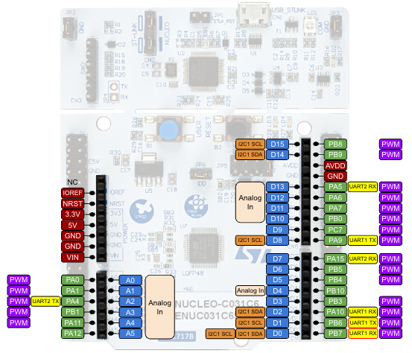
Analog inputs on the Nucleo
The STM32C031C6 has one analog-to-digital converter.
It can be accessed from 19 different pins.
11 of those are accessible via the Arduino headers.
The "traditional" Arduino analog input pins are those highlighted in the image.

Slide 11
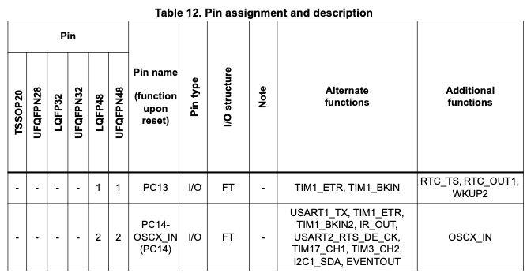
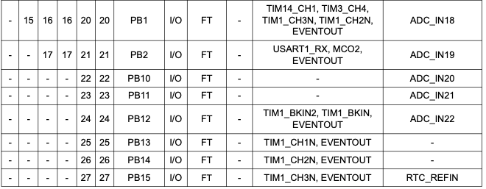
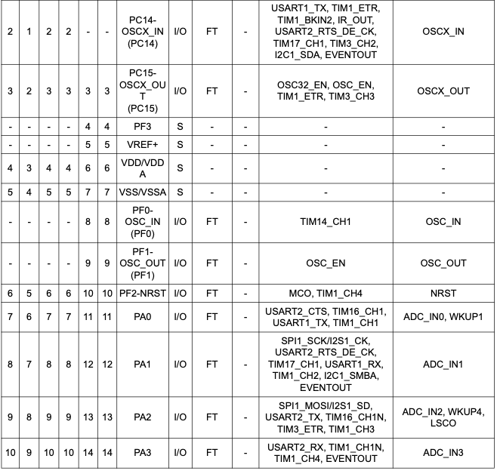
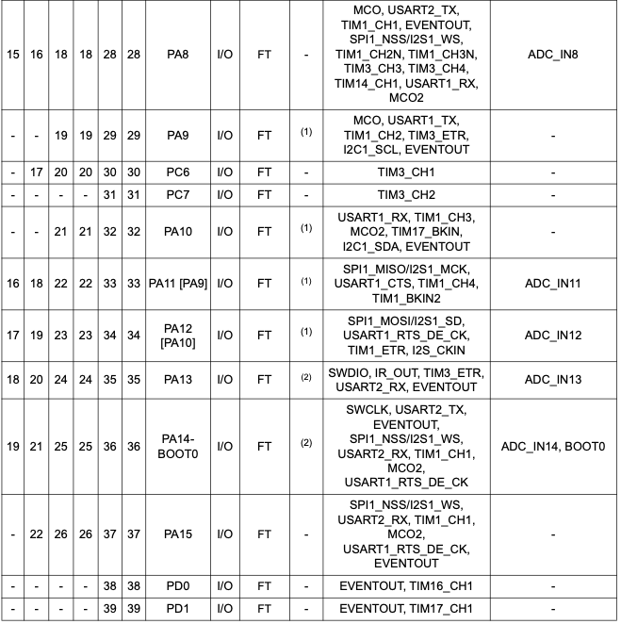
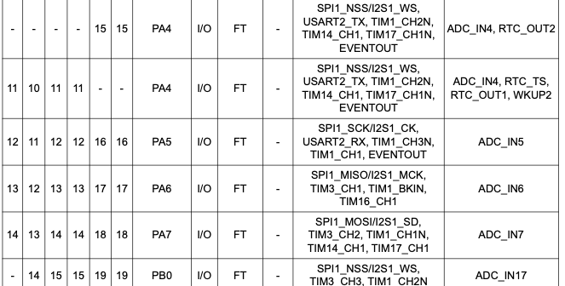
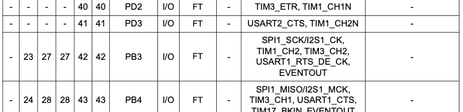
How do you know which pins can do analog?
Datasheet, Table 12, Pin assignment and description

Slide 12
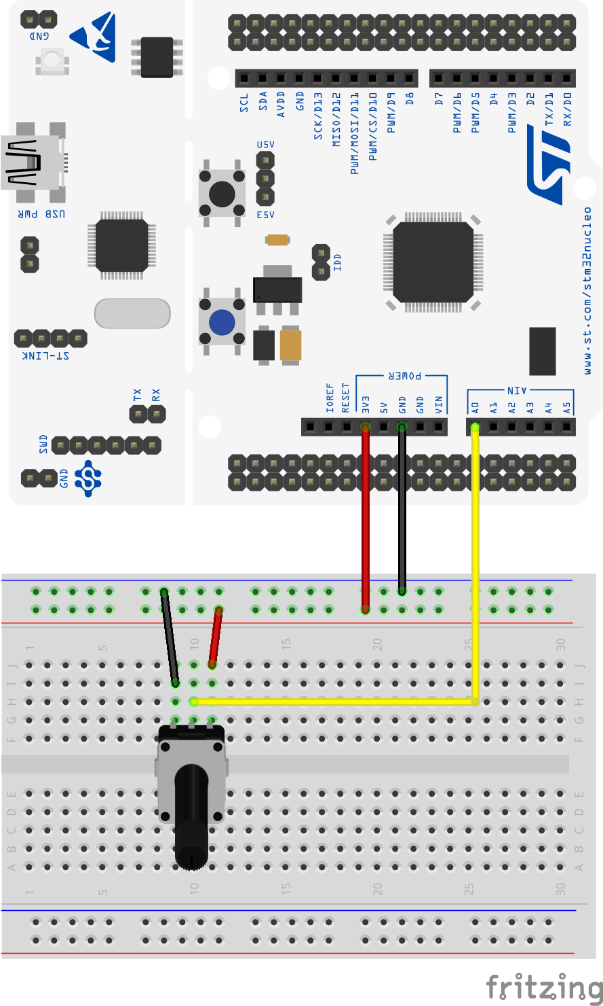
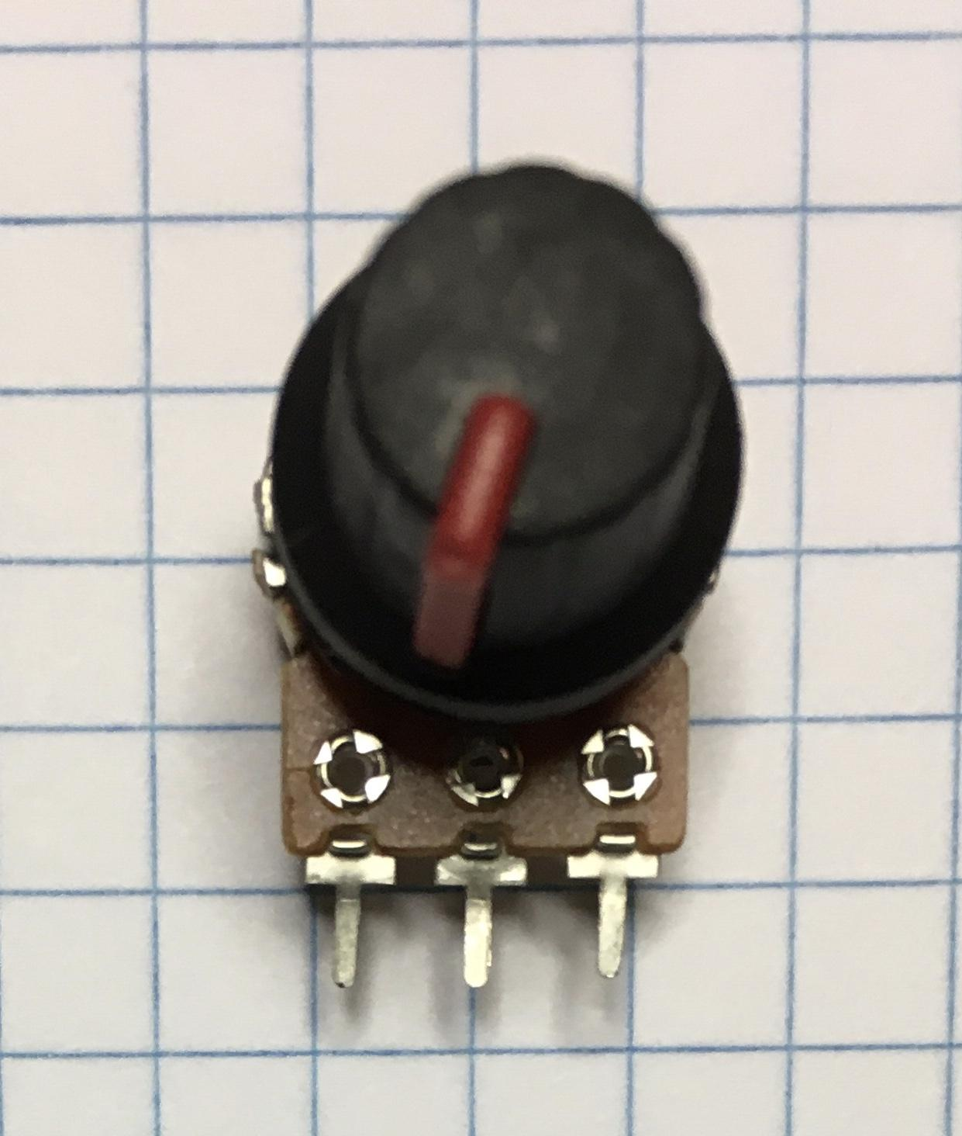
Test circuit
Set up this circuit on your breadboard. (This setup is the foundation of Lab 4).
You may be able to push (hard) the pot’s pins right into the breadboard. Or, you can use three of the pin-to-clip jumpers.
The pot is a variable voltage divider (review Lab 1 prelab). Wire power and ground so that as the knob is turned clockwise, the voltage at the center terminal increases.
Make a copy of your TemplateProject and name the copy ADCpot. Download the program ADCpot.c from Canvas, paste it into the Src folder in your ADCpot project, compile and run it.
Observe the maximum and minimum values of the ADC output.
You'll need to run CoolTerm.
10K potentiometer
GND A0 3.3V

Slide 13
ADCpot.c
/* Use a potentiometer as a variable voltage source to explore the ADC
* Engs 28
*
* Pot is wired to pin PA0
*/
#include <stdio.h>
#include "ES28.h"
#include "uart.h"
void pa0_adc_init(void);
void start_conversion(void);
uint16_t adc_read(void);
int main(void) {
uint16_t sensor_value;
uart2_init();
// A little "hello"
printf("\n\rHello from STM32C0!\r\n");
printf("Single conversion ADC test\r\n");
pa0_adc_init();
while(1) {
start_conversion();
sensor_value = adc_read();
printf("Sensor value: %d\r\n", sensor_value);
delay_ms(1000); // Delay
}
}
void pa0_adc_init(void) {
// Configure analog input pin
RCC->IOPENR |= RCC_IOPENR_GPIOAEN; // clock access
GPIOA->MODER &= ~GPIO_MODER_MODE0_Msk; // analog mode
GPIOA->MODER |= (GPIO_ANALOG << GPIO_MODER_MODE0_Pos);
// Configure ADC module
RCC->APBENR2 |= RCC_APBENR2_ADCEN; // clock access
ADC1->CHSELR |= ADC_CHSELR_CHSEL0; // Select channel 0
// Enable ADC module
ADC1->ISR = ADC_ISR_ADRDY; // Clear the ready bit
ADC1->CR |= ADC_CR_ADEN; // Set the ADC enable bit
}
void start_conversion(void) {
// Wait for ADC to be ready
while( (ADC1->ISR & ADC_ISR_ADRDY ) == 0){}
// Start single conversion
ADC1->CR |= ADC_CR_ADSTART;
}
uint16_t adc_read(void) {
// Wait for conversion to finish
while( (ADC1->ISR & ADC_ISR_EOC) == 0 ){} // Blocking
// Read converted value
return (uint16_t) ADC1->DR;
}

Slide 14
ADC Initialization
Perform once, before you start using ADC.

Slide 15
Function pa0_adc_init()
// Sampling ADC Channel 0 (which maps to PA0)
void pa0_adc_init(void) {
// Configure PA0 as analog input pin
RCC->IOPENR |= RCC_IOPENR_GPIOAEN; // Enable clock access to GPIOA
GPIOA->MODER &= ~GPIO_MODER_MODE0_Msk; // Set PA0 mode bits (0:1)
GPIOA->MODER |= (GPIO_ANALOG << GPIO_MODER_MODE0_Pos); // to analog (11)
// Configure ADC module
RCC->APBENR2 |= RCC_APBENR2_ADCEN; // Enable clock access to ADC module
ADC1->CHSELR |= ADC_CHSELR_CHSEL0; // Channel 0, CHSELRMOD=0 by default
// Enable ADC module
ADC1->ISR = ADC_ISR_ADRDY; // Clear the ready bit by writing '1' to it
ADC1->CR |= ADC_CR_ADEN; // Set the ADC enable bit
}
What is the clock source for the ADC?
How do you know what values to pick for ADC1->CHSELR, ADC1->CR, etc?
Note: While our chip only has one ADC module, there are chips that have multiple such modules. For software compatibility reasons we refer to our module as "ADC1".

Slide 16
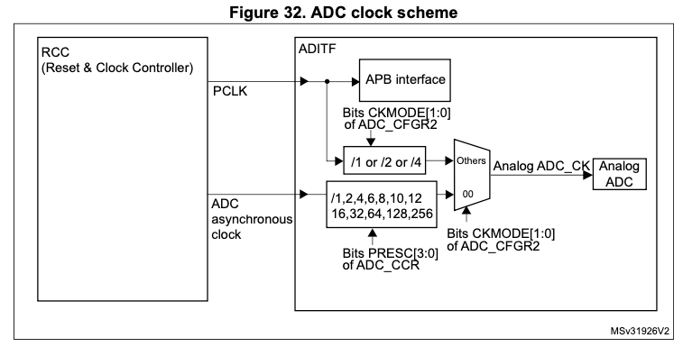
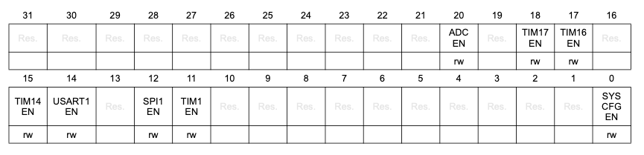
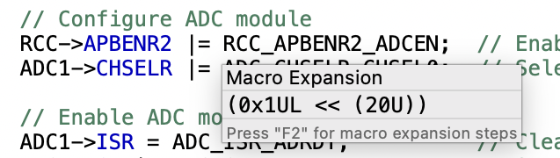
ADC Clock Source
The ADC has a dual clock-domain architecture, so that the ADC can be fed with a clock (ADC asynchronous clock) independent from the APB clock.
We will only use the default ADC asynchronous clock. We still need the ADC registers to get a 'regular' clock signal, enabled in RCC_APBENR2 (RCC APB peripheral clock enable register 2).
RCC_APBENR2:
RCC->APBENR2 |= RCC_APBENR2_ADCEN;
Notes:
The ADC is enabled in APBENR2 because that bit gates the APB bus interface, not the ADC’s conversion clock.
The ADC core runs on an independent clock, but the CPU still needs a bus clock to configure and read it.

Slide 17
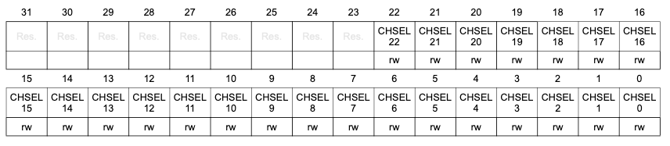
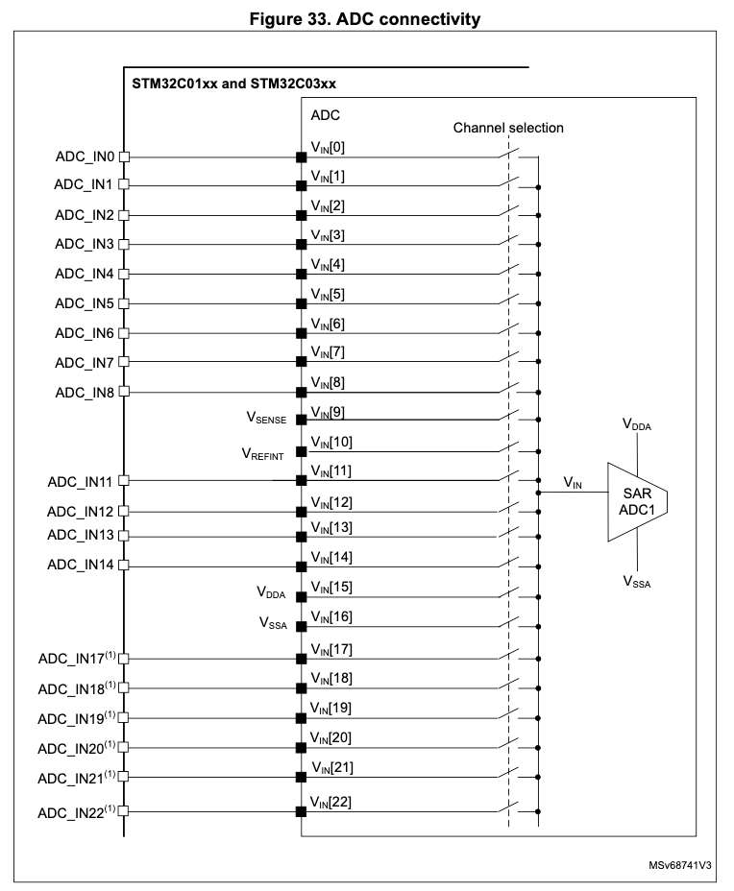
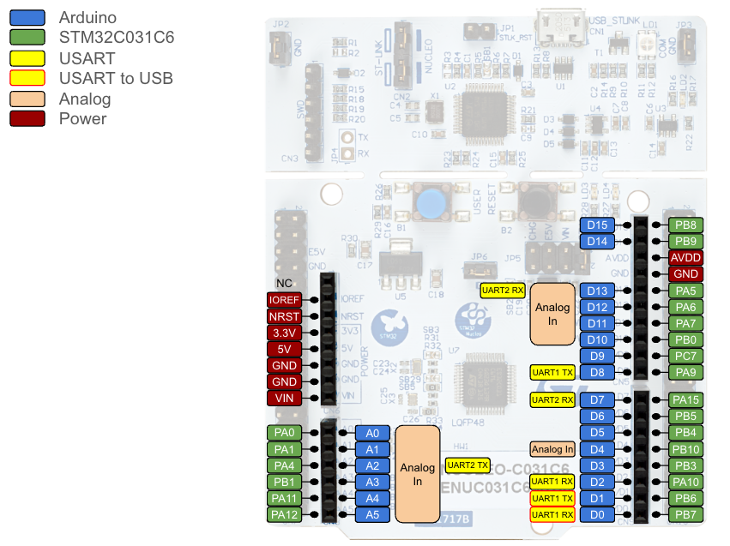
ADC Channel Selection Register (ADC_CHSELR)
Bits 22:0 CHSEL[22:0]: Channel-x selection
These bits are written by software and define which channels are part of the sequence of channels
to be converted.
0: Input Channel-x is not selected for conversion
1: Input Channel-x is selected for conversion
Note: The software is allowed to write this bit only when ADSTART= 0 (which ensures that no
conversion is ongoing).
PA0
PA1
PA4
PA11
PA12
PB1
ADC1->CHSELR |= ADC_CHSELR_CHSEL0;
Notes:
There are up to 23 multiplexed channels:
• Up to 19 analog inputs from GPIO pins (ADC_INx) (11 of those can be accessed on Arduino header pins)
• 4 internal analog inputs (temperature sensor, internal reference voltage, analog supply
and analog ground)

Slide 18
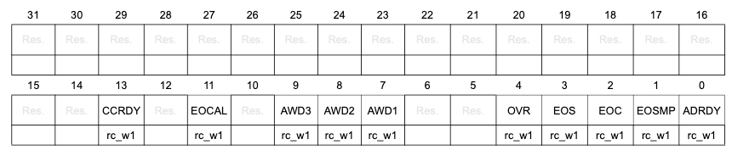
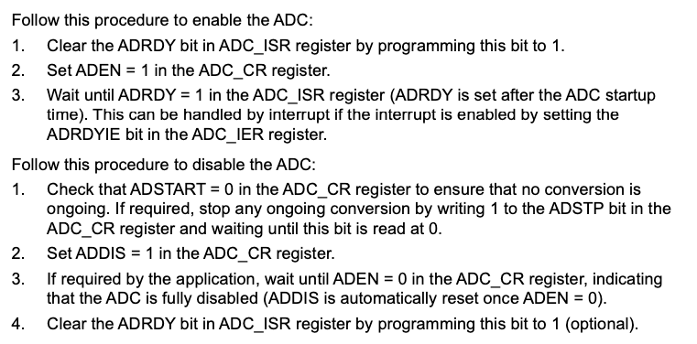
ADC interrupt and status register (ADC_ISR)
ADC1->ISR = ADC_ISR_ADRDY;
Who finds this a bit strange?

Slide 19
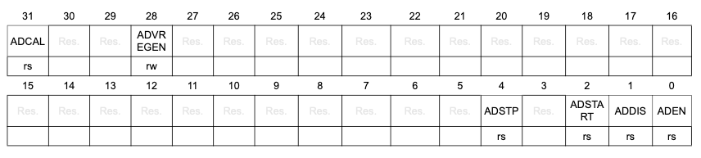
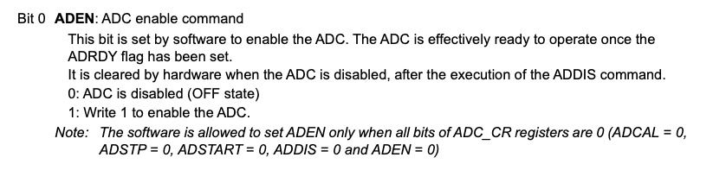
ADC control register (ADC_CR)
ADC1->CR |= ADC_CR_ADEN;

Slide 20
ADC interrupt and status register (ADC_ISR)
while( (ADC1->ISR & ADC_ISR_ADRDY ) == 0){}
We'll do this every time we start a new sample.

Slide 21
Quick aside…

Slide 22
Wait: WHAT?
How do we 'normally' clear a bit in a register? Remember Blinky?
#define LED_PIN (1U<<5) // 0b 0000 … 0001 0000
(...)
GPIOA->ODR |= LED_PIN; // set bit 5 to turn LED on
(...)
GPIOA->ODR &= ~LED_PIN; // clear bit 5 to turn LED off
So how does
ADC1->ISR = ADC_ISR_ADRDY;
clear the ADRDY bit?
Answer: The hardware behind the ADC1->CR register differs from that behind the GPIO registers.

Slide 23
Atomic Register Access
Most registers on our chip have to be accessed as 32-bit words, half-words or bytes. This makes
GPIOA->ODR &= ~LED_PIN;
into a multi-step operation:
Load the entire register into memory
'And' with 0b 1111 … 1101 1111
Write the entire (modified) register value back to the register. Note that ALL 32 bits are REWRITTEN.
If an interrupt occurs halfway through that modifies (different bits) of the same register then things can get messy.
Certain registers (such as ADC1->ADRDY) have different hardware that allows modifying one bit at a time. This is more costly on the hardware side and thus only implemented for crucial registers, such as interrupt and status registers.

Slide 24
Atomic Register Access
ADC interrupt and status register (ADC_ISR)
ADC1->ISR = ADC_ISR_ADRDY;
appears to write 0's into all bits except bit 0 of ADC_ISR. But since writing 0 has no effect and writing 1 clears a bit, in reality this:
Clears bit 0 of ADC_ISR
Leaves all other bits unchanged

Slide 25
ADC Sampling Process
Perform each time you want to take a sample.

Slide 26
Functions start_conversion() and adc_read()
void start_conversion(void) {
// Wait for ADC to be ready
while( (ADC1->ISR & ADC_ISR_ADRDY ) == 0){}
ADC1->CR |= ADC_CR_ADSTART; // Start a single conversion
}
uint16_t adc_read(void) {
// Wait for conversion to finish
while( (ADC1->ISR & ADC_ISR_EOC) == 0 ){}
// Read converted value
return (uint16_t) ADC1->DR;
}

Slide 27
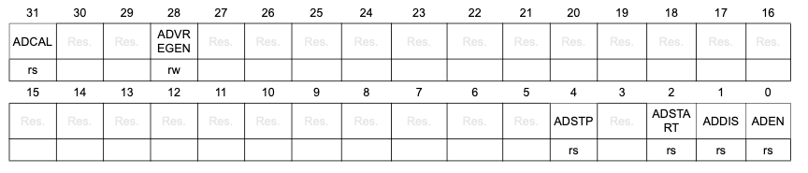
On-demand sampling
ADC control register (ADC_CR)
ADC interrupt and status register (ADC_ISR)
Wait for ADC to be ready (ISR_ADRDY bit) while( (ADC1->ISR & ADC_ISR_ADRDY ) == 0){}
Start conversion (CR_ADSTART bit) ADC1->CR |= ADC_CR_ADSTART;
Wait for the conversion to finish (ISR_EOC bit) while( (ADC1->ISR & ADC_ISR_EOC) == 0 ){}
Read the data register return (uint16_t) ADC1->DR;
Each time we'd like a sample:

Slide 28
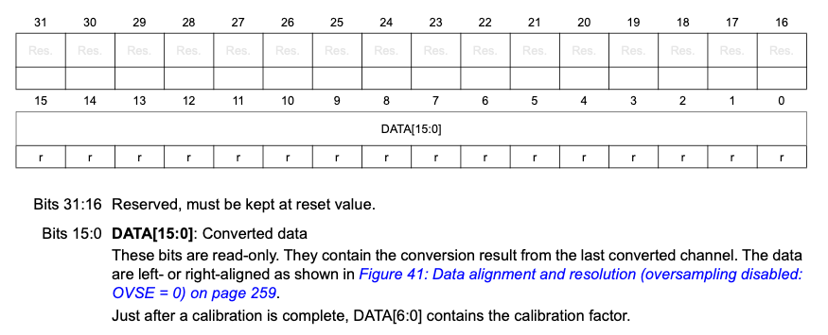
The ADC Data Register (ADC_DR)
For now, we'll use the default values: data right-aligned, no oversampling.

Slide 29
How the A/D converter works

Slide 30
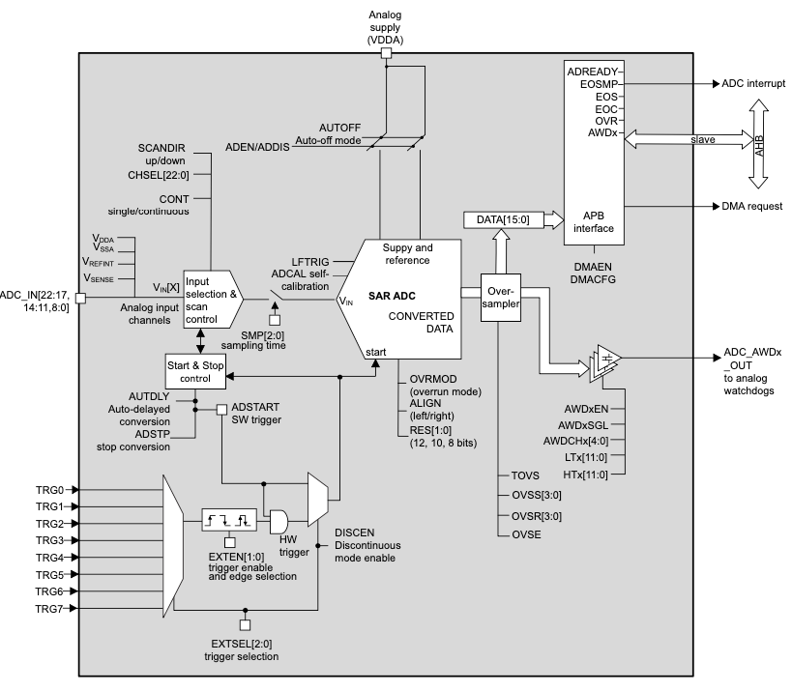
A/D section of MCU
On the Nucleo board this is wired to VDD (3.3V).
Data
Analog input signal
Focus on this part: Successive Approximation ADC
Notes:
We've seen the 2 control/status registers and the data register; the programmer's interface to the ADC.
We saw that there are different wires going in and out of the different pieces of the ADC. Now we'll study the pieces individually.

Slide 31
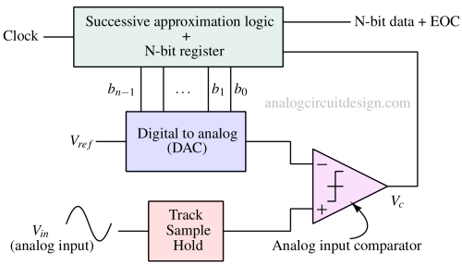
12-Bit Successive Approximation ADC
SAR 12-bit register
11
Sample / Hold
S/H keeps steady input for conversion even if V_{IN} is changing.
Hardware implements this algorithm:
SAR = 0;
for k = 11 downto 0,
Set bit k in the SAR, DAC outputs SAR × V_{REF}/4096
if V_{IN} ≥ V_{DAC}, keep SAR value
else clear bit k (back to previous SAR value)
end
THIS is why an ADC conversion takes many clock cycles.
Notes:
Demonstrate with guessing game: think of a number between 0 and 15 - let's say 7 for example.
SAR = 1000 Is your number less than 8? Yes
SAR = 0100 Is your number less than 4? No
SAR = 0110 Is your number less than 6? No
SAR = 0111 = 7.

Slide 32
Successive Approximation Example
Let's say B = 4. This is how successive approximation logic works, taking out the voltage conversion for simplicity:
Think of a number between 0 and 15 - say 7, for example.
SAR = 0b1000 (= 8 in decimal) Is your number ≥ 8? No. So:
SAR = 0b0100 (= 4 in decimal) Is your number ≥ 4? Yes. So:
SAR = 0b0110 (= 6 in decimal) Is your number ≥ 6? Yes. So:
SAR = 0b0111 (= 7 in decimal) I guessed your number!

Slide 33
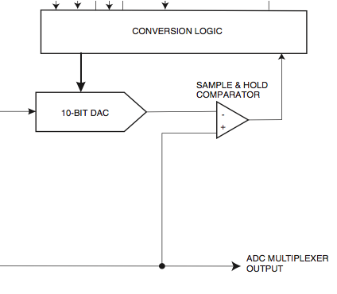
Core A/D hardware
Successive approximation A/D
Reference voltage on the Nucleo board
SB30 | AVDD | ON | VDD provides power to AVDD.
 |  | OFF | VDD does not provide power to AVDD.
SB28 | AGND | ON | AGND is connected to GND.
 |  | OFF | AGND is not connected to GND.
12 BIT DAC
Analog input selection
Notes:
3 main pieces of the ADC core hardware:
Voltage selection, analog input selection and converter itself.
Already talked about reference voltage selection and input selection. Will focus on A/D converter itself.

Slide 34
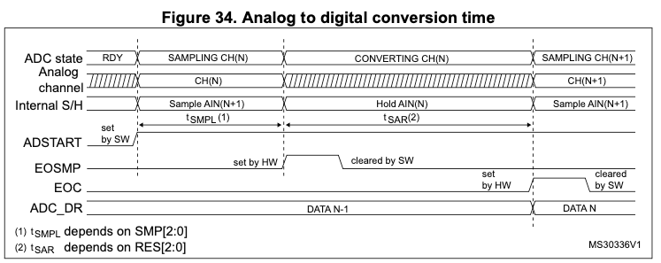
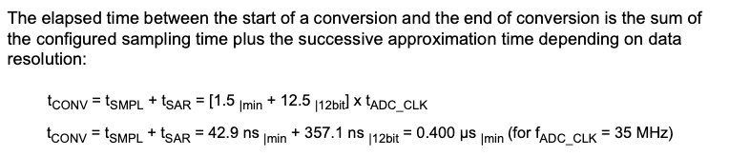
A/D conversion timing
14 ADC clock cycles
Without prescaling, our default clock runs at 12 MHz. How long does a 12-bit conversion take?
Notes:
This is the timing of how the A/D converter works. Each conversion takes a minimum of 14 ADC clock cycles.
When you are done, ADC output register contains the result.
Length of conversion at 12MHz: 14/(12*10^6) = 1.2*10^-6 seconds = 1.2 us

Slide 35
"Homework" - to help you get a head start on the lab
Dig into the STM32C0x1 reference manual and modify the ADC_pot.c program in a few ways (make one change at a time, then change it back). Keep records for Lab 4.
Change the analog input channel from from 0 to 3 (rewire the circuit appropriately). Make sure that the program still works properly. Here, Channel 3 refers to the pin labelled A3 on the board. You will need to find out what GPIO pin that is connected to (from the pinout chart on Canvas), then find out which internal ADC channel that GPIO is connected too. Lots of translations - proceed methodically!
Set your potentiometer output voltage to 1 volt (measured on your DMM). Note what the ADC output is. Change the resolution from 12 bits to 10, 8, or 6 bits (you’ll have to make several changes to the code), and note what the ADC output is. In each case, calculate ∆V, do the calculation ADC_value = Vin / ∆V, and compare with your observations.
You may notice that when you rotate the potentiometer knob through its full range the lowest value you can read is not zero. You may also notice that the ADC value reaches 4095 (the max value) well before the potentiometer has reached the end of its travel. This is because there is a DC offset in the conversion. Fortunately, our ADC provides an automated way to minimize the effects of this offset. Find the section of the reference manual that deals with calibration and try to understand the steps needed to calibrate the ADC.

