Slide 1


ENGS 28
Embedded Systems
Day 7x Debugging tips

Slide 2
Debugging Tips and Tricks

Slide 3
Instructor Notes
Lots of weird problems cropping up with the debugger. Some are probably related to not stopping one debug session before starting the next.
Many many cases of plugging VDD for the breadboard into the NRST pin. This tends to reset the processor unexpectedly.

Slide 4
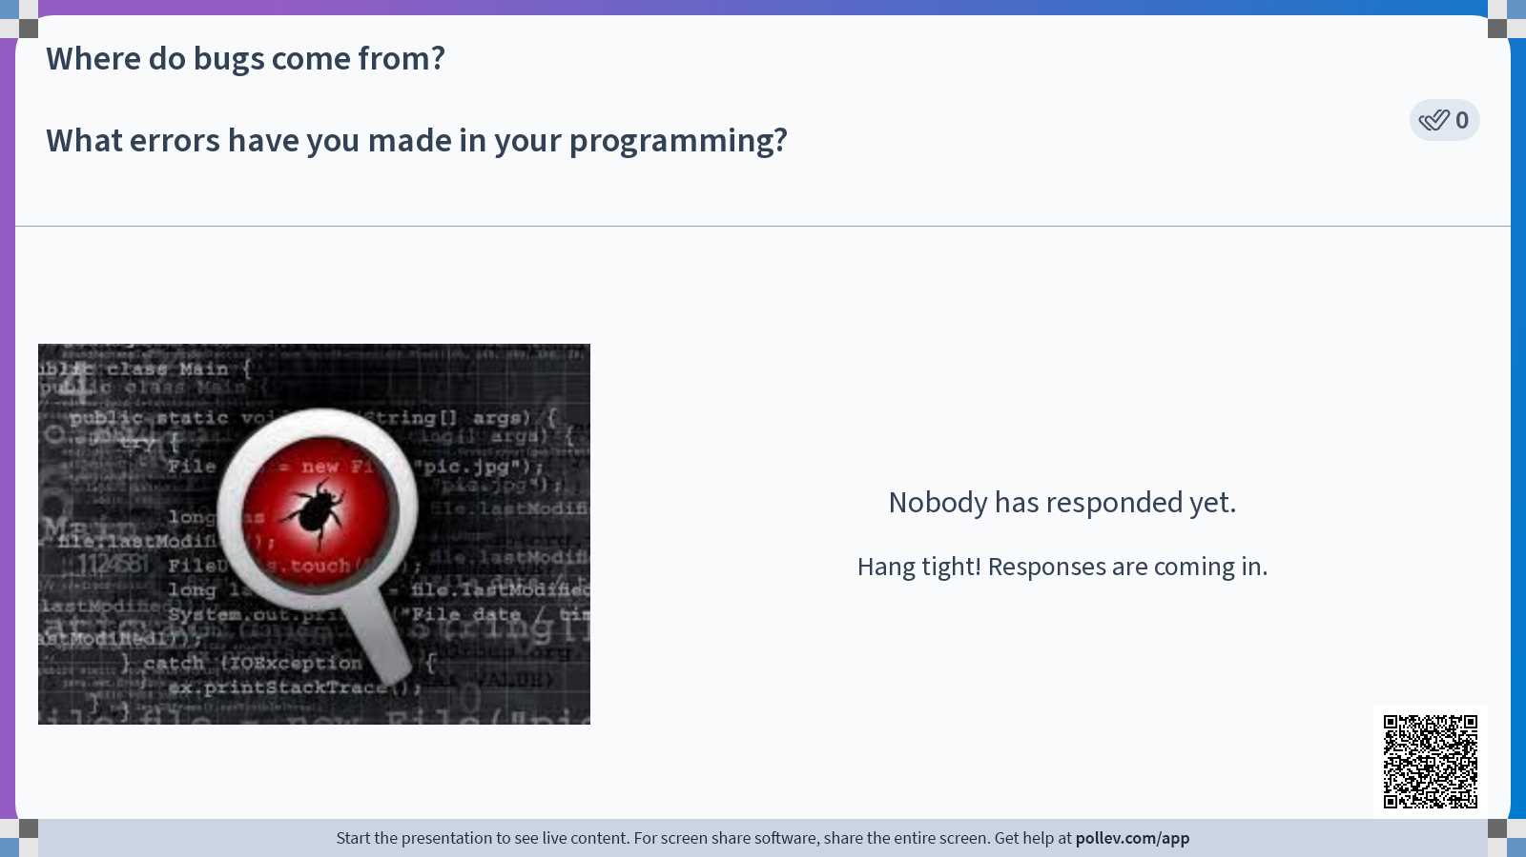

Slide 5
Where do bugs come from? How many of these programming errors have you made?
Missing or extra semicolon, ), or }
Incorrect register name
Missing #include files
Incorrect constant (#define) values
Undeclared or uninitialized variables
Misspelled names
Type mismatches
No return statement in a function
= or ==? & or &&? | or ||? ~ or !?
Alas, many others…
Some of these will be caught by the compiler.
The ones that aren’t caught lead to incorrect program execution.
When your program fails, how do you find the errors?

Slide 6


Slide 7
Good practices to help prevent bugs
Plan the design on paper — block diagrams, pseudocode, state diagrams, etc.
Use the file header to record information about the file.
Write in small chunks and test as you go.
Strive for readable code.
Use functions — a good function has one clear objective, “set up the UART”, “get a value from the ADC”.
Comment as you go, to narrate your process and leave notes for the next person.
Use named constants (const or #define) rather than literal constants (a.k.a. “magic numbers”).
Delete commented-out code from the final version.

Slide 8
Writing loops: for or while?
Typically, for is used when you know in advance how many times you want to iterate over the loop, e.g.,
for(i=0; i<N; i++) { /* do stuff */ }
On the other hand, while is typically used when you don't know how many times you will iterate, e.g.,
while (condition) { /* do stuff */ }
or
do { /* stuff */ } while (condition);
C allows the use of break to prematurely exit a for loop, but this may indicate an awkward situation where the code should be written differently (try while instead).

Slide 9


Slide 10
Finding bugs: Hardware
Check your wiring
Power and ground connected to the correct pins on devices?
Bypass capacitors installed?
LED polarity correct?
Are wires pushed into the breadboard all the way?
Does each wire begin and end where it should, according to your circuit diagram?
If (and only if) wiring checks out, apply power.
Remove power to make changes.
Use a multimeter & oscilloscope to check that voltages are what you expect.
Is each chip getting power (measure at the pins)?
Do the UART signals look right?
Are sensor outputs in the right range according to the datasheet?

Slide 11
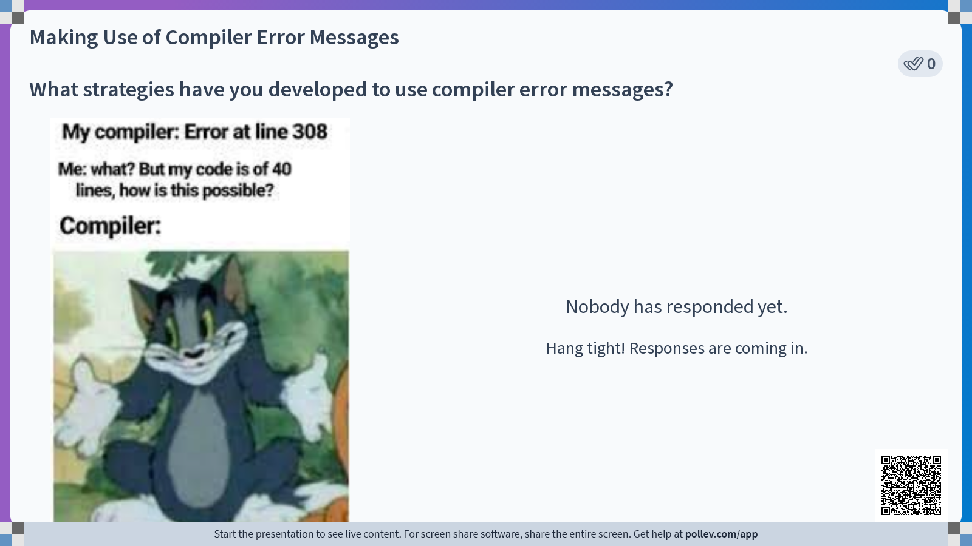

Slide 12
Using the C compiler error messages
One error can spawn many messages
The line where the error is thrown may not be where the actual error is, could just be where the compiler “gave up” trying to interpret the code. May need to read up from the indicated line to find the root problem.
Start at the top of the list of errors and work down. If you fix one, several later ones may also be fixed.
For really pesky errors, commenting out a block of code may help isolate the error (also for runtime errors).

Slide 13
Finding bugs: Using diagnostic printf statements
\r = return to start of line
\n = newline
\t = tab
Was this part of the code reached?
printf("(Function name): Entered!\r\n");
printf("Made it out of the loop.\r\n");
printf("The current temperature is %d (deg F)\r\n:, temp_F);
Am I getting reasonable data?
printf("ADC value is: %x,\t%u\r\n", value, value);
When did my loop crash?
for(uint8_t i=0; i<N; i++) {
…
printf("iteration %u: x=%d\r\n", i, x);
}

Slide 14
Diagnostic print statements (2)
Print what you expect the value to be.
printf("Temperature %d (deg F) should be less than 100\r\n", temp_F);
Is that I/O register holding what it should?
printf("GPIOA->ODR register contains 0x%04lx\r\n", GPIOA->ODR);
Print out what you are doing
printf("\n\rSetting pulse length to %d.%03d ms\n\r", value/2000, (value>>1)%1000);
Note:
To print a 32-bit register use the format specifier %lx.
To print a 16-bit register, use the format specifier %x.

Slide 15

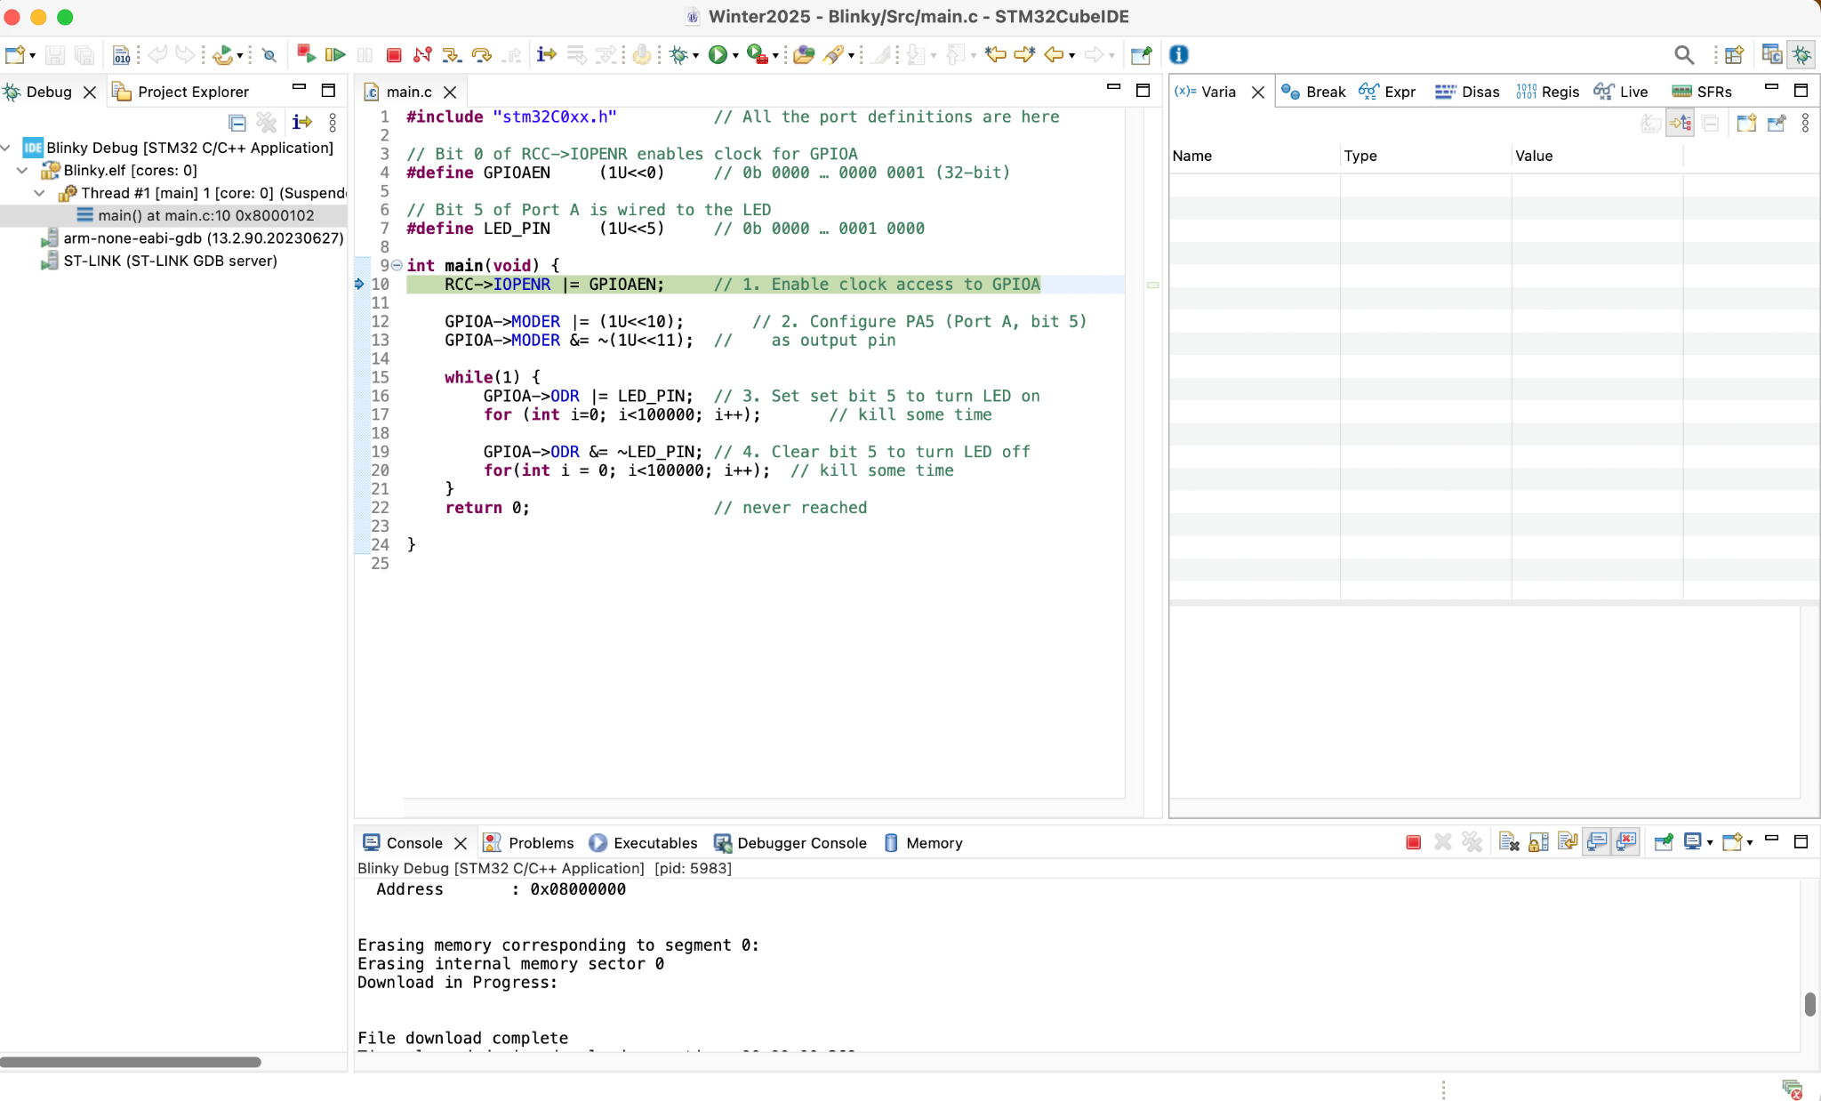
Using the Debugger
Our IDE (STM32 Cube IDE) comes with a built-in debugger.
The debugger is useful when trying to find runtime errors (the project has to compile and build without errors first).
Open your initial blinky project. Build and upload to your Nucleo to make sure everything is still working normally. The on-board LED should blink.
Now use the bug icon to launch the program along with the debugger. Accept the "Confirm perspective switch" popup. This opens a “debug perspective”, with windows useful for debugging, and halts execution at the first executable statement in the program, highlighted in green.
This is what you should see:

Slide 16
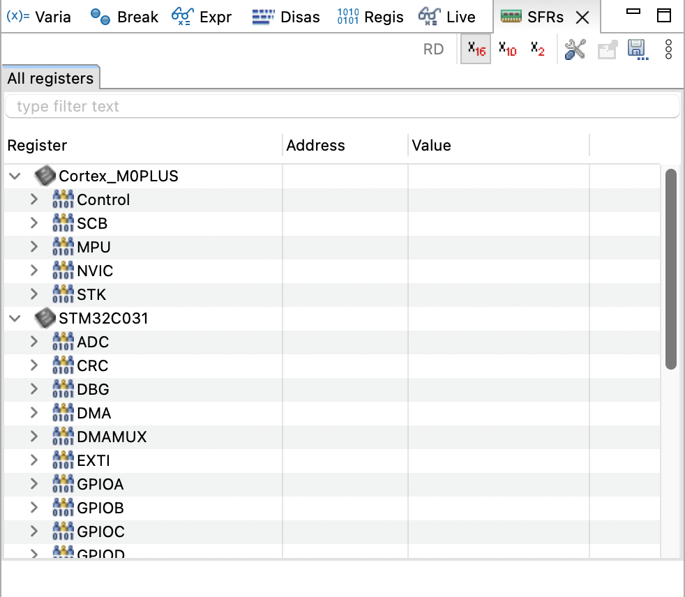
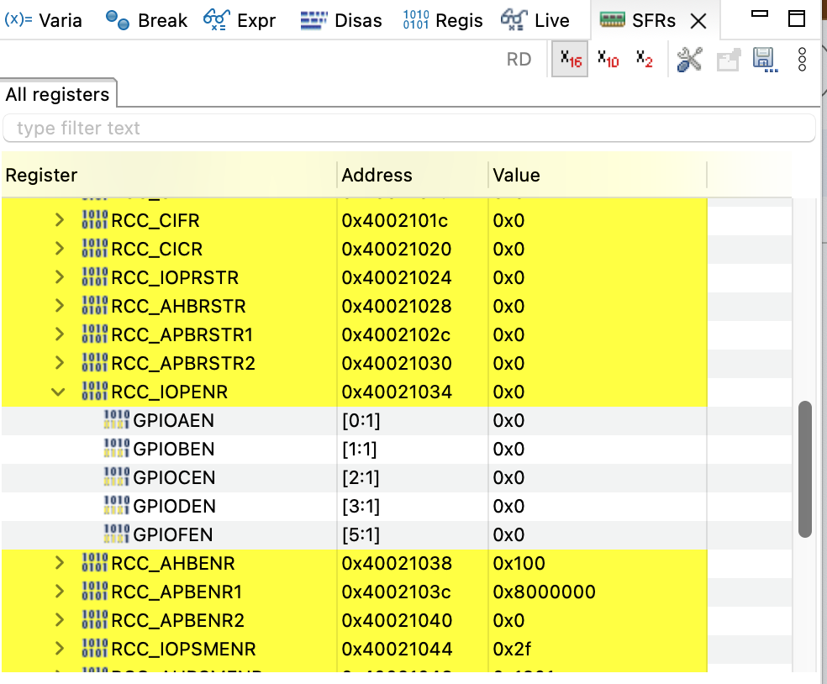
Take a look at registers
The debugger allows you to observe what the registers are doing. To the right of the editor window is a debug window, with tabs Variables, Breakpoints, … SFRs.
Click the SFRs tab (Special Function Registers).
Open RCC and look at the contents (value) of IOPENR (especially bit 0).
What do you expect to change when you execute the first instruction of our blinky code: RCC->IOPENR |= GPIOAEN; ?
Recall: #define GPIOAEN (1U<<0)

Slide 17

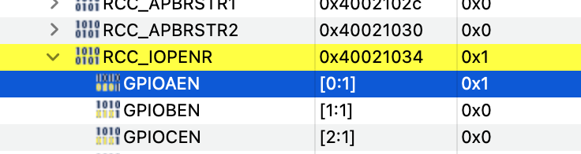
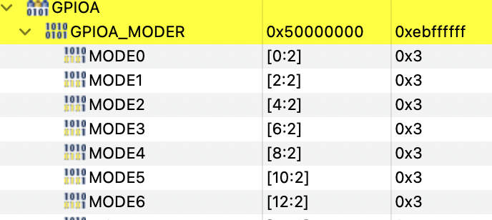
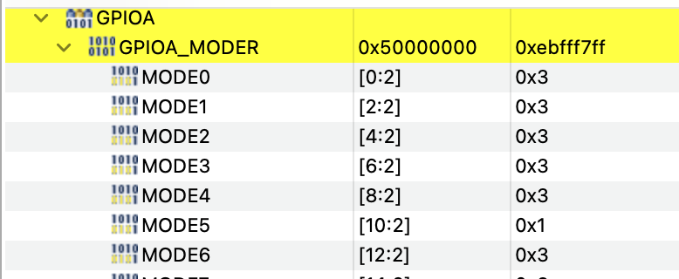
Execute one line of code
Execute the first line of code by clicking either "step in" or "step over":
Look at the RCC_IOPENR again and observe the change.
Repeat with the next two lines of code (GPIOA_MODER) and observe the changes.

Slide 18
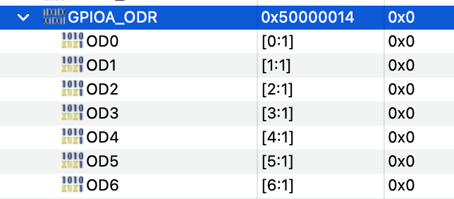
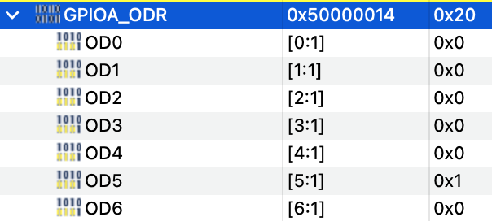


Repeat with GPIOA_ODR
Next, take a look at the GPIOA_ODR, in particular bit 5.
LED off
LED on
Careful: You do not want to single-step through that for-loop! If you accidentally did, click "terminate and relaunch" or "reset the chip and restart execution".

Slide 19
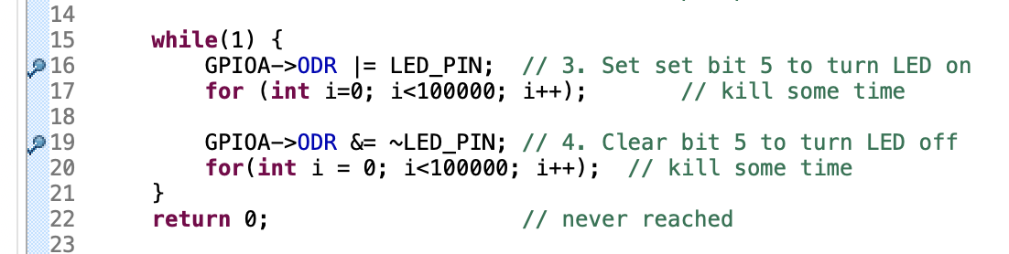

Setting Breakpoints
Find the thin blue strip running down the left margin of the code window.
Right click next to the statement where the LED is turned on, and select “Add Breakpoint”.
Do the same next to the statement where the LED is turned off.
Use the "resume execution" button:
You should find the execution suspends at the next breakpoint. Resume again and it will suspend at the next breakpoint. By resuming over and over you can hop from breakpoint to breakpoint. Observe the LED and the GPIOA_ODR register as you do.
The statements in between execute normally, but the program pauses when it gets to a breakpoint so that you can have a look at the registers (and, eventually, variables).

Slide 20
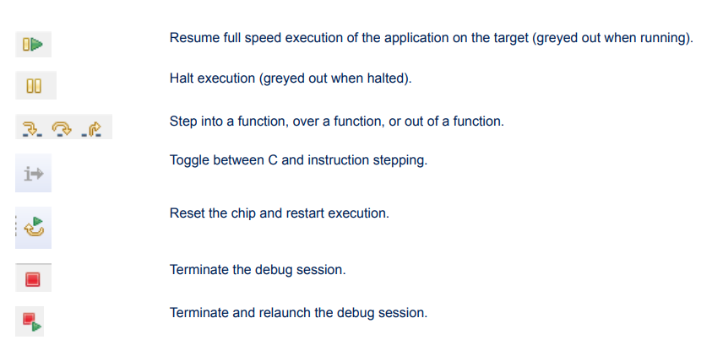
Main Debugger Control Icons

Slide 21
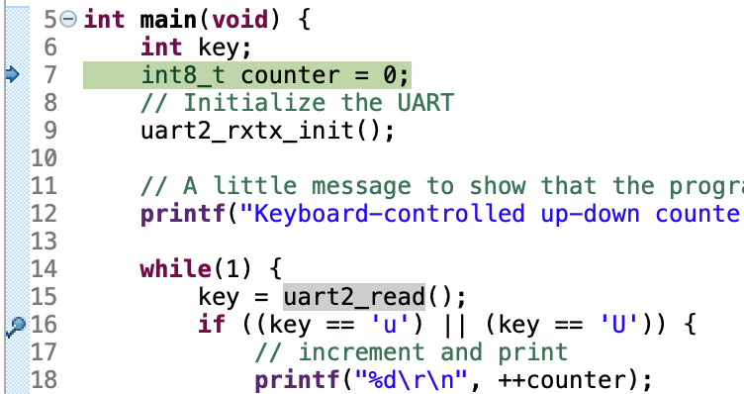
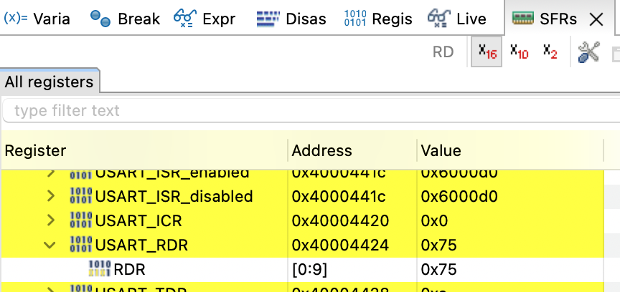
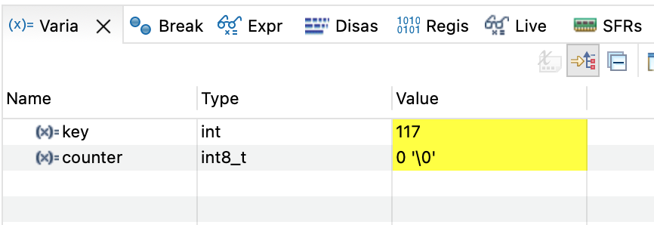
Observing Variables
Terminate blinky. The editor view returns to 'normal'.
Open your keyboard-controlled up-down counter.
Run the program in debug mode.
Open CoolTerm as per usual.
Set a breakpoint on the line right after the statement key = uart2_read();
Click "Resume". The program will halt on the key = uart2_read(); statement, waiting for you to press a key.
Press a key in your terminal application, then return to the editor.
Observe both the variable 'key' as well as the register USART2_RDR. Does everything make sense?
What key did I press?
Notes:
'u' = 117 = 0x75

Slide 22
Let's Work on Lab 4!

