Slide 1


Engs 28
Embedded Systems
Day 8

Slide 2
Some Feedback…
Sunday and Monday night TA hours tend to be very well attended, whereas other nights are much lighter in attendance. So: If you want to ensure adequate time and help from a TA, start early!
The more specific your question is, the better TAs can help you.
Instead of: "It's not working!" ask: "Is this the correct logic to poll a pin?"
Be sure to read the lab handout before asking questions :-)
It's against the honor code to compare your code against another student's code line-by-line.
Check your submission! If you are missing files or submit an empty pdf rather than the one you filled in you will lose points.
Difference between bitwise operations (|, &) and logical operations (||, &&)
Be systematic about your debugging!

Slide 3
Counters / Timers
The STM32C031C6 has five timers/counters:
TIM1, TIM3, TIM14, TIM16, TIM17
Of these, TIM14 is the simplest, followed by TIM16/17 then TIM3, then TIM1.
Other MCUs in the M-family might have other timers such as TIM2, TIM6, etc.
All timers are built around 16-bit counters on our microcontroller.
They can be programmed to count at a specified rate and set a flag when they reach a specified value.
They can also be set to restart immediately, to generate flags at regular intervals.
Timers/counters can do lots of other things also (and the more complex the timer, the more things it can do). We'll start with the above.

Slide 4
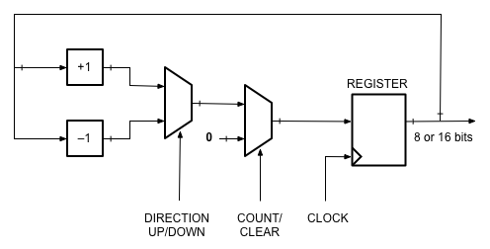
How does a counter work?
Basic idea (more features in microcontroller)
Multiplexers select next count value (n+1, n-1, 0)
Register stores current count, n
/ ⇒ multi-wire
Increment / decrement current count
Register contents update on rising edge of clock.
Notes:
Register to store the count. It's clocked. Every time the clock ticks the timer updates. You set the clock speed in the initialization process.
The register that stores the counter is 16 bit, it can count from 0 to anywhere < 2^16 is (65,536).
Couple things can happen: can take current value and increase by 1 (increment the counter): clock ticks, the register updates. At the next clock tick it's updated again, etc.
Some counters also enable you to decrement instead of incrementing (not TIM14). All on our chip enable you to zero the counter at certain events.
Two parts: register and incrementer.

Slide 5
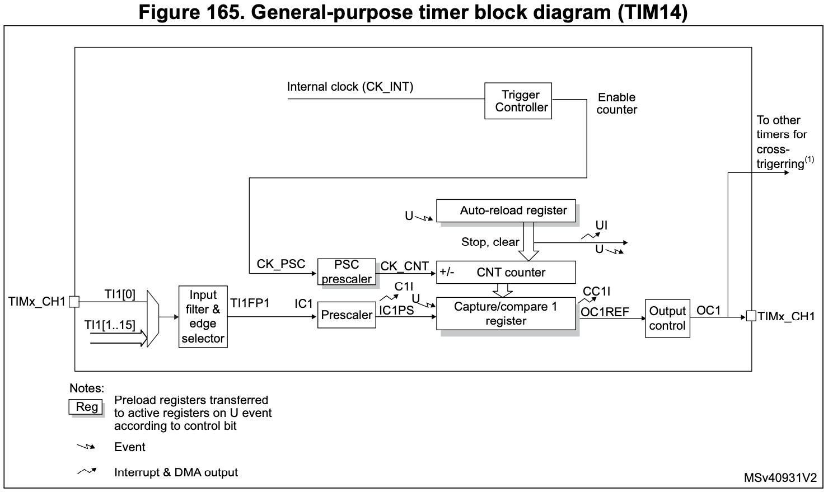
TIM14 Block Diagram
Auto-reload
(upper limit)
Prescaled clock input
Counter
Notes:
Inside the microcontroller: counter register is TCNT (Timer Counter) n (n = 0, 1, 2).
As it counts, there are a couple things it can do:
Have it compare its value to a number you have stored in a register. Suppose you wanted to count to 100. Then you could use the 8-bit counter, but instead of having it count to 255 you'd store 100 in the output compare register (OCR). Comparator will compare the numbers. When the counter gets to that number it does something (generate interrupt, etc)
Can tell it to do something when it reaches its top value (TOP), so when the counter overflows.
When counting down can tell it to do something when it reaches 0.
Timer overflow interrupt gets thrown when overflow is reached.
Output compare interrupt occurs when timer reaches value in OCR (if so chosen). Those are two different interrupts.
Each timer/counter has two comparison value registers, so you could in principle have one counter that interrupts both at 100 and also at 150. Seems difficult to think about, so have never used that personally…
It can do other things that we'll learn about in a few weeks.
So general functionality: Counter counts, generates interrupt when it reaches a specified value.
There are two control registers that set the various options (clock speed, what happens when it times out - reset or done? etc)

Slide 6
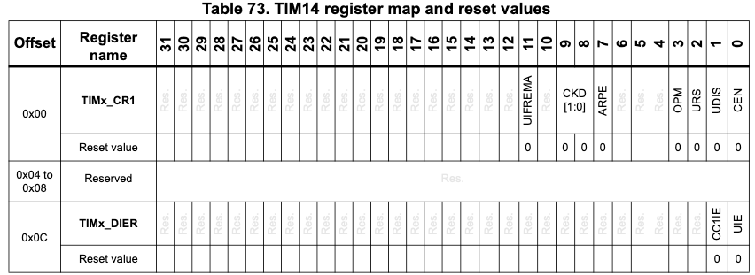
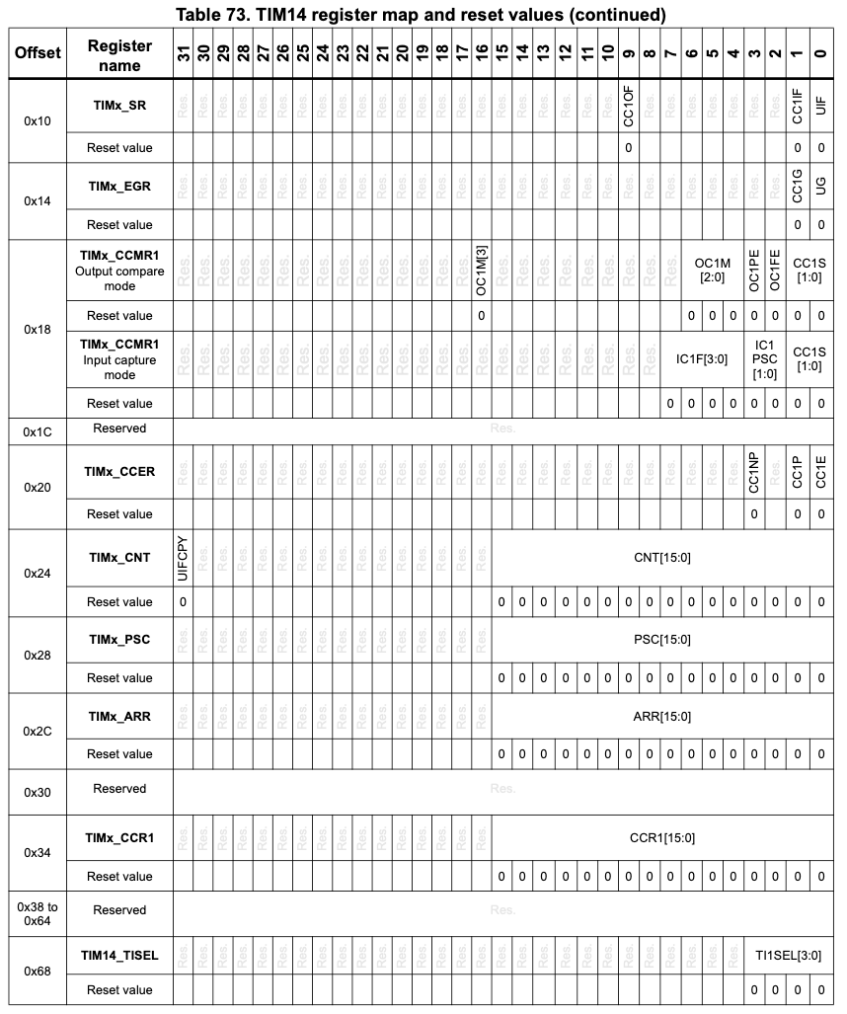
TIM14 Register Map
Control register
Status register
Counter
Prescale value
Auto-reload value

Slide 7
What can you do with a background timer?
Blinky, without wasting processor time in a delaying for-loop
Reading a sensor value (e.g., A/D conversion) at fixed intervals
Keeping time, making timestamps
Running a process at regular intervals
Asserting an output for a desired amount of time
Timing how long an input is asserted
Notes:
Asserting an output for a desired amount of time: you can have an output pin that you hold high for a specified amount of time and then low for a specified time. So just like blinky but without wasting any processor time. You don't have to sit there and generate the high and low signals in code. Rather, it's all done in the hardware. This will be incredibly important next week when we talk about motors.
Can time how long an input is asserted. How long is the signal high for? Start the timer when the signal goes high, stop the timer when the signal goes low, read the counter register value and do the math. Really useful when we make a tachometer for our motor.

Slide 8
Basic idea for programming a timer/counter
Decide how much time needs to pass between interrupts (1 sec, 200 ms, 429 µs, etc)
Determine a counting rate and a top value so that counting from 0 to that value will take the desired amount of time
Configure the control register, the prescale register, the auto-reload register (top value)
Start the timer
Notes:
You don't program the timer with the amount of time. Rather, you tell it the rate at which to count and how many counts it'll take to get to your desired time.

Slide 9
Registers: Only a few are needed for simple timing.
Timer 14
Counter Enable (start it)
Update Interrupt Flag (set by hardware whenever counter updates to 0 after reaching auto-reset value). Your responsibility to clear.

Slide 10
How fast and how far to count?
Our chip and board come with a lot of clock sources, some internal to the chip, some on the board. Up to 48MHz! We simply use the default internal high speed 48 MHz clock, scaled down by default to 12 MHz. Slower = less energy consumption.
Compute how many processor clock cycles your desired delay takes
Clock cycles = clock frequency × delay time
Clock frequency (HSI48 RC internal oscillator, scaled down by 4) = 12 MHz
Ex: A 500 ms delay will take ______________clock cycles.
Problem: This number is too large to be stored in a 16-bit register
Solution: If the desired number of clock cycles is > 65,535 then a prescaler must be used to divide down the system clock frequency in order for the counter to count more slowly.
Note: All timers are on the APB bus
Notes:
Have to do some math…
12,000,000 * 0.5 = 6,000,000 clock cycles. So we'd like to load 6,000,000 into the auto-reload register. What problem do you see with that?
So we need to divide down that clock.

Slide 11
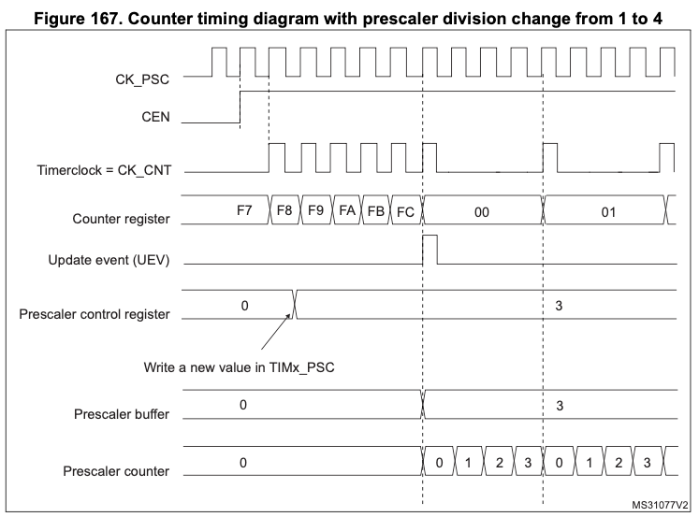
How does the Prescaler work?
clock source
counter enable
timer clock and counter start
counter reaches auto-reset value
new prescaler value takes effect
clock divided down by 4

Slide 12
Selecting the prescaler
Prescaler divides down the processor clock to a lower frequency
Any integer denominator choice is possible, as long as it fits the 16-bit prescaler register!
So any denominator between 1 and 65,536.
You write (denominator - 1) into the register.
Which denominator would you choose for our 500 ms (6,000,000 system clock cycles) timer?
Notes:
6,000,000 / 10,000 = 600
6,000,000 / 6000 = 1000
…

Slide 13
Selecting the prescaler
Prescaler divides down the processor clock to a lower frequency
Any integer denominator choice is possible, as long as it fits the 16-bit prescaler register!
So any denominator between 1 and 65,536.
You write (denominator - 1) into the register.
Which denominator would you choose for our 500 ms (6,000,000 system clock cycles) timer?
Lots of choices:
6,000,000 / 10,000 = 600 (prescaler = 10,000, auto-reload = 600)
6,000,000 / 6000 = 1000 (prescaler = 6000, auto-reload = 1000)
6,000,000 / 12,000 = 500 (prescaler = 12000, auto-reload = 500)
6,000,000 / 60 = 100,000 -> can't count that far
6,000,000 / 65,536 = 91.5527… -> not an integer
Each counter clock tick is 1ms!
Notes:
6,000,000 / 10,000 = 600
6,000,000 / 6000 = 1000
…

Slide 14
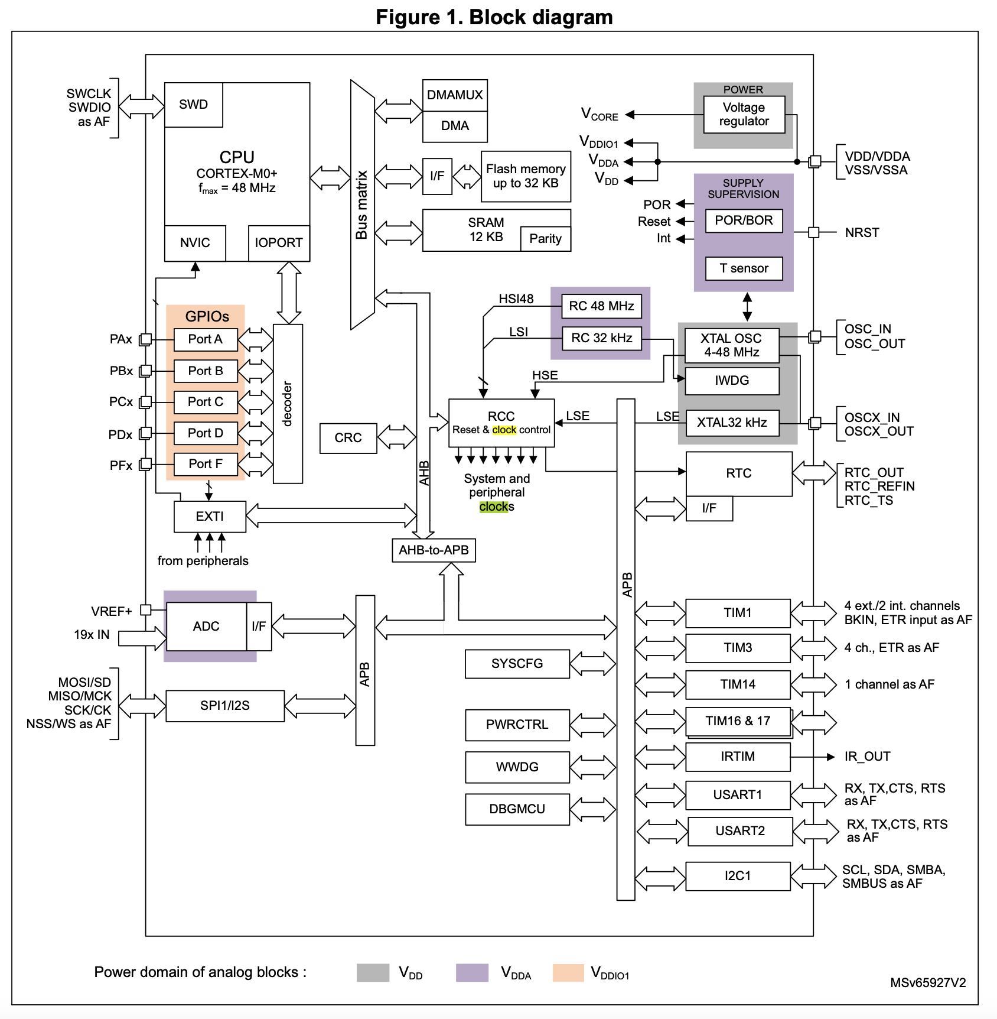
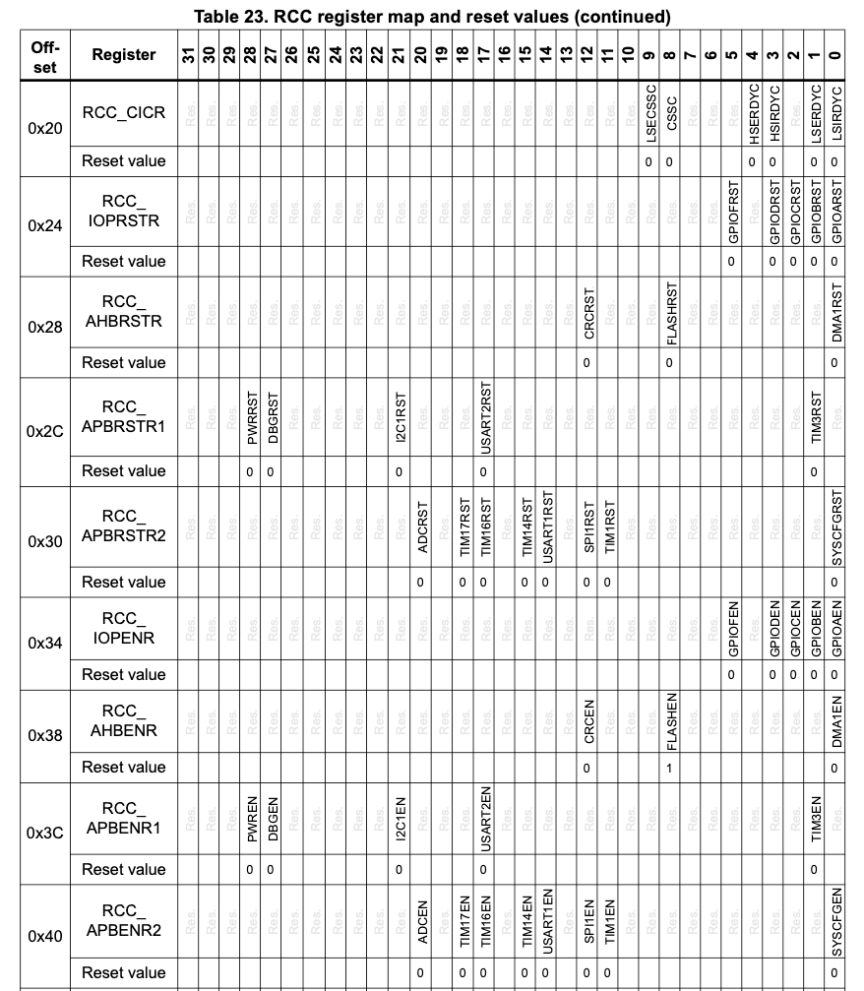
Counter/Timer Setup, 1
Enable clock access to timer 14 on the APB bus
RCC->APBENR2 |= RCC_APBENR2_TIM14EN;

Slide 15
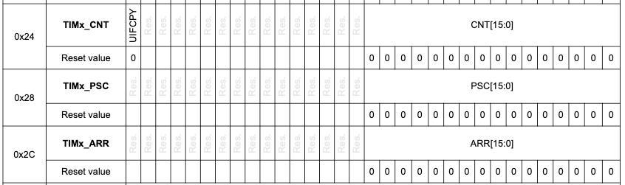
Counter/Timer Setup, 2
2. Set prescaler value:
Counter starts counting at 0, so subtract 1 from desired value.
#define PSC_FACTOR 12000 TIM14->PSC = PSC_FACTOR - 1;
3. Load maximum count into auto-reload register:
Counter will count to this value, then trigger the interrupt and reset to 0
#define ARR_FACTOR 500 TIM14->ARR = ARR_FACTOR - 1;
4. Clear the counter (wouldn't want to start counting at a random value):
TIM14->CNT = 0;

Slide 16
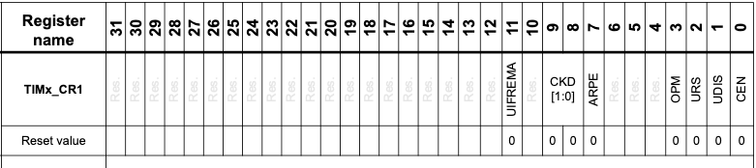
Counter/Timer Setup, 3
5. Enable timer: TIM14->CR1 |= TIM_CR1_CEN;
Summary: Timer Initialization:
void tim14_500ms_init() {
// enable clock access to timer 14 (on APB bus)
RCC->APBENR2 |= RCC_APBENR2_TIM14EN;
// Set prescaler value
TIM14->PSC = PSC_FACTOR - 1; // starts counting at 0
// Set auto-reload value
TIM14->ARR = ARR_FACTOR - 1;
// Clear counter
TIM14->CNT = 0;
// Enable timer
TIM14->CR1 |= TIM_CR1_CEN;
}

Slide 17
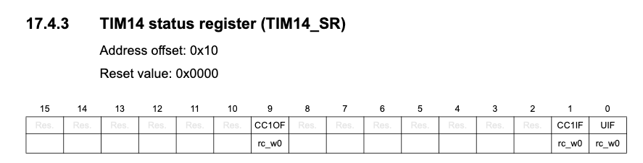
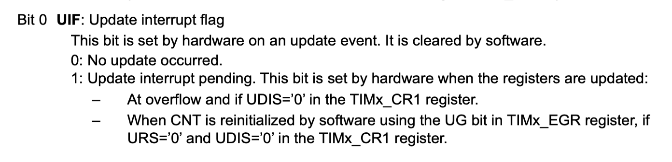
Timer 14 Status Register (TIM14_SR)
Now the counter is running… How do you know whether it has reached its top (autoreload) value?
Current Strategy:
Continuously check (poll) the UIF.
Once it goes up, clear the flag and and toggle the LED.

Slide 18
Timer 14 Status Register (TIM14_SR)
So we must clear the UIF bit via
TIM14->SR = ~TIM_SR_UIF;
Is it also okay to clear this bit via
TIM14->SR &= ~TIM_SR_UIF; ???
Have we seen something like this before?
Notes:
So the issue isn't as grave as with a rc_w1 bit, since writing a 1 has no effect. Writing a 0 to any bit that was already 0 just keeps it 0, and writing a 1 to any bit that was already 1 has no effect. But: The &= solution could still suffer from a race condition if another bit got modified via an interrupt in the middle of this operation.

Slide 19
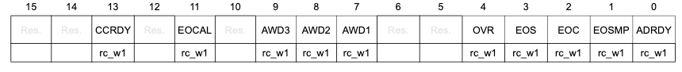
Recall: ADRDY bit in ADC_ISR register
We have to clear a bit (for example ADRDY) in this register using an assignment operator:
ADC1->ISR = ADC_ISR_ADRDY;
What could go wrong if we used the bitwise OR assignment operator instead?
ADC1->ISR |= ADC_ISR_ADRDY;

Slide 20
Recall: ADRDY bit in ADC_ISR register
We have to clear a bit (for example FPIF4) in this register using an assignment operator:
ADC1->ISR = ADC_ISR_ADRDY;
General Purpose Registers
… | …
…00000001 | R2
… | R3
Register name | Value
… | …
ADC_ISR | …00010101
… | …
ADC_ISR | …00010100

Slide 21
Recall: ADRDY bit in ADC_ISR register
We have to clear a bit (for example ADRDY) in this register using an assignment operator:
ADC1->ISR = ADC_ISR_ADRDY;
What could go wrong if we used the bitwise OR assignment operator instead?
ADC1->ISR |= ADC_ISR_ADRDY;
General Purpose Registers
… | …
…00000001 | R2
…00010101 | R3
Register name | Value
… | …
ADC_ISR | …00010101
… | …
Bitwise OR
…00010101 | R3
ADC_ISR | …00000000

Slide 22
Back to UIF bit in TIM14_SR
Compare with ADRDY bit in ADC_ISR register
Clear UIF bit via TIM14->UIF = ~TIM_SR_UIF;
Clear ARDY bit via ADC1->ISR = ADC_ISR_ADRDY;

Slide 23
The moral of the story…
For all peripheral status registers: bits are of rc_w1 or rc_w0 type.
Status registers in peripherals are "changed from inside", i.e. hardware changes their values.
Such a changed value (a "flag") indicates a state change of the hardware.
The user then "lowers the flag" by writing a certain value to the same register.
The various peripherals' IPs in STM32 have various origins (purchased from 3rd parties, developed in-house, historically various purposes, etc).
Thus the exact method how the status bits are cleared varies.
The correct way to clear a flag in a rc_w0 versus rc_w1 register is by writing a mask, for example:
TIM14->SR = ~TIM_SR_UIF; // rc_w0
ADC->ISR = ADC_ISR_ADRDY; // rc_w1
Notes:
Status registers in peripherals are "changed from inside", i.e. hardware changes their values (usually single bits) indicating various state changes of the hardware, the change is "acknowledged" by the user by writing a certain value to the same register.

Slide 24
Example: Blinky with a timer
Make a copy your TemplateProject, call the new project BlinkyTimerPolled.
Download blinkyTimerPolled.c from Canvas and put it in your new project's "Src" folder.
Build and run as per usual. You should see the on-board LED blink.

Slide 25
The whole thing
#include <stdio.h>
#include "ES28.h"
#define LED (1U<<5) // on-board LED
#define PSC_FACTOR 12000 // 1 kHz
#define ARR_FACTOR 500 // 2 Hz
void tim14_500ms_init();
int main(void) {
RCC->IOPENR |= RCC_IOPENR_GPIOAEN;
GPIOA->MODER &= ~GPIO_MODER_MODE5_Msk;
GPIOA->MODER |= (GPIO_OUTPUT <<
GPIO_MODER_MODE5_Pos);
GPIOA->ODR &= ~(LED); // LED is off
tim14_500ms_init();
while(1) {
if (TIM14->SR & TIM_SR_UIF) {
// Clear UIF in status register
TIM14->SR &= ~TIM_SR_UIF;
GPIOA->ODR ^= LED; // toggle LED
}
// Could do other stuff like poll
// a button here.
}
return 1;
}
void tim14_500ms_init() {
// enable clock access to timer 14
RCC->APBENR2 |= RCC_APBENR2_TIM14EN;
// Set prescaler value
TIM14->PSC = PSC_FACTOR - 1;
// Set auto-reload value
TIM14->ARR = ARR_FACTOR - 1;
// Clear counter
TIM14->CNT = 0;
// Enable timer
TIM14->CR1 |= TIM_CR1_CEN;
}

Slide 26
Introduction to Interrupts
Remember the button race game from Lab 2?
Two players, each has a button and an LED
Game LED flashes three times (a countdown)
When game LED comes on steady the players race to push their button as quickly as possible.
The player whose button is pushed first wins.
Trying to prevent "false starts" during the countdown period was challenging, especially while the code was "stuck" in a delaying for-loop.
We could now do this better, using our timer! But… still not great to constantly ask whether the timer has elapsed or the button has been pushed!
Notes:
Issues: If the button is pressed and released during the 1-second delay period it won't register as a reset.

Slide 27
Analogy
You are working on your next ENGS28 lab assignment. You have a clarification question and just sent off a message to Professor Bonfert-Taylor. Two strategies:
(1) You stare at your email program to will it to show you a response. After you hear from Professor Bonfert-Taylor you return to your lab.
(1a) You continue working through the lab. After every 20 characters read from the handout, you check your email for a response from Professor Bonfert-Taylor.
(2) You continue working through the lab. When your email program pings you with a notification, you check your email and find Professor Bonfert-Taylor's reply.
Which strategy is more efficient? Why?

Slide 28
Interrupts
In Methods 1 and 1a, you are polling your inbox (and not getting much work done). In Method 2 you continue working until your email program interrupts your thoughts to notify you that you have a new message. We can do the same in programming. Rather than using processor cycles to continuously poll each peripheral device, the responsibility to notify rests with the device, via an interrupt signal to the processor.
What can a processor do with the cycles that it saves by not polling?
It can do lots of calculations, since interrupts are relatively infrequent.
It can go into sleep mode to save power (very important for battery-powered systems). The interrupt wakes the processor long enough to handle the interrupting event, then the processor goes back to sleep.

Slide 29
How interrupts work (machine level)

Slide 30
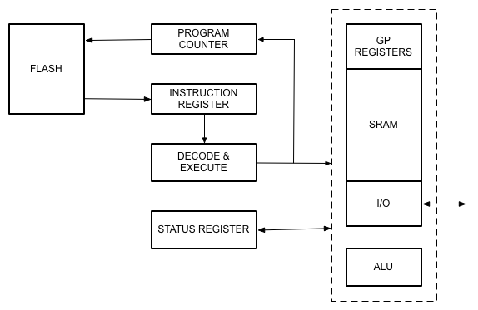
Normal program execution
DATAPATH
Notes:
flash : where program is stored
Program counter points at next instruction to be executed
Fetches instruction, puts it into the instruction register, gets decoded and executed (read registers, do arithmetic, do IO, etc).
When all done, program counter increments, fetch next instruction , etc.

Slide 31
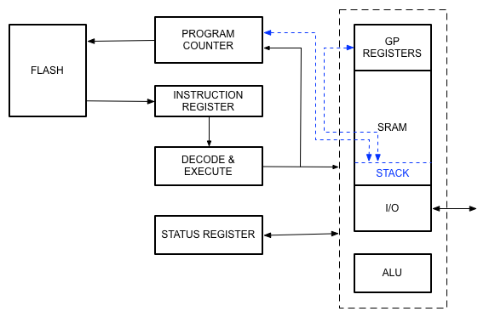
What happens when a function is called
DATAPATH
Function call:
Push machine state (PC + certain GP registers) onto stack.
Load address of function start into PC and continue.
Return:
Pop machine state from stack.
Increment PC and continue.
Notes:
Save machine state, jump to function, at end of function pop machine state, go to next instruction.
In flash memory, the code for the function lives in a different location from the main code. The starting address for that function is jumped to at the function call in the main code. At that instant, the current program counter is pushed onto the stack for later retrieval.
The way this jump happens is that part of the machine language instruction is the starting address of the function. So normal program flow is hijacked so that the program counter now points to the first instruction of the function. At the end of the function, the program counter is updated with what was previously pushed onto the stack, namely the address of the next instruction in the main code. Any registers were also pushed onto the stack during the initial jump (machine state was preserved).
So the last instruction in the function is to "pick up where you left off before". Registers get restored off the stack also.

Slide 32
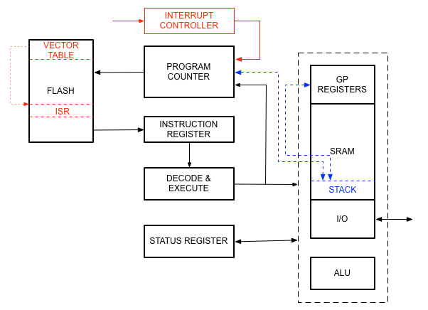
What happens when an interrupt occurs
What if we get two interrupts at the same time???
DATAPATH
When interrupt occurs:
Push machine state onto stack.
Interrupt controller loads vector (address of ISR) into PC.
Jump to ISR (address in flash).
When ISR returns, pop machine state from stack.
Execute next instruction before processing another interrupt.
Notes:
Something very similar happens during an interrupt. It causes a special function to be executed, namely an interrupt service routine.
A variety of things on the processor can cause an interrupt. Today: look at pin change interrupt.
Interrupt controller sees that an interrupt occurred, checks who interrupted, and based on that loads into the program counter the address from the vector table (a table that holds the starting addresses of the ISRs). From there it hops to the ISR. Interrupt vectors are always in the same spot in flash memory. Compiler fills in the jump-to addresses in that table, based on the length of your ISR code. Sort of like an indirect function call, caused by an external signal.
Function call is per usual: save machine state, do your thing, then pop machine state off the stack, return to previous location.
Interrupts can happen at *any* time, even while your code is stuck in a delay_ms. Interrupt is executed, then code returns to the delay_ms.

Slide 33
What happens when an interrupt occurs
What if we get two interrupts at the same time???
DATAPATH
When interrupt occurs:
Check priority level - service interrupt with highest priority first.
Notes:
Something very similar happens during an interrupt. It causes a special function to be executed, namely an interrupt service routine.
A variety of things on the processor can cause an interrupt. Today: look at pin change interrupt.
Interrupt controller sees that an interrupt occurred, checks who interrupted, and based on that loads into the program counter the address from the vector table (a table that holds the starting addresses of the ISRs). From there it hops to the ISR. Interrupt vectors are always in the same spot in flash memory. Compiler fills in the jump-to addresses in that table, based on the length of your ISR code. Sort of like an indirect function call, caused by an external signal.
Function call is per usual: save machine state, do your thing, then pop machine state off the stack, return to previous location.
Interrupts can happen at *any* time, even while your code is stuck in a _delay_ms. Interrupt is executed, then code returns to the _delay_ms.

Slide 34
Programming for interrupts

Slide 35
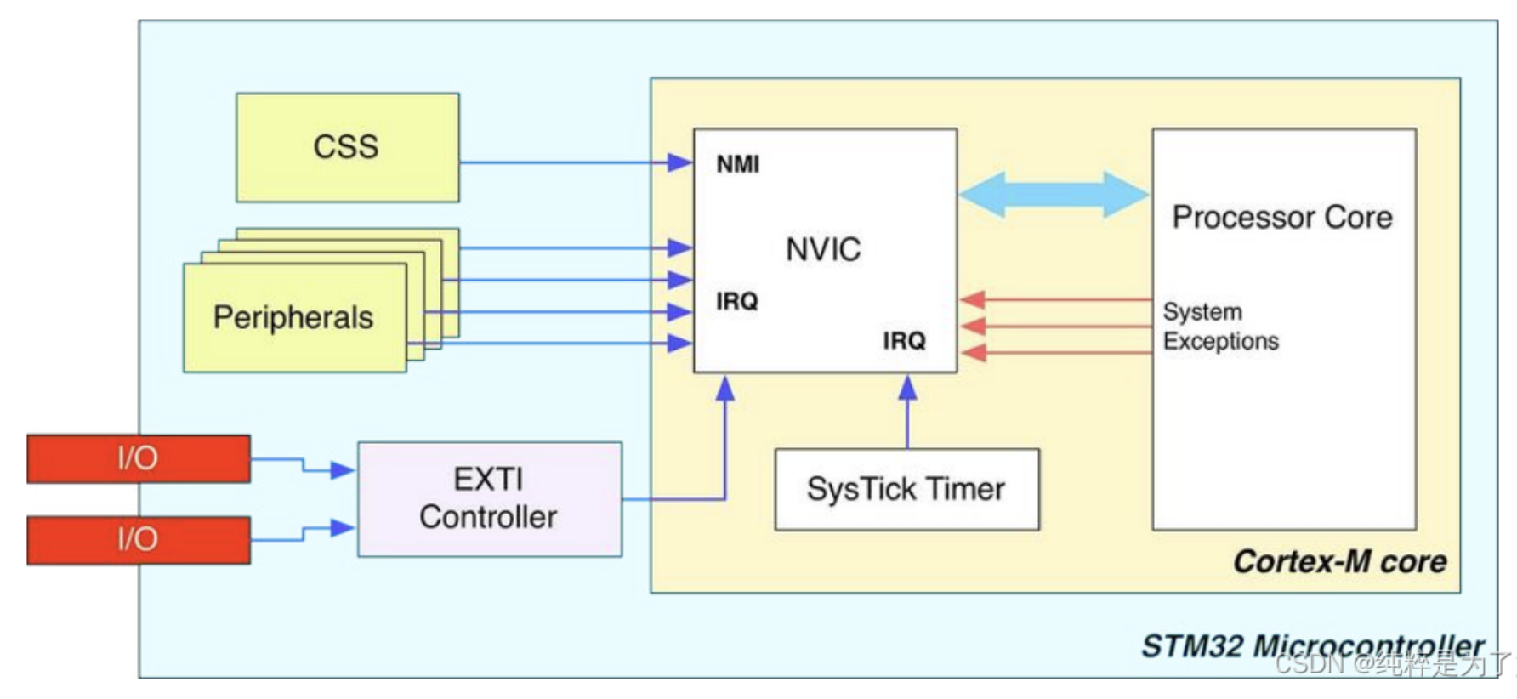
Back to our example:
Our timer can be programmed to generate an interrupt when it reaches its autoreload value.
Interrupt requests (IRQs) are handled by the Nested Vector Interrupt Controller (NVIC) which interacts with the CPU to process the IRQs.
When an IRQ is processed, an Interrupt Service Routine (ISR), which you program, is executed. When the ISR terminates the processor resumes normal program execution.

Slide 36
Example: ADC operation while blinking an LED
Handling an Interrupt Request
Suspend main thread
Save CPU state
Execute ISR
Restore CPU state
Resume main thread
Initialize ADC and Timer
Timer Interrupt
Start ADC Conversion
Read Sensor Value
Timer Interrupt Service Routine (ISR)
Clear the Timer Interrupt Flag
Toggle LED
Print Value
Kill Time
Next Timer Interrupt

Slide 37
What we need to do to program a timer interrupt
Configure timer:
Decide how much time needs to pass between interrupts (1 sec, 200 ms, 429 µs, etc)
Determine a counting rate and a top value so that counting from 0 to that value will take the desired amount of time
Configure the control register, prescale register, auto-reload register (top value)
Enable timer interrupts in the timer itself
Enable timer interrupt in the NVIC
Start the timer
Write an ISR
Clear the interrupt flag
Communicate with main program via global variables

Slide 38
Enable Timer Interrupt in the Timer Itself
Timer 14
Counter Enable (start it)
Update Interrupt Enable (interrupt whenever counter updates to 0 after reaching auto-reset value)
Update Interrupt Flag (set by hardware whenever counter updates to 0 after reaching auto-reset value). Your responsibility to clear.

Slide 39
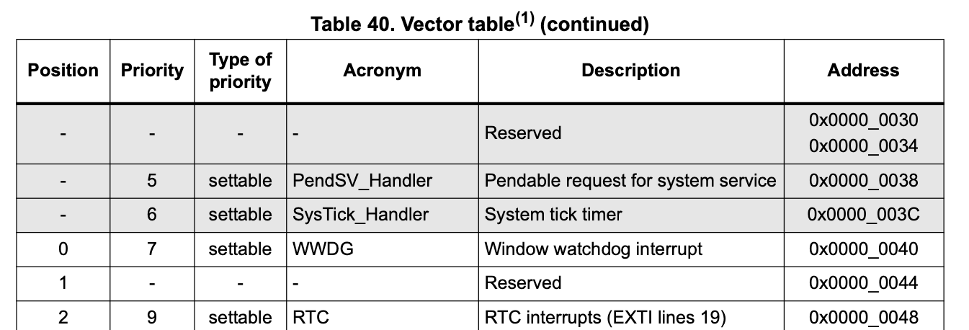
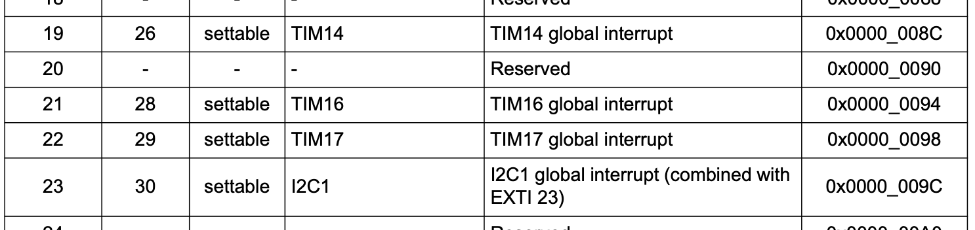
Tell the NVIC to enable interrupts from Timer 14: CMSIS function NVIC_EnableIRQ()
CMSIS = Common Microcontroller Software Interface Standard
Prototype: void NVIC_EnableIRQ(IRQn_Type IRQn);
…
NVIC_EnableIRQ(TIM14_IRQn);

Slide 40
Complete Timer Configuration:
void tim14_500ms_interrupt_init() {
// disable global interrupt
__disable_irq();
// enable clock access to timer 14 (on APB bus)
RCC->APBENR2 |= RCC_APBENR2_TIM14EN;
// Set prescaler value
TIM14->PSC = PSC_FACTOR - 1; // starts counting at 0
// Set auto-reload value
TIM14->ARR = ARR_FACTOR - 1;
// Clear counter
TIM14->CNT = 0;
// Enable update interrupt
TIM14->DIER |= TIM_DIER_UIE;
// Enable timer interrupt in NVIC
NVIC_EnableIRQ(TIM14_IRQn);
// Enable timer
TIM14->CR1 |= TIM_CR1_CEN;
// Enable global interrupts
__enable_irq();
}

Slide 41
Write an Interrupt Service Routine (ISR)
ISRs have special names (must get this right!)
No values may be returned.
No arguments may be passed in.
The actual code inside the ISR is simple. Don’t hang out in an ISR!
Priority | Interrupt Name | Description | IRQ Handler
(...)
12 | EXTI0_1_IRQn | EXTI line 0 & 1 interrupt | EXTI0_1_IRQHandler
13 | EXTI2_3_IRQn | EXTI line 2 & 3 interrupt | EXTI2_3_IRQHandler
14 | EXTI4_15_IRQn | EXTI line 4 to 15 interrupt | EXTI4_15_IRQHandler
(...)
19 | ADC1_IRQn | ADC interrupt | ADC_IRQHandler
(...)
26 | TIM14_IRQn | Timer 14 Interrupt | TIM14_IRQHandler
(...)
35 | USART2_IRQn | USART2 global interrupt | USART2_IRQHandler
Name of the ISR
Notes:
IRQ Handler names can be found in startup_stm32c031ctx.s

Slide 42
Example: Blinky with a timer
void tim14_500ms_interrupt_init() {
// disable global interrupt
__disable_irq();
// enable clock access to timer 14
RCC->APBENR2 |= RCC_APBENR2_TIM14EN;
// Set prescaler value
TIM14->PSC = PSC_FACTOR - 1;
// Set auto-reload value
TIM14->ARR = ARR_FACTOR - 1;
// Clear counter
TIM14->CNT = 0;
// Enable update interrupt
TIM14->DIER |= TIM_DIER_UIE;
// Enable timer interrupt in NVIC
NVIC_EnableIRQ(TIM14_IRQn);
// Enable timer
TIM14->CR1 |= TIM_CR1_CEN;
// enable global interrupt
__enable_irq();
}
void TIM14_IRQHandler(void) {
// disable global interrupt
__disable_irq();
TIM14->SR = ~TIM_SR_UIF; // Clear UIF
timerElapsed = 1; // set global flag
// Enable global interrupts
__enable_irq();
}
#include <stdio.h>
#include "ES28.h"
#define LED (1U<<5) // blinking the on-board LED
#define PSC_FACTOR 12000 // 12 MHz/12000 = 1 kHz
#define ARR_FACTOR 500 // 1 kHz/500 = 2 Hz
void tim14_500ms_interrupt_init();
volatile int timerElapsed; // global flag
int main(void) {
// Enable clock access to GPIOA
RCC->IOPENR |= RCC_IOPENR_GPIOAEN;
// Set PA5 as output pin
GPIOA->MODER &= ~GPIO_MODER_MODE5_Msk;
GPIOA->MODER |= (GPIO_OUTPUT <<
GPIO_MODER_MODE5_Pos);
GPIOA->ODR &= ~(LED); // Start LED as off
timerElapsed = 0; // initialize flag
// Initialize the 500 ms timer
tim14_500ms_interrupt_init();
while(1) {
if (timerElapsed) {
timerElapsed = 0; // clear flag
GPIOA->ODR ^= LED; // toggle LED
}
}
}

Slide 43
Communicating with ISRs
#include "ES28.h" volatile int timerElapsed; // shared variable int main(void) { timerElapsed = 0; while (1) { if (timerElapsed) { // do something timerElapsed = 0; } else { // do something else } } return 0; }
void TIM14_IRQHandler(void) {
_disable_irq(); // disable global interrupts
TIM14->SR = ~TIM_SR_UIF; // Clear UIF
timerElapsed = 1;
__enable_irq(); // Enable global interrupts
}
Global variables can be shared between main code and ISRs
ISRs can modify global variables, other code can check for changes in those variables
A flag is a variable that indicates whether a desired event has occurred. Steps:
Initialize global flag to 0
ISR sets flag (if event has occurred)
Other code checks flag, then resets to 0.

Slide 44
Don't dawdle inside an ISR!
Why not?
At the start of the ISR we are disabling global interrupts so that another interrupt cannot interrupt us.
Technically you don't have to disable interrupts here since our chip has the ability to keep track of nested interrupts. But can you imagine the mess this could cause?
Huh?
If you do lots of stuff inside one ISR, other interrupts could occur (and be ignored) during that time, delaying important actions.
We repeat:
Never do long-latency work inside an ISR.
Get in and out of an ISR quickly.
Do not call functions within an ISR that will take a long time to complete.
Instead: Set a flag in the ISR and do the actual work elsewhere.

Slide 45
“Volatile” variables
But, declaring a global variable as volatile tells the compiler not to optimize the code but always to get the latest value of the variable.
volatile uint8_t timerElapsed; // shared variable
int main(void) { timerElapsed = 0; while (1) { if (timerElapsed) { // do something timerElapsed = 0; } else { // do something else } } return 0; }
void TIM14_IRQHandler(void) {
_disable_irq(); // disable global interrupts
TIM14->SR = ~TIM_SR_UIF; // Clear UIF
timerElapsed = 1;
__enable_irq(); // Enable global interrupts
}
The compiler can be too helpful…
If "volatile" is left out:
Compiler notices that timerElapsed never changes inside main() (it’s always 0).
Compiler “optimizes” the code, to avoid reading timerElapsed from memory all the time.
Consequently:
while (1) { if (0) { // do something } else { // do something else } }

Slide 46
Summary: For any interrupt
Define the appropriate ISR: be sure to use the correct name, check whether your desired event occurred, clear that event's pending flag, set a flag (via a global volatile variable) that you then check in your main code.
void TIM14_IRQHandler(void) {
_disable_irq(); // disable global interrupts
TIM14->SR = ~TIM_SR_UIF; // Clear UIF
timerElapsed = 1;
__enable_irq(); // Enable global interrupts
}
During initialization, enable the interrupt source.
// Enable update interrupt
TIM14->DIER |= TIM_DIER_UIE;
// Enable timer interrupt in NVIC
NVIC_EnableIRQ(TIM14_IRQn);
Wait for the interrupt to occur or invoke behavior that will eventually lead to an interrupt, e.g., timer resets to 0 upon reaching autoreload value.

Slide 47
Example: Blinky with a timer
void tim14_500ms_interrupt_init() {
// disable global interrupt
__disable_irq();
// enable clock access to timer 14
RCC->APBENR2 |= RCC_APBENR2_TIM14EN;
// Set prescaler value
TIM14->PSC = PSC_FACTOR - 1;
// Set auto-reload value
TIM14->ARR = ARR_FACTOR - 1;
// Clear counter
TIM14->CNT = 0;
// Enable update interrupt
TIM14->DIER |= TIM_DIER_UIE;
// Enable timer interrupt in NVIC
NVIC_EnableIRQ(TIM14_IRQn);
// Enable timer
TIM14->CR1 |= TIM_CR1_CEN;
// enable global interrupt
__enable_irq();
}
void TIM14_IRQHandler(void) {
// disable global interrupt
__disable_irq();
TIM14->SR = ~TIM_SR_UIF; // Clear UIF
timerElapsed = 1; // set global flag
// Enable global interrupts
__enable_irq();
}
#include <stdio.h>
#include "ES28.h"
#define LED (1U<<5) // blinking the on-board LED
#define PSC_FACTOR 12000 // 12 MHz/12000 = 1 kHz
#define ARR_FACTOR 500 // 1 kHz/500 = 2 Hz
void tim14_500ms_interrupt_init();
volatile int timerElapsed; // global flag
int main(void) {
// Enable clock access to GPIOA
RCC->IOPENR |= RCC_IOPENR_GPIOAEN;
// Set PA5 as output pin
GPIOA->MODER &= ~GPIO_MODER_MODE5_Msk;
GPIOA->MODER |= (GPIO_OUTPUT <<
GPIO_MODER_MODE5_Pos);
GPIOA->ODR &= ~(LED); // Start LED as off
timerElapsed = 0; // initialize flag
// Initialize the 500 ms timer
tim14_500ms_interrupt_init();
while(1) {
if (timerElapsed) {
timerElapsed = 0; // clear flag
GPIOA->ODR ^= LED; // toggle LED
}
}
}
Note: Since you will never call an ISR from within your code, it does not need a prototype.
Upload this code to Canvas, it's already in the IDE
Add a second version that toggles directly in the ISR?

Slide 48
Run blinkyTimerInt!
Update the resource configurations:
Exclude blinkyTimerPolled.c from the build configuration and
Include blinkyTimerInt.c instead.
Compile and upload to your Nucleo, observe how the on-board LED blinks just as nicely.

Slide 49
Homework for Tuesday:
Update the Canvas assignment.
Modify
ADCPot.c
so that in addition to performing the ADC readings, the on-board LED is blinking at a steady rate of ⅓ second on, ⅓ second off, using a timer interrupt.
Hint: You may wish to toggle the LED directly in the ISR.
Hmmm… Should we instead have them use two timers, one for the LED, one for the ADC readings, so that we don't have the delay_ms in the ADCPot code?

Slide 50
Homework for Tuesday
Initialize ADC and Timer
Timer Interrupt
Start ADC Conversion
Read Sensor Value
Timer Interrupt Service Routine (ISR)
Clear the Timer Interrupt Flag
Toggle LED
Print Value
Kill Time
Next Timer Interrupt

Slide 51
Coding Challenge: Blinky with T_{on} ≠ T_{off}
Not as practically useful, but a good intellectual exercise.
This one is just for fun. No need to upload a solution.

Slide 52
Blinky with timer:
T_{ON} ≠ T_{OFF}
int main(void) {
RCC->IOPENR |= RCC_IOPENR_GPIOAEN;
GPIOA->MODER |= (1U<<10);
GPIOA->MODER &=~(1U<<11);
GPIOA->ODR &= ~(LED); // LED is off
state = LEDOFF;
timerFlag = 0;
tim14_ms_interrupt_init(T_OFF);
while(1) {
if (timerFlag) {
GPIOA->ODR ^= LED; switch (state) {
case LEDOFF:
TIM14->ARR = T_ON-1;
state = LEDON;
break;
case LEDON:
TIM14->ARR = T_OFF-1;
state = LEDOFF;
break;
}
timerFlag = 0;
}
}
}
#include <stdio.h>
#include "ES28.h"
#include "tim.h"
#define LED (1U<<5) // on-board LED
#define T_ON 200 // 200 ms
#define T_OFF 800 // 800 ms
typedef enum {LEDON, LEDOFF} state_t;
volatile state_t state;
volatile int timerFlag;
void TIM14_IRQHandler(void) {
__disable_irq();
/* Clear UIF in status register */
TIM14->SR = ~TIM_SR_UIF;
timerFlag = 1;
__enable_irq();
}

