Slide 1


Engs 28
Embedded Systems
Day 9

Slide 2
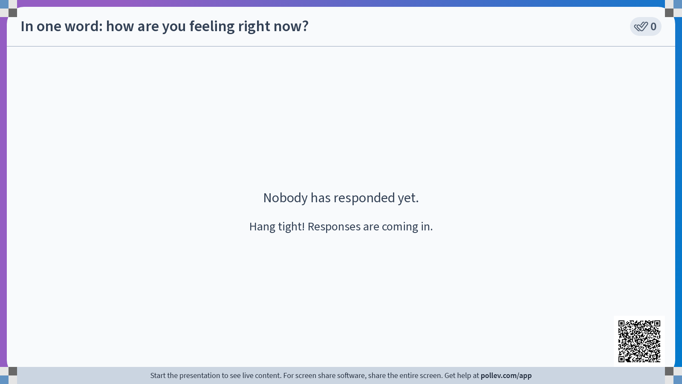

Slide 3
Midterm Survey Results
Thank you for completing the survey (on time…)
You should have heard from your Learning Fellow about feedback for your team.

Slide 4
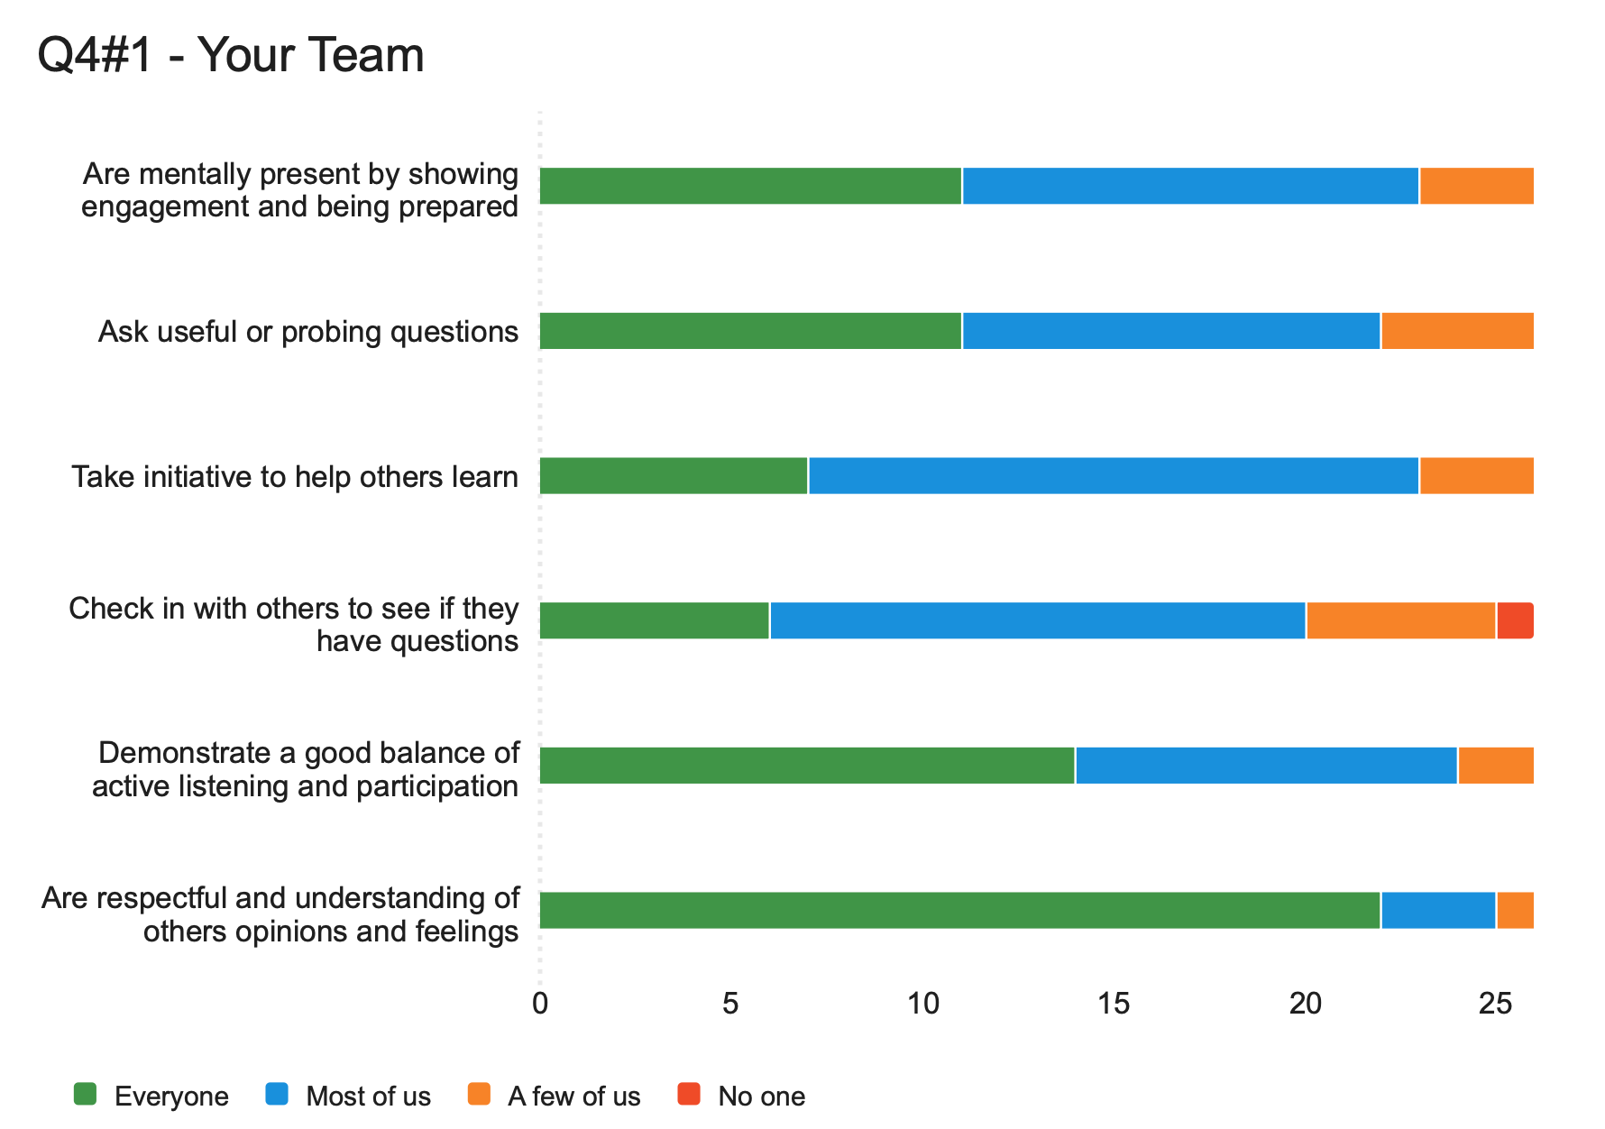
Midterm Survey Results

Slide 5
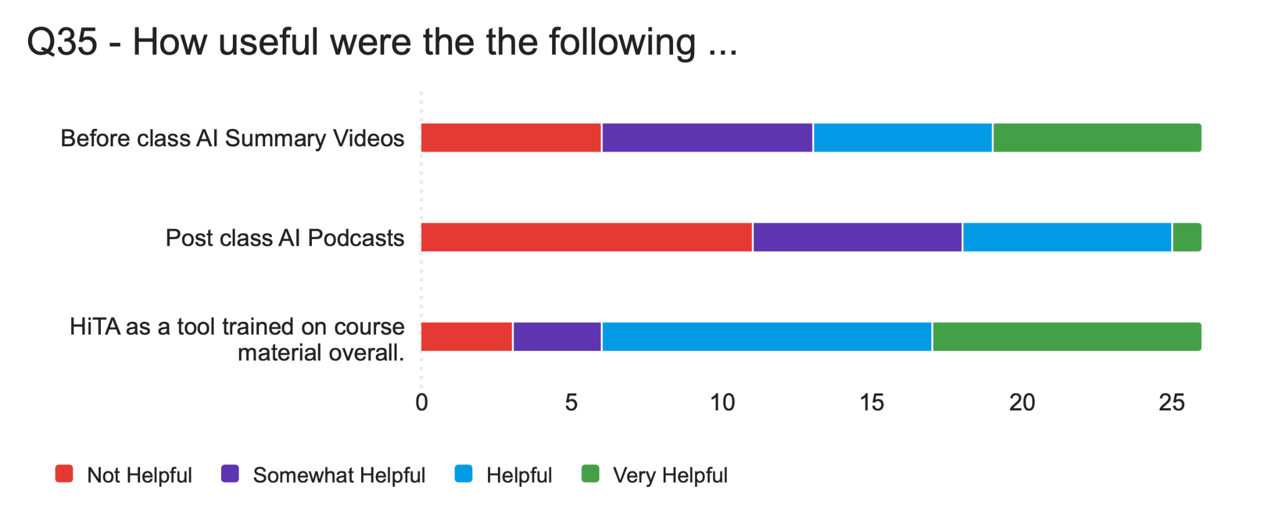
Midterm Survey Results

Slide 6
Agenda
Review timer interrupts
GPIO interrupts

Slide 7
Recall: For any interrupt
Define the appropriate ISR: be sure to use the correct name, check whether your desired event occurred, clear that event's pending flag, set a flag (via a global volatile variable) that you then check in your main code.
void TIM14_IRQHandler(void) {
_disable_irq(); // disable global interrupts
TIM14->SR = ~TIM_SR_UIF; // Clear UIF
timerElapsed = 1;
__enable_irq(); // Enable global interrupts
}
During initialization, enable the interrupt source.
// Enable update interrupt
TIM14->DIER |= TIM_DIER_UIE;
// Enable timer interrupt in NVIC
NVIC_EnableIRQ(TIM14_IRQn);
Wait for the interrupt to occur or invoke behavior that will eventually lead to an interrupt, e.g., timer resets to 0 upon reaching autoreload value.

Slide 8
Example: Blinky with a timer
void tim14_500ms_interrupt_init() {
// disable global interrupt
__disable_irq();
// enable clock access to timer 14
RCC->APBENR2 |= RCC_APBENR2_TIM14EN;
// Set prescaler value
TIM14->PSC = PSC_FACTOR - 1;
// Set auto-reload value
TIM14->ARR = ARR_FACTOR - 1;
// Clear counter
TIM14->CNT = 0;
// Enable update interrupt
TIM14->DIER |= TIM_DIER_UIE;
// Enable timer interrupt in NVIC
NVIC_EnableIRQ(TIM14_IRQn);
// Enable timer
TIM14->CR1 |= TIM_CR1_CEN;
// enable global interrupt
__enable_irq();
}
void TIM14_IRQHandler(void) {
// disable global interrupt
__disable_irq();
TIM14->SR = ~TIM_SR_UIF; // Clear UIF
timerElapsed = 1; // set global flag
// Enable global interrupts
__enable_irq();
}
#include <stdio.h>
#include "ES28.h"
#define LED (1U<<5) // blinking the on-board LED
#define PSC_FACTOR 12000 // 12 MHz/12000 = 1 kHz
#define ARR_FACTOR 500 // 1 kHz/500 = 2 Hz
void tim14_500ms_interrupt_init();
volatile int timerElapsed; // global flag
int main(void) {
// Enable clock access to GPIOA
RCC->IOPENR |= RCC_IOPENR_GPIOAEN;
// Set PA5 as output pin
GPIOA->MODER &= ~GPIO_MODER_MODE5_Msk;
GPIOA->MODER |= (GPIO_OUTPUT <<
GPIO_MODER_MODE5_Pos);
GPIOA->ODR &= ~(LED); // Start LED as off
timerElapsed = 0; // initialize flag
// Initialize the 500 ms timer
tim14_500ms_interrupt_init();
while(1) {
if (timerElapsed) {
timerElapsed = 0; // clear flag
GPIOA->ODR ^= LED; // toggle LED
}
}
}
Note: Since you will never call an ISR from within your code, it does not need a prototype.

Slide 9
Recall homework for today:
Modify
ADCPot.c
so that in addition to performing the ADC readings, the on-board LED is blinking at a steady rate of ⅓ second on, ⅓ second off, using a timer interrupt.
Hint: You may wish to toggle the LED directly in the ISR.
Discuss and compare your code with your group.

Slide 10
Another Blinky with a timer
void tim14_500ms_interrupt_init() {
// disable global interrupt
__disable_irq();
// enable clock access to timer 14
RCC->APBENR2 |= RCC_APBENR2_TIM14EN;
// Set prescaler value
TIM14->PSC = PSC_FACTOR - 1;
// Set auto-reload value
TIM14->ARR = ARR_FACTOR - 1;
// Clear counter
TIM14->CNT = 0;
// Enable update interrupt
TIM14->DIER |= TIM_DIER_UIE;
// Enable timer interrupt in NVIC
NVIC_EnableIRQ(TIM14_IRQn);
// Enable timer
TIM14->CR1 |= TIM_CR1_CEN;
// enable global interrupt
__enable_irq();
}
void TIM14_IRQHandler(void) {
// disable global interrupt
__disable_irq();
TIM14->SR = ~TIM_SR_UIF; // Clear UIF
GPIOA->ODR ^= LED; // toggle LED
// Enable global interrupts
__enable_irq();
}
#include <stdio.h>
#include "ES28.h"
#define LED (1U<<5) // blinking the on-board LED
#define PSC_FACTOR 12000 // 12 MHz/12000 = 1 kHz
#define ARR_FACTOR 500 // 1 kHz/500 = 2 Hz
void tim14_500ms_interrupt_init();
int main(void) {
// Enable clock access to GPIOA
RCC->IOPENR |= RCC_IOPENR_GPIOAEN;
// Set PA5 as output pin
GPIOA->MODER &= ~GPIO_MODER_MODE5_Msk;
GPIOA->MODER |= (GPIO_OUTPUT <<
GPIO_MODER_MODE5_Pos);
// Start LED as off
GPIOA->ODR &= ~(LED);
// Initialize the 500 ms timer
tim14_500ms_interrupt_init();
while(1) {
// empty while loop
}
}
Notes:
Careful in general - don't change any data in the ISR (will discuss this later). Toggling an LED is okay though.

Slide 11
GPIO Interrupts

Slide 12
Remember the button race game from Lab 2?
Can we get an interrupt from a button push?
Two players, each has a button and an LED
Game LED flashes three times (a countdown)
When game LED comes on steady the players race to push their button as quickly as possible.
The player whose button is pushed first wins.
Trying to prevent "false starts" during the countdown period was challenging, especially while the code was "stuck" in a delaying for-loop.
Notes:
Issues: If the button is pressed and released during the 1-second delay period it won't register as a reset.

Slide 13
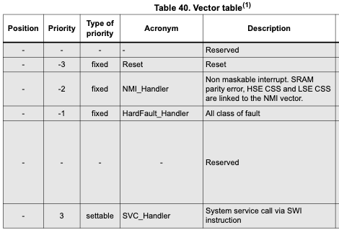
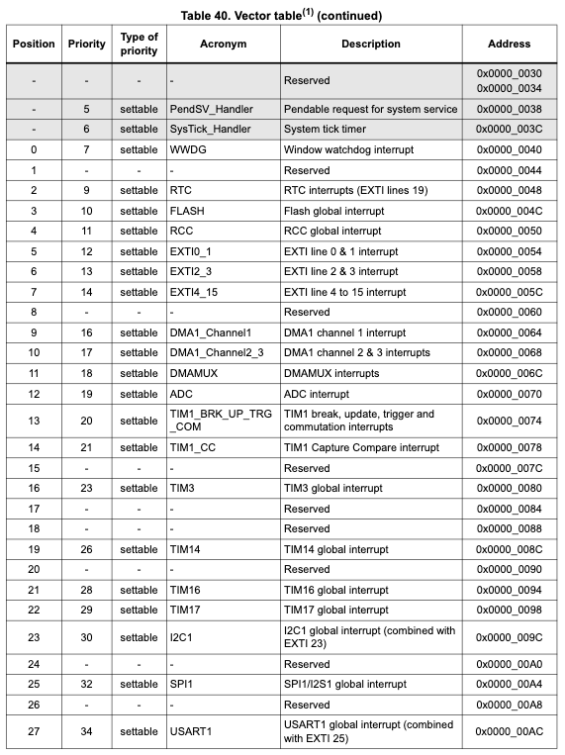
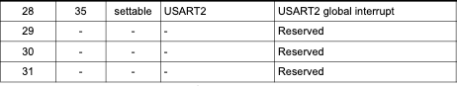
Other Interrupt Sources
Reset
Watchdog Timer
Counter, Timer
Serial communication modules such as USART, SPI, I2C
Interrupts can be configured to occur when data is received, sent, etc
ADC module
Can generate an interrupt once it's done converting
DMA (direct memory access - no processor involvement)
Can ping when transfer complete
FLASH (32 Kb on-chip memory)
Notes:
A watchdog timer is an electronic or software timer that is used to detect and recover from computer malfunctions.

Slide 14
External Interrupts
Today
So far…

Slide 15
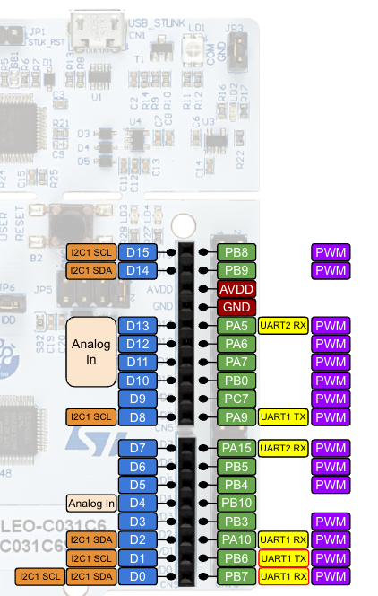
Exercise
Wire the pushbutton and capacitor to PB4.
Copy your TemplateProject and name the copy CounterResetButton. Download counterResetButtonPolled.c from Canvas and copy/paste it into your new project's Src folder.
Compile and upload to your Nucleo.
Observe: How does the program respond to a short tap on the button, vs a long tap-and-hold? (You'll need Coolterm.)
Download counterResetButtonInt.c from Canvas and also copy/paste it in your Src folder, save for later (i.e. exclude from build configuration for now).

Slide 16
Example: Counter with polled reset button
#include <stdio.h>
#include "ES28.h"
#include "uart.h"
#define WAIT 1000000
#define MAXCOUNT 100
#define BUTTON_PIN (1U<<4) // Button on PB4
int main(void) {
int counter = 0;
int buttonPushed;
uart2_init(); // initialize UART
RCC->IOPENR |= RCC_IOPENR_GPIOBEN; // enable clock
GPIOB->MODER &= ~GPIO_MODER_MODE4_Msk;
GPIOB->MODER |= (GPIO_INPUT << GPIO_MODER_MODE4_Pos); // input mode
GPIOB->PUPDR &= ~GPIO_PUPDR_PUPD4_Msk;
GPIOB->PUPDR |= (GPIO_PULLUP << GPIO_PUPDR_PUPD4_Pos); // pullup
while(1) {
printf("%x\t%d\r\n", counter, counter);
delay_ms(1000); // kill time
buttonPushed = ((GPIOB->IDR & BUTTON_PIN) == 0); // Poll the button (1 => pressed)
if ( (buttonPushed) || (counter == MAXCOUNT) ) {
counter = 0; // Reset the counter
} else {
counter++;
}
}
return 0;
}

Slide 17
Detecting a button press no matter when…
…
while(1) {
printf("%x\t%d\r\n", counter, counter);
delay_ms(1000); // kill time
buttonPushed = ((GPIOB->IDR & BUTTON_PIN) == 0); // Poll the button (1 => pressed)
if ( (buttonPushed) || (counter == MAXCOUNT) ) {
counter = 0; // Reset the counter
} else {
counter++;
}
}
…
We want to detect a button press no matter when it occurs: even while your code is in the delaying for-loop.
All GPIO pins are connected to the Extended Interrupt / Event Controller (EXTI) which processes processor-external events such as rising or falling edges on GPIO pins to generate interrupt requests (IRQs).
IRQs are handled by the Nested Vector Interrupt Controller (NVIC) which interacts with the CPU to process the IRQs.
When an IRQ is processed, an Interrupt Service Routine (ISR), which you program, is executed. When the ISR terminates the processor resumes normal program execution.

Slide 18
External Interrupts (such as GPIO)
The NVIC doesn't want to deal with too many interrupts - it's busy enough with the internal ones (timers, ADC, I2C, etc).
The EXTI (Extended Interrupt/Event Controller) is a flexible front-end for the NVIC (Nested Vector Interrupt Controller).
External events, like rising or falling edges on a GPIO pin, are processed by the EXTI to generate interrupt requests (IRQs) to the NVIC.
The NVIC then interacts with the CPU to process the IRQs.
The EXTI can be set to trigger on rising edges, falling edges, or both, and can mask and unmask individual interrupts.
Problem: There isn't enough room to have a separate IRQ line from the EXTI into the NVIC for each GPIO pin.
So: Multiple GPIO lines are multiplexed in the EXTI to a small number of IRQ lines into the NVIC.

Slide 19
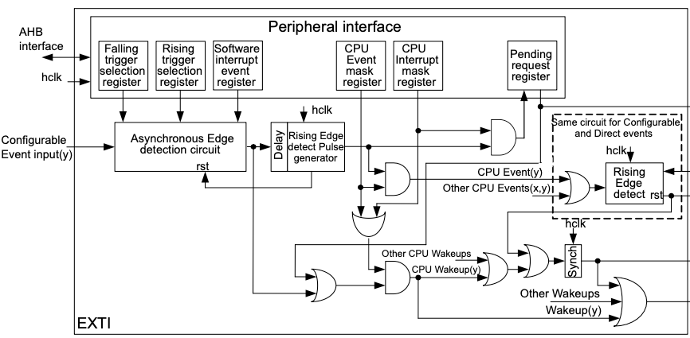
From Button Press to Interrupt
EXTI_FTSR1
EXTI_IMR1
EXTI_FPR1
Button Press
multiplexer
EXTI_EXTICRx
IRQ
Cortex M0+
NVIC
Notes:
The IMR1 exists to provide a layer of control over whether detected events should actually trigger an interrupt. It ensures flexibility, efficiency, and better power management in embedded systems.
1. Separation of Event Detection and Interrupt Enabling
• The EXTI system is designed to handle both events and interrupts.
• The trigger selection registers (FTSR1/RTSR1) only define when an event should be recognized.
• The mask register (IMR1) determines whether that event should actually cause an interrupt request (IRQ) to the processor.
2. Flexible Event/Interrupt Handling
• Some applications may want to detect an external event but not trigger an interrupt.
• Instead, the event might be polled manually (e.g., using the EXTI pending register EXTI_PR1).
• By separating FTSR1 from IMR1, the system allows users to enable event detection without forcing an IRQ.
3. Power and Performance Considerations
• In low-power applications, waking the processor for every external event may be inefficient.
• The IMR1 allows fine-grained control: you can configure event detection but only enable the interrupt when necessary.
4. Compatibility with NVIC and Software Masking
• The NVIC (Nested Vectored Interrupt Controller) already allows enabling/disabling interrupts at the CPU level, but the EXTI IMR1 provides a hardware-level gating mechanism before even reaching the NVIC.
• This is useful in scenarios where you want to temporarily mask an interrupt without modifying trigger configurations.
EXTI_FPR1 records pending EXTI events (whether or not they generate an interrupt).
• You must clear FPR1 manually inside the ISR or when polling.
• It allows checking events even if EXTI_IMR1 is not enabled (useful for software-driven event handling).
• Clearing it is done by writing a 1 to the corresponding bit.

Slide 20
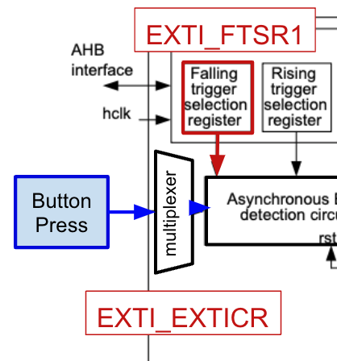
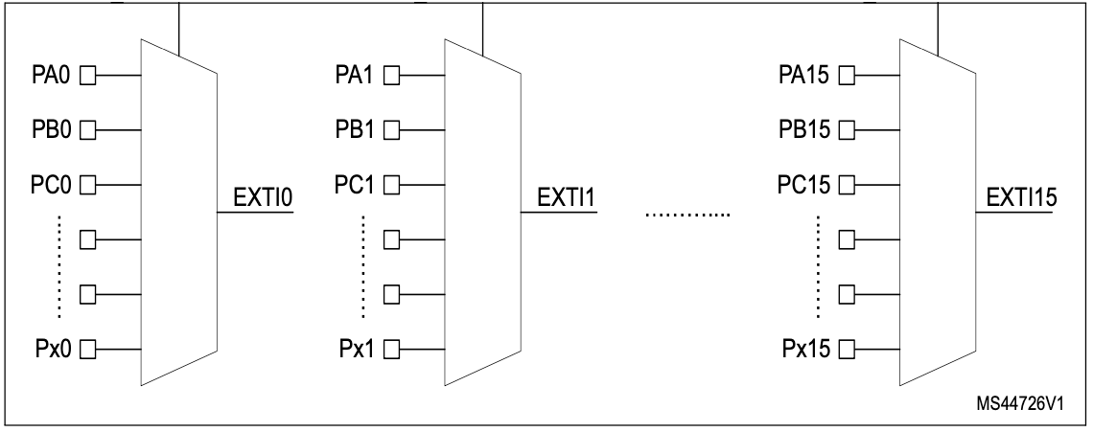
EXTI GPIO Multiplexer
The nth pins of every GPIO port are multiplexed to a single external interrupt line, EXTIn, which is passed into the NVIC.
BUT: these 16 EXTI lines share only three interrupt vectors:
EXTI0 and EXTI1 are IRQ5, priority 12
EXTI2 and EXTI3 are IRQ6, priority 13
EXTI4 … EXTI15 are IRQ7, priority 14
Note: The lower the priority number, the higher the priority of the interrupt.

Slide 21
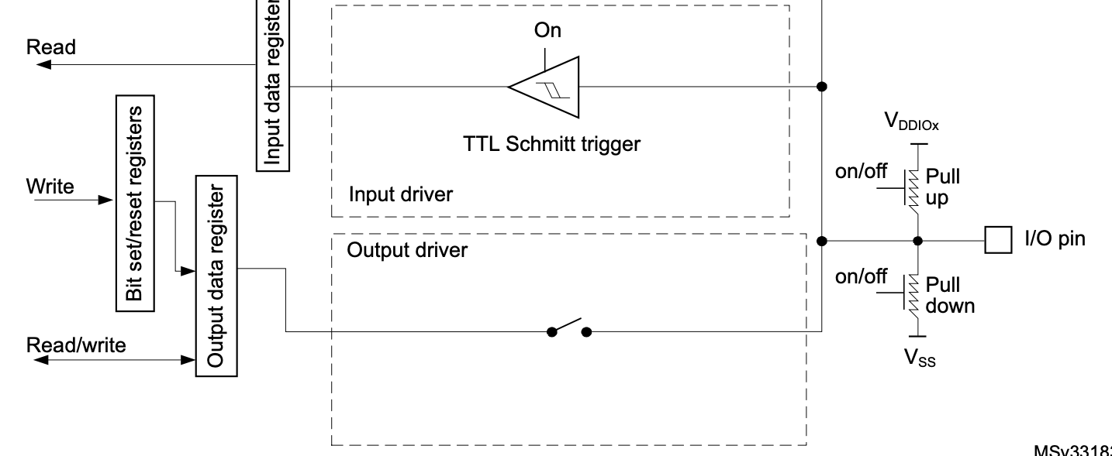
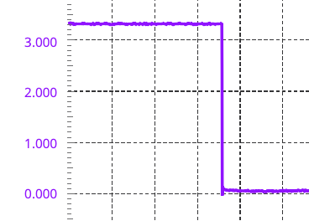
Recall a button with pull-up enabled
Internal pullup pulls pin high when switch is open
Debouncing capacitor
Pin is high when button is open
Pin is low when button is pressed
To detect a button press, look for a falling edge.
Notes:
When the I/O port is programmed as input:
• The output buffer is disabled
• The Schmitt trigger input is activated
• The pull-up and pull-down resistors are activated depending on the value in the GPIOx_PUPDR register
• The data present on the I/O pin are sampled into the input data register every AHB clock cycle
• A read access to the input data register provides the I/O state

Slide 22
What we need to do to program a pushbutton interrupt
Specifically, assume the button is on PB4.
Configure PB4 as an input pin with pullup as per usual.✅
Tell the EXTI multiplexer (via EXTI_EXTICRx) which of the 16 EXTI lines to enable: Line EXTI4, in particular port B.
Tell the EXTI that we are looking for a falling edge on line EXTI4 (via EXTI_FTSR1).
Tell the EXTI to unmask line EXTI4 so that events are actually noticed (via EXTI_IMR1).
Tell the NVIC to enable interrupts on line EXTI4 (via NVIC_EnableIRQ() - a function provided to us).

Slide 23
Tell the EXTI multiplexer to enable Port B on line EXTI4: Register EXTI_EXTICRx
4
4
4
4
4
How?
Control register | Responsible for
EXTI_EXTICR1 | EXTI0-3
EXTI_EXTICR2 | EXTI4-7
EXTI_EXTICR3 | EXTI8-11
EXTI_EXTICR4 | EXTI12-15
Note: Only one GPIO port can be connected to a given EXTI line at a time. For example, EXTI0 can be connected to PA0, PB0, PC0, etc., but only one of them can be selected at a time.
For a given EXTI line we need to specify which one (if any) port should be enabled.
Notes:
For a given EXTI line we need to specify which one (if any) port should be enabled.

Slide 24
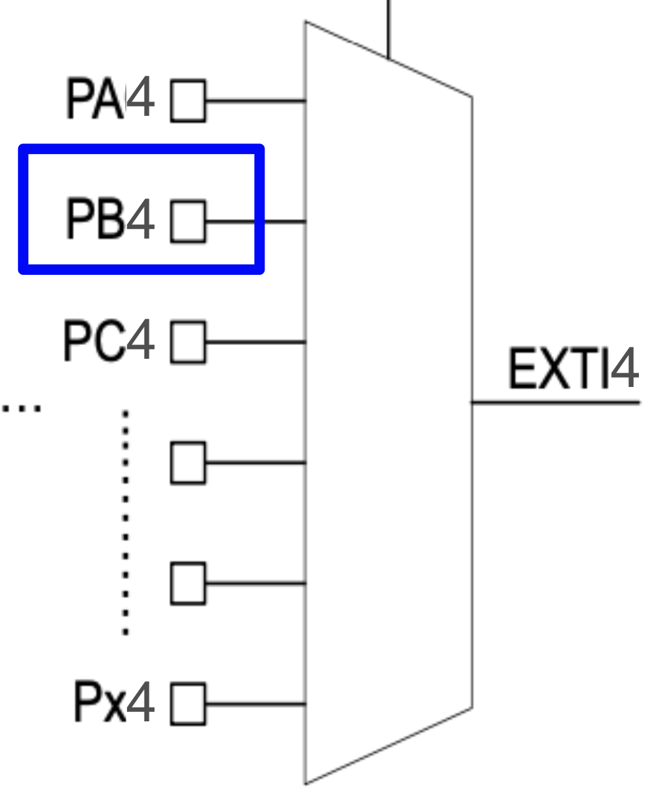
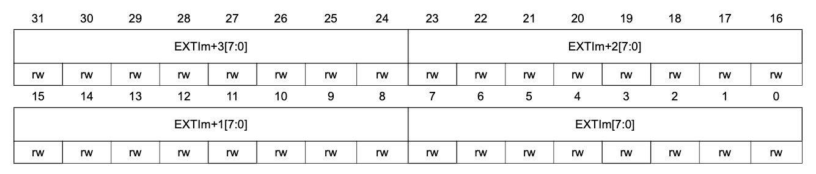
Tell the EXTI multiplexer to enable Port B on line EXTI4: Register EXTI_EXTICRx
Control register | Responsible for
EXTI_EXTICR1 | EXTI0-3
EXTI_EXTICR2 | EXTI4-7
EXTI_EXTICR3 | EXTI8-11
EXTI_EXTICR4 | EXTI12-15
Which port to enable in EXTI4 is configured in EXTI_EXTICR2:
EXTI7
EXTI6
EXTI5
EXTI4
0
0
0
0
0
0
0
1
PA: 0x0, PB: 0x1, PC: 0x2, PD: 0x3, PF: 0x5

Slide 25
Tell the EXTI multiplexer to enable Port B on line EXTI4: Register EXTI_EXTICRx
Control register | Responsible for
EXTI_EXTICR1 | EXTI0-3
EXTI_EXTICR2 | EXTI4-7
EXTI_EXTICR3 | EXTI8-11
EXTI_EXTICR4 | EXTI12-15
Which port to enable in EXTI4 is configured in EXTI_EXTICR2.
EXTI_EXTICR1-4 are stored in one array, EXTI->EXTICR, with 4 elements.
Array indexing in C starts at 0…
So…: EXTI_EXTICR2 is addressed in code as EXTI_EXTICR[1].
Notes:
4 = 4*(2-1) + 0, so x = 2, r = 0.

Slide 26
Tell the EXTI multiplexer to enable Port B on line EXTI4: Register EXTI_EXTICRx
Control register | Responsible for | In code
EXTI_EXTICR1 | EXTI0-3 | EXTI->EXTICR[0]
EXTI_EXTICR2 | EXTI4-7 | EXTI->EXTICR[1]
EXTI_EXTICR3 | EXTI8-11 | EXTI->EXTICR[2]
EXTI_EXTICR4 | EXTI12-15 | EXTI->EXTICR[3]
EXTI->EXTICR[1] &= ~EXTI_EXTICR2_EXTI4_Msk;
EXTI->EXTICR[1] |= (EXTI_PB << EXTI_EXTICR2_EXTI4_Pos);
defined in ES28.h
Notes:
Each EXTI line (EXTI0, EXTI1, etc.) is mapped to a specific bit in the EXTI registers, and only one GPIO port can be connected to a given EXTI line at a time. For example, EXTI0 can be connected to PA0, PB0, PC0, etc., but only one of them can be selected at a time.

Slide 27
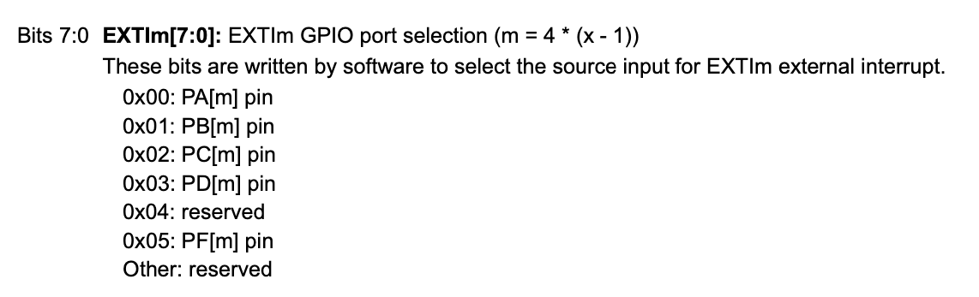
Tell the EXTI multiplexer (via EXTI_EXTICR2) to enable Port B on line EXTI4
4 = 4 ( 2 - 1 ) + 0 , so EXTI4 occupies bits 7:0 in EXTI_EXTICR2.
Reference Manual, in case you really wanted to know…
Notes:
4 = 4*(2-1) + 0, so x = 2, r = 0.

Slide 28
What we need to do to program a pushbutton interrupt
Specifically, assume the button is on PB4.
Configure PB4 as an input pin with pullup as per usual.✅
Tell the EXTI multiplexer (via EXTI_EXTICRx) which of the 16 EXTI lines to enable: Line EXTI4, in particular port B. ✅
Tell the EXTI that we are looking for a falling edge on line EXTI4 (via EXTI_FTSR1).
Tell the EXTI to unmask line EXTI4 so that events are actually noticed (via EXTI_IMR1).
Tell the NVIC to enable interrupts on line EXTI4 (via NVIC_EnableIRQ() - a function provided to us).

Slide 29
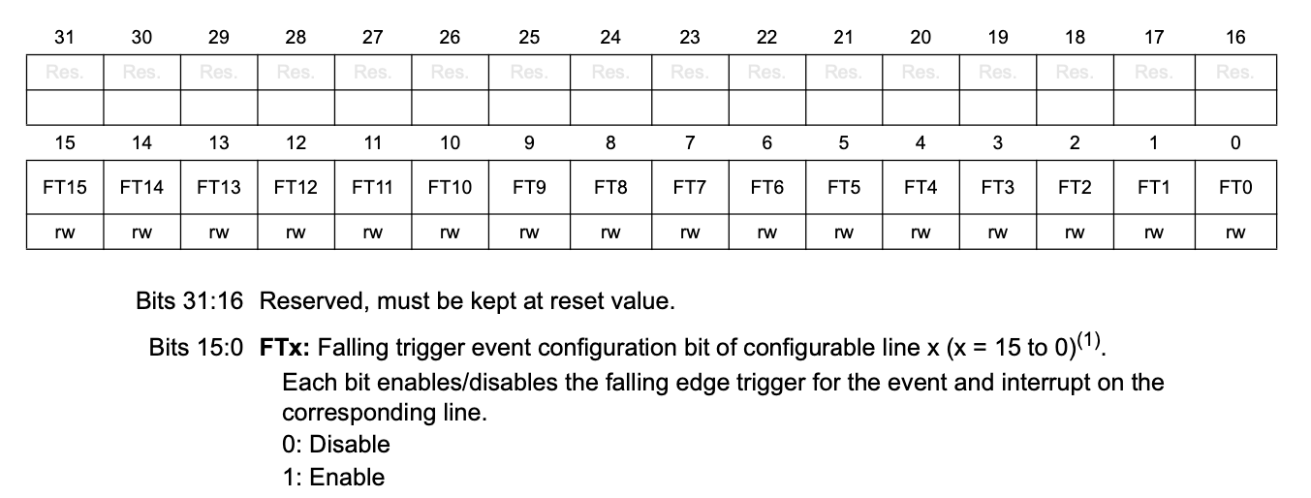
Tell the EXTI that we are looking for a falling edge on line EXTI4: Register EXTI_FTSR1
Falling Trigger Selection Register
Easy! All we need to do is set bit 4 in this register.
EXTI->FTSR1 |= EXTI_FTSR1_FT4;

Slide 30
What we need to do to program a pushbutton interrupt
Specifically, assume the button is on PB4.
Configure PB4 as an input pin with pullup as per usual.✅
Tell the EXTI multiplexer (via EXTI_EXTICRx) which of the 16 EXTI lines to enable: Line EXTI4, in particular port B. ✅
Tell the EXTI that we are looking for a falling edge on line EXTI4 (via EXTI_FTSR1). ✅
Tell the EXTI to unmask line EXTI4 so that events are actually noticed (via EXTI_IMR1).
Tell the NVIC to enable interrupts on line EXTI4 (via NVIC_EnableIRQ() - a function provided to us).

Slide 31
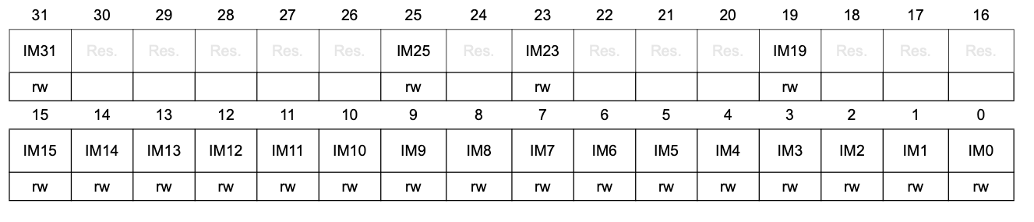
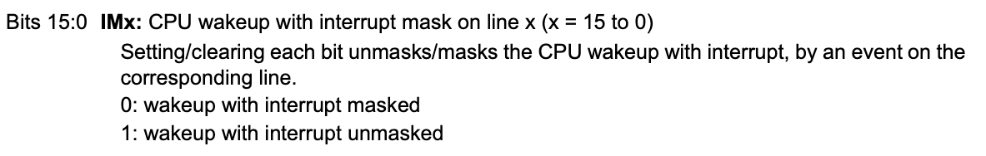
Your turn: Tell the EXTI to unmask line EXTI4: Register EXTI_IMR1
Interrupt Mask Register
Easy! All we need to do is set bit 4 in this register.
EXTI->IMR1 |= EXTI_IMR1_IM4;
Notes:
EXTI->IMR1 |= EXTI_IMR1_IM4;

Slide 32
What we need to do to program a pushbutton interrupt
Specifically, assume the button is on PB4.
Configure PB4 as an input pin with pullup as per usual.✅
Tell the EXTI multiplexer (via EXTI_EXTICRx) which of the 16 EXTI lines to enable: Line EXTI4, in particular port B. ✅
Tell the EXTI that we are looking for a falling edge on line EXTI4 (via EXTI_FTSR1). ✅
Tell the EXTI to unmask line EXTI4 so that events are actually noticed (via EXTI_IMR1). ✅
Tell the NVIC to enable interrupts on line EXTI4 (via NVIC_EnableIRQ() - a function provided to us).

Slide 33
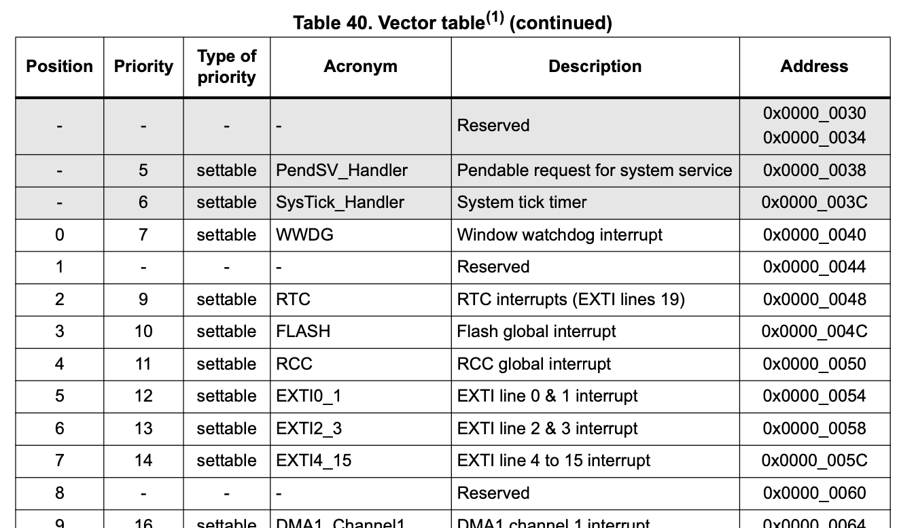
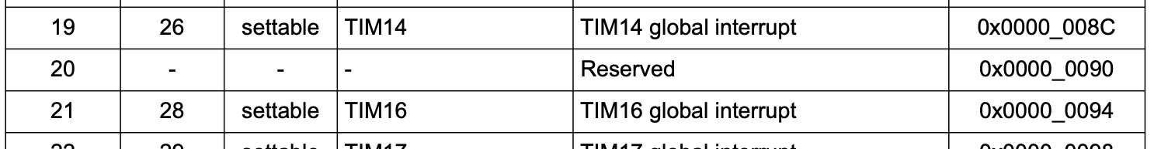
Tell the NVIC to enable interrupts on line EXTI4
NVIC_EnableIRQ(EXTI4_15_IRQn);
…

Slide 34
Summary: Initialization
void pb4_exti_init(void) {
__disable_irq(); // disable global interrupts
RCC->IOPENR |= RCC_IOPENR_GPIOBEN; // Enable clock access to GPIOB
GPIOB->MODER &= ~GPIO_MODER_MODE4_Msk; // Configure PB4 as input pin
GPIOB->MODER |= (GPIO_INPUT << GPIO_MODER_MODE4_Pos);
GPIOB->PUPDR &= ~GPIO_PUPDR_PUPD4_Msk; // enable pull-up for PB4
GPIOB->PUPDR |= (GPIO_PULLUP << GPIO_PUPDR_PUPD4_Pos);
EXTI->EXTICR[1] &= ~EXTI_EXTICR2_EXTI4_Msk; // Configure EXTICR2.
EXTI->EXTICR[1] |= (EXTI_PB << EXTI_EXTICR2_EXTI4_Pos); // accessed as EXTICR[1]
EXTI->FTSR1 |= EXTI_FTSR1_FT4; // Select falling edge trigger for line EXTI4
EXTI->IMR1 |= EXTI_IMR1_IM4; // Unmask line EXTI4
NVIC_EnableIRQ(EXTI4_15_IRQn); // Enable EXTI4 line in NVIC
__enable_irq(); // Enable global interrupts
}

Slide 35
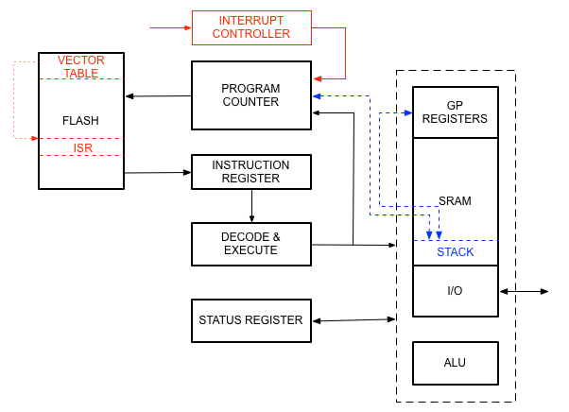
Again: What happens when an interrupt occurs
DATAPATH
Interrupt Service Routine
ISR

Slide 36
Interrupt Service Routines (ISR's)
ISRs have special names (must get this right!)
No values may be returned.
No arguments may be passed in.
The actual code inside the ISR is simple. Don’t hang out in an ISR!
Priority | Interrupt Name | Description | IRQ Handler
(...)
6 | SysTick_IRQn | System tick timer | SysTick_Handler
(...)
12 | EXTI0_1_IRQn | EXTI line 0 & 1 interrupt | EXTI0_1_IRQHandler
13 | EXTI2_3_IRQn | EXTI line 2 & 3 interrupt | EXTI2_3_IRQHandler
14 | EXTI4_15_IRQn | EXTI line 4 to 15 interrupt | EXTI4_15_IRQHandler
(...)
19 | ADC1_IRQn | ADC interrupt | ADC_IRQHandler
(...)
35 | USART2_IRQn | USART2 global interrupt | USART2_IRQHandler
Notes:
IRQ Handler names can be found in startup_stm32c031ctx.s

Slide 37
What happens inside the ISR?
volatile uint8_t buttonPushed; // shared variable
int main(void) { buttonPushed = 0; while (1) { if (buttonPushed) { // do something buttonPushed = 0; } else { // do something else } } return 0; }
void EXTI4_15_IRQHandler(void){
__disable_irq(); // disable global interrupts
if (EXTI->FPR1 & EXTI_FPR1_FPIF4) {
EXTI->FPR1 = EXTI_FPR1_FPIF4; // Clear PR flag
buttonPushed = 1;
}
__enable_irq(); // Enable global interrupts
}

Slide 38
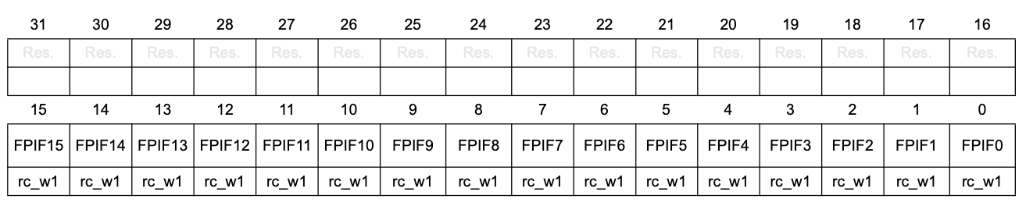
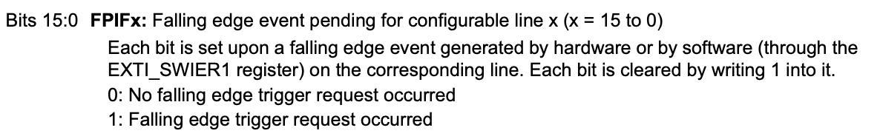
What happens inside the ISR?
// Interrupt service routine for the User button
void EXTI4_15_IRQHandler(void){
__disable_irq(); // disable global interrupts
if (EXTI->FPR1 & EXTI_FPR1_FPIF4) { // Check that EXTI4 interrupted
EXTI->FPR1 = EXTI_FPR1_FPIF4; // Clear PR flag by writing 1
buttonPushed = 1;
}
__enable_irq(); // Enable global interrupts
}
EXTI falling edge pending register 1
Notes:
Check that EXTI4 interrupted should really be "check that a falling edge triggered event happened on EXTI4.

Slide 39
Recall: For any interrupt
Define the appropriate ISR: be sure to use the correct name, check whether your desired event occurred, clear that event's pending flag, set a flag (via a global volatile variable) that you then check in your main code.
void EXTI4_15_IRQHandler(void){
__disable_irq();
if (EXTI->FPR1 & EXTI_FPR1_FPIF) { // Check that EXTI4 interrupted
EXTI->FPR1 = EXTI_FPR1_FPIF; // Clear PR flag
buttonPushed = 1;
}
__enable_irq();
}
During initialization, enable the interrupt source.
EXTI->EXTICR[1] &= ~EXTI_EXTICR2_EXTI4_Msk // Configure EXTICR2,
EXTI->EXTICR[1] |= (EXTI_PB << EXTI_EXTICR2_EXTI4_Pos); // accessed as EXTICR[1]
EXTI->FTSR1 |= EXTI_FTSR1_FT4; // Select falling edge trigger for line EXTI4
EXTI->IMR1 |= EXTI_IMR1_IM4; // Unmask line EXTI4
NVIC_EnableIRQ(EXTI4_15_IRQn); // Enable EXTI4 line in NVIC
Wait for the interrupt to occur or invoke behavior that will eventually lead to an interrupt, e.g., pressing the button.

Slide 40
Counter with interrupting reset button
Note: Since you will never call an ISR from within your code, it does not need a prototype.
#include <stdio.h>
#include "ES28.h"
#include "uart.h"
#define WAIT 1000000
#define MAXCOUNT 100
void pb4_exti_init(void);
volatile int buttonPushed;
int main(void) {
int counter = 0;
uart2_init();
printf("Hex \tDecimal\r\n");
pb4_exti_init();
buttonPushed = 0;
while(1) {
printf("%x\t%d\r\n", counter, counter);
for (int i=0; i<WAIT; i++){}
if (buttonPushed) {
counter = 0;
buttonPushed = 0;
} else if (counter == MAXCOUNT) {
counter = 0;
} else {
counter++;
}
}
return 0;
}
void pb4_exti_init(void) {
__disable_irq();
RCC->IOPENR |= RCC_IOPENR_GPIOBEN;
GPIOB->MODER &= ~GPIO_MODER_MODE4_Msk;
GPIOB->MODER |= (GPIO_INPUT << GPIO_MODER_MODE4_Pos);
GPIOB->PUPDR &= ~GPIO_PUPDR_PUPD4_Msk;
GPIOB->PUPDR |= (GPIO_PULLUP << GPIO_PUPDR_PUPD4_Pos);
EXTI->EXTICR[1] &= ~EXTI_EXTICR2_EXTI4_Msk;
EXTI->EXTICR[1] |= (EXTI_PB << EXTI_EXTICR2_EXTI4_Pos;
EXTI->FTSR1 |= EXTI_FTSR1_FT4;
EXTI->IMR1 |= EXTI_IMR1_IM4;
NVIC_EnableIRQ(EXTI4_15_IRQn);
__enable_irq();
}
void EXTI4_15_IRQHandler(void){
__disable_irq();
if (EXTI->FPR1 & EXTI_FPR1_FPIF4) {
EXTI->FPR1 = EXTI_FPR1_FPIF4;
buttonPushed = 1;
}
__enable_irq();
}

Slide 41
Run counterResetButtonInt!
Update the resource configurations:
Exclude counterResetButtonPolled.c from the build configuration and
Include counterResetButtonInt.c instead.
Compile and upload to your Nucleo, observe how the program now reacts to a short button push.

Slide 42
Design Exercise
Modify
counterResetButtonInt.c
so that in addition to the button on PB4 resetting the counter, the counting direction changes when the blue user button on the Nucleo board is pressed.
Hint: The blue user button is on PC13.

Slide 43
int main(void) {
int counter = 0;
int direction = 1;
uart2_init();
pb4_exti_init();
pc13_exti_init();
buttonB4Pushed = buttonC13Pushed = 0;
printf("Counter with two button reset demo\r\n");
printf("Hex \tDecimal\r\n");
while(1) {
printf("%x\t%d\r\n", counter, counter);
delay_ms(1000);
if (buttonB4Pushed) {
counter = 0;
buttonB4Pushed = 0; // clear the flag
} else if (buttonC13Pushed) {
direction *= -1;
counter += direction; // force one update
buttonC13Pushed = 0; //clear the flag
} else if ((counter == MAXCOUNT) && (direction == 1)) {
counter = 0;
} else if ((counter == 0) && (direction == -1)) {
counter = MAXCOUNT;
} else {
counter += direction;
}
}
return 0;
}
#include <stdio.h>
#include "ES28.h"
#include "uart.h"
#define MAXCOUNT 100
void pb4_exti_init(void);
void pc13_exti_init(void);
volatile int buttonB4Pushed;
volatile int buttonC13Pushed;
void EXTI4_15_IRQHandler(void){
__disable_irq();
if (EXTI->FPR1 & EXTI_FPR1_FPIF4) {
EXTI->FPR1 = EXTI_FPR1_FPIF4;
buttonB4Pushed = 1;
} else if (EXTI->FPR1 & EXTI_FPR1_FPIF13) {
EXTI->FPR1 = EXTI_FPR1_FPIF13;
buttonC13Pushed = 1;
}
__enable_irq();
}

Slide 44
void pb4_exti_init(void) {
// disable global interrupt
__disable_irq();
// Enable clock access to GPIOB
RCC->IOPENR |= RCC_IOPENR_GPIOBEN;
// Configure PB4 as input pin
// (not necessary since this is default)
GPIOB->MODER &= ~GPIO_MODER_MODE4_Msk;
GPIOB->MODER |= (GPIO_INPUT <<
GPIO_MODER_MODE4_Pos);
// enable pull-up for PB4
GPIOB->PUPDR &= ~GPIO_PUPDR_PUPD4_Msk;
GPIOB->PUPDR |= (GPIO_PULLUP <<
GPIO_PUPDR_PUPD4_Pos);
// Configure EXTICR2
// EXTICR1..4 are accessed as
// EXTICR[0..3]
EXTI->EXTICR[1] &= ~EXTI_EXTICR2_EXTI4_Msk;
EXTI->EXTICR[1] |= (EXTI_PB <<
EXTI_EXTICR2_EXTI4_Pos);
// Falling edge trigger for line EXTI4
EXTI->FTSR1 |= EXTI_FTSR1_FT4;
// Unmask line EXTI4
EXTI->IMR1 |= EXTI_IMR1_IM4;
// Enable EXTI4 line in NVIC
NVIC_EnableIRQ(EXTI4_15_IRQn);
// Enable global interrupts
__enable_irq();
}
void pc13_exti_init(void) {
// disable global interrupt
__disable_irq();
// Enable clock access to GPIOB
RCC->IOPENR |= RCC_IOPENR_GPIOCEN;
// Configure PC13 as input pin
// (not necessary since this is default)
GPIOC->MODER &= ~GPIO_MODER_MODE13_Msk;
GPIOC->MODER |= (GPIO_INPUT <<
GPIO_MODER_MODE13_Pos);
// enable pull-up for PC13 (not necessary
// since it is automatic for the blue button)
// Configure EXTICR4
// EXTICR1..4 are accessed as
// EXTICR[0..3]
EXTI->EXTICR[3] &= ~EXTI_EXTICR4_EXTI13_Msk;
EXTI->EXTICR[3] |= (EXTI_PC <<
EXTI_EXTICR4_EXTI13_Pos);
// Falling edge trigger for line EXTI13
EXTI->FTSR1 |= EXTI_FTSR1_FT13;
// Unmask line EXTI13
EXTI->IMR1 |= EXTI_IMR1_IM13;
// Enable EXTI13 line in NVIC
NVIC_EnableIRQ(EXTI4_15_IRQn);
// Enable global interrupts
__enable_irq();
}

Slide 45
Pushbutton interrupt
Button is on PB4 (PC13).
Configure PB4 (PC13) as an input pin with pullup as per usual.
Tell the EXTI multiplexer (via EXTI_EXTICRx) which of the 16 EXTI lines to enable: Line EXTI4 (EXTI13), in particular port B (port C).
Tell the EXTI that we are looking for a falling edge on line EXTI4 (EXTI13) (via EXTI_FTSR1).
Tell the EXTI to unmask line EXTI4 (EXTI13) so that events are actually noticed (via EXTI_IMR1).
Tell the NVIC to enable interrupts on line EXTI4 (EXTI13) (via NVIC_EnableIRQ() - a function provided to us).

Slide 46
Tell the EXTI multiplexer to enable Port C on line EXTI13: Register EXTI_EXTICRx
Control register | Responsible for | In code
EXTI_EXTICR1 | EXTI0-3 | EXTI->EXTICR[0]
EXTI_EXTICR2 | EXTI4-7 | EXTI->EXTICR[1]
EXTI_EXTICR3 | EXTI8-11 | EXTI->EXTICR[2]
EXTI_EXTICR4 | EXTI12-15 | EXTI->EXTICR[3]
3
3
3
3
3
EXTI->EXTICR[3] &= ~EXTI_EXTICR4_EXTI13_Msk;
EXTI->EXTICR[3] |= (EXTI_PC << EXTI_EXTICR4_EXTI13_Pos);
defined in ES28.h
Notes:
Each EXTI line (EXTI0, EXTI1, etc.) is mapped to a specific bit in the EXTI registers, and only one GPIO port can be connected to a given EXTI line at a time. For example, EXTI0 can be connected to PA0, PB0, PC0, etc., but only one of them can be selected at a time.

Slide 47
int main(void) {
int counter = 0;
int direction = 1;
uart2_init();
pb4_exti_init();
pc13_exti_init();
buttonB4Pushed = buttonC13Pushed = 0;
printf("Counter with two button reset demo\r\n");
printf("Hex \tDecimal\r\n");
while(1) {
printf("%x\t%d\r\n", counter, counter);
delay_ms(1000);
if (buttonB4Pushed) {
counter = 0;
buttonB4Pushed = 0; // clear the flag
} else if (buttonC13Pushed) {
direction *= -1;
counter += direction; // force one update
buttonC13Pushed = 0; //clear the flag
} else if ((counter == MAXCOUNT) && (direction == 1)) {
counter = 0;
} else if ((counter == 0) && (direction == -1)) {
counter = MAXCOUNT;
} else {
counter += direction;
}
}
return 0;
}
#include <stdio.h>
#include "ES28.h"
#include "uart.h"
#define MAXCOUNT 100
void pb4_exti_init(void);
void pc13_exti_init(void);
volatile int buttonB4Pushed;
volatile int buttonC13Pushed;
void EXTI4_15_IRQHandler(void){
__disable_irq();
if (EXTI->FPR1 & EXTI_FPR1_FPIF4) {
EXTI->FPR1 = EXTI_FPR1_FPIF4;
buttonB4Pushed = 1;
} else if (EXTI->FPR1 & EXTI_FPR1_FPIF13) {
EXTI->FPR1 = EXTI_FPR1_FPIF13;
buttonC13Pushed = 1;
}
__enable_irq();
}

Slide 48
void pb4_exti_init(void) {
// disable global interrupt
__disable_irq();
// Enable clock access to GPIOB
RCC->IOPENR |= RCC_IOPENR_GPIOBEN;
// Configure PB4 as input pin
// (not necessary since this is default)
GPIOB->MODER &= ~GPIO_MODER_MODE4_Msk;
GPIOB->MODER |= (GPIO_INPUT <<
GPIO_MODER_MODE4_Pos);
// enable pull-up for PB4
GPIOB->PUPDR &= ~GPIO_PUPDR_PUPD4_Msk;
GPIOB->PUPDR |= (GPIO_PULLUP <<
GPIO_PUPDR_PUPD4_Pos);
// Configure EXTICR2
// EXTICR1..4 are accessed as
// EXTICR[0..3]
EXTI->EXTICR[1] &= ~EXTI_EXTICR2_EXTI4_Msk;
EXTI->EXTICR[1] |= (EXTI_PB <<
EXTI_EXTICR2_EXTI4_Pos);
// Falling edge trigger for line EXTI4
EXTI->FTSR1 |= EXTI_FTSR1_FT4;
// Unmask line EXTI4
EXTI->IMR1 |= EXTI_IMR1_IM4;
// Enable EXTI4 line in NVIC
NVIC_EnableIRQ(EXTI4_15_IRQn);
// Enable global interrupts
__enable_irq();
}
void pc13_exti_init(void) {
// disable global interrupt
__disable_irq();
// Enable clock access to GPIOB
RCC->IOPENR |= RCC_IOPENR_GPIOCEN;
// Configure PC13 as input pin
// (not necessary since this is default)
GPIOC->MODER &= ~GPIO_MODER_MODE13_Msk;
GPIOC->MODER |= (GPIO_INPUT <<
GPIO_MODER_MODE13_Pos);
// enable pull-up for PC13 (not necessary
// since it is automatic for the blue button)
// Configure EXTICR4
// EXTICR1..4 are accessed as
// EXTICR[0..3]
EXTI->EXTICR[3] &= ~EXTI_EXTICR4_EXTI13_Msk;
EXTI->EXTICR[3] |= (EXTI_PC <<
EXTI_EXTICR4_EXTI13_Pos);
// Falling edge trigger for line EXTI13
EXTI->FTSR1 |= EXTI_FTSR1_FT13;
// Unmask line EXTI13
EXTI->IMR1 |= EXTI_IMR1_IM13;
// Enable EXTI13 line in NVIC
NVIC_EnableIRQ(EXTI4_15_IRQn);
// Enable global interrupts
__enable_irq();
}

Slide 49
Good Practice: Modularize!
put into your project's "Inc" folder
exti.h:
#ifndef EXTI_H_
#define EXTI_H_
#include "ES28.h"
void pc13_exti_init(void);
void pb4_exti_init(void);
#endif /* EXTI_H_ */
It is good practice to put the initialization functions pb4_exti_init() and pc13_exti_init() along with their prototypes and some of the preprocessor directives into separate files exti.c and exti.h:
The start of your main program then simplifies to:
#include <stdio.h>
#include "ES28.h"
#include "uart.h"
#include "exti.h"
#define MAXCOUNT 100
void buttonB4_callback(void);
void buttonC13_callback(void);
volatile int buttonB4Pushed;
volatile int buttonC13Pushed;
int main(void) {
int counter = 0;
int direction = 1;
uart2_init();
pb4_exti_init();
pc13_exti_init();
…
exti.c:
#include "exti.h"
void pb4_exti_init(void) {
// disable global interrupt
__disable_irq();
// Enable clock access to GPIOB
RCC->IOPENR |= RCC_IOPENR_GPIOBEN;
…
}
void pc13_exti_init(void) {
// disable global interrupt
__disable_irq();
// Enable clock access to GPIOB
RCC->IOPENR |= RCC_IOPENR_GPIOCEN;
…
}
put into your project's "Src" folder

Slide 50
Design Challenges

Slide 51
Coding Challenge 1: Counter with reset
Modify counterResetButtonInt to use a timer interrupt instead of a delay_ms(). Set the update period to 1 sec.
You'll upload your code on Thursday before class.

Slide 52
Counter with reset
counterResetButtonIntTimer.c
#include <stdio.h>
#include "ES28.h"
#include "tim.h"
#include "exti.h"
#include "uart.h"
#define LINE4 (1U<<4) // EXTI Line 4
#define MAXCOUNT 100
volatile int buttonB4Pushed;
volatile int timerFlag;
int main(void) {
int counter = 0;
uart2_init();
printf("Hex \tDecimal\r\n");
pb4_exti_init();
tim14_ms_interrupt_init(1000);
buttonB4Pushed = 0;
timerFlag = 0;
while(1) {
if (timerFlag) {
printf("%x\t%d\r\n", counter, counter);
if (counter == MAXCOUNT) {
counter = 0; // Roll over
} else {
counter++; // Increment
}
timerFlag = 0; // Clear timer flag
}
if (buttonB4Pushed) {
counter = 0;
buttonB4Pushed = 0; // clear button flag
}
}
return 0;
}
counterResetButtonIntTimer.c
void EXTI4_15_IRQHandler(void){
// disable global interrupt
__disable_irq();
if (EXTI->FPR1 & EXTI_FPR1_FPIF4) {
EXTI->FPR1 = EXTI_FPR1_FPIF4; // Clear PR flag
buttonB4Pushed = 1;
}
// Enable global interrupts
__enable_irq();
}
void TIM14_IRQHandler(void) {
// disable global interrupt
__disable_irq();
// Clear UIF in status register
TIM14->SR = ~TIM_SR_UIF; // Clear UIF
timerFlag = 1;
// Enable global interrupts
__enable_irq();
}

Slide 53
exti.c
#include "exti.h"
#include "ES28.h"
void pb4_exti_init(void) {
// disable global interrupt
__disable_irq();
// Enable clock access to GPIOB
RCC->IOPENR |= RCC_IOPENR_GPIOBEN;
// Configure PB4 as input pin
// (not necessary since this is default)
GPIOB->MODER &= ~GPIO_MODER_MODE4_Msk;
GPIOB->MODER |= (GPIO_INPUT <<
GPIO_MODER_MODE4_Pos);
// enable pull-up for PB4
GPIOB->PUPDR &= ~GPIO_PUPDR_PUPD4_Msk;
GPIOB->PUPDR |= (GPIO_PULLUP <<
GPIO_PUPDR_PUPD4_Pos);
// Configure EXTICR2
EXTI->EXTICR[1] &= ~EXTI_EXTICR2_EXTI4_Msk;
EXTI->EXTICR[1] |= (EXTI_PB <<
EXTI_EXTICR2_EXTI4_Pos);
// Falling edge trigger for line EXTI4
EXTI->FTSR1 |= EXTI_FTSR1_FT4;
// Unmask line EXTI4
EXTI->IMR1 |= EXTI_IMR1_IM4;
// Enable EXTI4 line in NVIC
NVIC_EnableIRQ(EXTI4_15_IRQn);
// Enable global interrupts
__enable_irq();
}
exti.h
#ifndef EXTI_H_
#define EXTI_H_
void pb4_exti_init(void);
#endif /* EXTI_H_ */
tim.c
#include "tim.h"
#include "stm32C0xx.h"
#define PSC_FACTOR 12000 // 12 MHz/12000 = 1 kHz
void tim14_ms_interrupt_init(int milliseconds) {
__disable_irq();
RCC->APBENR2 |= RCC_APBENR2_TIM14EN;
TIM14->PSC = PSC_FACTOR - 1;
TIM14->ARR = milliseconds - 1;
TIM14->CNT = 0;
TIM14->DIER |= TIM_DIER_UIE;
NVIC_EnableIRQ(TIM14_IRQn);
TIM14->CR1 |= TIM_CR1_CEN;
__enable_irq();
}
tim.h
#ifndef TIM_H_
#define TIM_H_
void tim14_ms_interrupt_init(int milliseconds);
#endif /* TIM_H_ */

Slide 54
A cautionary tale about interrupts
Back to the earlier problem: Capture a button press with a pin change interrupt and use it to reset a counter (we already solved this one…).

Slide 55
Two solutions
volatile int buttonPushed;
int main(void) {
int counter = 0;
uart2_rxtx_init();
pb4_exti_init();
buttonPushed = 0;
while(1) {
if (buttonPushed) {
counter = 0;
buttonPushed = 0;
} else {
counter++;
}
}
return 0;
}
void EXTI4_15_IRQHandler(void){
if (EXTI->FPR1 & EXTI_FPR1_FPIF4) {
EXTI->FPR1 = EXTI_FPR1_FPIF4;
buttonPushed = 1;
}
}
volatile int counter;
int main(void) {
uart2_init();
pb4_exti_init();
counter = 0;
while(1) {
counter++;
}
return 0;
}
void EXTI4_15_IRQHandler(void){
if (EXTI->FPR1 & EXTI_FPR1_FPIF4) {
EXTI->FPR1 = EXTI_FPR1_FPIF4;
counter = 0;
}
}
Shorter is better, right?
(Not so fast!)
Notes:
On the right: traditional way. Use flag. Counter resetting on a button press.
But why not just zero the counter in the ISR on the pin change interrupt? What's wrong with that?
Crucial distinction is that in the original solution you are setting a control signal (flag) in the ISR. The second method messes with the data itself.
Those two things can give you very different results.

Slide 56
Same code, in machine language
Counter Reset in the ISR
08000134: ldr r3, [pc, #20]
08000136: movs r2, #0
08000138: str r2, [r3, #0]
0800013a: bl 0x8000150
0800013e: ldr r3, [pc, #12]
08000140: ldr r3, [r3, #0]
08000142: adds r2, r3, #1
08000144: ldr r3, [pc, #4]
08000146: str r2, [r3, #0]
08000148: b.n 0x800013e
…
0800020a: ldr r3, [pc, #16]
0800020c: movs r2, #0
0800020e: str r2, [r3, #0]
int main(void) {
counter = 0;
pb4_exti_init();
while(1) {
counter++;
}
return 0; }
void EXTI4_15_IRQHandler(void){
if (EXTI->FPR1 & EXTI_FPR1_FPIF4) {
EXTI->FPR1 = EXTI_FPR1_FPIF4;
counter = 0;
}
}
What if you get interrupted here?
Notes:
The counter++ instruction compiles into five successive statements in machine language.
ldr r3, [pc, #12] loads the contents of the memory address located 12 bytes (3 words) after the current value of the program counter (PC) into register r3. This loads the memory location of counter into r3.
ldr r3, [r3, #0] loads the contents of the memory address now located in r3 - so it loads the actual value of counter into r3.
adds r2, r3, #1 adds r3 and 1 and stores the result in r2.
ldr r3, [pc, #4] loads the address of counter into r3 (note that pc has increased so we use #4 instead of the earlier #12)
str r2, [r3, #0] stores the value of r2 into the memory location stored 0 bytes from the one in r3, so it stores the value in r2 into counter.
ADD R6, R2, R6 ; increment index reg.
Opcode Dest Src1 Src2 Comment
Suppose you get interrupted while you are adding 1 to the counter. Suppose you have already loaded counter into register r3 and that's when you get interrupted. So counter register value sits in register r3. The machine state is stored on the stack (that includes the value of register r3). The ISR goes and zeroes counter. Then you return where you left off, restore machine state and the next step increases r3 by 1 and then writes the result into r2, then stores r2 (which holds the just incremented counter value) into the counter memory location. So?
Counter didn't reset because you got interrupted in the middle of the counter++ instruction. So that kind of stuff can happen. Let's compare this with the flag method.

Slide 57
Same code, in machine language
Set a button press flag in the ISR, counter reset in main()
int main(void) {
int counter = 0;
pb4_exti_init();
buttonPushed = 0;
while(1) {
if (buttonPushed) {
counter = 0;
buttonPushed = 0;
} else {
counter++;
}
}
return 0;
}
void EXTI4_15_IRQHandler(void){
if (EXTI->FPR1 & EXTI_FPR1_FPIF4) {
EXTI->FPR1 = EXTI_FPR1_FPIF4;
buttonPushed = 1;
}
}
08000136: movs r3, #0
08000138: str r3, [r7, #4]
…
08000144: ldr r3, [pc, #2]
08000146: ldr r3, [r3, #0]
08000148: cmp r3, #0
0800014a: beq.n 0x8000158
0800014c: movs r3, #0
0800014e: str r3, [r7, #4]
08000150: ldr r3, [pc, #12]
08000152: movs r2, #0
08000154: str r2, [r3, #0]
08000156: b.n 0x8000144 08000158: ldr r3, [r7, #4]
0800015a: adds r3, #1
0800015c: str r3, [r7, #4]
0800015e: b.n 0x8000144
…
0800021e: ldr r3, [pc, #16]
08000220: movs r2, #1
08000222: str r2, [r3, #0]
Notes:
Blue is where you test the flag.
The following instruction (branch if equal) branches if that zero-flag is set. So if buttonPushed is zero, then the zero-flag will be set by the and instruction and thus it jumps to the else case, where counter is incremented. Otherwise, move the value zero into r3 and reset all flags, store the value of r3 (which is 0) into the memory location that is 4 bytes from the location stored in r7 (this means counter = 0). Similar for buttonPushed.
If you get interrupted while incrementing counter no harm done since the button flag won't take effect until the next time you run through the loop.
The reason why this works is that you are just setting a flag in the ISR. This will ALWAYS work. Trust me.

Slide 58
Moral:
Distinguish between data signals and control signals (flags).
Be very careful about changing global data in an ISR (maybe don’t do it at all!)

Slide 59
Coding Challenge 2: Timer-controlled A/D conversion
Rewrite ADCPot.c, taking a measurement every second, using a timer instead of delay_ms().
This is a head start on Lab 5. No need to upload anything to Canvas right now since it'll simply get you started on Lab 5.
Notes:
Note: you'll still be polling the A/D converter to find out whether it's done. Simply get rid of the _delay_ms() so that the timer sets off the A/D converter to start.

Slide 60
Timer-controlled A/D conversion
ADCPotWithTimerInt.c
#include <stdio.h>
#include "ES28.h"
#include "uart.h"
#include "tim.h"
#include "adc.h"
volatile int timerFlag;
int main(void) {
uint16_t sensor_value;
unsigned voltage10;
uart2_init();
pa0_adc_init();
tim14_ms_interrupt_init(1000);
timerFlag = 0;
while(1) {
if (timerFlag) {
timerFlag = 0;
start_conversion();
sensor_value = adc_read();
voltage10 = (sensor_value*33)/4096;
printf("ADC: %u, voltage: %u.%u Volt\r\n",
sensor_value, voltage10/10, voltage10%10);
}
}
return 0;
}
void TIM14_IRQHandler(void) {
__disable_irq();
// Clear UIF in status register
TIM14->SR = ~TIM_SR_UIF;
timerFlag = 1;
__enable_irq();
}
adc.c
#include <stdint.h>
#include "adc.h"
#include "stm32C0xx.h"
void pa0_adc_init(void) {
RCC->IOPENR |= RCC_IOPENR_GPIOAEN;
GPIOA->MODER &= ~GPIO_MODER_MODE0_Msk;
GPIOA->MODER |= (GPIO_ANALOG <<
GPIO_MODER_MODE0_Pos);
RCC->APBENR2 |= RCC_APBENR2_ADCEN; ADC1->CHSELR |= (1U << 0);
ADC1->CR |= ADC_CR_ADVREGEN;
for (int i = 0; i<500; i++){}
ADC1->CR |= ADC_CR_ADCAL; while ((ADC1->ISR & ADC_ISR_EOCAL)==0){} uint8_t calibration = ADC1->DR & 0x7F;
ADC1->ISR = ADC_ISR_ADRDY;
ADC1->CR |= ADC_CR_ADEN;
ADC1->CALFACT = calibration;
}
void start_conversion(void) {
while( (ADC1->ISR & ADC_ISR_ADRDY) == 0){} ADC1->CR |= ADC_CR_ADSTART;
}
uint16_t adc_read(void) {
while( (ADC1->ISR & ADC_ISR_EOC) == 0 ){} return (uint16_t) ADC1->DR;
}
tim.c
#include "tim.h"
#include "ES28.h"
#define PSC_FACTOR 12000 // 12 MHz/12000 = 1 kHz
void tim14_ms_interrupt_init(int milliseconds) {
…

