Slide 1


Engs 28
Embedded Systems
Day 9X

Slide 2
Hear from a NASA Embedded Systems Developer
Tomorrow, February 5:
10:15am-10:45am
MacLean 210

Slide 3
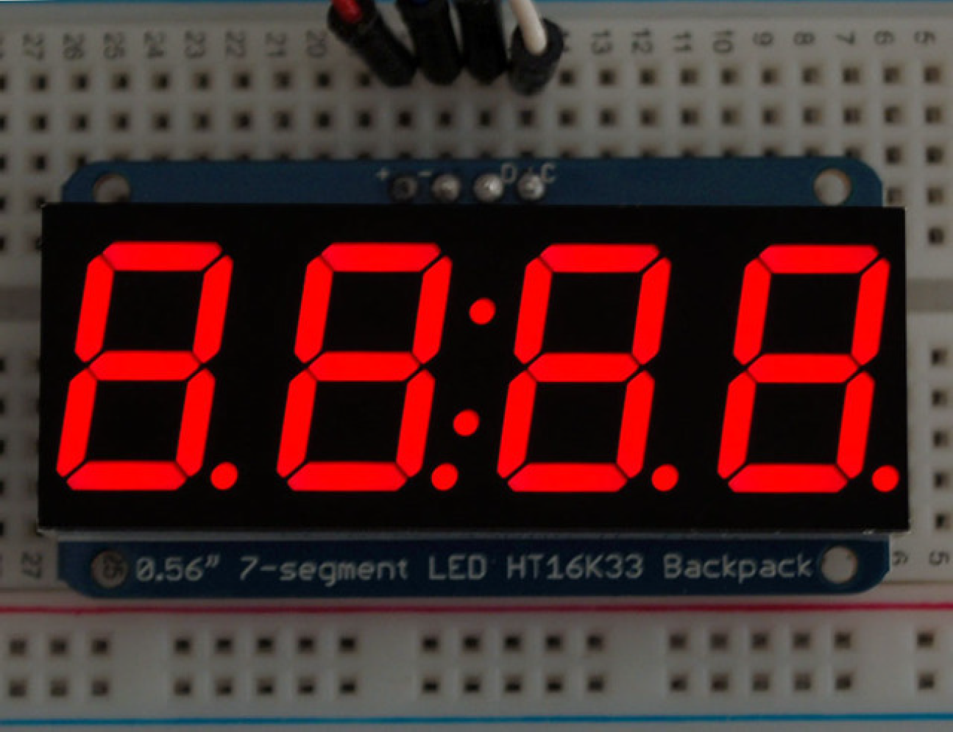
How many LEDs in this 4-digit 7-segment display?
If we want to control each of these LEDs individually, how many pins do we need on our microcontroller?
Notes:
We'll learn how to use this thing tomorrow. No need to use "screen" or "PuTTY"! You'll have an actual display built into your system (gas pump, etc).

Slide 4
Goal: Control more complex devices with just two wires
We mount the display on a "Backpack" that communicates with the microcontroller using just two wires.
The communication protocol is "I²C" (Inter-Integrated Circuit).
The backpack receives instructions from the microcontroller and drives the relevant LEDs accordingly.

Slide 5
I²C Communication
I²C is a serial communication protocol.
What other serial communication protocol do we already know?
Notes:
How do you efficiently move data from the microcontroller to a peripheral device?
We've talked about the UART. Old method, not particularly fast or flexible.
Today: I2C bus which takes care of these problems.
Will use I2C a few times this term, including in the current lab as well as future ones.

Slide 6
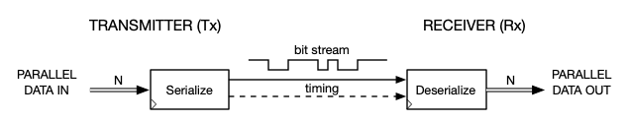
Serial Communication - Review
Recall:
UART does not have separate timing signals. Uses start and stop bits instead, with a known bit time (baud rate).
Today:
A fully synchronous method (data line + clock line), called “I²C” (or “TWI” for two-wire interface).
Notes:
Transmitter sends data to a receiver over one wire.
Data comes in in parallel (in bytes), transmitter turns it into an 8-bit serial, sends, gets deserialized at the receiver.
UART: the way the receiver knows what the individual bits are is that there is an agreed-upon bit rate (BAUD rate).
Today: Something that's better but doesn't work over long distances. Need an extra wire (clock wire).
There are a variety of synchronous protocols.

Slide 7
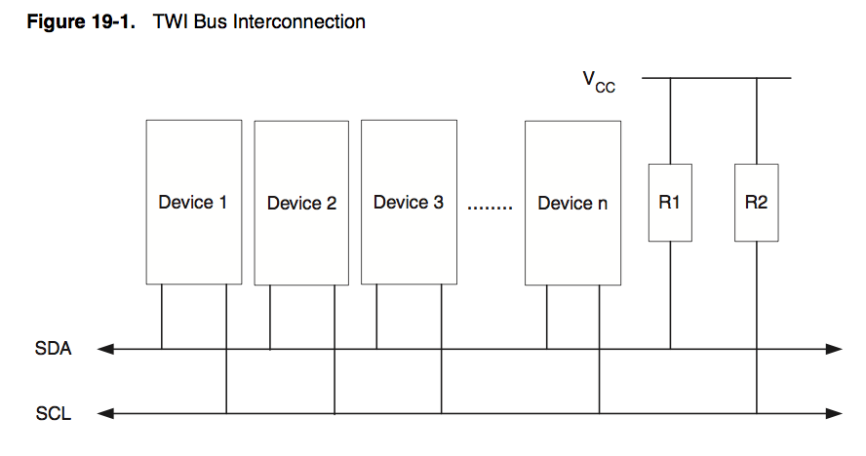
I²C (Inter-Integrated Circuit) bus
Trademarked name (Philips / NXP), also called, generically, “Two Wire Interface” (TWI).
Numerous devices have an I²C interface.
Two wires, like UART, but it’s synchronous. How?
Pullup resistors (wires idle HIGH)
Serial DAta (bidirectional)
Serial CLock (generated by bus controller device)
Notes:
I2C was invented by Philips (dutch electronics company). Trademarked, stands for Inter Integrated Circuit Bus.
2 wires: one for data, one for clock. Data wire is bi-directional. The two devices take turns. One sends, the other listens, then swap.
UART: one wire for transmit, one for receive. So "full duplex". I2C is only half duplex.

Slide 8
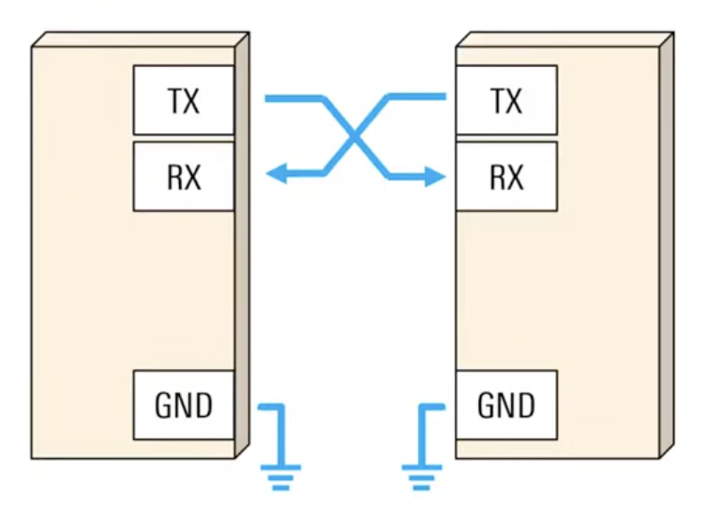
UART vs I²C
No serial clock. Start/stop bits used to synchronize data recovery.
Separate Tx and Rx lines. Full duplex (simultaneous transmit and receive) is possible.
Each peripheral device has its own Tx/Rx pair.
Serial clock, generated by bus controller, synchronizes data recovery.
Common clock line (SCL) and bidirectional data line (SDA). Bus controller and the peripheral device take turns writing and reading.
All peripherals use the same two wire bus. Each peripheral has its own bus address. Each packet of data from the controller begins with the address of the intended destination device.
Notes:
Master -> Controller
Slave -> Target
How do you tell the devices apart? They all share the same lines.
One device is in charge: the Controller device. The others are peripheral devices.
Controller is in charge. It initiates contact with the other device is wants to talk to and demands from the device data to talk back.
Each device has an address, a 7-bit number, so that the controller device can address it directly.
Controller initiates communication with that device by sending its address. All devices are listening. The device that recognizes its own address knows it's being spoken to. It then acknowledges by talking back 'yes what do you want'.
So devices have to be able to switch back and forth between sending and receiving. Only one device can talk at a time.

Slide 9
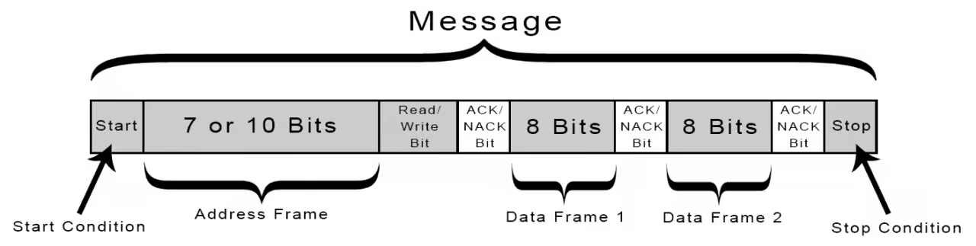
I²C protocol
Toward inclusive language:
Update the terms "master/slave" to "controller/target".
SCL and SDA idle high, because of the pullups.
START: Controller asserts control by pulling SDA low while SCL is high. SCL starts running.
Address + Read/Write: Controller transmits device address (7 bits) followed by 0 to command a write, or 1 to command a read. SDA changes only while SCL is low.
ACK: Controller lets go of data line; peripheral that recognizes its address acknowledges by sending a 0 back. Other devices on bus don’t respond. If nobody responds, the data line remains high (called NACK).
DATA: Controller sends a byte, listens for ACK or NACK, or receives a byte, and replies with ACK or NACK.
STOP: Controller returns SDA to high while SCL is high, then both remain idle.
Notes:
Here is the protocol.
Data and clock lines are held high when nobody is talking. When controller wants to initiate communication with a peripheral device it pulls the data line low (called a start condition). That starts the clock running. Then, synchronously with the clock it sends out the device's 7-bit address that indicates to whom it wants to talk, followed by a 0 or a 1, depending on whether it wants to send data to the device (0) or read data from the device (1). Now 8 bit have been sent. Now the controller flips the wire to receiving. It listens for the ACK (acknowledge) bit from the device it spoke to. If there is a device with that address on the bus, that device will send a 0 back (ACK). If the controller sees the 0 it knows that someone is out there. If not it knows that there is nobody out there.
Next, controller sends some kind of command to the peripheral device, telling it what it wants it to do. Then it flips the wire around to look for the ACK. Alternatively, the controller may wish to read data from the device. It indicates that by adding a 1 to the address. Now, when the byte comes back from the device, the controller sends back the ACK. Whoever talks, waits for the ACK from the one who is spoken to.
Once everything is complete (maybe multiple things have happened, multiple pieces of data transmitted, etc), the controller indicates that things are done by sending a STOP condition.
The beauty is that this is all built into HARDWARE inside the I2C module. The I2C submodule has the appropriate registers that you set and read. But other than that it's all done in hardware - YOU don't have to think about "do I need to send a bit or not?". YOU are responsible for knowing (from the datasheet) what you peripheral device's capabilities are.

Slide 10
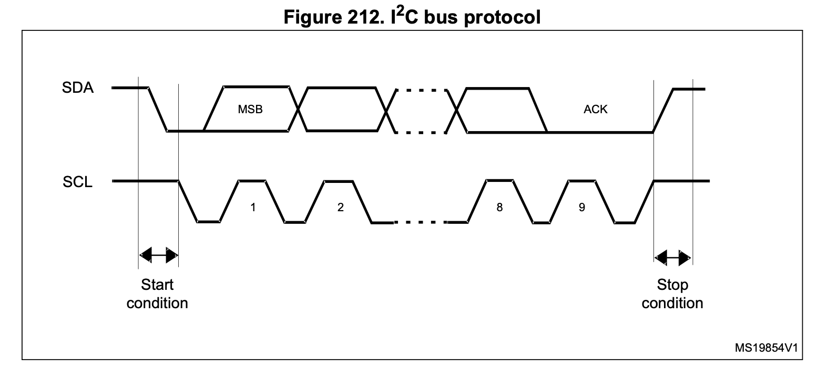
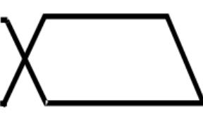
I²C protocol
ACK/NACK
START: Controller asserts control by pulling SDA low while SCL is high. SCL starts running.
Address/Data: SDA changes only while SCL is low.
STOP: Controller returns SDA to high while SCL is high, then both remain idle.
Notes:
Here is the protocol.
Data and clock lines are held high when nobody is talking. When controller wants to initiate communication with a peripheral device it pulls the data line low (called a start condition). That starts the clock running. Then, synchronously with the clock it sends out the device's 7-bit address that indicates to whom it wants to talk, followed by a 0 or a 1, depending on whether it wants to send data to the device (0) or read data from the device (1). Now 8 bit have been sent. Now the controller flips the wire to receiving. It listens for the ACK (acknowledge) bit from the device it spoke to. If there is a device with that address on the bus, that device will send a 0 back (ACK). If the controller sees the 0 it knows that someone is out there. If not it knows that there is nobody out there.
Next, controller sends some kind of command to the peripheral device, telling it what it wants it to do. Then it flips the wire around to look for the ACK. Alternatively, the controller may wish to read data from the device. It indicates that by adding a 1 to the address. Now, when the byte comes back from the device, the controller sends back the ACK. Whoever talks, waits for the ACK from the one who is spoken to.
Once everything is complete (maybe multiple things have happened, multiple pieces of data transmitted, etc), the controller indicates that things are done by sending a STOP condition.
The beauty is that this is all built into HARDWARE inside the I2C module. The I2C submodule has the appropriate registers that you set and read. But other than that it's all done in hardware - YOU don't have to think about "do I need to send a bit or not?". YOU are responsible for knowing (from the datasheet) what you peripheral device's capabilities are.

Slide 11
I²C Programming on the STM32C031xx

Slide 12
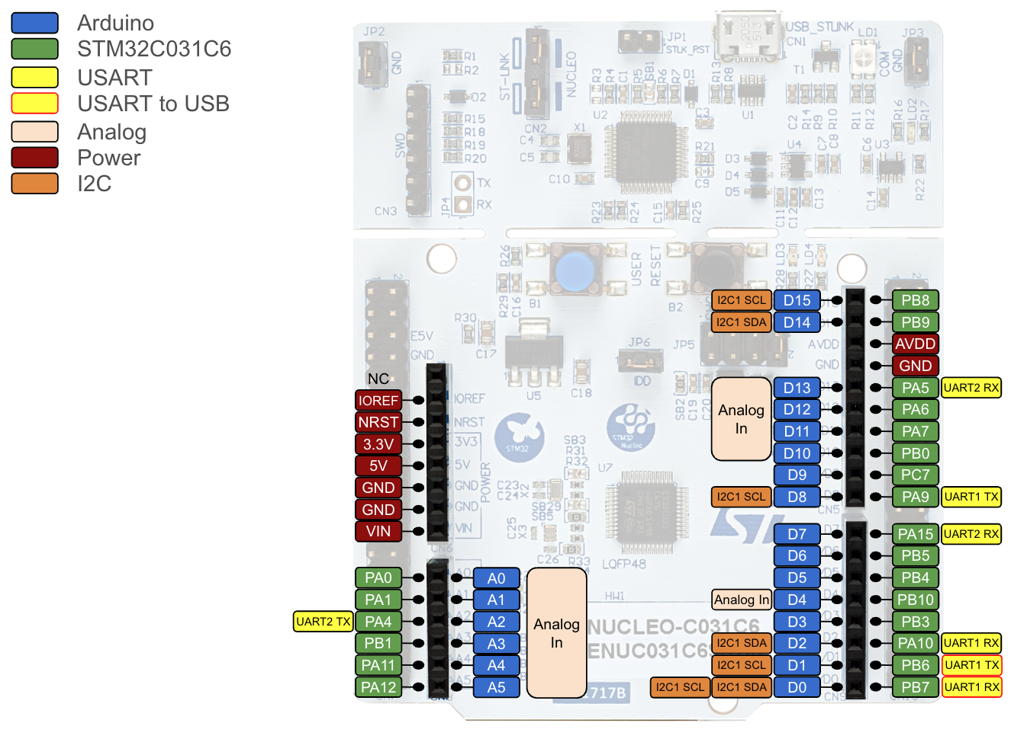
I²C Pins on the Nucleo: Lots of options
SCL = Serial Clock
SDA = Serial Data
Standard Arduino Choice

Slide 13
Configuring Pins
An I²C bus will not operate without pull-up resistors on both the clock and data lines; when there is no activity both lines must be in the high state.
Pull-up resistors are usually in the range of 5k𝛀 to 10k𝛀.
Thankfully, many I²C devices come with built-in pull-ups. Always check the data sheet!
Notes:
Both of the devices that we'll use in this class come with pull-up resistors. The devices are mounted on breakout boards, and these boards have the pins on them for connecting to the Nucleo. Those boards (or even the chips) have pull-up resistors.

Slide 14
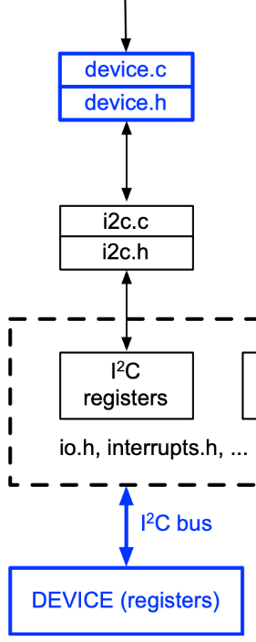
How to design an I²C interface?
Device drivers are device-specific, use the lower-level drivers.
Low-level drivers manage basic read and write operations.
Any device can use.
Notes:
We'll give the low-level drivers to you (i2c.c, i2c.h). On top of that you'll write device drivers (for 7-segment display, etc) that your main program talks to and that calls functions from the i2c library.

Slide 15
How to design an I²C interface?
Detailed explanation in Section 23.4.9 of the reference manual.
Based on how a transmission works, what low-level operations are needed?
Initialization (as always): Bit rate, etc.
Transmit a byte, wait for completion
Transmit multiple bytes, wait for completion
Receive a byte, stop communication thereafter
Receive multiple bytes, stop communication when done
Notes:
What do you need in terms of functions in an i2c driver?
You are given a function that can do each of these things.

Slide 16
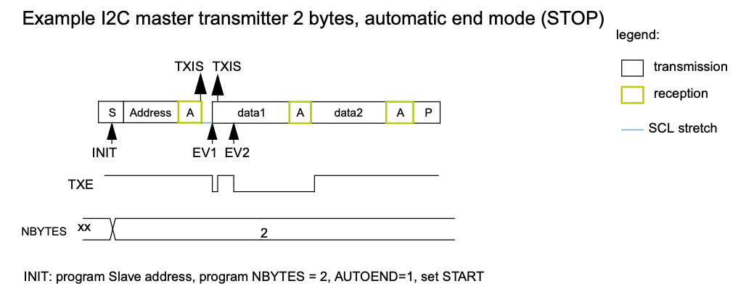
How to design an I²C interface?
Based on how a transmission works, what low-level operations are needed?
Initialization (as always): Bit rate, etc.
Transmit a byte, wait for completion
Transmit multiple bytes, wait for completion
Receive a byte, stop communication thereafter
Receive multiple bytes, stop communication when done
Detailed explanation in Section 23.4.9 of the reference manual.
Start
Ack
Stop
Transmit interrupt status bit
Controller sends
Controller receives
Transmit data register empty
Set-up
Notes:
What do you need in terms of functions in an i2c driver?
You are given a function that can do each of these things.

Slide 17
I²C library
Desired functions:
/* Configure I2C pins, initialize bus speed */
void i2c1_init(void);
/* Write one byte to target */
void i2c1_byteWrite(uint8_t deviceAddr, uint8_t data);
/* Read one byte from a target */
void i2c1_byteRead(uint8_t deviceAddr, uint8_t *data);
/* Write one or more bytes to a memory location within target */
void i2c1_memWrite(uint8_t deviceAddr, uint8_t registerAddr,
uint8_t nbytes, uint8_t *data);
/* Read one or more bytes from a memory location within target */
void i2c1_memRead(uint8_t deviceAddr, uint8_t registerAddr,
uint8_t nbytes, uint8_t *data);
Notes:
i2c1_init - sets pullups if needed, claim IO pins, initialize bus speed etc.
i2c1_byteWrite - send a single byte to the targetted device.
i2c1_byteRead - receive a single byte from the targetted device
i2c1_memWrite - send multiple bytes to specific address on the target
i2c1_memRead - receive multiple byte from specific address on the target
All these will be given to you. To use them properly we still need to understand how they work.

Slide 18
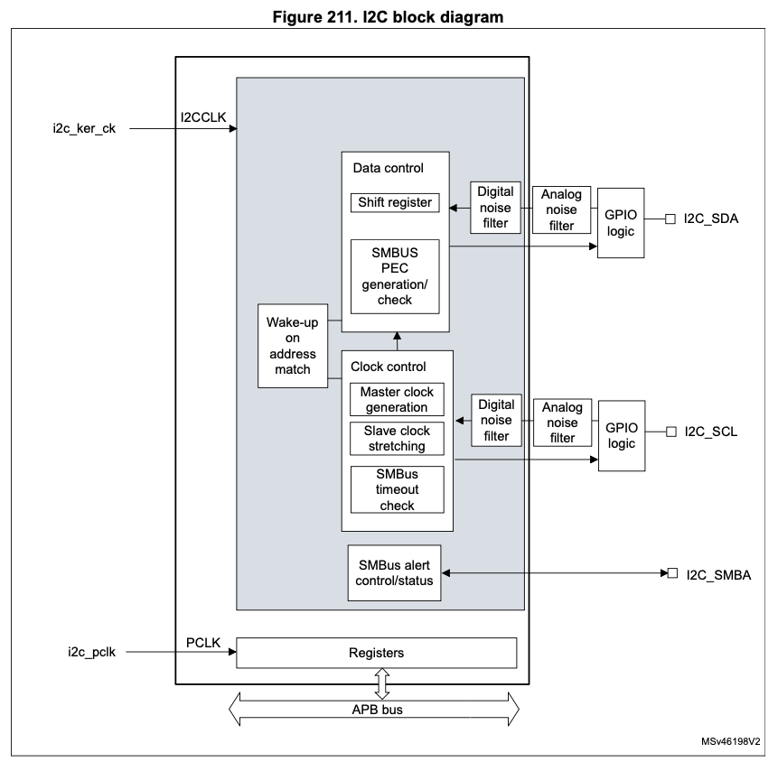
STM32C0xx I2C hardware
Address match is a peripheral function, not used when MCU is bus controller.
SCL and SDA pins
Relevant Registers:
CR1: control register 1
CR2: control register 2
TIMINGR: timing register
ISR: interrupt and status register
TXDR: transmit data register
RXDR: receive data register
Only relevant if using System Management Bus (SMBus) - we are not.
Notes:
Here are the registers used to program the I2C bus.
There is a prescaler, so there is a register to set the bit rate and other timings.
There is a register where you put the data to be sent or from which you read the data received. In there is also an ACK bit.
There is a control unit with a control register and a status register (usual stuff).
On the left is an address match unit that we won't be using since our Nucleo will always act as the bus controller. But if you ever build a peripheral with the STM32C0xx inside it as its processor then you'd have a register here where you store the address of the device you are making. Because we are the controller we don't need this. The controller does not have an address.

Slide 19
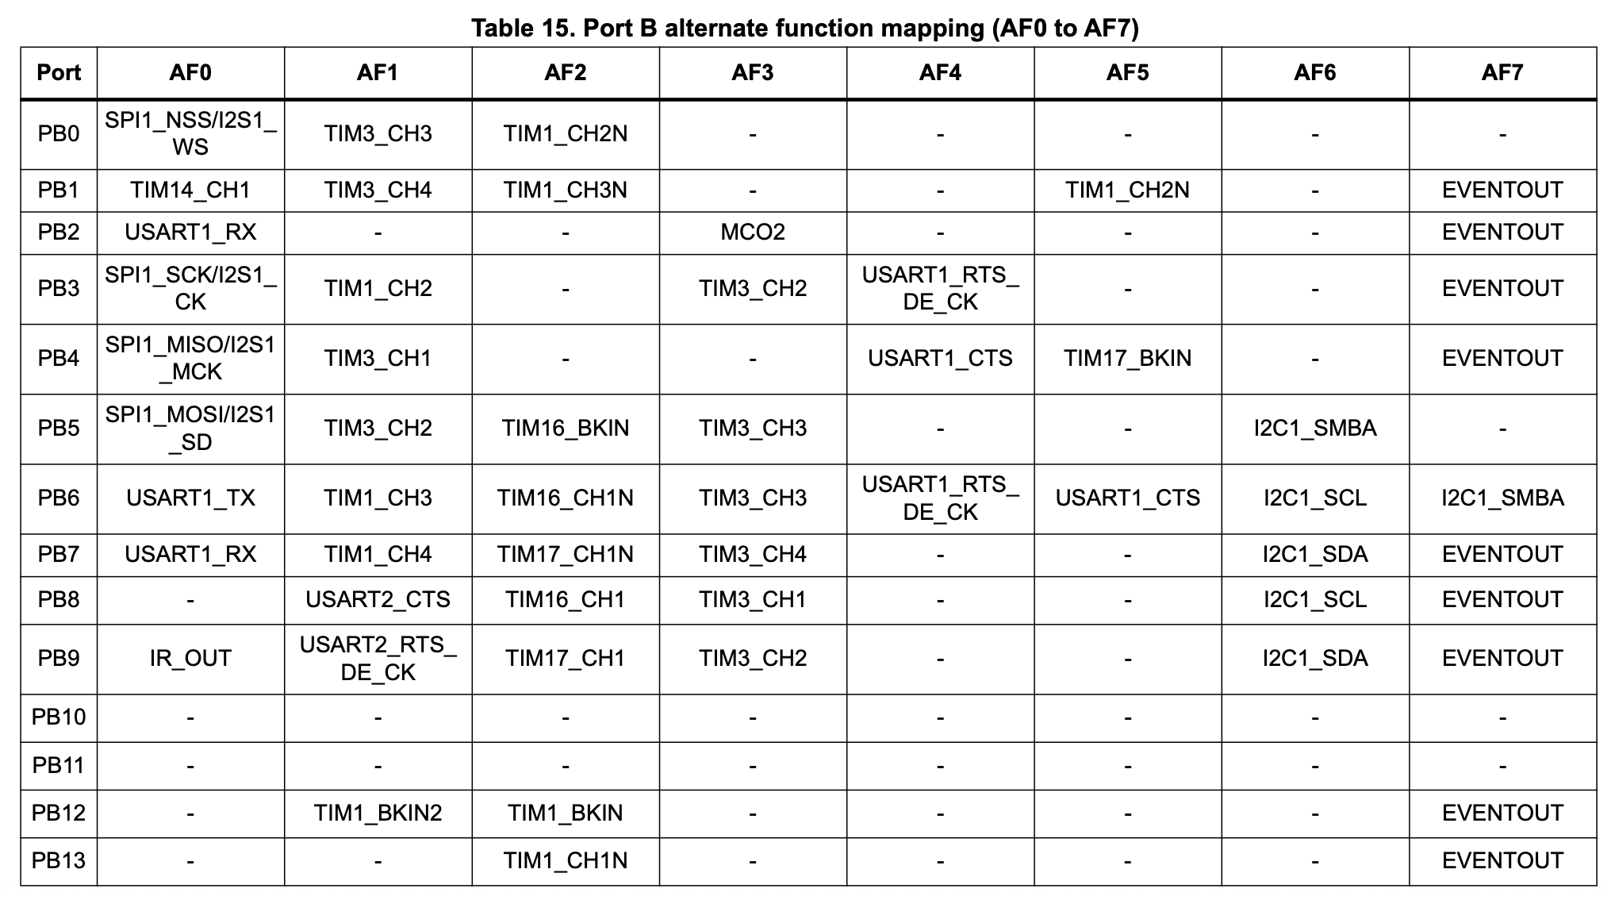
I2C Initialization
Open-drain mode: writing a '0' to the output register pulls the pin low, while writing a '1' leaves the pin floating, allowing the external pull-up resistor to bring it high.
Initialization is quite straightforward:
Configure the pins you'll be using for SCL and SDA
Enable clock access to the GPIO port
Select the correct alternate functions for the pins
Set the pins to "open drain" type
Activate pullup resistors if none of the devices on the bus have them
Configure the I2C module
Enable clock access to the I2C module
Disable the module for the next step
Write desired values into the timing register
Enable the module
Datasheet, Table 15
Notes:
Open Drain Type:
Multi-Master Capability: I2C allows multiple master devices to be on the same bus. If two masters tried to drive the line at the same time in push-pull mode (one driving high, the other low), it would create a direct short circuit between power and ground, potentially damaging the devices. Open-drain avoids this. Since devices can only pull the line low, there's no conflict if multiple devices try to do so simultaneously.
Bus Arbitration and Clock Stretching:
Arbitration: If two masters start talking at the same time, they monitor the bus. If a master tries to send a '1' (by letting the line float high) but sees the line is '0' (pulled low by another master), it knows it has lost arbitration and stops transmitting. This "wired-AND" logic is only possible with open-drain.
Clock Stretching: A slave device can hold the clock line (SCL) low to signal to the master that it needs more time to process a request. This is a form of flow control. The master will wait until the slave releases the line. This wouldn't work in push-pull mode.
As described in the "Make: AVR Programming" text, the I2C lines are held high by pull-up resistors. A device sends a '0' by pulling the line low with a transistor and sends a '1' by simply letting go and allowing the resistor to pull the line back up.
The STM32C0x1 Reference Manual confirms this behavior. When a GPIO pin is configured in open-drain mode, writing a '0' to the output register activates the N-MOS transistor to pull the pin low, while writing a '1' leaves the pin in a high-impedance (Hi-Z) state, allowing the external pull-up resistor to bring it high.

Slide 20
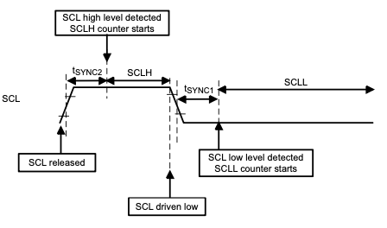
Determining and Setting the SCL Frequency
Initializations
Our chip is capable of communicating via I2C at up to 1 million bits per second, but only specialized devices that transmit vast amounts of data (like EEPROMs) are able to communicate at that speed.
Most common bitrates: 100,000 bits per second or 400,000 bits per second.
We'll use our devices at 100 kHz (standard mode).
Our chip allows you to configure every aspect of the clock pulse…
… that's why the timing register has lots of entries. The reference manual has sample values in case you ever need to modify things.
Notes:
Step 1: set frequency of the serial clock. Fair amount of flexibility but that's really not necessary. There are really only a few bit rates that are used in reality and are available on most devices, and that's either 100,000 bits per second or 400,000 bits per second. There are way faster ones that go up to millions of bits per second but they are only for specialized devices. If you go out and get one of those devices you'd look at the datasheet and if it says it can run at such a high speed then you can use it.
The devices we are using don't need that kind of speed and are slow. We'll use them at 100 kHz.

Slide 21
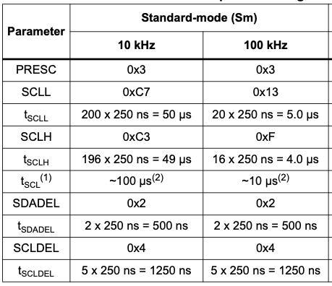
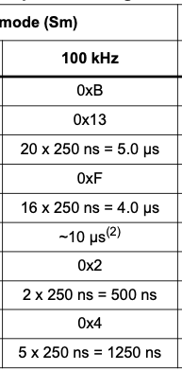
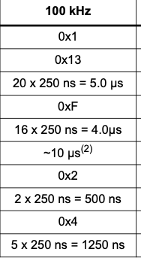
Example Settings for Standard Mode 100 kHz
Initializations
8 Mhz
16 Mhz
48 Mhz
Our default clock runs at 12 MHz. So we'll use PRESC = 0x2
SCLL = 0x13, SCLH = 0xF
SDADEL = 0x2, SCLDEL = 0x4.
Reference Manual, Section 23.4.10.
Notes:
SKIP!! THESE ARE JUST INSTRUCTOR NOTES…
8 Mhz with PRESC = 0x1 divides clock (by 2) down to 4 Mhz.
16 Mhz with PRESC = 0x3 divides clock (by 4) down to 4 Mhz.
48 Mhz with PRESC = 0xB divides clock (by 12) down to 4 Mhz.
So 12 Mhz with PRESC = 0x2 divides clock (by 3) down to 4 Mhz also.

Slide 22
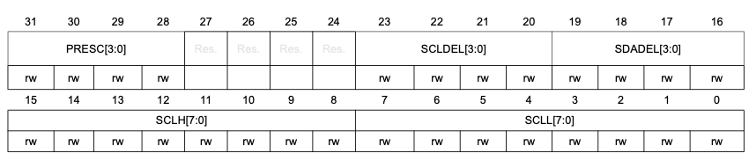
I2C_TIMINGR
Initializations
PRESC = 0x2
SCLL = 0x13, SCLH = 0xF
SDADEL = 0x2, SCLDEL = 0x4.
// Timing settings: Standard mode (100kHz) with 12MHz I2CCLK
I2C1->TIMINGR &= 0x0; // clear timing register
I2C1->TIMINGR |= (0x2 << I2C_TIMINGR_PRESC_Pos);
I2C1->TIMINGR |= (0x4 << I2C_TIMINGR_SCLDEL_Pos) | (0x2 << I2C_TIMINGR_SDADEL_Pos);
I2C1->TIMINGR |= (0xf << I2C_TIMINGR_SCLH_Pos) | (0x13 << I2C_TIMINGR_SCLL_Pos);
Notes:
SKIP

Slide 23
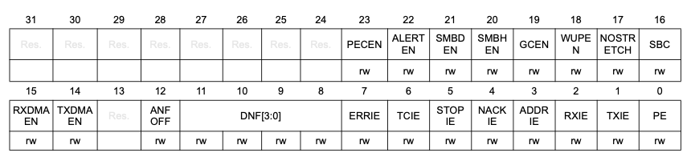
I2C_TIMINGR
I2C control register 1 (I2C_CR1)
Initializations
Timing settings for Standard mode (100kHz) with 12MHz I2CCLK
I2C1->TIMINGR &= 0x0; // clear timing register
I2C1->TIMINGR |= (0x2 << I2C_TIMINGR_PRESC_Pos);
I2C1->TIMINGR |= (0x4 << I2C_TIMINGR_SCLDEL_Pos) | (0x2 << I2C_TIMINGR_SDADEL_Pos);
I2C1->TIMINGR |= (0xf << I2C_TIMINGR_SCLH_Pos) | (0x13 << I2C_TIMINGR_SCLL_Pos);
I2C1->CR1 |= I2C_CR1_PE;
Peripheral enable
Notes:
SKIP

Slide 24
Initializations
void i2c1_init(void){
// Configure pins PB8 and PB9
// Enable clock access to GPIOB (for PB8 and PB9)
RCC->IOPENR |= RCC_IOPENR_GPIOBEN;
// Set PB8 and PB9 to alternate function mode
GPIOB->MODER = (GPIOB->MODER & ~GPIO_MODER_MODE8_Msk) | (GPIO_ALTERNATE << GPIO_MODER_MODE8_Pos);
GPIOB->MODER = (GPIOB->MODER & ~GPIO_MODER_MODE9_Msk) | (GPIO_ALTERNATE << GPIO_MODER_MODE9_Pos);
// Next, select AF6 for these pins.
GPIOB->AFR[1] = ((GPIOB->AFR[1]) & ~GPIO_AFRH_AFSEL8_Msk) | (GPIO_AF6 << GPIO_AFRH_AFSEL8_Pos);
GPIOB->AFR[1] = ((GPIOB->AFR[1]) & ~GPIO_AFRH_AFSEL9_Msk) | (GPIO_AF6 << GPIO_AFRH_AFSEL9_Pos);
// Set PB8 and PB9 to open drain
GPIOB->OTYPER |= (GPIO_OTYPER_OT8 | GPIO_OTYPER_OT9);
// Enable pull-ups for PB8 and PB9 if needed: our devices have their own pull-ups.
// Configure the i2c module
// Enable clock access to I2C1
RCC->APBENR1 |= RCC_APBENR1_I2C1EN;
// Enter reset mode (disable peripheral)
I2C1->CR1 &= ~I2C_CR1_PE;
// Timing settings: Standard mode (100kHz) with 12MHz I2CCLK
I2C1->TIMINGR &= 0x0; // clear timing register
I2C1->TIMINGR |= (0x2 << I2C_TIMINGR_PRESC_Pos);
I2C1->TIMINGR |= (0x4 << I2C_TIMINGR_SCLDEL_Pos) | (0x2 << I2C_TIMINGR_SDADEL_Pos);
I2C1->TIMINGR |= (0xf << I2C_TIMINGR_SCLH_Pos) | (0x13 << I2C_TIMINGR_SCLL_Pos);
// Exit reset mode (enable peripheral)
I2C1->CR1 |= I2C_CR1_PE;
}

Slide 25
Initializations
void i2c1_init(void){
// Configure pins PB8 and PB9
// Enable clock access to GPIOB (for PB8 and PB9)
RCC->IOPENR |= RCC_IOPENR_GPIOBEN;
// Set PB8 and PB9 to alternate function mode
GPIOB->MODER = (GPIOB->MODER & ~GPIO_MODER_MODE8_Msk) | (GPIO_ALTERNATE << GPIO_MODER_MODE8_Pos);
GPIOB->MODER = (GPIOB->MODER & ~GPIO_MODER_MODE9_Msk) | (GPIO_ALTERNATE << GPIO_MODER_MODE9_Pos);
// Next, select AF6 for these pins.
GPIOB->AFR[1] = ((GPIOB->AFR[1]) & ~GPIO_AFRH_AFSEL8_Msk) | (GPIO_AF6 << GPIO_AFRH_AFSEL8_Pos);
GPIOB->AFR[1] = ((GPIOB->AFR[1]) & ~GPIO_AFRH_AFSEL9_Msk) | (GPIO_AF6 << GPIO_AFRH_AFSEL9_Pos);
// Set PB8 and PB9 to open drain
GPIOB->OTYPER |= (GPIO_OTYPER_OT8 | GPIO_OTYPER_OT9);
// Enable pull-ups for PB8 and PB9 if needed: our devices have their own pull-ups.
// Configure the i2c module
// Enable clock access to I2C1
RCC->APBENR1 |= RCC_APBENR1_I2C1EN;
// Enter reset mode (disable peripheral)
I2C1->CR1 &= ~I2C_CR1_PE;
// Timing settings: Standard mode (100kHz) with 12MHz I2CCLK
I2C1->TIMINGR &= 0x0; // clear timing register
I2C1->TIMINGR |= (0x2 << I2C_TIMINGR_PRESC_Pos);
I2C1->TIMINGR |= (0x4 << I2C_TIMINGR_SCLDEL_Pos) | (0x2 << I2C_TIMINGR_SDADEL_Pos);
I2C1->TIMINGR |= (0xf << I2C_TIMINGR_SCLH_Pos) | (0x13 << I2C_TIMINGR_SCLL_Pos);
// Exit reset mode (enable peripheral)
I2C1->CR1 |= I2C_CR1_PE;
}

Slide 26
Am I sending or receiving?
With a bidirectional bus, how does the device know whether it's sending or receiving data?
Every communication starts by sending a start condition, then the device address with which to communicate.
The device address (7-bit) is combined with an 8th bit in the LSB position which indicates reading (1) or writing (0) to the peripheral device.
Notes:
How does a device know whether it's sending or receiving? The answer is in the R/W bit. The 7-bit address goes out first, followed by the R/W bit. It does this for you. But you are responsible to get the address right. You have to read the datasheet carefully.

Slide 27
Device Address
Device addresses are 7-bit addresses, some bits of which are pre-determined by the device, others you may be able to change (in order to avoid addressing conflicts).
The 8th bit (the LSB) is used to indicate whether the Transmitter is:
Writing to the device (0)
Reading from the device (1).
Example: 7-segment display with backpack:
7-bit address is 0b 0111 0000, or 0x70
There also is a 10-bit addressing mode but we won't be using that.
Caution: Some datasheets are not explicit on whether they are listing the 7-bit version or the 8-bit version of the address! This can be a major source of confusion.
Notes:
The device we'll be using has an address of 0x70. So 0b01110000. So perfect 8-bit number whose leading bit is a 0. Now you shift that to the left by 1 bit (have to do that!), and then stick in a 0 to write or 1 ro read. The hardware on our device actually does all this for us.
Some devices come with an 8-bit address… So what that means is that they have already shifted the address to the left and you only have to modify the lowest bit depending on read or write. This actually happened to us and we totally messed it up. It was the only device we have seen that does that. So be careful - you have to read the datasheet…

Slide 28
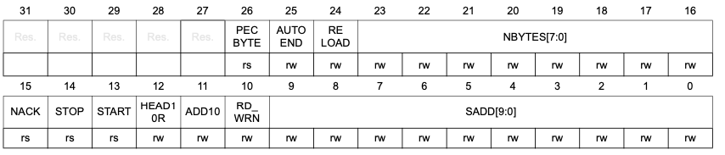
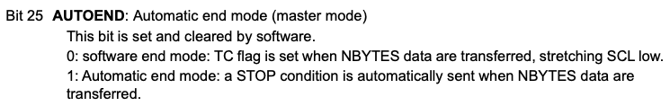

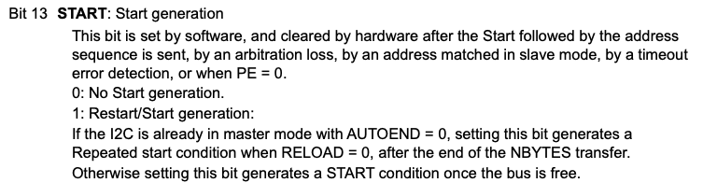

I2C Control Register 2 (I2C_CR2)

Slide 29
Send a byte of data to target
Sending data
Initiate communication: program
Target address
Transfer direction (0 for write by default)
Number of bytes to be sent (1 if just sending one byte)
Automatic stop condition if desired (yes for now).
Initiate start condition (set the START bit)
Wait until bus is free, make sure target sent Ack
Once transmit data register is empty, put data into it.
// Ping target address for writing 1 byte, use "=" to ensure all other bits are cleared
I2C1->CR2 = (deviceAddr<<1)
| (1U << I2C_CR2_NBYTES_Pos) // sending one byte only
| I2C_CR2_AUTOEND // Send Stop condition after transfer
| I2C_CR2_START; // Send Start condition
while( !(I2C1->ISR & I2C_ISR_BUSY) ); // Wait until Start is received
// Send the data
if( !(I2C1->ISR & I2C_ISR_NACKF) ) { // Make sure ACK received
while( !(I2C1->ISR & I2C_ISR_TXIS) ); // Wait for TX to be ready
I2C1->TXDR = data; // put data in send register
}
Notes:
To send a byte, load data register with the 8 bits you want to send out. The clear the interrupt flag, enable I2C (all in one step) and wait for the hardware to be done.
Here is the function.

Slide 30
Receive a byte of data from target
Reading data
Initiate communication: program
Target address
Transfer direction (1 for read)
Number of bytes to be read (1 if just reading one byte)
Automatic stop condition if desired (yes).
Initiate start condition (set the START bit)
Wait until bus is free, make sure target sent Ack
Once receive data register is non-empty, read data from it.
// Ping target address for reading one byte
I2C1->CR2 = (deviceAddr<<1) // target address
| (1 << I2C_CR2_NBYTES_Pos) // will read one byte
| I2C_CR2_RD_WRN // ping for reading
| I2C_CR2_AUTOEND // Send Stop condition after transfer
| I2C_CR2_START; // initiate start condition
while( !(I2C1->ISR & I2C_ISR_BUSY) ); // Wait until Start is received
// Read the data
if( !(I2C1->ISR & I2C_ISR_NACKF) ) { // Make sure ACK received
while( !(I2C1->ISR & I2C_ISR_RXNE) ); // Wait for Rx to be ready
*data = I2C1->RXDR; // Read the data
}
Notes:
Difference to sending:
Send address, shifted to left by 1 bit, or it with 1 (this tells it to read).
We either set or do not set the ACK bit. Typically you send an ACK when you want the communication to continue (so you are receiving a chain of bytes). When you received what you want to be the last byte you send a NACK (no ACK) to indicate that you want to be done. After that, the controller sends the STOP condition and now everything is back in "neutral" state, ready for another interaction.

Slide 31
Compare: Sending versus receiving one byte of data
// Ping target address for writing 1 byte, use "=" to ensure all other bits are cleared
I2C1->CR2 = (deviceAddr<<1)
| (1U << I2C_CR2_NBYTES_Pos) // sending one byte only
| I2C_CR2_AUTOEND // Send Stop condition after transfer
| I2C_CR2_START; // Send Start condition
while( !(I2C1->ISR & I2C_ISR_BUSY) ); // Wait until Start is received
// Send the data
if( !(I2C1->ISR & I2C_ISR_NACKF) ) { // Make sure ACK received
while( !(I2C1->ISR & I2C_ISR_TXIS) ); // Wait for TX to be ready
I2C1->TXDR = data; // put data in send register
}
Sending one byte of data
// Ping target address for reading one byte
I2C1->CR2 = (deviceAddr<<1) // target address
| (1 << I2C_CR2_NBYTES_Pos) // will read one byte
| I2C_CR2_RD_WRN // ping for reading
| I2C_CR2_AUTOEND // Send Stop condition after transfer
| I2C_CR2_START; // initiate start condition
while( !(I2C1->ISR & I2C_ISR_BUSY) ); // Wait until Start is received
// Read the data
if( !(I2C1->ISR & I2C_ISR_NACKF) ) { // Make sure ACK received
while( !(I2C1->ISR & I2C_ISR_RXNE) ); // Wait for Rx to be ready
*data = I2C1->RXDR; // Read the data
}
Receiving one byte of data
Notes:
To send a byte, load data register with the 8 bits you want to send out. The clear the interrupt flag, enable I2C (all in one step) and wait for the hardware to be done.
Here is the function.

Slide 32
Thursday: 7-segment LED Display
Notes:
We'll learn how to use this thing tomorrow. No need to use "screen" or "PuTTY"! You'll have an actual display built into your system (gas pump, etc).

