Slide 1


Engs 28
Embedded Systems
Day 10

Slide 2
Agenda
Timer interrupt design reviews
Device driver for the four-digit display

Slide 3
Recall: Homework from Tuesday
Counter with timer and reset: Modify counterResetButtonInt to use a timer instead of a delay_ms(). Set the update period to 1 sec.
Rewrite ADCPot.c, taking a measurement every second, using a timer instead of delay_ms().
Blinky with T_{on} ≠ T_{off}
Demonstrate your counter with timer and reset and discuss with your table partners.

Slide 4
I asked chatGPT and Gemini to do the counter with timer reset assignment for me…
With your group, pick one of the two solutions and study it.
Do you see advantages over your own solution?
Do you see problematic parts in the solution?
Would you revise your solution, having seen this one?

Slide 5
Counter with reset - ChatGPT
counterResetButtonIntTimerChatGPT.c
#include <stdio.h>
#include "ES28.h"
#include "uart.h"
#define MAXCOUNT 100
void pb4_exti_init(void);
void tim14_init(void);
volatile int buttonPushed;
volatile int timerElapsed;
int main(void) {
int counter = 0;
uart2_init();
printf("Counter demo\r\n");
printf("Hex \tDecimal\r\n");
pb4_exti_init();
tim14_init();
buttonPushed = 0;
timerElapsed = 0;
while (1) {
if (timerElapsed) {
timerElapsed = 0;
printf("%x\t%d\r\n", counter, counter);
if (buttonPushed) {
counter = 0;
buttonPushed = 0;
} else if (counter == MAXCOUNT - 1) {
counter = 0;
} else {
counter++;
}
}
}
}
void TIM14_IRQHandler(void) {
if (TIM14->SR & TIM_SR_UIF) {
TIM14->SR &= ~TIM_SR_UIF; // Clear PR flag
timerElapsed = 1;
}
}
void tim14_init(void) {
RCC->APBENR2 |= RCC_APBENR2_TIM14EN;
TIM14->PSC = 48000 - 1;
TIM14->ARR = 1000 - 1;
TIM14->SR &= ~TIM_SR_UIF;
TIM14->DIER |= TIM_DIER_UIE;
NVIC_EnableIRQ(TIM14_IRQn);
TIM14->CR1 |= TIM_CR1_CEN;
}
void EXTI4_15_IRQHandler(void){
// unchanged from our code
}
void pb4_exti_init(void) {
// unchanged from our code
}

Slide 6
Counter with reset - ChatGPT
counterResetButtonIntTimerChatGPT.c
#include <stdio.h>
#include "ES28.h"
#include "uart.h"
#define MAXCOUNT 100
void pb4_exti_init(void);
void tim14_init(void);
volatile int buttonPushed;
volatile int timerElapsed;
int main(void) {
int counter = 0;
uart2_init();
printf("Counter demo\r\n");
printf("Hex \tDecimal\r\n");
pb4_exti_init();
tim14_init();
buttonPushed = 0;
timerElapsed = 0;
while (1) {
if (timerElapsed) {
timerElapsed = 0;
printf("%x\t%d\r\n", counter, counter);
if (buttonPushed) {
counter = 0;
buttonPushed = 0;
} else if (counter == MAXCOUNT - 1) {
counter = 0;
} else {
counter++;
}
}
}
}
void TIM14_IRQHandler(void) {
if (TIM14->SR & TIM_SR_UIF) {
TIM14->SR &= ~TIM_SR_UIF; // Clear PR flag
timerElapsed = 1;
}
}
void tim14_init(void) {
RCC->APBENR2 |= RCC_APBENR2_TIM14EN;
TIM14->PSC = 48000 - 1;
TIM14->ARR = 1000 - 1;
TIM14->SR &= ~TIM_SR_UIF;
TIM14->DIER |= TIM_DIER_UIE;
NVIC_EnableIRQ(TIM14_IRQn);
TIM14->CR1 |= TIM_CR1_CEN;
}
void EXTI4_15_IRQHandler(void){
// unchanged from our code
}
void pb4_exti_init(void) {
// unchanged from our code
}
Should use only "="
Incorrect clock speed
Not zeroing counter - will start at a random place
Only checked when timer elapsed - could miss button presses

Slide 7
Counter with reset - Gemini
counterResetButtonIntTimerChatGPT.c
#include <stdio.h>
#include "ES28.h"
#include "uart.h"
#define MAXCOUNT 100
void pb4_exti_init(void);
void tim14_init(void);
volatile int buttonPushed;
int main(void) {
int counter = 0;
// Initialize peripherals
uart2_init();
pb4_exti_init();
tim14_init();
buttonPushed = 0;
printf("Counter …\r\n");
printf("Hex \tDecimal\r\n");
while(1) {
if (TIM14->SR & TIM_SR_UIF) {
TIM14->SR &= ~TIM_SR_UIF; // lear PR flag
printf("%x\t%d\r\n", counter, counter);
// Logic for counting and button reset
if (buttonPushed) {
counter = 0;
buttonPushed = 0;
} else if (counter >= MAXCOUNT - 1) {
counter = 0;
} else {
counter++;
}
}
}
return 0;
}
void tim14_init(void) {
RCC->APBENR2 |= RCC_APBENR2_TIM14EN;
TIM14->PSC = 16000 - 1;
TIM14->ARR = 1000 - 1;
TIM14->EGR |= TIM_EGR_UG;
TIM14->CR1 |= TIM_CR1_CEN;
}
void EXTI4_15_IRQHandler(void){
// unchanged from our code
}
void pb4_exti_init(void) {
// unchanged from our code
}

Slide 8
Counter with reset - Gemini
counterResetButtonIntTimerChatGPT.c
#include <stdio.h>
#include "ES28.h"
#include "uart.h"
#define MAXCOUNT 100
void pb4_exti_init(void);
void tim14_init(void);
volatile int buttonPushed;
int main(void) {
int counter = 0;
// Initialize peripherals
uart2_init();
pb4_exti_init();
tim14_init();
buttonPushed = 0;
printf("Counter …\r\n");
printf("Hex \tDecimal\r\n");
while(1) {
if (TIM14->SR & TIM_SR_UIF) {
TIM14->SR &= ~TIM_SR_UIF; // lear PR flag
printf("%x\t%d\r\n", counter, counter);
// Logic for counting and button reset
if (buttonPushed) {
counter = 0;
buttonPushed = 0;
} else if (counter >= MAXCOUNT - 1) {
counter = 0;
} else {
counter++;
}
}
}
return 0;
}
void tim14_init(void) {
RCC->APBENR2 |= RCC_APBENR2_TIM14EN;
TIM14->PSC = 16000 - 1;
TIM14->ARR = 1000 - 1;
TIM14->EGR |= TIM_EGR_UG;
TIM14->CR1 |= TIM_CR1_CEN;
}
void EXTI4_15_IRQHandler(void){
// unchanged from our code
}
void pb4_exti_init(void) {
// unchanged from our code
}
Incorrect clock speed
polling
Only checked when timer elapsed - could miss button presses

Slide 9
Counter with reset - solution
counterResetButtonIntTimer.c
#include <stdio.h>
#include "ES28.h"
#include "tim.h"
#include "exti.h"
#include "uart.h"
#define LINE4 (1U<<4) // EXTI Line 4
#define MAXCOUNT 100
volatile int buttonB4Pushed;
volatile int timerFlag;
int main(void) {
int counter = 0;
uart2_init();
printf("Hex \tDecimal\r\n");
pb4_exti_init();
tim14_ms_interrupt_init(1000);
buttonB4Pushed = 0;
timerFlag = 0;
while(1) {
if (timerFlag) {
printf("%x\t%d\r\n", counter, counter);
if (counter == MAXCOUNT) {
counter = 0; // Roll over
} else {
counter++; // Increment
}
timerFlag = 0; // Clear timer flag
}
if (buttonB4Pushed) {
counter = 0;
buttonB4Pushed = 0; // clear button flag
}
}
return 0;
}
counterResetButtonIntTimer.c
void EXTI4_15_IRQHandler(void){
// disable global interrupt
__disable_irq();
if (EXTI->FPR1 & EXTI_FPR1_FPIF4) {
EXTI->FPR1 = EXTI_FPR1_FPIF4; // Clear PR flag
buttonB4Pushed = 1;
}
// Enable global interrupts
__enable_irq();
}
void TIM14_IRQHandler(void) {
// disable global interrupt
__disable_irq();
// Clear UIF in status register
TIM14->SR = ~TIM_SR_UIF; // Clear UIF
timerFlag = 1;
// Enable global interrupts
__enable_irq();
}

Slide 10
exti.c
#include "exti.h"
#include "ES28.h"
void pb4_exti_init(void) {
// disable global interrupt
__disable_irq();
// Enable clock access to GPIOB
RCC->IOPENR |= RCC_IOPENR_GPIOBEN;
// Configure PB4 as input pin
// (not necessary since this is default)
GPIOB->MODER &= ~GPIO_MODER_MODE4_Msk;
GPIOB->MODER |= (GPIO_INPUT <<
GPIO_MODER_MODE4_Pos);
// enable pull-up for PB4
GPIOB->PUPDR &= ~GPIO_PUPDR_PUPD4_Msk;
GPIOB->PUPDR |= (GPIO_PULLUP <<
GPIO_PUPDR_PUPD4_Pos);
// Configure EXTICR2
EXTI->EXTICR[1] &= ~EXTI_EXTICR2_EXTI4_Msk;
EXTI->EXTICR[1] |= (EXTI_PB <<
EXTI_EXTICR2_EXTI4_Pos);
// Falling edge trigger for line EXTI4
EXTI->FTSR1 |= EXTI_FTSR1_FT4;
// Unmask line EXTI4
EXTI->IMR1 |= EXTI_IMR1_IM4;
// Enable EXTI4 line in NVIC
NVIC_EnableIRQ(EXTI4_15_IRQn);
// Enable global interrupts
__enable_irq();
}
exti.h
#ifndef EXTI_H_
#define EXTI_H_
void pb4_exti_init(void);
#endif /* EXTI_H_ */
tim.c
#include "tim.h"
#include "stm32C0xx.h"
#define PSC_FACTOR 12000 // 12 MHz/12000 = 1 kHz
void tim14_ms_interrupt_init(int milliseconds) {
__disable_irq();
RCC->APBENR2 |= RCC_APBENR2_TIM14EN;
TIM14->PSC = PSC_FACTOR - 1;
TIM14->ARR = milliseconds - 1;
TIM14->CNT = 0;
TIM14->DIER |= TIM_DIER_UIE;
NVIC_EnableIRQ(TIM14_IRQn);
TIM14->CR1 |= TIM_CR1_CEN;
__enable_irq();
}
tim.h
#ifndef TIM_H_
#define TIM_H_
void tim14_ms_interrupt_init(int milliseconds);
#endif /* TIM_H_ */

Slide 11
Timer-controlled A/D conversion
ADCPotWithTimerInt.c
#include <stdio.h>
#include "ES28.h"
#include "uart.h"
#include "tim.h"
#include "adc.h"
volatile int timerFlag;
int main(void) {
uint16_t sensor_value;
unsigned voltage10;
uart2_init();
pa0_adc_init();
tim14_ms_interrupt_init(1000);
timerFlag = 0;
while(1) {
if (timerFlag) {
timerFlag = 0;
start_conversion();
sensor_value = adc_read();
voltage10 = (sensor_value*33)/4096;
printf("ADC: %u, voltage: %u.%u Volt\r\n",
sensor_value, voltage10/10, voltage10%10);
}
}
return 0;
}
void TIM14_IRQHandler(void) {
__disable_irq();
// Clear UIF in status register
TIM14->SR = ~TIM_SR_UIF;
timerFlag = 1;
__enable_irq();
}
adc.c
#include <stdint.h>
#include "adc.h"
#include "stm32C0xx.h"
void pa0_adc_init(void) {
RCC->IOPENR |= RCC_IOPENR_GPIOAEN;
GPIOA->MODER &= ~GPIO_MODER_MODE0_Msk;
GPIOA->MODER |= (GPIO_ANALOG <<
GPIO_MODER_MODE0_Pos);
RCC->APBENR2 |= RCC_APBENR2_ADCEN; ADC1->CHSELR |= ADC_CHSELR_CHSEL0;
ADC1->CR |= ADC_CR_ADVREGEN;
delay_ms(2);
ADC1->CR |= ADC_CR_ADCAL; while ((ADC1->ISR & ADC_ISR_EOCAL)==0){} uint8_t calibration = ADC1->DR & 0x7F;
ADC1->ISR = ADC_ISR_ADRDY;
ADC1->CR |= ADC_CR_ADEN;
ADC1->CALFACT = calibration;
}
void start_conversion(void) {
while( (ADC1->ISR & ADC_ISR_ADRDY) == 0){} ADC1->CR |= ADC_CR_ADSTART;
}
uint16_t adc_read(void) {
while( (ADC1->ISR & ADC_ISR_EOC) == 0 ){} return (uint16_t) ADC1->DR;
}
tim.c
#include "tim.h"
#include "ES28.h"
#define PSC_FACTOR 12000 // 12 MHz/12000 = 1 kHz
void tim14_ms_interrupt_init(int milliseconds) {
…

Slide 12
Blinky with timer:
T_{ON} ≠ T_{OFF}
int main(void) {
RCC->IOPENR |= RCC_IOPENR_GPIOAEN;
GPIOA->MODER |= (1U<<10);
GPIOA->MODER &=~(1U<<11);
GPIOA->ODR &= ~(LED); // LED is off
state = LEDOFF;
timerFlag = 0;
tim14_ms_interrupt_init(T_OFF);
while(1) {
if (timerFlag) {
GPIOA->ODR ^= LED; switch (state) {
case LEDOFF:
TIM14->ARR = T_ON-1;
state = LEDON;
break;
case LEDON:
TIM14->ARR = T_OFF-1;
state = LEDOFF;
break;
}
timerFlag = 0;
}
}
}
#include <stdio.h>
#include "ES28.h"
#include "tim.h"
#define LED (1U<<5) // on-board LED
#define T_ON 200 // 200 ms
#define T_OFF 800 // 800 ms
typedef enum {LEDON, LEDOFF} state_t;
volatile state_t state;
volatile int timerFlag;
void TIM14_IRQHandler(void) {
__disable_irq();
/* Clear UIF in status register */
TIM14->SR = ~TIM_SR_UIF;
timerFlag = 1;
__enable_irq();
}

Slide 13
Seven-segment display

Slide 14
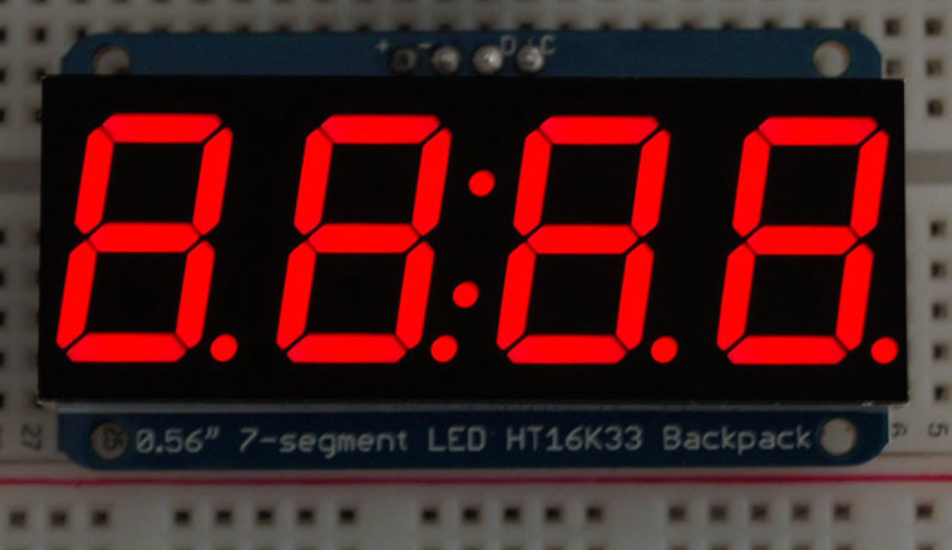
7-segment LED Display with HT16K33 Backpack
Notes:
Connected to the Arduino via 4 wires: power, ground, data and clock. It's mounted on a "backpack" so that we can easily access the pins. The Backpack provides the i2c functionality. You speak to the controller on the backpack via i2c and tell it which segments you want to have lit up, the brightness level, and whether or not you want it to blink.

Slide 15
"Ping" the display
#include "ES28.h"
#include "i2c.h"
#define HT16K33_ADDR 0x70 // I2C address of our backpack controller
int main(void) {
uint8_t display_addr = HT16K33_ADDR;
uint8_t data = 0b0; // The hardware requires us to send some data, not important here.
i2c1_init();
// Ping the display's address, repeatedly
while(1) {
// Configure I2C and send start condition
I2C1->CR2 = (display_addr<<1) | (1U << I2C_CR2_NBYTES_Pos)
| I2C_CR2_AUTOEND // Send Stop condition after transfer
| I2C_CR2_START; // Send Start condition
while( !(I2C1->ISR & I2C_ISR_BUSY) ); // Wait until Start is received
// Send the data
if( !(I2C1->ISR & I2C_ISR_NACKF)) { // Make sure ACK received
while( !(I2C1->ISR & I2C_ISR_TXIS) ); // Wait for TX to be ready
I2C1->TXDR = data; // put data in send register
}
delay_ms(250);
}
return 0;
}

Slide 16
"Ping" the display - using i2c library
#include "ES28.h"
#include "i2c.h"
#define HT16K33_ADDR 0x70 // I2C address of our backpack controller
int main(void) {
uint8_t data = 0b0; // The hardware requires us to send some data, not important here.
i2c1_init();
// Ping the display's address, repeatedly
while(1) {
// Send data to the display
i2c1_byteWrite(HT16K33_ADDR, data);
delay_ms(250);
}
return 0;
}

Slide 17
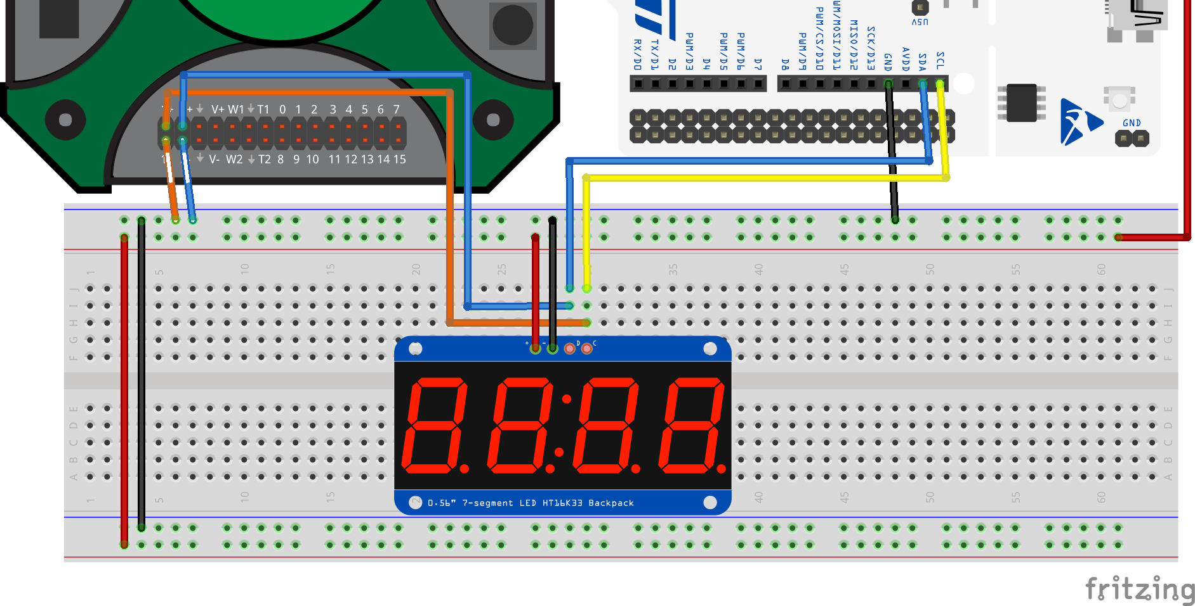
Step 1: Ping the display
Wire the display to the Nucleo as in the image.
Wire the AD2 as in the image, with Ch1 on SCL, Ch2 on SDA.
Download "i2c.c" and "i2c.h" and put them into your mylib folder.
Download "pingDisplay.c" from Canvas and put it in a new project "SevenSegI2CFirstSteps" (copy of TemplateProject).
Start the AD2 and put it in oscilloscope mode.
Compile and flash the code to your Nucleo.
+V, GND, SDA, SCL

Slide 18
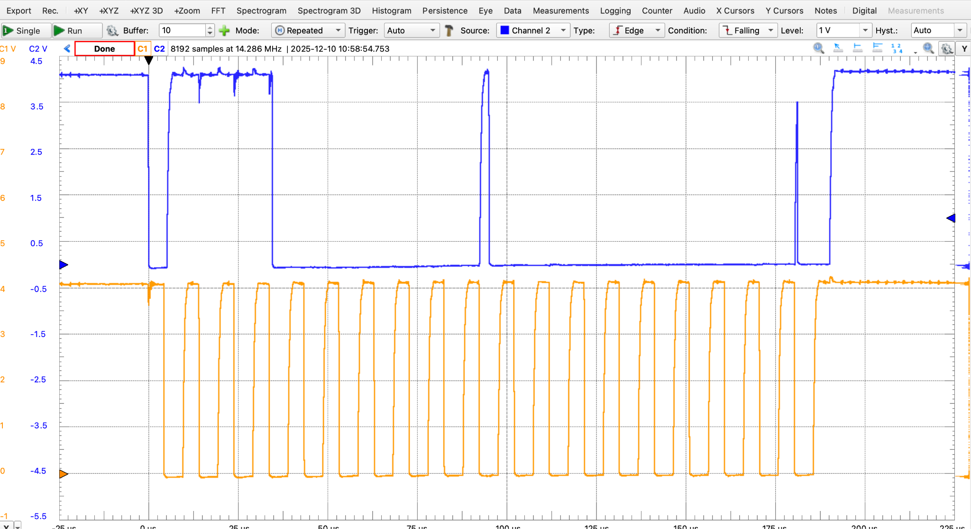
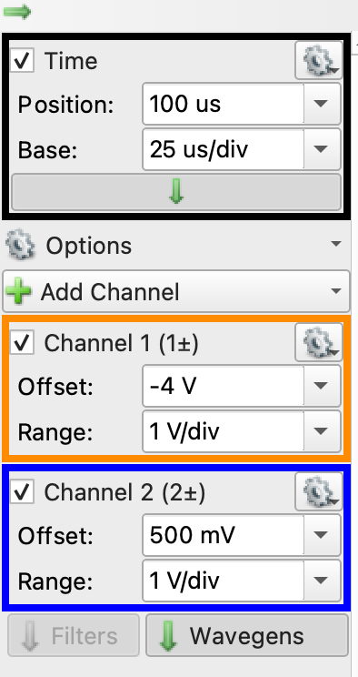
Take a single sweep

Slide 19
Take a single sweep
In an I2C conversation, the data on the SDA line is considered stable and is read only when the SCL clock line is high. The data line should not change its state while the clock is high, except for two special cases: the START and STOP conditions.
SDA
SCL
Can you find the start condition? How do you know that's what it is?
What address is being sent?
Notes:
After the address and the r/w bit have been sent, the controller continues to maintain the clock, so sends an “extra” clock out for the ACK/NACK. When it drives the low edge of the clock out, it lets go of the data line. Now –
For an ACK, the target grabs the line and pulls low sometime during the low portion of the clock. Depending on specific implementation and chips and wiring and all that, we may see a blip high while the clock is low. The important thing is that the ACK is stable when the next rising clock comes along.
Since the data isn’t allow to change when the clock is high (except for start and stop) the target has to hold ACK until the clock falls again. At this point, the target lets go and the controller takes over again. Here, again - depending on timing, we could see a blip while the handoff occurs, but as long as the proper value is there at the end of the low portion, no one will be the wiser.

Slide 20
Take a single sweep
Start condition
SDA
Ack
SCL
0x70 = 0b01110000. What is the "extra" 0 to the right of the address?
How do you recognize the "Ack"? Who sends it?
Notes:
The extra '0' is to tell the target that we wish to write to it.
After that last 0 has been sent, when the clock is next low, the controller lets go of the data line. If there is a target that recognized its address, it'll grab the data line and pull it low during that low portion of the clock so that when the clock goes high, the data reads low again, that's the Ack. During the next low of the clock the target lets go of the data and the controller takes over again and starts sending the data.
After the address and the r/w bit have been sent, the controller continues to maintain the clock, so sends an “extra” clock out for the ACK/NACK. When it drives the low edge of the clock out, it lets go of the data line. Now –
For an ACK, the target grabs the line and pulls low sometime during the low portion of the clock. Depending on specific implementation and chips and wiring and all that, we may see a blip high while the clock is low. The important thing is that the ACK is stable when the next rising clock comes along.
Since the data isn’t allow to change when the clock is high (except for start and stop) the target has to hold ACK until the clock falls again. At this point, the target lets go and the controller takes over again. Here, again - depending on timing, we could see a blip while the handoff occurs, but as long as the proper value is there at the end of the low portion, no one will be the wiser.

Slide 21
What happens when …
With your team, attempt the first question - move on to the second if you have time.
What happens when you ping the wrong address?
Modify the code so that the device address is 0x60 (for example). Re-compile and flash your code.
Take a single sweep - you may need to start the single sweep and then restart your Nucleo (black on-board button). What do you observe?
What happens when you send a different data byte?
Go back to the correct device address: 0x70.
Modify the data byte and observe the difference after you reflash and take a single sweep.

Slide 22
What happens when you ping the wrong address?
Modify the code so that the device address is 0x60 (for example). Re-compile and flash your code.
Take a single sweep - you may need to start the single sweep and then restart your Nucleo (black on-board button). What do you observe?

Slide 23
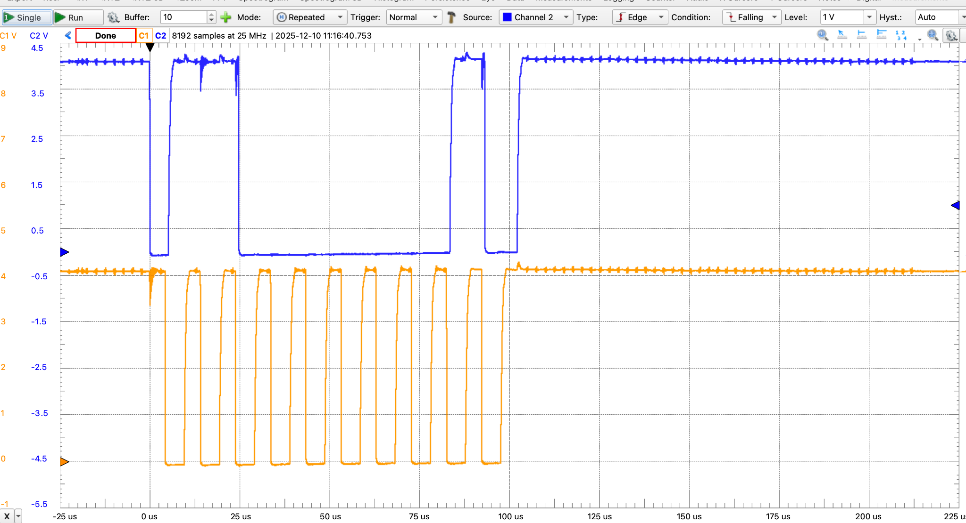

Wrong i2c address…
SDA
NoAck
SCL
0x60 = 0b01100000. The "extra" 0 to the right of the address indicates that we are writing to the device.
Since there is no Ack from any device, the controller initiates a Stop condition. Can you find it?
Notes:
After that last 0 has been sent, when the clock is next low, the controller lets go of the data line. No target recognized the address, so the data line remains high and when the clock goes high, the data still reads high, that's the NoAck. During the next low of the clock the controller pulls the data line low again and then, during the next high clock, lets go of the data line. That's the stop condition.

Slide 24
What does a different data byte look like?
Go back to the correct device address:0x70. Modify the data byte and observe the difference after you reflash and take a single sweep.

Slide 25
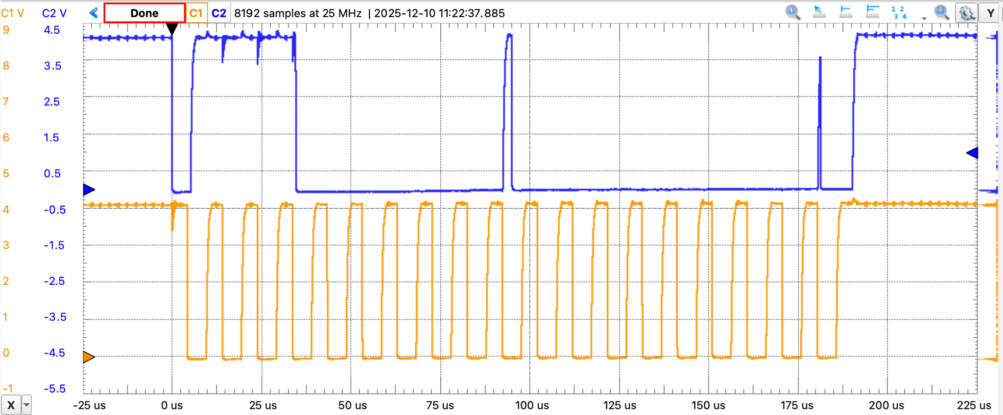
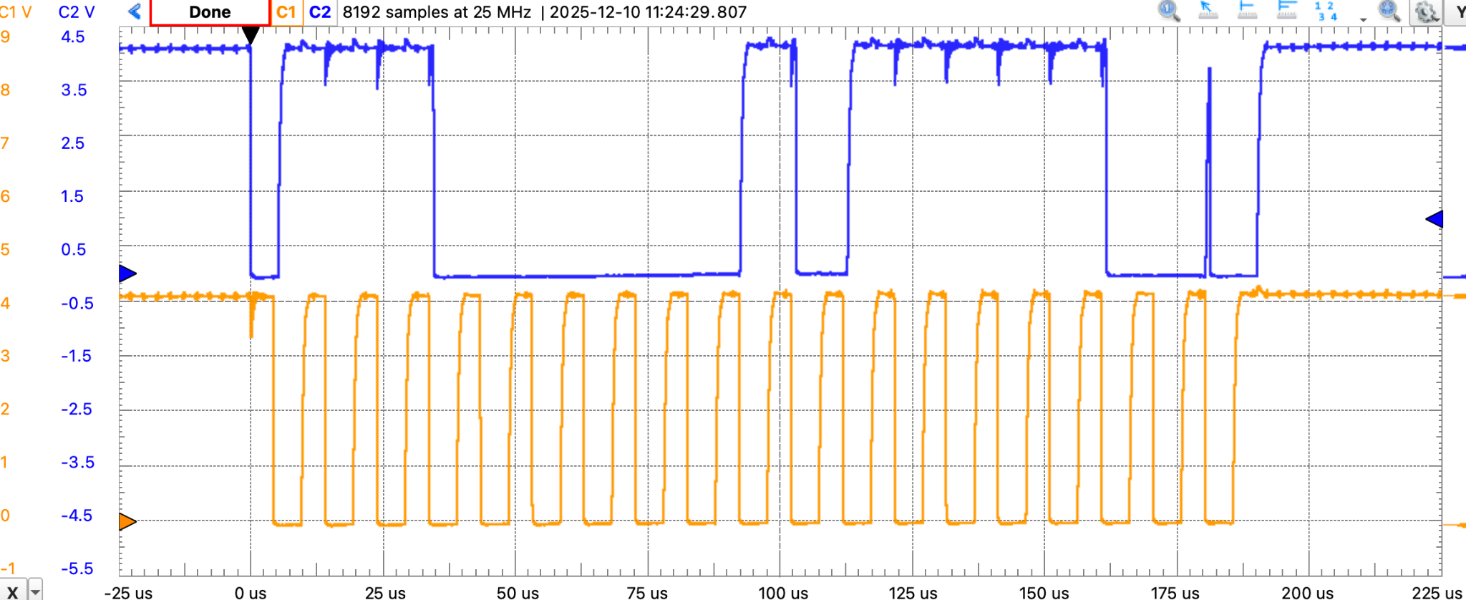
Data = 0b0;
Data = 0b1011110;

Slide 26
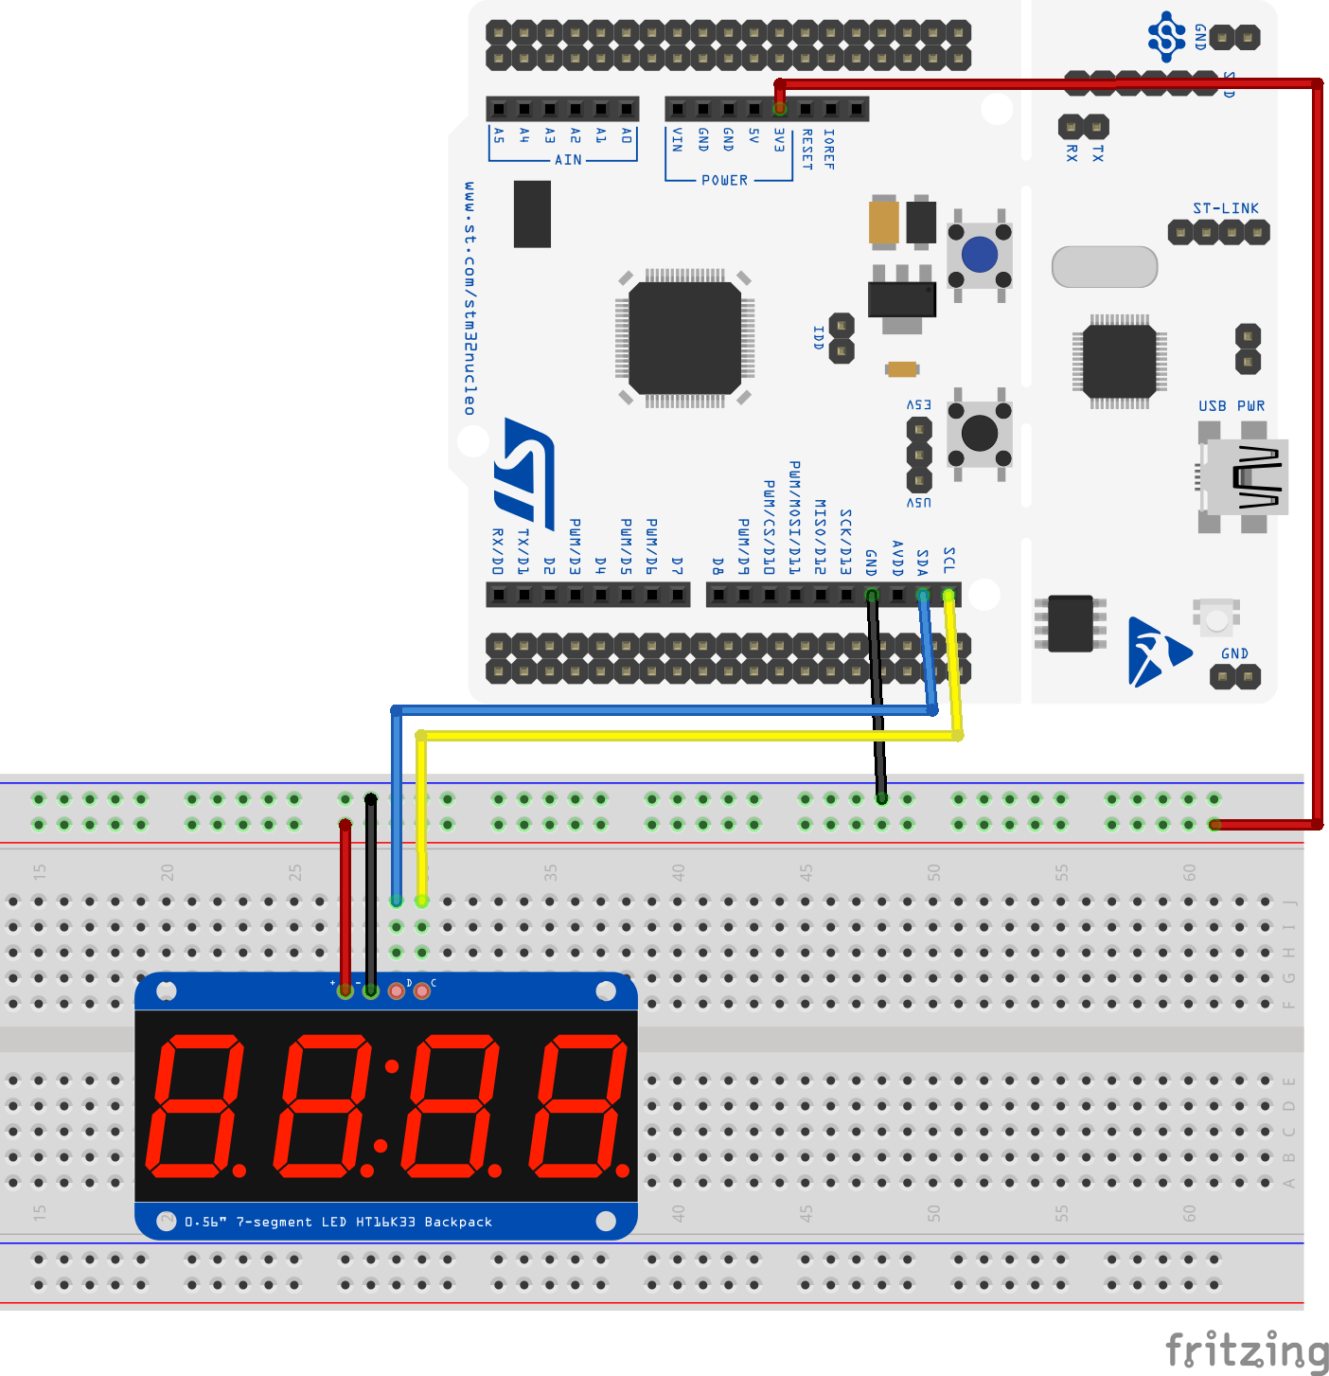
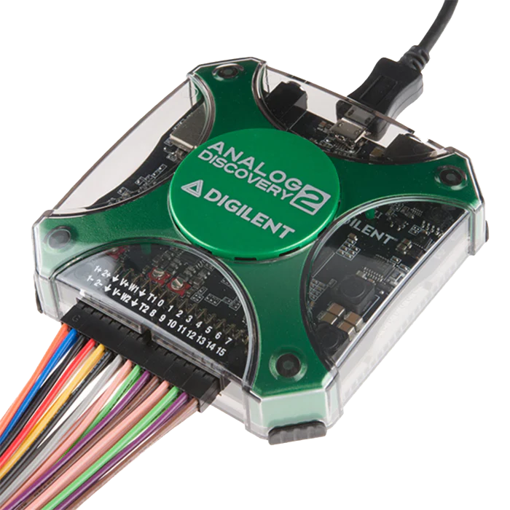
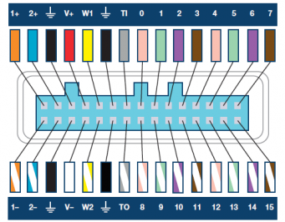
Looking at the oscilloscope trace is not exactly … wonderful?!
The AD2 also has a logic analyzer mode that decodes i2c for us!
Use AD2 digital channels (larger flying lead bundle). Wire 3 leads as follows:
GND (black) to ground (duh) D0 (pink) to SDA D1 (green) to SCL
on the breadboard.

Slide 27
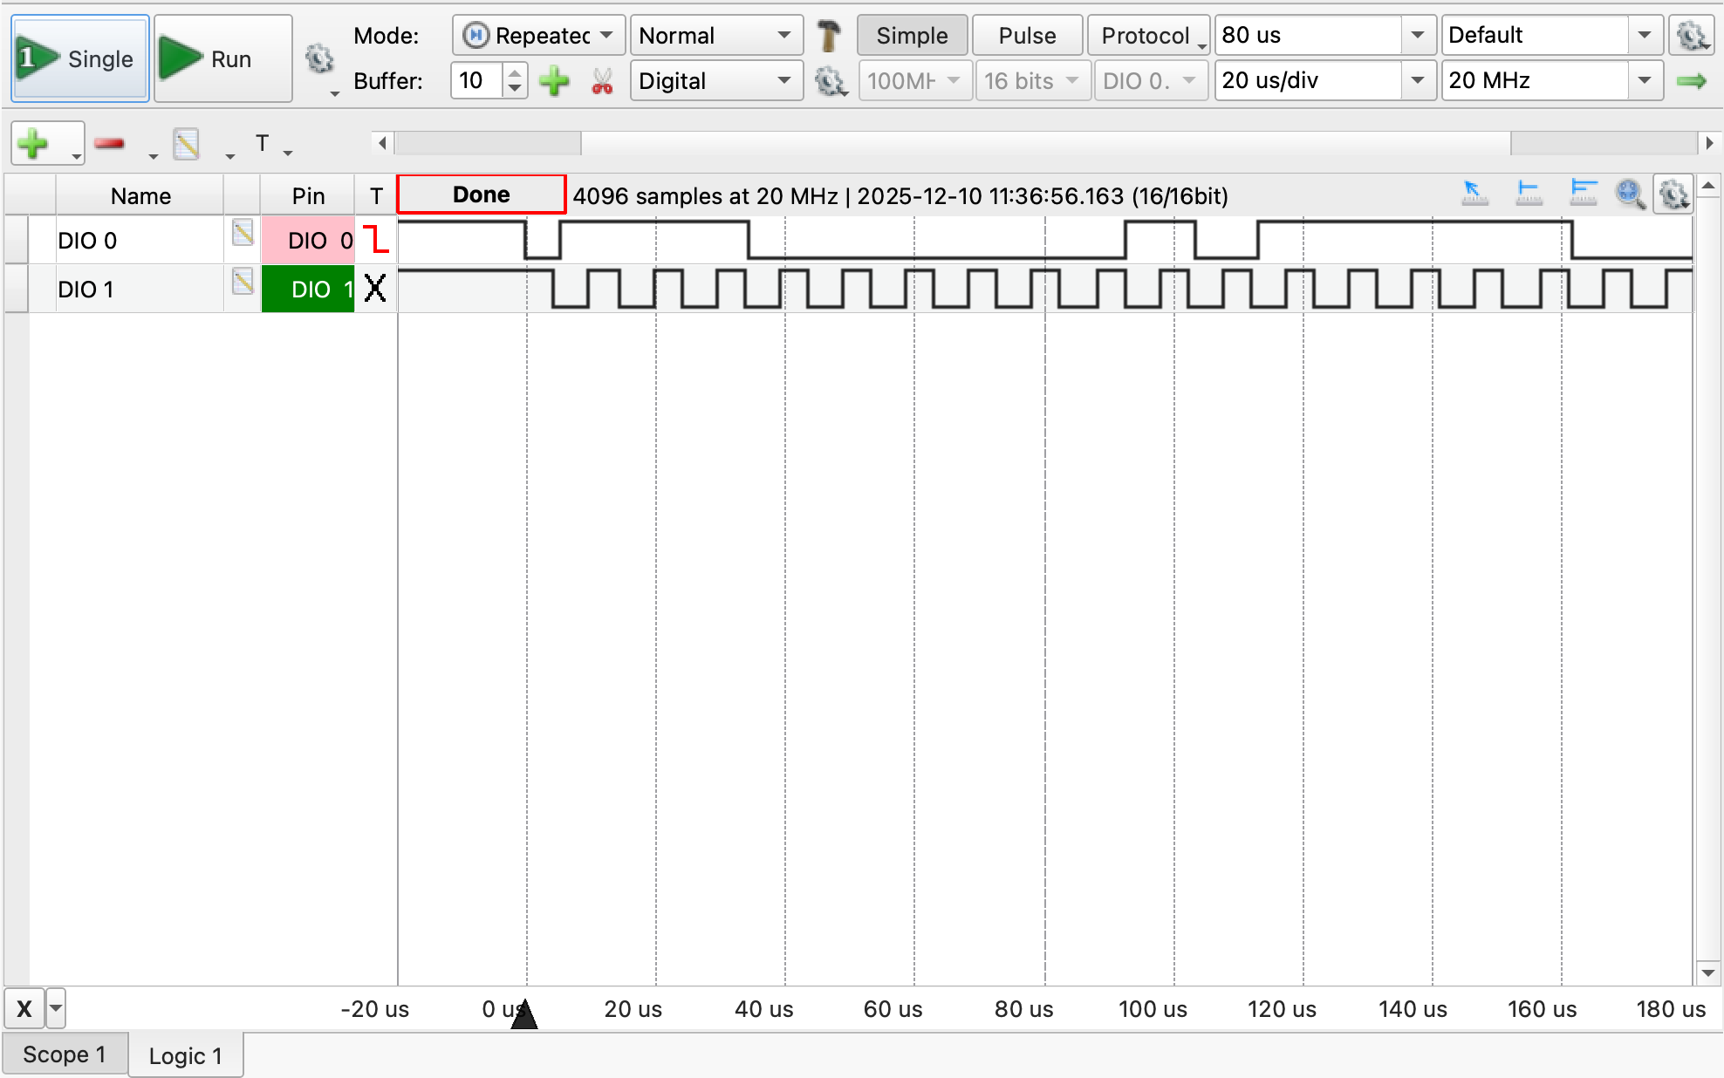
Set up Waveforms to decode I²C
Set Waveforms to Logic mode.
2: Set timebase to 20us
1: Add (signals) DIO0 and DIO1
3: Click to set DIO0 falling as trigger
4: Take a single sweep.
5: Use cursors to measure clock period / frequency.
6: Drag this so start bit is on the left
Notes:
Follow the instructions on the slide. Trigger settings depend on your scopy software version…
First we want to simply look at the clock and serial data. That's what this slide gets you to accomplish. By setting the sampling rate to 10Mega bits per second you stretch out the picture so you can get a good look at the clock. Use the cursors to measure the period and frequency of the clock, verify that it's 100kHz (standard I2C clock frequency). Then we'll move on to start the decode.
Almost like an oscilloscope except not quite. Signals are just high or low, not continuous voltages as they were in oscilloscope mode. There are 16 digital channels, so you can look at lots of digital signals simultaneously which can be important if you are trying to monitor lots of signals at the same time.
All modern mixed signal oscilloscopes, including the M2K, can decode the bits on the serial bus. So you can put Scopy into I2C mode and it will take that bitstream, decode it and show you what's actually being sent. So you don't have to do all of the interpreting on your own. Super useful for debugging.
You can also decode a UART this way: stick it on the TX/RX and it can show you the ASCII characters (not just the bits).
It can also do SPI (which we'll only use sort of during wifi in week 9).
Can also do CANBUS protocol which is from automotive applications. Those in DFR will know this.

Slide 28
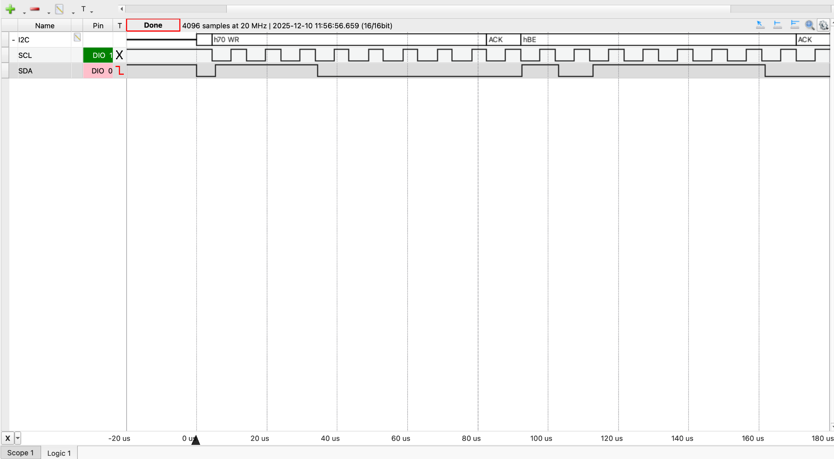
Set up AD2 to decode I²C (2)
2: Click to set DIO0 falling as trigger
1: Add an I2C bus. Select DIO1 as clock and DIO0 as data
3: If your old trace disappears, take a single sweep again.
Notes:
Now we set up the actual decoding. Change settings as in the slide.

Slide 29
Now ping the wrong address again.
Modify the code so that the device address is 0x60 (for example). Re-compile and flash your code.
Take a single sweep - you may need to start the single sweep and then restart your Nucleo (black on-board button). What do you observe?

Slide 30
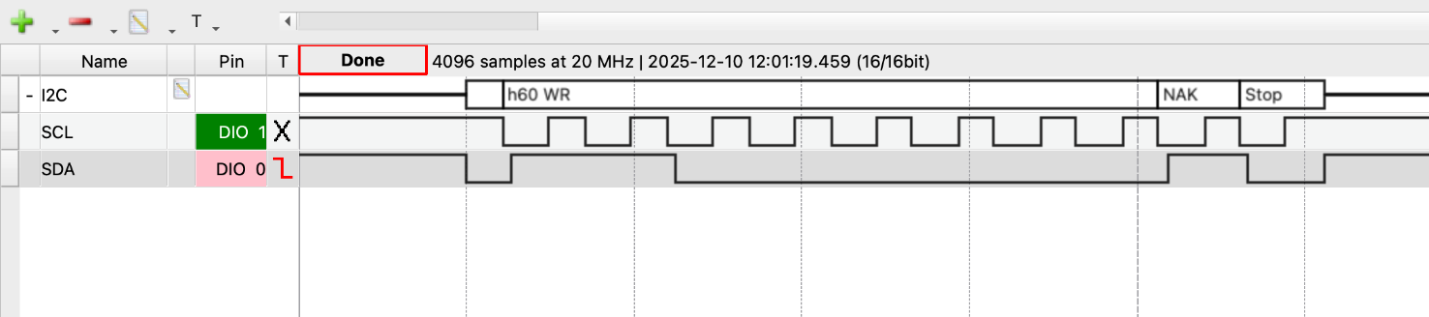
Pinging the wrong address

Slide 31
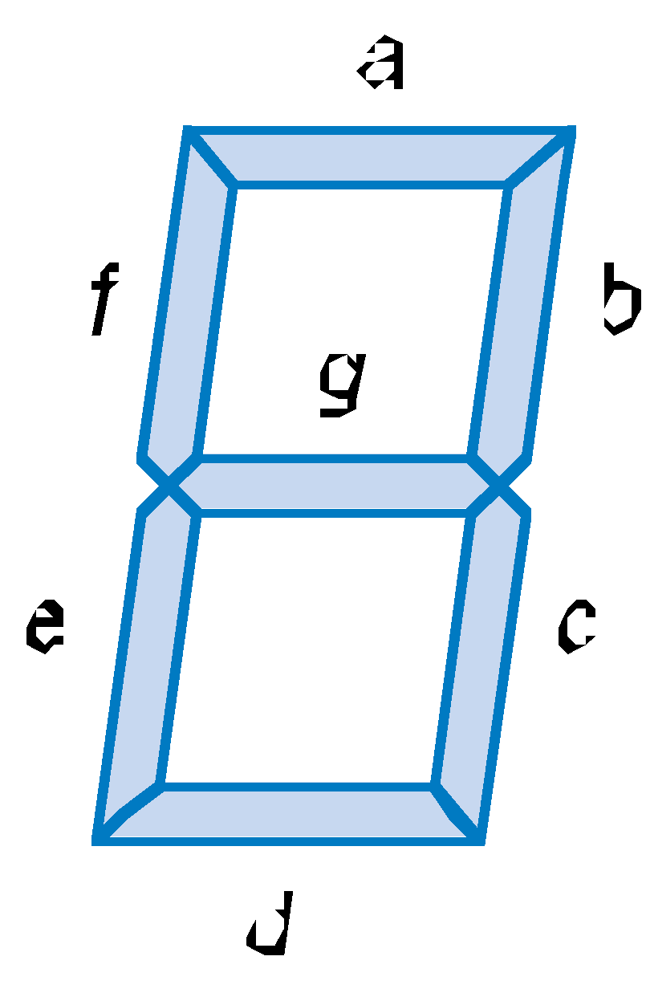
How a 7-segment display digit works
N | a | b | c | d | e | f | g
0 | 1 | 1 | 1 | 1 | 1 | 1 | 0
1 | 0 | 1 | 1 | 0 | 0 | 0 | 0
2 | 1 | 1 | 0 | 1 | 1 | 0 | 1
3 | 1 | 1 | 1 | 1 | 0 | 0 | 1
4 | 0 | 1 | 1 | 0 | 0 | 1 | 1
5 | 1 | 0 | 1 | 1 | 0 | 1 | 1
6 | 1 | 0 | 1 | 1 | 1 | 1 | 1
7 | 1 | 1 | 1 | 0 | 0 | 0 | 0
8 | 1 | 1 | 1 | 1 | 1 | 1 | 1
9 | 1 | 1 | 1 | 0 | 0 | 1 | 1
etc(10-15) | A, b, C, d, E, F
Each segment is an LED.
A decoder maps the number to the segments (seven bits).
Notes:
Each digit consists of 7 segments, these are labeled a, b, c, d, e, f, g. Each segment corresponds to one LED.
To display a 0, for example, you want to turn on the a, b, c, d, e, f segments and leave the g segment off. You'd thus send 00111111 (.GFEDCBA) to the decoder.
The table shows 0-9, can also come up with A, b, C, d, E, F (some upper, some lower-case). Can make other letters as well. Can also make a minus sign, the hamburger menu, etc.

Slide 32
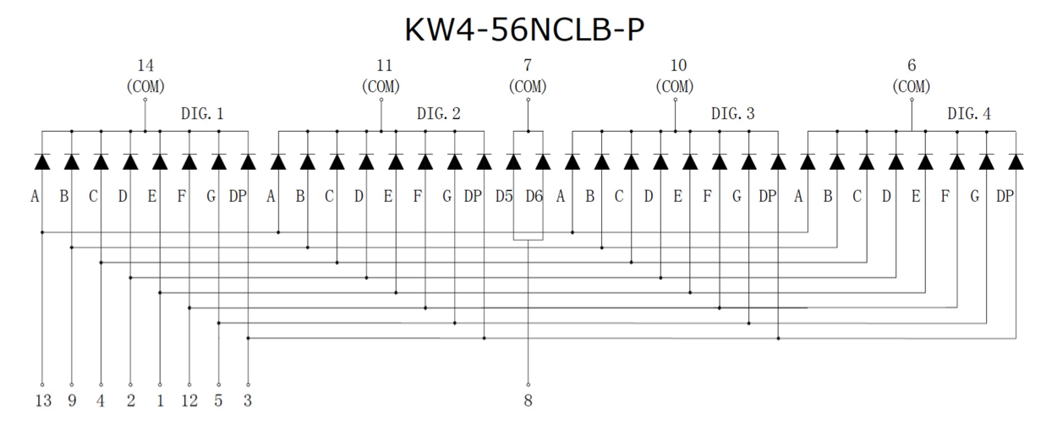
How four digits are wired
Common cathode display: Each segment is an LED, all cathodes in a digit are wired together.
All four "a" anodes are wired together, all four "b" anodes are wired together, etc.
Result: Four digits are driven by only 12 wires. The colon has its own two wires, for a total of 14.
How do you turn on the 'a' segment in digit 2?
How do you turn on the 'a' segment in digit 2 AND the 'b' segment in digit 3?
Notes:
This is how it's built: Each segment is an LED. All LEDs (for one digit) have their cathodes tied together. All the cathodes for the next digit are tied together, etc. The two cathodes for the colon are tied together.
In addition, all the anodes for all the 'a' segments are tied together, all those for the 'b' segments are tied together, etc.
So if you want to turn on the 'a' segment in digit 2, you drive all the 'a' segments high and you take the common cathode for digit 2 and you ground it (drive it low). That combination is unique and current will only flow through the LED for the 'a' segment in digit 2.
So you need 4 wires for the common cathodes, 8 wires for the 7 segments and the decimal point, that's 12 wires, plus two for the colon, so 14 wires with which you can control a total of 34 LEDs.
If I want to turn on 0 in digit 3, I'll activate the a, b, c, d, e, f segments on the anode side and ground the digit 3 cathode, and digit 3 will display a 0. But that will only turn on a 0 in digit 3.
So if I want to display a four-digit number I'll need to do the digits in sequence and sweep through them rapidly enough so that my eyes don't notice. It looks like all 4 digits are lit up at the same time.

Slide 33
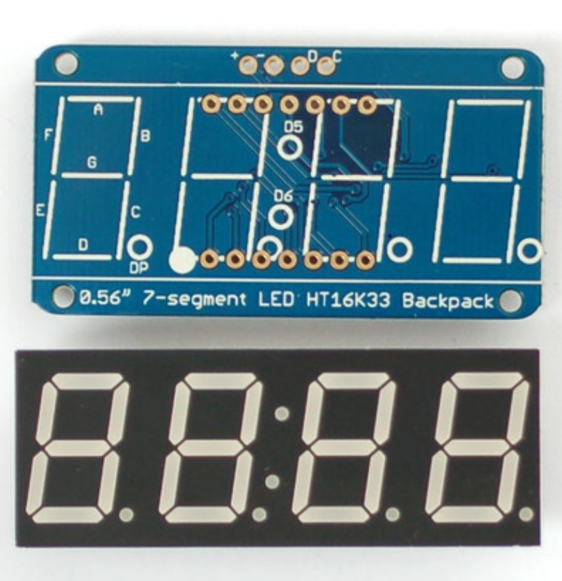
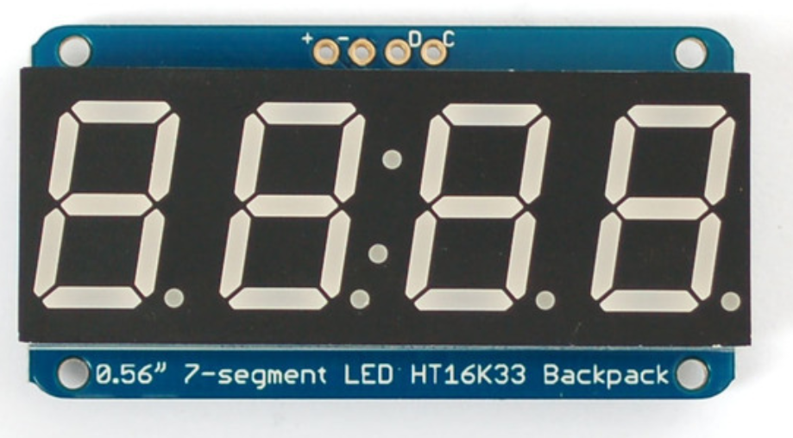
HT16K33 Controller Driver Backpack
A four-digit (plus decimal points and a colon) 7-segment display requires 14 I/O pins (5 cathodes and 9 anodes) to address! That would tie up a lot of pins on the Nucleo...
That's why we use a controller driver: The four-digit display is wired to a “backpack” that does the multiplexing and decoding, and interfaces to the processor via I²C.
GND
SDA
VCC
SCL
Notes:
All that sequencing is done by the Backpack controller driver. It does all of the multiplexing, timing, decoding, etc and also provides the I2C interface with the processor.

Slide 34
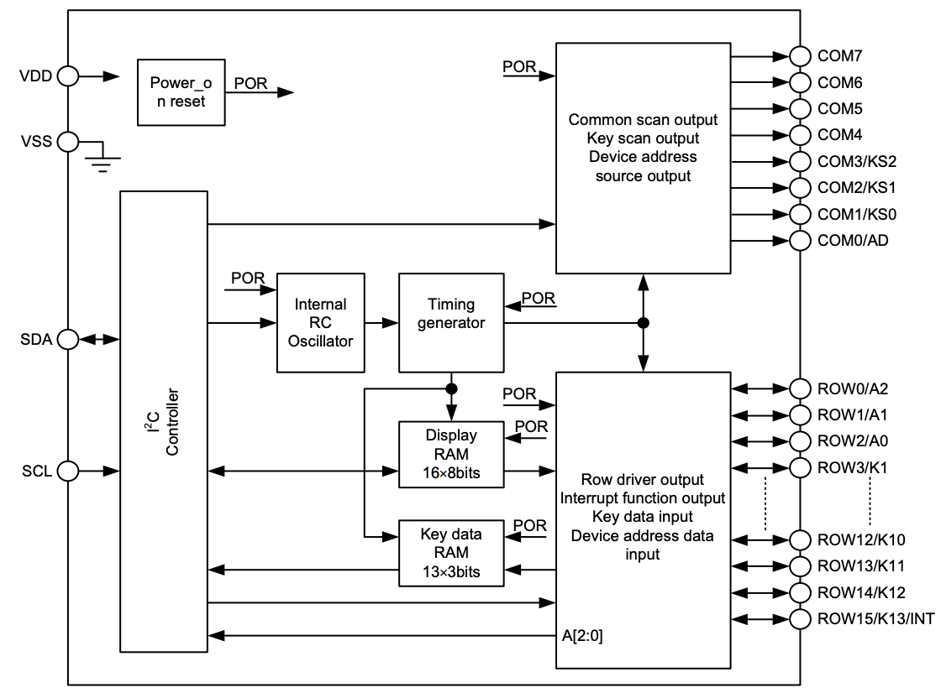
HT16K33 Controller Driver
Control registers configure the driver:
Display or keypad
Digits or LED matrix (row-column)
Brightness, blinking
Data registers (2×8 bits for each COM line)
Interface: I²C to internal control and data
Block Diagram
Colon cathode
4 cathodes
I²C
I²C address
Anodes: 7 segments, decimal point, colon
Notes:
I2C controller manages all of the stuff on the device end. In orange, those are control signals that set the modes that the chip will run it. Turns out, the chip can do all kinds of things beyond managing the 4-digit 7-segment display. You command that particular mode by setting a particular mode.
The display RAM is where the individual bit patterns are stored for the segments you are currently lighting up. Each segment is stored as a 16-bit number (2 8-bit numbers); in the case of the 7-segment display we only use the first of these two bytes for each segment. We still need to send both bytes though (so send a '0' after each 'real' piece of data).
The controller can also control dot-matrix displays, keypads and more. That's why it has more capabilities than we need and in particular more storage in the display memory than we need.

Slide 35
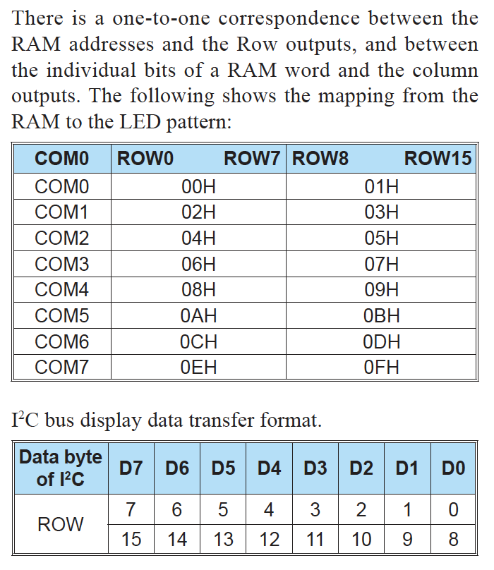
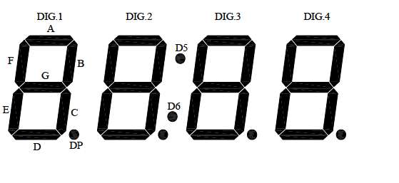
Display Memory - RAM Structure
Digit 1
Digit 2
Colon
Digit 3
Digit 4
The display memory is organized as follows:
For each digit, there are two bytes.
The first byte consists of the seven bits of digit 1 and the decimal point.
The second byte is for other purposes (when the controller is used for a dot matrix or keypad) - so we always simply put a 0 there.
Example: To turn on the G segment in the first digit:
Write 2 bytes to display memory:
0b01000000 to address 0x00 and
0b00000000 to address 0x01.
Notes:
The display memory is organized as follows: for each digit, there are two bytes. The first byte is the seven bits of digit 1 and the decimal point. The second byte is the second 8 bits which we aren't using - so we always need to stick a 0 in there.
Example: activate the G segment of the first digit. That is 0b01000000 (the 1 is in the g slot). Then send 0b00000000 for the second byte which is always 0 in our case.
(Need to activate the common cathode for digit 1 (COMM0) and the common anode for all g segments (ROW6). Skip details…)
The way to write the memory is you write the byte that is for the first digit, then a byte of zeros, then the byte for the second digit, then a byte of zeros, same for the second digit, then the colon, then the third, then the fourth digit. So altogether you write 10 bytes of data all in one i2c transaction. Each time you write a byte, it goes into the display memory and a pointer inside the controller advances. If you don't write the zeros, the pointer won't advance.

Slide 36
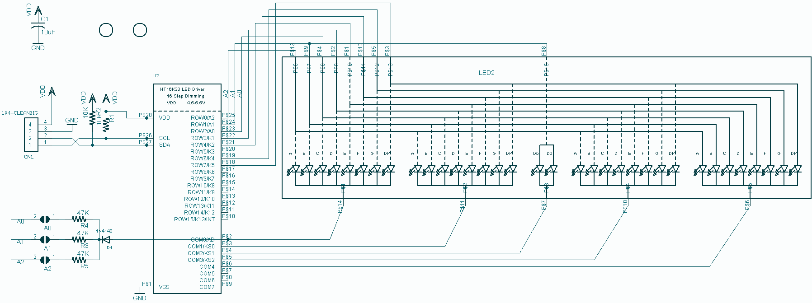
Display Memory - RAM Structure
10K pull-ups
To turn on the G segment in the first digit: Write 2 bytes to display memory:
0b01000000 to address 0x00 and
0b00000000 to address 0x01.
Notes:
SKIP - for reference only
The display memory is organized as follows: for each digit, there are two bytes. The first byte is the seven bits of digit 1 and the decimal point. The second byte is the second 8 bits which we aren't using - so we always need to stick a 0 in there.
Example: activate the G segment of the first digit. That is 0b01000000 (the 1 is in the g slot). Then send 0b00000000 for the second byte which is always 0 in our case.
(Need to activate the common cathode for digit 1 (COMM0) and the common anode for all g segments (ROW6). Skip details…)
The way to write the memory is you write the byte that is for the first digit, then a byte of zeros, then the byte for the second digit, then a byte of zeros, same for the second digit, then the colon, then the third, then the fourth digit. So altogether you write 10 bytes of data all in one i2c transaction. Each time you write a byte, it goes into the display memory and a pointer inside the controller advances. If you don't write the zeros, the pointer won't advance.

Slide 37
Display Memory - Make a Pattern
How would you populate the display memory to display this pattern?
Digit | Display memory location | Binary number . G F E D C B A
1 | 0x00 | 0b 0 1 1 1 1 0 0 1
 | 0x01 | 0b 0 0 0 0 0 0 0 0
2 | 0x02 | 0b
 | 0x03 | 0b 0 0 0 0 0 0 0 0
Colon | 0x04 | 0b
 | 0x05 | 0b 0 0 0 0 0 0 0 0
3 | 0x06 | 0b
 | 0x07 | 0b 0 0 0 0 0 0 0 0
4 | 0x08 | 0b
 | 0x09 | 0b 0 0 0 0 0 0 0 0
Notes:
Here is a fun exercise.

Slide 38
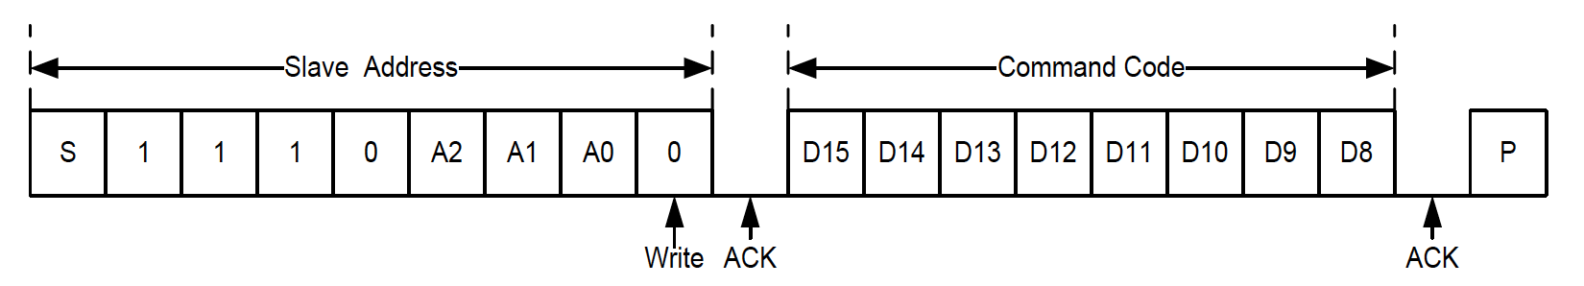
Initializations
Many i2c devices have registers inside the device that are their own control and status registers.
The way to access them is via various commands or sometimes via various addresses that you send to the device. The datasheet will tell you.
For the backpack: pages 24-25 of the HK16K33 datasheet describe these:
Start
Stop
Device Address
0x70
Send the device address, followed by a '0' for writing.
Next comes a command:
System setup: 0x21 turns on the oscillator.
Display setup: 0x81 turns on the display, no blinking.
Dimming set: 0xEF sets display full strength (no dimming).
Where do you find the details?
Notes:
Many i2c devices have their own registers inside that are their own control and status registers. The way to access them is via various commands or sometimes via various addresses that you send to the device. The datasheet will tell you.
Here: First need to get the attention of the device, so send the address, shifted left by 1. Next comes a command.
0x21 turns on the oscillator.
0x81 turns on the display, no blinking.
0xEF turns on the display fully (no dimming).

Slide 39
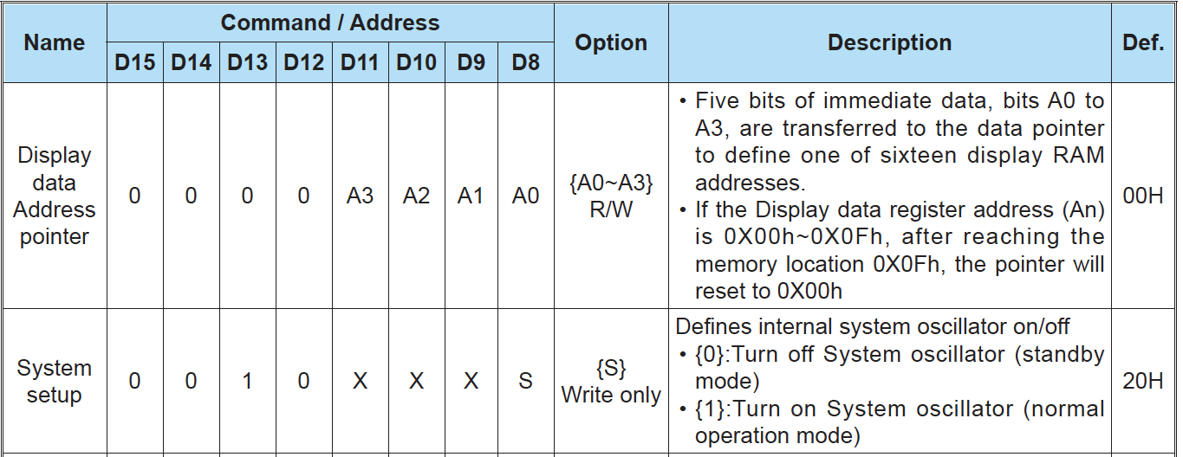
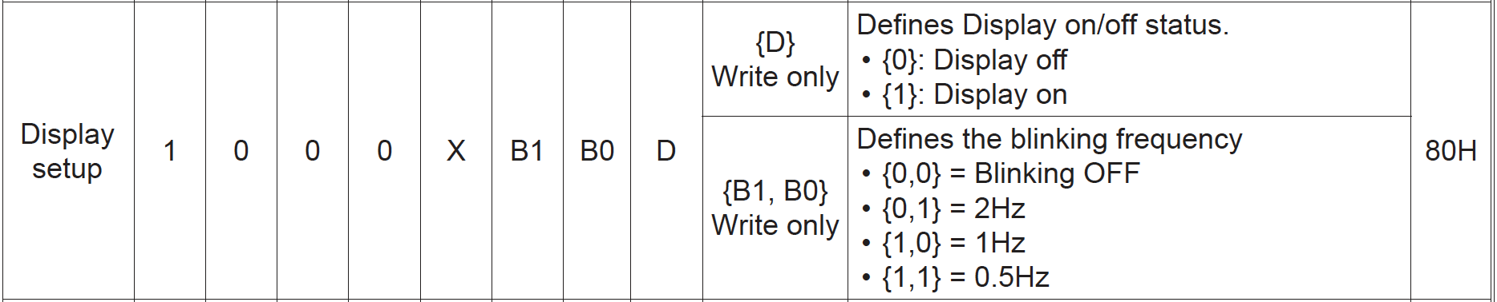
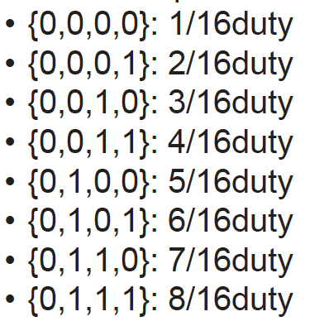
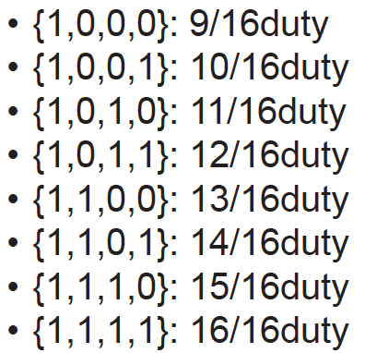
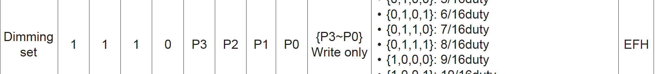
Initializations - Details - You'll need these later
Start
Stop
Device Address
0x70
#define HT16K33_ADDR 0x70
Command
Options
i2c1_byteWrite(
HT16K33_ADDR,
0x21);
i2c1_byteWrite(
HT16K33_ADDR,
0x81);
Adjust if blinking desired
i2c1_byteWrite(
HT16K33_ADDR,
0xEF);
Adjust if dimming desired
Notes:
Many i2c devices have their own registers inside that are their own control and status registers. The way to access them is via various commands or sometimes via various addresses that you send to the device. The datasheet will tell you.
Here: First need to get the attention of the device, so send the address, shifted left by 1. Next comes a command.
0x21 turns on the oscillator.
0x81 turns on the display, no blinking.
0xEF turns on the display fully (no dimming).

Slide 40
Writing display data (digit mode)
The entire display RAM of the backpack is written in one long multibyte transmission (“page write”) operation, p. 22 of datasheet.
Start
Stop
0x70
To write the entire display all at once:
In ONE I2C communication (cannot let go of the bus between pieces of data):
Send display starting address (0x0 if you are writing the entire display)
Send first digit byte
Send 0
Send second digit byte
Send 0
…
Send last digit byte
Send 0
Command
Option
(starting address)
To write one specific digit:
In ONE I2C communication (cannot let go of the bus between pieces of data):
Send digit's address (0, 2, 4, 6, 8)
Send digit byte
Notes:
If you send all zeros for the command right after the backpack address, that means you want to write the display memory (all of it). The 0x00 is really the start of the display memory. You could choose a different address here and only write some of the memory, but that's crazy complicated. We'll just write the whole thing.
The way display memory addresses are distinguished from commands on the previous page is that they all start with 0000.

Slide 41
Communicating with the HT16K33 Controller Driver - Summary
To send commands (turn oscillator on, configure blinkrate, etc):
Start
Stop
Device Address
0x70
i2c1_byteWrite(HT16K33_ADDR, command code);
To write to the display (one digit or entire display):
Start
Stop
To write to the display (one digit or all digits):
0x70
i2c1_memWrite(HT16K33_ADDR, where to write in display memory, number of bytes coming, array with data);

Slide 42
Write to one digit of the display
Copy your TemplateProject to a new project named "SevenSegI2CSecondSteps".
From Canvas:
Download SevenSegPartial.c and put it into your new project's Src folder
Download SevenSegPartial.h and put it into your project's Inc folder
Download writeFirstDigit.c and put it into your project's Src folder
Compile and flash the code, then:
Modify the code to write the second digit, etc
Modify what you write to the digit - E, S, 2, 8

Slide 43
Write one digit with i2c library
#include "ES28.h"
#include "i2c.h"
#include "SevenSegPartial.h"
int main(void) {
uint8_t display_addr = HT16K33_ADDR;
uint8_t display_subaddr = 0; // 0, 2, 4, 6, 8 - depending on the digit
uint8_t digit_data = 0b01111001; // 'E'
i2c1_init();
SevenSeg_init();
while(1) {
i2c1_memWrite(display_addr, display_subaddr, 1, &digit_data);
delay_ms(250);
}
return 0;
}

Slide 44
Seven-segment display driver

Slide 45
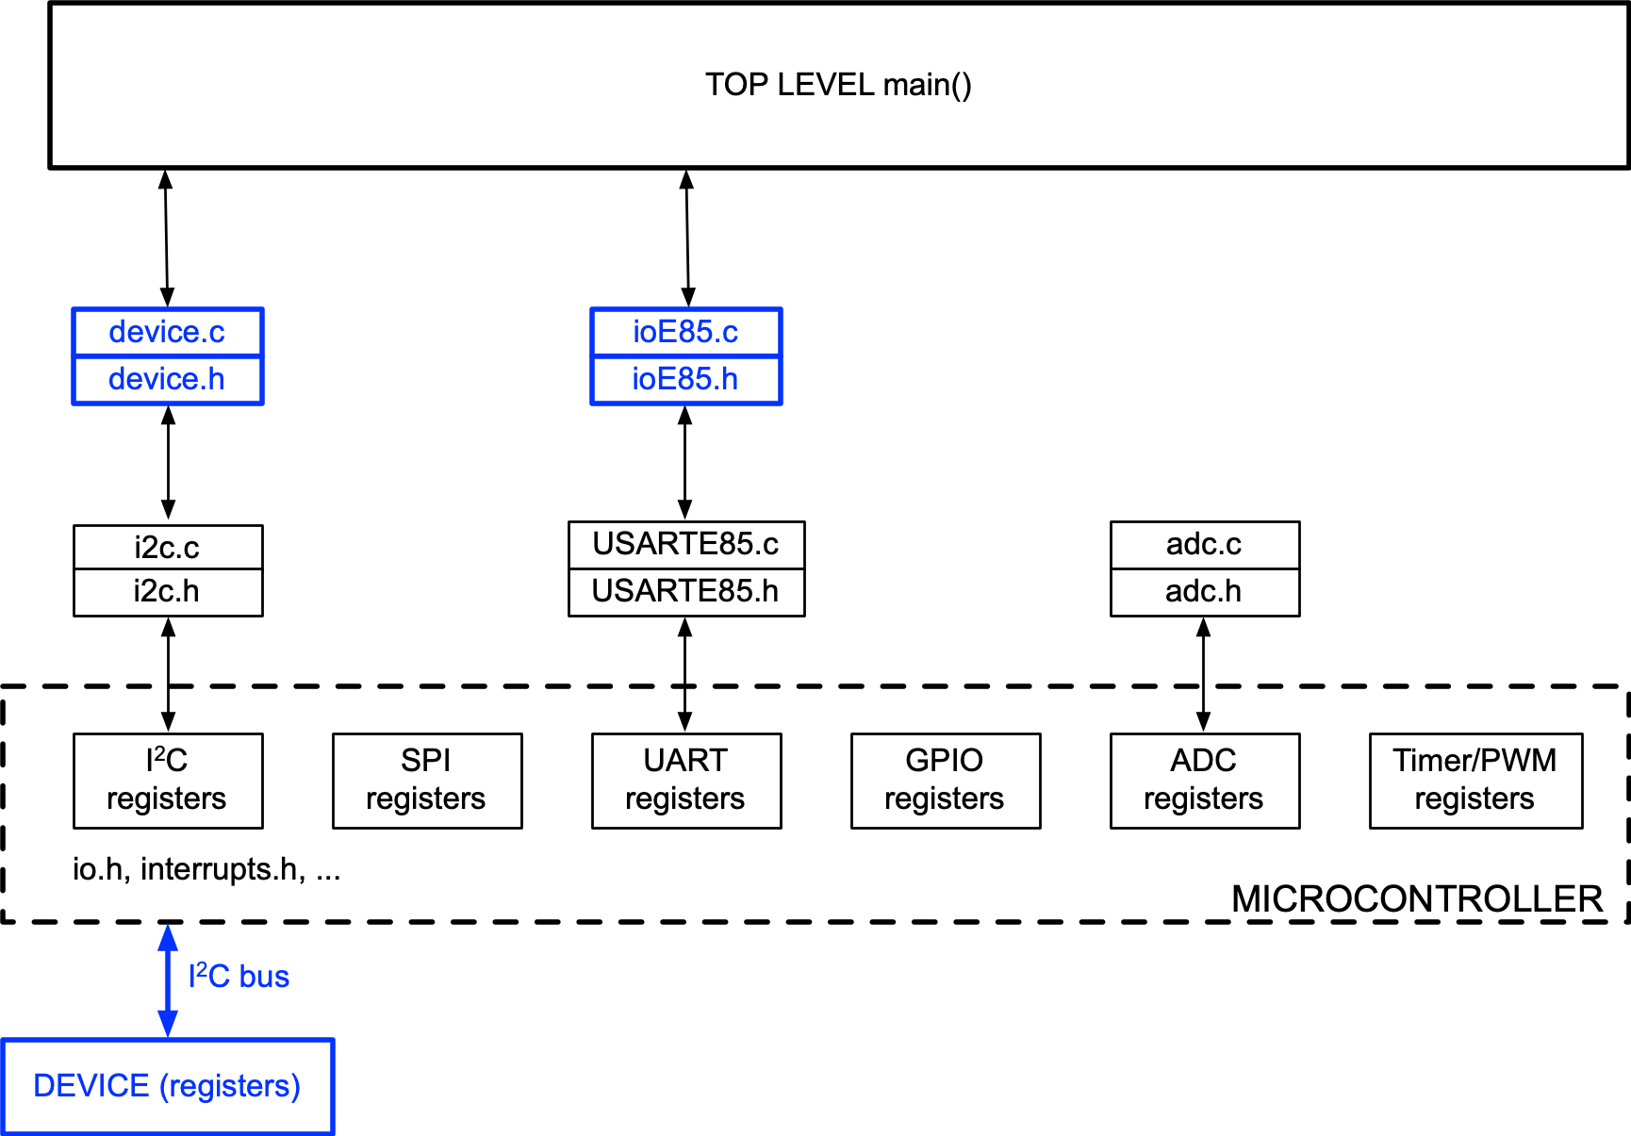
Firmware design layers
TOP LEVEL CODE
Access devices via drivers / APIs
Don’t directly access device registers or machine registers.
DEVICE DRIVERS / APIs
Access device registers via interface drivers
Don’t directly access machine registers
stdio.c
stdio.h
INTERFACE DRIVERS Access machine registers
uart.c
uart.h
PHYSICAL CONNECTIONS (I/O PORTS)
Notes:
You'll build the device driver!

Slide 46
How will we store the data about all of the digits of the display so that we can easily pass it to functions?
An array with 10 elements of type uint8_t
Elements 0 and 1 describe digit 1, elements 2 and 3 describe digit 2, etc.
entry | digit | . | g | f | e | d | c | b | a
0 | 1 | 0 | 1 | 1 | 1 | 0 | 1 | 1 | 0
1 |  | 0 | 0 | 0 | 0 | 0 | 0 | 0 | 0
2 | 2 | 0 | 0 | 1 | 1 | 1 | 1 | 1 | 1
3 |  | 0 | 0 | 0 | 0 | 0 | 0 | 0 | 0
4 | colon | 0 | 0 | 0 | 0 | 0 | 0 | 0 | 0
5 |  | 0 | 0 | 0 | 0 | 0 | 0 | 0 | 0
6 | 3 | 0 | 0 | 1 | 1 | 1 | 0 | 0 | 0
7 |  | 0 | 0 | 0 | 0 | 0 | 0 | 0 | 0
8 | 4 | 0 | 1 | 1 | 1 | 0 | 1 | 1 | 1
9 |  | 0 | 0 | 0 | 0 | 0 | 0 | 0 | 0
What message will be displayed if you send this data to the display?

Slide 47
In code:
entry | digit | . | g | f | e | d | c | b | a
0 | 1 | 0 | 1 | 1 | 1 | 0 | 1 | 1 | 0
1 |  | 0 | 0 | 0 | 0 | 0 | 0 | 0 | 0
2 | 2 | 0 | 0 | 1 | 1 | 1 | 1 | 1 | 1
3 |  | 0 | 0 | 0 | 0 | 0 | 0 | 0 | 0
4 | colon | 0 | 0 | 0 | 0 | 0 | 0 | 0 | 0
5 |  | 0 | 0 | 0 | 0 | 0 | 0 | 0 | 0
6 | 3 | 0 | 0 | 1 | 1 | 1 | 0 | 0 | 0
7 |  | 0 | 0 | 0 | 0 | 0 | 0 | 0 | 0
8 | 4 | 0 | 1 | 1 | 1 | 0 | 1 | 1 | 1
9 |  | 0 | 0 | 0 | 0 | 0 | 0 | 0 | 0
uint8_t HOLA_message[2*HT16K33_NBUF] = {0b01110110, 0x00,
0b00111111, 0x00,
0x00, 0x00,
0b00111000, 0x00,
0b01110111, 0x00 };

Slide 48
Write device driver
From data sheet, #define basic addresses / commands
Define functions to implement actions
Write functions using i2c functions to send commands & data
Devise Unit Tests to confirm the drivers are working

Slide 49
Device driver operations
Example: Turn on the oscillator by sending
HT16K33_SYSTEM_CMD | HT16K33_OSC_ON
Use #define to make a list of commands (datasheet, pp 24-25), put in header (.h) file
What do you want the display to do? | What does the device driver write to the bus?
Initialize (system setup) | #define HT16K33_SYSTEM_CMD 0x20 #define HT16K33_OSC_ON 0x01
Enable/disable (display setup) | #define HT16K33_DISPLAY_CMD 0x80 #define HT16K33_DISPLAY_ON 0x01
Set blinking (display setup) | #define HT16K33_DISPLAY_CMD 0x80 #define HT16K33_BLINK_OFF 0x00 #define HT16K33_BLINK_HALFHZ 0x06 #define HT16K33_BLINK_1HZ 0x04 #define HT16K33_BLINK_2HZ 0x02
Set brightness (dimming) | #define HT16K33_BRIGHT_CMD 0xE0 // OR with brightness 0 to 15
Set RAM address (data address ptr) | #define HT16K33_ADDR_PTR 0x00 // OR with location 0 to 15
Notes:
This is a nice way to structure writing a device driver.
You look at the datasheet and see there are different commands: enabling display, dimming, blinking, etc. Here those all are.
Example: system setup is 0b0010000{s}, where s is 0 if oscillator off and 1 for oscillator off. So the system command by itself is just 0b00100000 = 0x20, and you OR that with 0x01 to turn the oscillator on. So you'd then use HT16K33_SYSTEM_CMD | HT16K33_OSC_ON: you can use the names rather than the numbers in your code.
All this is in your .h file.
Similar for brightness, display on/off, etc.

Slide 50
Device driver functions
Declare these in the header (.h) file
void SevenSeg_init(); // Initialize the display
void SevenSeg_blink(uint8_t rate); // Blink the display
void SevenSeg_dim(uint8_t brightness); // Dim the display
void SevenSeg_write(uint8_t *display_buffer); // Write the display RAM
void SevenSeg_number(int16_t num, uint8_t *display_buffer);
// Convert 4-digit number to
// segments for SevenSeg_write()
These are the functions you'll need to write.
Notes:
These are the functions you'll need to write.
SevenSseg_write() takes all the bits and writes them to the display memory. In your main code you define an array that you fill up with the numbers you want to send. You then pass the pointer to that array to the write function that loops through these numbers and sends them to the display memory.
Won't use arrays all that often but this is the time.
Also: you won't want to remember what segments to light up for a particular number. The function SevenSeg_number is passed a number num (a 4-digit number you wish to display) and it does the job for you of filling up the display array whose pointer is given to it.

Slide 51
Coding Challenge 1
Note what is in SevenSegPartial.h besides function prototypes
Complete SevenSegPartial.c
// Blink the display
void SevenSeg_blink(uint8_t rate) {
}
// Dim the display
void SevenSeg_dim(uint8_t brightness) {
}
// Write the display RAM
void SevenSeg_write(uint8_t *display_buffer) {
// display_buffer is size 2*HT16K33_NBUF (high byte, low byte)
// You can either write one digit at a time or (more efficient!) write the entire
// display all at once. Do not directly modify i2c register addresses. Use the i2c
// library instead.
}
Notes:
Download sevenseg.h and sevenseg_partial.c. Take a look and fill in the blanks. Finish the blink function and finish the dim function. Change the name to SevenSeg.c and stick it (with the .h file) into your mylib.

Slide 52
Coding Challenge 1
Note what is in SevenSegPartial.h besides function prototypes
Complete SevenSegPartial.c
// Change the display flashing
void SevenSeg_blink(uint8_t rate) {
i2c1_byteWrite(HT16K33_ADDR, HT16K33_DISPLAY_CMD | HT16K33_DISPLAY_ON | (rate & 0x6));
}
// Dim the display
void SevenSeg_dim(uint8_t brightness) {
i2c1_byteWrite(HT16K33_ADDR, HT16K33_DISPLAY_CMD | HT16K33_BRIGHT_CMD | (brightness & 0xf));
}
// Write the display RAM
void SevenSeg_write(uint8_t *display_buffer) {
// display_buffer is size 2*HT16K33_NBUF (high byte, low byte)
i2c1_memWrite(HT16K33_ADDR, HT16K33_ADDR_PTR, 2*HT16K33_NBUF, display_buffer);
}
Notes:
Download sevenseg.h and sevenseg_partial.c. Take a look and fill in the blanks. Finish the blink function and finish the dim function. Change the name to SevenSeg.c and stick it (with the .h file) into your mylib.

Slide 53
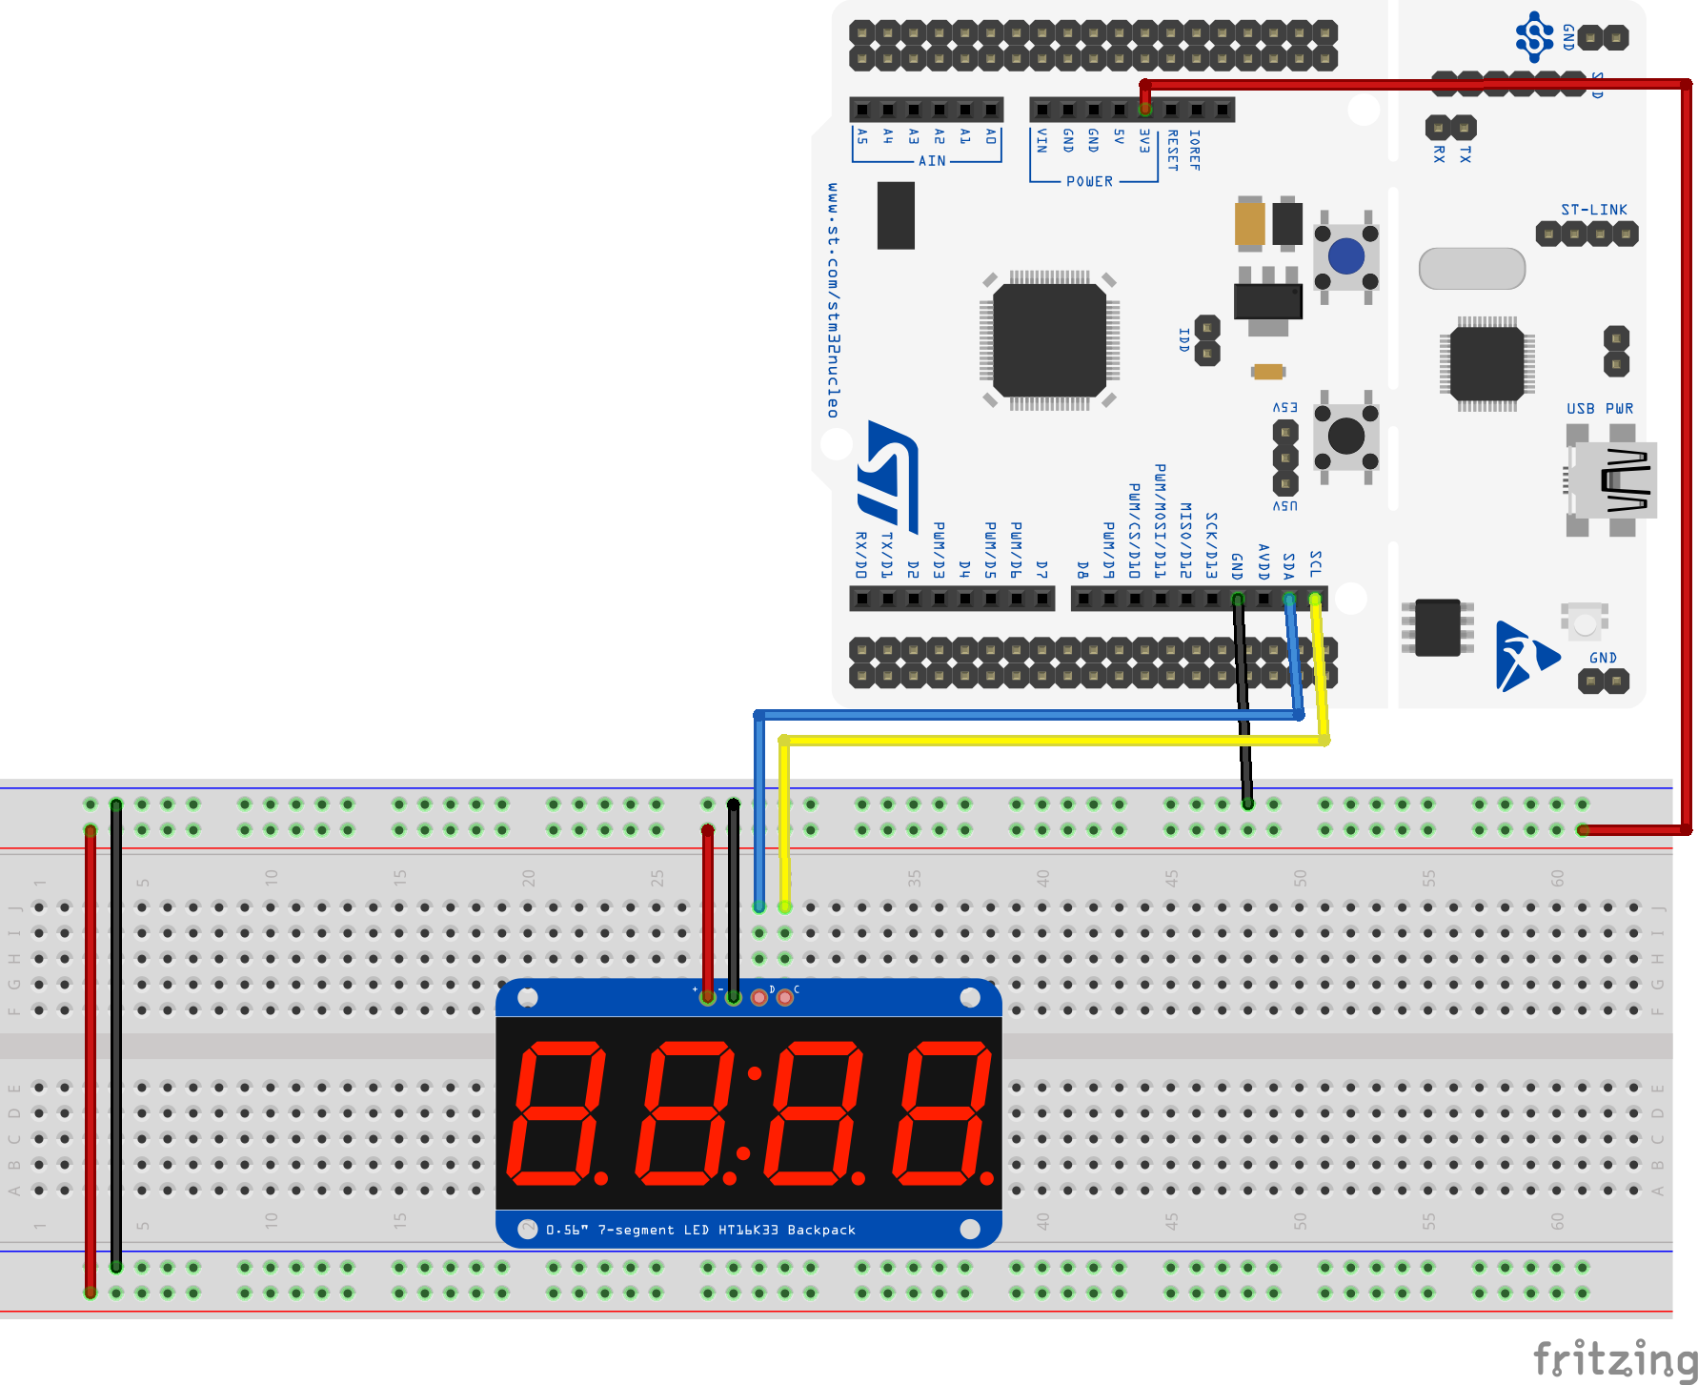
Coding Challenge 1
Test your drivers:
Copy your TemplateProject and name the new project "SevenSegI2CFinal"
Download SevenSeg_test.c from Canvas and put it into your new project's Src folder
Copy your completed SevenSegPartial.c and SevenSegPartial.h into your mylib folder and rename to SevenSeg.c and SevenSeg.h
Compile and flash.
Debug SevenSeg.c as needed
+V, GND, SDA, SCL
Notes:
You can test your device driver with the file SevenSeg_test.c from Canvas. If you get this done today you are doing really well. Most likely you won't get any further.

Slide 54
Coding Challenge 2
Initialize the display to be on steady at full brightness.
Display ES.28.
Wait 1 second.
Blink the display at 1Hz.
Wait 5 seconds.
Turn the display back on steady but at a lower brightness level.
Start with this only! Get it working. Then add on.

Slide 55
Coding Challenge 2 - Solution
#include "ES28.h"
#include "i2c.h"
#include "SevenSeg.h"
int main(void) {
uint8_t display_buffer[2*HT16K33_NBUF];
i2c1_init();
SevenSeg_init();
SevenSeg_dim(15);
display_buffer[0] = 0b01111001; // E
display_buffer[1] = 0;
display_buffer[2] = 0b11101101; // S.
display_buffer[3] = 0;
display_buffer[4] = 0; // no colon
display_buffer[5] = 0;
display_buffer[6] = numbertable[2]; // 2
display_buffer[7] = 0;
display_buffer[8] = numbertable[8]; // 8
display_buffer[9] = 0;
SevenSeg_write(display_buffer);
delay_ms(1000);
SevenSeg_blink(HT16K33_BLINK_1HZ);
delay_ms(5000);
SevenSeg_blink(HT16K33_BLINK_OFF);
SevenSeg_dim(5);
return 0;
}

Slide 56
Coding Challenge 3
Write and display some counters:
Basic 16 bit unsigned (SevenSeg_num will make EEEE when >9999).
8-bit signed (–128 to 127); figure out how to add the minus sign; if you need an abs() function, #include <stdlib.h>.
Digital clock MM:SS (with colon)
Notes:
This is the setup for lab 5.

