Slide 1


Engs 28
Embedded Systems
Day 11

Slide 2
Motor Control

Slide 3
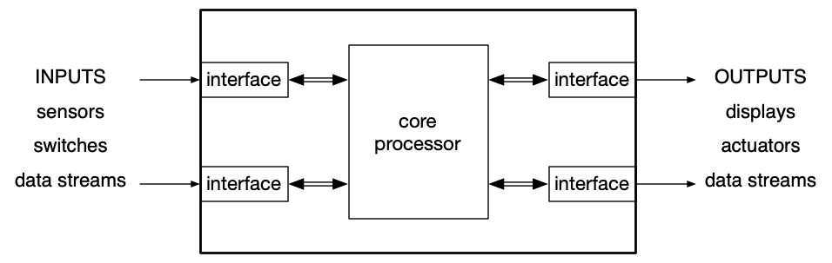
Top-level embedded system view
Notes:
We've been spending time on the input side (sensors, switches), and we started talking about some outputs (displays). Today we'll focus on actuators.

Slide 4
Recall: Typical sensor signal chain
physical
quantity
voltage
voltage
integers
World
Sensor
AFE
ADC
MCU
Sensor = Mechanism that translates one physical variable into another
AFE = Analog front end: Amplify, reduce noise (a.k.a. signal conditioning)
ADC = Analog to digital converter
MCU = Microcontroller unit (i.e., our STM32C031xx)
Many sensors are “bare” (example: thermocouple, phototransistor, force-sensitive resistor)
Often, the sensor you buy has the AFE built in (example: TMP235 temperature sensor)
Often, the sensor you buy has the AFE and the ADC built in, and a serial communication interface. (example: LSM303AGR accelerometer / magnetometer)
Usually, the MCU has an ADC built in (ours does).

Slide 5
Now: Typical actuator signal chain
integers
voltage
voltage or current
physical quantity
DAC
MCU
Driver
Actuator
World
MCU = Microcontroller unit (i.e., our STM32C031xx)
DAC = Digital to analog converter
Driver = Convert low voltage (current) from DAC to higher voltage (current) for actuator.
Actuator = Convert voltage or current into a physical quantity (force, motion, heat, flow)
All but the smallest actuators require a driver.
Many MCUs don’t have true linear DACs (integer → voltage), but they almost always have an approximate DAC called a pulse width modulator (PWM).
Notes:
This kind of runs in reverse to the sensor chain:
Numbers coming out of the microcontroller, converted to voltage by DAC, converted to usable voltage by driver (driver is sort of the opposite of the analog front end that takes a feeble signal and amplifies it to use it). The driver makes the feeble analog signal into one that can actually be used.

Slide 6
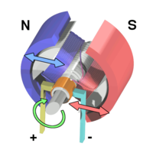
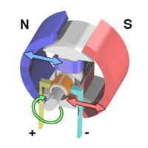
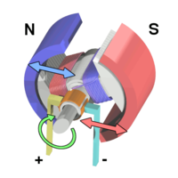
How a DC permanent magnet motor works
Electric current flowing through brushes into armature coils creates a magnetic field.
Repulsion by field from permanent magnets causes armature to rotate.
Current flow is reversed via commutator so the armature continues to be repelled by magnets and keeps rotating.
Motor torque is proportional to current.
Armature rotating in magnetic field generates a “back emf” proportional to speed.
See Williams, pp 297-303 (Chapter 11, DC Motors section).
Ref: Wikipedia, “Brushed DC Electric Motor”
https://en.wikipedia.org/wiki/Brushed_DC_electric_motor
Notes:
This is all in the video - so we'll skip this slide.
The motor spins because current-carrying conductors experience Lorentz force in the magnetic field; back EMF arises because those same conductors, once moving, cut magnetic flux and generate a voltage via Faraday’s law.
The term back electromotive force is also commonly used to refer to the voltage that occurs in electric motors where there is relative motion between the armature and the magnetic field produced by the motor's field coils or permanent magnet field, thus also acting as a generator while running as a motor. This effect is not due to the motor's inductance, which generates a voltage in opposition to a changing current via Faraday's law, but a separate phenomenon. That is, the back-EMF is also due to inductance and Faraday's law, but occurs even when the motor current is not changing, and arises from the geometric considerations of an armature spinning in a magnetic field.
Cause of rotation:
Current in conductors + magnetic field → Lorentz force → torque → rotation
Cause of back EMF:
Moving conductor + magnetic field → induced voltage

Slide 7
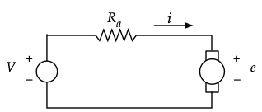
How voltage drives motor speed
𝜏 - torque i - current 𝜔 - rotational speed e - back EMF V - voltage
Current ➞ electromagnet field ➞ repels permanent magnet field ➞ torque
Torque is proportional to current: 𝜏 = K_{t} i
At steady speed, torque just overcomes friction: 𝜏 = b 𝜔
Moving coil in magnetic field ➞ voltage (generator)
Generator voltage (“back emf”) is proportional to speed e = K_{e} 𝜔
Motor coils have some DC resistance: V – e = i R_{a}
Notes:
What is the model that models how the motor functions as a function of the input, namely the current?
Two pieces:
When you pass a current through the motor coil (the armature), that generates an electric field that repels the field that is set up by the permanent magnet. The repellent field makes the armature move and that generates torque.
The torque is proportional to the current; there is a proportionality constant K called the motor constant. Tau = K_t i.
As the armature turns it encounters friction. At a steady speed the torque that is generated just overcomes the friction (they are equal in steady state): tau = friction (b times omega) - omega is the rotational speed.
Also, as you move a coil in a magnetic field, it creates a voltage (that is a generator effect); that voltage is proportional to the speed (like in a dynamo of a bike: the faster you pedal, the brighter the light). E = K_e omega.
The motor coil also has some electric resistance, so you get some more equations: that voltage drop is equal to the current times that resistance. V - e = iR_a (Ohm's law).
You can take all of these equations and combine them:

Slide 8
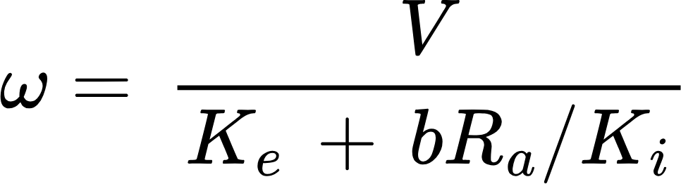
How voltage drives motor speed (2)
𝜏 - torque i - current 𝜔 - rotational speed e - back EMF V - voltage
Solve for equilibrium speed:
Speed ∝ Voltage
How do the various parameters affect the speed?
Increase this parameter: | Does 𝜔 increase or decrease?
Friction, b
Resistance, R_{a}
Generator constant, K_{e} (e = K_{e} 𝜔)
Torque constant, K_{i} (𝜏 = K_{i} i)
Notes:
This is what the equations combine to: Speed of the motor is proportional to the voltage. This is just the steady state model - it does not apply to starting etc. You'll learn all that in ENGS 22 or 26.
This equation tells you how the motor will behave. None of this should be surprising. Refer to your physical intuition. Take a look at the table and think intuitively, then verify with the equation. Take a few minutes at your table.
As you increase friction, what happens to the motor speed? Goes down.
If the resistance of the motor increases, what happens to the motor speed?
If the generator constant K_e increases, what happens? This is a bit more tricky. More back EMF, so speed goes down.
If the torque constant goes up, what happens? Speed goes up!

Slide 9
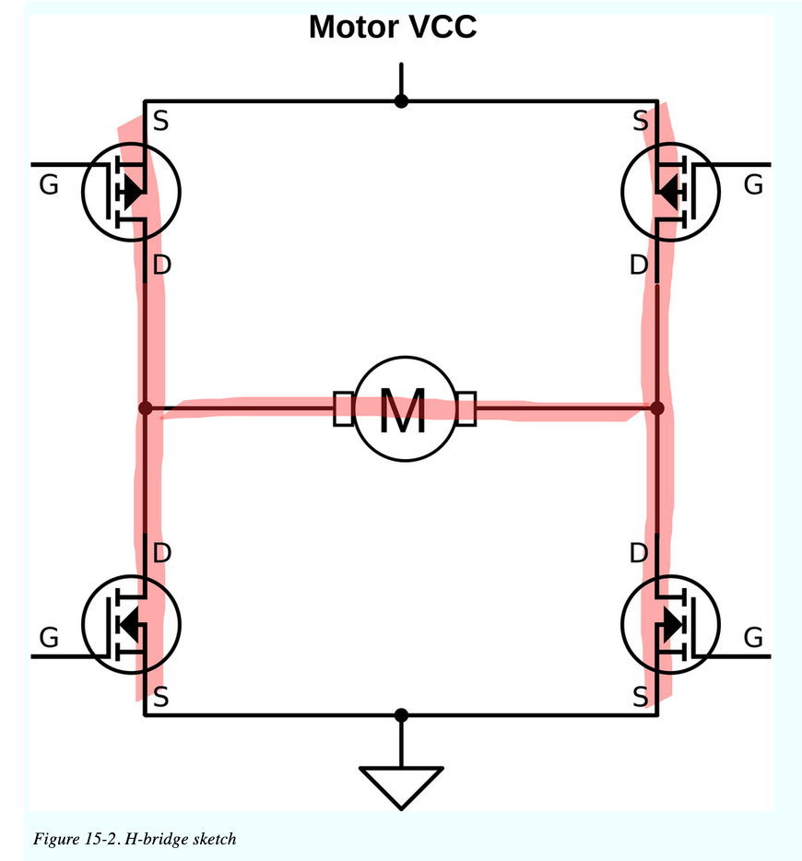
What determines motor direction?
To reverse the direction of the motor, switch the + and – connections.
An H-bridge circuit does this with electronic switches.
Notes:
If you want to change the speed of the motor you change the voltage.
If you want to change the direction of the motor you change the polarity of the voltage (causes everything to run backwards).
So you want to take the two wires and reverse them. The problem is that in an embedded system there is no person swapping the wires. You need to be able to supply voltage to the motor in a way that allows you to electronically reverse the polarity. The electronic means to do so is called a little circuit called an H-bridge. You need to understand H-bridges. Whenever you work with a motor there's going to be an H-bridge involved.
Supply power is at the top, ground is at the bottom.
It has four switches (power transistors called MOSFETs). The switches can be configured so that the current either goes from top left to bottom right and so through the motor from left to right or from top right to bottom left, and so from right to left through the motor, depending on which switches are on and off.
The whole circuit is in the shape of an H so it's called an H-bridge.

Slide 10
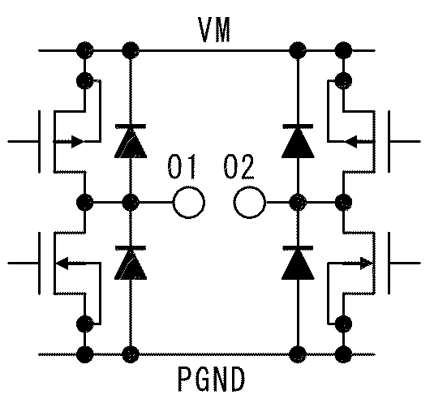
H-bridge motor driver
Toshiba TB6612FNG motor driver contains two “H-bridge” circuits. (See Williams, Chapter 15, pp 305-317 - "Advanced Motors")
g
g
pMOS power transistors, ON when gate input is LOW
nMOS power transistors, ON when gate input is HIGH
g
g
Ref: Toshiba TB6612FNG data sheet
Notes:
The switches come in two kinds: pMOS and nMOS (never mind what p and n stand for and how they work).
On a pMOS transistor, when the gate is low (gets a digital signal of 0), the transistor is on and lets current through, and when the gate is high (gets a digital signal of 1 - or high voltage - 3V) the transistor is off and doesn't let current through.
An nMOS transistor works the opposite way, so they are opposite each other.

Slide 11
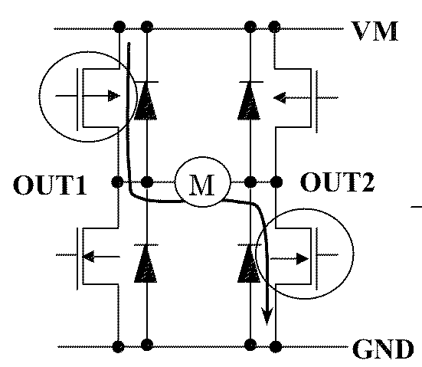
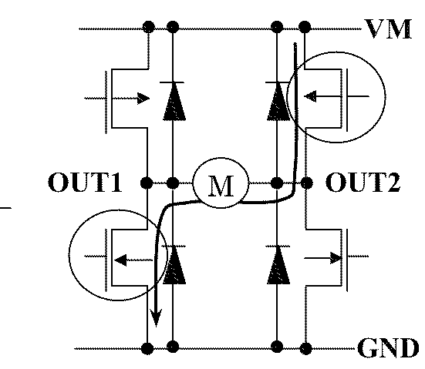
H-bridge
Learn more about motor control circuits in Engs 125, Power Electronics.
Easy to reverse current flow through motor, reverse direction of rotation.
IN1
IN2
Counter-clockwise
motor rotation
IN1=LOW, IN2=HIGH
Clockwise
motor rotation
IN1=HIGH, IN2=LOW
Ref: Toshiba TB6612FNG data sheet
Notes:
The way the transistors are stacked up and connected is really cool: If IN1 is low and IN2 is high, then the motor turns one way. If it is reversed, the motor turns the other way. So with high or low switches you can control the direction of the motor.

Slide 12
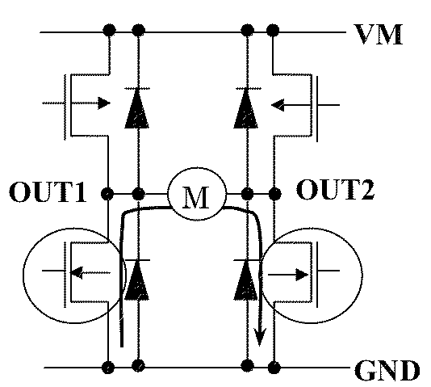
H-bridge
When motor is turned by kinetic energy (e.g., rolling car), it generates electricity.
IN1
IN2
Braking
IN1=HIGH, IN2=HIGH
Dumps kinetic energy by sending generator current to ground.
Ref: Toshiba TB6612FNG data sheet
Notes:
If you take both sides and make them high, no current can flow into the motor. But if the motor is still turning, then any current that is in the motor (back EMF via momentum), you can dump that power to ground, so this brakes the motor.

Slide 13
H-bridge modes: summary
IN1 | IN2 | MODE
L | L | STOP
L | H | CCW
H | L | CW
H | H | BRAKE
CCW
CW
Brake
Stop (all off)
Ref: Toshiba TB6612FNG data sheet
Notes:
STOP Mode (Coasting)
• In STOP mode, all MOSFETs in the H-Bridge are turned OFF, leaving the motor terminals floating or open.
• Since there is no active connection to power or ground, the motor spins down due to natural friction and load resistance, meaning it “coasts” to a stop.
• This mode is achieved when both IN1 and IN2 (or PWM inputs) are set to LOW.
BRAKE Mode (Dynamic Braking)
• In BRAKE mode, the motor terminals are shorted together through the low-side MOSFETs (or sometimes the high-side MOSFETs, depending on the design).
• This creates a closed circuit for the back-EMF generated by the spinning motor, which causes a countercurrent that resists motion and slows the motor quickly.
• Dynamic braking is much stronger than coasting, making the motor stop faster.
• This mode is usually activated by setting both IN1 and IN2 to HIGH (depending on the motor driver).
• When all MOSFETs are off (STOP mode), the motor’s own inertia keeps it spinning because there’s no opposing force except natural friction.
• When the motor terminals are shorted (BRAKE mode), the back-EMF generates a current that opposes rotation, causing rapid deceleration due to energy dissipation.

Slide 14
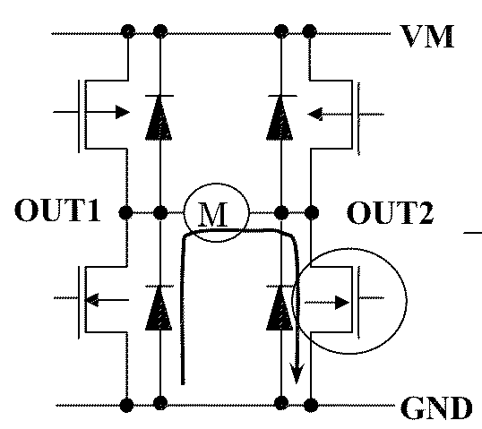
Cultural Enrichment: Shoot-Through
Shoot-through (“penetrating current”)
Different switching times for transistors can allow both transistors on one side to be ON during a reversal.
Instantaneous high current can destroy transistors.
TB6612FNG has a layer of logical circuitry that staggers the switching so all transitions pass through a brief state with one side completely off.
Still, a good idea when changing direction to insert a “short brake” state.
Ref: Toshiba TB6612FNG data sheet
Notes:
Cultural enrichment: In the event someone goofs it up so that two transistors are on at the same time, instantaneous high current can flow through (shoot through) and the transistors blow ("magic smoke will be released…").
The board we'll use has additional logical circuitry included that prevents this from happening.

Slide 15
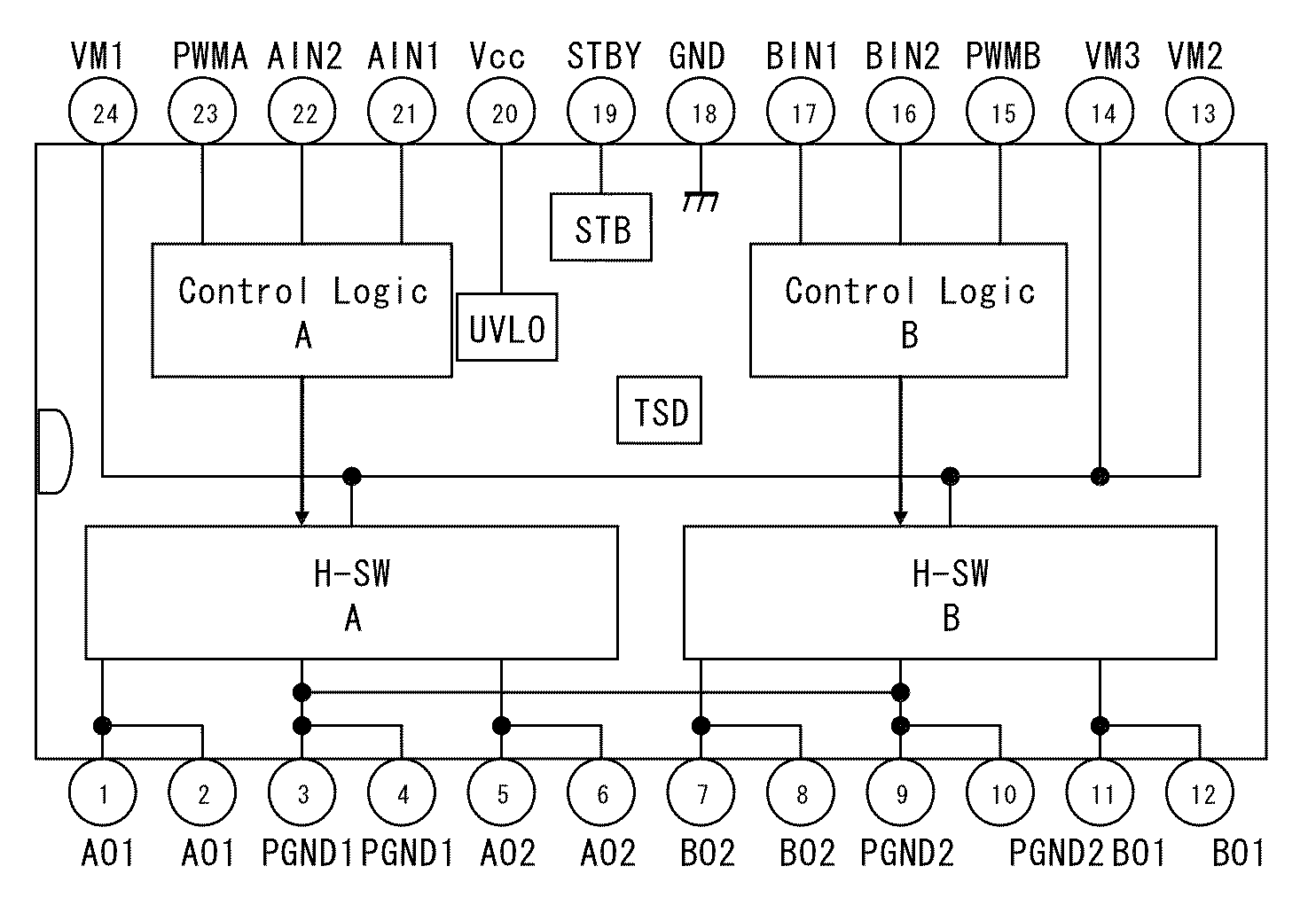
Inside the motor controller IC
Motor power
(high voltage, current)
Logic Vcc & GND
(low voltage, current)
IN1, IN2, PWM control direction and speed
Translate inputs to H-bridge control
4 wires
(to transistor gates)
H-bridge
OUT1, OUT2 to motor.
Separate PGND for motor power.
Ref: Toshiba TB6612FNG data sheet
Notes:
We'll use a chip/circuit board; the chip is the Toshiba TB6612FNG; it has a bunch of terminals on it (which are not the same as the pins on the edge of the board). The main thing to note is that there are inputs (in red: PWMA, AIN2, AIN1) that go into logic and that ultimately controls the direction and speed of the motor. Then there are these blue terminals that are actually for the high voltage, high current that passes through the transistors and through the motor.
So low power logic control from the microcontroller is used to switch on/off/ a high amount of current/voltage required to drive the motor. If you just tried to connect your motor directly to the microcontroller nothing would happen because the microcontroller is not capable of driving enough current to run the motor.
So this is the motor driver: the driver of the actuator signal chain.

Slide 16
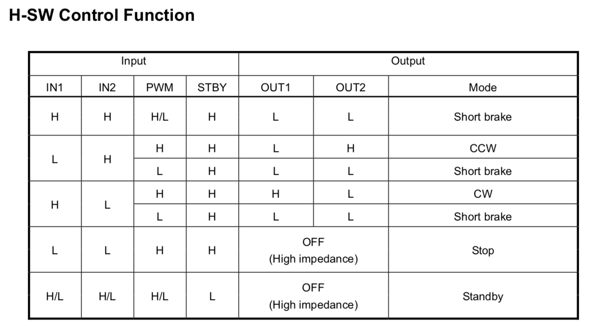
Summary: Motor controller truth table
Automatically pulled up through our breakout board
counterclockwise
clockwise
Ref: Toshiba TB6612FNG data sheet
Notes:
We'll tinker with this later.

Slide 17
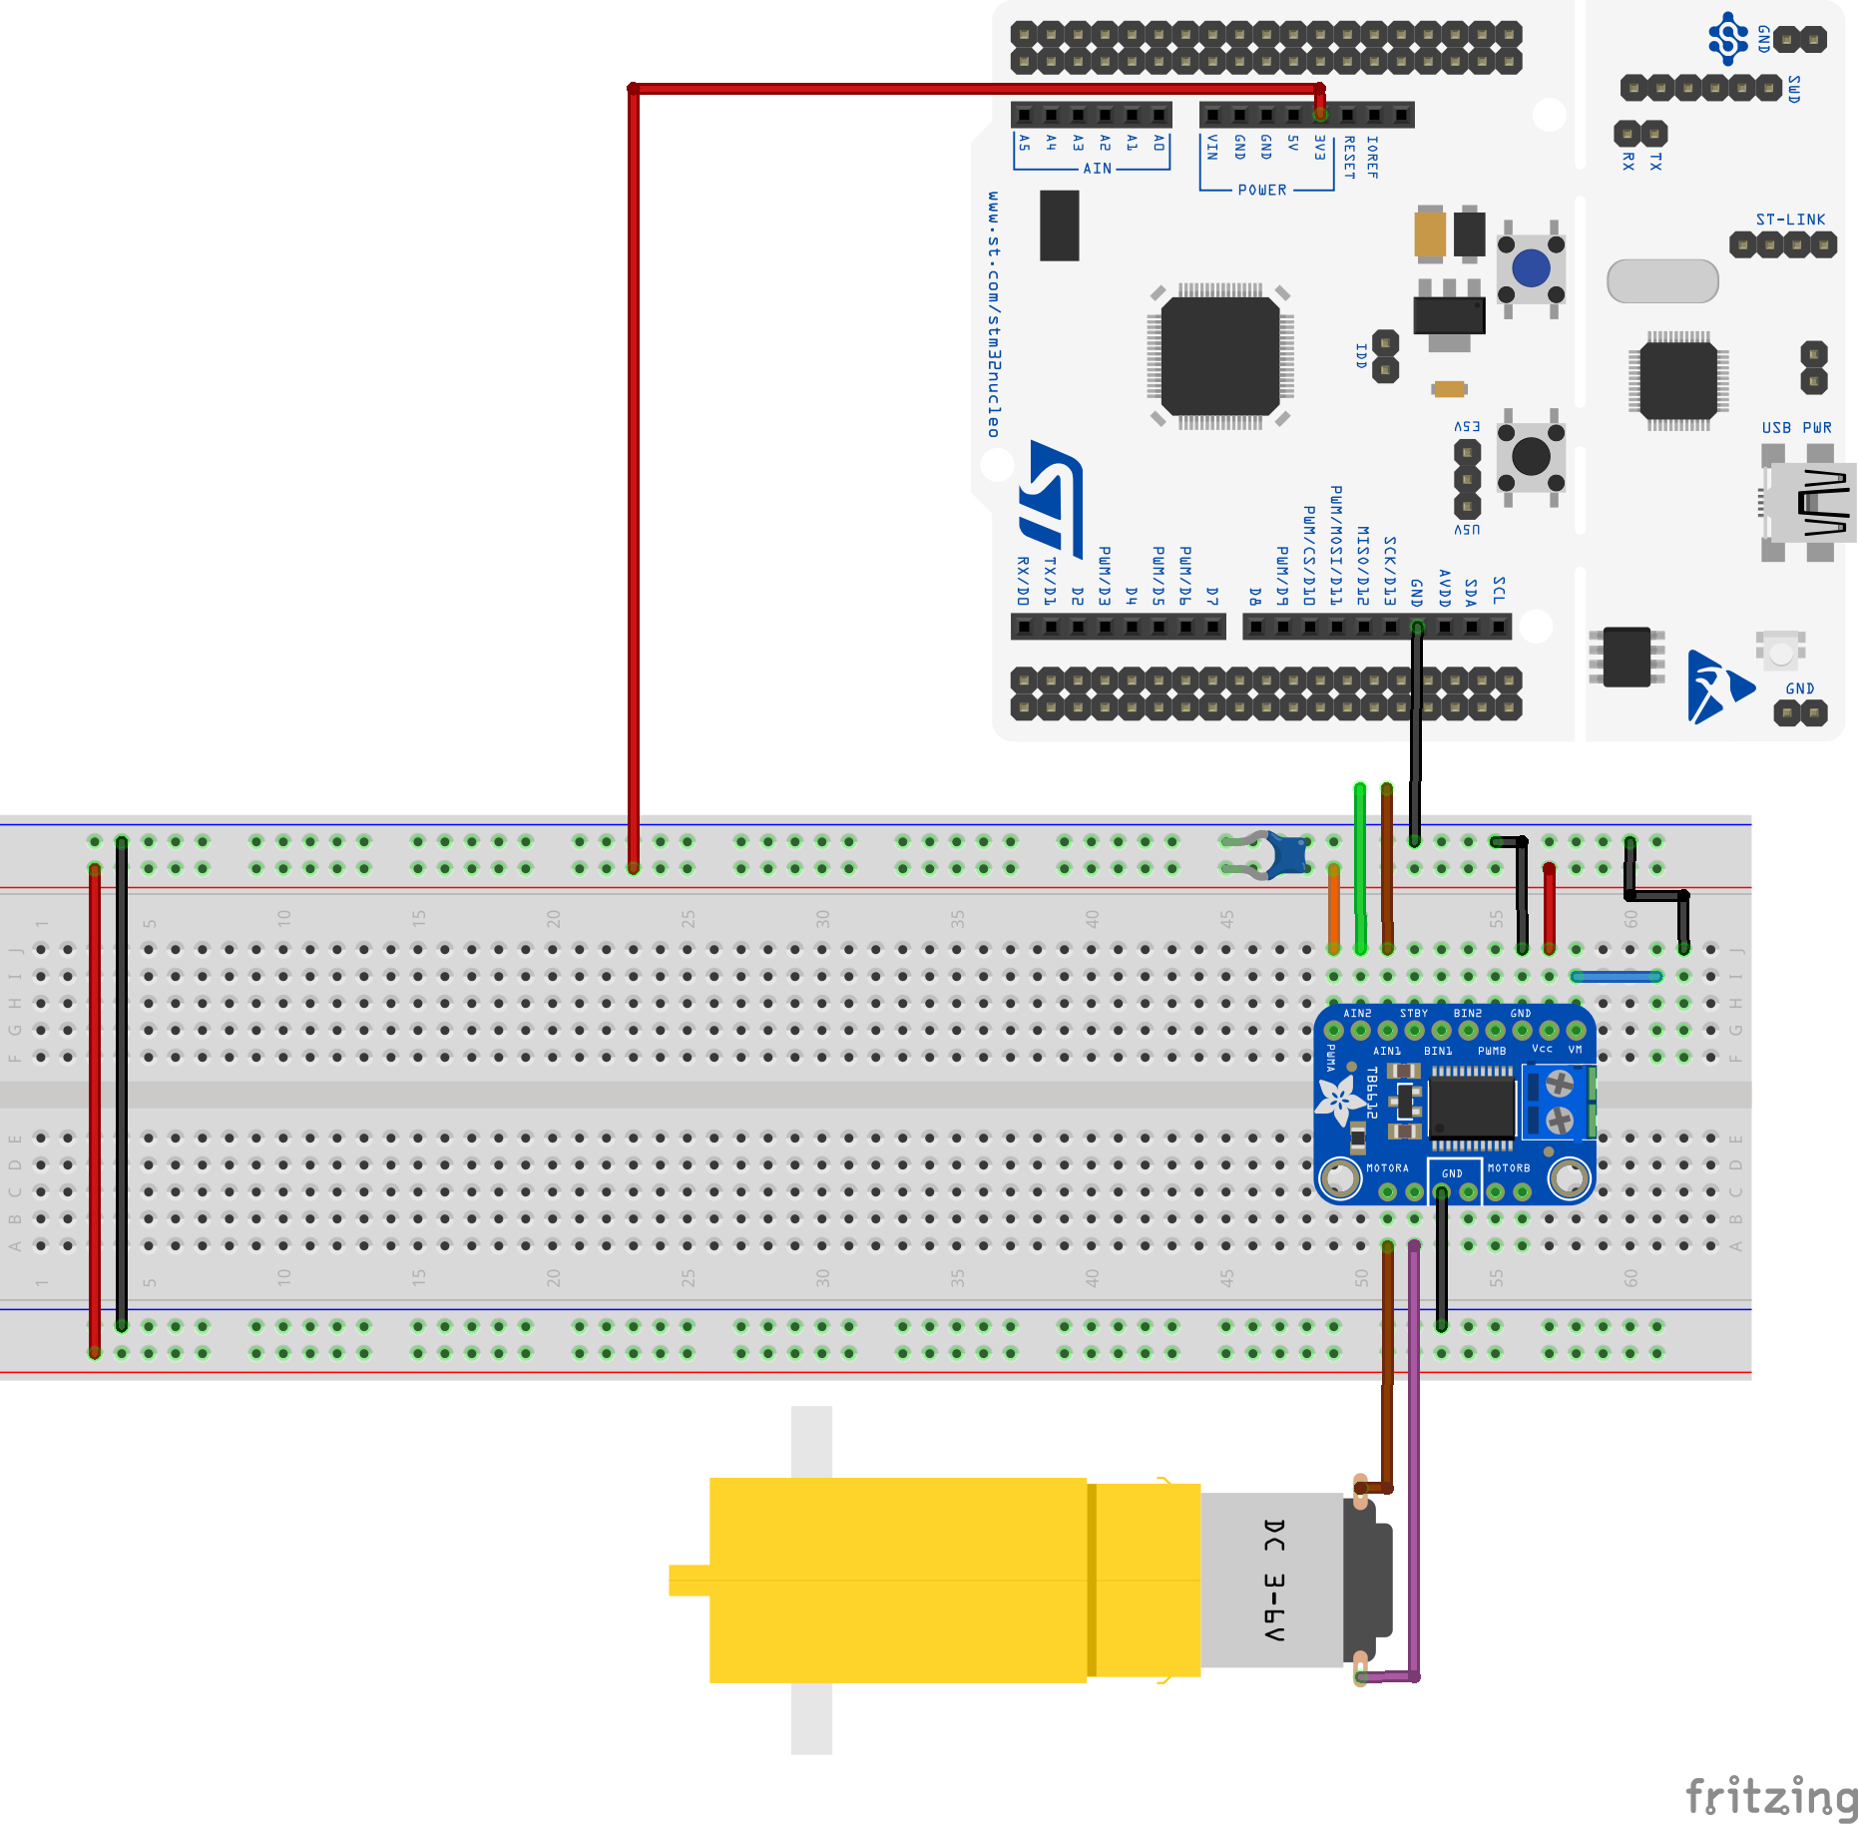
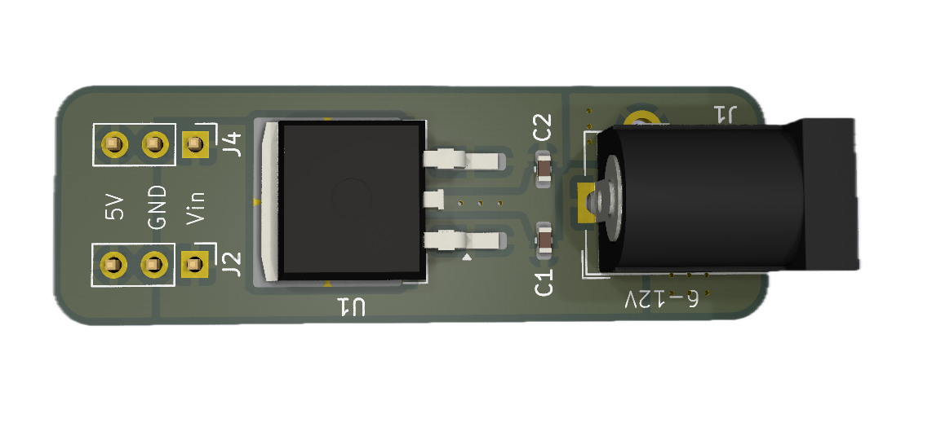
TB6612 breakout wiring — first exercise
We will use an external power supply.
Leave USB disconnected.
Do NOT plug in external power yet.
PWM held high; AIN1 and AIN2 unconnected.
.22 uF
Barrel connector
Once you have this wired up, have your wiring checked by one of us.
Voltage regulator: regulates incoming voltage down to 5V
Notes:
Capacitor values (can read these from the schematic on the lab):
C1 = .22 uF (between logic power and ground)
Just wire this all up and we'll come around to make sure it's right. Do NOT power anything up yet.

Slide 18
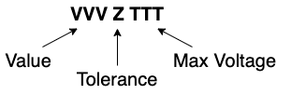
Recall: Reading Capacitor Codes
Our Metal Film Capacitors have 3 fields in their marking
Value is 2 digits and a decimal point.
The decimal point can be an n, a p, or a dot
The default values (dot) are in microfarads.
P means PIco
N mean Nano.
Replace the letter with a decimal point and move to the end
22nJ100 => 22.0nF +/- 5% Max 100V
.15J63 => 0.15uF +/- 5% Max 63V
2n2K100 => 2.2nF +/-10% Max 100V
p22J63 => 0.22pF +/- 5% Max 63V
.22J63 => 0.22uF +/- 5% Max 63V
Tolerance is a single letter.
J means +/-5%
K means +/-10%

Slide 19
First exercise — manual direction control
AFTER your wiring has been checked: Plug in your Nucleo via the USB cable. Plug in the wall wart.
Connect AIN1 and AIN2 jumpers to power and ground rails (++, +–, –+, – –), observe motor behavior.
Later, we’ll let the Nucleo control the PWM, AIN1 and AIN2 wires.
Notes:
Here is the next step: Once your wires have been checked by one of us, plug in the wall wart. Then take those two dangling wires (green and blue in the picture) and connect one of them to ground, the other to (logic) power. That should make the motor turn in one direction. If you reverse which is in power, which is in ground, the motor should reverse direction. This is a neat way to check your wiring.

Slide 20
Motor speed control (3)
H-bridge controls the direction of current flow through the motor, but how do we control the amplitude of the voltage (which governs the speed)?
MCU doesn’t have a linear DAC (integer → voltage). All it can output is HIGH and LOW.
Notes:
The H-bridge determines the direction of the motor. How do we change the speed?
It's the Motor VCC that'll do that. Right now: Motor runs full speed one direction or the other.
Our processor does not have a DAC (digital to analog) converter that would take numbers and convert them to voltage. Thus we'll have to use pulse width modulation (PWM).

Slide 21
Pulse width modulation

Slide 22
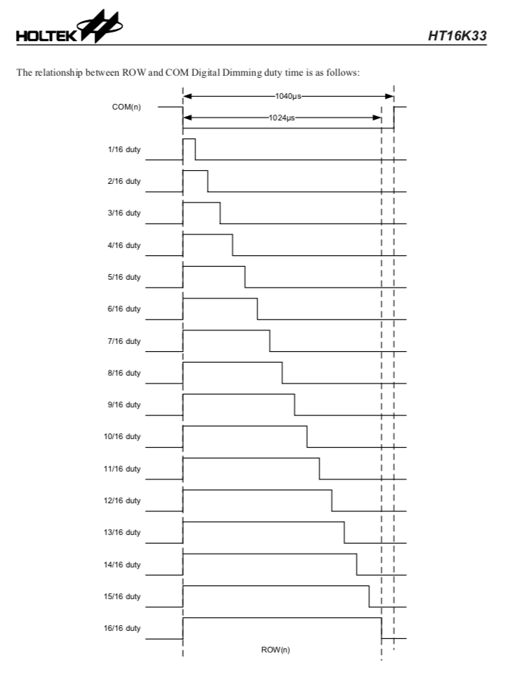
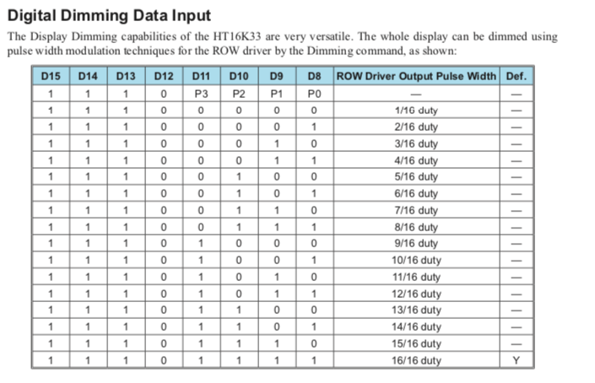
Reall: Dimming the seven-segment display
Holtek HT16K33 data sheet, Version 1.20
Anode voltage waveform modulates the brightness.
Wider pulse ➞ higher duty cycle ➞ brighter light.
void SevenSeg_dim(uint8_t brightness) {
i2c1_byteWrite(HT16K33_ADDR,
HT16K33_DISPLAY_CMD |
HT16K33_BRIGHT_CMD |
(brightness & 0xf) );
}
Notes:
Remember how we were able to dim the 7-segment display? What happened there was that it was actually pulsing the LED which makes it appear more or less bright.
Depending on the number you sent in there, it sets the duty cycle (thus the proportion of time during one cycle for which the LED is on).

Slide 23
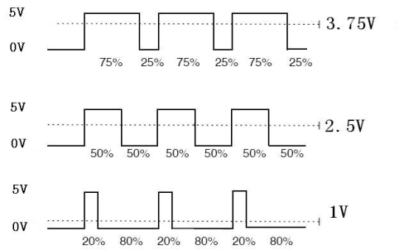
Pulse width modulation (PWM)
Control the duty cycle (T_{HIGH} / T) of a square wave.
Average voltage is proportional to duty cycle: V_{PWM} ≈ V_{SUPPLY} × T_{HIGH} / T
Some PWM applications:
Controlling LED brightness (e.g., the seven-segment display)
Motor speed control!
Digital to analog conversion
Audio and sound generation (frequency -> pitch, duty cycle -> loudness)
Notes:
This is not just for LEDs!
Ratio of on-time to entire period is called the duty cycle.
So if it's on as much as it's off, it's called a 50% duty cycle.
If you take such a square wave and average the voltage over them then that average is proportional to the duty cycle. If the duty cycle is 10%, then the average is 10% of the input voltage.
For a motor: in theory this would produce a pulsing motor, but due to the inertia of the armature, the inertia averages it all out.
For LED: it pulses and your eyes average it out.

Slide 24
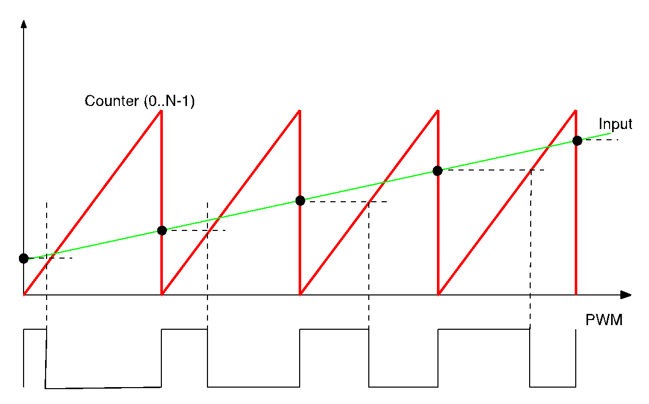
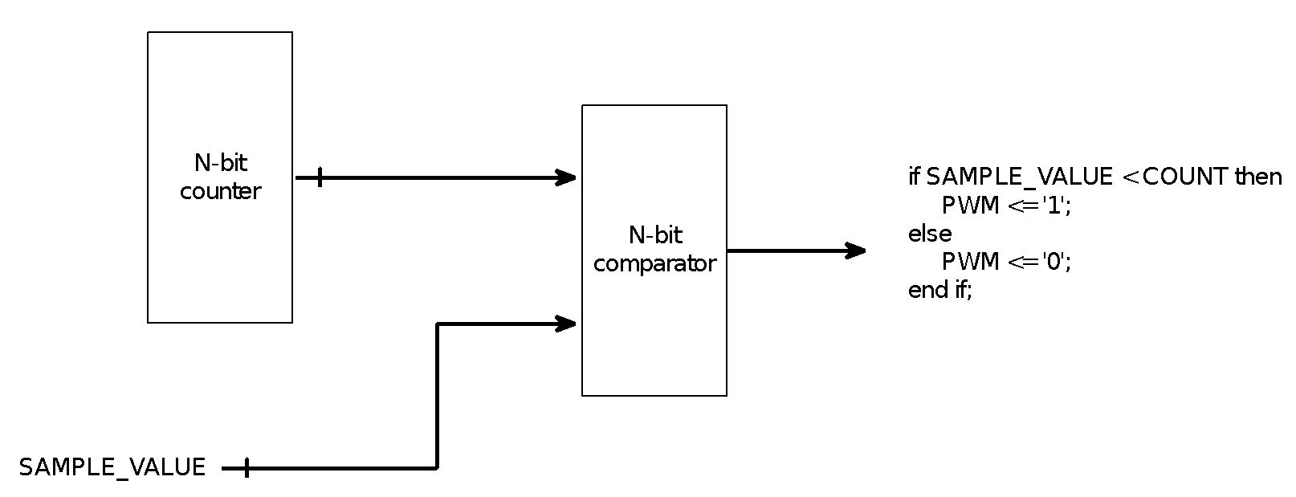
Basic PWM (“Fast PWM”)
Simple hardware!
if (counter < input) {
PWM = 1;
} else {
PWM = 0;
}
This is the software equivalent of what actually happens in hardware.
Notes:
Super simple to create a square wave:
Take a counter (counts from 0 to max value, restarts). Take that counter and compare its value to the signal input. Output will be true as long as counter value is less than the number you wish to convert. As soon as the counter passes that number the comparator yields a 0. So the larger the sample value, the longer the output is going to be high. That's exactly what you want from the duty cycle.

Slide 25
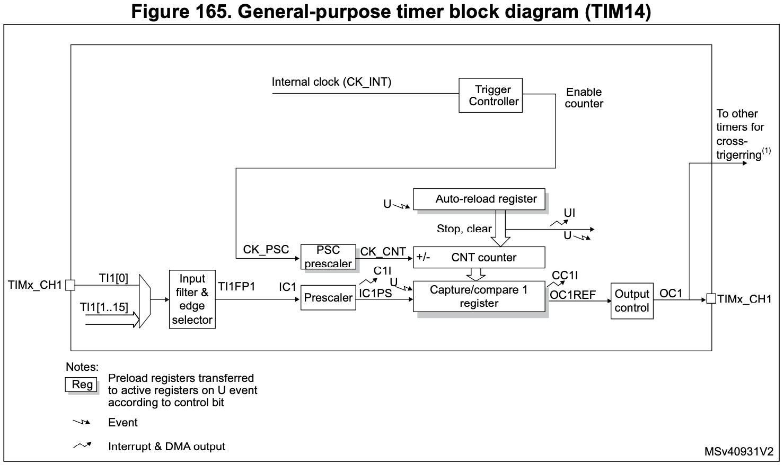
PWM is built into the STM32C0 timer/counters
Auto-reload
(upper limit)
Prescaled clock input
Counter
Compare register
Notes:
Inside the microcontroller: counter register is CNT.
As it counts, there are a couple things it can do:
Have it compare its value to a number you have stored in a register. Suppose you wanted to count to 100. Then you could use the 8-bit counter, but instead of having it count to 255 you'd store 100 in the output compare register (OCR). Comparator will compare the numbers. When the counter gets to that number it does something (generate interrupt, etc)
Can tell it to do something when it reaches its top value (TOP), so when the counter overflows.
When counting down can tell it to do something when it reaches 0.
Timer overflow interrupt gets thrown when overflow is reached.
Output compare interrupt occurs when timer reaches value in OCR (if so chosen). Those are two different interrupts.
Each timer/counter has two comparison value registers, so you could in principle have one counter that interrupts both at 100 and also at 150. Seems difficult to think about, so have never used that personally…
It can do other things that we'll learn about in a few weeks.
So general functionality: Counter counts, generates interrupt when it reaches a specified value.
There are two control registers that set the various options (clock speed, what happens when it times out - reset or done? etc)

Slide 26
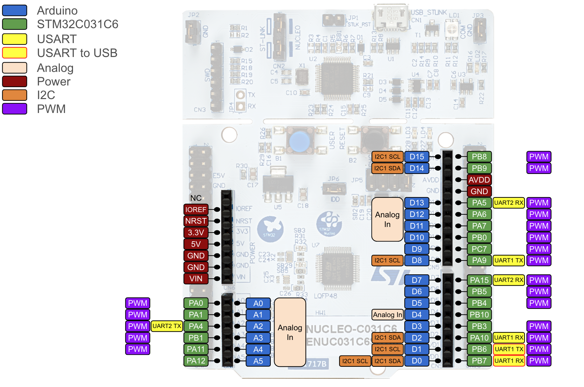
Nucleo PWM outputs
Almost every pin is capable of PWM, driven by different counters.
PA4, PA7 and PB1 can be driven by TIM14.
See Datasheet, Table 12.
Notes:
Almost every pin is capable of PWM, driven by different counters.
PA4, PA7 and PB1 can be driven by TIM14.
See Datasheet, Table 12.
For the motor controller we'll use Arduino pins 11, 12 and 13. We'll take pin 11 with PWM to control the voltage going into the H-bridge, so instead of those transistors going to be on all the time the will go open/close/etc (this is on the logic end of things!), so that the actual full current passes through and gets blocked according to the duty cycle.
You don't have to think about this hard since it's all built into the chip.

Slide 27

TB6612 breakout wiring — second exercise
PWM + 2 wires for direction control.
Notes:
Take the PWM wire (that was connected to logic power) and connect it to PA7. Then take the two dangling wires and connect them to PA 5 and 6, respectively. We'll use pwm on PA7 to change the speed of the motor and use PA 5 and 6 to determine the direction of the motor.

Slide 28
Second exercise
Make a copy of your TemplateProject and call it DCmotor. Download TTmotor_ramp.c, and paste it into your new project's Src folder.
Compile and run TTmotor_ramp.c, observe the PWM signal with the oscilloscope as you watch the motor run.

Slide 29
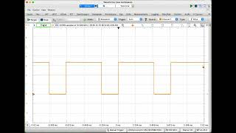
TTMotorRamp on the Waveforms Oscilloscope
Notes:
https://youtu.be/MuDX2vrNV3Q

Slide 30
Homework
HiTA activity due Thursday:
The demo program uses the TIM14 PWM. Work through the demo code with the data sheet to understand how this is programmed to achieve the pwm functionality.
Get started now!

