Slide 1


Engs 28
Embedded Systems
Day 11x

Slide 2
Review: Basic DC motor control

Slide 3
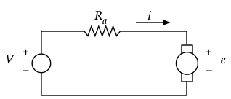

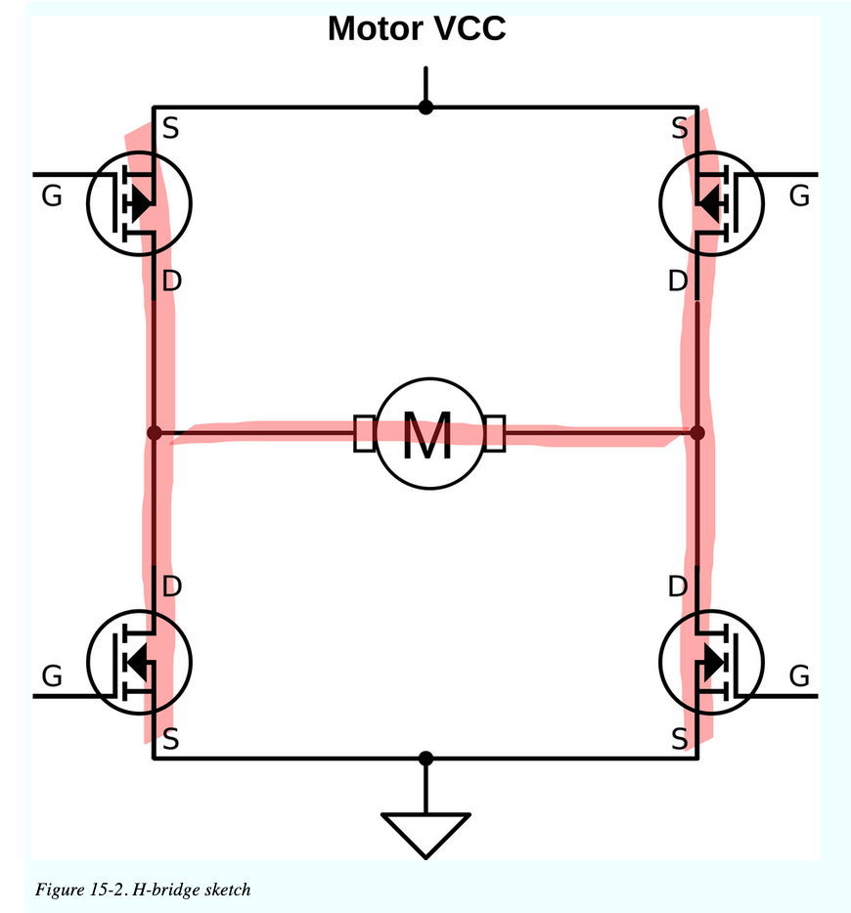
Voltage ➞ motor speed
H-bridge circuit controls direction of rotation.
Pulse-width modulation of the active switches controls the speed of rotation.

Slide 4
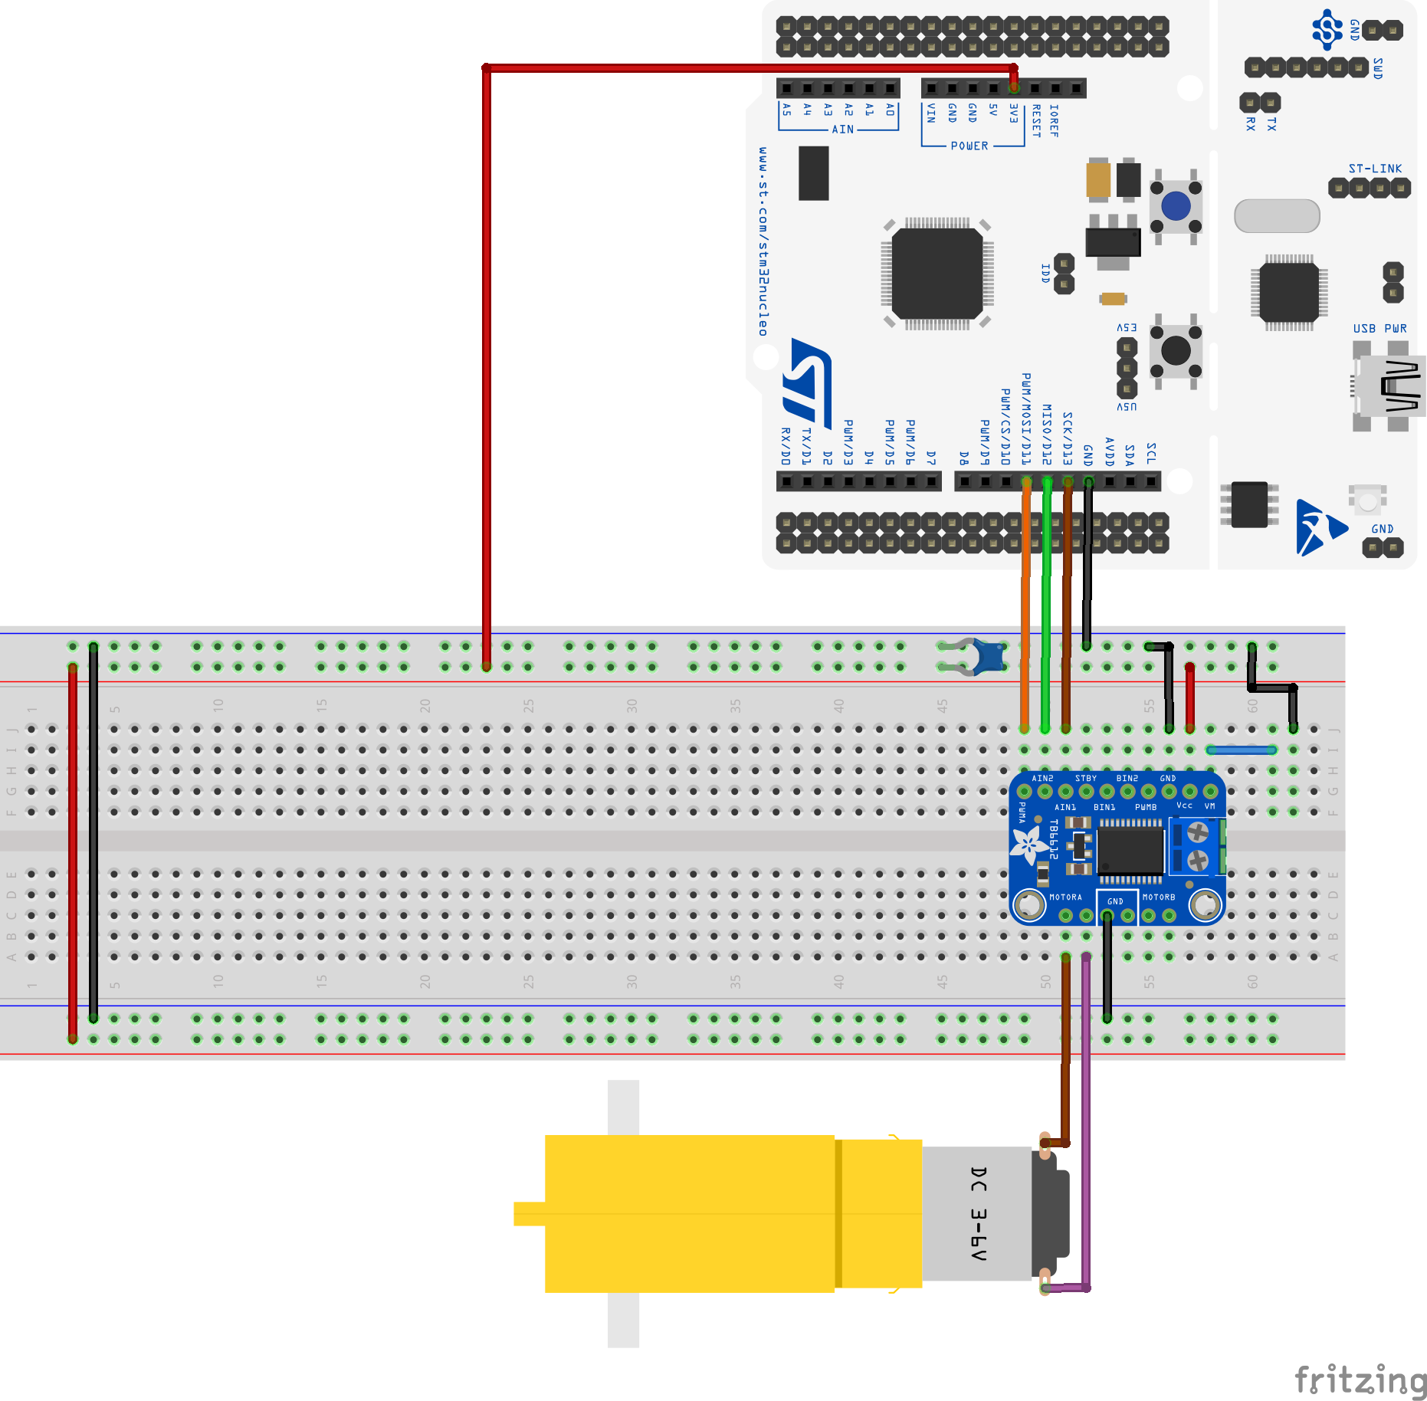
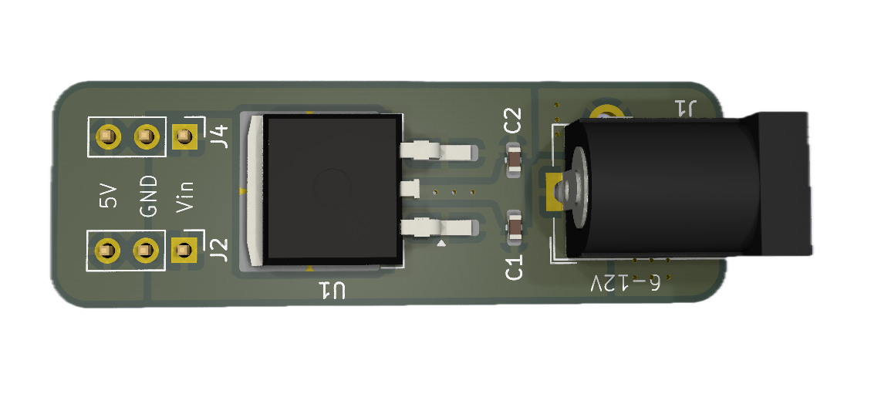
Our motor controller setup
Logic power
Motor power
Direction / PWM controls
TB6612 H-bridge breakout board
Notes:
The voltage regulator's job is to drop down the voltage coming in from the wall wart which is too high for our motor.

Slide 5
Writing code for PWM
Now that we wired up the circuit we wish to write code to control the motor speed with PWM. Please answer the following questions with your table group:
Which data sheet do we need to dig into?
Let's use timer 14 and pin PA7. What registers do we need to modify to:
Enable clock access to the pin?
Make the pin a pwm pin?
Enable clock access to Timer 14?
Set the prescaler?
Set the top (autoreload) value of the counter?
Set pwm mode on the timer, having the pin switch from high to low on compare match?
Enable the TIM14_CH1 in output mode?
Enable the timer?
Once all these initializations are in place, what register controls the speed of the motor?

Slide 6
Writing code for PWM
Now that we wired up the circuit we wish to write code to control the motor speed with PWM. Please answer the following questions with your table group:
Which data sheet do we need to dig into? Reference Manual
Let's use timer 14 and pin PA7. What registers do we need to modify to:
Enable clock access to the pin? RCC_IOPENR
Make the pin a pwm pin? GPIOA_MODER, GPIOA_AFR[0]
Enable clock access to Timer 14? RCC_APBENR2
Set the prescaler? TIM14_PSC
Set the top (autoreload) value of the counter? TIM14_ARR
Set pwm mode on the timer, having the pin switch from high to low on compare match? TIM14_CCMR1
Enable the TIM14_CH1 in output mode? TIM14_CCER
Enable the timer? TIM14_CR1
Once all these initializations are in place, what register controls the speed of the motor? TIM14_CCR1

Slide 7
Writing code for PWM
References:
Williams, Chapter 10, pp 199-206 (start of chapter up to "Initializing Timers")
Reference Manual, Section 17.3.8

Slide 8
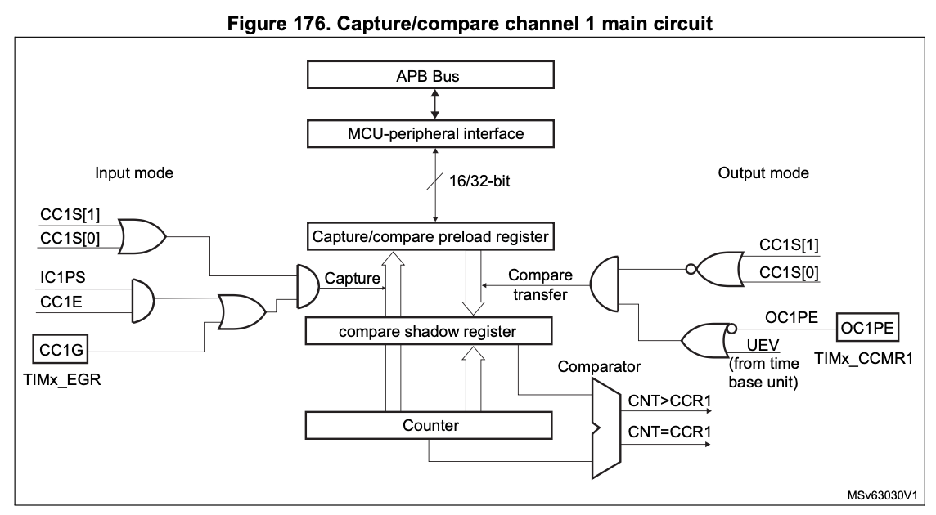
Timer 14 PWM Ch 1
T_{HIGH}
T_{HIGH}
V_{avg} = V_{M} × T_{HIGH} / T_{PERIOD}
T_{PERIOD}
Output Mode
CCR1 determines T_{HIGH}
TIM14_ARR determines T_{PERIOD}
Counter
To PWM
Notes:
Demo code uses Timer 1 PWM which is different from Timers 0 and 2 PWM. Recall that Timer 1 is the 16-bit timer.
Timer 1 PWM has an additional feature.
Period is always the same, amount of time the signal is high changes to adjust the motor speed. Ratio of THIGH/TPERID is called the duty cycle. Multiplied by motor voltage this gives you the average voltage that drives the motor.
First need to set the period. Period depends on how long it takes the timer to count all the way to the top and reset.
With timer 1 you have control over that top value. Timers 0 and 2 always count to 255 and there is nothing you can do about that. The top value for timer 1 is stored in ICR1 and determines the period.
The duty cycle is then set by putting a value into OCR1A. The counter will continuously count from 0 to ICR1. When these match, the counter resets and starts over, so this establishes the pulse period of the PWM.
While the counter is counting up it continuously compares with OCR1A. As long as the counter value is less than this register the output at the PWM will be high. When the counter reaches the OCR1A value the output goes low.
So if you want to change the duty cycle in your program you'd simply write a new value to OCR1A like this: OCR1A = …
Same with Timer 0 and 2, except you have no control over the period.

Slide 9
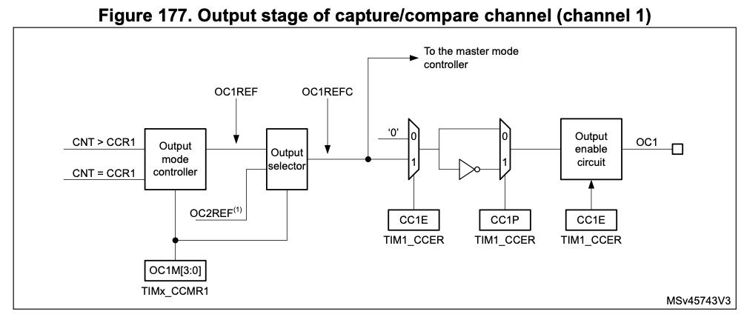
Timer 14 PWM Ch 1
T_{HIGH}
T_{HIGH}
V_{avg} = V_{M} × T_{HIGH} / T_{PERIOD}
T_{PERIOD}
From previous pg
PWM
Output enable

Slide 10
Example code: TTmotor_ramp.c
These are the core PWM functions. Everything else is creating the ramp signal and managing the direction bits. Consult the reference manual, section 17.3.8 (PWM mode), 17.4 (TIM14 registers), for details.
// tim14_pa7_pwm_init, continued:
// Timer configuration
// Clock access, prescaler, autoreload
RCC->APBENR2 |= RCC_APBENR2_TIM14EN;
TIM14->PSC = PSC_FACTOR-1;
TIM14->ARR = PWM_TIMER_MAX-1;
// Initialize compare register value - speed of 0
TIM14->CCR1 = 0;
// Set pwm mode 1 (0110)
TIM14->CCMR1 &= ~TIM_CCMR1_OC1M_Msk;
TIM14->CCMR1 |= TIM_OC1_PWM1<<TIM_CCMR1_OC1M_Pos;
// Make sure timer is in output mode
TIM14->CCMR1 &= ~TIM_CCMR1_CC1S_Msk;
TIM14->CCMR1 |= TIM_CC1_OUTPUT<<TIM_CCMR1_CC1S_Pos;
// Enable TIM14_CH1 in output mode
TIM14->CCER |= TIM_CCER_CC1E;
// Generate update event (registers, counter,..)
TIM14->EGR |= TIM_EGR_UG;
// Enable timer
TIM14->CR1 |= TIM_CR1_CEN;
}
#define PSC_FACTOR 6 // 12 MHz / 6 = 2 MHz
#define PWM_TIMER_MAX 1250 // 2/1250=1.6kHz
void tim14_pa7_pwm_init(void) {
// GPIO pin configuration
// Enable clock access to GPIOA
RCC->IOPENR |= RCC_IOPENR_GPIOAEN;
// PA7 alternate function mode (10)
GPIOA->MODER &= ~GPIO_MODER_MODE7_Msk;
GPIOA->MODER |= GPIO_ALTERNATE <<
GPIO_MODER_MODE7_Pos;
// PA7 alt. function type (AF4, 0100)
GPIOA->AFR[0] &= ~GPIO_AFRL_AFSEL7_Msk;
GPIOA->AFR[0] |= GPIO_AF4 <<
GPIO_AFRL_AFSEL7_Pos;
void tim14_pwm_set(uint16_t value) {
if (value>PWM_TIMER_MAX-1)
value = PWM_TIMER_MAX-1;
else if (value < 0)
value = 0;
TIM14->CCR1 = value;
}

Slide 11
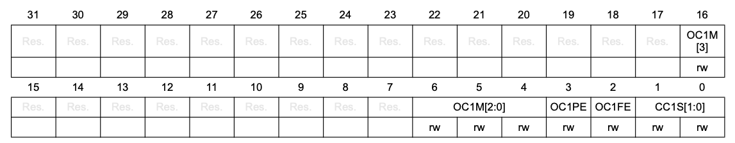
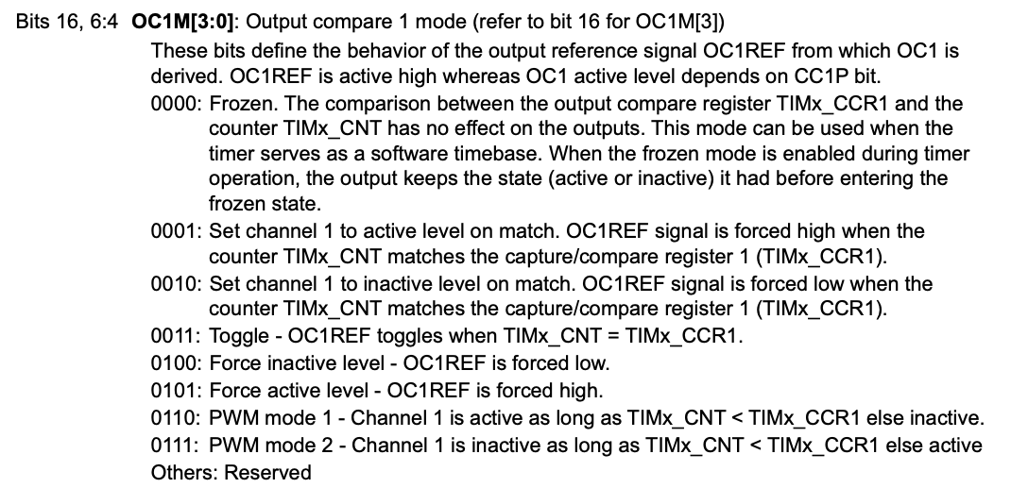
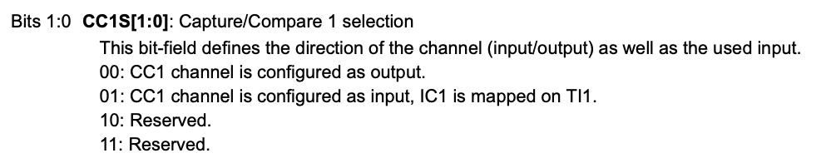
Timer 14 Registers
TIM14 capture/compare mode register 1 (TIM14_CCMR1) in Output Compare Mode
// Set pwm mode 1 (0110)
TIM14->CCMR1 &= ~TIM_CCMR1_OC1M_Msk;
TIM14->CCMR1 |= (TIM_OC1_PWM1 <<
TIM_CCMR1_OC1M_Pos);
// Set pwm mode 1 (0110)
TIM14->CCMR1 &= ~TIM_CCMR1_CC1S_Msk;
TIM14->CCMR1 |= TIM_CC1_OUTPUT <<
TIM_CCMR1_CC1S_Pos;

Slide 12
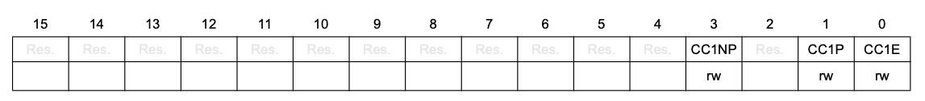
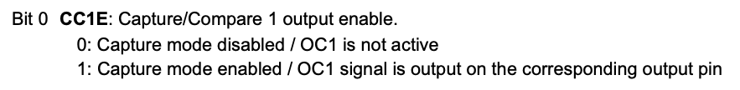
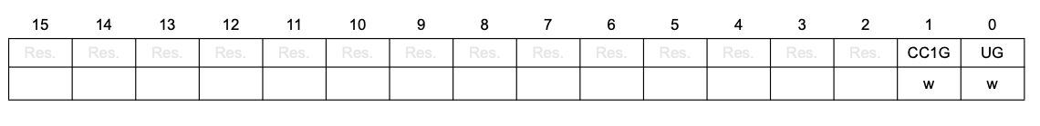
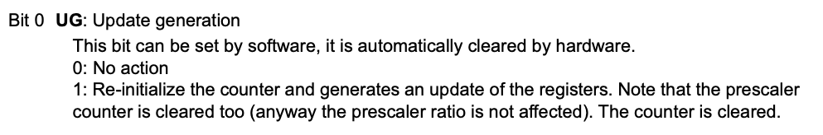
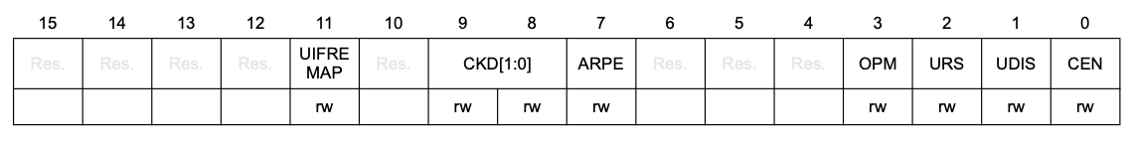
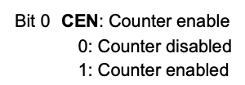
Timer 14 Registers
TIM14 capture/compare enable register (TIM14_CCER)
TIM14 event generation register (TIM14_EGR)
TIM14 control register 1 (TIM14_CR1)

Slide 13
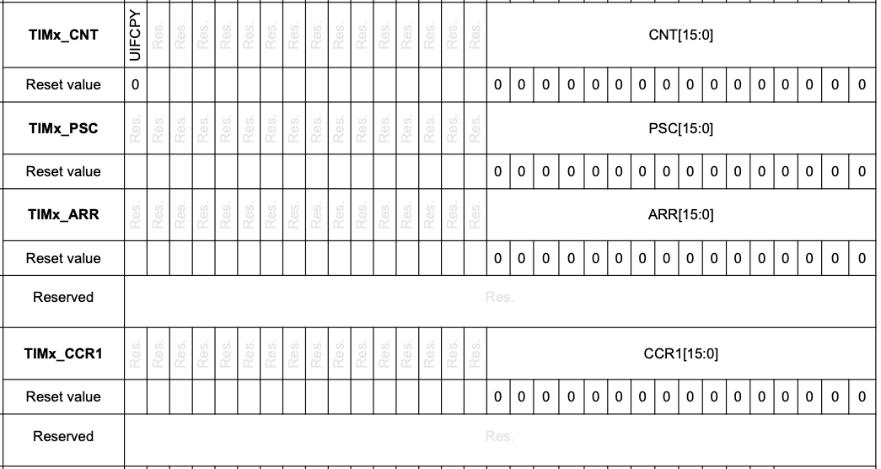
Timer 14 Registers
V_{avg} = V_{M} × T_{HIGH} / T_{PERIOD}
T_{HIGH}
T_{HIGH}
T_{PERIOD}
Prescaler - counting rate
determines T_{PERIOD}
determines T_{HIGH}

Slide 14
Example code: TTmotor_ramp.c (2)
If it is detected that the motor will change direction, force it to brake first.
// First set direction
if(counter_new > 0) {
if (counter_old < 0) { // changing direction
TB6612_AIN1 = 1;
TB6612_AIN2 = 1; // short brake
} else {
TB6612_AIN1 = 1;
TB6612_AIN2 = 0; // CW
}
} else {
if (counter_old > 0) { // changing direction
TB6612_AIN1 = 1;
TB6612_AIN2 = 1; // short brake
} else {
TB6612_AIN1 = 0;
TB6612_AIN2 = 1; // CCW
}
}
GPIOA->ODR = (GPIOA->ODR & ~GPIO_ODR_OD5_Msk) | (TB6612_AIN1 << GPIO_ODR_OD5_Pos);
GPIOA->ODR = (GPIOA->ODR & ~GPIO_ODR_OD6_Msk) | (TB6612_AIN2 << GPIO_ODR_OD6_Pos);
Notes:
If I ever detect the motor is going to change direction I force it to brake before applying the reverse current. Read the code and you'll see how it goes.

Slide 15
Example code: TTmotor_ramp.c (3)
The ramp signal is bipolar, so take absolute value before passing to PWMtimer1_set().
// Now set the magnitude
TB6612_PWMA = abs(counter_new); // magnitude (speed)
tim14_pwm_set(TB6612_PWMA); // Update the PWM
Notes:
If you look at the ramp code in detail (for Thursday!) you'll see why the abs is necessary (can't put a negative number into the counter). Abs lives in the standard C-library.
Need to study this for lab 6. Hopefully have given you an idea of what the major points are.

Slide 16
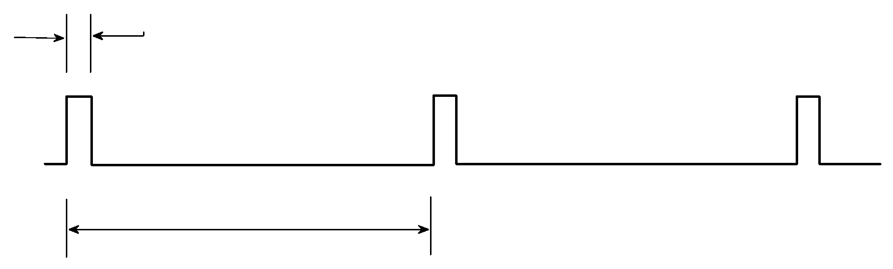
PWM design
Minimum pulse width, T₀ = T_{p}/ PWM_TIMER_MAX
Pulse period, T_{p}
Parameter | Calculated from | Set by
PWM resolution (#steps) | PWM_TIMER_MAX ≤ 2¹⁶–1 | TIMx_ARR
PWM frequency (1/T_{p}) | Timer clock freq / PSC_FACTOR | TIMx_PSC
PWM duty cycle (≤ 1) | N / PWM_TIMER_MAX | N: TIMx_CCR1
Pulse width | Duty cycle × T_{p} | N: TIMx_CCR1
Notes:
Summary of resolution of PWM

Slide 17
Motor speed sensing

Slide 18
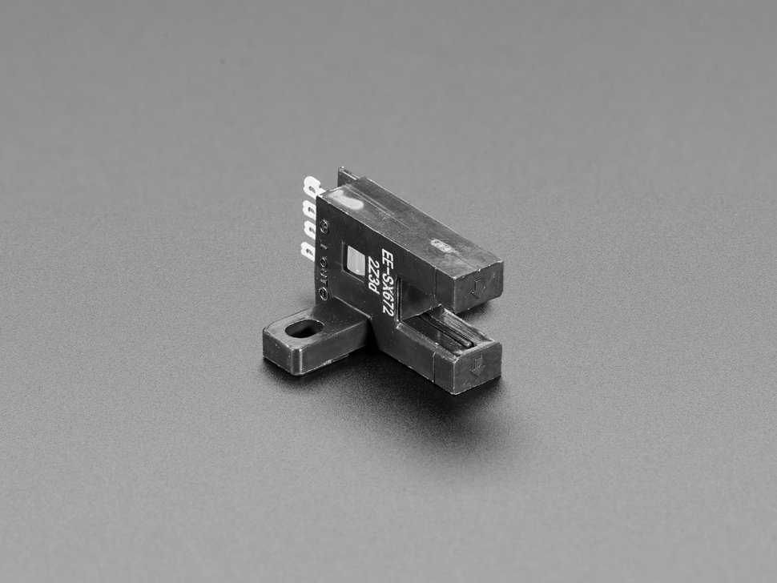
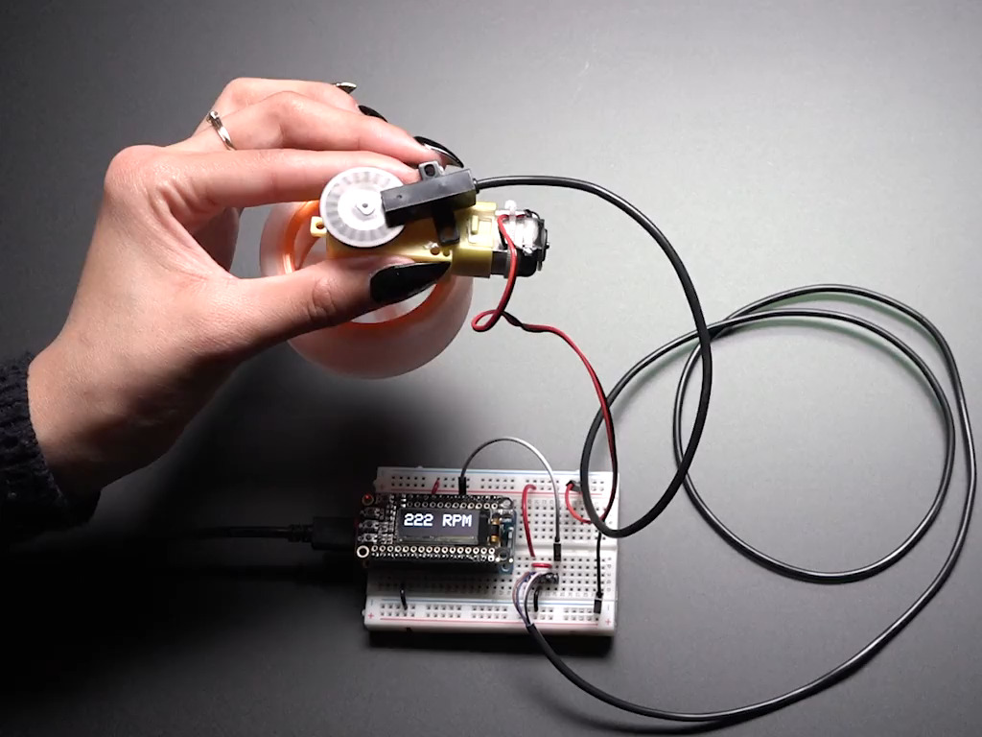
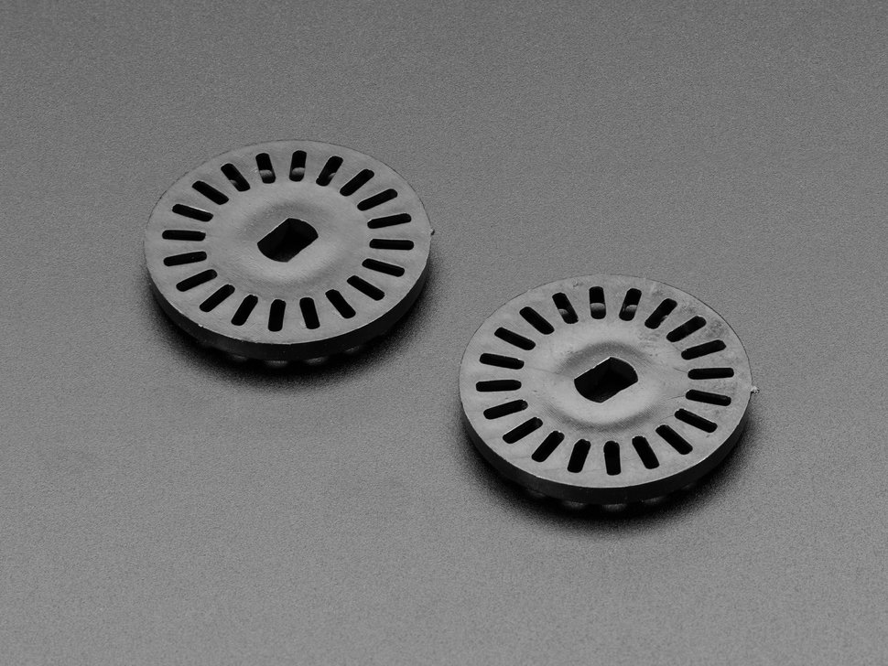
We will use an optical incremental sensor
LED + photosensor → series of pulses as slotted wheel interrupts the beam.
Detect and count the pulses in the MCU.
https://www.adafruit.com/product/3985
https://www.adafruit.com/product/3782
https://www.adafruit.com/product/3985
Notes:
There are much more complicated ways (quadrature sensors). We'll use this. There is a nice video at the adafruit site.
LED on one side, photosensor on the other side.
This is built into your motor setup.

Slide 19
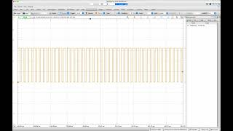
Photointerrupter on the oscilloscope: Motor speed increasing from 30 RPM to 180 RPM
Notes:
https://youtu.be/VH0-zO2LpDc

Slide 20
With your table group, discuss:
Remember how to detect falling/rising edge of the pulse?
Once you can detect those, how do you use that signal to find the speed of the motor (in rpm)?
Is it possible to tell the direction in which the motor turns from the signal?

Slide 21
Decoding shaft position from sensor output
Regardless of technology (mechanical, optical, magnetic), must translate pulse train into position / velocity information.
Decode by counting pulses (rising or falling edges):
pulse_count × ∆𝜃 = angular position (relative to zero)
pulse_count / time × ∆𝜃 = avg angular speed over interval of length time
∆𝜃 = 2𝜋 / #slots (radians), 360 / #slots (degrees), 1 / #slots (revolutions)
With a quadrature encoder (we are not using one), you can count with an up-down counter, can get direction as well as position or speed.
Some sensors do the decoding in hardware, present a result, e.g., via I²C.
Notes:
Need to take pulse train and turn into velocity information.
Idea: count number of pulses in a fixed amount of time, then convert that to a velocity.
Tomorrow in class: Use voltmeter / oscilloscope to understand PWM signal better for changing the motor speed.
Then wire up the photointerruptor. Put that on oscilloscope and watch the pulses go by. Next wire this into the microcontroller. How do you detect them? How do you count them? How do you convert to an rpm? Then display on 7-seg display.
How do you get the number into the PWM to determine speed? Use potentiometer to drive the motor. Now you have a throttle! And a sensor that tells you how fast it's going.

