Slide 1


Engs 28
Embedded Systems
Day 12

Slide 2
Review: Basic DC motor control

Slide 3
Discuss At Your Table
How does TTmotor_ramp.c work?
Do you understand all of the register bits that are set?
What questions do you have about the code?

Slide 4
Motor speed sensing

Slide 5
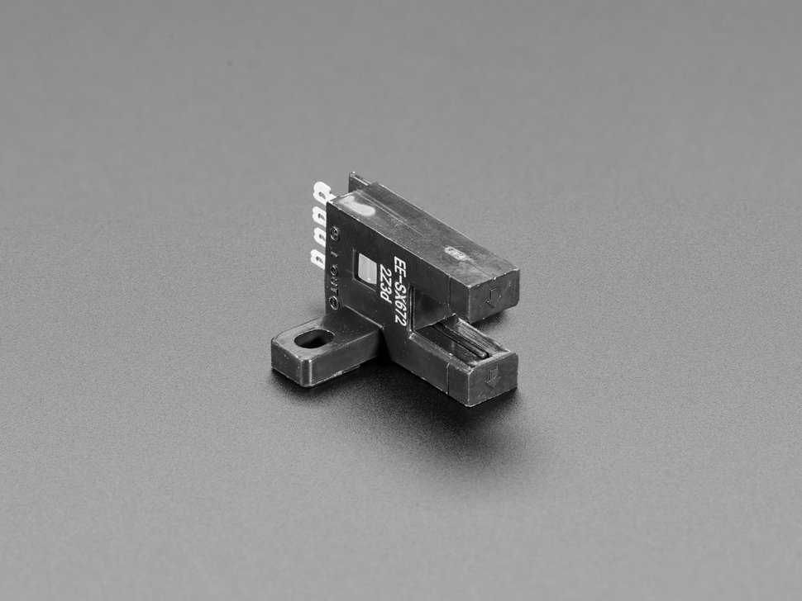
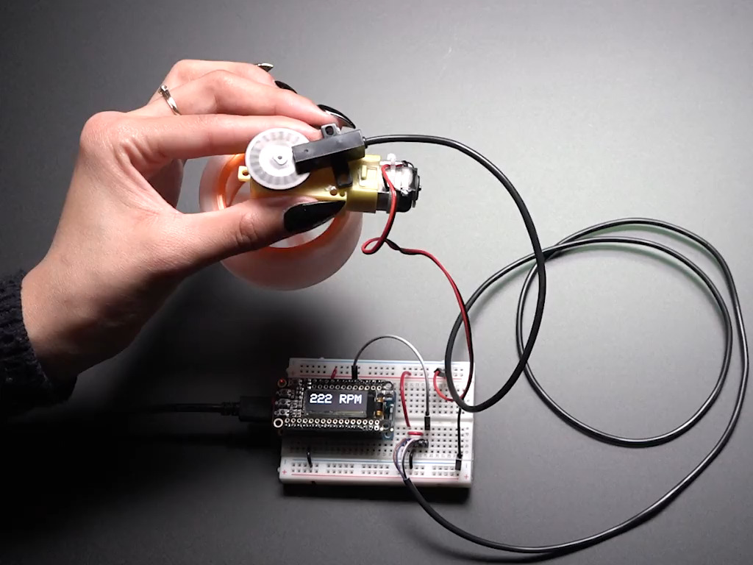
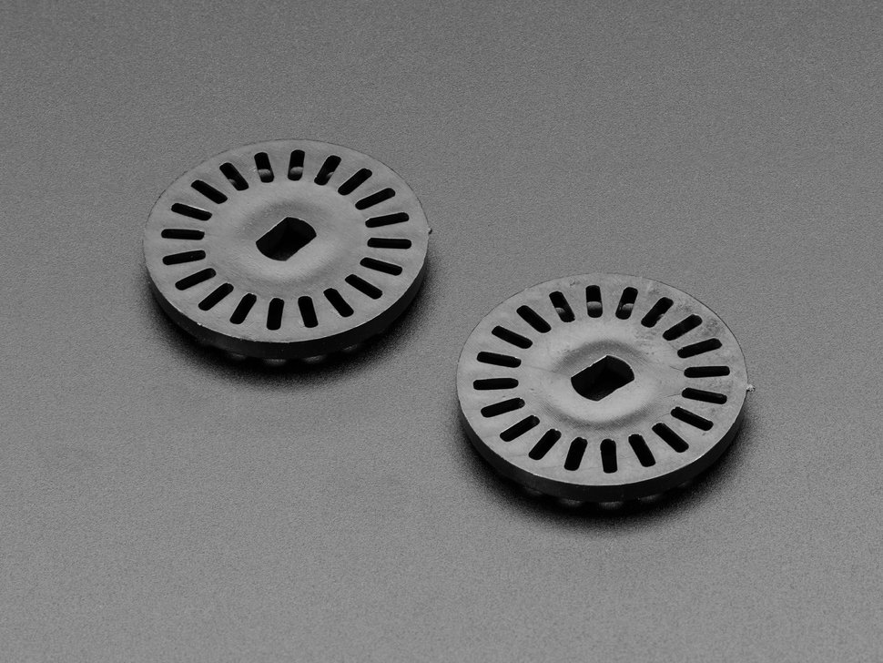
We will use an optical incremental sensor
LED + photosensor → series of pulses as slotted wheel interrupts the beam.
Detect and count pulses in the MCU, convert to RPM.
https://www.adafruit.com/product/3985
https://www.adafruit.com/product/3782
https://www.adafruit.com/product/3985
Notes:
Really important that you get this working before you leave today. This is what we'll use to measure speed. It's the U-shaped object that's wrapped around the slotted wheel. It has an LED on one side and a photosensor on the other side. You'll figure out how to capture those pulses with the microcontroller and count them in Lab 6 and how to convert those counts to the rpm of the motor.

Slide 6
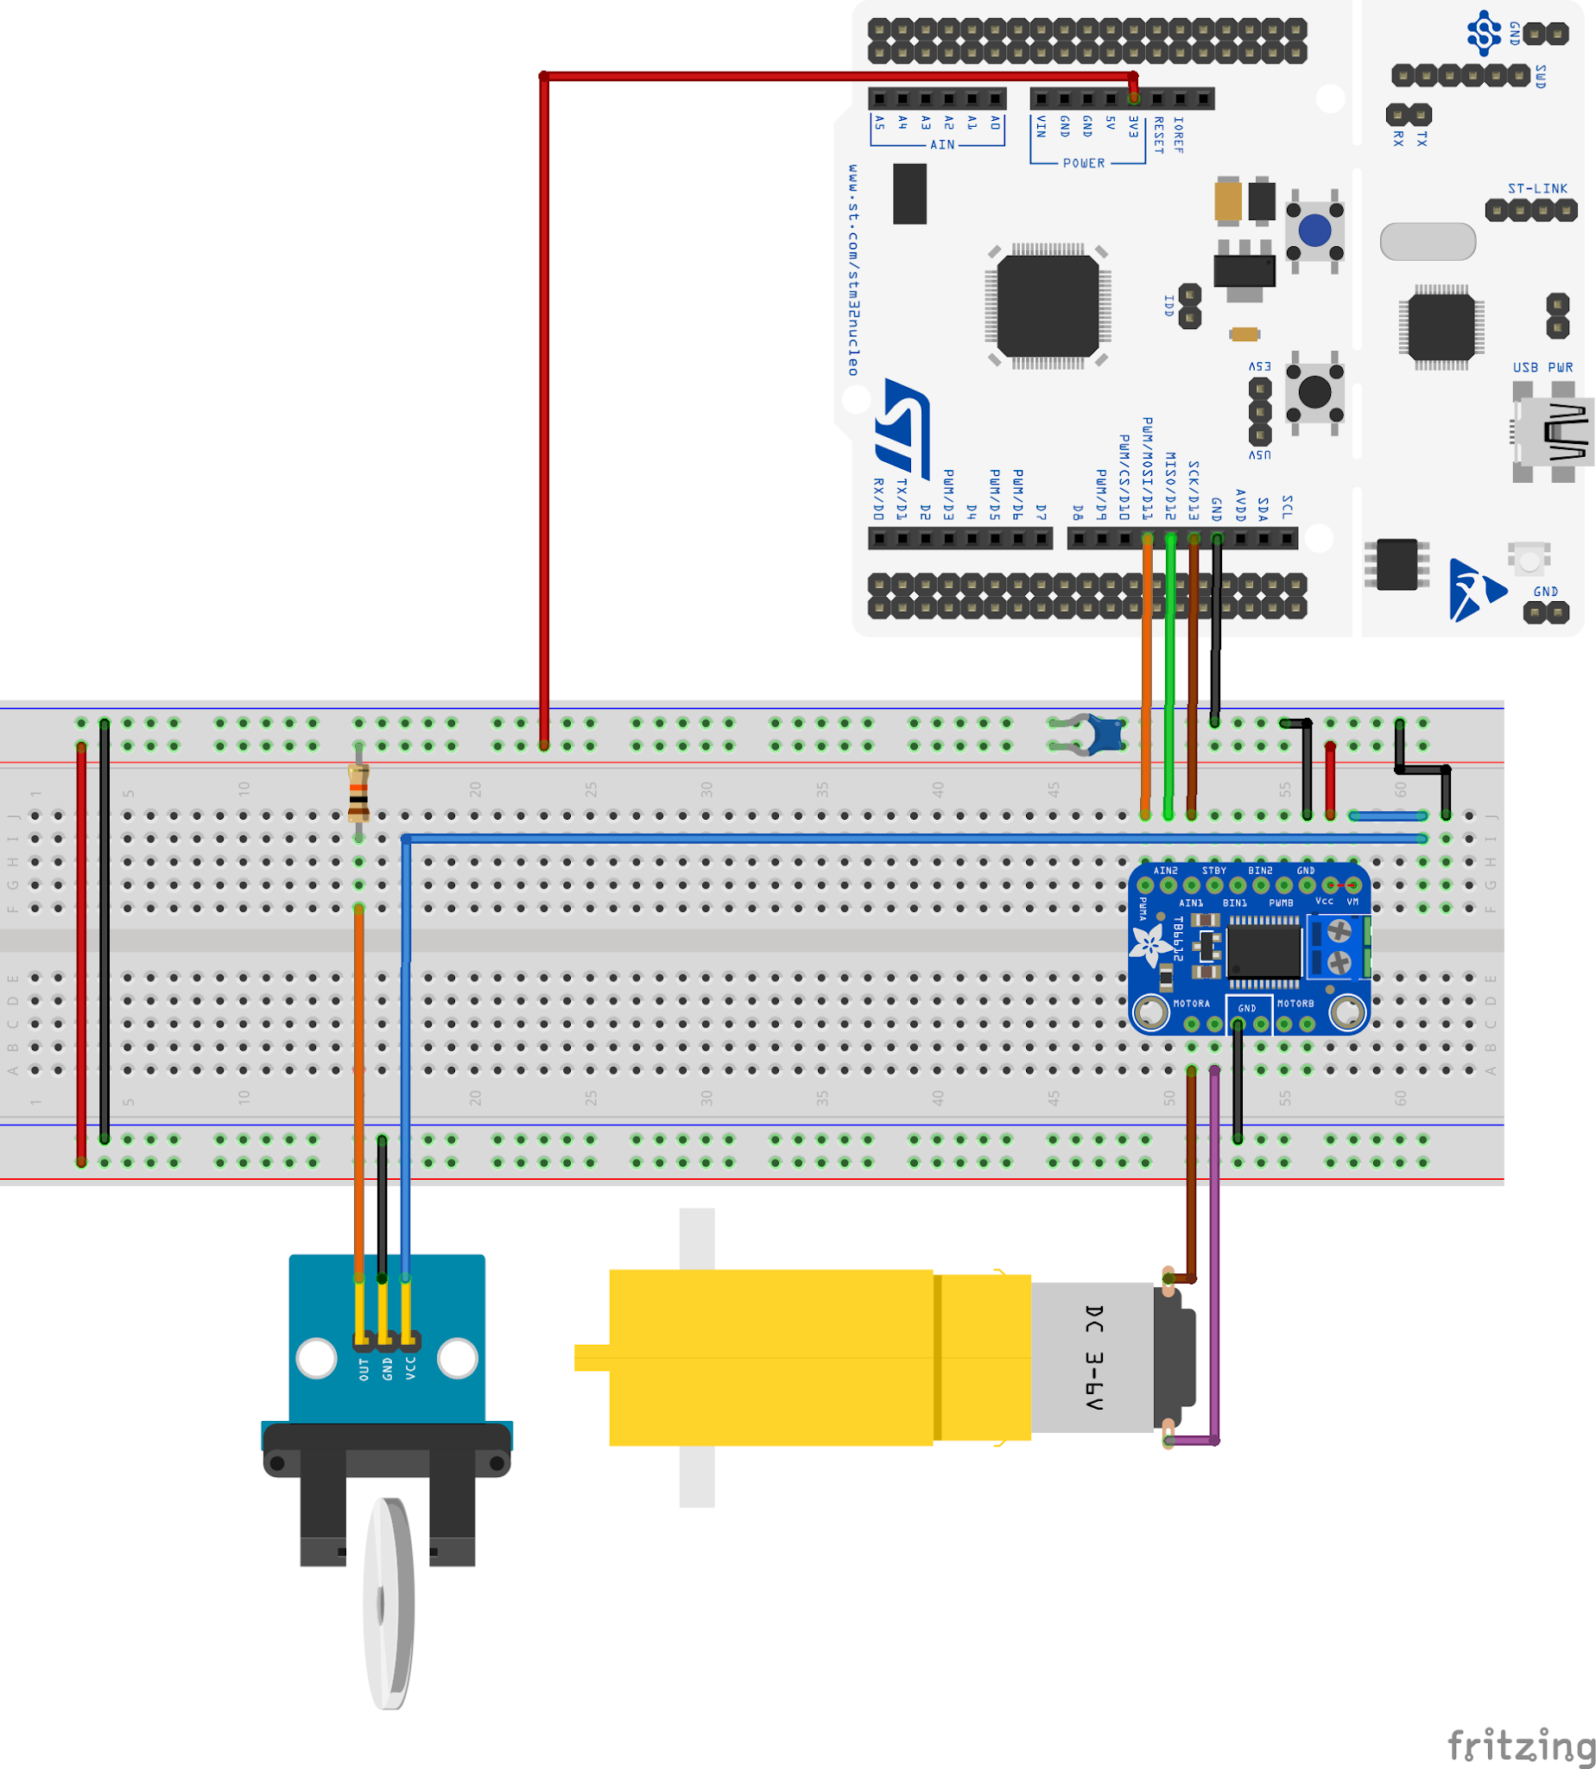
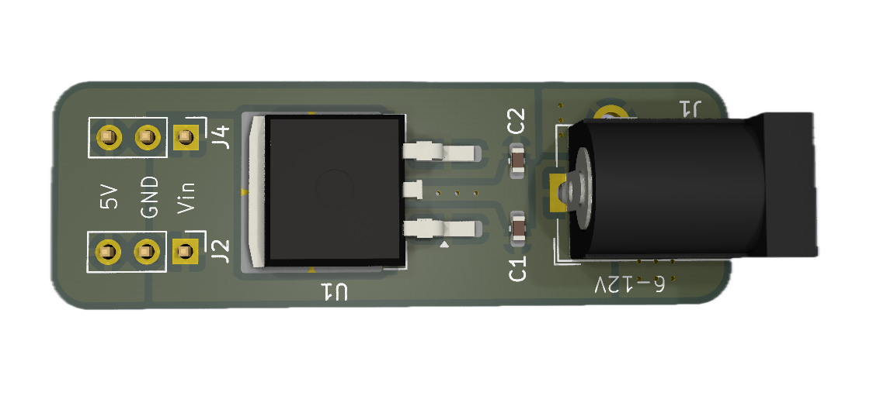
Exercise #1
Wire the photointerrupter to your setup.
Connect the AD2 to monitor the photointerrupter output using Waveforms.
Run TTmotor_ramp.c, observe the photointerrupter signal on the oscilloscope as the motor changes speed.
~10 KΩ pullup
Don't wire the signal wire into the Nucleo yet. We'll observe its signal with the oscilloscope.
Later, when you wire it to the Nucleo you can simply enable the pull-up on that pin.
The photointerrupter needs a 5V voltage supply.
Notes:
Take down the oscilloscope, multimeter, etc. Back to the barebones circuit. Take the three wires out of the photointerruptor and wire them how you see here. Don't wire the signal wire (orange in this picture, white in your setup) into the Arduino yet. For now, just wire power and ground to logic power and ground. We'll observe the signal on the orange wire with Scopy.
You'll need a pullup resistor on the orange wire since the phototransistor doesn't make any current. So run the orange wire onto the breadboard and connect a ~10K pullup resistor between it and the power rail. Then you can measure the voltage at the signal wire with scopy.
When you build this in Lab 6 you'll wire this into the Arduino and so you can just enable the pullup on that Arduino pin.

Slide 7
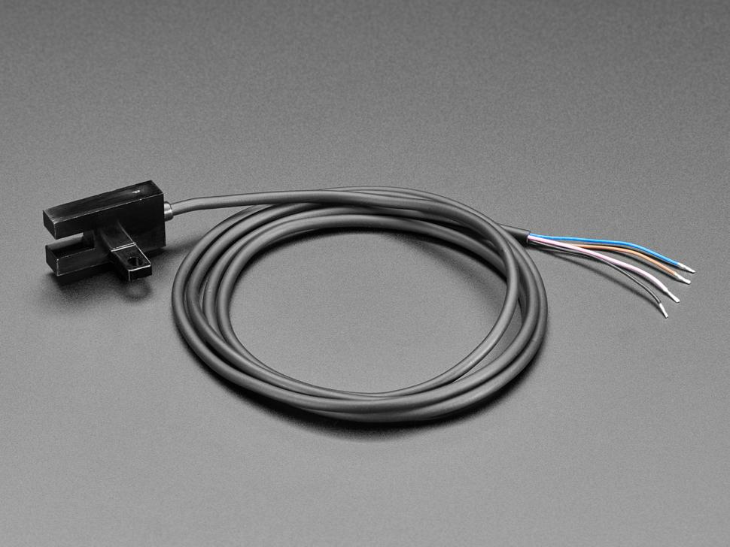
Wiring the Fancy Photointerrupter
Some of you have a photointerrupter with a long cable on it. The signals are listed below (and in the lab handout!)
Brown wire - 5V
Pink wire - Led (optional) to 5V
Black wire - Output
Blue wire - Ground

Slide 8
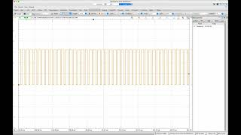
Photointerrupter on the oscilloscope: Motor speed increasing from 30 RPM to 180 RPM
Notes:
https://youtu.be/VH0-zO2LpDc

Slide 9
Exercise #2: Photointerrupter → RPM (on paper)
Discuss, at your table, how to convert the pulse stream from the photosensor into measurements of RPM:
How do you detect the pulses on the microcontroller?
How do you count the pulses?
How do you convert the count to an rpm?

Slide 10
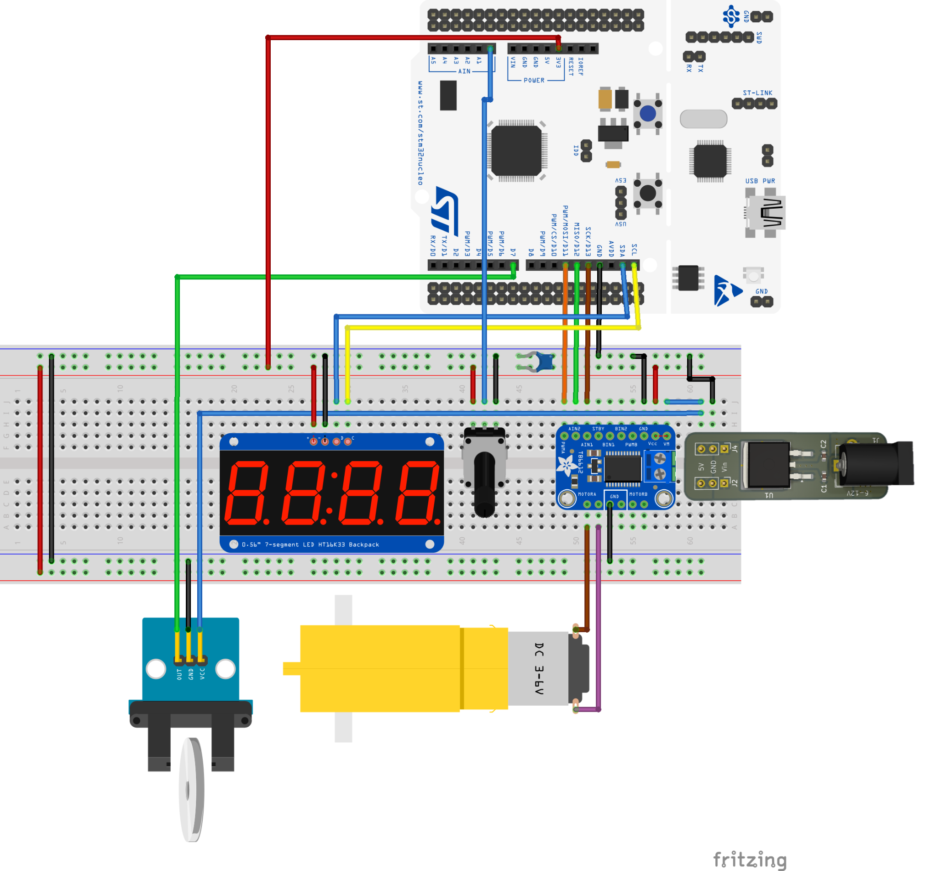
Complete Lab 6 setup
Hardware: today’s setup, plus:
Wire potentiometer to ADC, use ADC value to set motor speed via PWM.
Wire photointerrupter OUT to PA15 (internal or external pullup).
Firmware:
Write device driver for the TB6612.
Write code to convert photointerrupter pulse train to RPM, display on screen.
Add the 7-segment display, show ±RPM.

