Slide 1


Engs 28
Embedded Systems
Day 13

Slide 2
Agenda
Back to I2C!
Accelerometers
Serial (I²C) debugging

Slide 3
Accelerometer LSM303AGR

Slide 4
Accelerometer LSM303AGR
We interact with the accelerometer via I2C (breakout board is wired for this by default). Remember I2C?
Other option: SPI (another serial communication protocol)
It also has a magnetometer but we'll only use the accelerometer in this class.
"I still have my 7-segment display connected to the I2C pins of my Nucleo. Do I need to take that down? What if I wanted to use both the accelerometer and the 7-segment display in one project?"

Slide 5
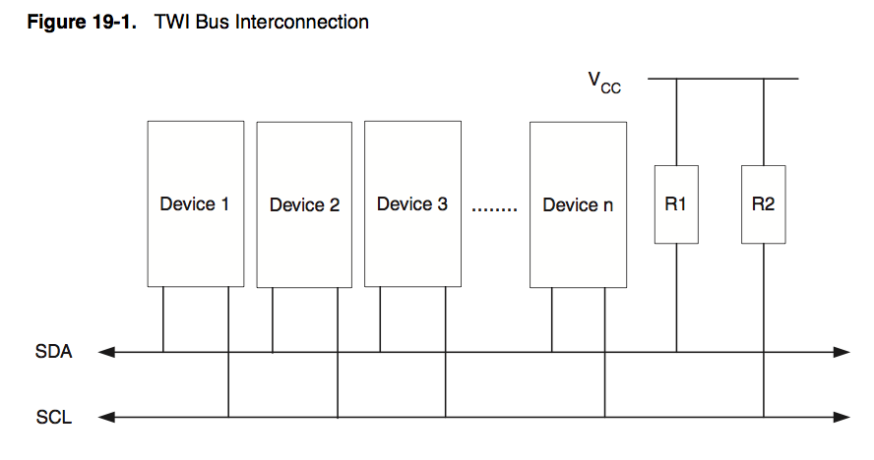
I²C
Pullup resistors (wires idle HIGH)
Serial DAta (bidirectional)
Serial CLock (generated by bus controller device)
Serial clock, generated by bus controller, synchronizes data recovery.
Common clock line (SCL) and bidirectional data line (SDA). Bus controller and the peripheral device take turns writing and reading.
All peripherals use the same two wire (I2C) bus. Each peripheral has its own bus address.
Each packet of data from the controller begins with the address of the intended destination device.
Notes:
How do you tell the devices apart? They all share the same lines.
One device is in charge: the Controller device. The others are peripheral devices.
Controller is in charge. It initiates contact with the other device is wants to talk to and demands from the device data to talk back.
Each device has an address, a 7-bit number, so that the controller device can address it directly.
Controller initiates communication with that device by sending its address. All devices are listening. The device that recognizes its own address knows it's being spoken to. It then acknowledges by talking back 'yes what do you want'.
So devices have to be able to switch back and forth between sending and receiving. Only one device can talk at a time.

Slide 6
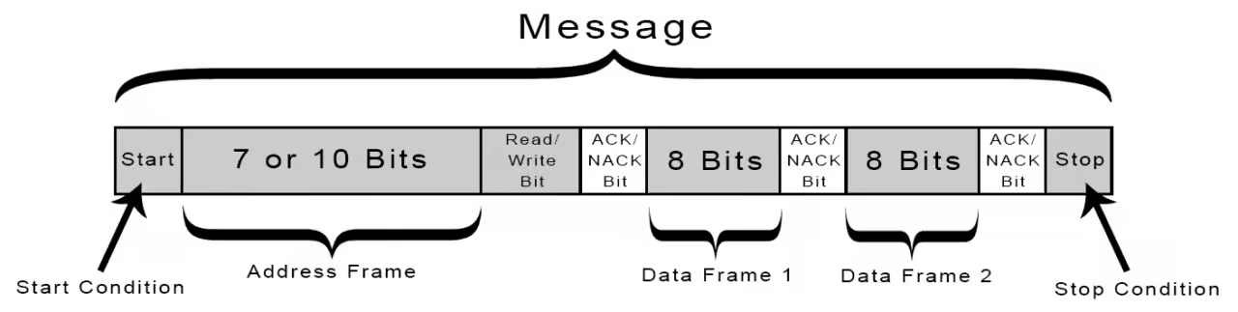
I²C protocol
Toward inclusive language:
Update the terms "master/slave" to "controller/target".
SCL and SDA idle high, because of the pullups.
START: Controller asserts control by pulling SDA low while SCL is high. SCL starts running.
Address + Read/Write: Controller transmits device address (7 bits) followed by 0 to command a write, or 1 to command a read. SDA changes only while SCL is low.
ACK: Controller lets go of data line; peripheral that recognizes its address acknowledges by sending a 0 back. Other devices on bus don’t respond. If nobody responds, the data line remains high (called NACK).
DATA: Controller sends a byte, listens for ACK or NACK, or receives a byte, and replies with ACK or NACK.
STOP: Controller returns SDA to high while SCL is high, then both remain idle.
Notes:
Here is the protocol.
Data and clock lines are held high when nobody is talking. When controller wants to initiate communication with a peripheral device it pulls the data line low (called a start condition). That starts the clock running. Then, synchronously with the clock it sends out the device's 7-bit address that indicates to whom it wants to talk, followed by a 0 or a 1, depending on whether it wants to send data to the device (0) or read data from the device (1). Now 8 bit have been sent. Now the controller flips the wire to receiving. It listens for the ACK (acknowledge) bit from the device it spoke to. If there is a device with that address on the bus, that device will send a 0 back (ACK). If the controller sees the 0 it knows that someone is out there. If not it knows that there is nobody out there.
Next, controller sends some kind of command to the peripheral device, telling it what it wants it to do. Then it flips the wire around to look for the ACK. Alternatively, the controller may wish to read data from the device. It indicates that by adding a 1 to the address. Now, when the byte comes back from the device, the controller sends back the ACK. Whoever talks, waits for the ACK from the one who is spoken to.
Once everything is complete (maybe multiple things have happened, multiple pieces of data transmitted, etc), the controller indicates that things are done by sending a STOP condition.
The beauty is that this is all built into HARDWARE inside the I2C module. The I2C submodule has the appropriate registers that you set and read. But other than that it's all done in hardware - YOU don't have to think about "do I need to send a bit or not?". YOU are responsible for knowing (from the datasheet) what you peripheral device's capabilities are.

Slide 7
I²C library
Recall I2C Library Functions:
/* Configure I2C pins, initialize bus speed */
void i2c1_init(void);
/* Write one byte to target */
void i2c1_byteWrite(uint8_t deviceAddr, uint8_t data);
/* Read one byte from a target */
void i2c1_byteRead(uint8_t deviceAddr, uint8_t *data);
/* Write one or more bytes to a memory location within target */
void i2c1_memWrite(uint8_t deviceAddr, uint8_t registerAddr,
uint8_t nbytes, uint8_t *data);
/* Read one or more bytes from a memory location within target */
void i2c1_memRead(uint8_t deviceAddr, uint8_t registerAddr,
uint8_t nbytes, uint8_t *data);
Notes:
All these will be given to you. To use them properly we still need to understand how they work.

Slide 8
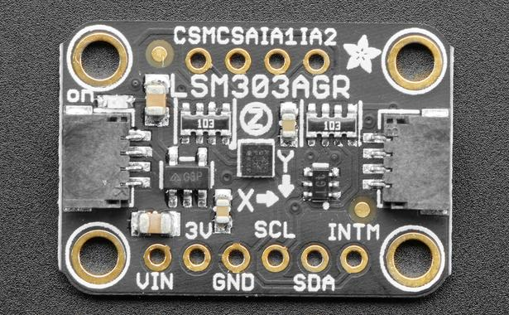
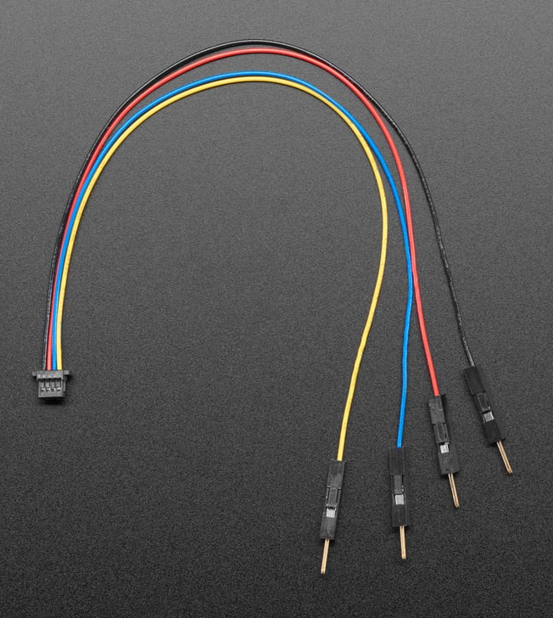
LSM303AGR accelerometer with STEMMA connector
GND: black
VIN: red
SCL: yellow
SDA: blue
3.3V-5V GND SCL SDA
It's an I2C device! Remember I2C?

Slide 9
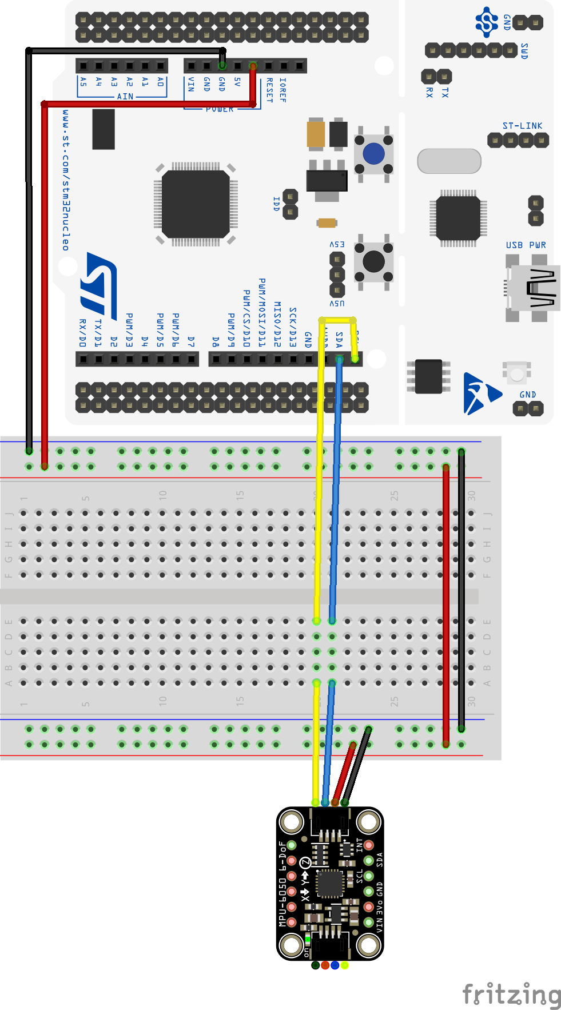
Test code: whoami_test.c
Build the circuit as seen in the picture.
Make a copy of your TemplateProject, call the new one “Accelerometer”.
Download whoami_test.c from Canvas and paste it in the Src folder of your new project. Build and upload.
The accelerometer has a special register called WHOAMI that contains the value 0x33. If you read the WHOAMI register and get the right result, you can be confident in your I²C setup.
Run CoolTerm to make sure it's working.

Slide 10
Test code: whoami_test.c
#define LSM303_ADDRESS_ACCEL (0x32 >> 1) // 7-bit address 0b0011001
#define LSM303_WHO_AM_I_A 0x0F // default value: 00110011
int main(void) {
uint8_t who_am_i = 0;
i2c1_init();
uart2_init();
printf("LSM303AGR initialization test \n\r");
while(1) {
who_am_i = lsm303_AccelRegisterRead(LSM303_WHO_AM_I_A);
if( who_am_i == 0x33 ) {
printf("Accelerometer initialized! \n\r");
} else {
printf("Could not connect to accelerometer \n\r");
}
delay_ms(1000);
}
return 0;
}

Slide 11

Test code: whoami_test.c
uint8_t lsm303_AccelRegisterRead(uint8_t RegisterAddress) {
uint8_t data;
i2c1_memRead(LSM303_ADDRESS_ACCEL, RegisterAddress, 1, &data);
return data;
}

Slide 12
Recall: i2c1_memRead()
void i2c1_memRead(uint8_t deviceAddr, uint8_t registerAddr, uint8_t nbytes, uint8_t *data) {
// Ping target address for writing 1 byte (the register address)
I2C1->CR2 = (deviceAddr<<1) // target address
| (1U << I2C_CR2_NBYTES_Pos) // for registerAddr
| I2C_CR2_AUTOEND // Send Stop condition after transfer
| I2C_CR2_START; // Send Start condition
while( !(I2C1->ISR & I2C_ISR_BUSY) ); // Wait until Start is received
if( !(I2C1->ISR & I2C_ISR_NACKF) ) { // Make sure ACK received
// Send register address
while( !(I2C1->ISR & I2C_ISR_TXIS) ); // Wait for Tx to be ready
I2C1->TXDR = registerAddr; // Send register address
}
// Restart, with read request for n bytes
I2C1->CR2 = (deviceAddr<<1) // target address
| (nbytes << I2C_CR2_NBYTES_Pos) // will read n bytes
| I2C_CR2_RD_WRN // ping for reading
| I2C_CR2_AUTOEND // Send Stop condition after transfer
| I2C_CR2_START; // Send Start condition
while( !(I2C1->ISR & I2C_ISR_BUSY) ); // Wait until Start is received
// Read the data
if( !(I2C1->ISR & I2C_ISR_NACKF) ) { // Make sure ACK received
for(uint8_t i=0; i<nbytes; i++) {
while( !(I2C1->ISR & I2C_ISR_RXNE) ); // Wait for Rx to be ready
data[i] = I2C1->RXDR; // Read the data
}
}
}

Slide 13
Debugging the I²C bus with an oscilloscope

Slide 14
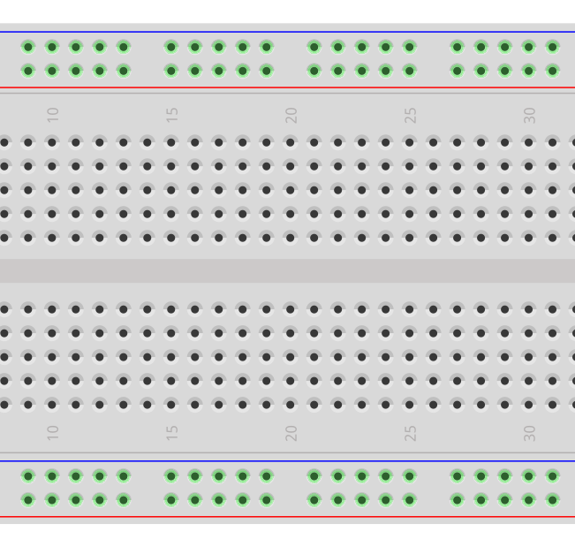
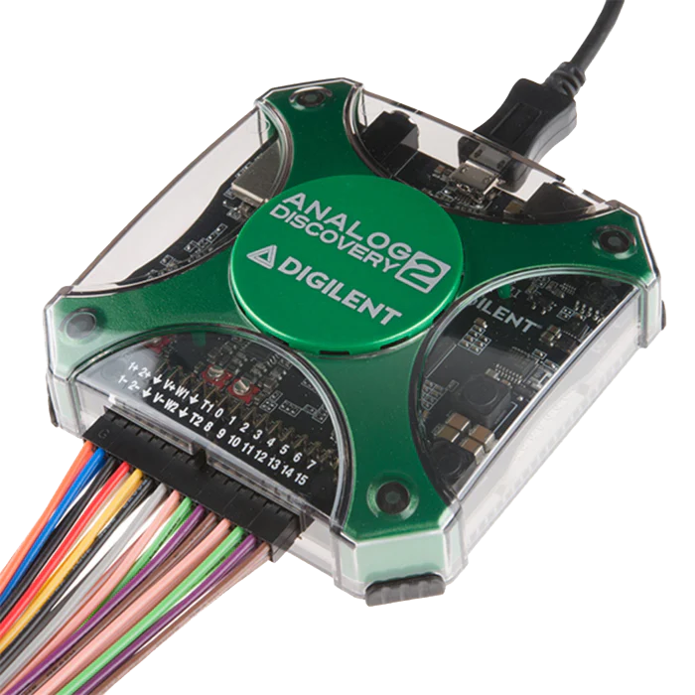
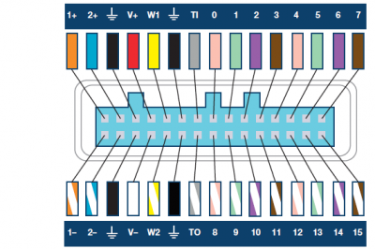
Wire the AD2 to your setup.
Use AD2 digital channels. Wire 3 leads as follows:
GND (black) to ground (duh) D0 (pink) to SDA D1 (green) to SCL
Connect me!
Notes:
Just a few minutes- then spend time on the activity before making sure their setups work

Slide 15
Wire the AD2 to your setup.
Use AD2 digital channels (larger flying lead bundle). Wire 3 leads as follows:
GND (black) to ground (duh) D0 (pink) to SDA D1 (green) to SCL
on the breadboard.

Slide 16
What do you expect to see on the logic analyzer when you run whoami_test.c?
#define LSM303_ADDRESS_ACCEL (0x32 >> 1)
#define LSM303_WHO_AM_I_A 0x0F // default value: 00110011
int main(void) {
uint8_t who_am_i = 0;
i2c1_init();
uart2_init();
printf("LSM303AGR initialization test \n\r");
while(1) {
who_am_i = lsm303_AccelRegisterRead(LSM303_WHO_AM_I_A);
if( who_am_i == 0x33 ) {
printf("Accelerometer initialized! \n\r");
} else {
printf("Could not connect to accelerometer \n\r");
}
delay_ms(1000);
}
return 0;
}
uint8_t lsm303_AccelRegisterRead(uint8_t RegisterAddress) {
uint8_t data;
i2c1_memRead(LSM303_ADDRESS_ACCEL, RegisterAddress, 1, &data);
return data;
}
Notes:
What you should see is you get a NACK back instead of an ACK.
You may have to press single and then hit reset on the Arduino to catch that first interaction (I really don't think so since it's part of the while loop???).

Slide 17
Reminder: i2c1_memRead()
void i2c1_memRead(uint8_t deviceAddr, uint8_t registerAddr, uint8_t nbytes, uint8_t *data) {
// Ping target address for writing 1 byte (the register address within target from which to read)
I2C1->CR2 = (deviceAddr<<1) // target address
| (1U << I2C_CR2_NBYTES_Pos) // for registerAddr
| I2C_CR2_AUTOEND // Send Stop condition after transfer
| I2C_CR2_START; // Send Start condition
while( !(I2C1->ISR & I2C_ISR_BUSY) ); // Wait until Start is received
// Send register address
if( !(I2C1->ISR & I2C_ISR_NACKF) ) { // Make sure ACK received so we are actually talking
while( !(I2C1->ISR & I2C_ISR_TXIS) ); // Wait for Tx to be ready
I2C1->TXDR = registerAddr; // Send register address
}
// Restart, with read request for n bytes
I2C1->CR2 = (deviceAddr<<1) // target address
| (nbytes << I2C_CR2_NBYTES_Pos) // will read n bytes
| I2C_CR2_RD_WRN // ping for reading
| I2C_CR2_AUTOEND // Send Stop condition after transfer
| I2C_CR2_START; // Send Start condition
while( !(I2C1->ISR & I2C_ISR_BUSY) ); // Wait until Start is received
// Read the data
if( !(I2C1->ISR & I2C_ISR_NACKF) ) { // Make sure ACK received so we are actually talking
for(uint8_t i=0; i<nbytes; i++) {
while( !(I2C1->ISR & I2C_ISR_RXNE) ); // Wait for Rx to be ready
data[i] = I2C1->RXDR; // Read the data
}
}
}

Slide 18
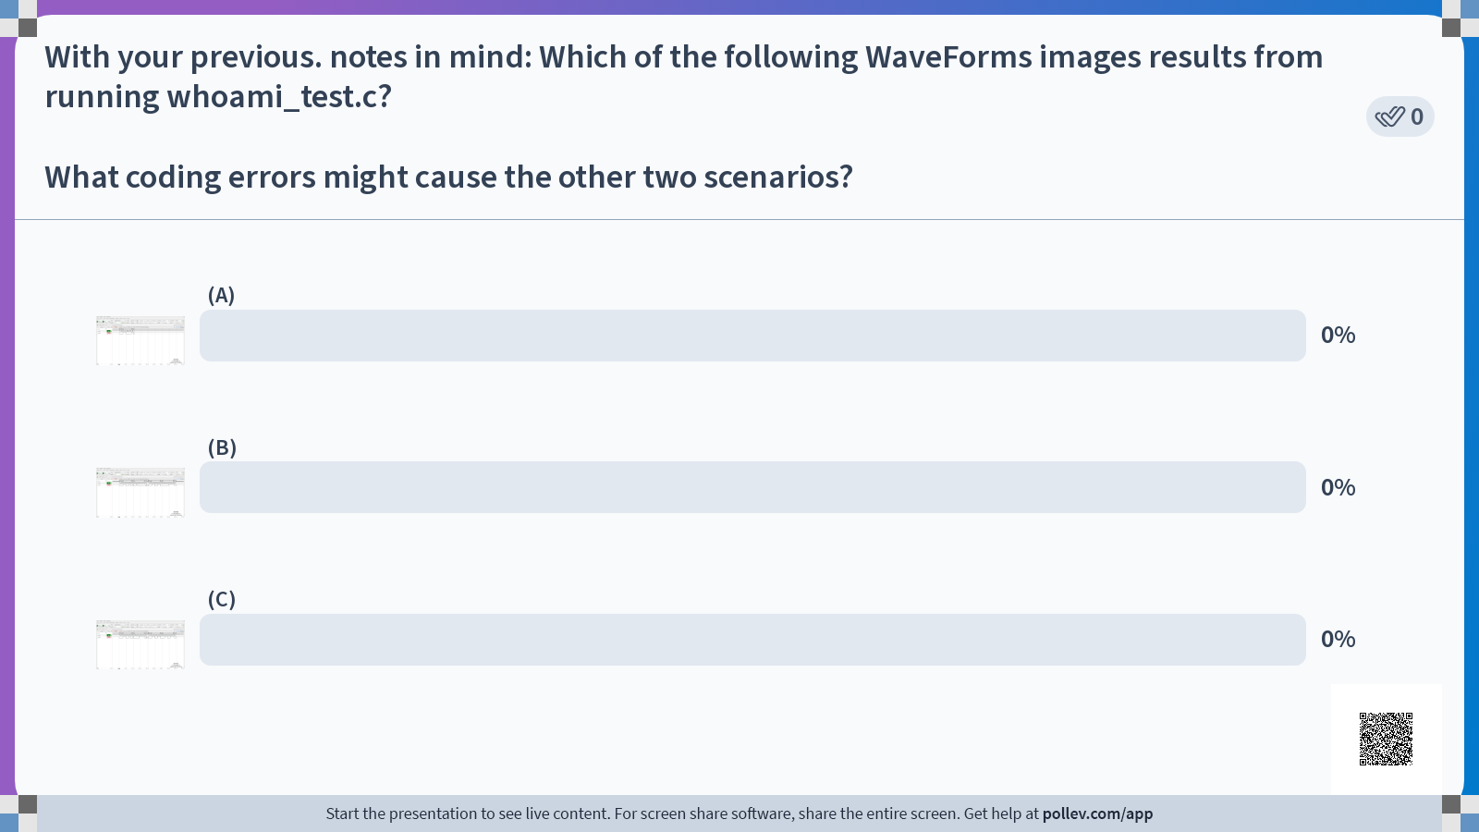

Slide 19
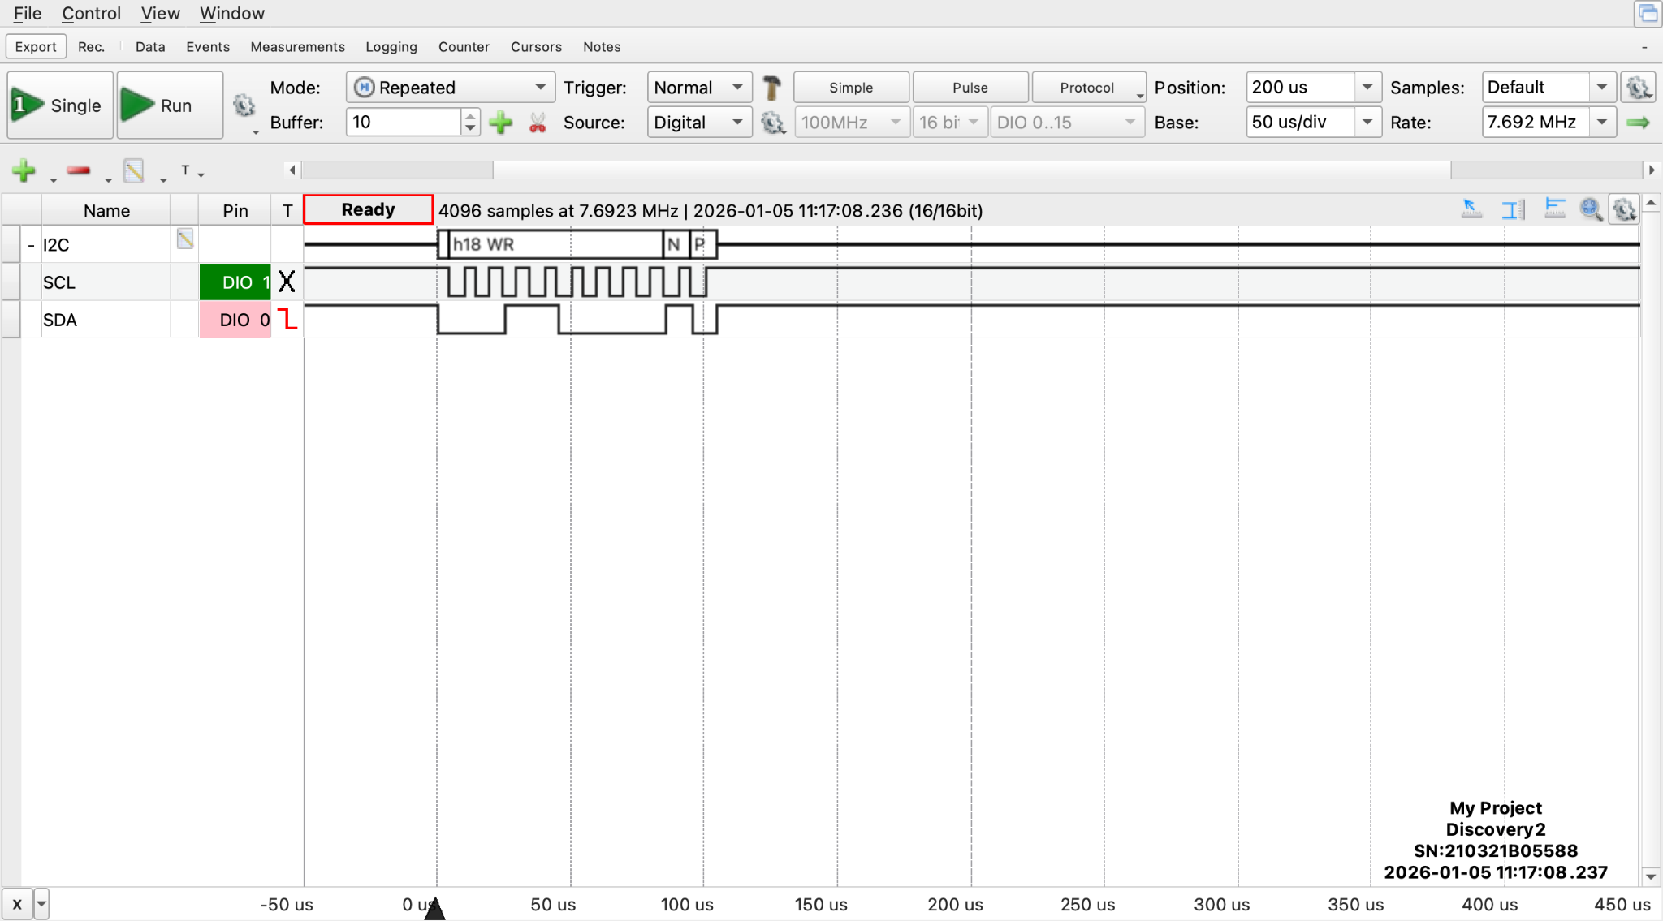
Waveforms Image A
Notes:
Incorrect address: results in NACK after the address.

Slide 20
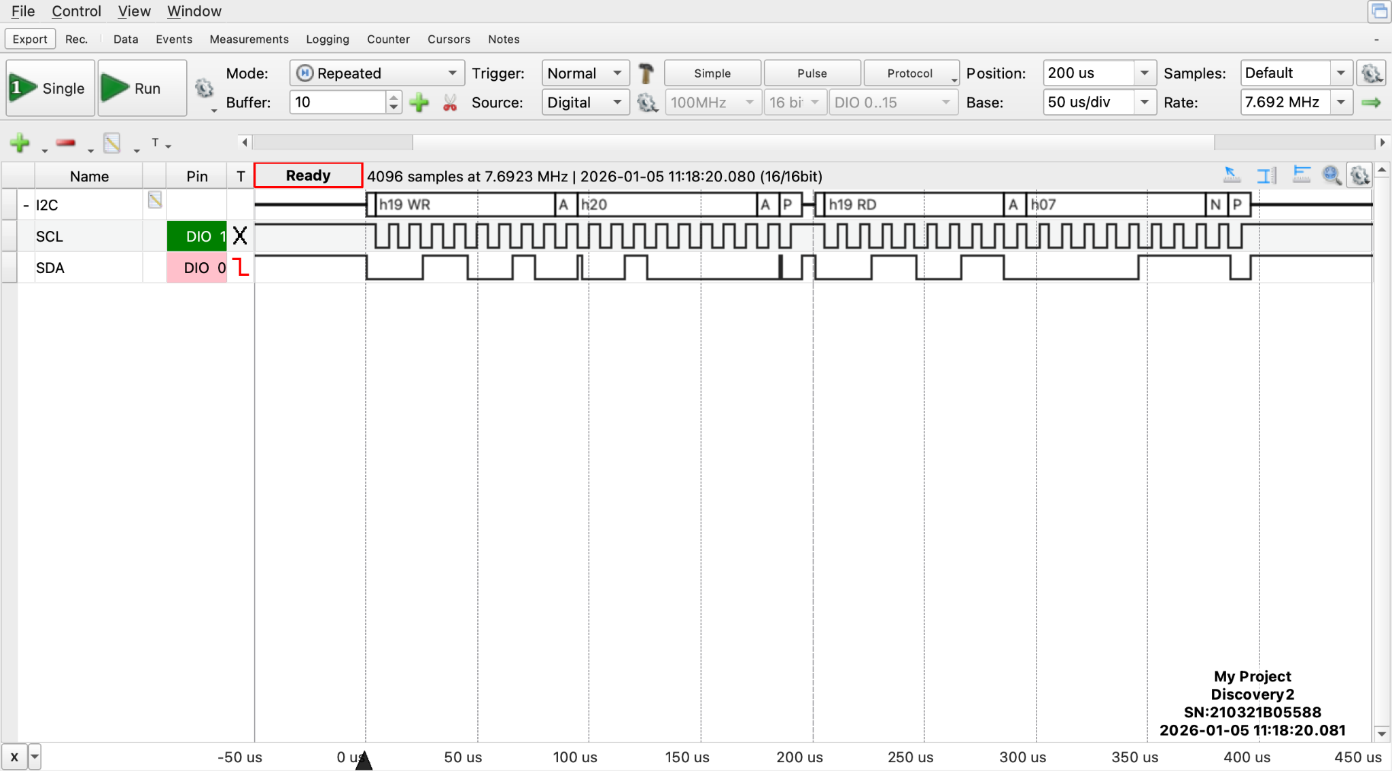
Waveforms Image B
Notes:
Correct address, incorrect register address: results in the value that's stored at that incorrect register address to be returned, and not 0x33.

Slide 21

Waveforms Image C
Notes:
Correct address, correct register address, see 0x33 being returned.

Slide 22
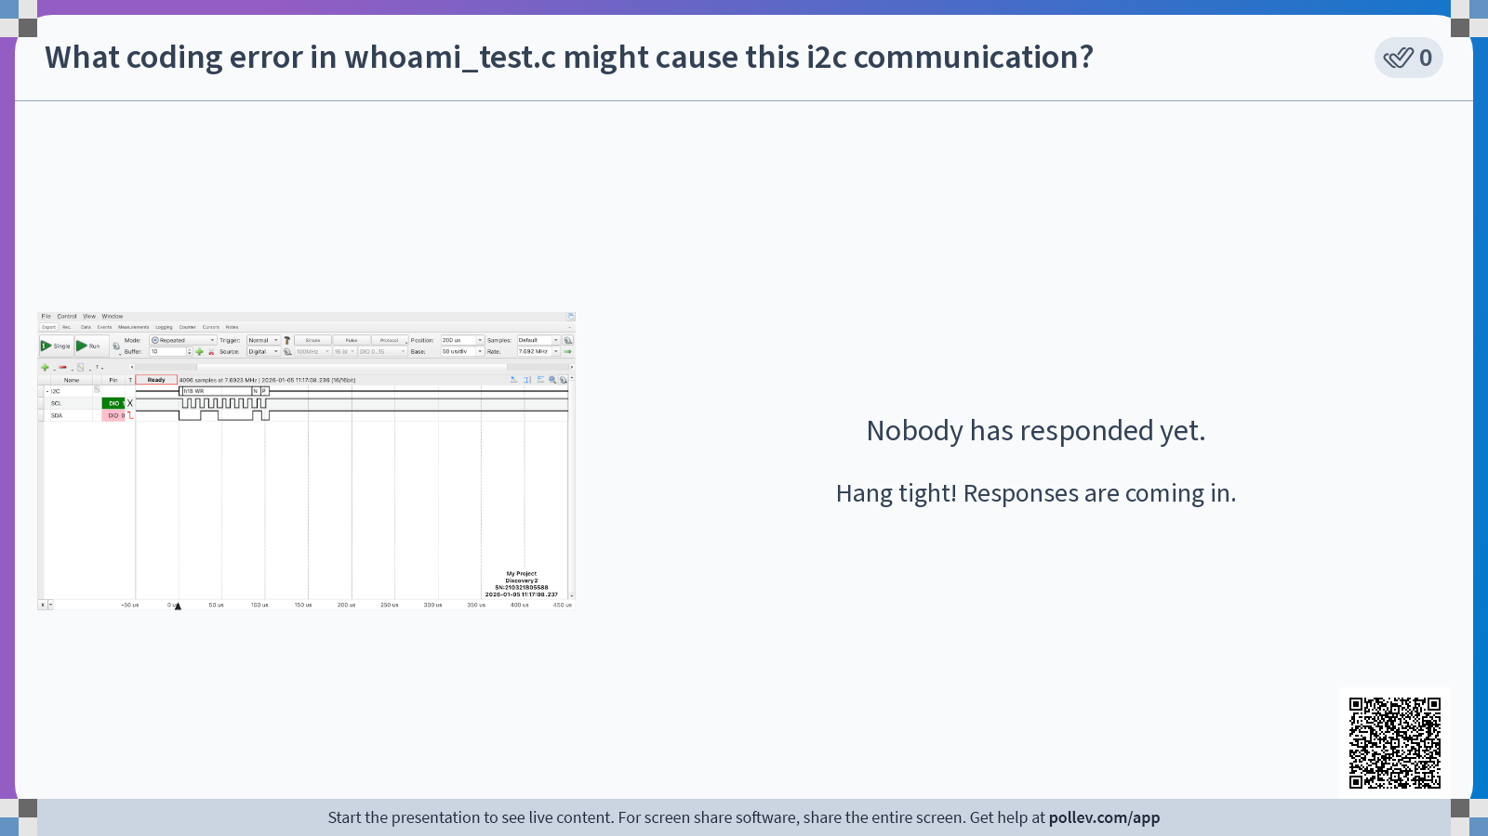

Slide 23
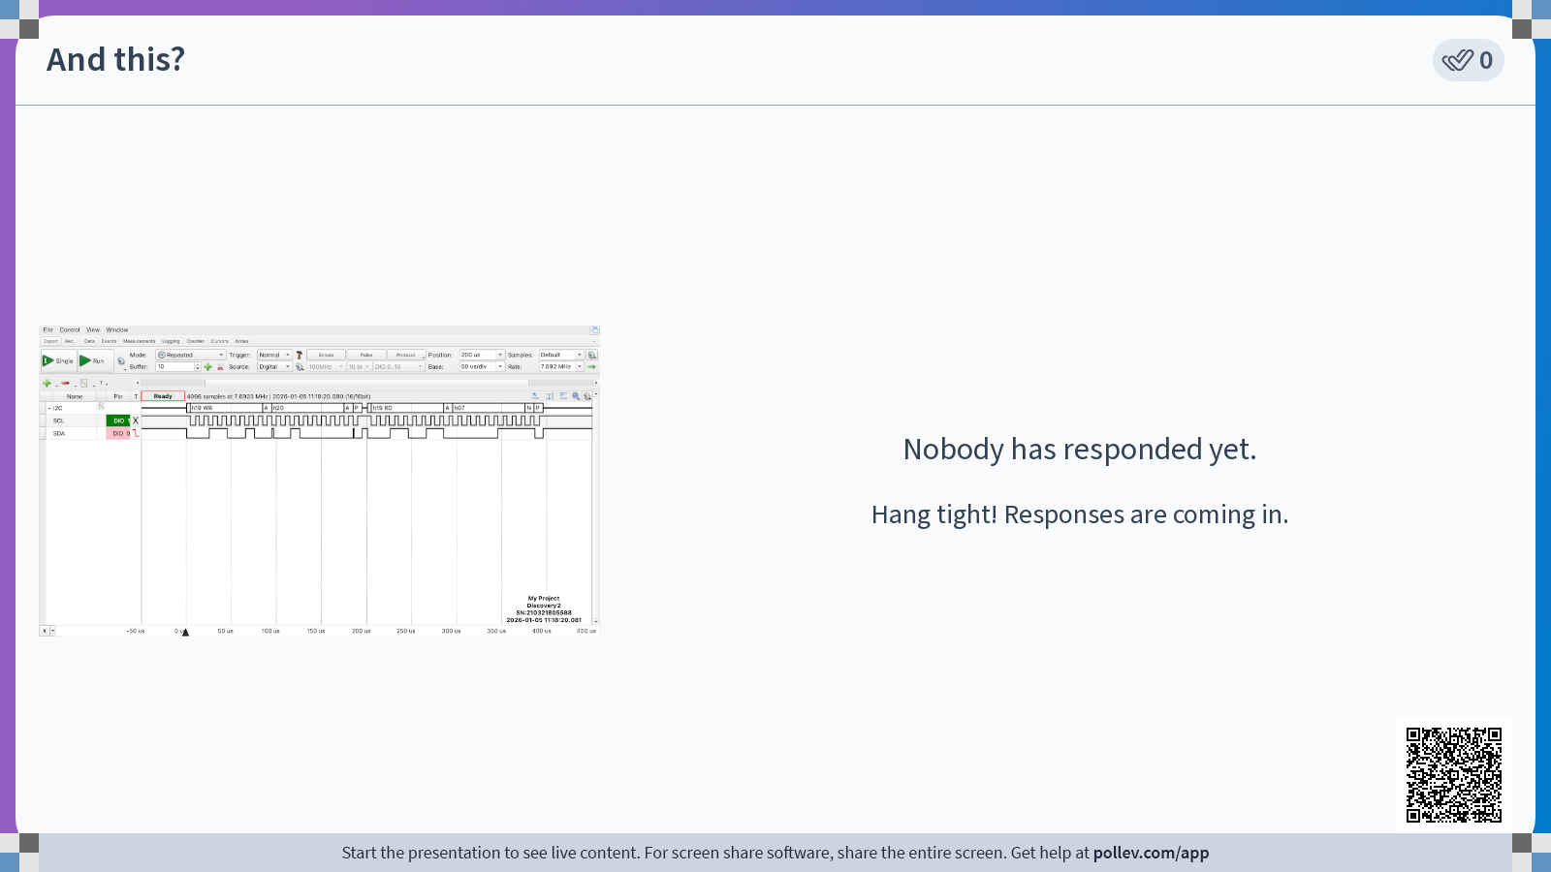

Slide 24
Digging Deeper
Why is the device address showing up as 0x19, even though it is 0x32?
Who is sending that address?
Who is sending the ACK after the address has been sent?
Why are there two separate times that this address is being transmitted?
Where are we telling the accelerometer which register to read from?
Where does the accelerometer put the register contents on the data line?
Notes:
0x32 >> 1 = 0b00110010 >> 1 = 0b00011001 = 0x19.

Slide 25
Are you seeing the correct Waveforms image?
Use AD2 digital channels (larger flying lead bundle). Wire 3 leads as follows:
GND (black) to ground (duh) D0 (pink) to SDA D1 (green) to SCL
Connect me!
Notes:
Just a few minutes- then spend time on the activity before making sure their setups work

Slide 26
Accelerometer device driver

Slide 27
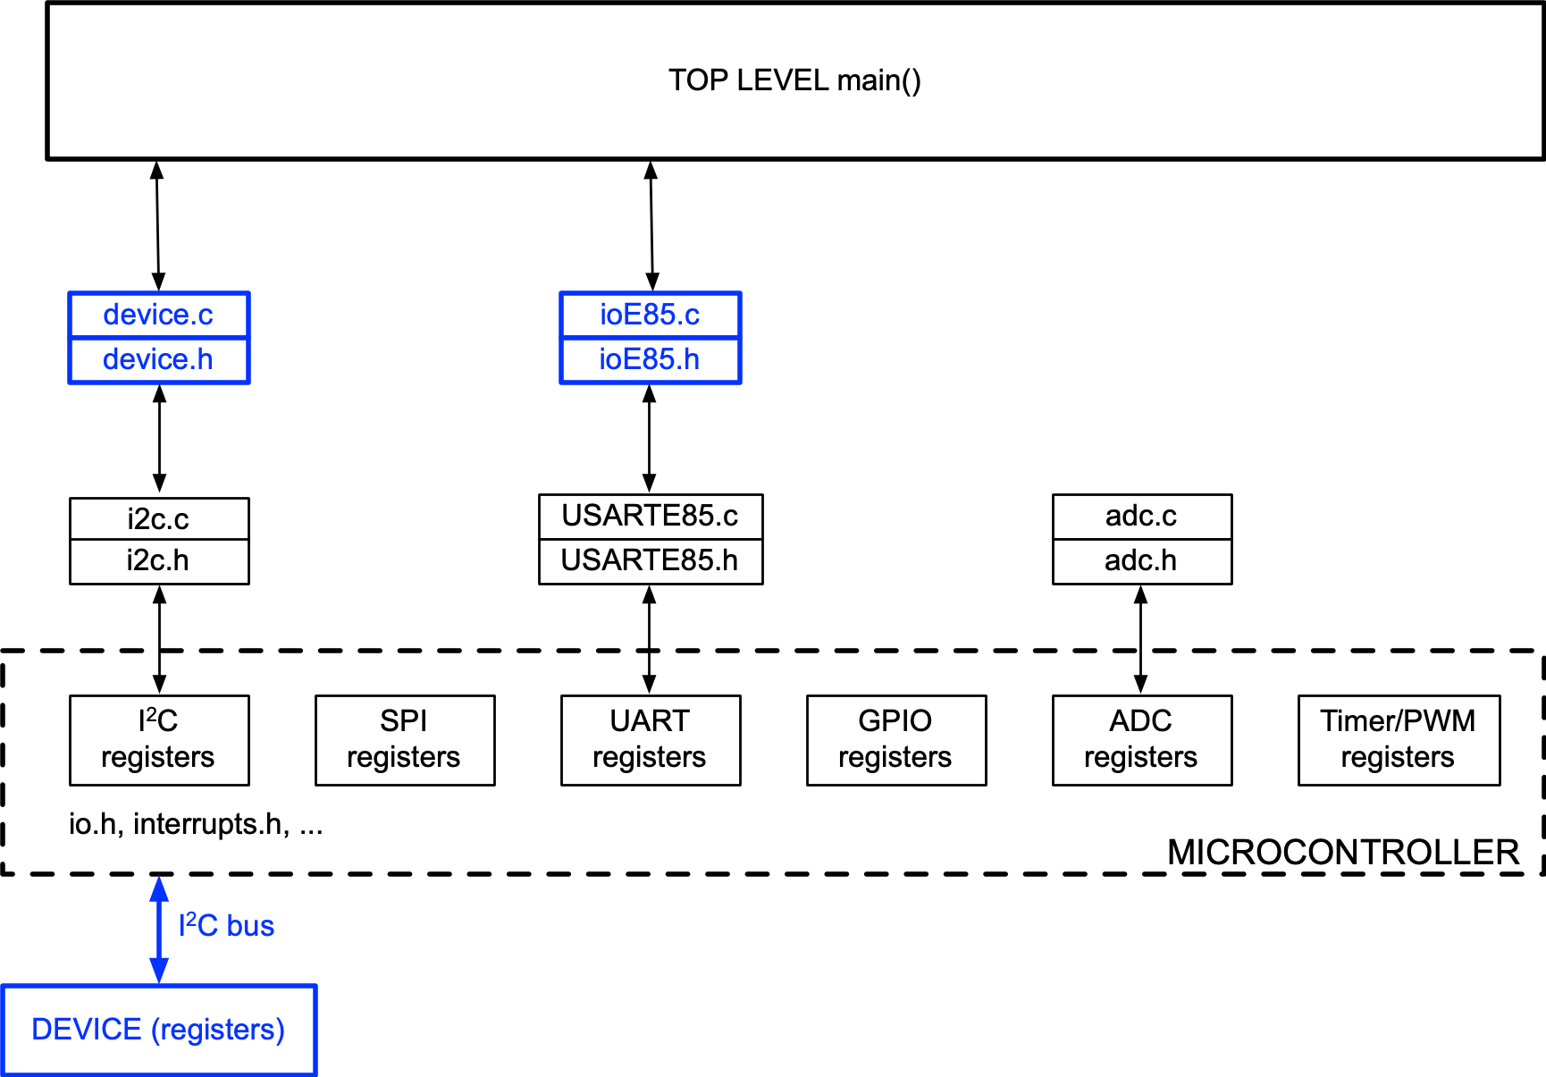
Firmware design layers
TOP LEVEL CODE
Access devices via drivers / APIs
Don’t directly access device registers or machine registers.
DEVICE DRIVERS / APIs
Access device registers via interface drivers
Don’t directly access machine registers
stdio.c
stdio.h
INTERFACE DRIVERS Access machine registers
uart.c
uart.h
PHYSICAL CONNECTIONS (I/O PORTS)
Notes:
You'll build the device driver!

Slide 28
Writing a device driver
From data sheet, understand the basic I²C transfers for reading and writing.
From the data sheet, #define basic addresses / commands
Define functions to implement actions
Write functions using i2c functions to send commands & data
Devise Unit Tests to confirm the drivers are working
Done (see lsm303agr.h on Canvas).
Notes:
Definitely look at .h file and compare with the table of addresses in the data sheet.
Define the functions that you want the accelerometer to do.
Functions will be implemented using the i2c primitive functions.

Slide 29
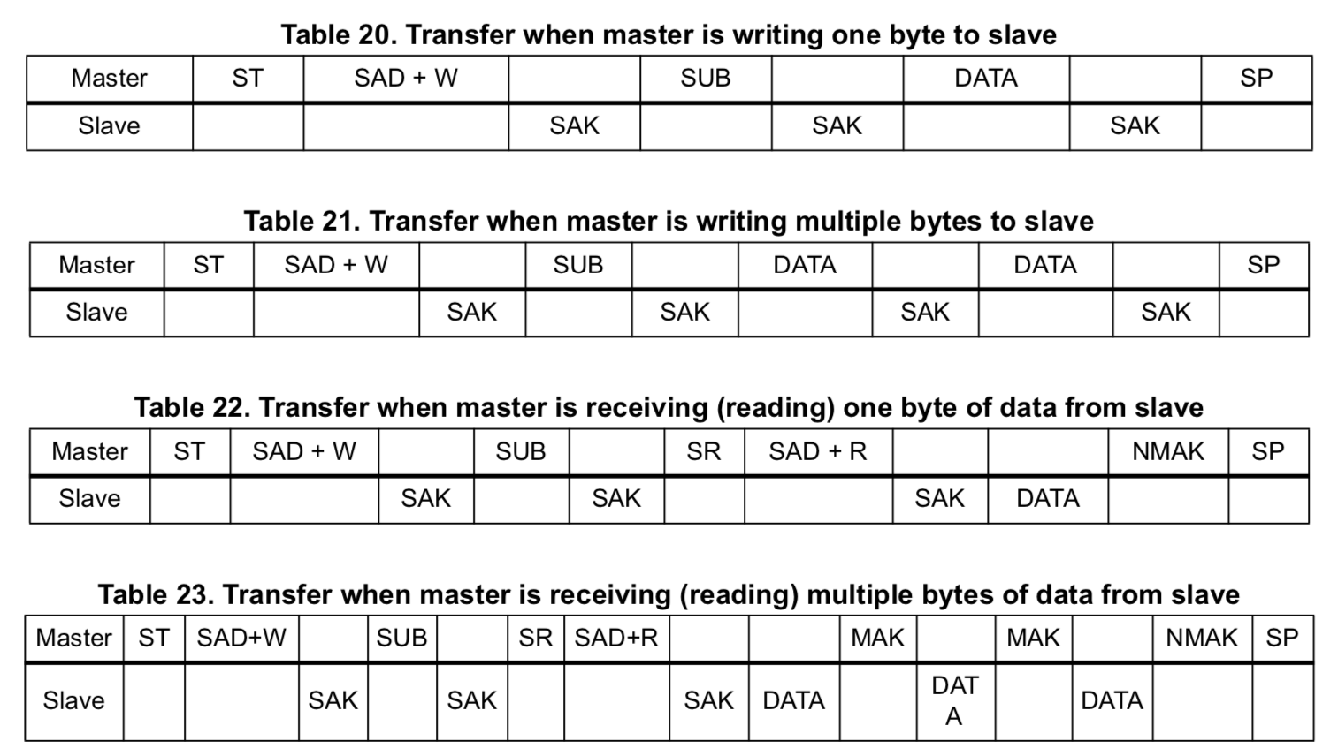
I²C transfers, Controller (MCU) ⟷ Peripheral (sensor)
start sensor addr ACK subaddr ACK byte ACK stop
Subaddress autoincrements for multiple writes, see Sec 6.1.1
start sensor addr ACK subaddr ACK start sensor addr ACK byte NACK stop
Subaddress autoincrements for multiple reads, see Sec 6.1.1
Notes:
These are the basic operations. Have already done first and third.
With the accelerometer, need to read a bunch of bytes, so there is a way to read multiple bytes of data all in one fell swoop (just like we could write multiple bytes to the display driver for the 7-seg display).
Address plus write, subaddress, restart, address plus read, get data, you ack, it sends more data, you ack again, it sends data, etc, until you send noAck.

Slide 30
Device header file, lsm303agr.h
Includes macros and addresses for all the registers, e.g.,
#define LSM303_ADDRESS_ACCEL (0x32 >> 1) // append r/w bit
// NAME ADDR DEFAULT TYPE
#define LSM303_WHO_AM_I_A 0x0F // 00110011 r
#define LSM303_CTRL_REG1_A 0x20 // 00000111 rw
#define LSM303_CTRL_REG2_A 0x21 // 00000000 rw
#define LSM303_CTRL_REG3_A 0x22 // 00000000 rw
#define LSM303_CTRL_REG4_A 0x23 // 00000000 rw
#define LSM303_CTRL_REG5_A 0x24 // 00000000 rw
#define LSM303_CTRL_REG6_A 0x25 // 00000000 rw
#define LSM303_REFERENCE_A 0x26 // 00000000 r
#define LSM303_STATUS_REG_A 0x27 // 00000000 r
#define LSM303_OUT_X_L_A 0x28
#define LSM303_OUT_X_H_A 0x29
#define LSM303_OUT_Y_L_A 0x2A
#define LSM303_OUT_Y_H_A 0x2B
#define LSM303_OUT_Z_L_A 0x2C
#define LSM303_OUT_Z_H_A 0x2D
Download lsm303agr.h and put it into your mylib folder.
Notes:
This is the header. Contains the address, the address of the Who_am_I register, control registers, addresses of the low and high bytes fo x, y, and z direction acceleration.

Slide 31
Device driver function prototypes
Names are borrowed from Adafruit’s driver for the Arduino
// The accelerometer has several gain and update rate settings. These are described
// in Section 7.1 of the datasheet and are set up in the AccelInit function.
int lsm303_AccelInit();
// The AccelRegisterWrite function should take a register address and a command byte
// to be written into the register.
void lsm303_AccelRegisterWrite(uint8_t RegisterAddress, uint8_t data);
// The AccelRegisterRead function should take a register address and return a data byte
// read from the register.
uint8_t lsm303_AccelRegisterRead(uint8_t RegisterAddress);
// Here is the higher-level function to read the acceleration vector. Output struct
// contains raw (unscaled) acceleration values.
void lsm303_AccelReadRaw(lsm303AccelData_s *result);
Notes:
These are the functions you'll need in your device driver.
Last one reads the entire vector of acceleration all in one.

Slide 32
Homework for Thursday
Do the accelerometer readings on the daily page.
On paper, write lsm303_AccelRegisterWrite(). (Mimic the read function.)
What are the settings you need to put into lsm303_AccelInit()? Take notes on paper.
Wednesday and Thursday: We’ll get some acceleration data out of the sensor, and then use it in Lab 7.
Notes:
Still working on that water bottle filling station!
Don't have to test - just mimic the read function.
Look through the data sheet and see if you can figure out the settings you need for the init function.
Tomorrow: theory of how this thing works. Thursday: get some data.

