Slide 1


Engs 28
Embedded Systems
Day 13x

Slide 2
Accelerometers

Slide 3
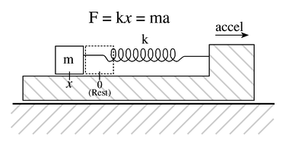
Accelerometer
A proof mass is connected to a spring which is attached to a case.
If the case is accelerated, the mass wants to stay behind because of its inertia.
Acceleration a results in force ma on the mass.
This force causes the spring to compress or expand (depending on the direction of the movement).
Spring counteracts with force kx (k = spring constant, x = displacement).
Measure displacement x when forces balance: kx = ma.
a = (k/m) x, so if we observe a displacement x then the mass has undergone acceleration a.
If we can measure the displacement we can compute acceleration!
Note:
This system is one-dimensional and only measures acceleration along the length of the spring.
For a 3-axis accelerometer, duplicate this system along three axes.
How do we measure displacement?
Mass-spring system (Phys 13, Engs 22)

Slide 4
How do we measure "displacement"?
Multiple ways of measuring displacement:
resistive techniques
capacitive techniques
inductive techniques.
Capacitive: Imagine capacitor plates attached to mass and case:
As x increases, so does capacitance.
Measuring capacitance allows us to compute x.

Slide 5
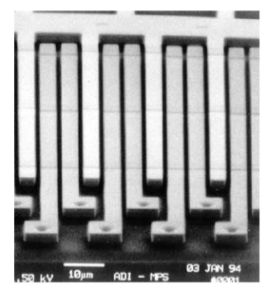
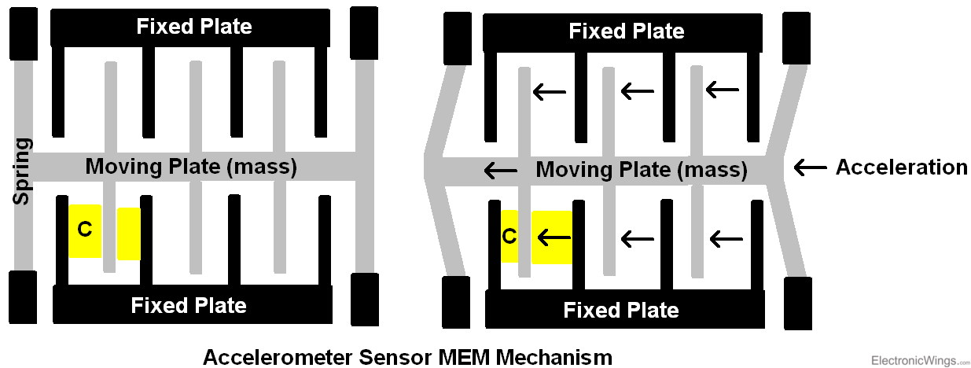
MEMS accelerometer
(Micro Electro-Mechanical System)
Analog Devices single-axis accelerometer
https://www.electronicwings.com/public/images/user_images/images/Sensor%20%26%20Modules/Accelerometer/1_Accelerometer_Sensor_MEMs_Mechanism.PNG
Surface micromachined capacitors
Roger Howe, Stanford
Proof mass, spring, and capacitive sensor are “machined” out of silicon.
Motion of moving plate (proof mass) relative to fixed plate (substrate) produces a varying capacitance.
A capacitance-to-voltage circuit translates the dynamic variation in capacitance to a voltage signal.
Notes:
Huge innovation in the last 30 years: figure out how to put these systems into silicone.
Capacitor is the black vertical plate(s) of the fixed plate together with the grey vertical plate(s) of the moving mass (see yellow).
So you've got all the pieces of a spring mass system accelerometer: fixed case, moving mass, springs, sensor. These things can be made on micron scales in silicon chips like the one on our chip. You can make 3-axes accelerometers out of micro-machined silicone.
Inside the chip:
A proof mass is suspended by tiny springs.
On both sides are interdigitated comb fingers.
These form two capacitors:
C1andC2C_1 \quad \text{and} \quad C_2C1​andC2​
When acceleration occurs:
The mass moves slightly.
One capacitor increases.
The other decreases.
So the system measures:
ΔC=C1−C2\Delta C = C_1 - C_2ΔC=C1​−C2​
Q=CV
If C1C_1C1​ increases and C2C_2C2​ decreases, the differential charge changes:
ΔQ=(C1−C2)Vexc\Delta Q = (C_1 - C_2) V_{exc}ΔQ=(C1​−C2​)Vexc​

Slide 6
Accelerometer applications
Acceleration
Tilt (e.g., phone, game controller)
Vibration (e.g., condition based monitoring of machinery)
Shock (e.g., airbag sensor)
Wearables (e.g., pedometer, football helmets)
Free fall detection (e.g., laptop protection)
3-axis accelerometer + 3-axis gyro = Inertial Measurement Unit (e.g., vehicles): A real-time 6-dimensional motion derivative sensor.
Local precision motion sensor company founded by a Thayer alum: SignalQuest, https://signalquest.com
Local medical device company, founded by a Thayer alum: Simbex, https://simbex.com/our-work/wearables-development/
https://www.technologyreview.com/2007/09/10/223860/a-helmet-that-detects-hard-hits/
Notes:
Applications that you experience every day:
MEMS (Microelectromechanical systems) accelerometers have been a game changer.
Airbag sensor senses when you are hitting something.
Pedometer set up to pick up impact of every foot slapping the ground.
Football helmets have accelerometers to measure shock to head under collision.
Before solid state hard drives it was catastrophic to drop your laptop (head crash on your spinning hard drive). Accelerometer would detect free fall and pull heads off disk drive to prevent catastrophic damage.
Gyroscope picks up twisting rather than shifting. Same technology
Used in drones or cars (IMUs).
Thayer has some connections to this business: Signal Quest in Leb, founded by Thayer alum. Integrates chips on boards and assembly.
Simbex, local medical device company, initiated accelerometers in football helmets.
Vibration: relatively new application of accelerometers. Learn vibration patterns of a normal operating machine. Then accelerometers can pick up vibration changes as the machine starts to fail and know of issues before anyone would otherwise figure out. So accelerometer plus machine learning is a huge new up and coming field.
In MEMS Gyroscopes
This is where it becomes engineering magic.
Inside a MEMS gyro:
A tiny mass vibrates with velocity vvv.
If the chip rotates with angular rate ΩΩΩ,
The vibrating mass feels a sideways Coriolis force.
That tiny perpendicular displacement is measured capacitively.

Slide 7
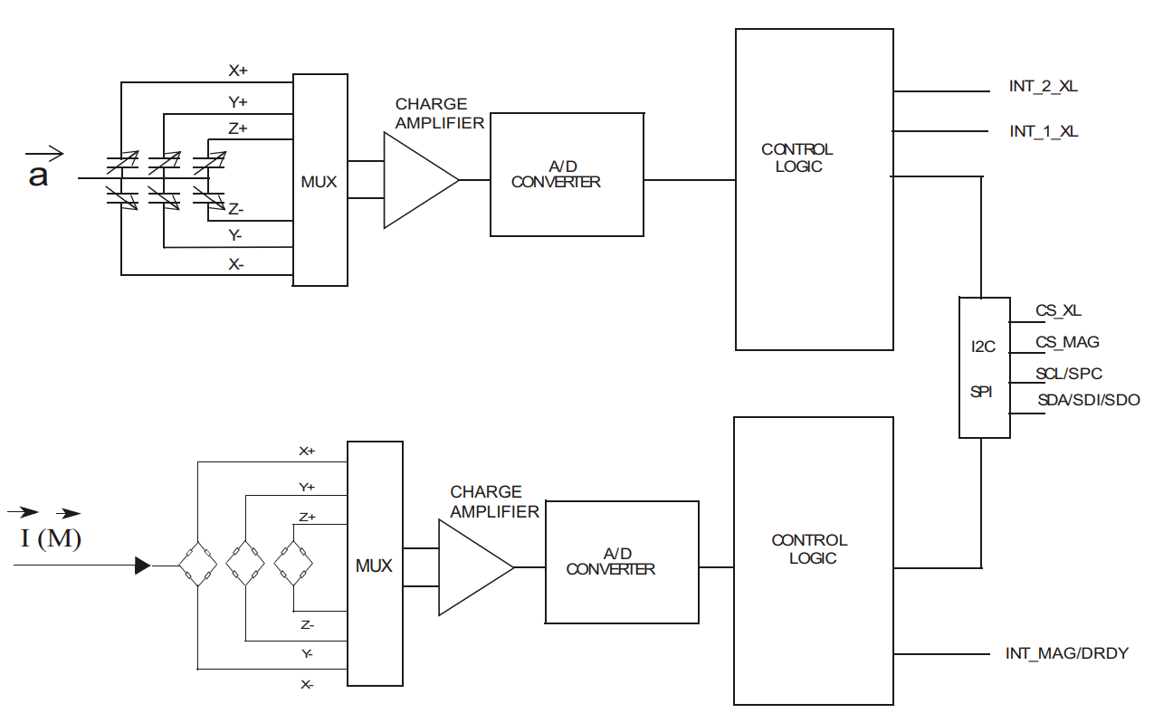
STMicro LSM303AGR
3-axis accelerometer + 3-axis magnetometer + temperature sensor
We’re only using the accelerometer portion.
Notes:
Our device.
Three capacitors with arrow through them are variable capacitors whose capacitance changes as the sensors move back and forth in their three respective axes (those are the ones in the accelerometer), that are processed to a voltage by some analog circuitry, that is fed into an A/D converter that feeds some control logic that creates a signal for the I2C bus.
There is also a magnetometer but we are not using that.

Slide 8
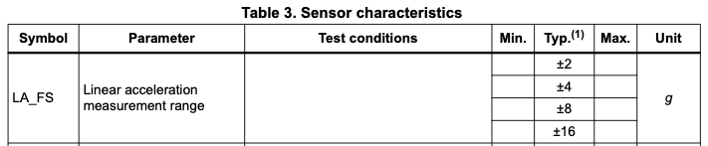
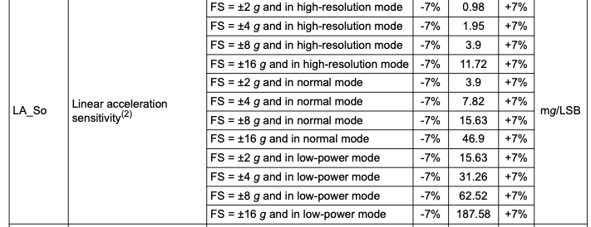
STMicro LSM303AGR
Important accelerometer specifications
12-bit
Full range
2^{#bits}
10-bit
8-bit
Notes:
We are continuing to slowly expose you to data sheets.
Here are the sensor characteristics of how the acceleration at the input end gets translated into bits at the output end. So the number it creates is a function of the physics.
Measurement range: measured in units of g's (gravity) (rather than in volts, degrees Fahrenheit, etc). So the first thing you need to decide is what your measurement range is so that you can select the correct setting.
Next is the sensitivity. How are bits at the output related to acceleration at the input? Sensitivity is full measurement range divided by 2^bits. So this is the resolution of the sensor. This accelerometer has 3 resolution modes: 8 bit, 10 bit or 12 bit. The lower the number of bits, the faster you can generate measurements but the lower the resolution. 2^bits is the number of bins that the input range is divided into. The width of each bin is the sensitivity. Example: +-2g, so a 4g range; at 10 bit, 4g/2^10 = 4g/1024 = 3.9 mg (milli g) is the sensitivity. So you can only pick up differences that are more than 3.9 mg.
In low power mode you only get 8 bits, in normal mode 10 bits, in high 12 bits. Notice how the sensitivity gets better as you go to higher resolutions. mg/LSB stands for mg per least significant bit (which is the significance of the last bit).
Zero-g level offset accuracy: If you lay this thing out on a perfectly flat surface you'd expect to measure exactly 1g. If you flipped it over you'd expect -1g. It won't be totally accurate though, and that's what's called the 0g offset. Similarly, when you put it vertical, you should get exactly 0g. But you won't. That's again the zero-g offset accuracy. 40mg is a significant amount of error! You can calibrate this out by reading the value on a perfectly flat surface: take the average of perfectly flat and flipped over, and that's what you need to calibrate out.
Also, temperature dependency etc but we don't consider those. Each sensor datasheet has tables like this.

Slide 9
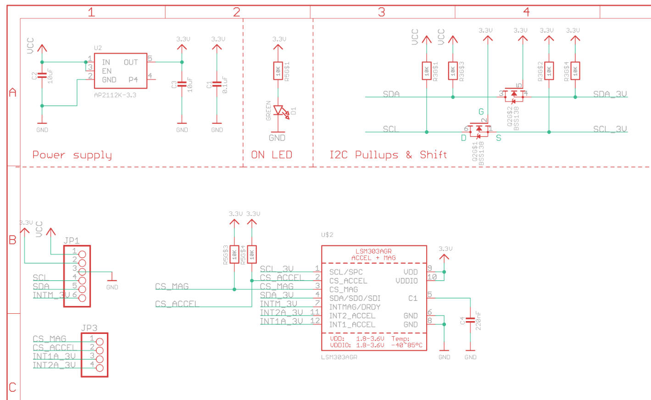
Breakout board schematic (partial)
I²C pullups
5V-3.3V regulator
Pullups set device for I²C
6-pin header
Notes:
Schematic of the board. Shows how things are wired together.
Big chip is the accelerometer, little chip is the voltage regulator. Can see the SDA and SCL wires, including, right on the board, pullup resistors.

Slide 10
How do you interact with the device?
I²C or SPI interface (breakout is wired for I²C by default)
Control and data registers
Hardware interrupt pins (we’re not using)
INT_MAG (magnetometer)
INT_1_XL and INT_2_XL (accelerometer)
Notes:
If you wanted to use one of the interrupts you'd take the interrupt pin and wire it to a pin on your microcontroller, set a pin change interrupt. They you'd write an ISR for that pin change interrupt.
We won't use these: we'll strictly communicate via I2C.

Slide 11
Settings for basic accelerometer operation
Control registers:
Data rate, power mode, axis selection
Analog filter selection (accept defaults)
Interrupt selection (none used, off by default)
Full-scale range selection (±2g, ±4g, ±8g, ±16g)
More interrupts (none used, off by default)
Yet more interrupts (none used, off by default)
For Thursday: Think about setups for Control Registers 1 and 4.
Notes:
There are 6 control registers, all have I2C addresses.
We only need registers 1 and 4 (the others are all about interrupts). We we only need to understand 1 and 4.
Look at data sheet and take a look at what the bits of these control registers do.
We'll code this in class tomorrow.

Slide 12
Device header file, lsm303agr.h
Includes macros and addresses for all the registers, e.g.,
#define LSM303_ADDRESS_ACCEL (0x32 >> 1) // append r/w bit
// NAME ADDR DEFAULT TYPE
#define LSM303_WHO_AM_I_A 0x0F // 00110011 r
#define LSM303_CTRL_REG1_A 0x20 // 00000111 rw
#define LSM303_CTRL_REG2_A 0x21 // 00000000 rw
#define LSM303_CTRL_REG3_A 0x22 // 00000000 rw
#define LSM303_CTRL_REG4_A 0x23 // 00000000 rw
#define LSM303_CTRL_REG5_A 0x24 // 00000000 rw
#define LSM303_CTRL_REG6_A 0x25 // 00000000 rw
#define LSM303_REFERENCE_A 0x26 // 00000000 r
#define LSM303_STATUS_REG_A 0x27 // 00000000 r
#define LSM303_OUT_X_L_A 0x28
#define LSM303_OUT_X_H_A 0x29
#define LSM303_OUT_Y_L_A 0x2A
#define LSM303_OUT_Y_H_A 0x2B
#define LSM303_OUT_Z_L_A 0x2C
#define LSM303_OUT_Z_H_A 0x2D
Notes:
This again is the header file (address of control registers, WHO_AM_I register, addresses of the data registers, etc.

Slide 13
Device driver function prototypes
Names are borrowed from Adafruit’s driver for the Arduino
// The accelerometer has several gain and update rate settings. These are described
// in Section 7.1 of the datasheet and are set up in the AccelInit function.
int lsm303_AccelInit();
// The AccelRegisterWrite function should take a register address and a command byte
// to be written into the register.
void lsm303_AccelRegisterWrite(uint8_t RegisterAddress, uint8_t data);
// The AccelRegisterRead function should take a register address and return a data byte
// read from the register.
uint8_t lsm303_AccelRegisterRead(uint8_t RegisterAddress);
// Here is the higher-level function to read the acceleration vector. Output struct
// contains raw (unscaled) acceleration values.
void lsm303_AccelReadRaw(lsm303AccelData_s * const result);
These functions use i2c.c and lsm303agr.h.
Notes:
We'll need 4 functions. Have given you the single register read function. You'll write the write function. Given you skeleton for the init function. Giving you the readraw function. You'll finish the others tomorrow. Think about it for tomorrow.

Slide 14
Getting data out of the accelerometer

Slide 15
Accelerometer data format
The output of the accelerometer is a 16-bit, left-justified 2s complement number. Assuming a full-range of 4g (±2g):
Low-power (8-bits), resolution = 4g/2⁸
Normal mode (10 bits), resolution = 4g/2¹⁰
High-resolution (12 bits), resolution = 4g/2¹²
Acceleration = (raw >> 8) * resolution
= (raw / 2⁸) * 4g/2⁸ = 4g*raw/2¹⁶
b b b b b b b b 0 0 0 0 0 0 0 0
Acceleration = (raw >> 6) * resolution = (raw / 2⁶) * 4g/2¹⁰ = 4g*raw/2¹⁶
b b b b b b b b b b 0 0 0 0 0 0
Acceleration = (raw >> 4) * resolution
= (raw / 2⁴) * 4g/2¹² = 4g*raw/2¹⁶
b b b b b b b b b b b b 0 0 0 0
Notes:
3 resolution modes. Even though you have this 16 bit number, many of them are zeros. Always need 2 bytes. Some bits are always zero.

Slide 16
Accelerometer data format (2)
For a full-scale range of +/- 2g, one thus computes the acceleration a by
a = 4*ACCEL_raw / 2¹⁶ (g)
The units of the accelerometer output are “g”, i.e., 1 g = 9.8 m/s².
In “milli-g”,
a = (4 * ACCEL_raw * 1000) / 2¹⁶ (mg)
a = (ACC_FS * ACCEL_raw * MILLI) / 2^{ACC_REGISTERWIDTH} (mg)
#define ACC_FS 4
#define ACC_REGISTERWIDTH 16
#define MILLI 1000

Slide 17
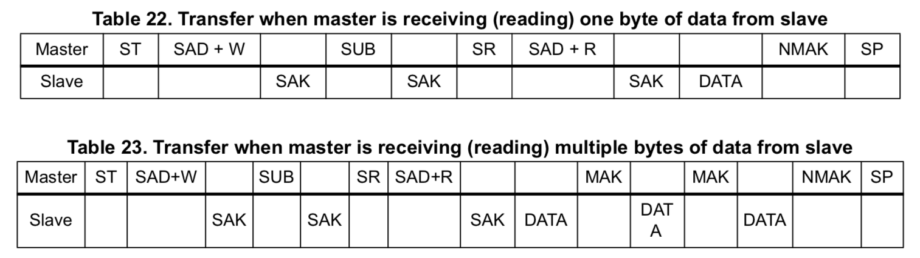
I²C transfers, Control (MCU) ⟷ Peripheral (sensor)
start sensor addr ACK subaddr ACK start sensor addr ACK byte NACK stop
Subaddress autoincrements for multiple reads, see Sec 6.1.1
Data registers are at successive subaddresses.
You can read all six bytes of data in one transfer, starting at 0x28, but note (see datasheet 6.1.1):
#define LSM303_OUT_X_L_A 0x28
#define LSM303_OUT_X_H_A 0x29
#define LSM303_OUT_Y_L_A 0x2A
#define LSM303_OUT_Y_H_A 0x2B
#define LSM303_OUT_Z_L_A 0x2C
#define LSM303_OUT_Z_H_A 0x2D
"After the start condition (ST) a slave address is sent, once a slave acknowledge (SAK) has been returned, an 8-bit sub-address (SUB) is transmitted: the 7 LSb represent the actual register address while the MSB enables address auto increment. If the MSb of the SUB field is ‘1’, the SUB (register address) is automatically increased to allow multiple data read/writes."
Notes:
So instead of sending 0x28 as the address you need to send 0x28 | (1<<7).
If you start reading at 0x28 | (1<<7), it sends you data, you ACK back, then it sends you the next piece of data, you ACK back, etc, so that you can read all 6 in one transfer. This is implemented in our driver.

Slide 18
lsm303_AccelReadRaw() function
lsm303agr.h declares a structure, lsm303AccelData_s:
typedef struct{
int16_t x;
int16_t y;
int16_t z;
} lsm303AccelData_s;
#define LSM303_OUT_X_L_A 0x28
#define LSM303_OUT_X_H_A 0x29
#define LSM303_OUT_Y_L_A 0x2A
#define LSM303_OUT_Y_H_A 0x2B
#define LSM303_OUT_Z_L_A 0x2C
#define LSM303_OUT_Z_H_A 0x2D
A pointer to a variable of that structure type is passed to lsm303_AccelReadRaw():
void lsm303_AccelReadRaw(lsm303AccelData_s * result) {
uint8_t data[6];
i2c1_memRead(LSM303_ADDRESS_ACCEL, LSM303_OUT_X_L_A | (1<<7), 6, &data[0]);
result->x = ((int16_t) data[1] << 8) | ((int16_t) data[0]);
result->y = ((int16_t) data[3] << 8) | ((int16_t) data[2]);
result->z = ((int16_t) data[5] << 8) | ((int16_t) data[4]);
}

Slide 19
Homework for Thursday
Do the accelerometer readings on the daily page.
On paper, write lsm303_AccelRegisterWrite(). (Mimic the read function.)
From the data sheet, what values should you program into Control Registers 1 and 4? Take notes on paper.
Notes:
The reading quiz gives you a scavenger hunt through the data sheet.

