Slide 1


Engs 28
Embedded Systems
Day 14

Slide 2
Agenda
Complete the accelerometer device driver
Send x-y-z data to screen, observe tilt
Send x-y-z data to Coolterm's serial plotter, observe shock, vibration

Slide 3
Water Bottle Filling Station: In-class HiTA Activity
With your table group, reverse-engineer the water bottle filling stations at Thayer. What are the sensors, actuators, and displays? From observing its behavior, draw a signal / actuator / processor block diagram and program flow.
Consider questions such as:
What are you sensing?
What is the display telling you?
What is the actuator doing?
What is the logic behind it all?
When the sensor does this, what happens?
Then what?

Slide 4
Accelerometer: Measuring gravity

Slide 5
Settings for basic accelerometer operation
Control registers:
Data rate, power mode, axis selection
Analog filter selection (accept defaults)
Interrupt selection (none used, off by default)
Full-scale range selection (±2g, ±4g, ±8g, ±16g)
More interrupts (none used, off by default)
Yet more interrupts (none used, off by default)
Discuss your settings for Control Registers 1 and 4.

Slide 6
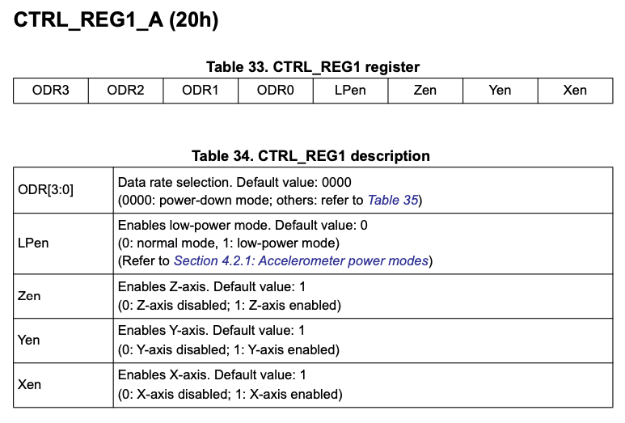
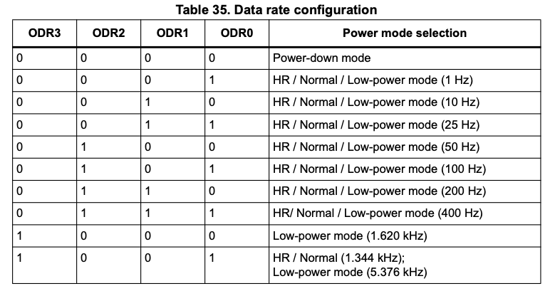
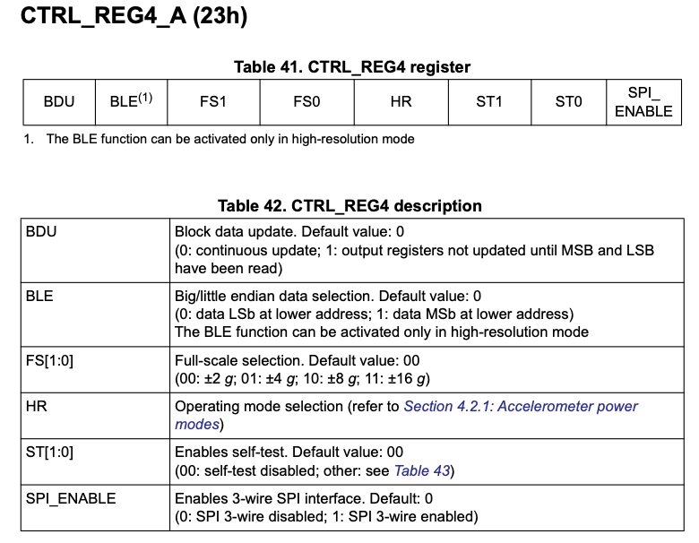
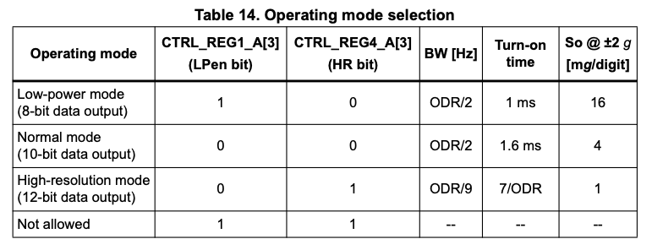
Setting: 0b01110111
Setting: 0b00000000

Slide 7
Complete the device driver
// The accelerometer has several gain and update rate settings. These are described
// in Section 7.1 of the datasheet and are set up in the AccelInit function.
uint8_t lsm303_AccelInit();
// The AccelRegisterWrite function should take a register address and a command byte
// to be written into the register.
void lsm303_AccelRegisterWrite(uint8_t RegisterAddress, uint8_t data);
// The AccelRegisterRead function should take a register address and return a data byte
// read from the register.
uint8_t lsm303_AccelRegisterRead(uint8_t RegisterAddress);
// Here is the higher-level function to read the acceleration vector. Output struct
// contains raw (unscaled) acceleration values.
void lsm303_AccelReadRaw(lsm303AccelData_s *result);
Download lsm303agr_partial.c and accel_test.c from Canvas and paste both into the Src folder in your Accelerometer project. Exclude whoami_test.c from the build configuration.

Slide 8
Complete the device driver
Complete the initialization and register write functions in the partial driver file.
// The accelerometer has several gain and update rate settings. These are described
// in Section 7.1 of the datasheet and are set up in the AccelInit function.
uint8_t lsm303_AccelInit();
// The AccelRegisterWrite function should take a register address and a command byte
// to be written into the register.
void lsm303_AccelRegisterWrite(uint8_t RegisterAddress, uint8_t data);
Once finished, test with the provided accel_test.c. Watch output with CoolTerm.
Run test program (accel_test.c) to stream accelerometer data via UART.

Slide 9
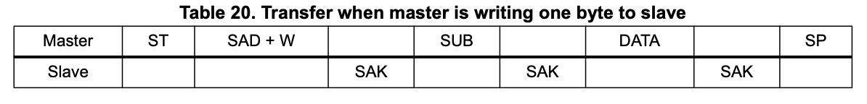
Write to a register
/**************************************************************************
* Write one byte to an accelerometer register (Datasheet, Table 20)
*/
void lsm303_AccelRegisterWrite(uint8_t RegisterAddress, uint8_t data) {
i2c1_memWrite(LSM303_ADDRESS_ACCEL, RegisterAddress, 1, &data);
}

Slide 10
Test program accel_test.c
#define ACC_FS 4
#define ACC_REGISTERWIDTH 16
#define MILLI 1000
⋮
lsm303AccelData_s accel_raw;
i2c1_init();
uart2_init();
if( lsm303_AccelInit() ) {
printf("Accelerometer initialized! \n\r");
} else {
printf("Could not connect to accelerometer \n\r");
}
printf("Control Register 1 = %x \n\r", lsm303_AccelRegisterRead(LSM303_CTRL_REG1_A));
printf("Control Register 4 = %x \n\r", lsm303_AccelRegisterRead(LSM303_CTRL_REG4_A));
while(1) {
lsm303_AccelReadRaw(&accel_raw);
accel_x = (ACC_FS * accel_raw.x * MILLI) >> ACC_REGISTERWIDTH;
accel_y = (ACC_FS * accel_raw.y * MILLI) >> ACC_REGISTERWIDTH;
accel_z = (ACC_FS * accel_raw.z * MILLI) >> ACC_REGISTERWIDTH;
printf("accel_x=%d mg, accel_y=%d mg, accel_z=%d mg \n\r", accel_x, accel_y, accel_z);
delay_ms(2000);
}

Slide 11
Suggested tests
Note that 1000 mg = 9.8 m/s². A “perfect” value is 1000.
Flip the accelerometer over, note sign change of acceleration.
Rotate the accelerometer to align x and y axes with g.
Try all three resolutions (8-bit, 10-bit, 12-bit).
Anything else?
Once everything is working, rename lsm303agr_partial.c to lsm303agr.c
Copy lsm303agr.c into your mylib folder.
Afterwards, delete lsm303agr.c from the Accelerometer's Src folder.
Rebuild the Accelerometer project to make sure everything still works.

Slide 12
Accelerometer: Displaying motion

Slide 13
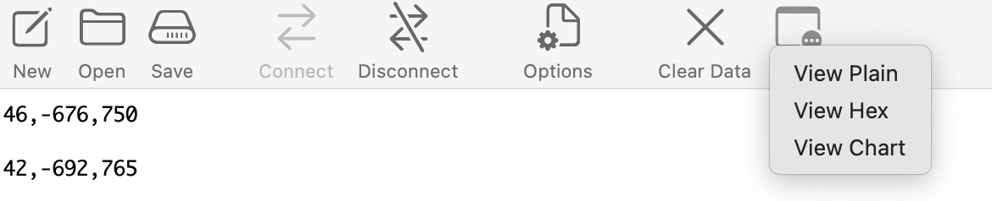
Plot accelerations with CoolTerm
Modify accel_test.c:
Comment out all printf() statements
Inside the while(1) loop, in place of the existing printf(),
printf("%d,%d,%d\n\r", accel_x, accel_y, accel_z);
Change delay_ms to 100 or less.
In CoolTerm:
Connect as per usual.
In the "View" menu, select "View Chart".

Slide 14
Suggested tests
Flip the accelerometer chip over, note sign change of acceleration.
Rotate the accelerometer to align x and y axes with g.
Raise and lower the accelerometer, periodically, at different speeds.
Shake the accelerometer.
Place the accelerometer on the table, and bang the table (shock)
Anything else?

Slide 15
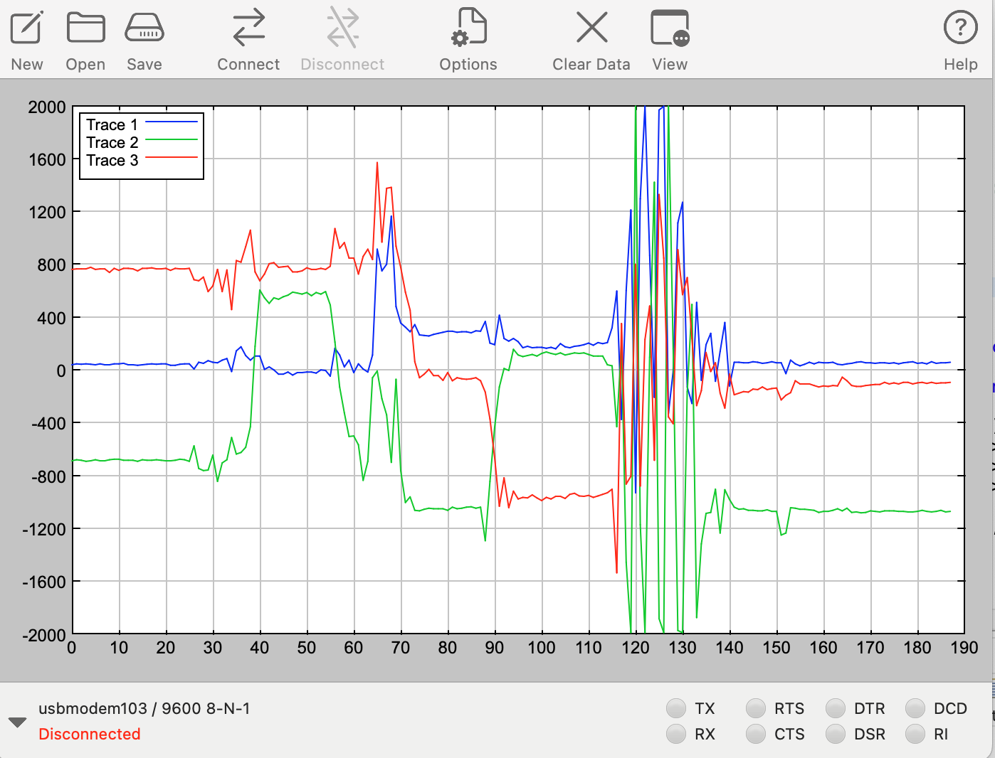
Serial Plotter

Slide 16
Accelerometer: Measuring tilt

Slide 17
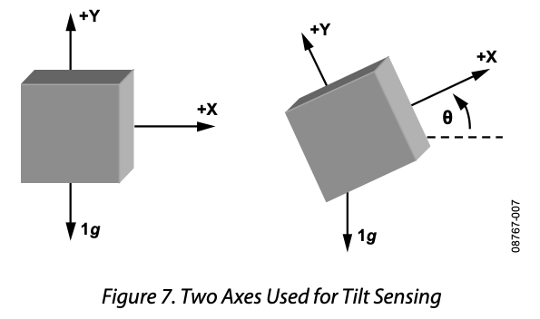
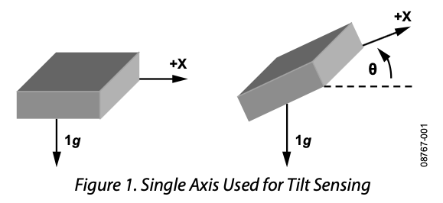
Geometry
Analog Devices, AN-1057, “Using an Accelerometer for Inclination Sensing” (2010)
A_{X} = g sin 𝜃
⇒ 𝜃 = sin^{–1}(A_{x}/g)
For small tilt, sin 𝜃 ≈ 𝜃.
Most sensitive (large ∆A_{X} / ∆𝜃) near 0°, poor sensitivity near 90°.
Can’t measure full 360° range.
A_{X} = g sin 𝜃, A_{y} = g cos 𝜃,
⇒ 𝜃 = tan^{–1}(A_{x}/A_{y})
For small tilt, tan 𝜃 ≈ 𝜃.
Constant sensitivity.
Complete 360° tilt sensing, if you are careful about quadrants.
Using all three axes, can fully orient in space. See app note for details.
Notes:
https://www.analog.com/en/app-notes/an-1057.html
In Figure 1 a single axis (the x-axis in this example) is rotated through gravity. Because this approach uses only a single axis and requires the gravity vector, the calculated angle of inclination is accurate only when the device is oriented such that the x-axis is always in the plane of gravity. Any rotation about the other axes reduces the magnitude of the acceleration on the x-axis and results in error in the calculated angle of inclination.
For applications that require higher resolution or the ability to distinguish angles of inclination in a complete 360° arc, a second axis, as shown in Figure 7, or a second sensor is necessary. If a second sensor is used, it should be oriented such that the sensing axis of the second sensor is orthogonal to the sensing axis of the first sensor.

Slide 18
Sine? Cosine? Tangent?
Looks like we need floating point arithmetic…

Slide 19
Recall Accelerometer data format (2)
For a full-scale range of +/- 2g, one computes the acceleration a by
a = 4*ACCEL_raw / 2¹⁶ (g)
The units of the accelerometer output are “g”, i.e., 1 g = 9.8 m/s².
In “milli-g”,
a = (4 * ACCEL_raw * 1000) / 2¹⁶ (mg)
a = (ACC_FS * ACCEL_raw * MILLI) / 2^{ACC_REGISTERWIDTH} (mg)
#define ACC_FS 4
#define ACC_REGISTERWIDTH 16
#define MILLI 1000

Slide 20
Floating point arithmetic
A float (“single precision floating point”) is 4 bytes (same size as int32_t). To express acceleration as a float,
float a = (float) ACCEL_RAW * ACC_FS / 65536; (no need for milli-g, 65536 = 2^16)
Make sure the division happens as a floating point operation! (How?)
Compute with floating point (#include <math.h> for functions), convert back to integers ( round()) for printing and display.
Floating point format has a sign bit, an 8-bit exponent, and a 23-bit fraction, or mantissa:
N = ± fraction × 2^{exponent}
int32_t has more precision than a float, but float has more dynamic range. Note that the accelerometer, in highest precision mode, is only 12 bits.
Floating point arithmetic is more complex, but more convenient for using mathematical functions, e.g., sine and cosine. Our processor lacks floating point hardware, does arithmetic in software: slower and takes up more flash memory.
Notes:
All floating point operations exist in a library math.h. Our processor does not have the hardware to do floating point operations, that's why a software library is necessary (and that's why it's slow). But it exists. Using this library makes your code a whole lot bigger.

Slide 21
Lab 7
Manage two I2C devices on the same I2C bus.
Calculate and display tilt.
Simulate phone rotation / image orientation.

