Slide 1


Engs 28
Embedded Systems
Day 15

Slide 2
Agenda
Final Project Survey (please complete by 4pm TODAY - see Canvas)
Servomotors (Williams, Chapter 11)
Photosensors (Williams, pp 129-133) — Thursday
You will need today:
Nucleo & breadboard
AD2
Power supply
Potentiometer
Servomotor
Power board

Slide 3

Final Project Survey: Due Today

Slide 4
Servomotors

Slide 5
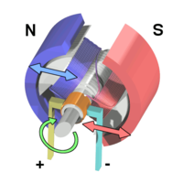
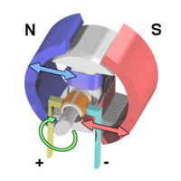
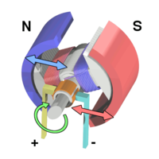
Review: DC permanent magnet motor
Electric current flowing through brushes into armature coils creates a magnetic field.
Repulsion by field from permanent magnets causes armature to rotate.
Current flow is reversed via commutator so the armature continues to be repelled by magnets and keeps rotating.
Motor torque is proportional to current.
Armature rotating in magnetic field generates a “back emf” proportional to speed. When back emf = applied voltage, motor is at equilibrium speed.
See Williams, "DC Motors" section in Chapter 14 "Switches".
Key fact we need going forward.
Ref: Wikipedia, “Brushed DC Electric Motor”
https://en.wikipedia.org/wiki/Brushed_DC_electric_motor
Notes:
A DC motor works by the current flowing through a coil interacting with a permanent magnetic field set up by the magnets outside. Torque is proportional to current. Now we are going to add on to it.

Slide 6
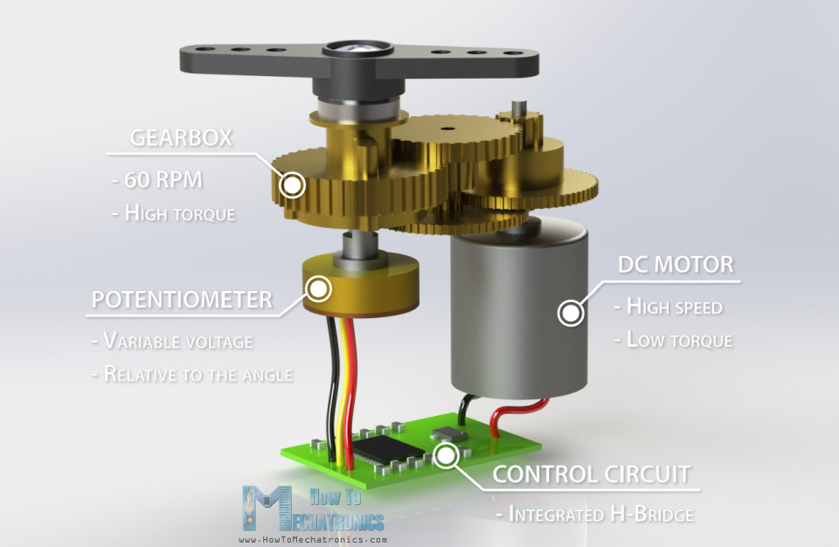
What is a servomotor?
Potentiometer senses the motor position and provides feedback to the motor control electronics.
Through a gear train, power = torque × angular velocity is (except for friction) conserved:
𝝉_{in} 𝝎_{in} ≈ 𝝉_{out} 𝝎_{out}
https://howtomechatronics.com/how-it-works/how-servo-motors-work-how-to-control-servos-using-arduino/
Notes:
This is what's inside your servo. There is a DC Motor that's connected to a little circuit board (including an H-bridge). The motor shaft goes through this gear train that gears it way down to the output shaft that is not turning very fast. A potentiometer is attached to this shaft and gives you the angular position of the shaft. Corresponding to that angular position the pot puts out a voltage that is fed into the control circuit where it is compared with the desired voltage and then the control circuit adjusts the motor speed and direction if necessary using the h-bridge until the feedback loop signals that the error is zero.
Why all the gears? Power is the product of torque and angular velocity. Through the gear train the speed going in is much higher than the speed going out. Since power is preserved, the torque going out is much higher than the torque going in. In goes a high speed motor with not a lot of torque, and out comes a low speed with a large amount of torque.

Slide 7
Servomotors provide precise position control
Robot joints
Aircraft control surfaces (both hobby and full-scale)
Camera auto-focus (adjusting the lens)
Conveyor belts
Solar trackers
Metal and wood processing (CNC tools)
Antenna azimuth and elevation positioning
Opening and closing doors, windows, vents
Opening and closing valves
Notes:
Used particularly to provide precise position control.
Robot: servo is making that elbow move
Aircraft control surfaces: moving rudder etc
Camera auto-focus (adjusting the lens)
Conveyor belts: moving back and forth quickly
Solar trackers: you'll build one in lab 8
Metal and wood processing (CNC tools): bring something in, pull something out
Antenna azimuth and elevation positioning: point antenna
Opening and closing doors, windows, vents
Opening and closing valves: want precise position, open and close. May require a lot of torque but don't need to move very fast.

Slide 8
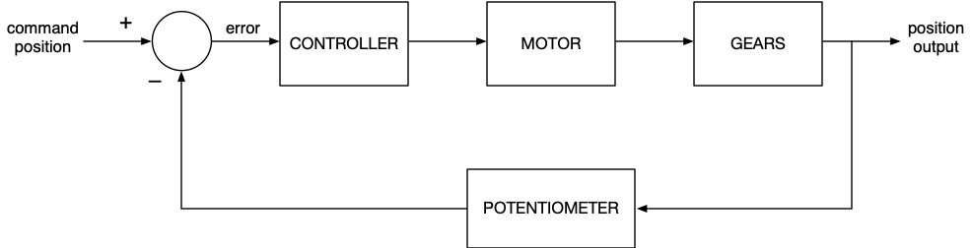
How a servomotor works: feedback
Command position input is a voltage.
Potentiometer, turned by the motor, outputs a voltage proportional to position output.
Controller drives the motor until position error voltage is zero. If a disturbance perturbs the motor’s position, the feedback loop corrects.
For details of controller design, see Engs 26. Our servomotors have the controller built in, we just have to supply the command signal.
Notes:
It's the ability to go to precisely someplace that's the really valuable feature. This works by feedback.
You never take a servo all the way around. If you do you break it. That's why you can measure the position with a pot.
Angle goes into the pot, resistance varies, out comes voltage. You have set the position that you want the servo to go to, so you have the position you want (with a voltage), the position that you have (out of the pot) and an error. The feedback makes the error want to go to 0 so that the angle of the servo is the same you want.
Once in its position, if you try to turn the servo by hand the pot is going to sense that and the controller is going to counteract that error. So the servo will strongly resist. How exactly the controller does this is something you study in ENGS 26.
All we have to do is stick in a signal to command the position. The circuitry does the rest.

Slide 9
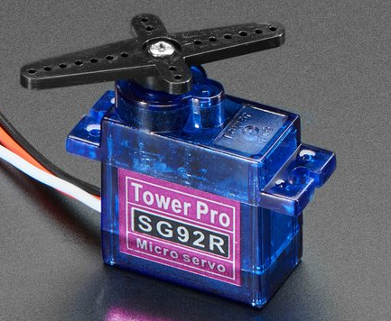
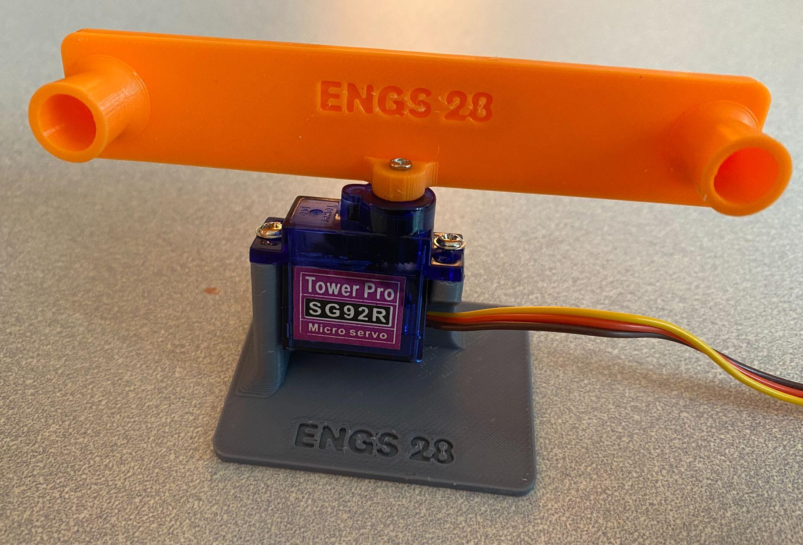
Our Servomotor
Tower-Pro SG92R microservo
Much cooler than those horns!
Relevant specs:
Stall torque: 2.5 kgf-cm (0.245 N-m, 35 ozf-in, 0.18 lbf-ft)
Speed: 0.1s/60°
Dead band width: 1µs
Notes:
Little plastic pieces are called servo horns. The holes allow you to attach rods that can then elevate things etc. Please be careful with your servos. Please don't break them. Please don't try to turn them by hand all that much.
The stall torque is the amount of torque the servo puts out if you try to resist its turning (so hold the horns in place). Unit is kgf-cm for these hobby servos which you are probably not used to from physics (there, torque is measured in Nm, or for cars its measure in foot-pounds). A kgf (kilogram force) is the gravity exerted on 1kg of mass. So kgf-cm is still force times distance. So 2.5 kgf-cm is not a huge force, but remember it's a tiny motor!
It takes 1/10 of a second to go through 60 degrees.
Will explain dead band when we get there.

Slide 10
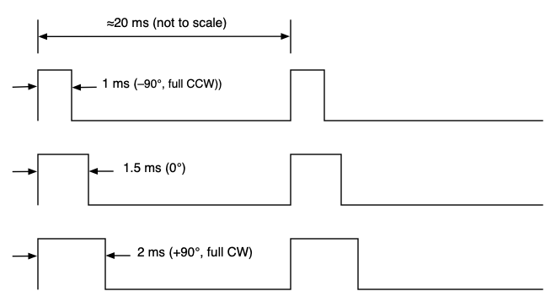
Commanding a servo with a microcontroller
Microcontroller has only digital outputs. How do we get a command voltage?
Servo controller electronics convert pulse width to control voltage.
Pulse widths between 1ms and 2ms, repeated regularly, roughly every 20 ms (so 50Hz).
The width of the pulse is conveying information to the controller on how far to turn the motor.
Notes:
Servos don't have an i2c interface… Technology is fairly old, and there is a historic way to control them. This hasn't changed.
You apply a pwm signal. The width of the pulse is conveying information to the controller on how far to turn the motor. So you are using pwm as a way to communicate with the controller rather than directly sending it to the motor.
For a typical hobby servo, the pwm pulse is repeated at 50Hz. That means each pulse lasts around 20ms. 60Hz also works fine as it turns out…
By convention, a 1.5 ms pulse brings the servo to the middle (a zero angle). 1ms turns it to -90 degrees, 2ms turns it to 90 degrees. This is hypothetical. Our servos don't go all that far. Please do not try to turn them that far. As long as the same pulse is applied to the motor, it stays at that one position and is held there. If you shut the signal down there is no power on the motor. So a servo spins to the correct position and then sticks there as long as you apply the same pulses. If anything tries to move it out of that position it tries to move back.
So the signal is a position signal and you have to keep sending it.

Slide 11
Setting up a timer for PWM
We need a 50Hz PWM frequency (pretty small, compared to 12MHz clock). So the counter needs to take 20ms to count from 0 to its auto-reload value.
Lots of ways to accomplish this! Which of these are usable?
prescaler | Timer clock speed | Autoreload (≤65,635)
1
2
6
60
240

Slide 12
Setting up a timer for PWM
We need a 50Hz PWM frequency (pretty small, compared to 12MHz clock). So the counter needs to take 20ms to count from 0 to its auto-reload value.
Lots of ways to accomplish this! Which of these are usable?
prescaler | Timer clock speed | Autoreload (≤65,635)
1 | 12 MHz | 240,000
2 | 6 MHz | 120,000
6 | 2 MHz | 40,000
60 | 200 kHz | 4,000
240 | 50 kHz | 1,000

Slide 13
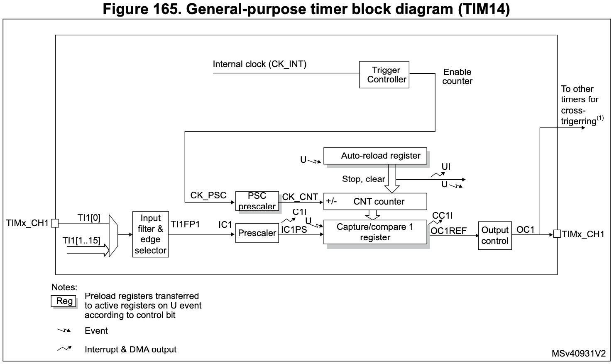
Review: Timer 14 PWM on the STM32C0
Auto-reload
(upper limit)
Prescaled clock input
Counter
Compare register
Notes:
Inside the microcontroller: counter register is TCNT (Timer Counter) n (n = 0, 1, 2).
As it counts, there are a couple things it can do:
Have it compare its value to a number you have stored in a register. Suppose you wanted to count to 100. Then you could use the 8-bit counter, but instead of having it count to 255 you'd store 100 in the output compare register (OCR). Comparator will compare the numbers. When the counter gets to that number it does something (generate interrupt, etc)
Can tell it to do something when it reaches its top value (TOP), so when the counter overflows.
When counting down can tell it to do something when it reaches 0.
Timer overflow interrupt gets thrown when overflow is reached.
Output compare interrupt occurs when timer reaches value in OCR (if so chosen). Those are two different interrupts.
Each timer/counter has two comparison value registers, so you could in principle have one counter that interrupts both at 100 and also at 150. Seems difficult to think about, so have never used that personally…
It can do other things that we'll learn about in a few weeks.
So general functionality: Counter counts, generates interrupt when it reaches a specified value.
There are two control registers that set the various options (clock speed, what happens when it times out - reset or done? etc)

Slide 14
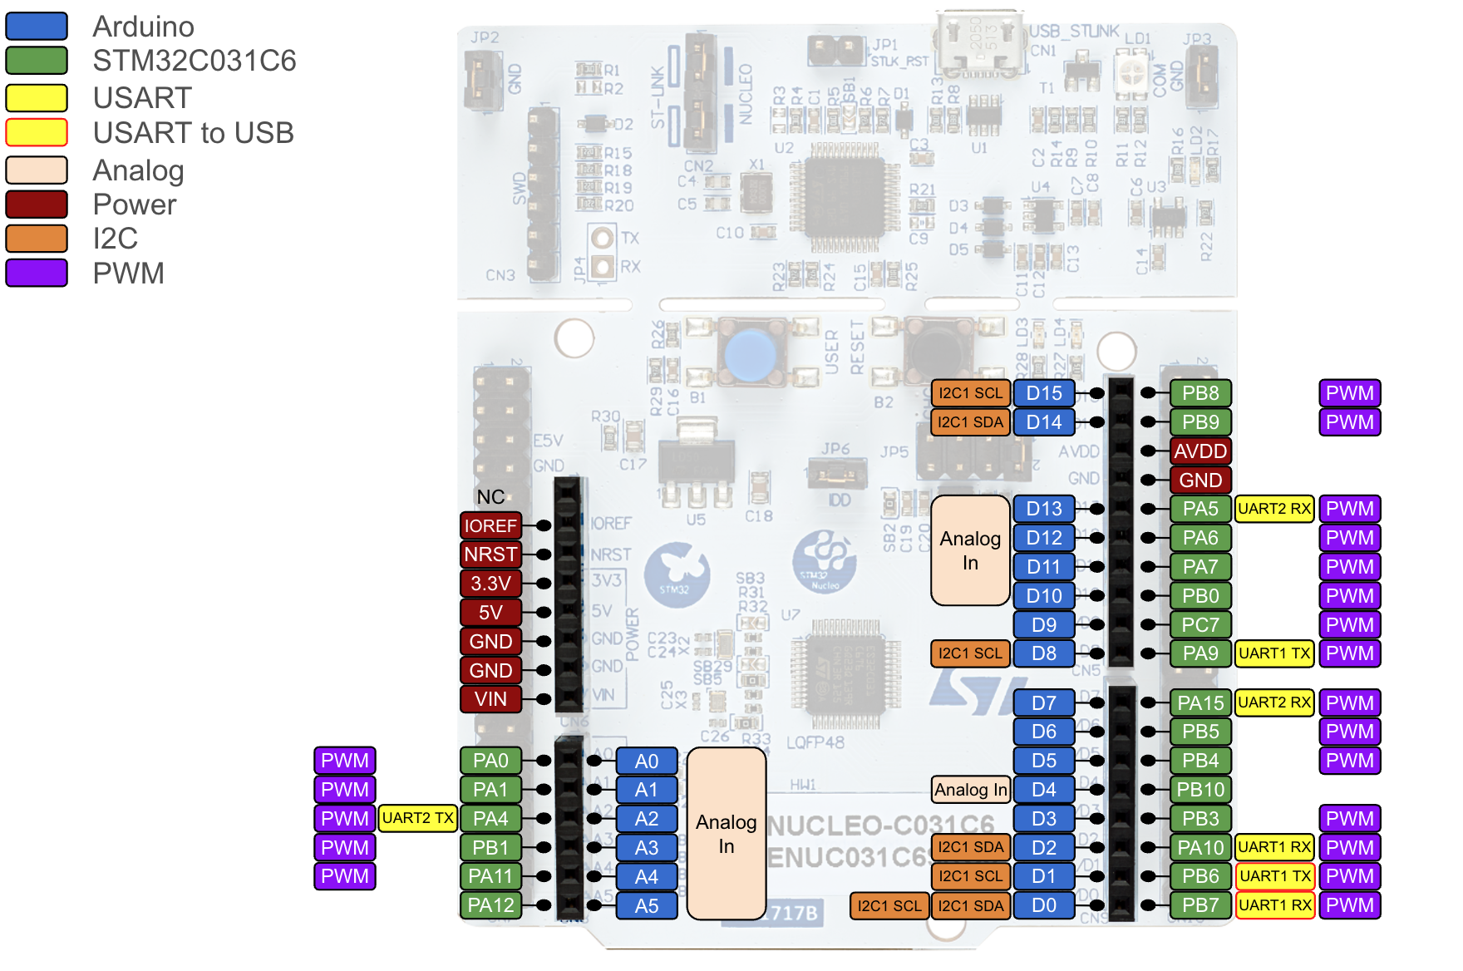
Nucleo PWM outputs
Almost every pin is capable of PWM, driven by different counters.
PA4, PA7 and PB1 can be driven by TIM14.
See Datasheet, Table 12.
Notes:
The digital I/O pins that have a little wiggle next to them can do PWM: a PWM output from a timer/counter.
For the motor controller we'll use Arduino pins 9, 10 and 11. We'll take pin 11 with PWM to control the voltage going into the H-bridge, so instead of those transistors going to be on all the time the will go open/close/etc (this is on the logic end of things!), so that the actual full current passes through and gets blocked according to the duty cycle.
You don't have to think about this hard since it's all built into the chip.

Slide 15
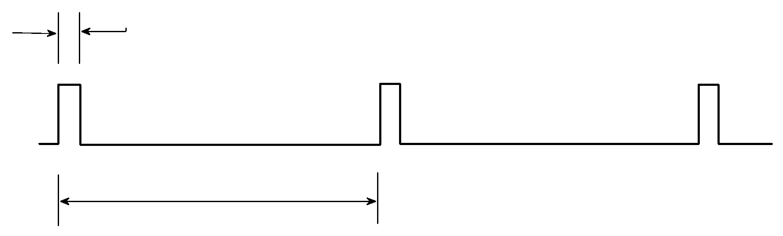
Setting up Timer 14 for PWM
50 Hz frequency gives a pulse period of T_{p} = 1000/50 = 20ms.
Minimum pulse width, T₀ = T_{p}/ MAXCOUNT
Pulse period, T_{p}
prescaler | ARR+1 | T₀ = 20ms / (ARR+1) | #steps, 1ms - 2ms | ∆𝜃 = 180° / #steps
6 | 40000 | 0.5µs | (2ms–1ms) / 0.5µs = 2000 | 0.09°
60 | 4000 | 5µs | 200 | 0.9°
240 | 1000 | 20µs | 50 | 3.6°
Which one do you like best?
If you change the pulse by 1µs the motor won't notice.
Recall: The servo has a dead band of 1µs.
Notes:
So all three prescalers will give the appropriate pulse period.
What is the minimum pulse width we can achieve with each of these? Since each pulse has a period of 20ms, that width is divided into ARR+1 number of bins. So 20ms/(ARR+1) gives you the smallest pulse width. All useful angles occur between a pulse width of 1ms and 2ms. The number of steps in between 1ms and 2ms is the resolution of your servo, so for the prescaler = 6 for example each step corresponds to 0.09 degrees. Amazing angular resolution! But this thing is made out of plastic. So… is that worth it?
The servo has a dead band of 1 us. That means that if you change the pulse by that amount the motor won't notice it. So the pulse width has to have a difference of at least 1us if the motor is going to respond. So with a prescaler of 6, is that a good place to work? No, since 0.5 us is less than the dead band. It's more finely grained than is worth doing. But the 4us is good, so a prescaler of 60 is great. Next one is fine too.

Slide 16
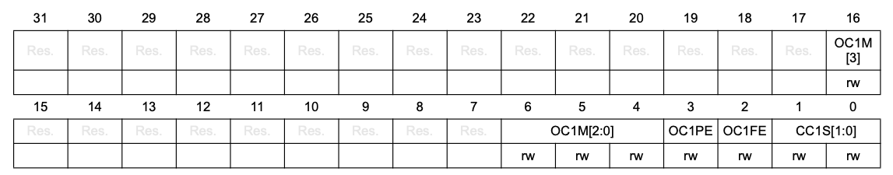
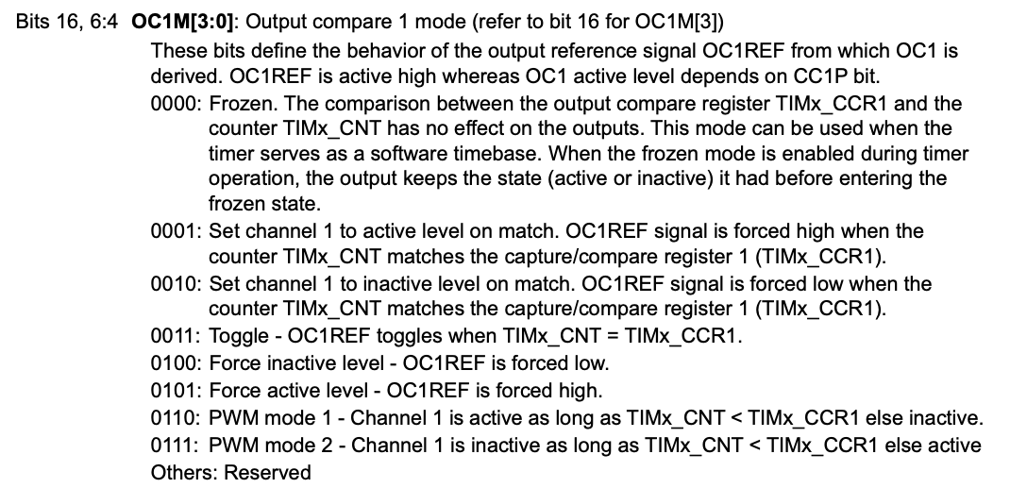
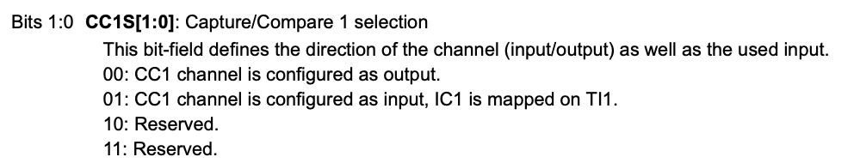
Timer 14 Registers
TIM14 capture/compare mode register 1 (TIM14_CCMR1) in Output Compare Mode
// Set pwm mode 1 (0110)
TIM14->CCMR1 &= ~TIM_CCMR1_OC1M_Msk;
TIM14->CCMR1 |= (TIM_OC1_PWM1 <<
TIM_CCMR1_OC1M_Pos);
// Set pwm mode 1 (0110)
TIM14->CCMR1 &= ~TIM_CCMR1_CC1S_Msk;
TIM14->CCMR1 |= TIM_CC1_OUTPUT <<
TIM_CCMR1_CC1S_Pos;

Slide 17
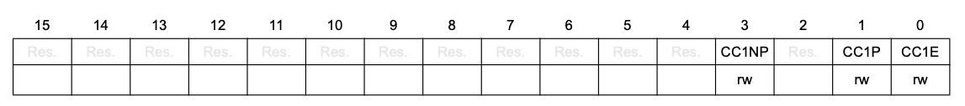
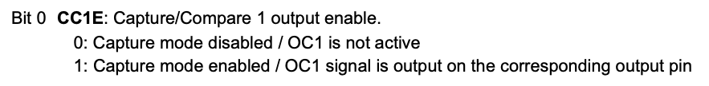
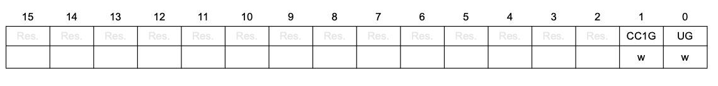
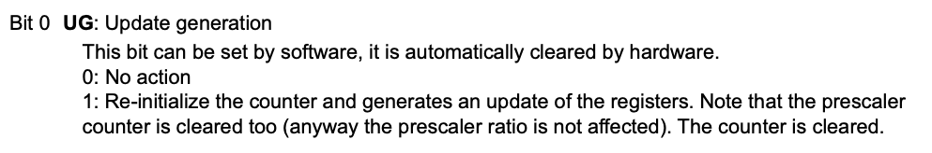
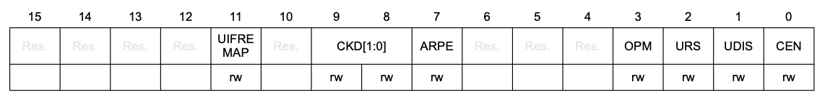
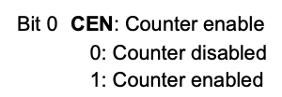
Timer 14 Registers
TIM14 capture/compare enable register (TIM14_CCER)
TIM14 event generation register (TIM14_EGR)
TIM14 control register 1 (TIM14_CR1)

Slide 18
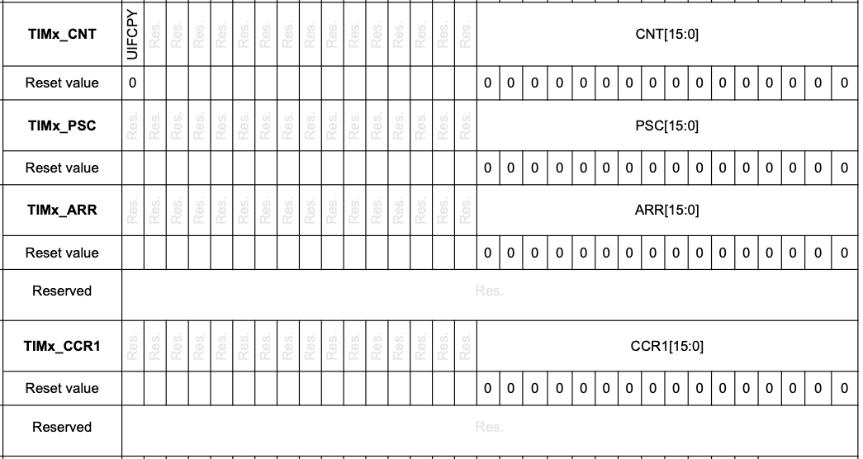
Timer 14 Registers
V_{avg} = V_{M} × T_{HIGH} / T_{PERIOD}
T_{HIGH}
T_{HIGH}
T_{PERIOD}
Prescaler - counting rate
determines T_{PERIOD}
determines T_{HIGH}

Slide 19
Choosing TIM14_ARR and TIM14_CCR1
1-2ms
Recall: By default the oscillator on the STM32C031 runs at
_____________ MHz.
Prescaler slows the clock down to
______________MHz.
What value should we chose for ARR+1?
_____________ = PWM_TIMER_MAX
What value for CCR1 will yield a pulse of:
1ms: _____________ = SERVO_MIN
1.5ms: _____________= SERVO_MID
2ms: _____________= SERVO_MAX
Pick one
~20 ms
Timer 14 will:
Count continuously from 0 to the value stored in TIM14_ARR
Drive the connected pin high while the timer is between 0 and the value stored in TIM14_CCR1
Drive the pin low while the timer is between TIM14_CCR1 and TIM14_ARR
Notes:
/* Clock runs at 12MHz */
/* Need to prescale by 60 to have counting to 4000 take 20ms */
#define PWM_PSC_FACTOR 60 // 12 MHz / 60 = 200 KHz
#define PWM_TIMER_MAX 4000 // 200 KHz / 4000 = 50 Hz with prescale 60 (20ms)
#define SERVO_MIN 200 // 1 ms
#define SERVO_MID 300 // 1.5 ms
#define SERVO_MAX 400 // 2 ms
Important to know SERVO_MIN and MAX since you HAVE to stay between those to not damage the servo.

Slide 20
Design exercise, Part 1
Make a copy of your TemplateProject and call the new one Servo. Download Day15_servo_template.c and tim.c, tim.h from Canvas and place them into your new project's Src and Inc folders, respectively.
You'll also need your adc code. If you have previously added your adc code to the mylib folder you are good to go, otherwise you'll need to copy your adc.c and adc.h into the Src and Inc folders or your Servo project, respectively.
Complete the missing pieces in Day15_servo_template.c:
Set up Timer 14 prescaling
Define SERVO_MIN, SERVO_MAX, SERVO_MID, PWM_TIMER_MAX for your prescaling
Write an expression to map the pot_value to the pwm_value.
Adjust anything adc-related to your own adc files.
Notes:
The potentiometer is going into the A2D. This produces a 10-bit number between 0 and 1023. You need to convert that to a number between SERVO_MIN and SERVO_MAX so that 0 gets mapped to SERVO_MIN, 1023 to SERVO_MAX.
Be sure to verify with Scopy - that's your safety check so that you won't break the servo.
This exercise takes students a LONG time. Lots of trouble-shooting to do. Some will get it done: send them to the lab handout or to tomorrow's slides.

Slide 21
Design exercise, Part 1
Wire potentiometer to Analog 0, as usual. Wire AD2 Channel 1 to PA7 and ground.
Run your code and verify, using the AD2, that your pulse widths smoothly sweep from 1ms to 2ms as you rotate the potentiometer. Demonstrate to an instructor or LF.
What setting might you use for your time base? Trigger on the rising edge.
Note and remember the potentiometer position that gives you a 1.5ms pulse. Remove and reattach the knob, if necessary, so that it is at the midway position.
1-2ms
~20 ms
Notes:
The potentiometer is going into the A2D. This produces a 10-bit number between 0 and 1023. You need to convert that to a number between SERVO_MIN and SERVO_MAX so that 0 gets mapped to SERVO_MIN, 1023 to SERVO_MAX.
Be sure to verify with Scopy - that's your safety check so that you won't break the servo.
This exercise takes students a LONG time. Lots of trouble-shooting to do. Some will get it done: send them to the lab handout or to tomorrow's slides.

Slide 22
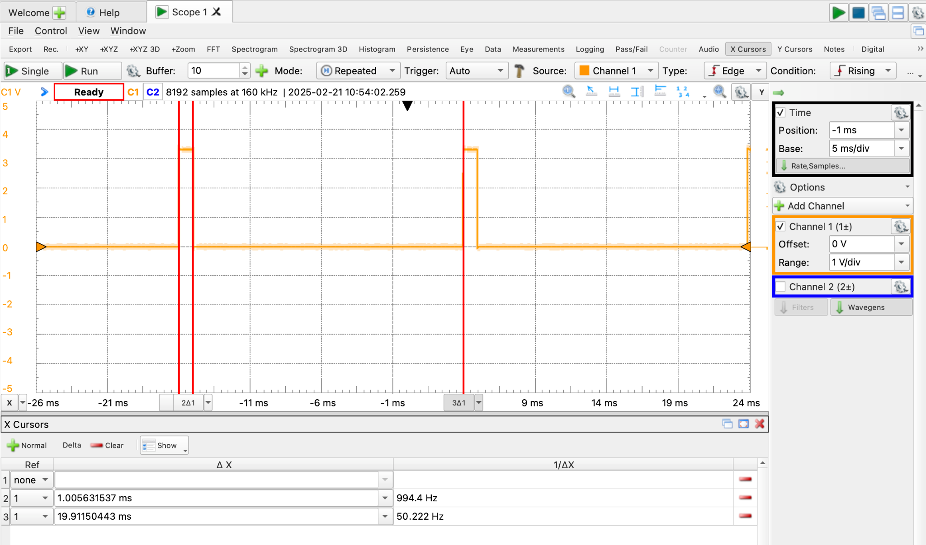
Potentiometer knob in the leftmost position (1ms pulse)

Slide 23
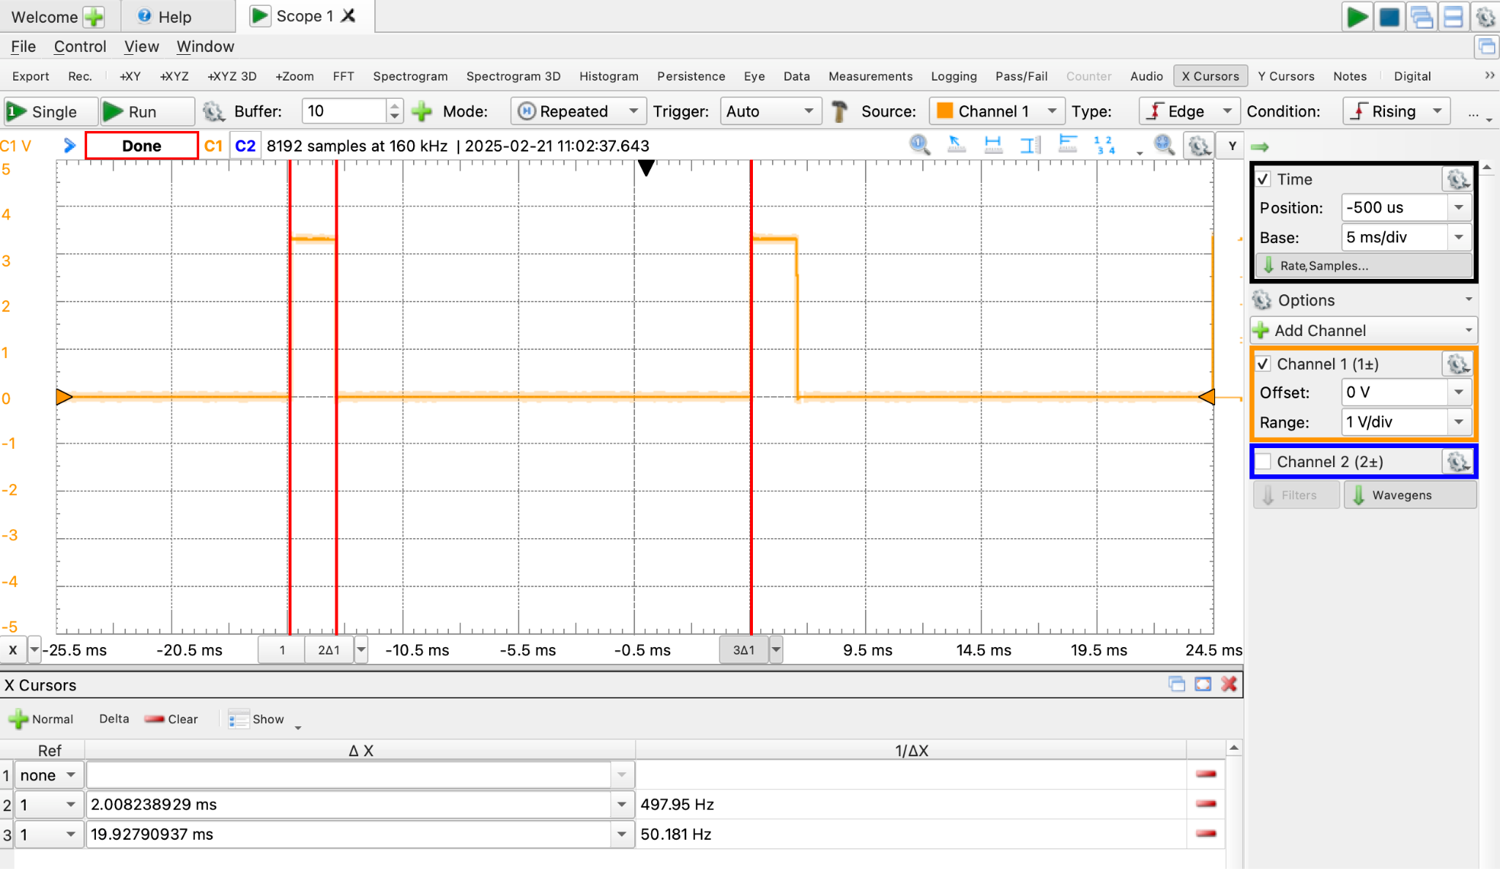
Potentiometer knob in the rightmost position (2ms pulse)

Slide 24
Day15_servo_template.c
Adjust to your own adc code
/* Potentiometer: Analog channel PA0
* Servo PWM input: PA7 */
#include <stdio.h>
#include "ES28.h"
#include "uart.h"
#include "adc.h"
#include "tim.h"
#define PWM_PSC_FACTOR // prescaler
#define PWM_TIMER_MAX // 20 ms
#define SERVO_MIN // 1 ms
#define SERVO_MID // 1.5 ms
#define SERVO_MAX // 2 ms
#define MAXADC 4096 // 12-bit converter
volatile uint8_t timerFlag = 0;
void updateServo(uint16_t value);
void updateServo(uint16_t value) {
if (value>SERVO_MAX)
value = SERVO_MAX;
else if (value < SERVO_MIN)
value = SERVO_MIN;
tim14_pwm_set(value);
}
void TIM16_IRQHandler(void) {
__disable_irq();
/* Clear UIF in status register */
TIM16->SR &= ~TIM_SR_UIF;
timerFlag = 1;
__enable_irq();
}
int main(void) {
int16_t pot_value = 0;
int16_t pwm_value = SERVO_MIN;
uart2_init();
tim14_pa7_pwm_init(PWM_PSC_FACTOR, PWM_TIMER_MAX);
pa0_adc_init();
printf("Potentiometer-controlled servo\n\r");
timerFlag = 0;
tim16_ms_interrupt_init(500);
while(1) {
if(timerFlag==1) {
start_conversion();
pot_value = adc_read(); // Pot value (0 to 4095)
pwm_value = // Map pot_value to pwm_value
updateServo(pwm_value); // Update the PWM
printf("pot_value=%d, \tpwm_value=%d\n\r",
pot_value, pwm_value);
timerFlag=0; // Put the flag down
}
}
return 0;
}
complete
Notes:
#define TIMER1_TOP 40000 // 20 ms
#define SERVO_MIN 2000 // 1 ms
#define SERVO_MAX 4000 // 2 ms
#define SERVO_MID 3000 // 1.5 ms
pwm_value = SERVO_MIN + (int32_t)pot_value*(SERVO_MAX-SERVO_MIN)/1023;
TCCR1B |= (1<<CS11);

Slide 25
Day15_servo_template.c
Adjust to your own adc code
/* Potentiometer: Analog channel PA0
* Servo PWM input: PA7 */
#include <stdio.h>
#include "ES28.h"
#include "uart.h"
#include "adc.h"
#include "tim.h"
#define PWM_PSC_FACTOR 60 // prescaler
#define PWM_TIMER_MAX 4000 // 20 ms
#define SERVO_MIN 200 // 1 ms
#define SERVO_MID 300 // 1.5 ms
#define SERVO_MAX 400 // 2 ms
#define MAXADC 4096 // 12-bit converter
volatile uint8_t timerFlag = 0;
void updateServo(uint16_t value);
void updateServo(uint16_t value) {
if (value>SERVO_MAX)
value = SERVO_MAX;
else if (value < SERVO_MIN)
value = SERVO_MIN;
tim14_pwm_set(value);
}
void TIM16_IRQHandler(void) {
__disable_irq();
/* Clear UIF in status register */
TIM16->SR &= ~TIM_SR_UIF;
timerFlag = 1;
__enable_irq();
}
int main(void) {
int16_t pot_value = 0;
int16_t pwm_value = SERVO_MIN;
uart2_init();
tim14_pa7_pwm_init(PWM_PSC_FACTOR, PWM_TIMER_MAX);
pa0_adc_init();
printf("Potentiometer-controlled servo\n\r");
timerFlag = 0;
tim16_ms_interrupt_init(500);
while(1) {
if(timerFlag==1) {
start_conversion();
pot_value = adc_read(); // Pot value (0 to 4095)
pwm_value = SERVO_MIN +
pot_value*(SERVO_MAX-SERVO_MIN)/MAXADC;
updateServo(pwm_value); // Update the PWM
printf("pot_value=%d, \tpwm_value=%d\n\r",
pot_value, pwm_value);
timerFlag=0; // Put the flag down
}
}
return 0;
}
complete
Notes:
#define TIMER1_TOP 40000 // 20 ms
#define SERVO_MIN 2000 // 1 ms
#define SERVO_MAX 4000 // 2 ms
#define SERVO_MID 3000 // 1.5 ms
pwm_value = SERVO_MIN + (int32_t)pot_value*(SERVO_MAX-SERVO_MIN)/1023;
TCCR1B |= (1<<CS11);

Slide 26
tim.c
void tim14_pa7_pwm_init(uint16_t prescaleFactor, uint16_t timerMax) {
RCC->IOPENR |= RCC_IOPENR_GPIOAEN;
// Set PA7 in alternate function mode (10)
GPIOA->MODER &= ~GPIO_MODER_MODE7_Msk;
GPIOA->MODER |= GPIO_ALTERNATE <<
GPIO_MODER_MODE7_Pos;
// Set PA7 alternate function type AF4
GPIOA->AFR[0] &= ~GPIO_AFRL_AFSEL7_Msk;
GPIOA->AFR[0] |= GPIO_AF4 <<
GPIO_AFRL_AFSEL7_Pos;
// Enable clock access to Timer 14
RCC->APBENR2 |= RCC_APBENR2_TIM14EN;
// Set prescaler
TIM14->PSC = prescaleFactor-1;
// Set autoreload value
TIM14->ARR = timerMax;
// Set the compare register value
TIM14->CCR1 = 0;
// Set pwm mode 1 (0110)
TIM14->CCMR1 &= ~TIM_CCMR1_OC1M_Msk;
TIM14->CCMR1 |= TIM_OC1_PWM1 <<
TIM_CCMR1_OC1M_Pos;
// Make sure timer is in output mode
TIM14->CCMR1 &= ~TIM_CCMR1_CC1S_Msk;
TIM14->CCMR1 |= TIM_CC1_OUTPUT <<
TIM_CCMR1_CC1S_Pos;
// Enable TIM14_CH1 in output mode
TIM14->CCER |= TIM_CCER_CC1E;
// Generate an update event
TIM14->EGR |= TIM_EGR_UG;
// Enable timer
TIM14->CR1 |= TIM_CR1_CEN;
}
#include "tim.h"
#include "ES28.h"
#define TIM16_PSC_FACTOR 12000
void tim16_ms_interrupt_init(int milliseconds) {
// enable clock access to timer 16
RCC->APBENR2 |= RCC_APBENR2_TIM16EN;
// Set prescaler value
TIM16->PSC = TIM16_PSC_FACTOR - 1;
// Set auto-reload value
TIM16->ARR = milliseconds - 1;
// Clear counter
TIM16->CNT = 0;
// Enable update interrupt
TIM16->DIER |= TIM_DIER_UIE;
// Enable timer interrupt in NVIC
NVIC_EnableIRQ(TIM16_IRQn);
// Enable timer
TIM16->CR1 |= TIM_CR1_CEN;
}
void tim14_pwm_set(uint16_t value) {
TIM14->CCR1 = value-1;
}
Notes:
#define TIMER1_TOP 40000 // 20 ms
#define SERVO_MIN 2000 // 1 ms
#define SERVO_MAX 4000 // 2 ms
#define SERVO_MID 3000 // 1.5 ms
pwm_value = SERVO_MIN + (int32_t)pot_value*(SERVO_MAX-SERVO_MIN)/1023;
TCCR1B |= (1<<CS11);

Slide 27
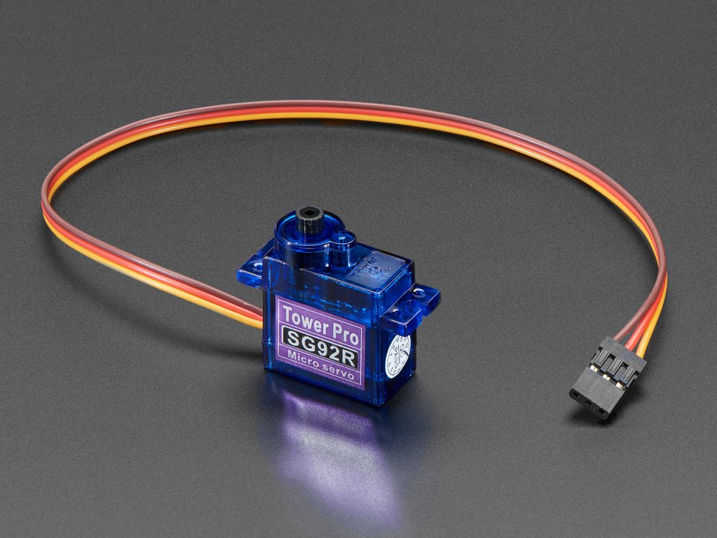
Servo wiring
UNPLUG POWER before making any changes to wiring.
Brown wire → ground
Red/Orange wire → power
Yellow wire → a PWM pin
TIM14 can control PA7.
Tower-Pro SG92R

Slide 28
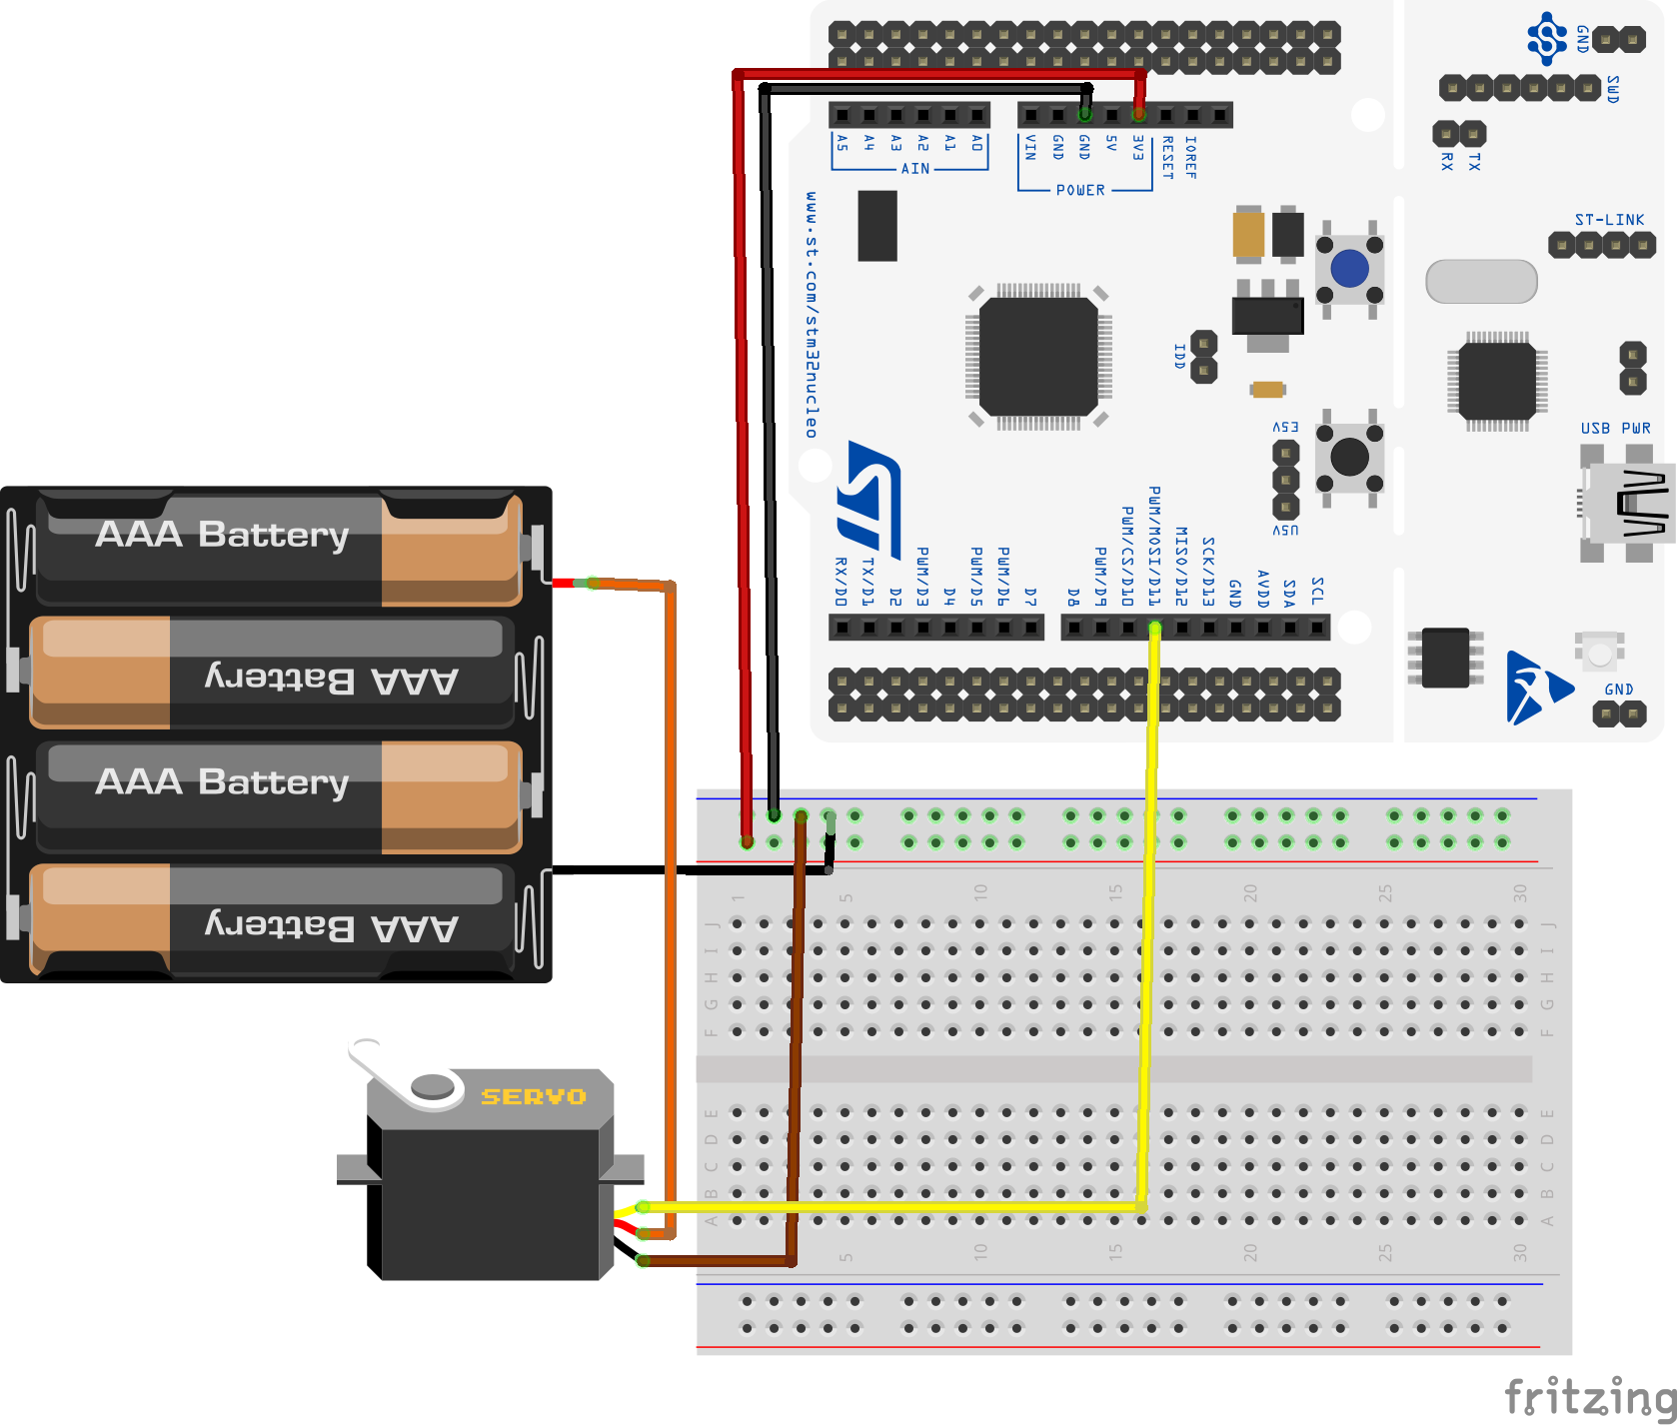
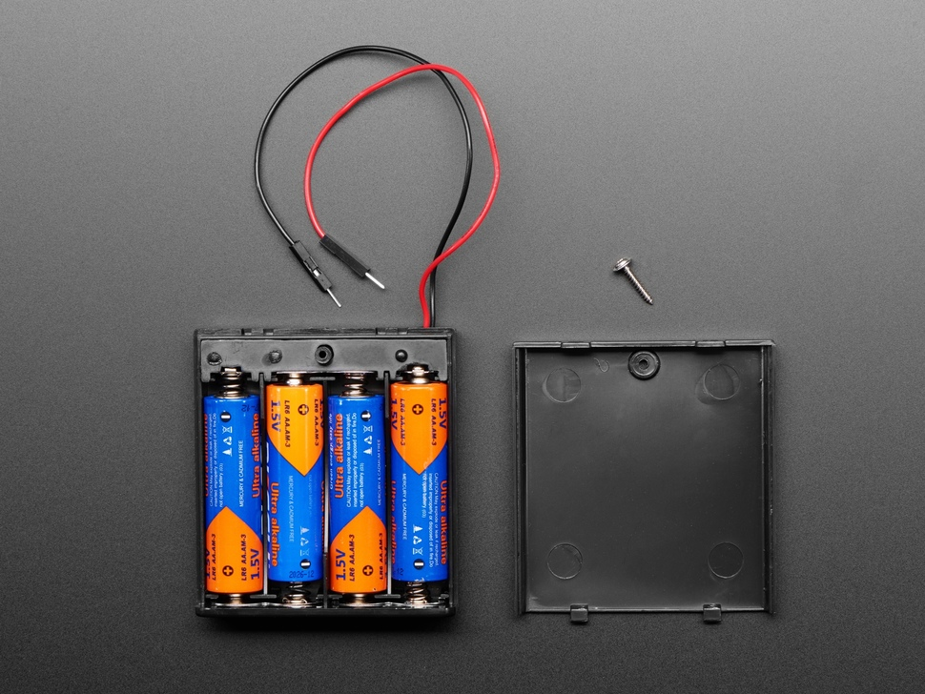
How to power a servo
Servo runs on 4-6V, draws a lot of current. It may draw 250mA while moving, can be much higher if stalled.
Because of high current draw, power the servo from a separate supply, NOT from the Nucleo’s +3/5V pin. For example, 4 AA batteries in series = 6V. Use a prewired “battery box” for convenience. Higher capacity rechargeable batteries are good for extended use.
Why? The USB power from your laptop is limited to 500mA. High current draw by the servo can starve the Nucleo, causing it to “brown out” and reset itself.
https://www.adafruit.com/product/830
Notes:
Used to do this but kept running out of batteries. That's why we use our external power supply again, just like in the motor lab.

Slide 29
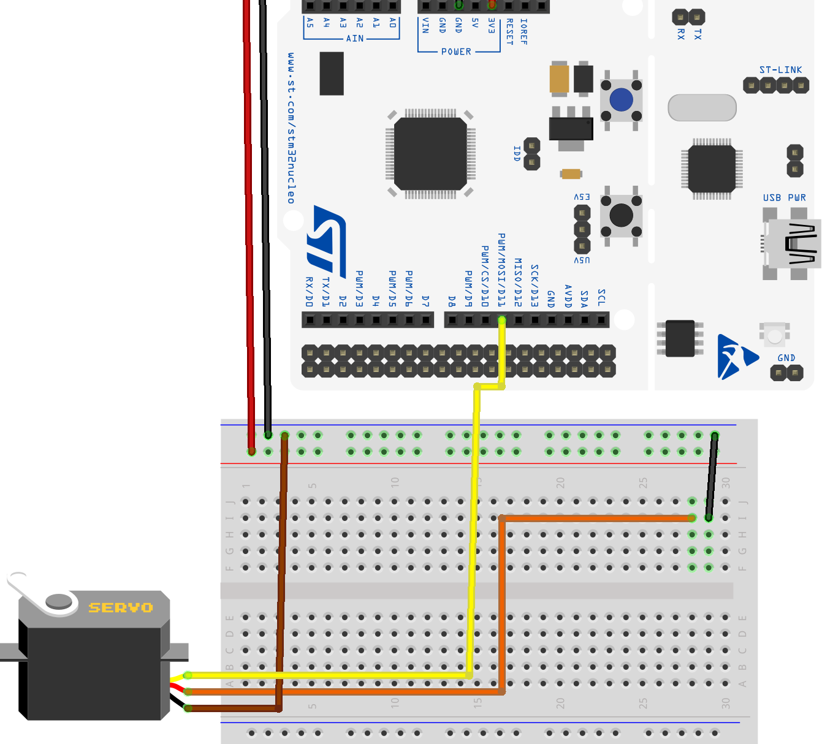
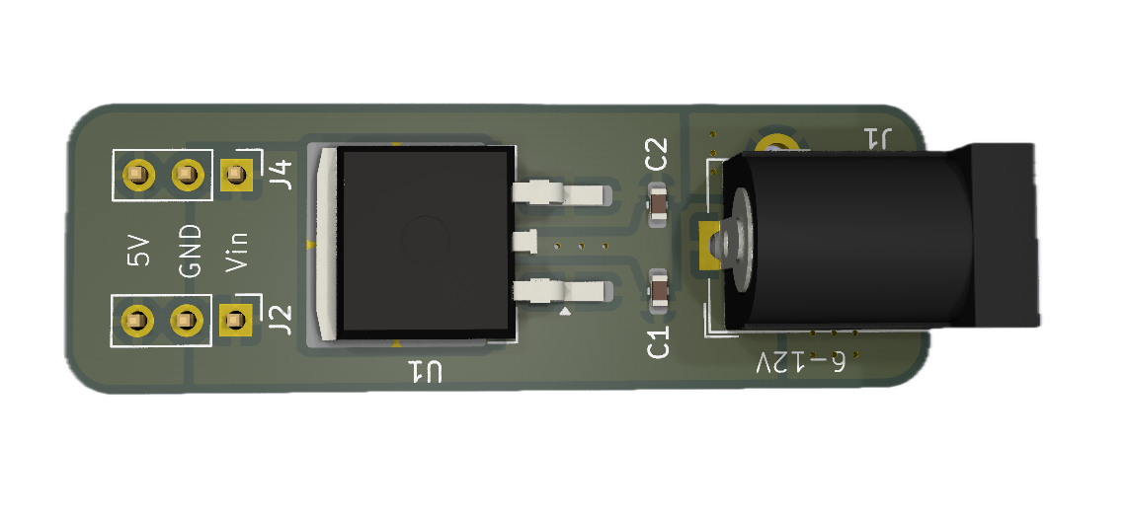
How to power a servo (2)
We'll use the same external power supply setup as we did for the motor:
We'll use a 9V wall charger. But 9V is too high for a servo! The power board contains a 7805 linear voltage regulator that converts 9V to 5V, up to 1.5A.
(Consult the 7805 data sheet for pinout and bypass capacitor instructions if you are interested in using the voltage regulator outside of the power board).
Brown ➝ GND
Orange ➝ power
Yellow ➝ PWM
Notes:
Voltage regulator has 3 pins: Take a look at the datasheet. Pin 1 is power in, pin 2 (middle) is ground, pin 3 is power to the servo. Need those bypass capacitors.
The yellow wire from the servo goes to the PWM pin. But don't wire that yet.

Slide 30
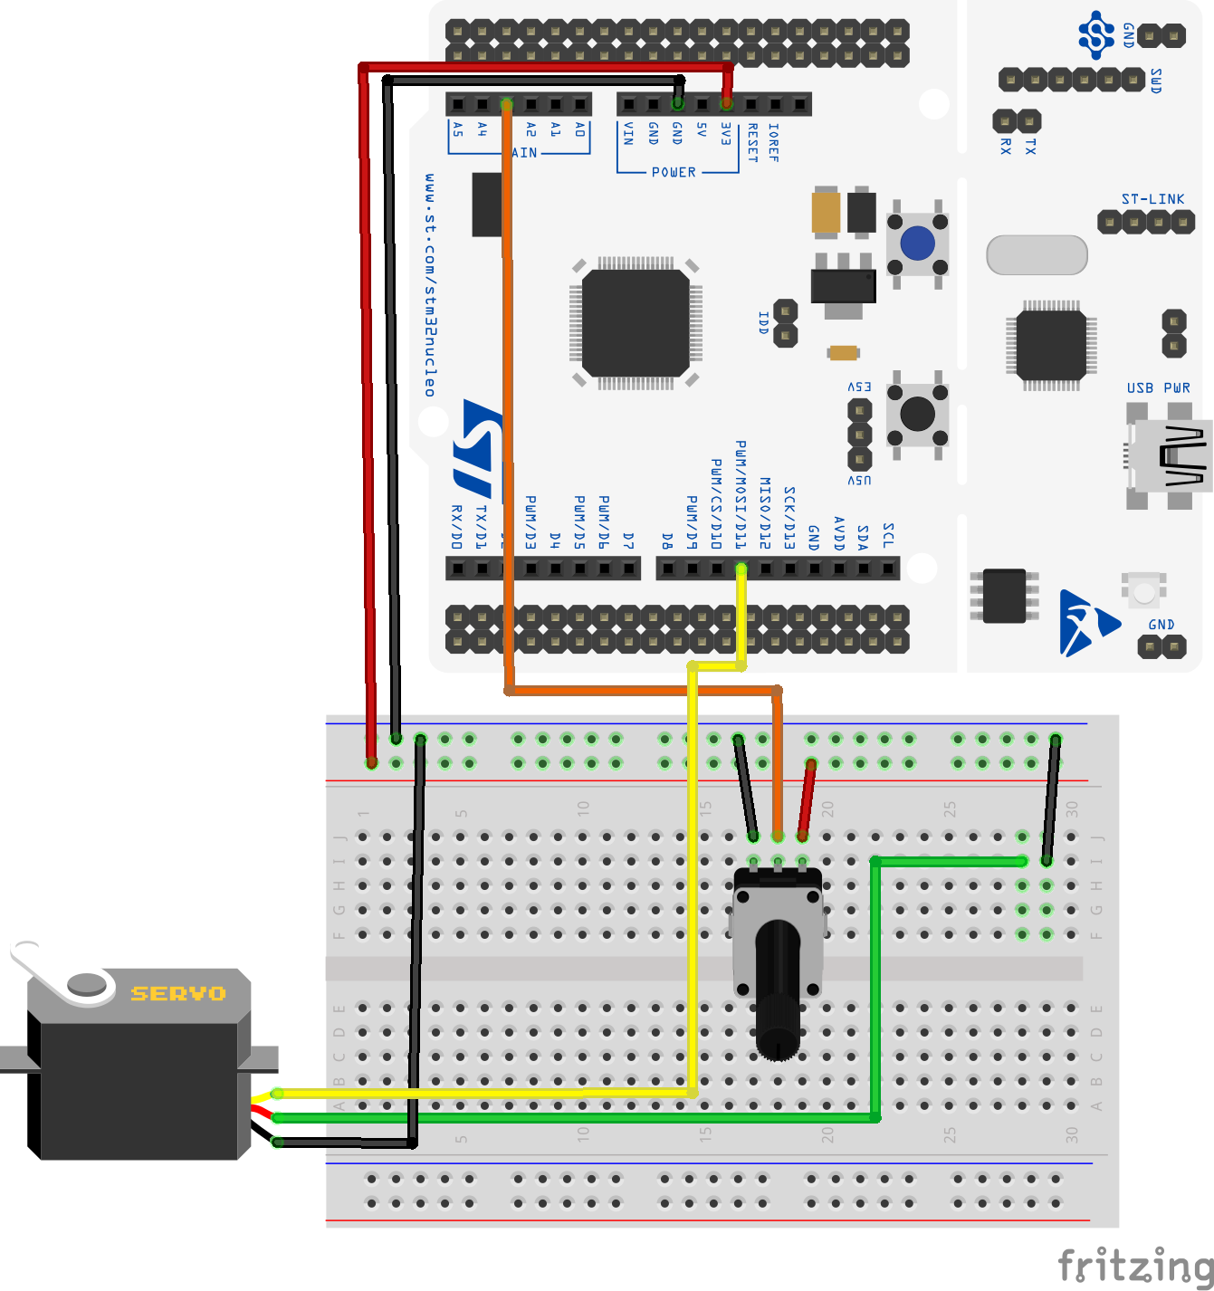
Design Exercise, Part 2
Wire the servo and power board to the breadboard. Check wiring with instructor.
Pot → ADC → PWM controls the servo.
Your program is still there on your Nucleo, so you should see the servo rotate, smoothly, as you adjust the potentiometer.
Brown ➝ GND
Orange ➝ power
Yellow ➝ PWM

Slide 31
If you finished everything…
… then you don't need to come to tomorrow's x-hour.

