Slide 1


Engs 28
Embedded Systems
Day 15x

Slide 2
If you didn't finish Tuesday's design exercise you need to complete that first, before moving on to the next exercise.

Slide 3
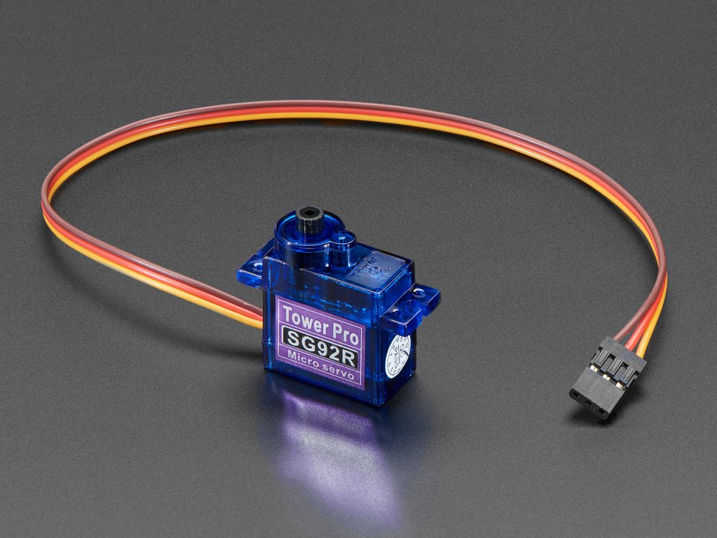
Servo wiring
UNPLUG POWER before making any changes to wiring.
Brown wire → ground
Red/Orange wire → power
Yellow wire → a PWM pin
TIM14 can control PA7.
Tower-Pro SG92R

Slide 4
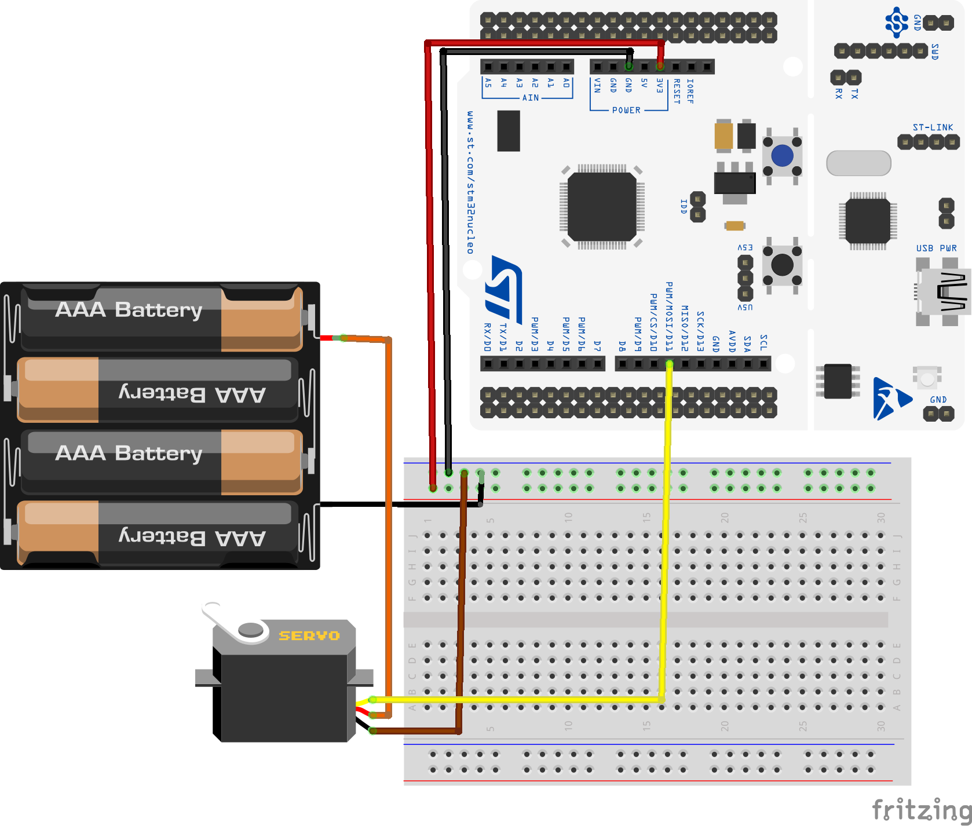
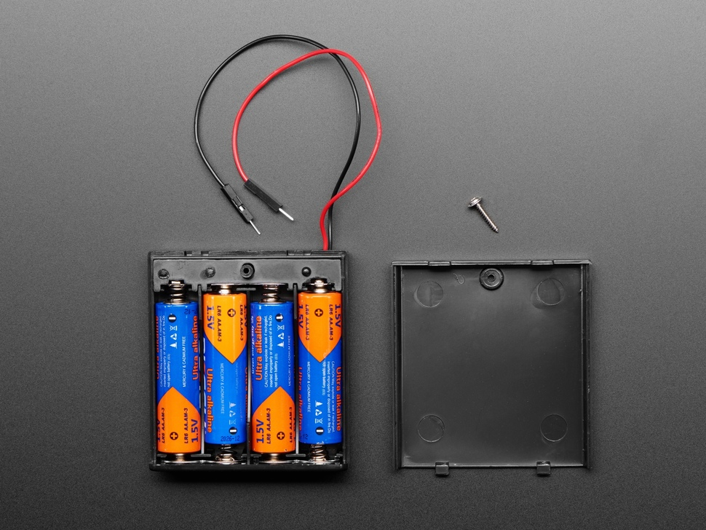
How to power a servo
Servo runs on 4-6V, draws a lot of current. It may draw 250mA while moving, can be much higher if stalled.
Because of high current draw, power the servo from a separate supply, NOT from the Nucleo’s +3/5V pin. For example, 4 AA batteries in series = 6V. Use a prewired “battery box” for convenience. Higher capacity rechargeable batteries are good for extended use.
Why? The USB power from your laptop is limited to 500mA. High current draw by the servo can starve the Nucleo, causing it to “brown out” and reset itself.
https://www.adafruit.com/product/830
Notes:
Used to do this but kept running out of batteries. That's why we use our external power supply again, just like in the motor lab.

Slide 5
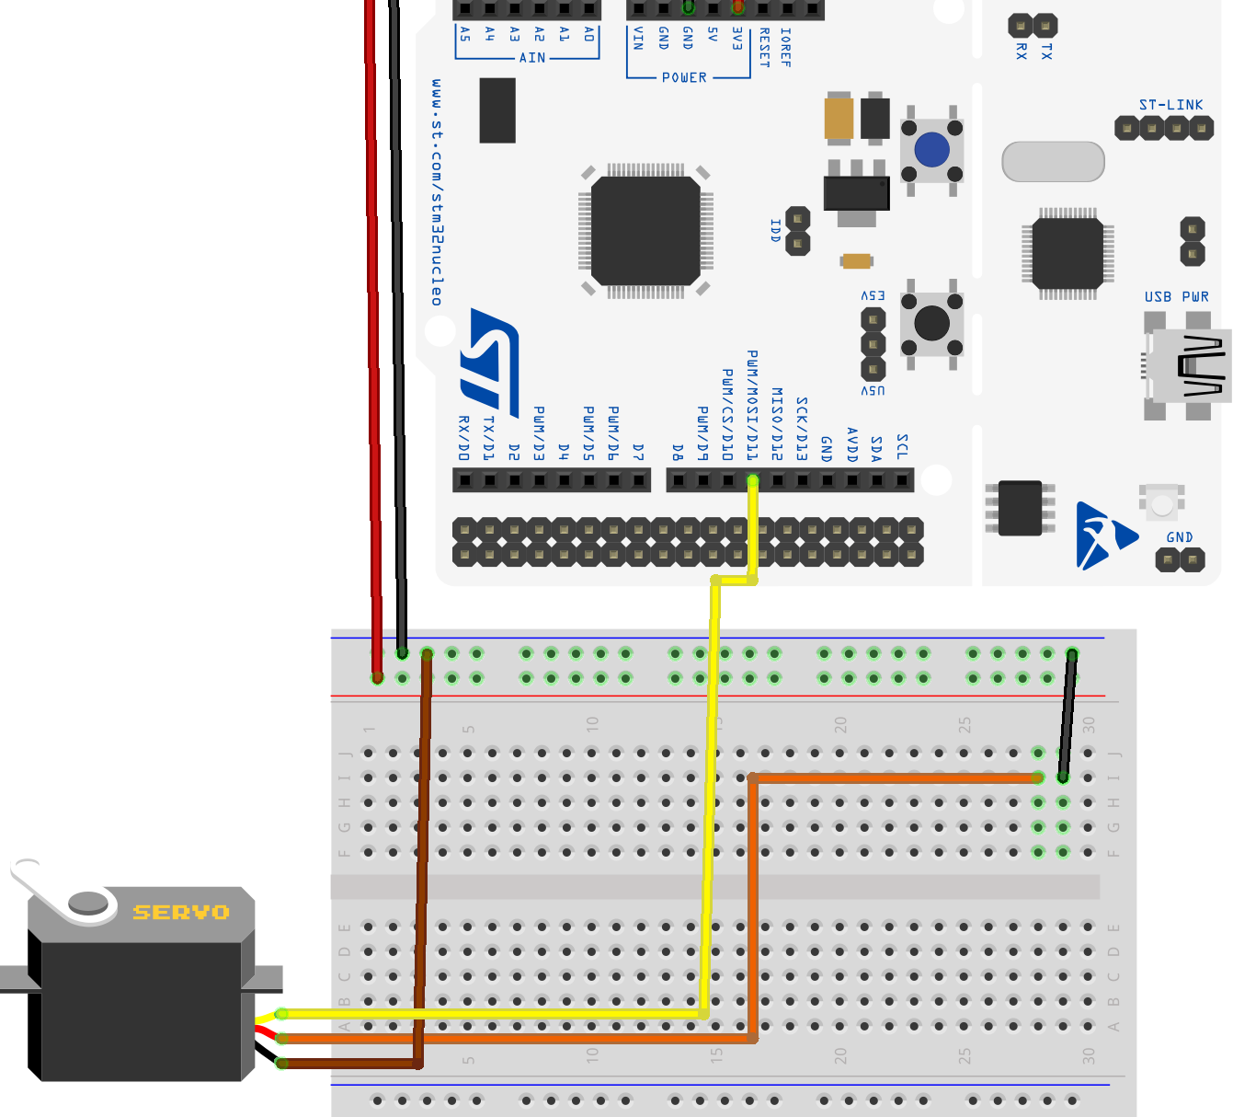
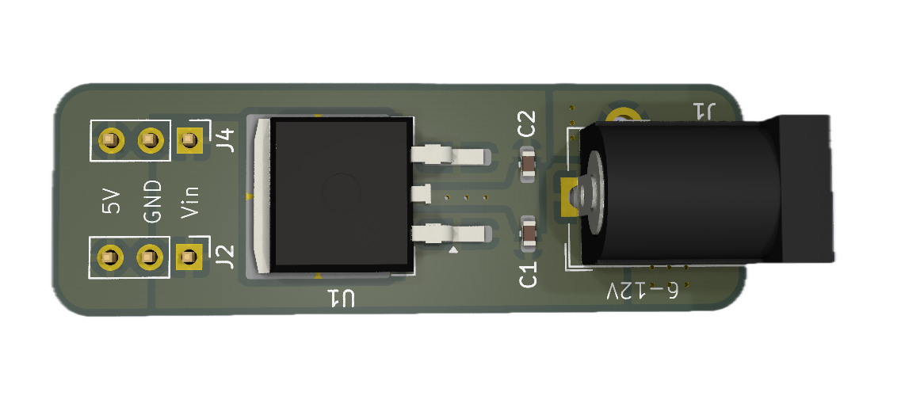
How to power a servo (2)
We'll use the same external power supply setup as we did for the motor:
We'll use a 9V wall charger. But 9V is too high for a servo! The power board contains a 7805 linear voltage regulator that converts 9V to 5V, up to 1.5A.
(Consult the 7805 data sheet for pinout and bypass capacitor instructions if you are interested in using the voltage regulator outside of the power board).
Brown ➝ GND
Orange ➝ power
Yellow ➝ PWM
Notes:
Voltage regulator has 3 pins: Take a look at the datasheet. Pin 1 is power in, pin 2 (middle) is ground, pin 3 is power to the servo. Need those bypass capacitors.
The yellow wire from the servo goes to the PWM pin. But don't wire that yet.

Slide 6
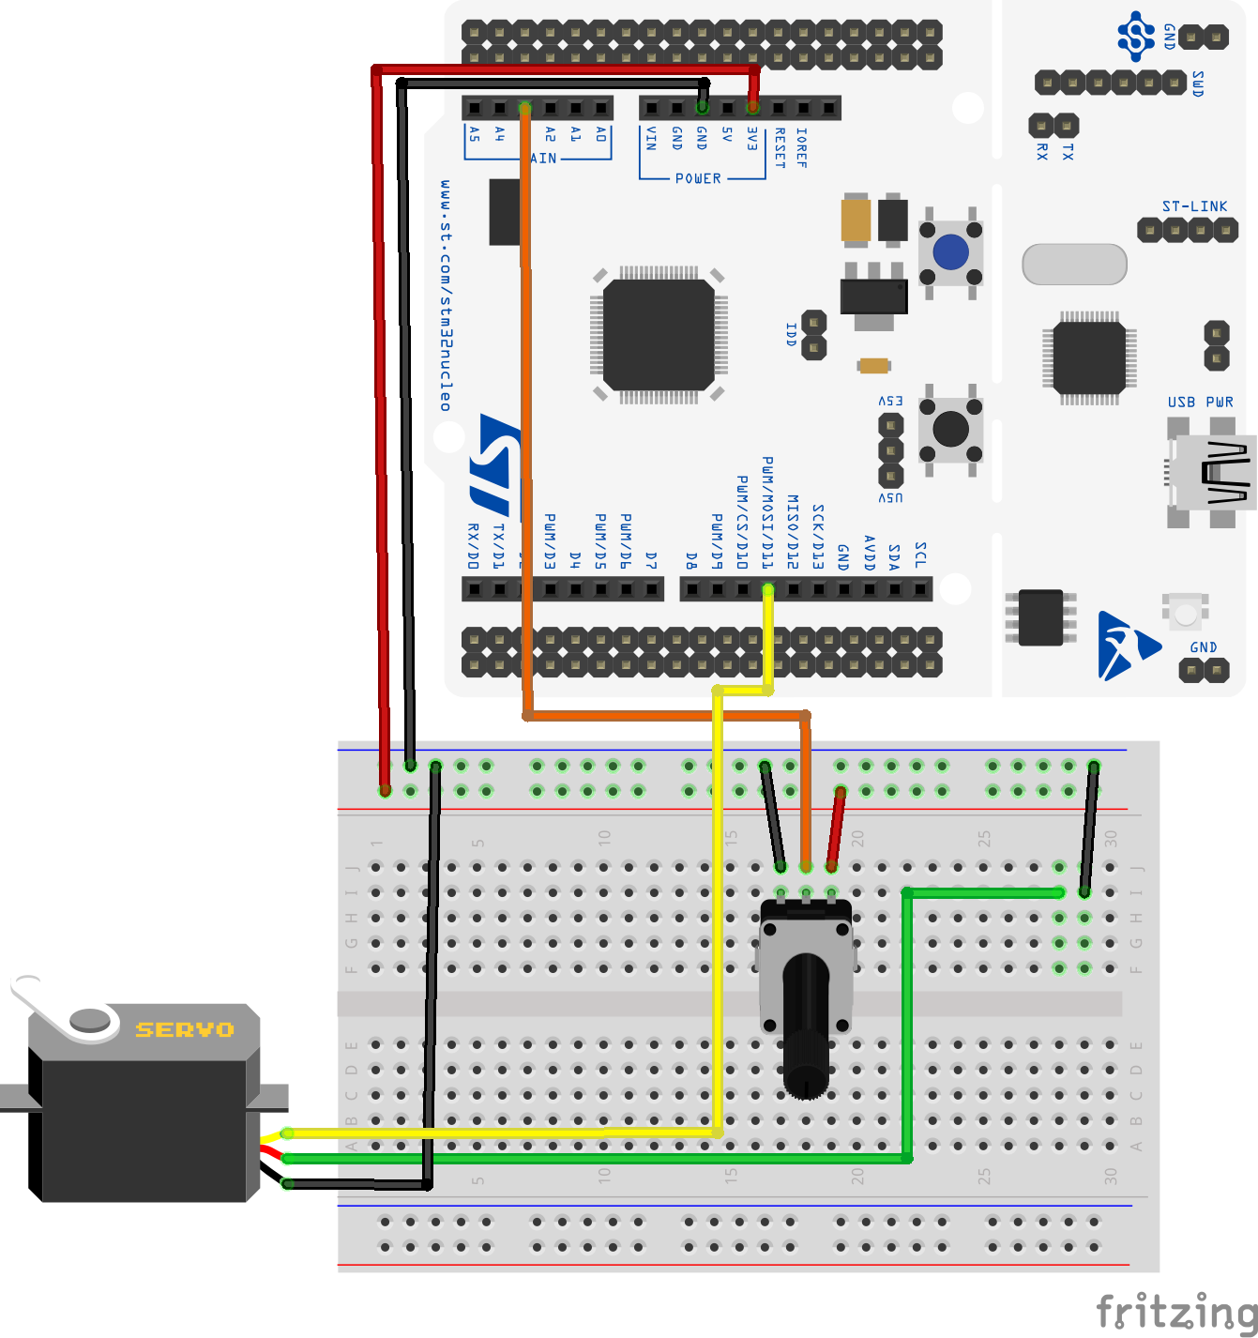
Design Exercise, Part 2
Wire the servo and power board to the breadboard. Check wiring with instructor.
Pot → ADC → PWM controls the servo. Use the code from Day15_servo_template.c that you completed last class.
Your program is still there on your Nucleo, so you should see the servo rotate, smoothly, as you adjust the potentiometer.
Brown ➝ GND
Orange ➝ power
Yellow ➝ PWM

