Slide 1
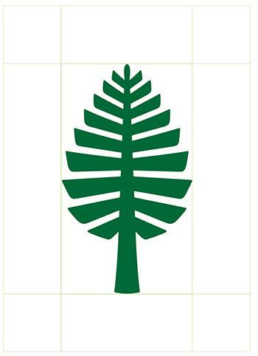

Engs 28
Embedded Systems
Day 16

Slide 2
Photosensors

Slide 3
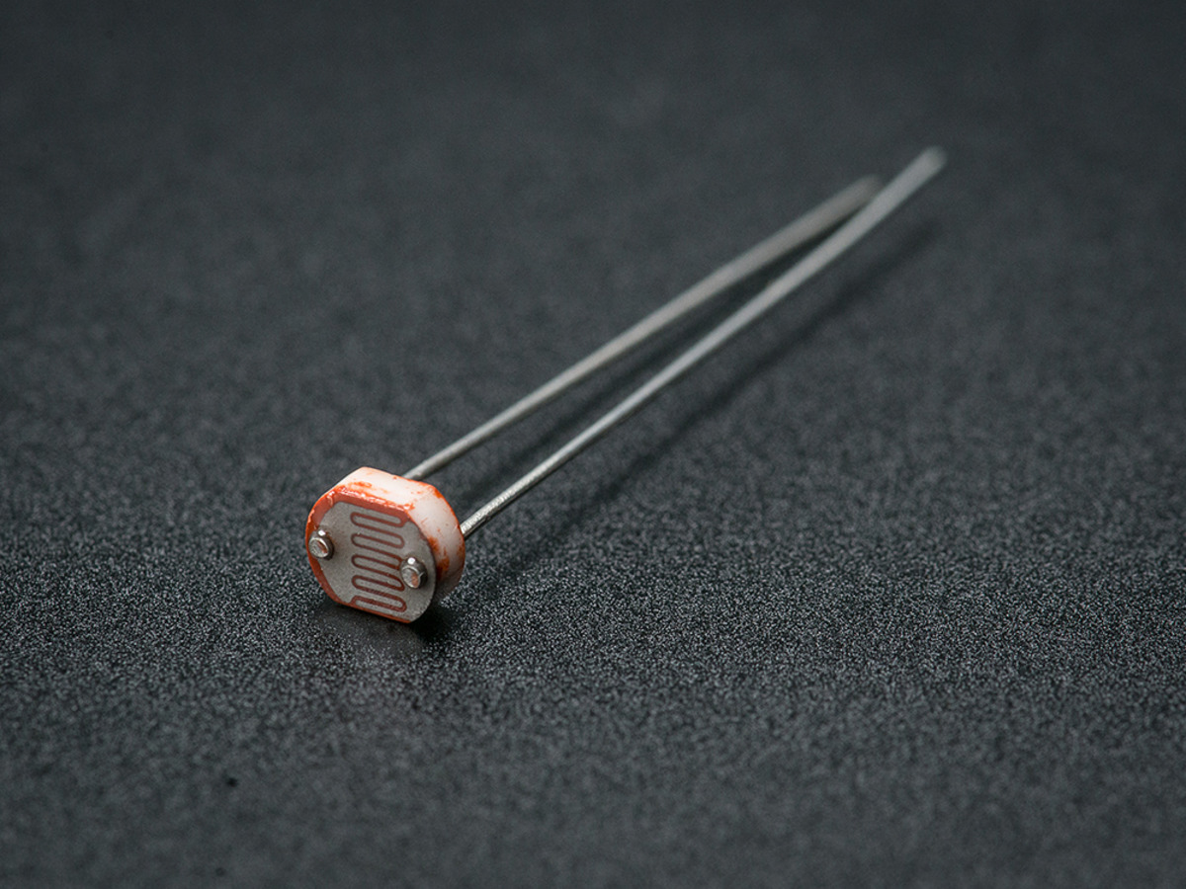
Photocell = light-dependent resistor (LDR)
Made out of semiconductor material with high resistance.
Photons are absorbed by the material and the energy transferred to electrons gives some of them sufficient energy to break free, resulting in lower resistance.
Very low cost, but are very inaccurate.
Each photocell sensor will act a little differently than the other.
The variations can be really large, 50% or higher!
They shouldn't be used to try to determine precise light levels. Instead, you can expect to only be able to determine basic light changes.
Cadmium sulfide’s resistivity decreases with increasing light exposure.
https://www.adafruit.com/product/161
Notes:
An LDR or photoresistor is made of semiconductor material with a high resistance. It has a high resistance because there are very few electrons that are free and able to move - the vast majority of the electrons are locked into the crystal lattice and unable to move. Therefore in this state there is a high LDR resistance.
As light falls on the semiconductor, the light photons are absorbed by the semiconductor lattice and some of their energy is transferred to the electrons.
The amount of energy transferred to the electrons gives some of them sufficient energy to break free from the crystal lattice so that they can then conduct electricity. This results in a lowering of the resistance of the semiconductor and hence the overall LDR resistance.
The process is progressive, and as more light shines on the LDR semiconductor, so more electrons are released to conduct electricity and the resistance falls further.

Slide 4
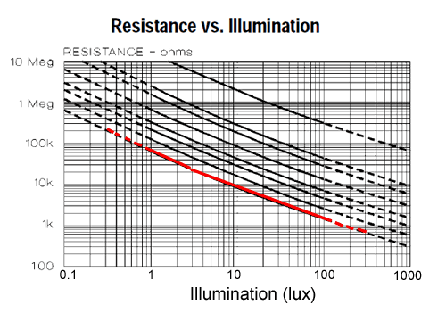
Photosensors are frequently nonlinear
The CdS photosensor has nonlinear response: its resistance is not a linear function of the illumination.
This isn’t a problem if used as a “light / dark” sensor for night lights, etc.
If you want a quantitative result (lux), must implement a conversion function.
“lux” = lumens per square meter
Ref: https://learn.adafruit.com/photocells
Notes:
Quite non-linear (at least over a wide range). Lines look relatively straight but…: this is a log-log scale.
Datasheet gives an approximation of what the functional relationship is.
Each photocell is a bit different, even if they are "the same". They are very low cost, easy to get in many sizes and specifications, but are very inaccurate.
Each photocell sensor will act a little differently than the other, even if they are from the same batch. The variations can
be really large, 50% or higher! For this reason, they shouldn't be used to try to determine precise light levels in lux or
millicandela. Instead, you can expect to only be able to determine basic light changes.
To obtain the typical resistance versus illumination characteristic for a specific photocell:
1. Look up 2 footcandle resistance in table.
2. Insert resistance given and draw a curve through that point
and parallel to the closest member of the family of curves
shown for the appropriate type of photo-sensitive material.

Slide 5
Photosensors are frequently nonlinear
The CdS photosensor has nonlinear response: its resistance is not a linear function of the illumination.
Log-log plot approximate relationship (data sheet)
log₁₀(R100) – log₁₀(R10) = -0.6 ( log₁₀(E100) – log₁₀(E10) )
“lux” = lumens per square meter
Ref: https://learn.adafruit.com/photocells

Slide 6
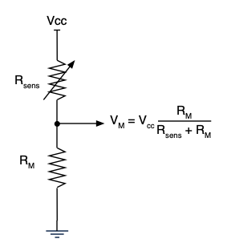
Many sensors are based on resistance
Sensors based on variable resistance:
Potentiometer, linear and rotary (position, angle)
Force-sensing resistor (force)
Photoresistor (light)
http://www.resistorguide.com/photoresistor/
Thermistor (temperature)
https://www.omega.com/en-us/resources/temperature-probes
Also:
Strain gage: senses tiny stretch/compression
https://www.omega.com/en-us/resources/strain-gages
Load cell: measures weight (uses strain gage)
https://www.omega.com/en-us/resources/load-cells
Strain gages require more complex electronics than a simple voltage divider.

Slide 7
Using a CdS photocell to measure light
Discuss at your table: As the light gets brighter, does V_{M} increase or decrease?
Part 1 of the lab will guide you deeper into the data sheet.

Slide 8
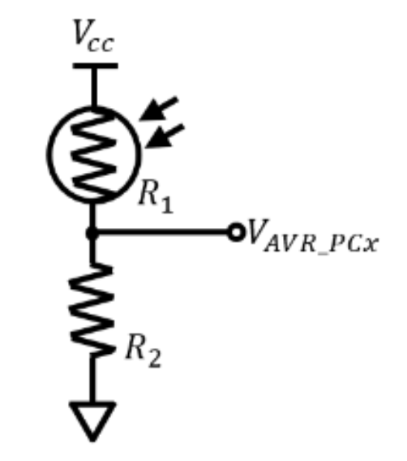

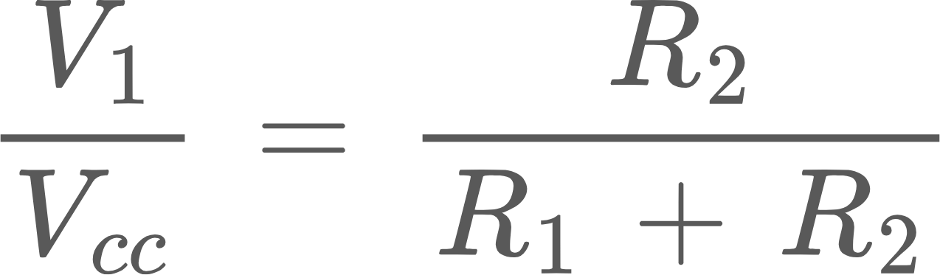
Part 1 of Lab 8: Technical Study of Photocells
Using the datasheet, record the minimum dark resistance and minimum illuminated resistance for R₁.
Using your multimeter and a flashlight, record the dark resistance and illuminated resistance for R₁.
Why might the measured values disagree with the datasheet?
On page 133 of Williams, it is recommended that the value of R₂ be set as the geometric mean of R_{dark} and R_{illuminated}, i.e. Based on the values you measured, compute R₂.
Recall that the equation for the voltage divider as drawn above is Using the values you measured, roughly what are the voltages that you would expect to see at V₁ when the sensor is illuminated and when the sensor is dark, assuming V_{cc} = 3.3V ?
You are limited by the discrete resistor values made available for your use in the laboratory, so you might not have the exact value you calculated. Assume that you have a 10kΩ resistor available to you. Repeat the calculations from the previous deliverable. Is using a 10kΩ going to be a problem?

Slide 9
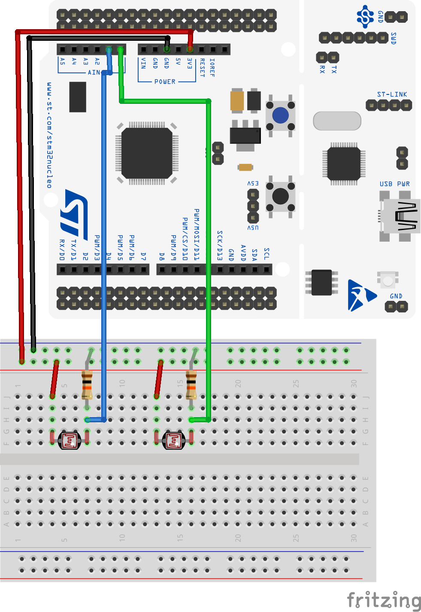
Technical Study of Photocells, continued
7. Wire the two photosensors to 10K resistors on your breadboard as shown in the figure.
(a) Write a program to measure the two sensor voltages and print them on your screen. This should be an easy two-channel modification of the earlier A/D + potentiometer program. A one-second sampling period is fine.
(b) Also wire the sensor voltages to analog channels 1 and 2 of the AD2, to display the voltages with Waveform’s voltmeter function. Does your measured value for each channel fall within the range you calculated in the question 6?
(c) Slowly sweep a flashlight beam (the one on your phone is fine) across the two sensors and observe how the voltages change. Note the maximum and minimum voltages. How do they compare to your theoretical maximum and minimum voltages?

Slide 10
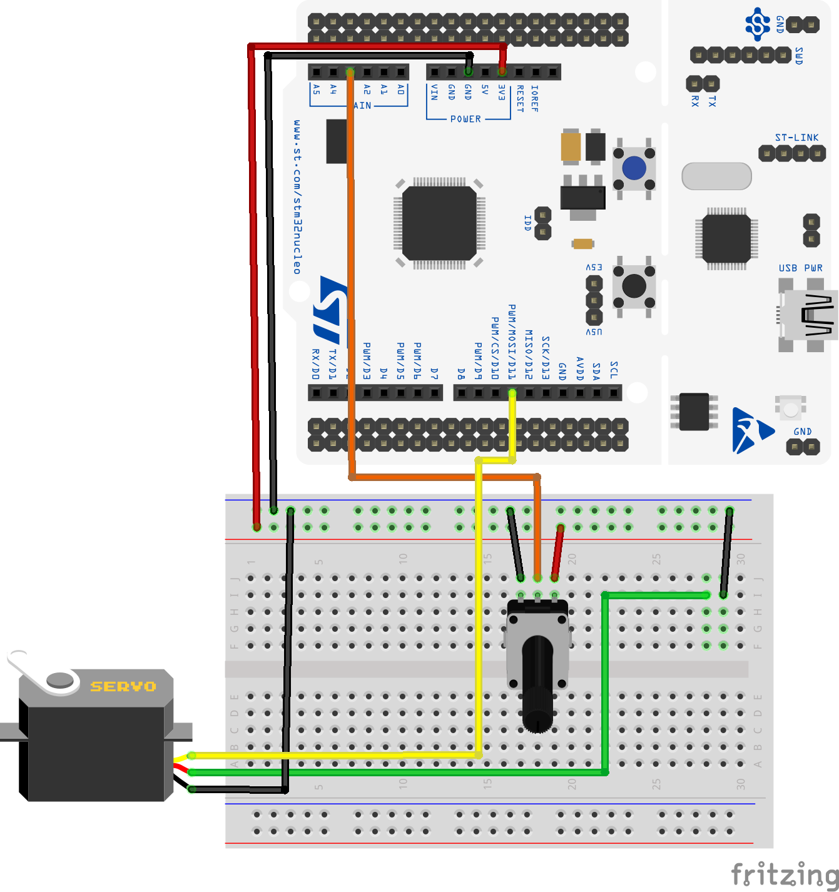
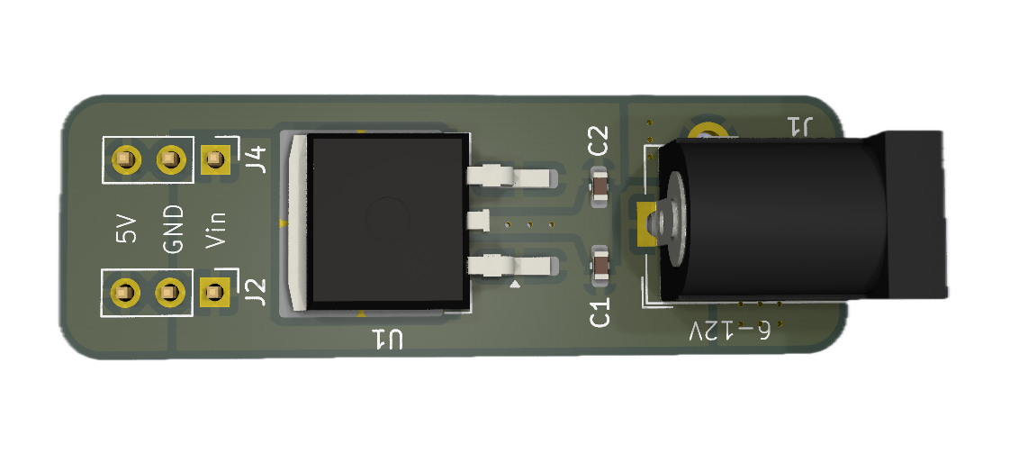
Review: servo test setup
The 7805 linear voltage regulator on the powerboard converts 9V external supply to 5V, up to 1.5A.
Pot → ADC → PWM controls the servo. Use the code from Day15_servo_template.c that you completed last class.
We'll now add the photocells to the tracker arm of your servo motor.
Brown ➝ GND
Orange ➝ power
Yellow ➝ PWM

Slide 11
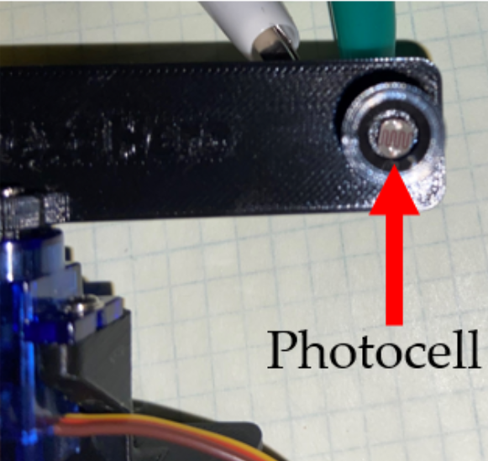
Solar Tracker Assembly
Remove your photocells from the breadboard and insert them into the shielding cups on the motorarm, like so:

Slide 12
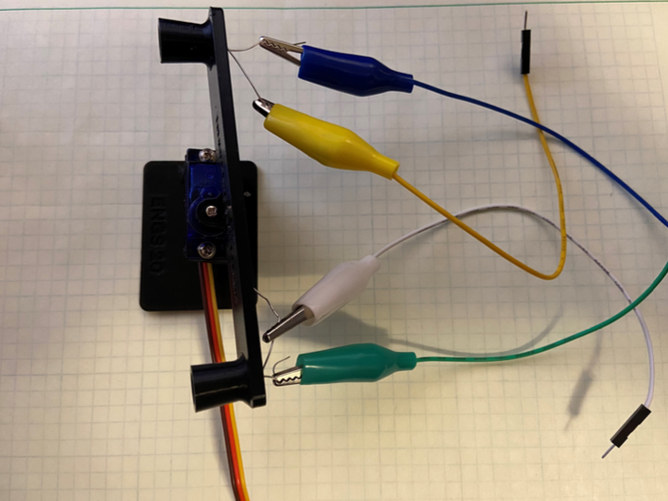
Solar Tracker Assembly, continued
Use alligator-to-breadboard clips to make the electrical connections between the leads of the photosensors and your breadboard:

Slide 13
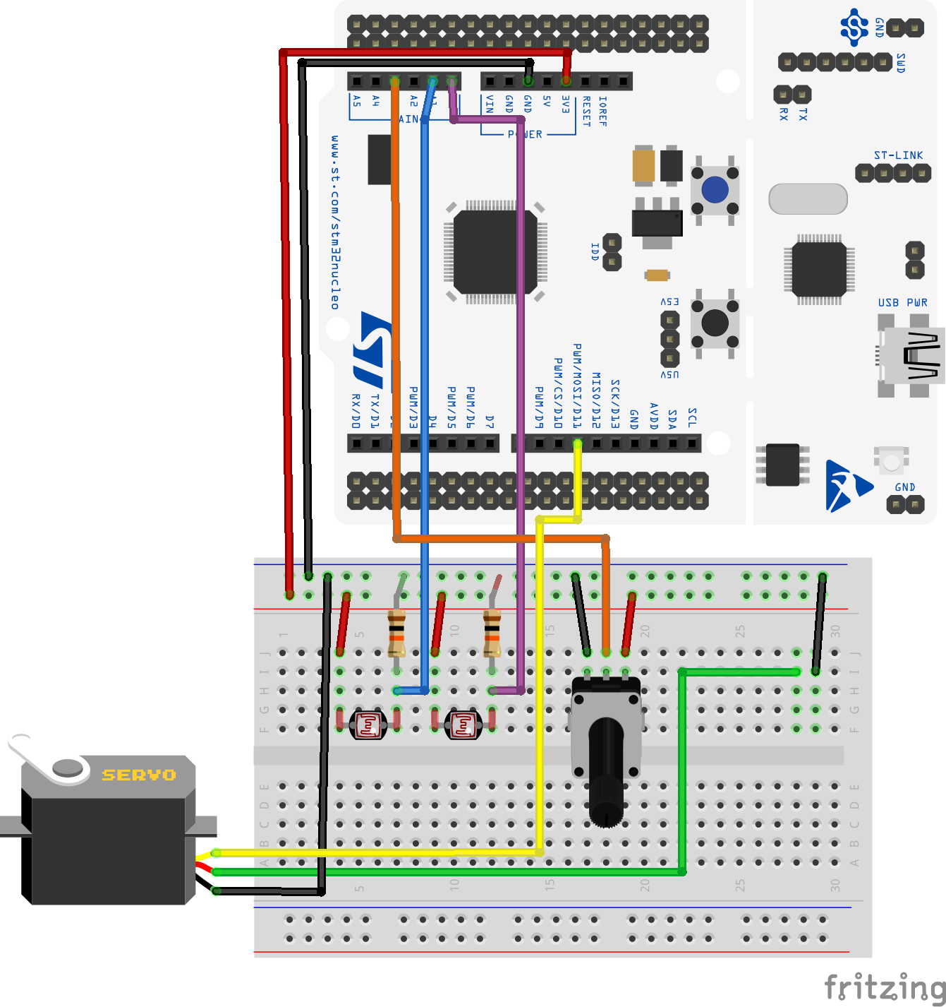
Solar Tracker Assembly, last step
Connect the leads of the alligator clips to your breadboard to recreate the photocell circuit from earlier in the lab.
After you’ve confirmed that your servo (still) works properly with the pot in Part 2 of the lab handout, you can remove the pot.
Physically located in the cups of your tracker arm

Slide 14
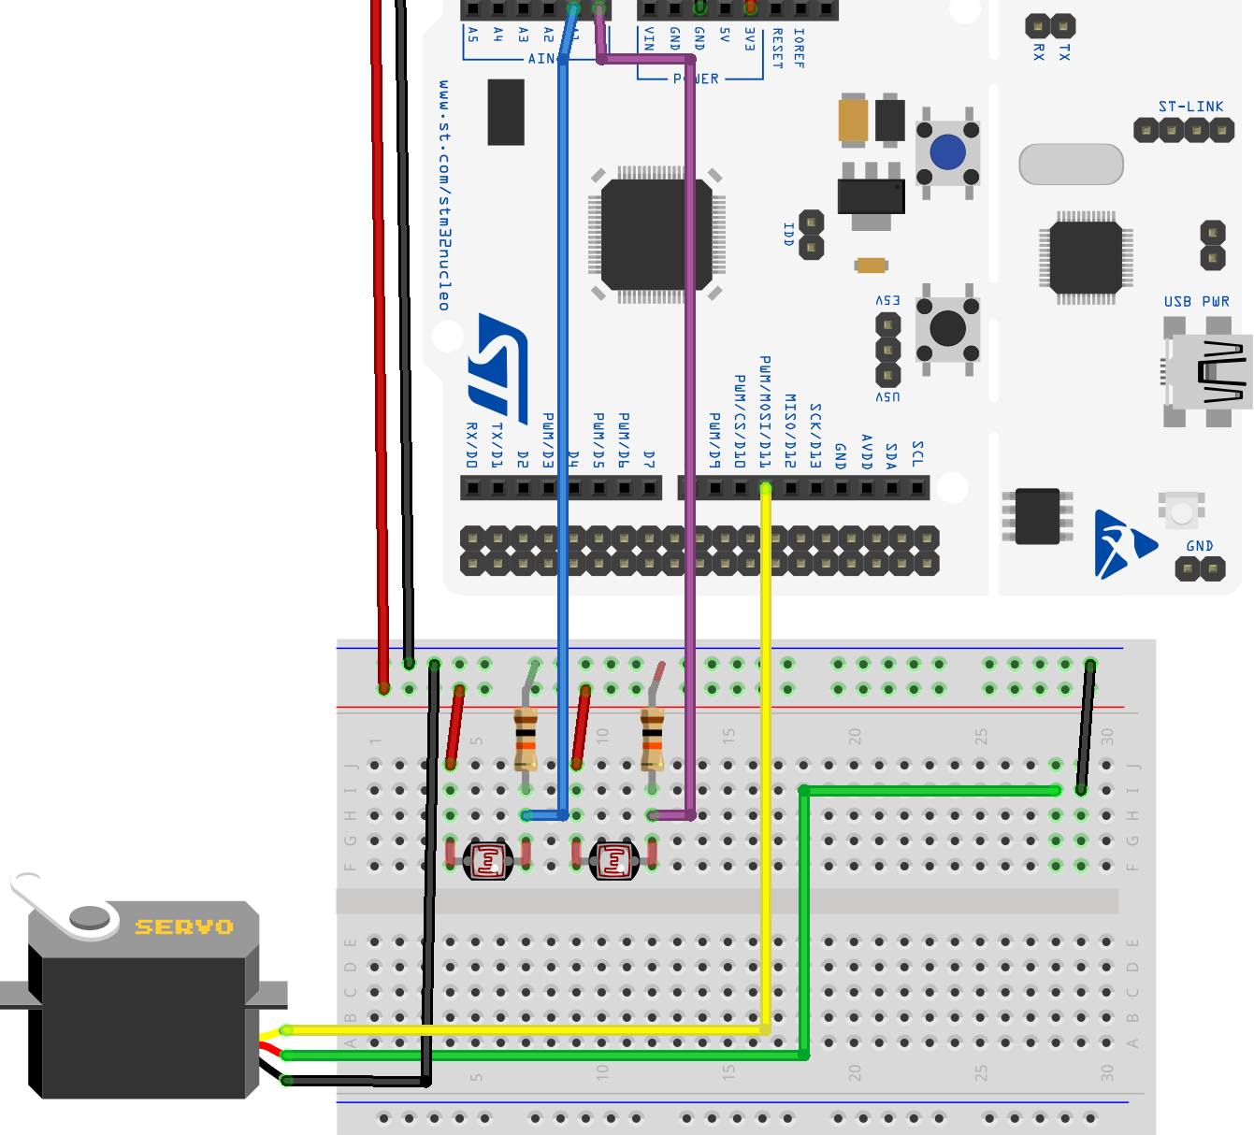
Ultimate Setup

Slide 15
Read "A Solar Tracker" in the lab handout
Discuss at your table how you might implement the feedback loop.

Slide 16


Student Feedback Survey
dartgo.org/genaifeedback
I am a Gen AI Teaching grantee this term.
This survey is to gather feedback on the intervention (aka HiTA) in this course.
This should take you approximately 5 minutes.
Your answers are anonymous and will be shared in aggregate with me after the term has ended.

