Slide 1


Engs 28
Embedded Systems
Day 17

Slide 2
Final Project Student Groupings

Slide 3
Peyton
Oliver
Tiffany
Thor
Starlone
JP
Ollie
Napu
Nina
Teaen
Jeff
Gent
Molly
Soleil
Meiirzhan
Andrew
Papa
Simrah
Renata
Holden
Tad and TAs
Stefan
Konstantinos
Aikins
Rachel
Hunter
Please sit at your assigned table.
Ryan
Owen
Leah
Claire
Hope
Alex
Brianna
Maya
Petra

Slide 4
Agenda
Introduction to BLE
Final Project Work

Slide 5
Bluetooth Low Energy (BLE)

Slide 6
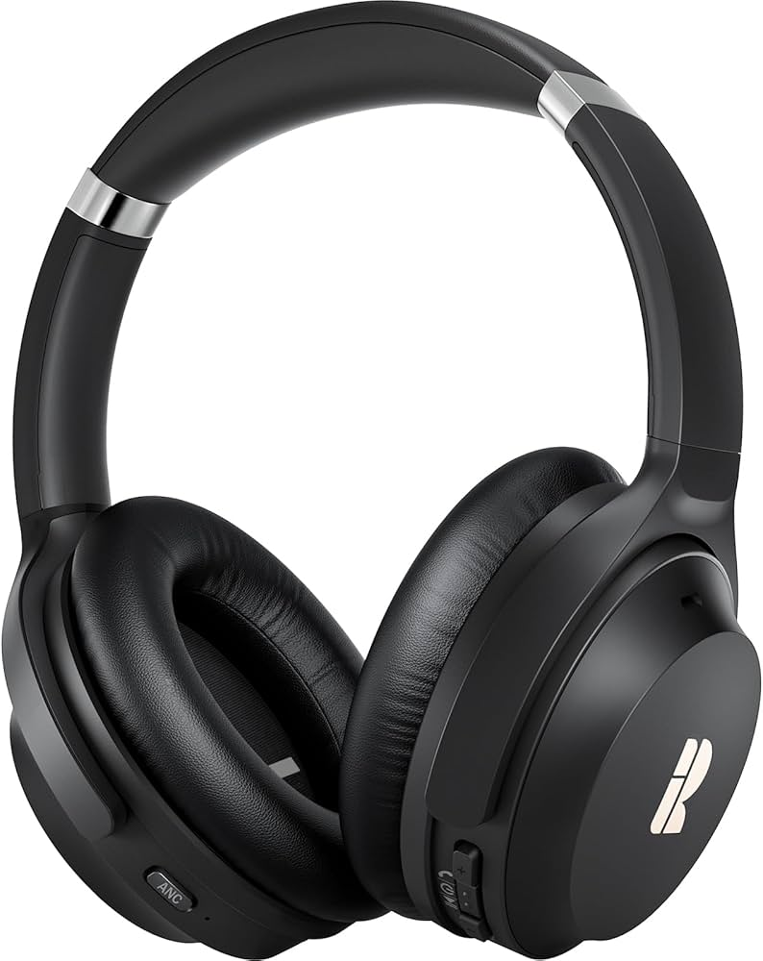
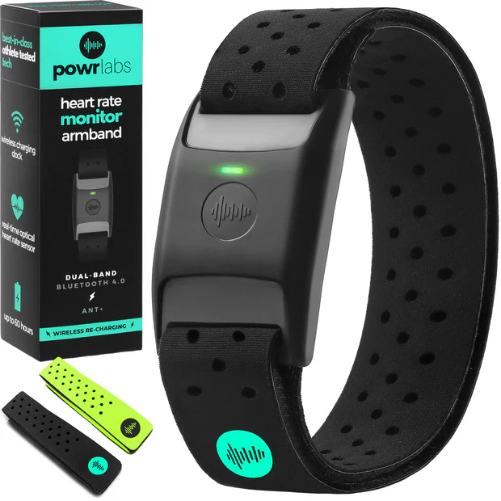
"Bluetooth Classic" vs. "BLE"
Bluetooth Low Energy
Designed for:
Continuous data streaming
Audio (headphones, speakers)
Higher data rates
Longer connection times
Higher power consumption
"Stay connected and stream a lot."
Designed for:
Tiny bursts of data
Sensors
Battery-powered devices
Very low energy use
"Wake up → send small data → go back to sleep."

Slide 7
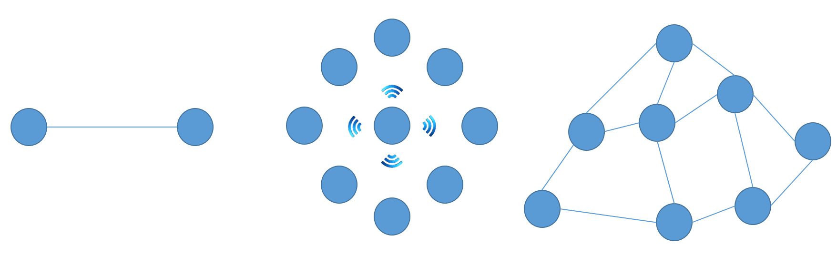
BLE Connection Modes
Point-to-Point
Central ↔ Peripheral
• Two-way communication
• Structured data (Services &
Characteristics)
• Most common BLE mode
What we will use!
Broadcast
Peripheral → Everyone nearby
• No connection required
• Small packets
• One-way only
Ex: Fitness sensors
Mesh
Many ↔ Many
• Messages hop device to
device
• No single central
• Large IoT systems
Ex: Environmental monitoring in a greenhouse

Slide 8
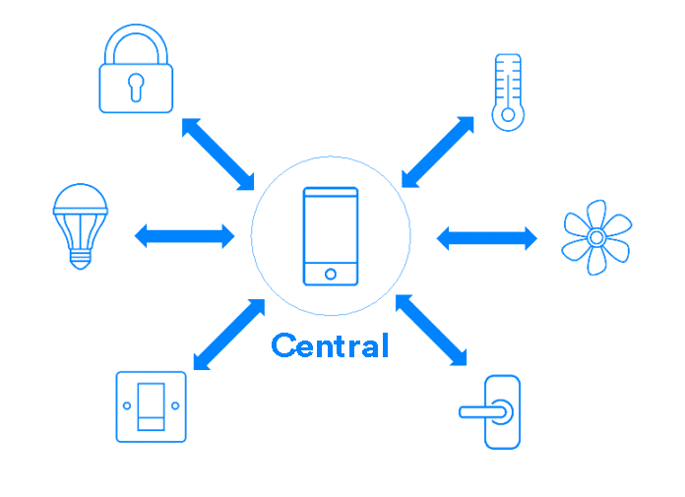
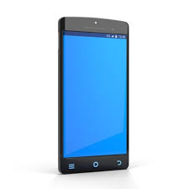
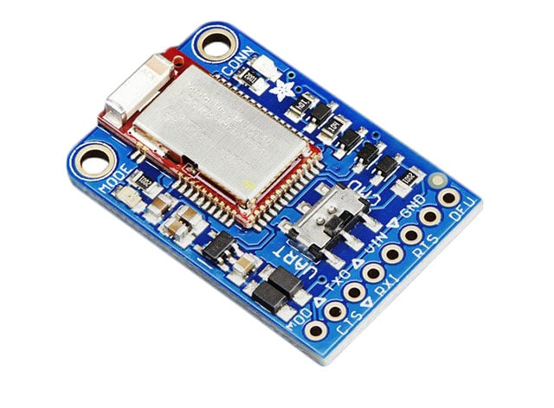
Central vs. Peripheral
For us:
Central
Your phone
Called "Client" in BLE speak
Initiates communication and requests data
Peripheral
Adafruit Bluefruit BLE
Called "Server" in BLE speak (it stores the data, services, and characteristics that another device (the client) wants to read, write, or subscribe to)

Slide 9
How a Connection is Made (GAP)
GAP = Generic Access Profile
Controls connections and advertising in Bluetooth
Peripheral advertises a short packet containing its name, supported services, and a unique identifier (called a Universally Unique Identifier or UUID)
The central scans for advertisements, decides which device to connect to
As soon as a connection is established, the peripheral will stop advertising itself and other devices will no longer be able to see it or connect to it until the existing connection is broken
Found your service: Let's talk! Send me temperature updates and let me change the motor speed!
Helllllloooooooo! I have data from my ENGS 28 team's final project for you, including temperature and motor speed! Interested? Anyone?

Slide 10
How Communication Happens (GAAT Protocol)
GAAT = Generic Attribute Profile
Defines how two BLE devices transfer data back and forth
Is used once a dedicated connection is established between two devices
Peripheral (Server) Team 15 Bluefruit Device
└── Service(s) └── ENGS 28 Super Cool Final Project
└── Characteristic(s) └── Temperature └── Motor speed
└── Value └── 72 °F └── 65 rpm
└── Properties └── read └── write
Service = category of functionality
Characteristic = one piece of data
Value = the actual data
Properties = read, write, notify, …
Central can request the current value.
Central can send a new value.
Peripheral can push a new value to the central whenever it changes.

Slide 11

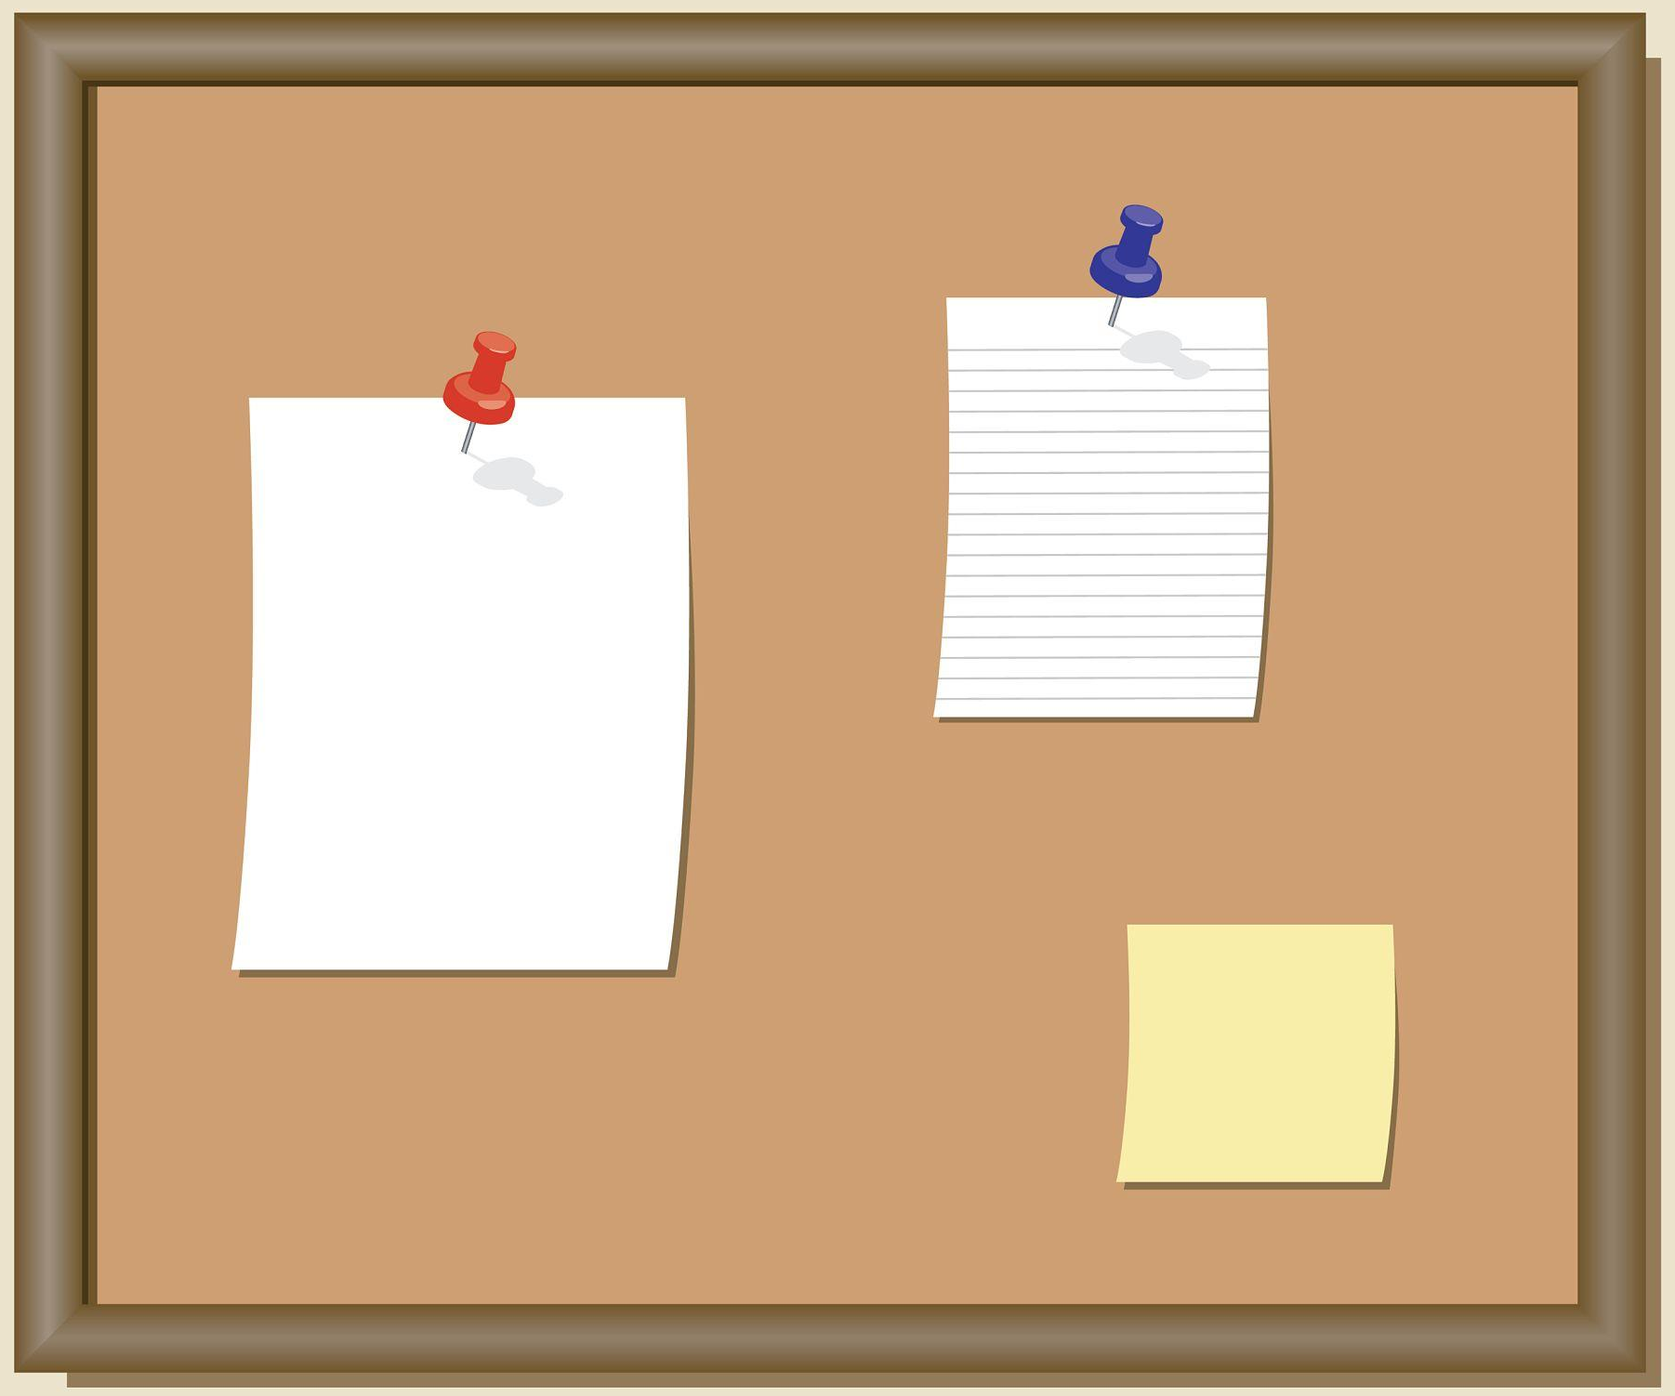
Key Takeaway
Peripheral wakes up
Begins advertising
Announces available services & characteristics
Each characteristic defines its rules
Whether it can be written, read, etc
These rules define how the client can interact with the characteristics
Analogy: Message board
Peripheral periodically pins a note to a public board
Central occasionally checks the board for updates
No constant conversation
Just structured updates when needed

Slide 12
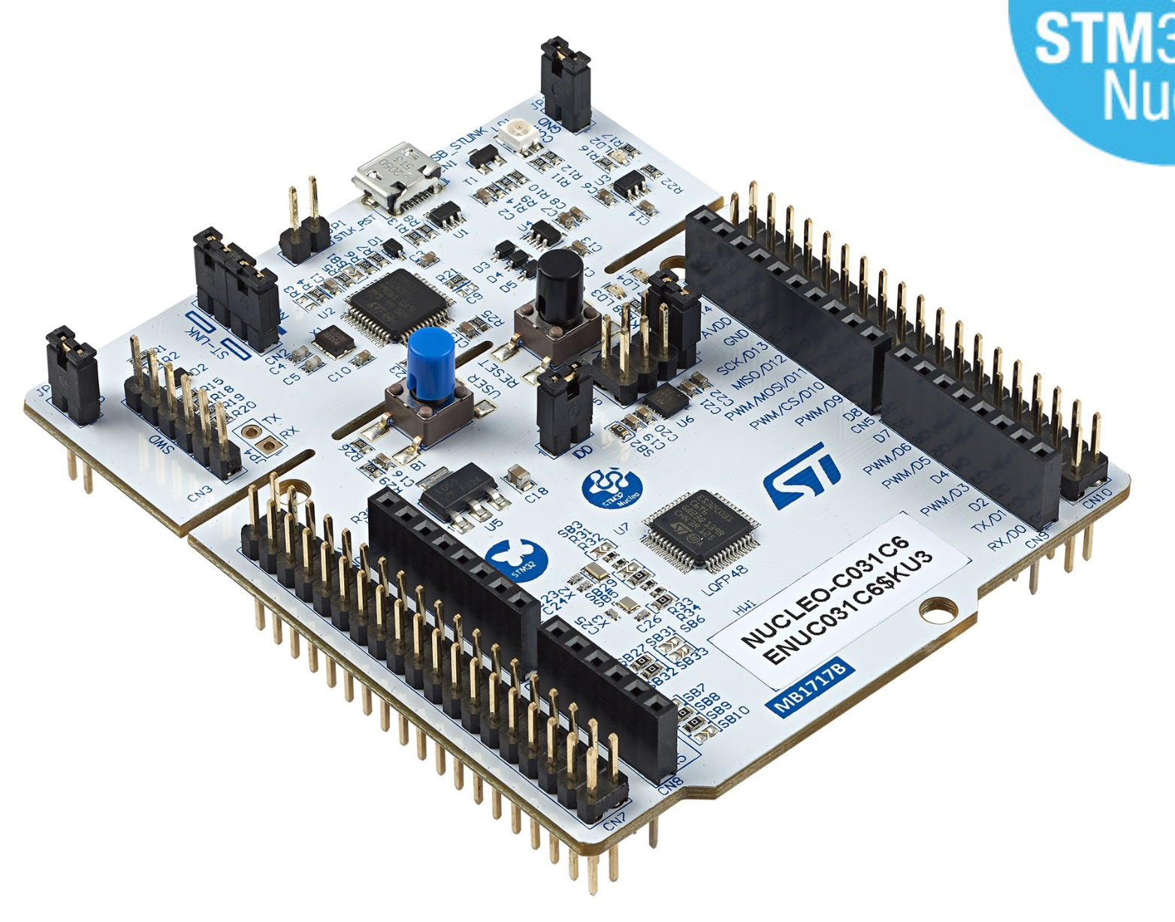

Adafruit Bluefruit LE UART Friend
Connects to your Nucleo via USART
Two operating modes:
Command mode – the device listens for AT commands (AT+…).
Data (transparent) mode – the device streams raw data to a participating central device.
Built‑in LED – useful for debugging the connection state.
I can offer a USART service!
Let me subscribe to the UART service!
USART1
USART Passthrough
Outcome:
Nucleo and phone can talk to each other as if they had a direct USART connection.
Adafruit Bluefruit LE Connect App

Slide 13
Using the USART1 and Hardware Flow Control
The Bluefruit device requires the use of USART1 and the use of hardware based flow control.
Read the details of USART1 in the reference manual to understand how to enable this feature.
Once you understand how to enable it, examine the alternate function mappings in the product data sheet. You will need to decide which physical pins you will use for the 4 USART1 signals.
USART Function | Port/Pin | Alt Function | Bluefruit Pin
USART1_TX |  |  | RXI
USART1_RX
USART1_CTS
USART1_RTS |  |  | CTS

Slide 14
Write your USART1 driver
Write USART1_init():
You can start with USART2_init() and modify it to use the pins that you decided on previously.
Also remember that you need to enable hardware flow control.
Write the rest of your USART1 driver:
Mimic the USART2 Driver!
In the final system, you won’t know which USART will transmit first, so you must devise a way to determine if there are any characters in the receive data register.
Do not use the existing read function unless you already know there is a byte waiting, otherwise, you may block indefinitely.

Slide 15
Test your USART1 via Passthrough
Write a small program which connects the transmitter of USART2 (CoolTerm) to the receiver of USART1 and vice versa.
You can use your AD2 to observe the pins on USART1 in order to confirm that it is working properly using the "Protocol" tab in the main Waveforms menu (on the left-hand side of the welcome tab).
The AD2 will be acting as another UART device that can send and receive; in the protocol settings you define which AD2 DIO pin acts as Tx and which acts as Rx.
Sending characters from Coolterm:
Coolterm sends to USART2_Rx
Your passthrough program passes this on to USART1_Tx
USART1 sends this out and the AD2 observes it on the Rx DIO pin.
Sending characters from the AD2:
The character you send through the AD2 TX is received by USART1_Rx and then passed on to USART2_Tx via your program.
You will see this in Coolterm.
You need to be a little careful (send 1 character at a time) because the AD2 does not support hardware flow control.

Slide 16
/* passthrough.c */
#include <stdio.h>
#include "uart.h"
#include "uart1.h"
#include "ES28.h"
int uart2_RxAvail(void);
int main(void) {
uart1_init();
uart2_init();
printf("UART1-2 passthrough test.\r\n");
while (1) {
if (uart1_RxAvail()) {
int c = uart1_read();
uart2_write(c);
}
if (uart2_RxAvail()) {
int c = uart2_read();
uart1_write(c);
}
}
return 0;
}
int uart2_RxAvail(void) {
if (USART2->ISR & USART_ISR_RXNE_RXFNE) {
return 1;
} else {
return 0;
}
}

Slide 17
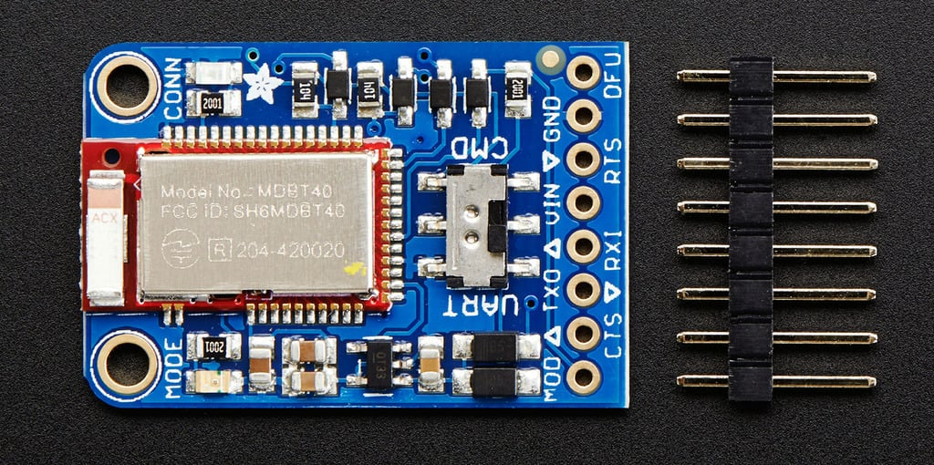
Connecting the Bluefruit to your Nucleo
Power Pins
VIN: power supply for the module, use 3.3V.
GND: The common/GND pin for power and logic
Other Pins
MOD: Mode Selection. The Bluefruit has two modes, Command and Data.
UART Pins
TXO - UART Transmit pin (Bluefruit LE --> MCU)
RXI - UART Receive pin (MCU --> Bluefruit LE).
CTS - Clear to Send hardware flow control pin into the the breakout (MCU --> Bluefruit LE).
RTS - Request to Send flow control pin out of the module (Bluefruit LE --> MCU).
Notes:
TXO - This is the UART Transmit pin out of the breakout (Bluefruit LE --> MCU), it's at 3.3V logic level.
RXI - This is the UART Receive pin into the breakout (MCU --> Bluefruit LE). This has a logic level shifter on it, you can use 3-5V logic.
CTS - Clear to Send hardware flow control pin into the breakout (MCU --> Bluefruit LE). Use this pin to tell the Bluefruit that it can send data back to the microcontroller over the TXO pin. This pin is pulled high by default and must be set to ground in order to enable data transfer out! If you do not need hardware flow control, tie this pin to ground it is a level shifted pin, you can use 3-5V logic
RTS - Request to Send flow control pin out of the module (Bluefruit LE --> MCU). This pin will be low when its fine to send data to the Bluefruit. In general, at 9600 baud we haven't seen a need for this pin, but you can watch it for full flow control! This pin is 3.3V out

Slide 18
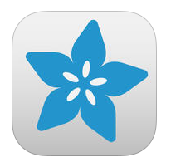
Connect your Bluefruit to your Nucleo.
Install the Adafruit Bluefruit LE Connect App on your phone.
Bluefruit Pin | Nucleo Pin
RXI | USART1_TX
TXO | USART1_RX
RTS | USART1_CTS
CTS | USART1_RTS
VIN | 3V3
GND | GND

Slide 19
Test UART Mode (aka "Data Mode" in Adafruit Speak)
Slide the little switch on the bluefruit board to “UART”.
Run the passthrough program on your Nucleo.
Open the Adafruit bluetooth app on your phone and select the “Must have UART Service” filter.
Find and connect to your device.
Open the UART tab.
Test sending and receiving characters over bluetooth. Make sure that characters you type here appear on CoolTerm and vice versa.
If you have trouble finding your device, you may need to go to a space with fewer ES28 students trying to find their devices! Alternatively, give your device a name via Command Mode (next slide).
Notes:
You can sort devices that show up in your app by signal strength. This should help you identify your own.

Slide 20
CMD (Command) Mode
In this mode you can send instructions to your device.
Place your Bluefruit into CMD mode by sliding the little switch toward CMD.
Instructions to your Bluefruit come in the form of AT commands.
Read up on AT commands in the Adafruit documentation.
Continue running the passthrough program on your Nucleo.
Type a few AT commands into Coolterm, for example:
ATZ : Soft reset (restarts the bluetooth stack)
AT+FACTORYRESET : The big hammer.
AT+GAPDEVNAME : This is how you give your device a recognizable name. You need to issue an ATZ command after changing your devices name so that it starts advertising the change.
You should still be running your “passthrough” code at this point. This will allow you to see if your commands were processed correctly (Bluetooth responds “OK”) or incorrectly (Bluetooth response “Error”).
Notes:
AT+GAPDEVNAME=chosenName

Slide 21
Switching Modes via Mode Pin
You wouldn't want to keep sliding that little switch by hand…
Connect a GPIO pin on your Nucleo to the Mode Pin on the Bluefruit.
You can control the mode by switching the pin high (CMD Mode) or low (UART mode).
In you code you'll need to initialize the GPIO pin (as what kind of pin?)
BLE Startup - Initialization:
Switch the mode pin to CMD mode.
Performs a factory reset
Assigns a device name.
Perform a soft reset (so the device will start advertising the new name).
Switch to UART mode.
The device should then sit idly doing nothing.
Consider placing the initialization in its own file as a function you can call from any program.

Slide 22
You are now ready to build your system!
Your system should behave normally even if there is no other device connected.
When a bluetooth device connects, it should start receiving data from your system, and your system should start responding to commands from the Bluetooth device. Assume the Bluetooth device will come and go periodically, and make sure that your main loop does not depend on any particular state of the Bluetooth system.
Notes:
3*4 = 12

Slide 23
A Few Notes on the Final Project
Read the project description carefully. Ask questions as needed.
Get started with your paper design!
By Friday (10pm), submit your paper design (pseudocode, block diagram etc).

Slide 24
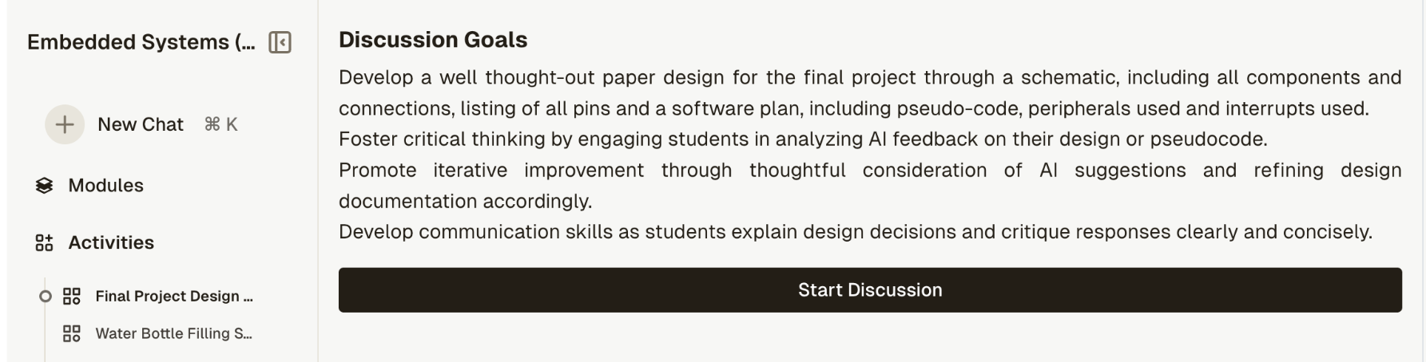
Paper Design
Your paper design is due FRIDAY!
This is a large, complicated project. Do not start coding until you have developed a plan!
Begin the process on paper by describing, with a block diagram, high level pseudo-code, or a state machine diagram exactly which components you are using and how they will interact. Consider in particular: Are you using timers and if so, which one(s)? Will you need interrupts? If so which one(s)? What components will you use (buttons, display, motors, etc)? If you are using a state machine, what are its states?
Your paper design should include a listing of all the IO (input/output) in your system and, importantly, how you are using it. Rather than state you are using a button for example, make notes detailing how often you will sample it (or are you using an interrupt?) and how you will use the value to decide what happens next.
If you write pseudo code, keep it at a high level and abstract. This will help you focus on the bigger picture before you get mired in the details. Do not write C! Pseudocode isn’t real code. It is just a structured way of blocking out the main steps you will need to take. Non-obvious things (such as resetting pins) should have some notations about why you are doing them.
Initially there will be a lot missing, but approaching the problem in a very high level top down approach will allow you to evolve your code gradually (and gracefully) so that without too much effort, you are able to map from your high level ideas to the low level pieces we’ve been studying all term.
Optional HiTA activity to help with your paper design

Slide 25
Lab Kits Return on Tuesday
All lab kits will be collected on Tuesday after class. Be sure to bring EVERYTHING back to class on Tuesday.

Slide 26
Project Work Time!

