Slide 1


Engs 28
Embedded Systems
Day 19

Slide 2
Agenda
Project Presentations
Wrapping up the course

Slide 3
Share Projects!

Slide 4
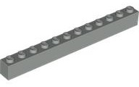
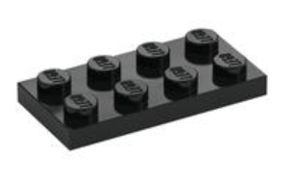
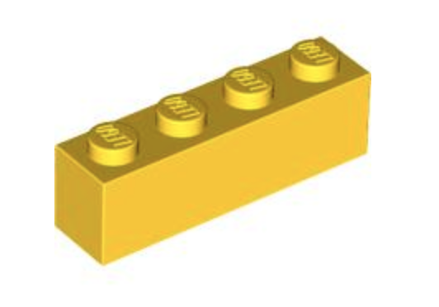
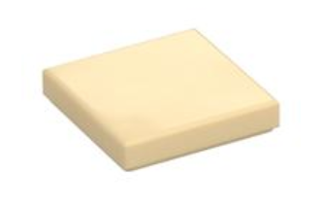
Share Projects!
One project partner stays at their table, the other walks around to look at other projects.
Each person gets to vote on:
Most Creative System (1x12)
Cleverest Device Name (2x4)
Best use of Adafruit App (1x4)
Best Overall Solution (2x2)

Slide 5
Wrapping up

Slide 6
Review: Engs 28 learning objectives
Here’s where we’ve been:
Break a problem down and construct a modular hardware+software solution.
Use embedded programming techniques to write “bare metal” microcontroller programs in C.
Write interrupt-driven and timer-driven programs.
Read an electronic component data sheet to understand how to use it.
Design and test basic analog electronic circuits.
Use the key principles and specifications of analog-to-digital converters to accurately acquire low frequency signals.
Use the physical principles and electrical specifications of common sensors and actuators for embedded design.
Communicate data between a microcontroller and sensors/actuators using a few standard protocols (UART, I²C, GPIO).
Notes:
Just to remind you what we did this term. YOU DID ALL THESE THINGS!!! Can you believe it?

Slide 7
Where to go from here?
Courses that have been mentioned during Engs 28
Engs 21, Introduction to Engineering
Engs 22, Systems
Engs 32, 61, 125, Analog and Power Electronics
Engs 129, Biomedical Instrumentation
Engs 31, Digital Electronics and CoSc 51, Computer Architecture
Engs/CoSc 50, Software Design and Engs 62, Microprocessors
Engs 26, Control Theory and Engs 147, Mechatronics
Engs 62, Microprocessors in Engineered Systems (next winter)
Engs 68, Communication Theory and Engs 110, Signal Processing
Notes:
In 21 some projects use Arduinos!
22: set-up for all the electronics courses.
If you liked all the electronics stuff (opAmps, etc), then the 32-61-125 track is for you.
129 officially requires 28 as a prerequisite (Kofi teaches it).
If you like the digital stuff, 31 is for you.
CS 51 is a really nice complement to 31. 31 goes deeper into the hardware, 51 talks about designing a computer's instruction set. How does the machine language work?
CS 50: hardcore software design.
62: higher-end microprocessor design course (higher-level processor)
26 control theory (if you like the feedback stuff), 147 mechatronics (microprocessors, feedback etc)
68: if you think wireless is cool, this one teaches you more about the modulation stuff and how it works. 110: broader in scope, also includes digital audio.

Slide 8
Last things to do
Return your kit to Tad after demo.
Return the Bluefruit device to Tad.
Complete the College’s course evaluation
Thank you for a great term!!!

