Slide 1
Digital Inputs & the Oscilloscope
ENGS 28 · Day 3 — In-Class

Slide 2
Reminder: Late Lab Assignment Policy
Each student has an account of 2 late days, used at your discretion for lab assignments. To use one, say so in a submission comment.
Submit within 24 hours of the original deadline using a late day → no penalty.
Otherwise: late labs accepted up to two days late (due date adjusted for used late days) at a 10% penalty per day.
After two days beyond the deadline, lab assignments are not accepted for credit.
Notes:
Hidden from the student export. Instructor reference.

Slide 3
Reminder: Labs and the Honor Code
You work alone on the labs unless we specifically say otherwise.
Interaction while learning is encouraged — but exchange ideas, not code. The work you turn in must be your own.
Copying any portion of another person's code (or a design posted online / written in another course) violates the Honor Principle.
Always cite your lab and study partners by name, as you would any other source.
Notes:
Hidden from the student export. Instructor reference.

Slide 4
Reminder: AI Use in ENGS 28
You may use the HiTA tool (in Canvas) for help. Do not use other GenAI tools unless explicitly invited.
Give notice that you used an AI tool, and how, in your code comments and lab report.
If you base work on generated code, rigorously test and adapt it to the assignment and your understanding.
You must understand any code you submit and be able to explain it. All comments must be in your own words.
Notes:
Hidden from the student export. Instructor reference.

Slide 5
Agenda
Code review — blinkyCNT.c from Lab 1
Making measurements with the Analog Discovery 2 oscilloscope
Wiring and reading a pushbutton switch
Button exercises — a head start on Lab 2

Slide 6
Part 1 · Code Review — blinkyCNT.c
Notes:
Suggested timing: ≈ 10 min.

Slide 7
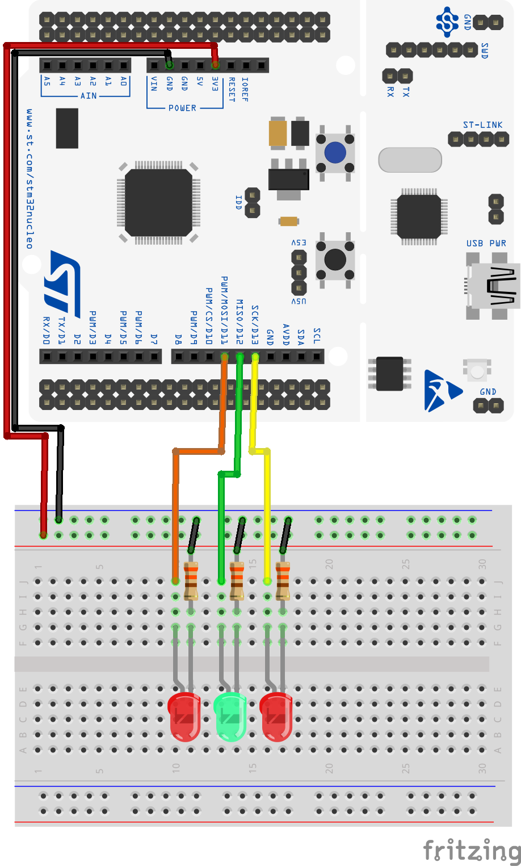
Recall: Lab 1
Wire up three LEDs.
blinkySIM.c — blink all three LEDs simultaneously.
blinkySEQ.c — blink the LEDs sequentially (a running light).
blinkyCNT.c — display a 3-bit binary count on the LEDs.

Slide 8
Activity: blinkyCNT Code Review
Share your blinkyCNT.c from Lab 1 within your table group. Read each other's solutions and be ready to explain how you displayed a 3-bit binary count on three LEDs.
Read your partners' code. Can you follow the logic? For each solution, identify how bits are placed into the correct LED positions in GPIOA->ODR.
Compare the approach below with your own. What does count << LED1_BIT accomplish? Why is it necessary to clear the LED bits first?
GPIOA->ODR &= ~LED_ALL; // clear the three LED bits
GPIOA->ODR |= (count << LED1_BIT); // then write the new count

Slide 9
Solution — blinkySIM.c
#include "ES28.h"
#define GPIOAEN (1U<<0) // bit 0 enables clock for GPIOA
// LEDs on D13, D12, D11 (PA5, 6, 7)
#define LED_PIN1 (1U<<5)
#define LED_PIN2 (1U<<6)
#define LED_PIN3 (1U<<7)
#define LED_ALL (LED_PIN1 | LED_PIN2 | LED_PIN3)
int main(void) {
RCC->IOPENR |= GPIOAEN; // 1. clock access to GPIOA
GPIOA->MODER |= (1U<<10)|(1U<<12)|(1U<<14); // 2. PA5,6,7 as outputs
GPIOA->MODER &= ~(1U<<11) & ~(1U<<13) & ~(1U<<15);
while (1) {
GPIOA->ODR |= LED_ALL; // 3. turn LEDs on
delay_ms(500);
GPIOA->ODR &= ~LED_ALL; // 4. turn LEDs off
delay_ms(500);
}
}
Notes:
Hidden from the student export. Instructor reference.

Slide 10
Solution — blinkySEQ.c
#include "ES28.h"
#define GPIOAEN (1U<<0)
#define LED_PIN1 (1U<<5)
#define LED_PIN2 (1U<<6)
#define LED_PIN3 (1U<<7)
int main(void) {
RCC->IOPENR |= GPIOAEN; // clock access to GPIOA
GPIOA->MODER |= (1U<<10)|(1U<<12)|(1U<<14); // PA5,6,7 as outputs
GPIOA->MODER &= ~(1U<<11) & ~(1U<<13) & ~(1U<<15);
while (1) {
GPIOA->ODR = (GPIOA->ODR & ~LED_PIN3) | LED_PIN1; // -> LED1
delay_ms(500);
GPIOA->ODR = (GPIOA->ODR & ~LED_PIN1) | LED_PIN2; // -> LED2
delay_ms(500);
GPIOA->ODR = (GPIOA->ODR & ~LED_PIN2) | LED_PIN3; // -> LED3
delay_ms(500);
}
}
Notes:
Hidden from the student export. Instructor reference.

Slide 11
Solution — blinkyCNT.c
#include "ES28.h"
#define GPIOAEN (1U<<0)
#define LED1_BIT 5
#define LED_PIN1 (1U<<LED1_BIT)
#define LED_PIN2 (1U<<(LED1_BIT+1))
#define LED_PIN3 (1U<<(LED1_BIT+2))
#define LED_ALL (LED_PIN1 | LED_PIN2 | LED_PIN3)
int main(void) {
RCC->IOPENR |= GPIOAEN; // clock access to GPIOA
GPIOA->MODER |= (1U<<10)|(1U<<12)|(1U<<14); // PA5,6,7 as outputs
GPIOA->MODER &= ~(1U<<11) & ~(1U<<13) & ~(1U<<15);
while (1) {
for (unsigned count = 0; count < 8; count++) {
GPIOA->ODR &= ~LED_ALL; // turn all LEDs off
GPIOA->ODR |= count << LED1_BIT; // write the count
delay_ms(500);
}
}
}
Notes:
Hidden from the student export. Instructor reference.

Slide 12
Part 2 · The Analog Discovery 2 Oscilloscope
Notes:
Suggested timing: ≈ 20 min.

Slide 13
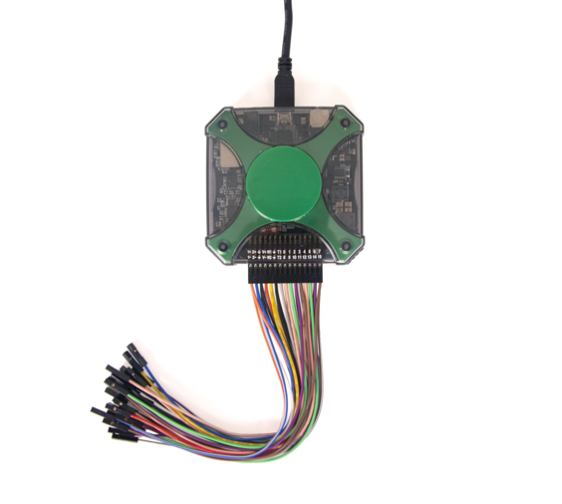
Making measurements: the Analog Discovery 2
A compact USB instrument: oscilloscope, waveform generator, logic analyzer, and more.
Plug it into your laptop and open the Waveforms application.
This is your window into the real voltages on your circuit.
The AD2 connects to a laptop over USB; flying-lead cables reach your breadboard.

Slide 14
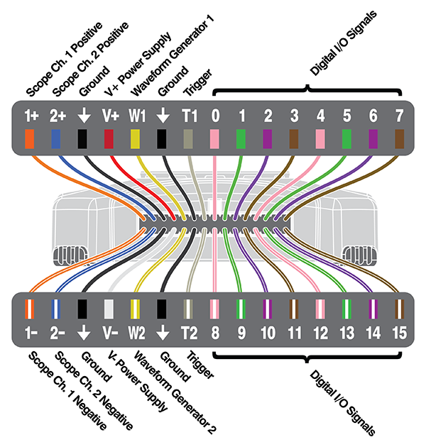
AD2 connector pinout
Color-coded flying leads plug directly into breadboard holes.
Channel 1 = 1+ / 1− (orange)
Channel 2 = 2+ / 2− (blue)
The minus (−) leads have a white stripe — always connect these to GND.
The two analog scope channels — CH1 & CH2 →
Each channel has a plus (signal) and a minus (ground-reference) lead.

Slide 15
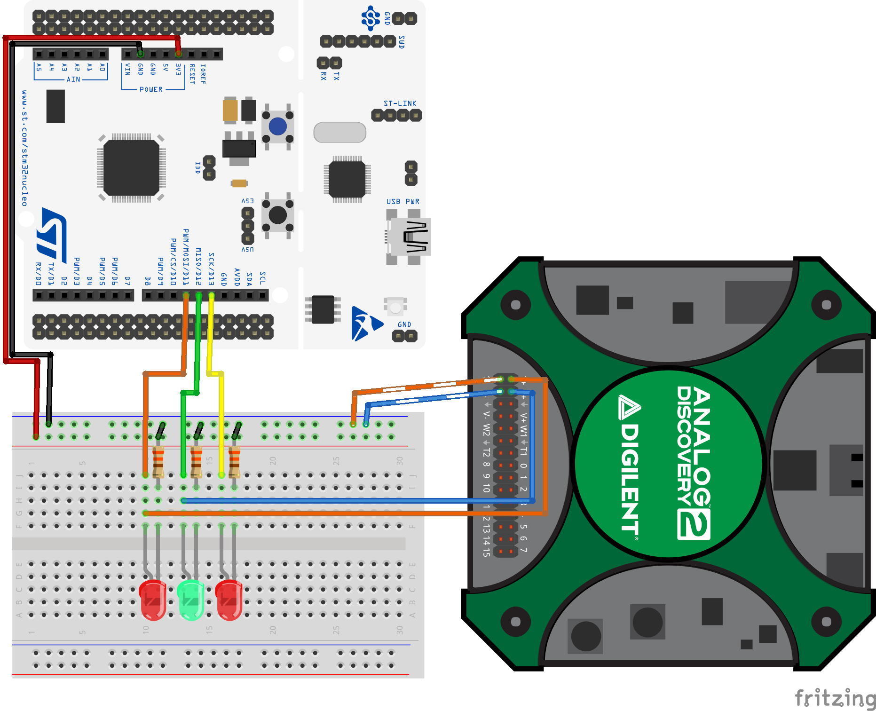
Wire the AD2 to your Lab 1 setup
Load blinkySEQ.c onto your Nucleo.
Connect both minus (white-stripe) leads to GND.
CH1 (+) → one LED anode
CH2 (+) → a second LED anode
Minus leads to ground; CH1 and CH2 plus leads to two LED anodes.

Slide 16
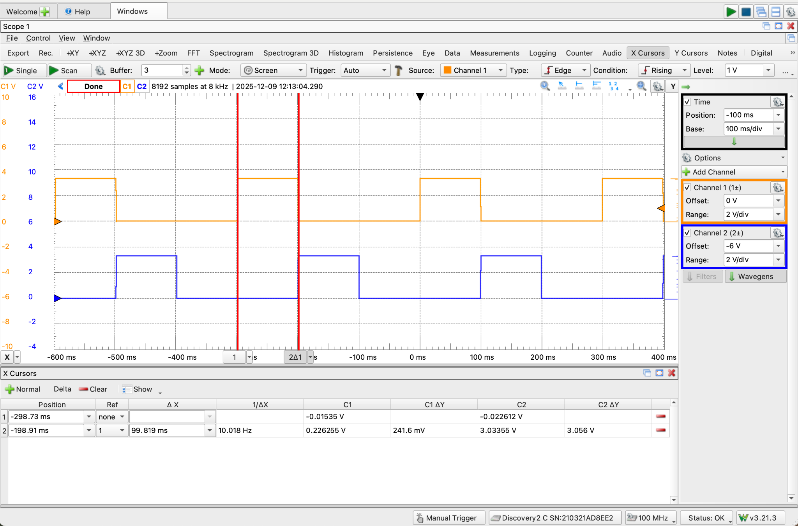
Measure pulse width with cursors
Drag two vertical cursors to the rising and falling edges of a pulse.
The toolbar shows the time difference (Δt) between them.
You'll use this to measure pulse widths — and soon, switch bounce.
Two cursors bracket one LED pulse; the toolbar reads the time difference.

Slide 17
Activity: Exploring the Oscilloscope (1 of 2)
Setup: load blinkySEQ.c; minus (white-stripe) leads → GND, CH1(+) → one LED anode, CH2(+) → a second LED anode.
Run the scope and observe both channels. Then experiment with the settings and answer at your table:
What does Time Base control? What value shows one full blink cycle across the screen?
What does Range control? Set it so the waveform fills roughly half the vertical space.
What does Offset do? How do you use it to separate two overlapping channels?
What voltage does the scope measure on a GPIO pin when the LED connected to it is on?

Slide 18
Activity: Exploring the Oscilloscope (2 of 2)
Measure the pulse width of one LED's ON period with the cursor tool. Does it match the delay_ms value in your code?
In your blinkySIM project, set 1 ms ON / 10 ms OFF and flash it; then swap to 10 ms ON / 1 ms OFF. How does brightness change, and why?
You want to observe a switch bounce that lasts about 1 ms. Which time base setting would you choose, and why?
Save a screenshot of your scope view: File → Export → Image tab → Save. You'll need this for every lab report.

Slide 19
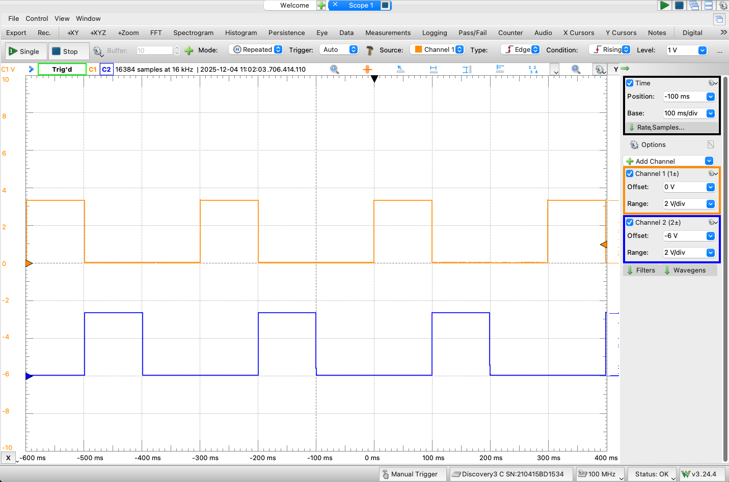
Debrief: the four controls
Time Base — time across the screen (100 ms/div for a blink; 20 µs/div for bounce).
Range — vertical scale, V/div; fill about half the height.
Offset — shift a channel to separate overlapping traces.
Trigger — start capture when a signal crosses a threshold.
CH1 (orange) & CH2 (blue) pulses, ~100 ms wide; settings panel at right.
Notes:
REVEAL after the Exploring activity — confirm what students discovered about each control.

Slide 20
Part 3 · Wiring & Reading a Digital Input
Notes:
Suggested timing: ≈ 25 min.

Slide 21
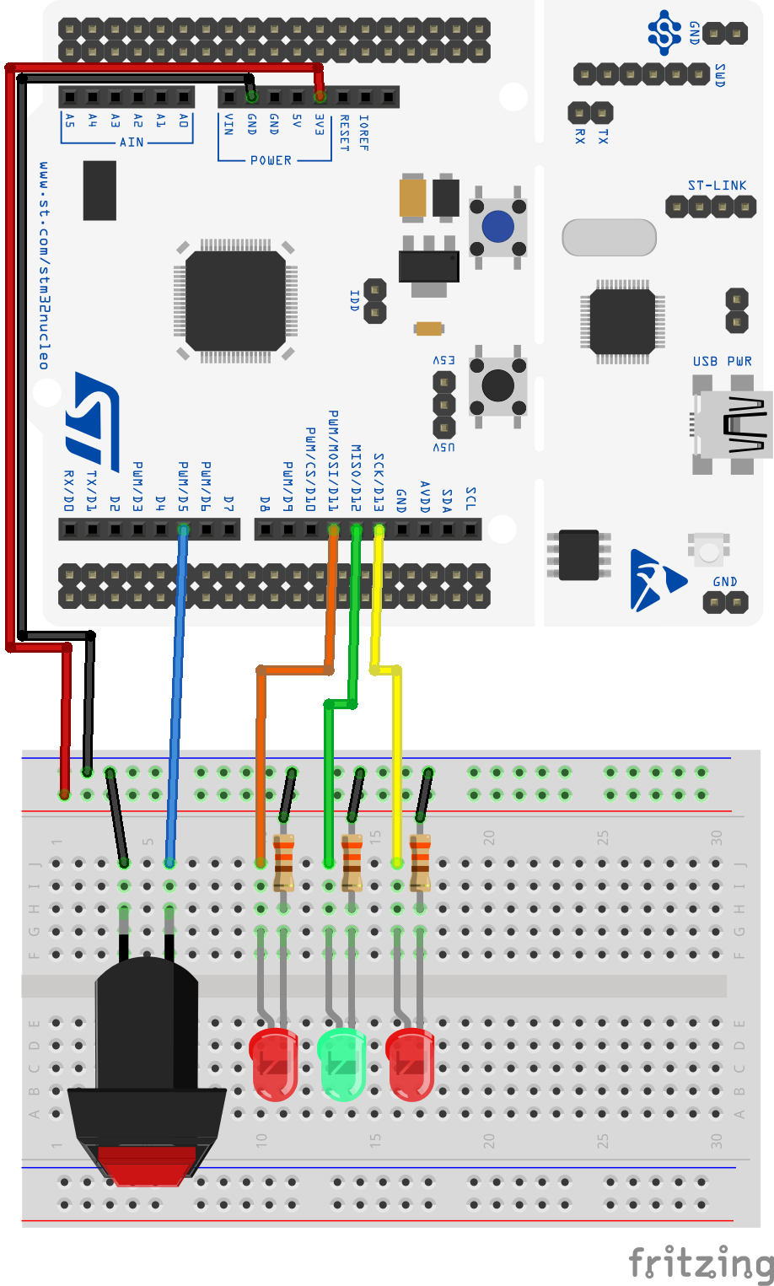
Wire up a pushbutton switch
Add a pushbutton to your Lab 1 breadboard.
Wire one side to D5, the other side to GND.
Use D5 (PB4) specifically — the button.c starter code is written for PB4.
The button bridges two rows: one terminal to the GPIO pin, the other to GND.

Slide 22
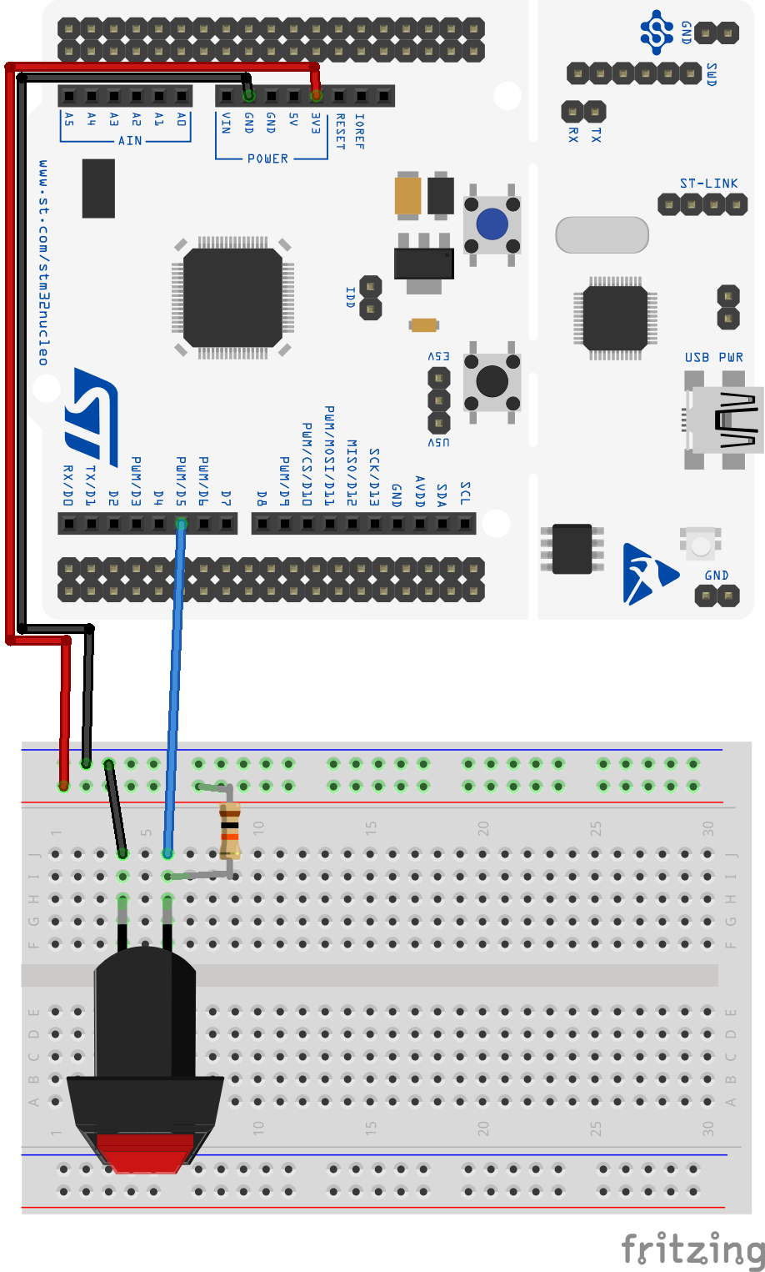
How to wire a pushbutton: pull-ups & active-low
An unconnected pin floats — it drifts with noise and reads random 0s and 1s.
A pull-up resistor to 3.3 V holds the pin HIGH when the button is open.
Pressing connects the pin to GND → pulls it LOW.
Active-low: pressed = 0, released = 1.
The STM32 has ~40 kΩ internal pull-ups you enable in software — no external resistor needed.
An external pull-up shown for intuition; on the STM32 we use the internal one.

Slide 23
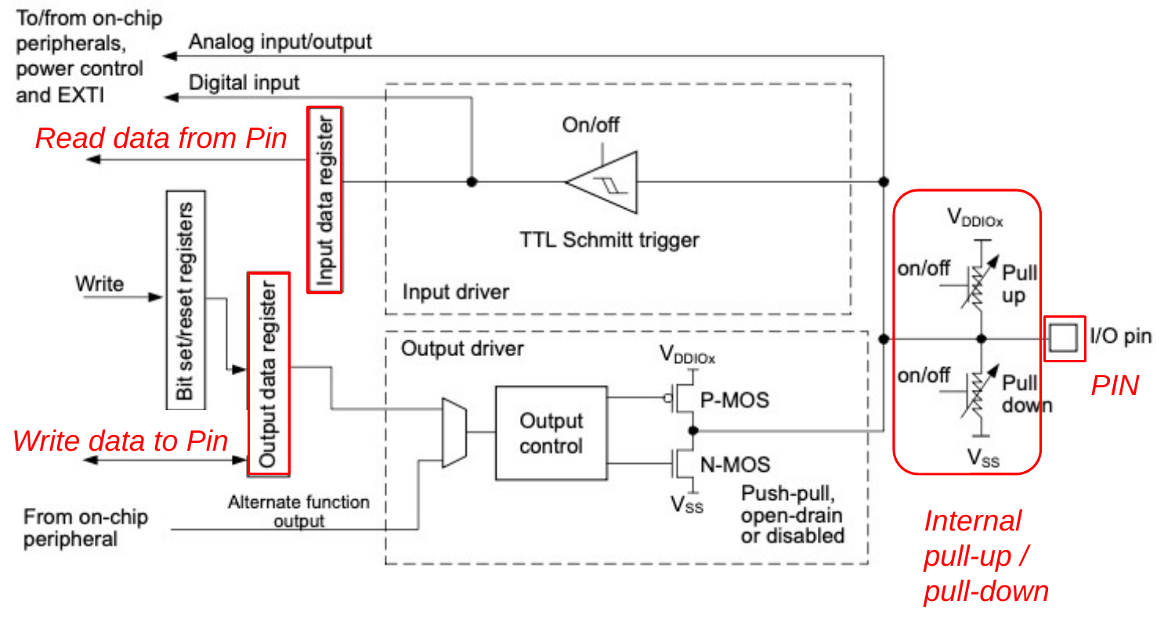
Basic structure of an I/O port bit
Read path (input): pin → pull-up/down → Schmitt trigger → IDR. Write path (output): ODR → output control → pin. The same pull-up/pull-down serve both modes.

Slide 24
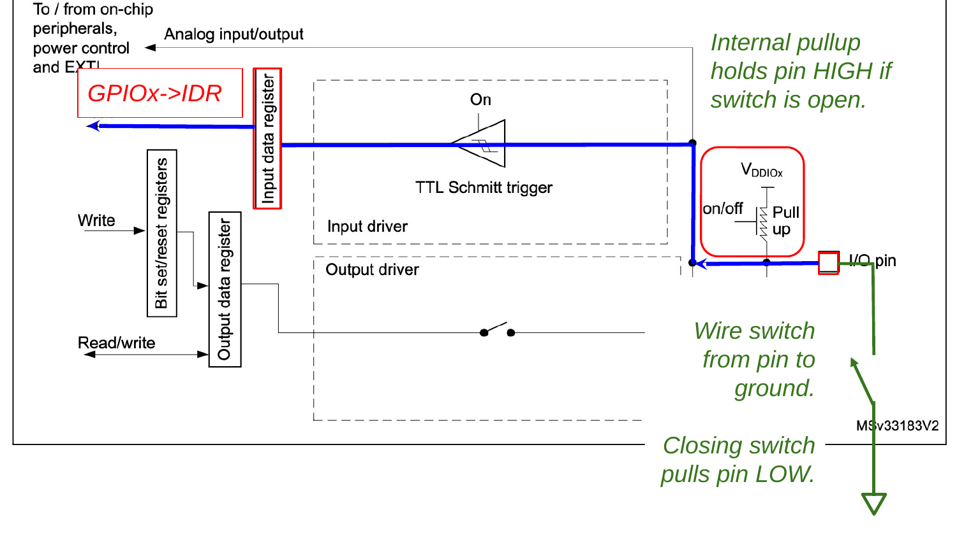
How the switch connects to the port bit
The same port bit, now wired to a button: the internal pull-up holds the pin HIGH when the switch is open; closing the switch pulls the pin to GND (LOW). The blue path shows the level flowing into IDR.
Notes:
OPTIONAL — bridges the internal port-bit diagram to the external wiring (switch to ground). Show if it helps; skip if it's one thing too many.

Slide 25
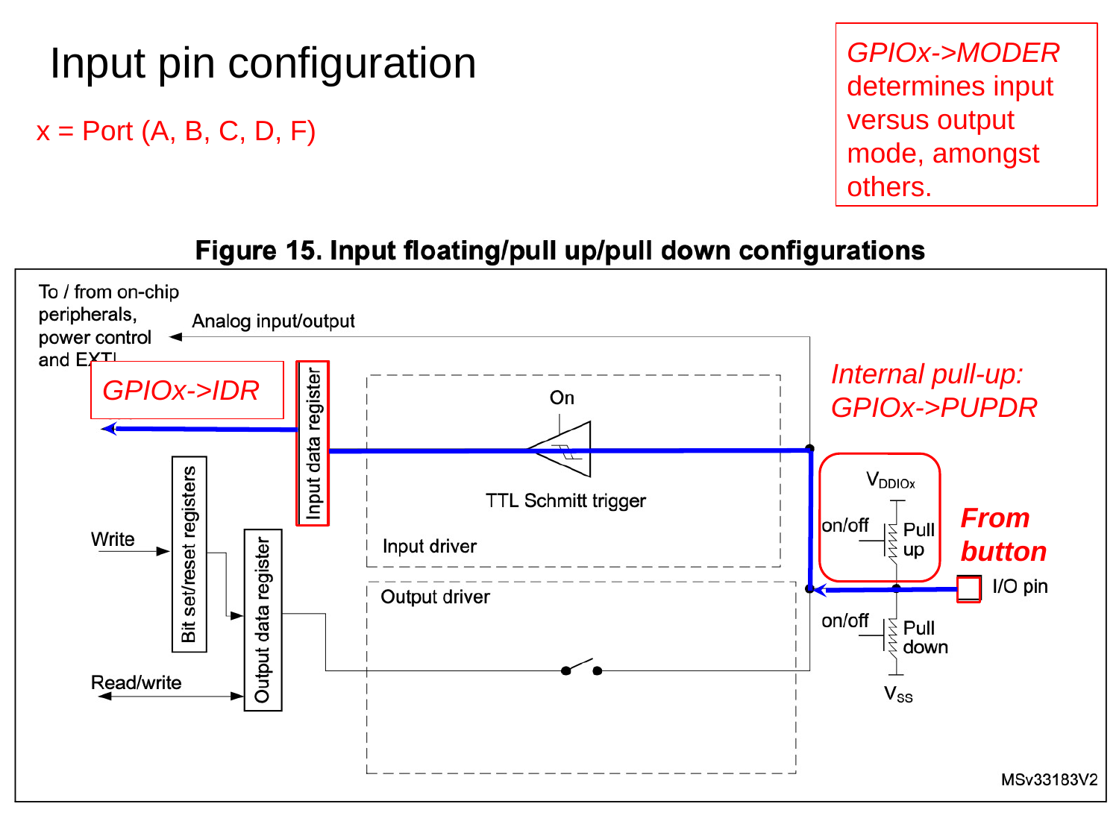
Input pin configuration: MODER, PUPDR, IDR
GPIOx→MODER — sets pin mode (input / output / alternate / analog).
GPIOx→PUPDR — turns the internal pull-up or pull-down on or off.
GPIOx→IDR — read-only; each bit is the live level on that pin.
x = port letter (A, B, C, D, F). The exact bit values are in the reference manual.
The blue path: button → pull-up → Schmitt trigger → IDR.

Slide 26
Activity: Finding Configuration Details in the Reference Manual
You know what MODER, PUPDR, and IDR do — but not the specific bit values yet. Open the STM32C031 reference manual, find General-purpose I/Os (GPIO) in the table of contents, then go to Section 6.4 GPIO registers. Looking up registers is a skill you'll use constantly.
Find GPIOx_MODER (§6.4.1). What two-bit value selects input mode? What is the power-on default for all pins?
Find GPIOx_PUPDR. Which two-bit value enables the internal pull-up? Write the C statements that enable the pull-up on PB4 (pin 4 of Port B), using bit masks.

Slide 27
Reveal: Configuring PB4 as an input
// PB4 = D5, active-low button with internal pull-up
#define GPIOBEN (1U << 1) // IOPENR bit 1 -> GPIOB clock
#define BUTTON_PIN (1U << 4) // PB4 = D5
RCC->IOPENR |= GPIOBEN; // 1. enable GPIOB clock
// 2. MODER [9:8] = 00 by default -> input (no write needed)
GPIOB->PUPDR |= (1U << 8); // 3. PUPDR [9:8] = 01 -> pull-up
GPIOB->PUPDR &= ~(1U << 9);
MODER 00 = input (power-on default) · 01 = output
PUPDR 01 = pull-up · 10 = pull-down · 00 = floating
IDR read-only; bit n = live logic level on pin n
Notes:
OPTIONAL / REVEAL — show after the activity if useful, or skip if the class is on track.

Slide 28
Reference: Reading a pin (VIL / VIH thresholds)
When a pin is an input, the STM32 samples its voltage into the Input Data Register (IDR) — one bit per pin.
Below VIL (≈ 0.3 × VDD ≈ 1.0 V) reads a reliable 0.
Above VIH (≈ 0.7 × VDD ≈ 2.3 V) reads a reliable 1.
Voltages in between are indeterminate — the result is unpredictable.
In clean digital circuits you stay well outside this zone. It matters for slow-rising signals, noisy lines, or mixed supply voltages.
Notes:
OPTIONAL / REVEAL — show after the activity if useful, or skip if the class is on track.

Slide 29
button.c — reading a pin (excerpt)
// PB4 = D5 button, PA5 = D13 LED (active-low button)
GPIOB->PUPDR |= (1U << 8); // enable pull-up on PB4
GPIOB->PUPDR &= ~(1U << 9);
delay_ms(50); // give the pull-up time to pull the pin HIGH
while (1) {
if ((GPIOB->IDR & BUTTON_PIN) == 0) // low-true: 0 = pressed
GPIOA->ODR |= LED_PIN; // LED on
else
GPIOA->ODR &= ~LED_PIN; // LED off
}
Copy your TemplateProject → Buttons; download button.c from Canvas into Src. Read it before flashing.

Slide 30
Activity: Reading a Button in Code
In STM32CubeIDE, copy your TemplateProject and name the copy Buttons. Download button.c from Canvas into the Src folder. Read the code, then answer before flashing:
The code calls delay_ms(50) immediately after enabling the pull-up. Why? What would happen if you removed that line?
The main loop uses (GPIOB->IDR & BUTTON_PIN) == 0 to detect a press. Why == 0 rather than != 0?
Flash it (press → LED on, release → off). Then modify blinkySEQ.c so a press interrupts the sequence and lights all three LEDs; releasing returns to the sequence.

Slide 31
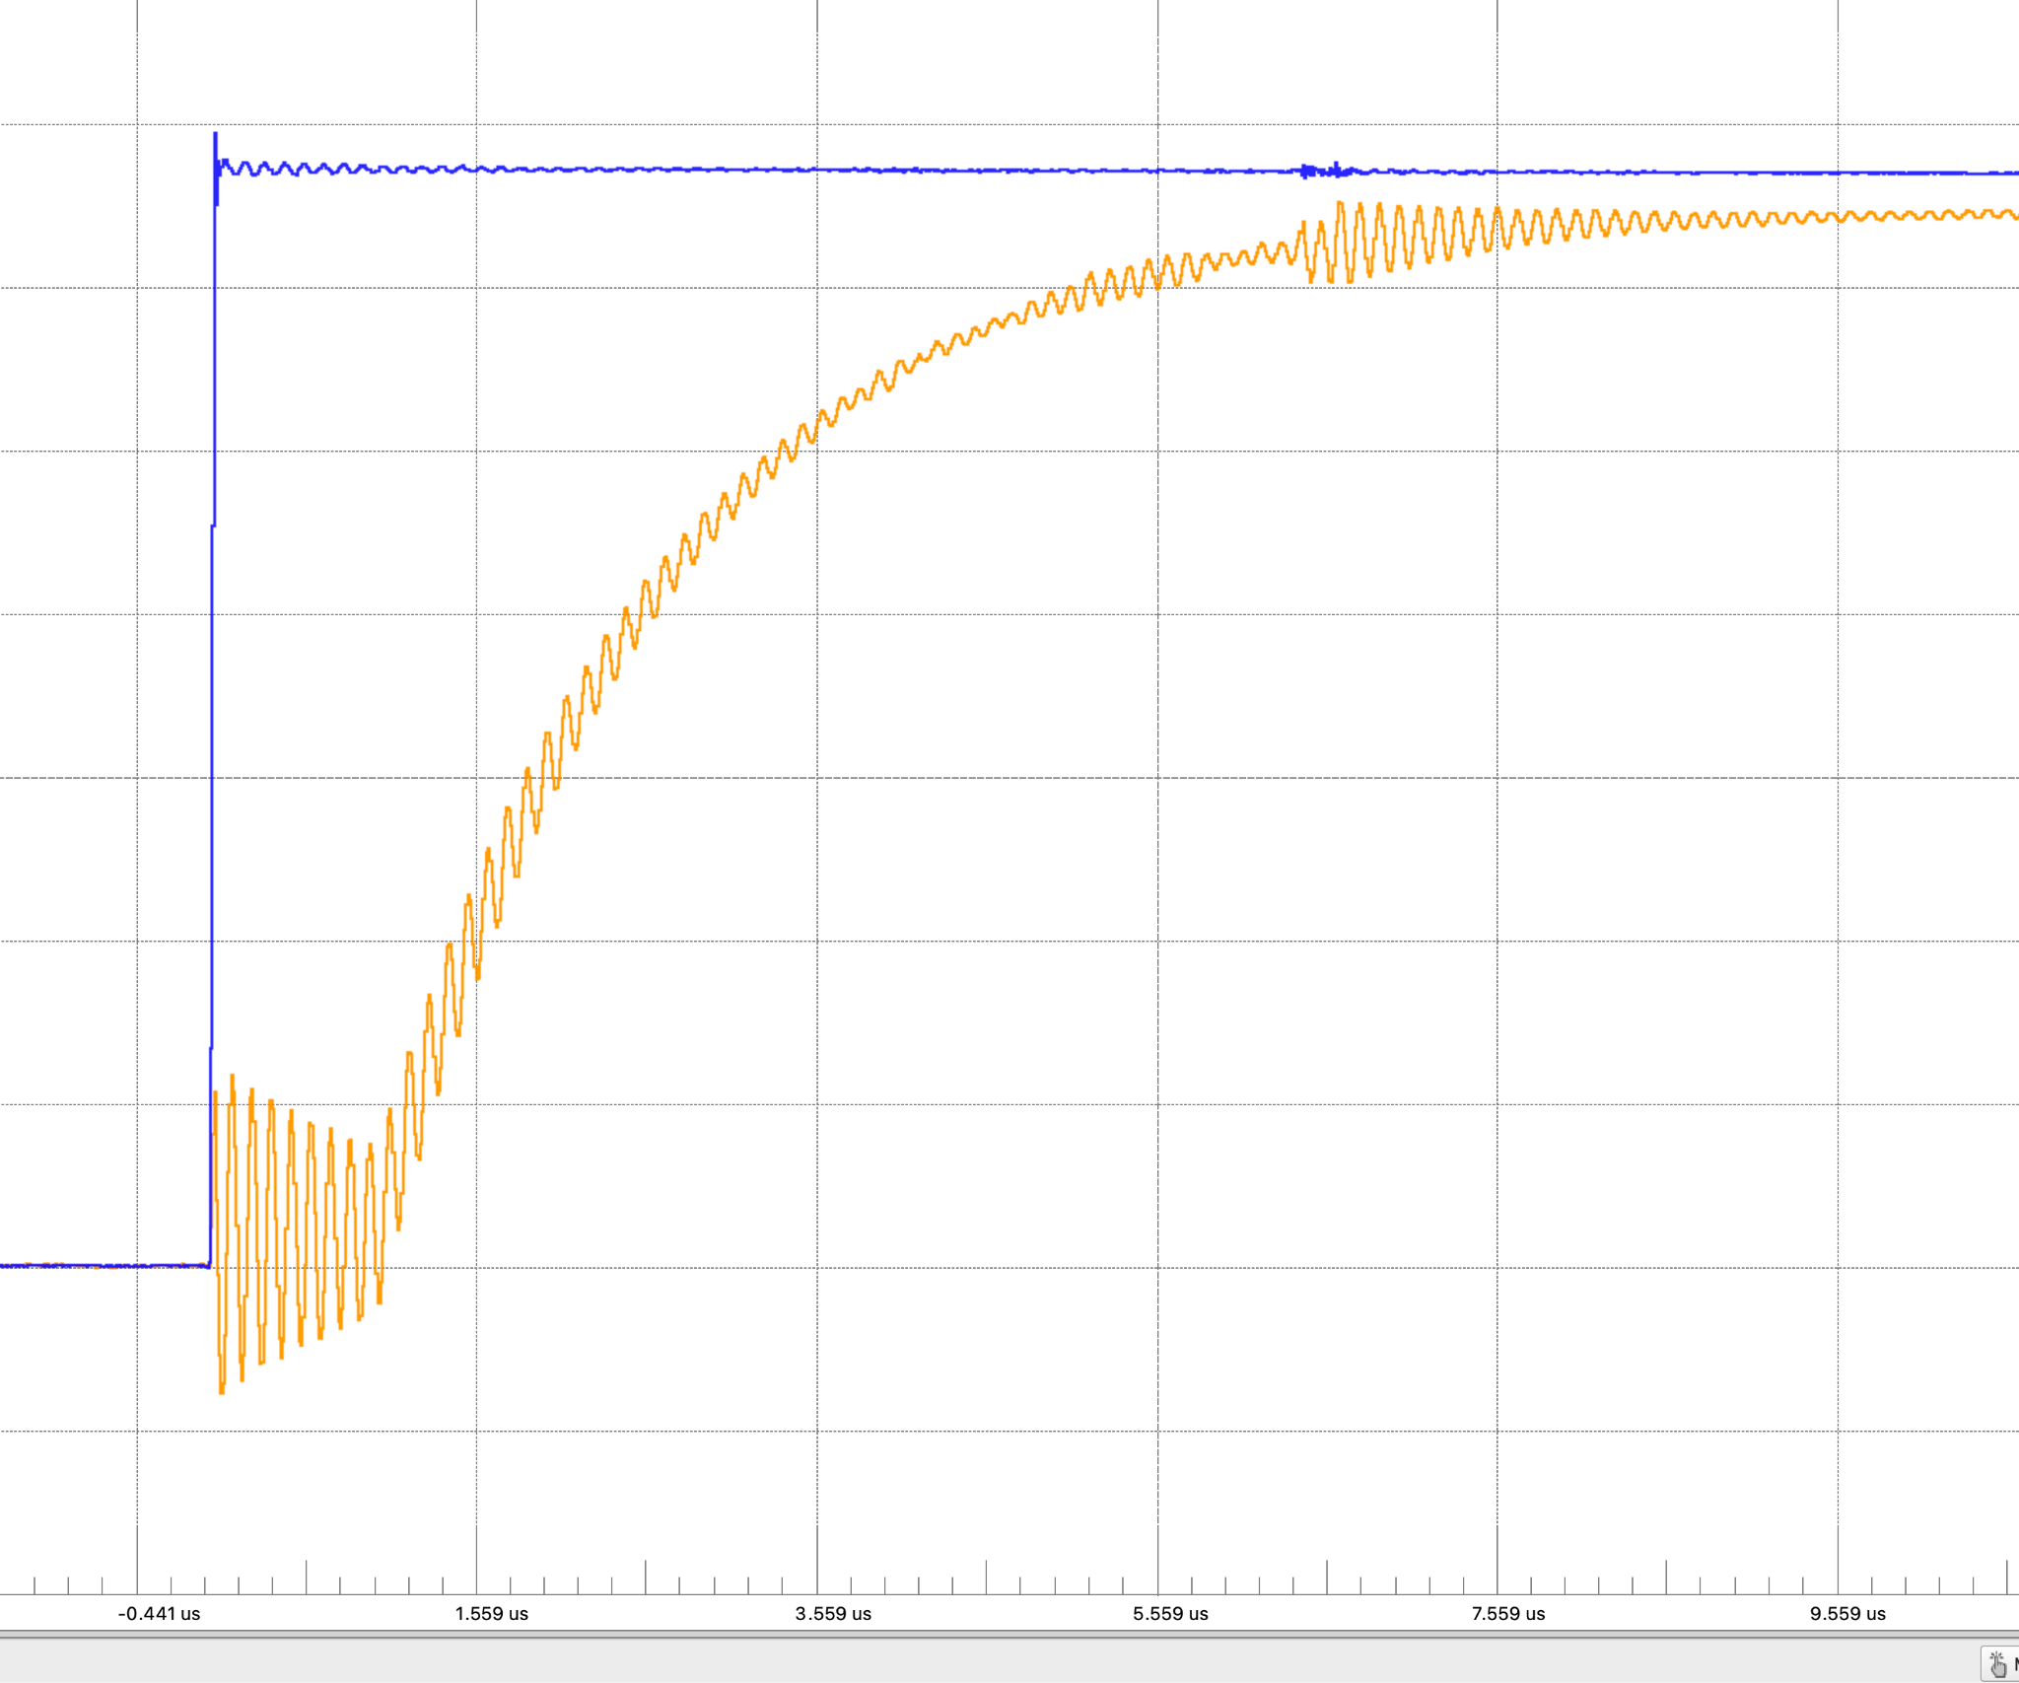
Why the delay_ms() after the pull-ups?
The pin doesn't jump to HIGH instantly — the pull-up charges the pin capacitance.
It reaches the HIGH threshold in about 2.5 µs.
Read IDR before it settles and you get a spurious 0 — so delay first.
Pin voltage rising after the internal pull-up is enabled: ~2.5 µs to reach HIGH.

Slide 32
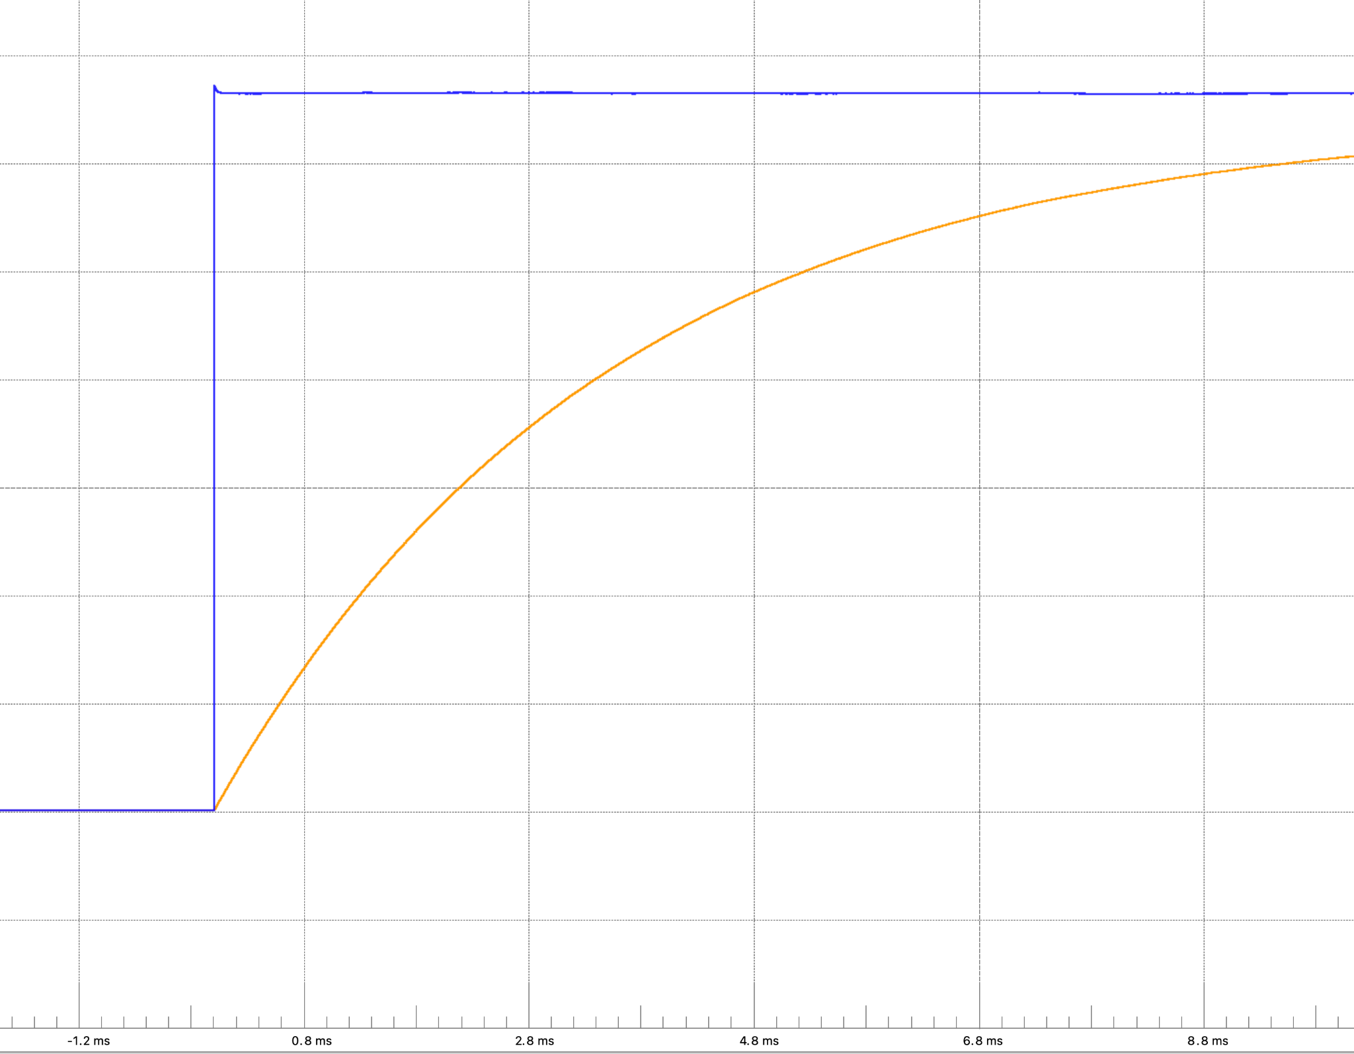
Preview: a debounce capacitor slows this down more
Tomorrow we add a capacitor across the button to tame bounce.
With a 0.1 µF cap the pin takes ~4 ms to reach HIGH.
That leaves even more time to accidentally read the old 0 — a preview of Day 3X.
Exponential pull-up response with a 0.1 µF debouncing capacitor (~4 ms).
Notes:
OPTIONAL / REVEAL — show after the activity if useful, or skip if the class is on track.

Slide 33
Part 4 · Button Exercises
A head start on Lab 2 — you may not finish in class, and that's fine.
Notes:
Suggested timing: ≈ 15 min.

Slide 34
Activity: Button Exercises
Modify blinkyCNT.c so that pressing the button pauses the counter and releasing resumes it.
Homework (due Thursday): Write toggleLED.c so the on-board LED toggles each time the button is pressed and released: first press turns the LED on, second press turns it off, and so on.
You'll likely see erratic behavior (“glitches”) — bring your observations to Day 3X.

