Slide 1
Observing & Fixing Switch Bounce
ENGS 28 · Day 3X — In-Class

Slide 2
Review — and where we're headed
On Tuesday: the AD2 oscilloscope, and how to wire and read a pushbutton on the STM32.
Today: put a scope on the button and see what actually happens when you press it.
Then fix the mess — first with hardware (a capacitor), then in software (edge detection).

Slide 3
Part 1 · Observing and Fixing Bounce
Notes:
Suggested timing: ≈ 20 min.

Slide 4
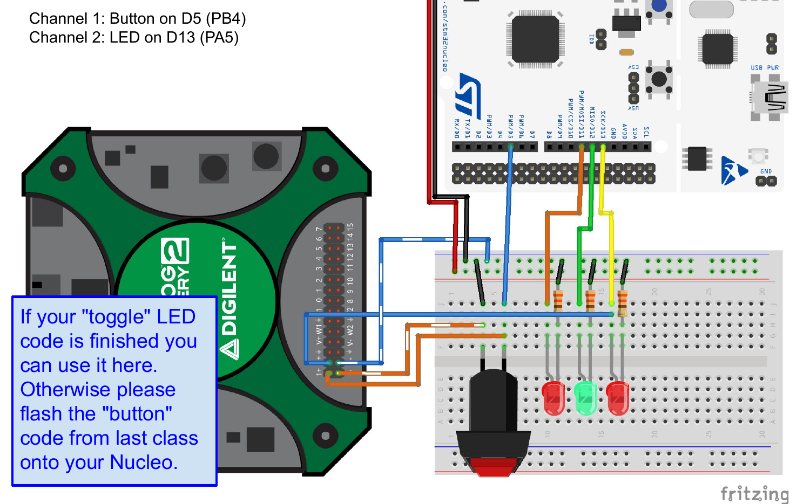
Wire the AD2 to watch the button
Load your toggleLED.c (or button.c if the homework isn't done).
CH1 (orange) on D5 / PB4 (button)
CH2 (blue) on D13 / PA5 (LED)
Minus (white-stripe) leads to GND.
CH1 on the button (PB4), CH2 on the LED (PA5); minus leads to GND.

Slide 5
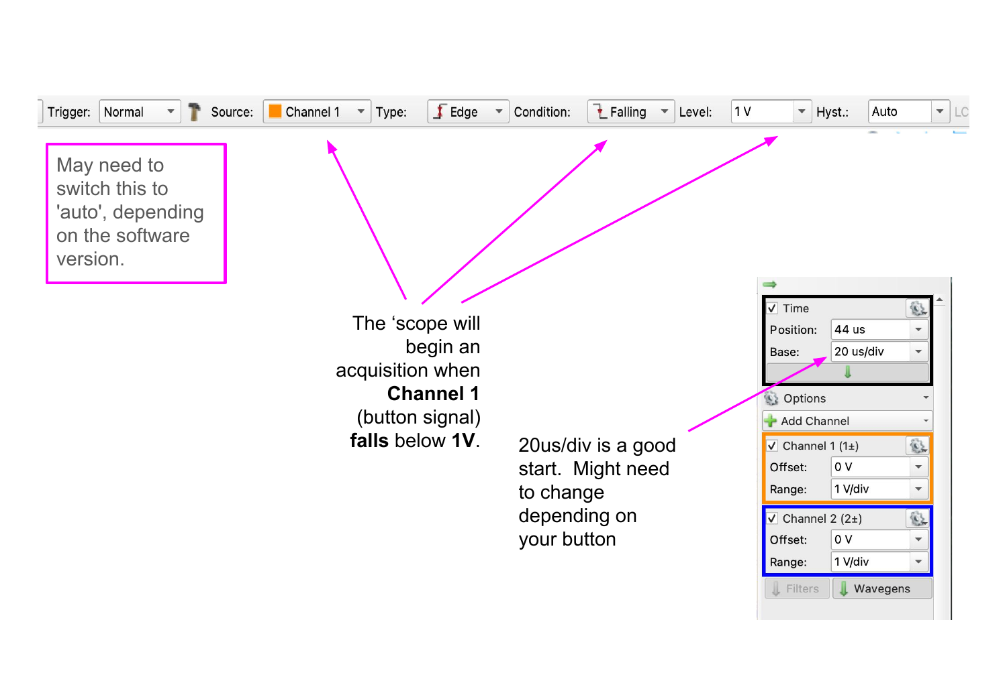
Set up the trigger to catch one press
Source: Channel 1 · Type: Edge · Condition: Falling · Level: 1 V.
Time base: 20 µs/div to start.
Click Single, press the button once, and examine the capture.
(Depending on your Waveforms version, you may need Normal or Auto mode.)
Trigger on Channel 1, falling edge, 1 V.

Slide 6
Activity: Capturing Switch Bounce
Configure the trigger (Source: CH1, Type: Edge, Condition: Falling, Level: 1 V) and set 20 µs/div. Click Single, press once, and look at the capture.
What do you see instead of a clean falling edge?
Use cursors to measure the total bounce duration on your button. Compare with other groups — do all switches bounce the same amount?
Look at CH2 (LED). How many times does the LED change state during a single physical press? Why?

Slide 7
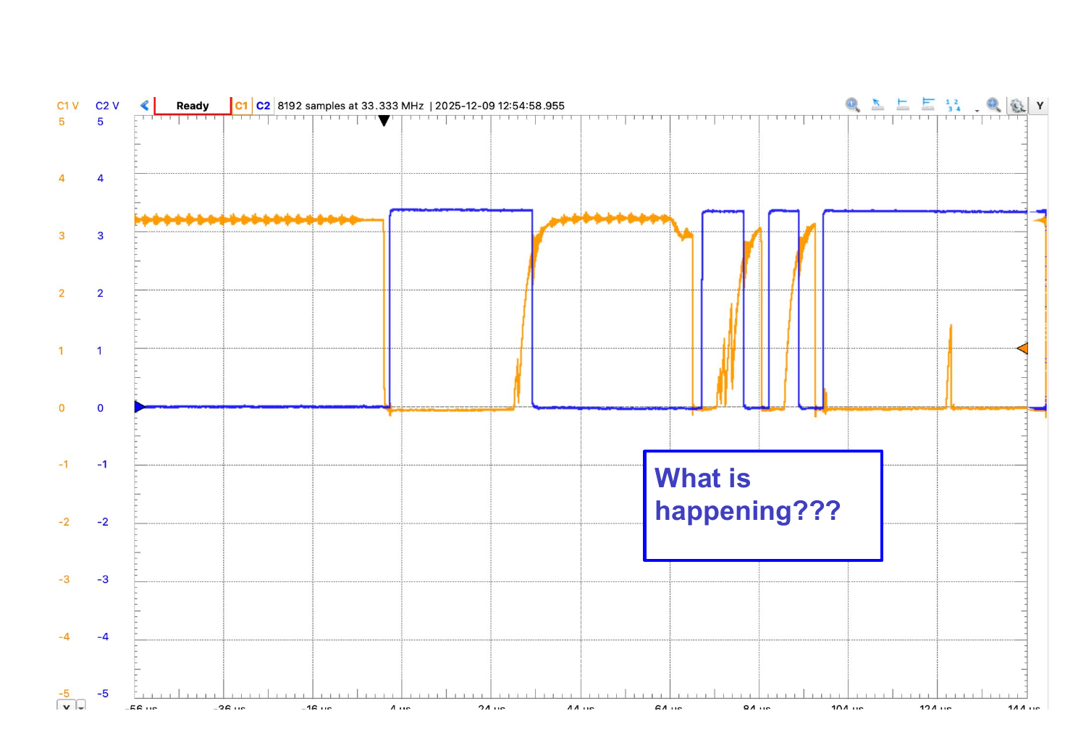
What contact bounce looks like
One press on CH1 (orange) makes many rapid HIGH/LOW transitions before settling. CH2 (blue) shows the LED toggling on each bounce — not just once. Bounce lasts ~50 µs to a few ms, and varies by switch.
Notes:
OPTIONAL / REVEAL — show after the activity if useful, or skip.

Slide 8
Hardware fix: add a capacitor
Add a small capacitor across the switch (from D5/PB4 to GND).
When the switch closes, the cap discharges through the low-resistance contacts instead of bouncing.
When it opens, the ~40 kΩ internal pull-up recharges it slowly.
The RC time constant smooths the bounce spikes away.

Slide 9
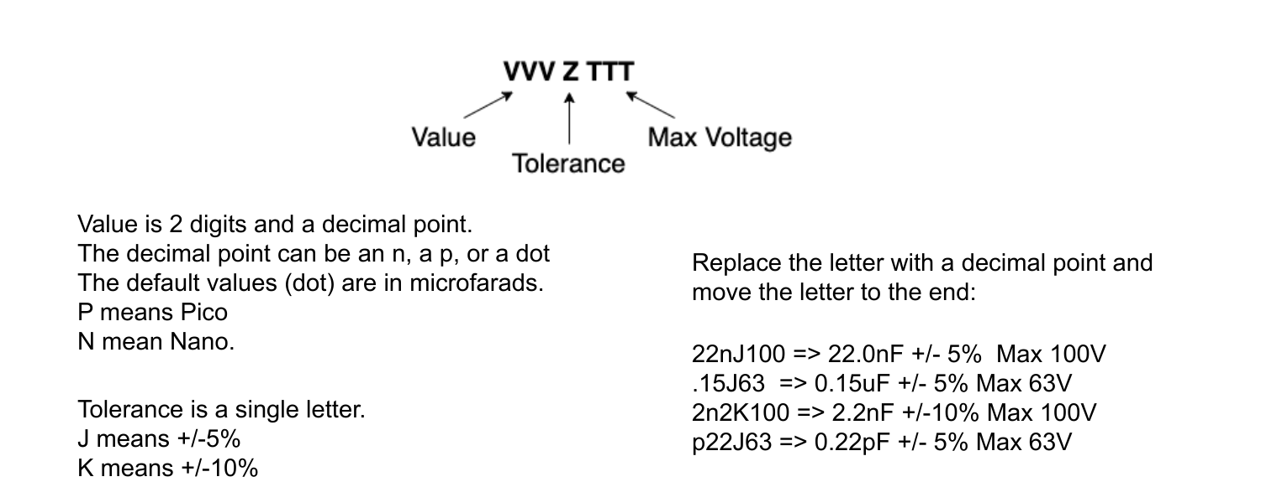
Reading capacitor codes
Metal-film capacitor markings: value, tolerance, and max voltage. The decimal point can be an n (nano), p (pico), or a dot (micro). Example: .1J63 = 0.1 µF, ±5%, 63 V.

Slide 10
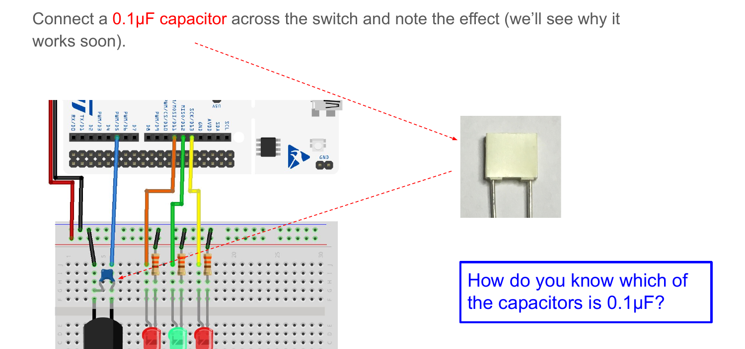
Where the capacitor goes
Place a 0.1 µF capacitor across the button, from D5 (PB4) to GND — in parallel with the switch.

Slide 11
Activity: Hardware Fix: Adding a Capacitor
Identify the 0.1 µF capacitor in your kit using its marking code.
Place the capacitor across the button (one leg on the GPIO-pin side, the other to GND). Capture the button waveform again with the same scope settings. How has it changed?
Look at CH2 (LED) again. Does the LED now toggle exactly once per press? Save a screenshot showing both channels, with and without the capacitor, for your lab report.

Slide 12
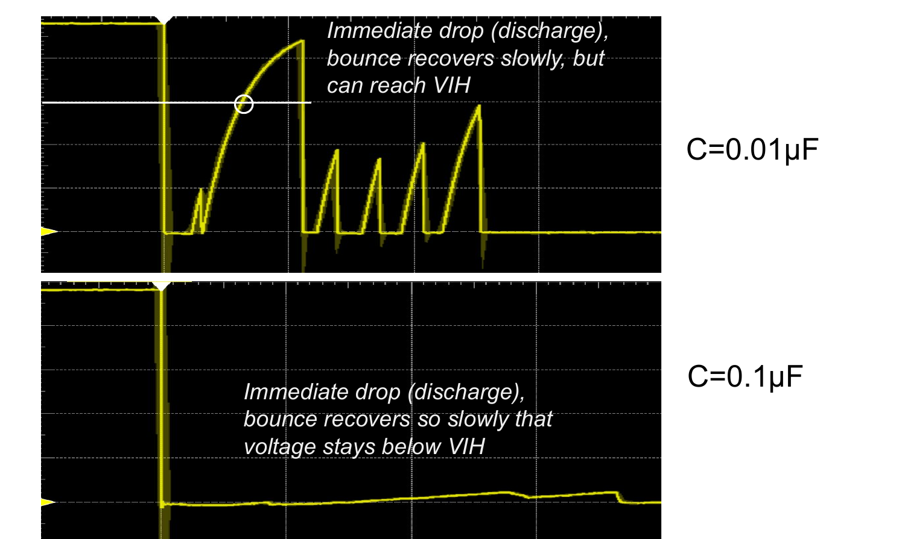
With vs. without the capacitor
Adding the capacitor rounds off the fast bounce so the pin makes one clean transition — and the LED toggles once per press.
Notes:
OPTIONAL / REVEAL — show after the activity if useful, or skip.

Slide 13
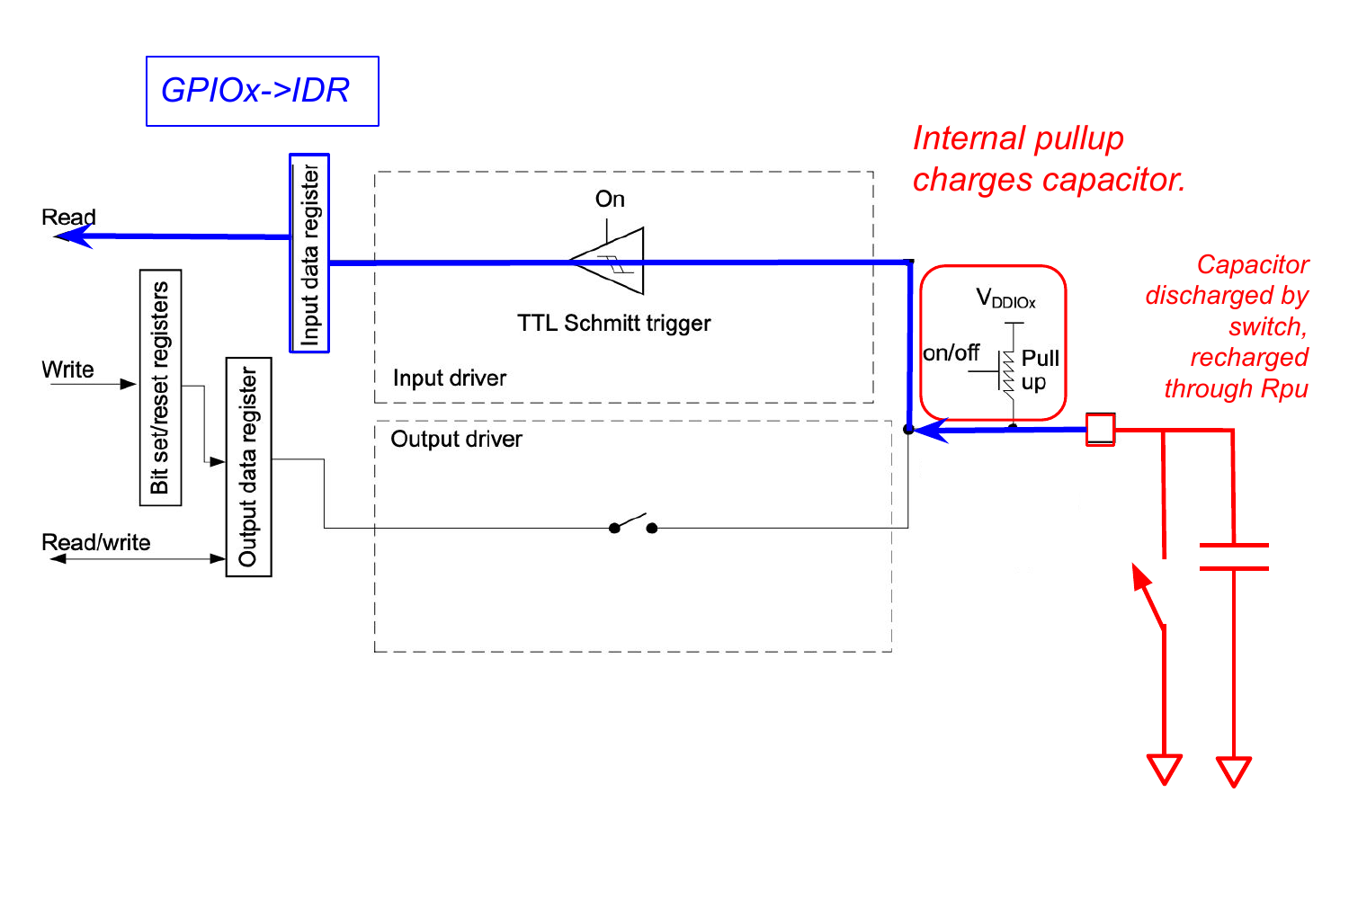
Why it works: the RC filter
Recall from Phys 14: a capacitor stores charge and can't change its voltage instantly.
The internal pull-up (~40 kΩ) and the capacitor form an RC low-pass filter.
When the switch bounces open, the cap recharges slowly through the pull-up.
If C is large enough, the voltage never climbs back above VIH during the bounce — so no spurious edges reach the pin.
R_pu (~40 kΩ) and C form an RC filter; the cap recharges slowly through R_pu when the switch bounces open.

Slide 14
Part 2 · The Toggle Problem
Notes:
Suggested timing: ≈ 15 min.

Slide 15
Polling — and why a naive toggle fails
Polling = reading the pin every iteration of the main loop and acting on it. Simple, but it has a subtle problem for a toggle.
Even with a debounced switch, consider this loop:
while (1) {
buttonPushed = ((GPIOB->IDR & BUTTON_PIN) == 0);
if (buttonPushed) {
GPIOA->ODR ^= LED_PIN; // toggle LED
}
}

Slide 16
Activity: The Toggle Problem
Predict: if you press and hold the button for half a second, how many times will the LED toggle? Why?
The loop runs at ~12 MHz. Roughly how many times does it execute while a human holds the button for 200 ms? How many toggles does that produce?
The fix is to detect the transition from unpressed to pressed — not just the level. The skeleton on the next slide does this; fill in the missing lines. When should the LED toggle, and when should it not?

Slide 17
The fix: detect the leading edge — fill in the blanks
unsigned buttonAlreadyPressed = 0;
while (1) {
buttonPushed = ((GPIOB->IDR & BUTTON_PIN) == 0);
if (!buttonAlreadyPressed && buttonPushed) {
// TODO: toggle the LED
// TODO: remember that the button is now pressed
} else if (!buttonPushed) {
// TODO: reset so the next press can be detected
}
}
Notes:
Students complete the three TODO lines. Full solution is on the hidden slide at the end.

Slide 18
Looking ahead to Day 4
Day 4 shows a cleaner way to write this same logic — the state machine design pattern.
Before then, read the state-machine section and be ready to discuss how the state variable corresponds to buttonAlreadyPressed.

Slide 19
Solution — toggleLED.c (edge-detected)
#include "ES28.h"
#define GPIOAEN (1U<<0)
#define GPIOBEN (1U<<1)
#define LED_PIN (1U<<5) // PA5 / D13
#define BUTTON_PIN (1U<<4) // PB4 / D5
int main(void) {
unsigned buttonAlreadyPressed = 0, buttonPushed;
RCC->IOPENR |= (GPIOAEN | GPIOBEN);
GPIOA->MODER |= (1U<<10); GPIOA->MODER &= ~(1U<<11); // PA5 output
GPIOB->MODER &= ~(1U<<8) & ~(1U<<9); // PB4 input
GPIOB->PUPDR |= (1U<<8); GPIOB->PUPDR &= ~(1U<<9); // PB4 pull-up
while (1) {
buttonPushed = ((GPIOB->IDR & BUTTON_PIN) == 0);
if (!buttonAlreadyPressed) {
if (buttonPushed) { GPIOA->ODR ^= LED_PIN; buttonAlreadyPressed = 1; }
} else if (!buttonPushed) {
buttonAlreadyPressed = 0;
}
}
}
Notes:
Hidden from the student export. Instructor reference.

