Slide 1
State Machines
ENGS 28 · Day 4 — In-Class

Slide 2
Announcements
Labs: start early — greater chance of 1-on-1 TA time on Tue/Wed/Thu.
Signatures: try your best to get an in-person signature (video submissions as backup).
Quiz 1: available from noon Sunday to noon Tuesday. Going forward, quizzes open Mondays.
Notes:
Hidden from the student export. Instructor reference.

Slide 3
Agenda
Code review — your toggleLED.c
The state machine design pattern
Designing and implementing your own state machines
Lab 2 design challenges

Slide 4
Part 1 · Code Review — toggleLED.c
Notes:
Suggested timing: ≈ 10 min.

Slide 5
Activity: toggleLED Code Review
Set up your Nucleo with your toggleLED.c (with the 0.1 µF debounce capacitor across the switch) and share it with your group.
Read each partner's code. Can you follow its logic and explain it line by line? There are at least two valid structures using a buttonAlreadyPressed flag — one checks the flag in the outer if, the other checks buttonPushed first. Are both correct? Is one clearer?
Identify the parts of your code that correspond to FSM concepts: where is the state stored? What are the events? What action happens on which transition?

Slide 6
Solution — toggleLED.c (structure 1)
#include "ES28.h"
#define GPIOAEN (1U<<0)
#define GPIOBEN (1U<<1)
#define LED_PIN (1U<<5) // PA5 / D13
#define BUTTON_PIN (1U<<4) // PB4 / D5
int main(void) {
unsigned buttonAlreadyPressed = 0, buttonPushed;
RCC->IOPENR |= (GPIOAEN | GPIOBEN);
GPIOA->MODER |= (1U<<10); GPIOA->MODER &= ~(1U<<11); // PA5 output
GPIOB->MODER &= ~(1U<<8) & ~(1U<<9); // PB4 input
GPIOB->PUPDR |= (1U<<8); GPIOB->PUPDR &= ~(1U<<9); // PB4 pull-up
while (1) {
buttonPushed = ((GPIOB->IDR & BUTTON_PIN) == 0);
if (!buttonAlreadyPressed) {
if (buttonPushed) { GPIOA->ODR ^= LED_PIN; buttonAlreadyPressed = 1; }
} else {
if (!buttonPushed) buttonAlreadyPressed = 0;
}
}
}
Notes:
Hidden from the student export. Instructor reference.

Slide 7
Solution — toggleLED.c (structure 2)
#include "ES28.h"
#define GPIOAEN (1U<<0)
#define GPIOBEN (1U<<1)
#define LED_PIN (1U<<5) // PA5 / D13
#define BUTTON_PIN (1U<<4) // PB4 / D5
int main(void) {
unsigned buttonAlreadyPressed = 0, buttonPushed;
RCC->IOPENR |= (GPIOAEN | GPIOBEN);
GPIOA->MODER |= (1U<<10); GPIOA->MODER &= ~(1U<<11); // PA5 output
GPIOB->MODER &= ~(1U<<8) & ~(1U<<9); // PB4 input
GPIOB->PUPDR |= (1U<<8); GPIOB->PUPDR &= ~(1U<<9); // PB4 pull-up
while (1) {
buttonPushed = ((GPIOB->IDR & BUTTON_PIN) == 0);
if (buttonPushed) {
if (buttonAlreadyPressed == 0) {
GPIOA->ODR ^= LED_PIN; buttonAlreadyPressed = 1;
}
} else {
buttonAlreadyPressed = 0;
}
}
}
Notes:
Hidden from the student export. Instructor reference.

Slide 8
Part 2 · The State Machine Pattern
Notes:
Suggested timing: ≈ 15 min.

Slide 9
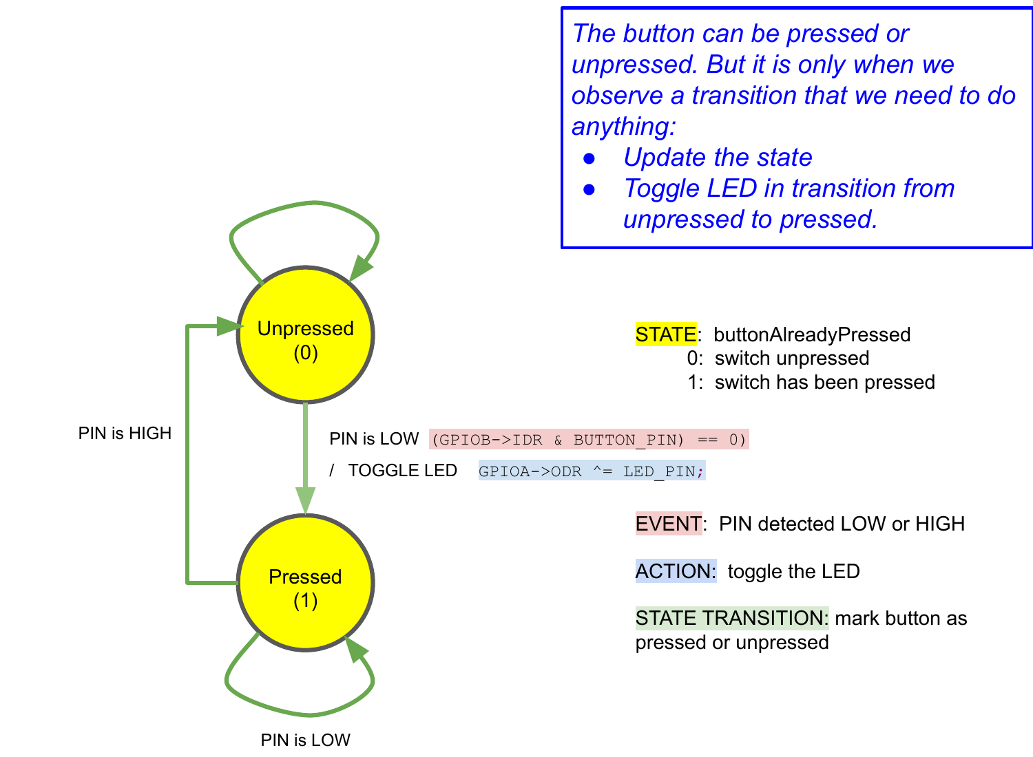
Your toggle code IS a state machine
The buttonAlreadyPressed variable is the state.
Two states: Unpressed / Pressed.
The LED toggles exactly once — on the Unpressed → Pressed transition.
The snippet on each arrow is the C expression that triggers it.
Button-toggle FSM: two states, with the triggering C expression on each transition.

Slide 10
The same logic as idiomatic C (enum + switch)
typedef enum { UNPRESSED, PRESSED } state_t;
state_t state = UNPRESSED;
while (1) {
int btn = !(GPIOB->IDR & (1U << 4)); // 1 if pressed (active-low)
switch (state) {
case UNPRESSED:
if (btn) {
GPIOA->ODR ^= (1U << 5); // toggle LED on press
state = PRESSED;
}
break;
case PRESSED:
if (!btn) state = UNPRESSED; // wait for release
break;
}
}

Slide 11
Why write it this way?
There is no blocking while loop inside — the FSM does a little work each pass and returns.
So it embeds inside a larger main loop that also blinks LEDs, reads a UART, or does other work.
The state variable preserves context across iterations.
A finite state machine = states, events that cause transitions, and actions taken on each transition. It scales cleanly as you add states or events.

Slide 12
Part 3 · Designing State Machines
Notes:
Suggested timing: ≈ 20 min.

Slide 13
Activity: Drawing a State Diagram
Before writing any code, draw the diagram on paper or your whiteboard. Label each state (box), each transition arrow with its triggering event, and each action taken on the transition.
Draw the diagram for a 3-state LED cycling FSM: each press advances to the next LED pattern (A → B → C → A → …). You choose the patterns. How many states? What are the events? What action on each transition?
Draw the diagram for the Lab 2 pause/resume counter: it blinks normally until a press pauses it; a second press resumes. How is this different from the 3-state cycling FSM?

Slide 14
Part 4 · Implementing a State Machine in C
Notes:
Suggested timing: ≈ 30 min.

Slide 15
Activity: Implementing Your FSM
Start from your toggleLED.c or blinkyCNT.c project. Replace blocking logic or bare flags with a proper enum + switch FSM.
Implement the pause/resume counter FSM: the counter blinks the LEDs in binary and a press pauses or resumes counting. Test it — does a single physical press always produce exactly one state change?
If you finish early: implement the 3-state LED cycling FSM, or add a second button that resets the counter to zero from either state. How does the diagram change?
Verify on the oscilloscope that LED transitions are clean (no multiple toggles per press), with and without the debounce capacitor.

Slide 16
Lab 2 Introduction
Two design challenges — read the full spec in the lab handout.
Notes:
Suggested timing: ≈ 15 min.

Slide 17
Activity: Lab 2 Design Challenges
Challenge 1 — Pause/resume counter: if your FSM from Part 3 already implements this, review the lab spec and make sure your solution meets all requirements (correct state behavior, debouncing, clean scope traces).
Challenge 2 — Reaction-time game: draw the state diagram before writing code. How many states does the game have? What are the events (button presses, timer expiry)? What actions does each transition trigger?

