Slide 1
Talking to Your Computer over UART
ENGS 28 · Day 5 — In-Class

Slide 2
Before we start
Lab 1 feedback is posted — read the comments. From now on, poor style and inefficient/redundant code will cost more points.
HiTA reminder: if the AI judges your understanding is thin, it may grade the conversation lower. Engage with it.
Print statements are your most-used debugging tool for the rest of the course — today you set them up.
Notes:
Hidden from the student export. Instructor reference.

Slide 3
Part 1 · Does printf Work?
Notes:
Suggested timing: ≈ 25 min.

Slide 4
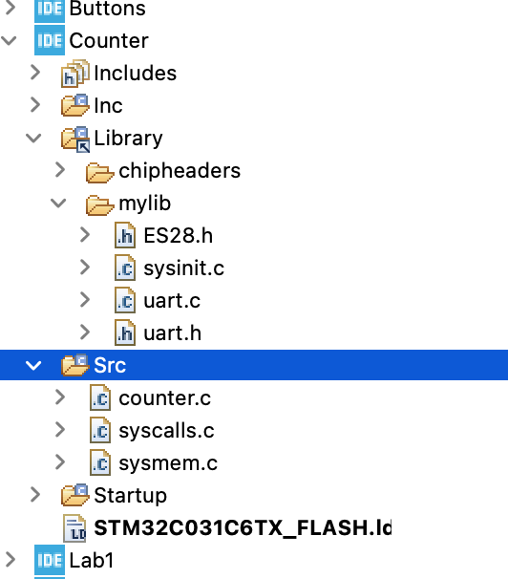
A live counter, printed to your laptop
You'll set up a project that prints a live counter over UART.
Same workflow you'll use as a debugging tool all term.
uart.c / uart.h live in Library/mylib/; counter.c in Src/. All three from Canvas.
Finished Counter project in STM32CubeIDE.
Notes:
INSTRUCTOR DEMO — run the finished counter yourself first (CoolTerm at 9600, press reset), let them watch, then switch to 4800 and 115200 and ask what they see. Don't answer — let them hypothesize.

Slide 5
Activity: Set Up and Run the Counter
Download counter.c, uart.c, uart.h from Canvas.
Copy TemplateProject and rename the copy Counter.
Put uart.c/.h in mylib, and counter.c in Counter/Src/. Build and flash.
Open CoolTerm → Options, configure it as on the next slide, then Save the config as ENGS28.CoolTermSettings.
Click Connect, press the black reset button — you should see the counter incrementing.
Then change Baudrate to 4800, reconnect, reset — observe. Try 115200. Write one sentence explaining each garbled result in terms of bit period.

Slide 6
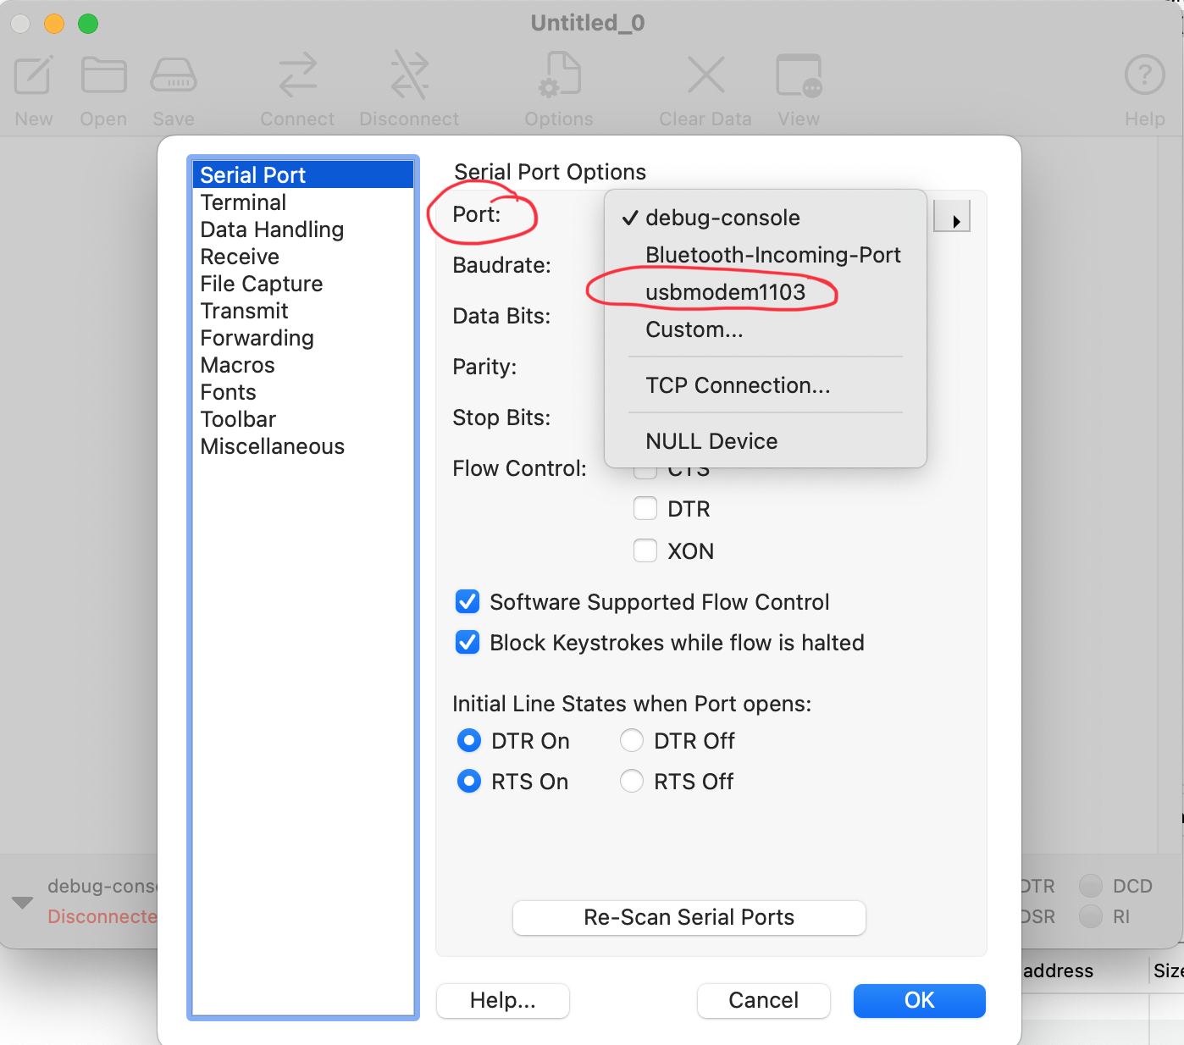
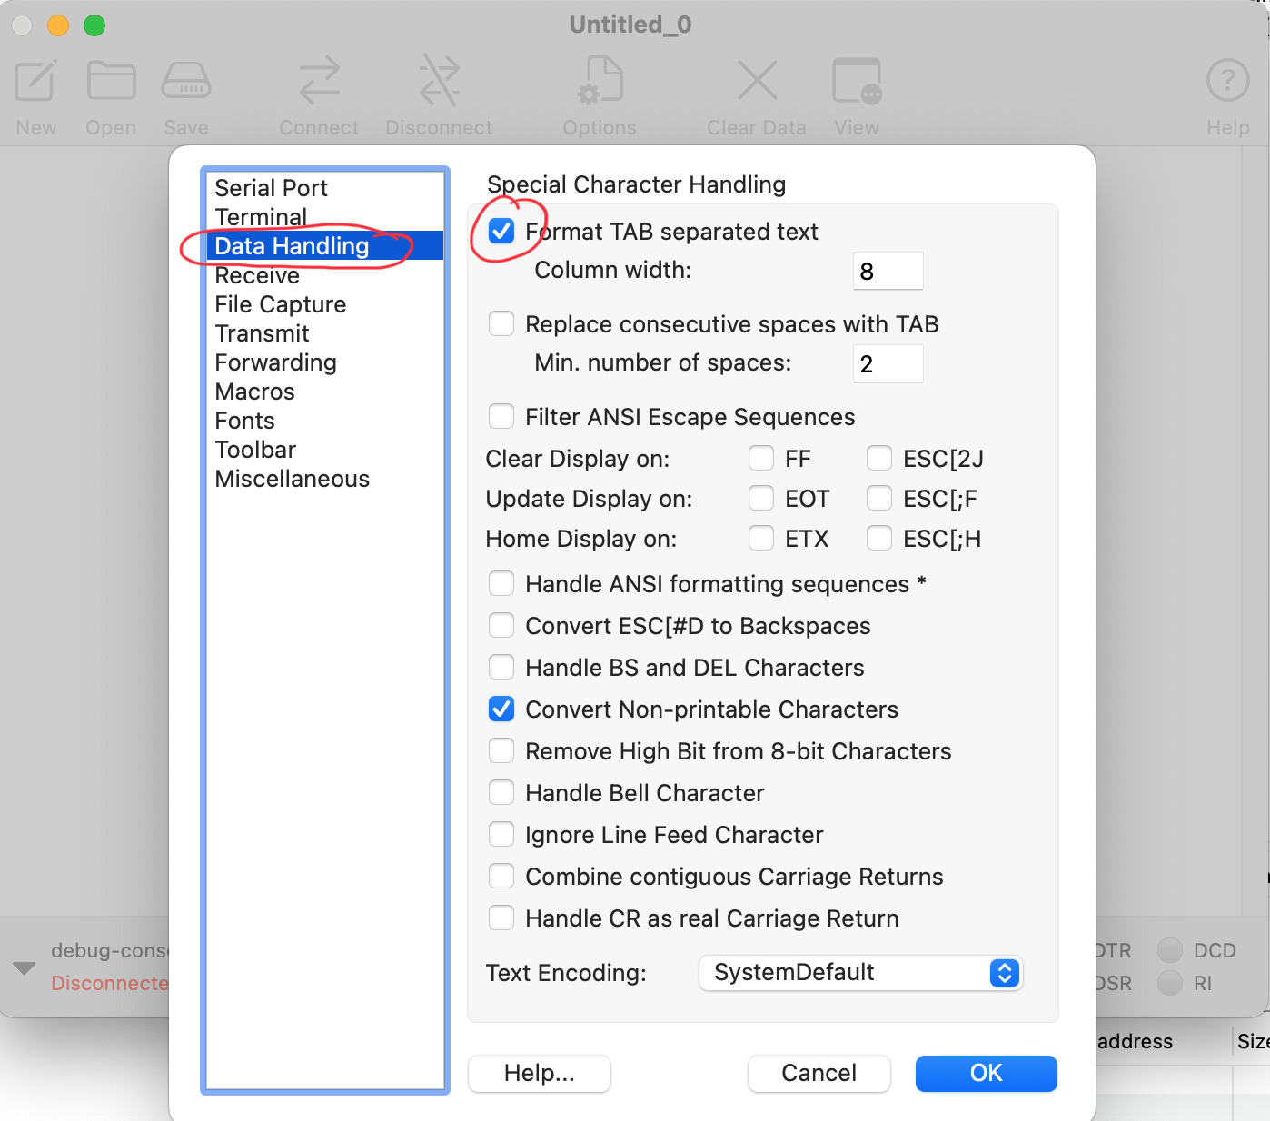
CoolTerm settings
Serial Port: pick the USB-modem / USB-serial port; 9600 · 8 · None · 1, no flow control.
Data Handling: check Format TAB separated text and Convert Non-printable Characters.

Slide 7
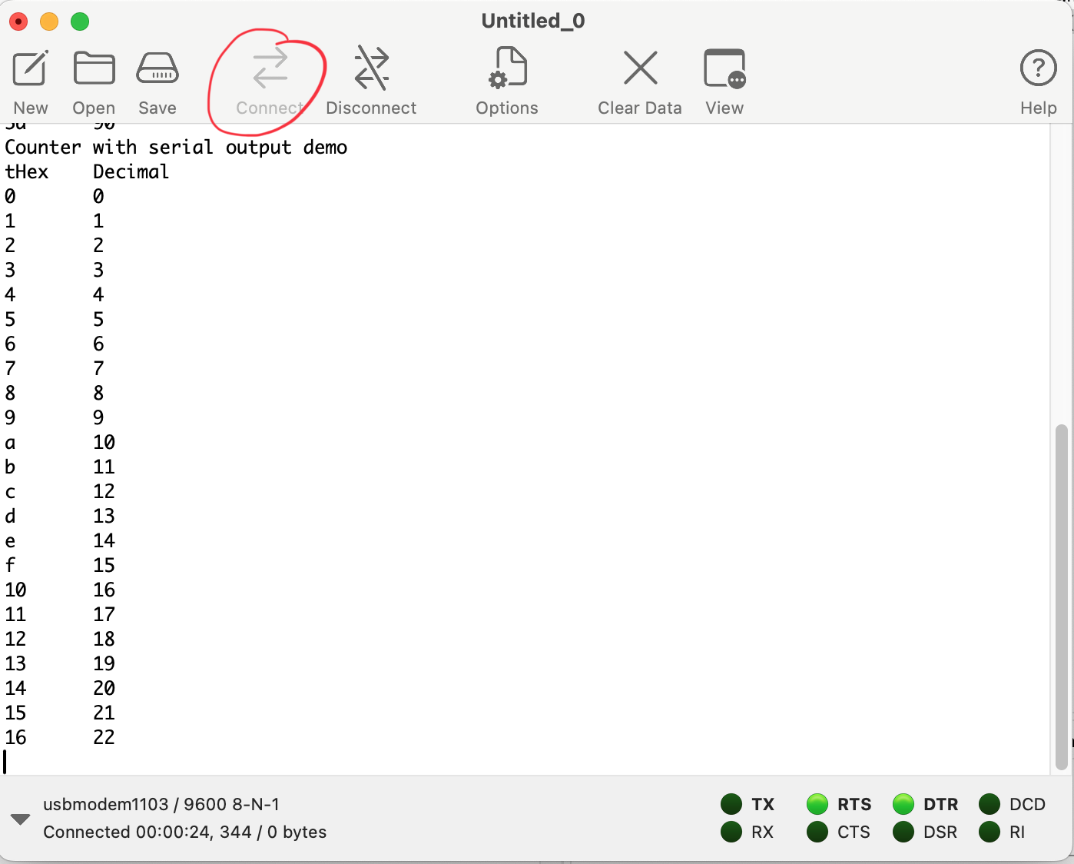
What you should see
Each line prints once per 500 ms.
Press the Nucleo reset button and the count restarts from zero.
4800 baud is half the correct rate — the receiver samples each bit for twice as long, so every byte is corrupted. Baud mismatch = garbage.
CoolTerm showing counter output at 9600 baud.

Slide 8
Using printf in your code
printf("count = %d\r\n", count); // signed decimal
printf("MODER = 0x%08lx\r\n", GPIOA->MODER); // 32-bit reg: %lx (long)
printf("adc_val = 0x%04x\r\n", adc_val); // 16-bit: %x
printf("%d\t%x\r\n", count, count); // tab-separated columns
printf("key = %c\r\n", ch); // single character
Setup: add #include <stdio.h> and #include "uart.h" at the top of your file, and call uart2_init() once before any printf.
End each line with \r\n (not just \n) so the cursor returns to the left edge.
No %f: the course printf can't format floats. Convert first — int mV = (int)(v*1000); printf("%d mV", mV).

Slide 9
Part 2 · How Does the UART Driver Work?
Notes:
Suggested timing: ≈ 20 min.

Slide 10
Jigsaw: annotate the driver
Below is uart.c with all comments stripped. Annotate your assigned section — explain what each line does and why it's necessary.
Groups A & B: uart2_init (GPIO/AF, then clock/BRR/CR1). Groups C & D: uart2_write and uart2_read.
After 8 minutes, pair up across the split and teach each other. Goal: your partner could explain any line without your help.

Slide 11
uart.c — comments stripped
#define APB_CLK 12000000U
#define BAUD_RATE 9600U
void uart2_init(void) {
// -- Group A --
RCC->IOPENR |= RCC_IOPENR_GPIOAEN;
GPIOA->MODER &= ~((3U<<4) | (3U<<6));
GPIOA->MODER |= ((2U<<4) | (2U<<6));
GPIOA->AFR[0] &= ~((0xFU<<8) | (0xFU<<12));
GPIOA->AFR[0] |= ((1U<<8) | (1U<<12));
// -- Group B --
RCC->APBENR1 |= RCC_APBENR1_USART2EN;
USART2->BRR = APB_CLK / BAUD_RATE;
USART2->CR1 = USART_CR1_TE | USART_CR1_RE | USART_CR1_UE;
}
// -- Group C --
void uart2_write(int ch) {
while (!(USART2->ISR & USART_ISR_TXE_TXFNF)) {}
USART2->TDR = (ch & 0xFF);
}
// -- Group D --
int uart2_read(void) {
while (!(USART2->ISR & USART_ISR_RXNE_RXFNE)) {}
return USART2->RDR & 0xFF;
}

Slide 12
Driver reference (annotated) — instructor key
void uart2_init(void) {
RCC->IOPENR |= RCC_IOPENR_GPIOAEN; // clock to GPIOA
GPIOA->MODER &= ~((3U<<4)|(3U<<6)); // clear PA2/PA3 mode
GPIOA->MODER |= ((2U<<4)|(2U<<6)); // 10 = alternate function
GPIOA->AFR[0] &= ~((0xFU<<8)|(0xFU<<12)); // clear AF nibbles
GPIOA->AFR[0] |= ((1U<<8)|(1U<<12)); // AF1 = USART2 TX/RX
RCC->APBENR1 |= RCC_APBENR1_USART2EN; // clock to USART2 (APB bus)
USART2->BRR = APB_CLK / BAUD_RATE; // 12e6/9600 = 1250
USART2->CR1 = USART_CR1_TE|USART_CR1_RE|USART_CR1_UE; // TX,RX,enable last
}
void uart2_write(int ch) {
while (!(USART2->ISR & USART_ISR_TXE_TXFNF)) {} // wait: TX register empty
USART2->TDR = (ch & 0xFF); // send one byte
}
int uart2_read(void) {
while (!(USART2->ISR & USART_ISR_RXNE_RXFNE)) {} // wait: byte received
return USART2->RDR & 0xFF; // read it (clears RXNE)
}
Notes:
Hidden from the student export. Instructor reference.

Slide 13
Under the Hood: How the UART Works
What the driver code you just read is actually doing.
Notes:
Suggested timing: ≈ 15 min.

Slide 14
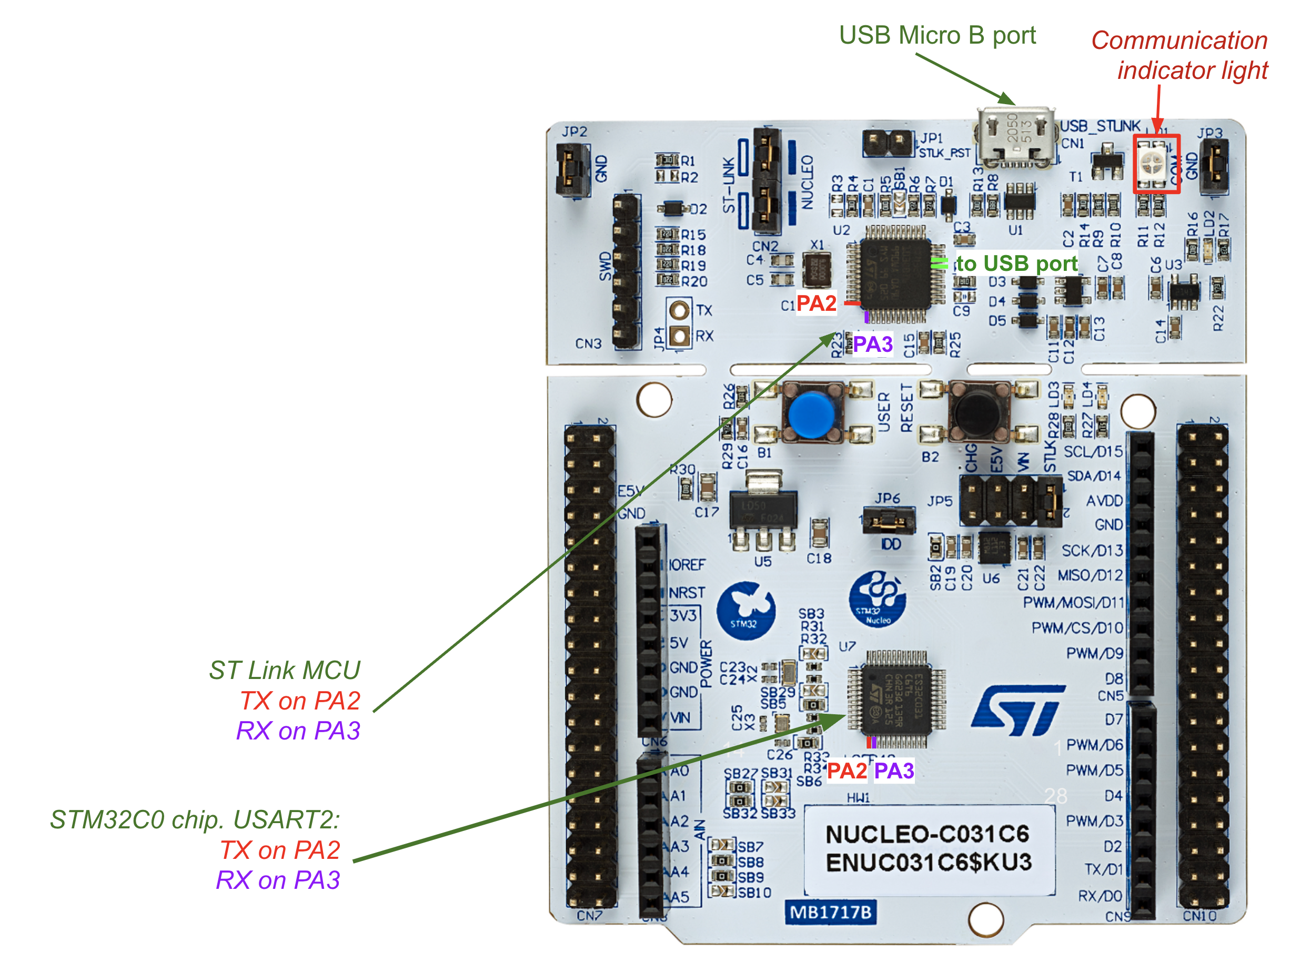
How your board reaches your laptop
The ST-Link section (top of the board) is a second STM32 that is both the programmer and a USB-to-serial bridge.
USART2 TX = PA2, RX = PA3 on your STM32C0 connect internally (solder bridges) to the ST-Link — no external wiring.
The ST-Link appears on your laptop as a USB serial device.
So: printf → PA2 → ST-Link → USB → CoolTerm.
PA2 (TX) and PA3 (RX) connect internally to the ST-Link, which is the USB serial device.

Slide 15
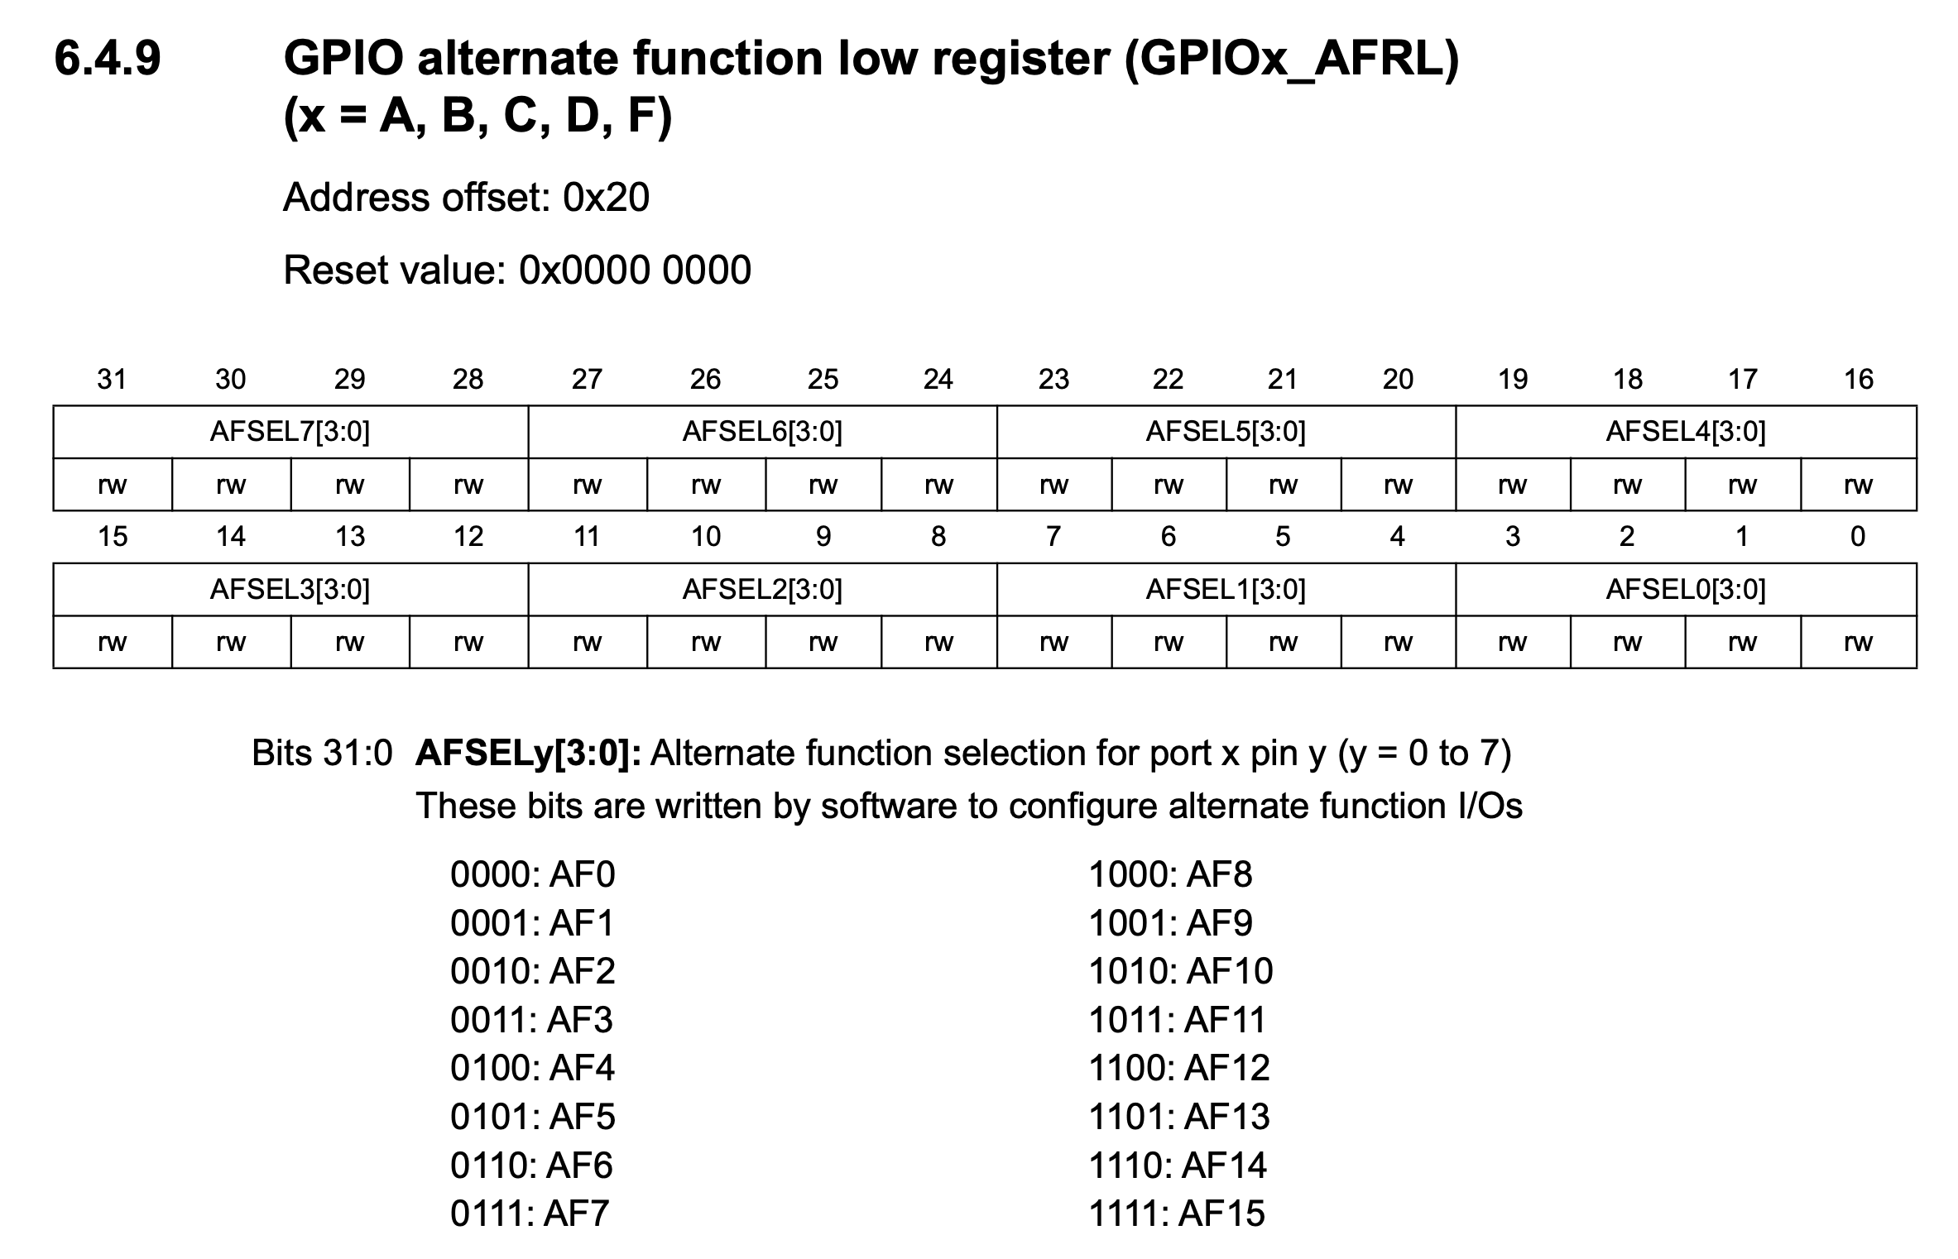
Routing pins to the UART: alternate function
One physical pin can serve many peripherals. Two fields decide which:
GPIOA->MODER = 10 puts PA2/PA3 in Alternate Function mode.
GPIOA->AFR[0] picks which function — 4 bits per pin. AF1 = USART2 for PA2/PA3.
That is exactly the Group A code in the driver.
AFRL — 4 bits per pin: PA2 = bits [11:8], PA3 = bits [15:12]; write 0001 (AF1) into each.

Slide 16
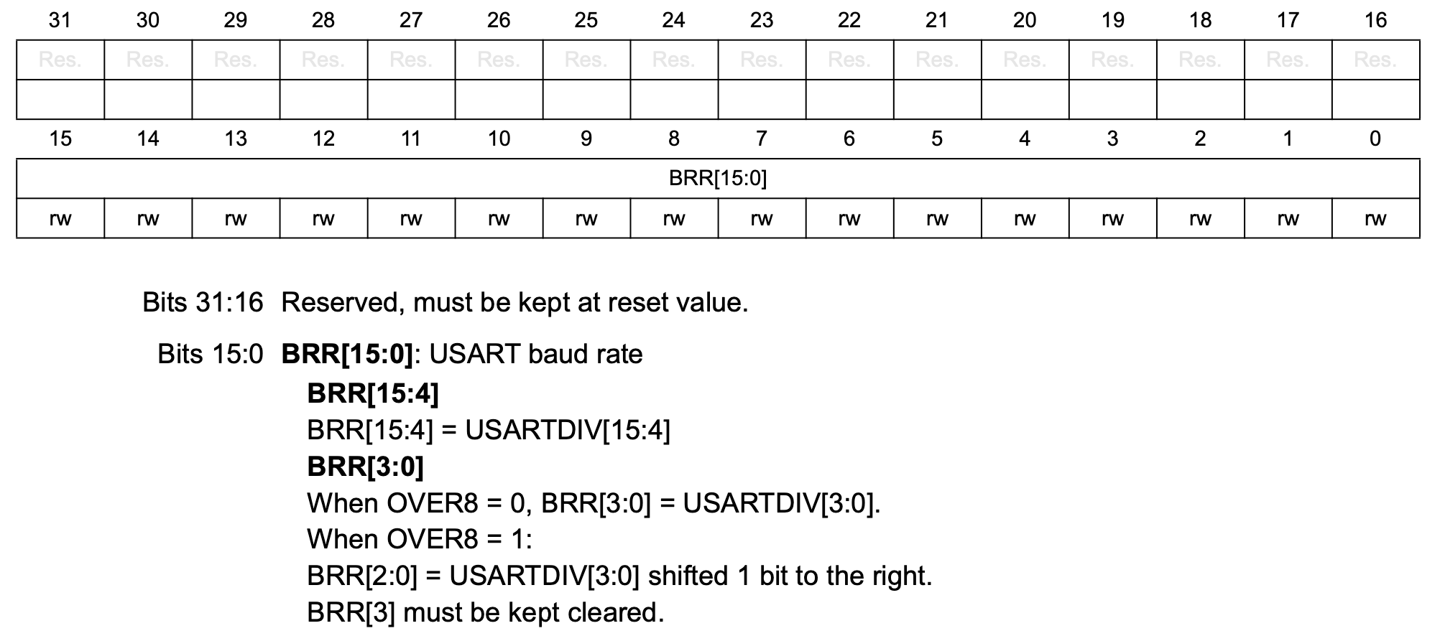
Setting the speed: the baud-rate register
No shared clock wire, so both ends must agree on the bit rate in advance.
USART_BRR holds USARTDIV, a plain divisor of the APB clock.
BRR = f_APB / baud = 12,000,000 / 9600 = 1250.
Load the wrong divisor and every bit is mistimed → garbage. That's what the 4800 experiment showed.
USART_BRR bits [15:0] = USARTDIV. 9600 baud at 12 MHz → 1250 (0x04E2).

Slide 17
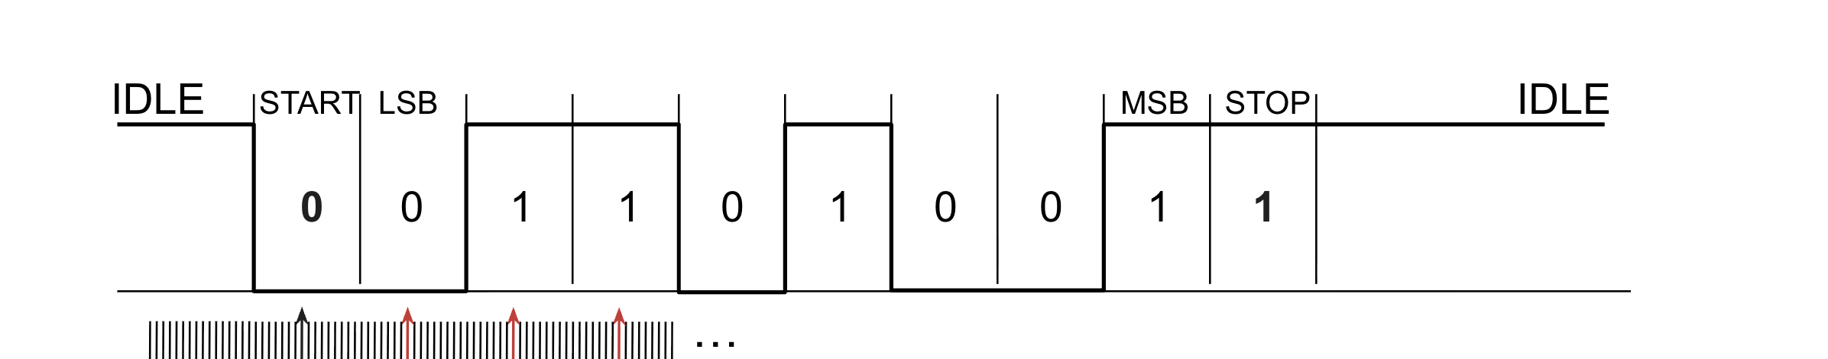
How the receiver recovers timing: oversampling ×16
Each byte is framed: the line idles HIGH, a START bit (LOW) begins it, 8 data bits follow LSB-first, and a STOP bit (HIGH) ends it (8N1).
The receiver runs its sample clock at 16× the baud rate. It catches the START falling edge, counts 8 ticks to the bit center, then samples every 16 ticks — always mid-bit, where the signal is stable.
That is how it counts several identical bits correctly with no clock wire.
Dense ticks = the 16× sample clock. Black arrow = start-bit center; red arrows = each bit sampled at its center.

Slide 18
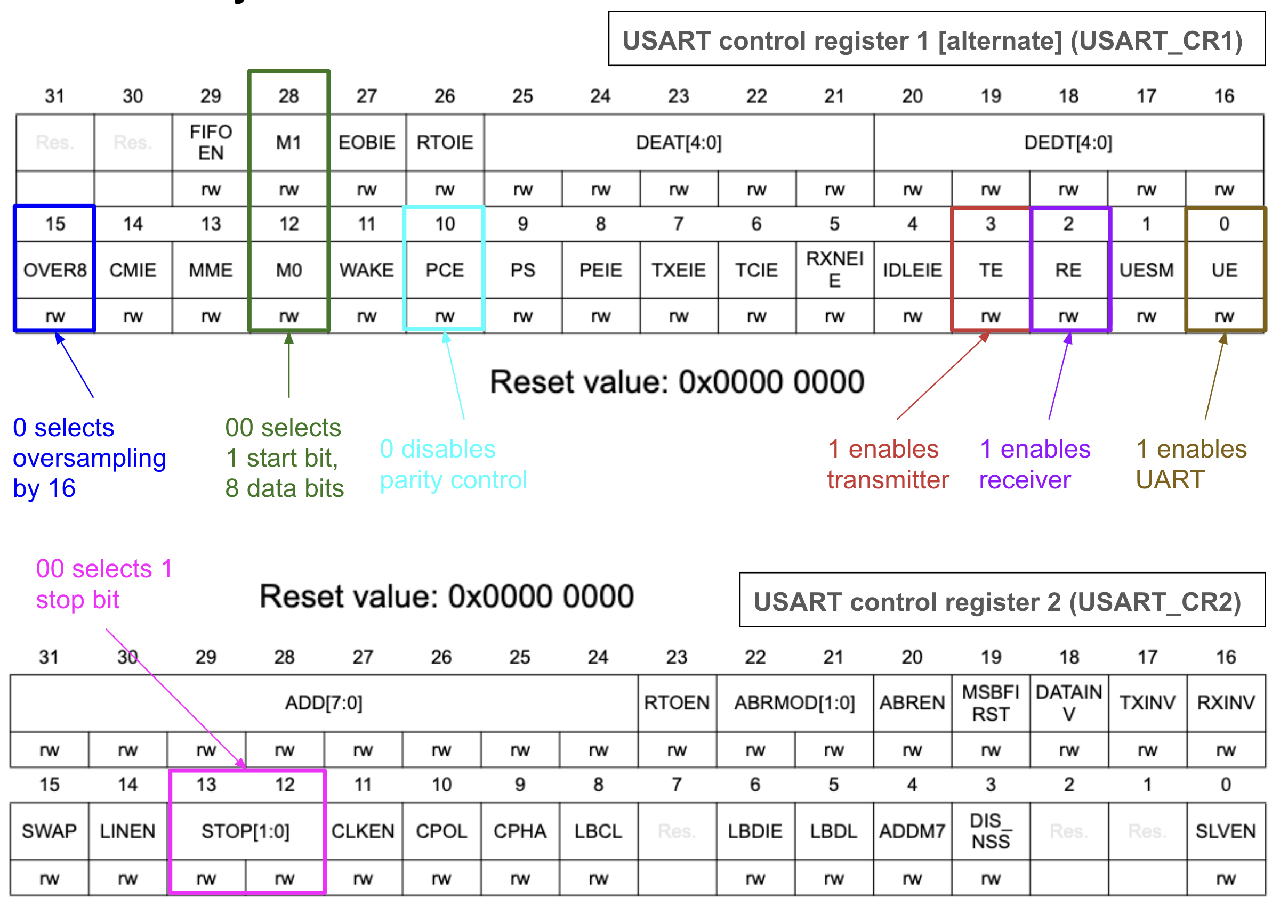
Frame format for free: CR1 = 8N1
The reset value of CR1/CR2 (0x00000000) already gives 8 data bits, no parity, 1 stop bit, and oversampling ×16 — exactly 8N1.
So we set only three bits: TE (transmit), RE (receive), and UE (enable).
UE must be set last, after BRR. That is the Group B code.
USART_CR1/CR2: reset already selects 8N1 + oversampling ×16; set TE, RE, UE (UE last).

Slide 19
Part 3 · Start the Keyboard Counter
Notes:
Suggested timing: ≈ 10 min + finish at home.

Slide 20
Listen without freezing the counter
Your counter only sends data — now make it listen too. Pressing a key should change the count.
But calling uart2_read() at the top of the loop would block forever waiting for a key, freezing the counter.
The fix: poll the RXNE flag. If a byte is waiting, read it and act; if not, skip straight to the print and delay. (You just studied the driver — you can complete the read line yourself.)
while (1) {
if (USART2->ISR & USART_ISR_RXNE_RXFNE) {
char key = /* read from the right register */; // complete this
// handle key here ...
}
printf("count = %d\r\n", count);
delay_ms(500);
}

Slide 21
Activity: Keyboard-Controlled Counter
Modify counter.c so it no longer auto-increments — it only changes on a control key. Any other key (or none) leaves the count unchanged and reprints the same value every 500 ms.
u/U increments · d/D decrements · r/R resets to zero.
Use the RXNE flag for a non-blocking receive. Do not call uart2_read() — it blocks and freezes the counter. Test in CoolTerm.
Optional challenge: make u/d set a direction so the counter auto-counts every 500 ms; r resets and pauses until a new direction key. This is the lab deliverable — finish at home.

Slide 22
Solution — keyboard counter (reference)
#include <stdio.h>
#include "ES28.h"
#include "uart.h"
int main(void) {
int count = 0;
uart2_init();
printf("Keyboard-controlled counter\r\n");
while (1) {
if (USART2->ISR & USART_ISR_RXNE_RXFNE) {
char key = USART2->RDR & 0xFF;
if (key == 'u' || key == 'U') count++;
else if (key == 'd' || key == 'D') count--;
else if (key == 'r' || key == 'R') count = 0;
}
printf("count = %d\r\n", count);
delay_ms(500);
}
}
Notes:
Hidden from the student export. Instructor reference.

