Slide 1
Transistors: BJTs & MOSFETs
ENGS 28 · Day 6 — In-Class

Slide 2
Part 1 · Code Interview
Notes:
Suggested timing: ≈ 15 min.

Slide 3
Activity: Reviewing the Keyboard Counter
Exchange your keyboard-counter code with a neighbor and read it silently for two minutes. Then take turns asking the questions below — answer each about your partner's code, not your own.
Trace: the user presses u, then d, then r (each once, just before the RXNE check in a loop iteration). What count shows after each of those three loop cycles?
State: where is the counter stored? What type? Largest value before it wraps? Does that matter in practice?
Extension: without changing existing lines, where/how would you add z or Z to increment by 10? How many new lines?
Timing: RXNE is checked once per loop before printf and delay_ms(500). If two keys are pressed in the same 500 ms window, what happens? Bug, or fundamental limit?

Slide 4
Discussion: what happens during delay_ms?
The USART keeps receiving independently of the CPU — it doesn't pause during delay_ms. A byte's bits are assembled in the shift register, transferred to RDR, and RXNE is set. The byte waits in RDR until the loop checks — so one keypress is buffered for free.
A second key while RDR is still full is lost. The shift register receives it, but transferring to an occupied RDR sets the Overrun Error (ORE) flag and the new byte is silently discarded. The first key survives; the program never knows.
Not a bug — a deliberate trade-off that works for a slow manual counter. The general fix is a UART receive interrupt that stores each byte in a software queue (later in the course).

Slide 5
Part 2 · STM32 Bit-Manipulation Macros
Notes:
Suggested timing: ≈ 20 min.

Slide 6
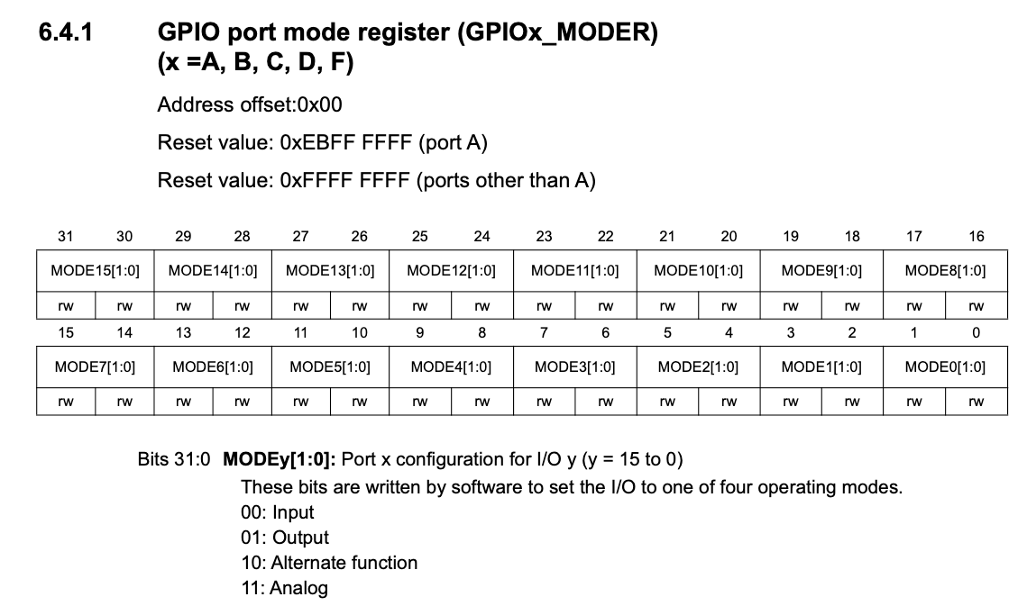
Named macros instead of hand-counted bits
Every register write so far used raw bit positions and hex masks. That works, but a wrong shift is invisible to the compiler.
CMSIS (via ES28.h) names every bit field: each gets a mask (_Msk) and a position (_Pos).
The pattern is always: clear the field, then OR in the value shifted into place.
The MODER register: each pin has a 2-bit field. CMSIS defines GPIO_MODER_MODE5_Msk and _Pos (=10).

Slide 7
Configuring PA5 as output — raw vs. macros
// Raw version — a wrong constant is a silent bug
GPIOA->MODER &= ~(1U << 11); // clear bit 11 of the MODE5 field
GPIOA->MODER &= ~(1U << 10); // clear bit 10 of the MODE5 field
GPIOA->MODER |= (1U << 10); // set bit 10 (output = 0b01)
// Macro version — names are checked by the compiler
GPIOA->MODER &= ~GPIO_MODER_MODE5_Msk;
GPIOA->MODER |= (GPIO_OUTPUT << GPIO_MODER_MODE5_Pos);
// ES28 mode constants: GPIO_INPUT 0, GPIO_OUTPUT 1,
// GPIO_ALTERNATE 2, GPIO_ANALOG 3

Slide 8
Activity: Rewriting with Macros
This code configures PB5 as an output (the pin that drives the transistor base in lab). Rewrite it using CMSIS macros:
RCC->IOPENR |= (1U << 1); // enable GPIOB clock
GPIOB->MODER &= ~(1U << 11);
GPIOB->MODER &= ~(1U << 10);
GPIOB->MODER |= (1U << 10); // PB5 output
GPIOB->ODR |= (1U << 5); // drive PB5 high
1. Rewrite the three MODER lines with GPIO_MODER_MODE5_Msk, _Pos, and GPIO_OUTPUT.
2. What macro replaces (1U << 1) for the GPIOB clock? (Hint: how was GPIOA's clock enabled in the UART driver?)
3. Rewrite the ODR line using GPIO_ODR_OD5 instead of (1U << 5).

Slide 9
Solution — macro rewrite
RCC->IOPENR |= RCC_IOPENR_GPIOBEN; // enable GPIOB clock
GPIOB->MODER &= ~GPIO_MODER_MODE5_Msk; // clear PB5 field
GPIOB->MODER |= (GPIO_OUTPUT << GPIO_MODER_MODE5_Pos);
GPIOB->ODR |= GPIO_ODR_OD5; // drive PB5 high
Notes:
Hidden from the student export. Instructor reference.

Slide 10
Part 3 · Designing a Low-Side NPN Driver
Notes:
Suggested timing: ≈ 25 min.

Slide 11
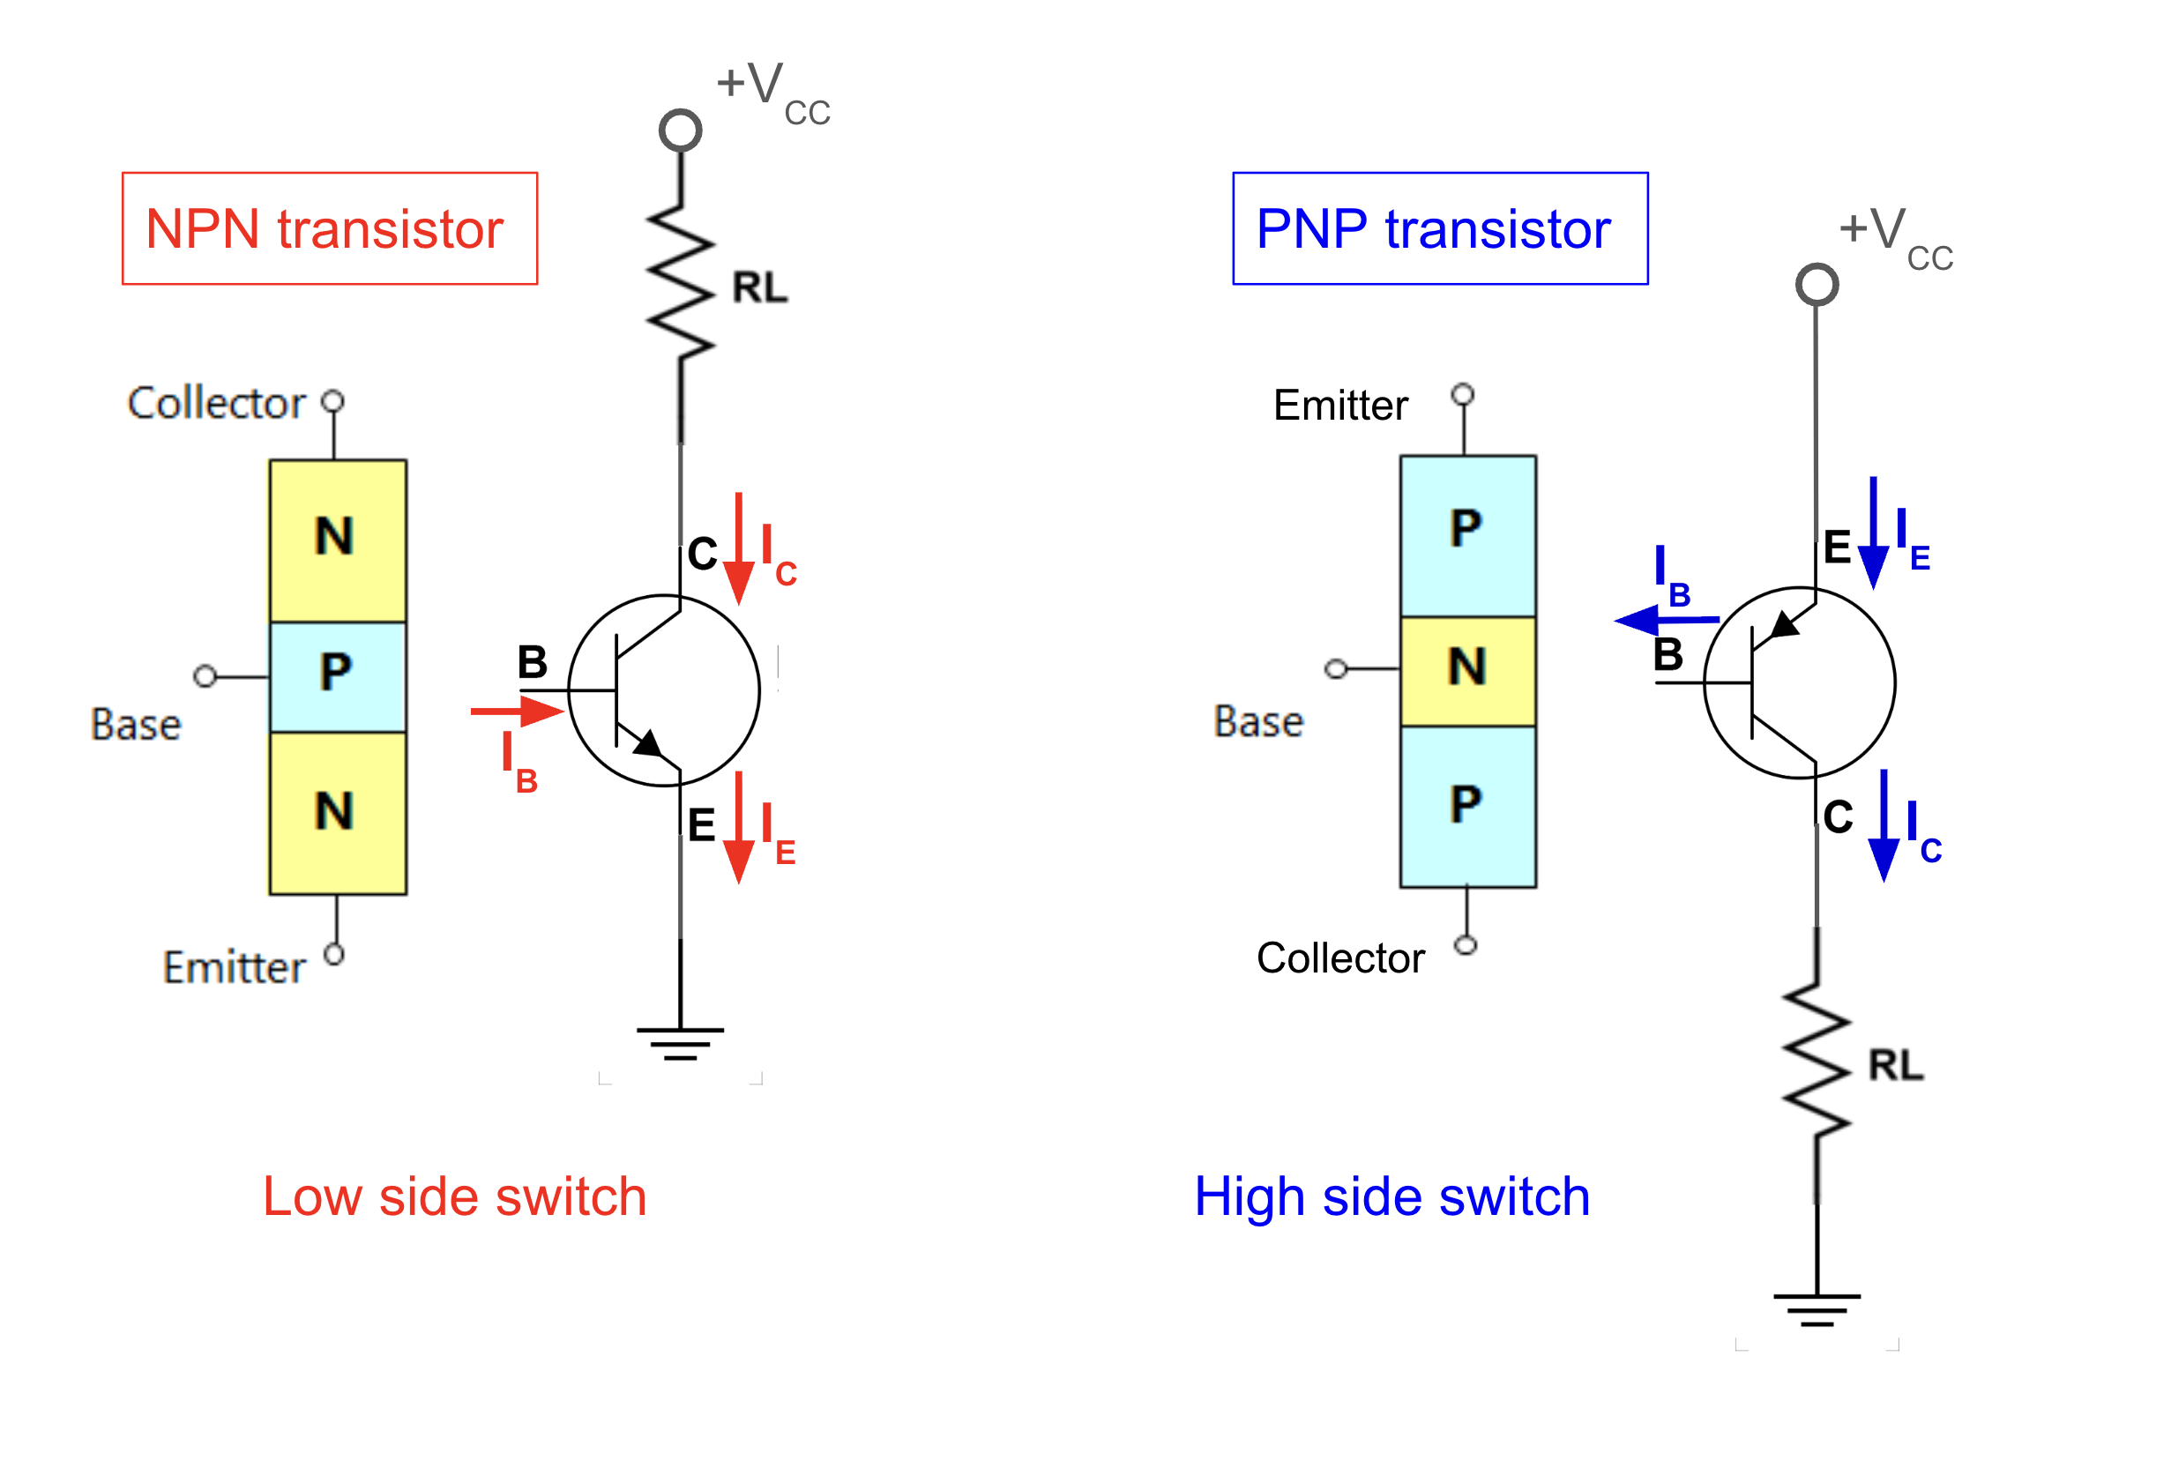
Where does the load connect?
NPN low-side switch (left): load between supply and collector, emitter to ground. PNP high-side switch (right): emitter to supply, load below the collector to ground.

Slide 12
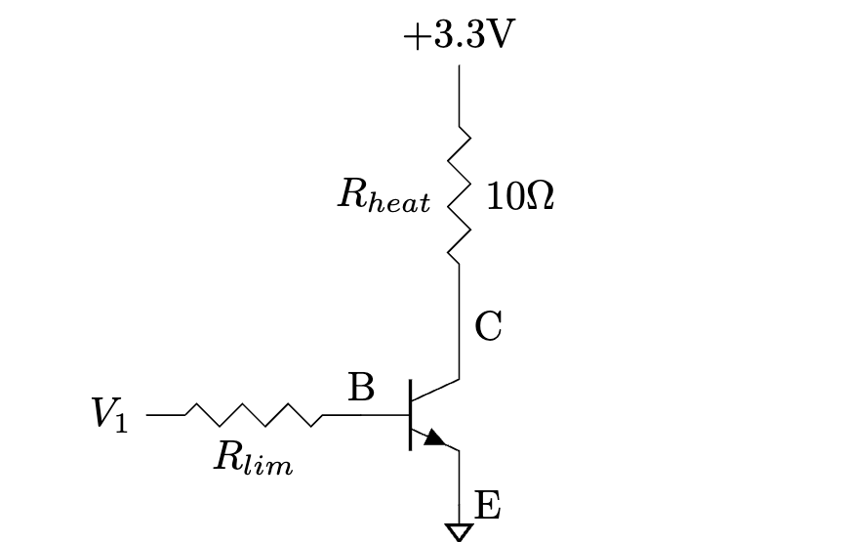
The NPN low-side driver
In this course you'll use NPN transistors as low-side switches.
The load R_heat sits between the supply and the collector.
R_lim (base-current limiting resistor) connects the GPIO pin to the base; the emitter goes to ground.
Design question: what value should R_lim be?
NPN low-side driver: R_lim sets the base current.

Slide 13
Worked example: choosing R_lim
Given: load needs 100 mA from 5 V; NPN has β_min = 50, V_BE = 0.7 V; GPIO outputs 3.3 V.
1. Collector current: the load sets I_C = 100 mA.
2. Min base current to saturate: I_B,min = I_C / β_min = 100 mA / 50 = 2 mA.
3. Safety margin ×2 (real β can be below datasheet min) → target I_B = 4 mA.
4. Voltage across R_lim: V = V_GPIO − V_BE = 3.3 − 0.7 = 2.6 V.
5. Resistance: R_lim = 2.6 V / 4 mA = 650 Ω → pick the nearest standard value at or below (620 Ω or 560 Ω) to stay in saturation.
MOSFET low-side switch: no R_lim needed — the gate is capacitive. Just check V_th < 3.3 V and max drain current > load current.

Slide 14
Part 4 · MOSFETs
Notes:
Suggested timing: ≈ 15 min.

Slide 15
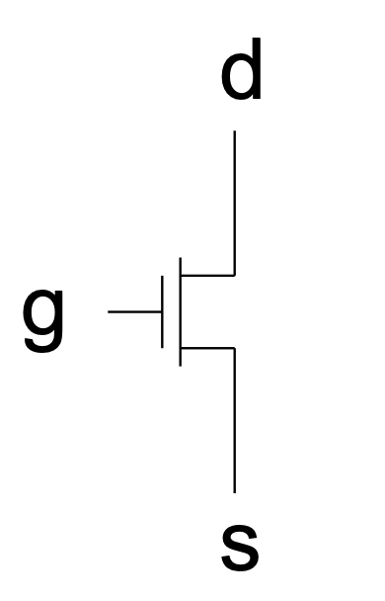
MOSFETs: voltage-controlled switches
Three terminals: Gate (G), Drain (D), Source (S).
Voltage-controlled — the gate draws essentially no steady current (insulated by a thin oxide).
When V_GS exceeds the threshold V_th, a channel opens between drain and source.
The gap between the gate line and the channel in the symbol represents that oxide.
N-channel enhancement MOSFET.

Slide 16
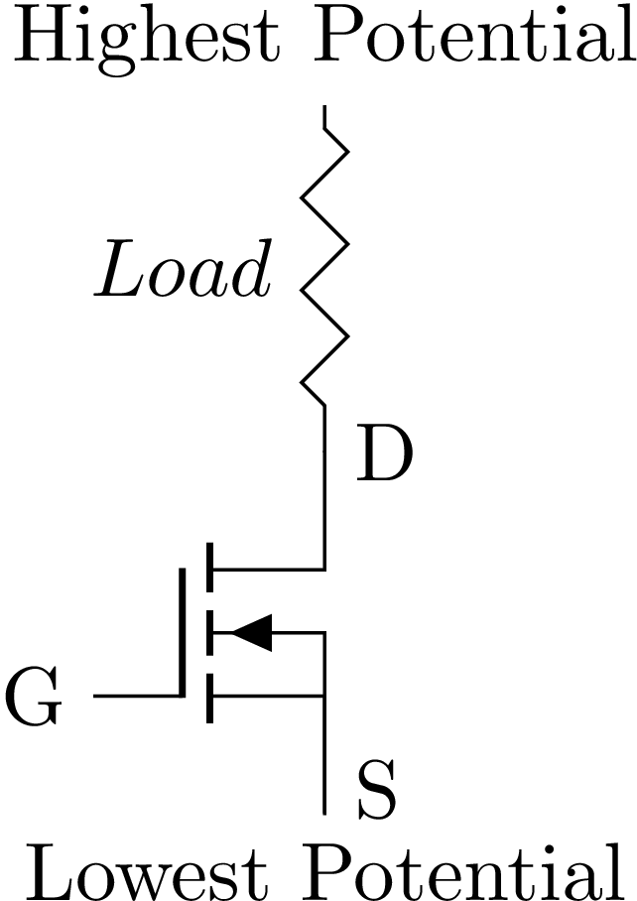
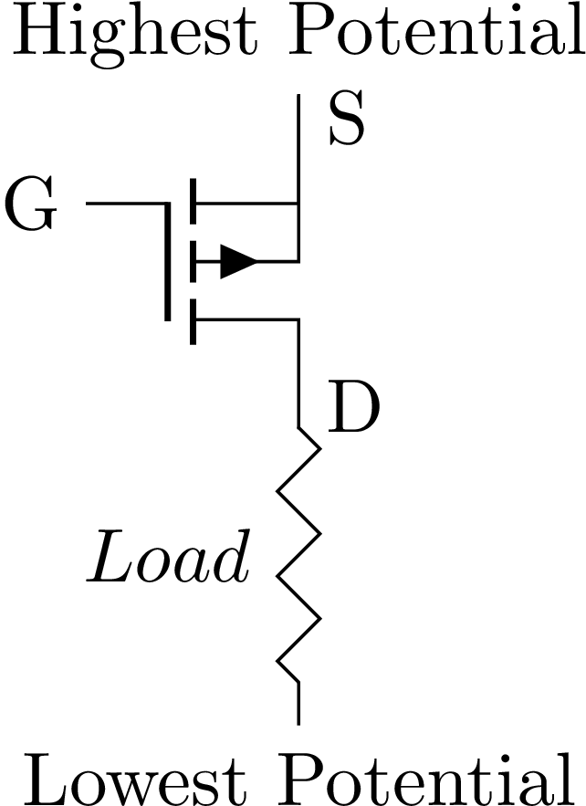
N-channel low-side & P-channel high-side
N-channel low-side: load between supply and drain, source to ground. Drive gate HIGH to turn on.
P-channel high-side: source at the supply, load below the drain. Turns on when the gate is pulled LOW.

Slide 17
BJT vs. MOSFET for embedded switching
 | MOSFET | BJT
Terminals | Gate, Drain, Source | Base, Collector, Emitter
Controlled by | Gate voltage; ~zero gate current | Base current; flows continuously while on
Saturation | Easy; no resistor sizing needed | Needs careful R_lim sizing
Power | Lower — no steady gate current | Higher — base current while on
ESD | Vulnerable (thin gate oxide) | More robust
For direct GPIO drive, use logic-level MOSFETs: |V_th| below 3.3 V.

Slide 18
Part 5 · Reading Transistor Datasheets
Notes:
Suggested timing: ≈ 10 min.

Slide 19
Min / Typ / Max — and which to use
Three columns reflect real manufacturing spread. β (h_FE) can vary 3× across one batch. Min/Max mark the ±3σ boundaries; Typ is the mean.
Will my circuit function at all? Use the worst-case minimum. Design for β_min and it saturates even with the weakest part.
Will my circuit break or overheat? Use the worst-case maximum — the part that conducts most or swings highest.
Rule of thumb: ask “does a higher or lower value make it harder to succeed?” and use that value. All these numbers shift with temperature.

Slide 20
Activity: BJT Datasheets
Use the datasheets on Canvas. Record type, DC current gain h_FE (record the minimum when a range is given), and max continuous collector current.
Part Number | Type (NPN/PNP) | h_FE (minimum) | Max collector current
KSC2073
TIP42
2N3906
2N3904

Slide 21
Activity: MOSFET Datasheets
Record type, threshold voltage V_th, and max continuous drain current. Watch the sign of V_th for PFET devices.
Part Number | Type (NFET/PFET) | Threshold V_th | Max drain current
IRF9Z24
BS250P
IRFZ24
BS107P

Slide 22
Time to work on Lab 3
We'll likely finish the material early — use the rest of class to start Lab 3.
Build and test your low-side NPN driver: pick R_lim to saturate the transistor, and check it switches your load cleanly.
Try the MOSFET drivers too — no R_lim needed, just a logic-level threshold.
TAs are here now — ask questions while you have help in the room. Starting early beats a last-minute rush.

