Slide 1
MULTIMEDIA WIRELESS NETWORKS | A2
An intent can fit and still break a slice
ns-3.48 + 5G-LENA setup, a 3GPP TR 26.926 XR video traffic model, and a first intent-driven slicing scenario
slice A 90 %
B 10 %
one 100 MHz carrier, split by an intent
Petrajoy Davidson | M11502803 | Advanced path: IBN for O-RAN slicing | 2026/10/20
Notes:
Hello everyone. I am Petrajoy, and this is my A2: ns-3 setup and traffic model.
My project is about intent-based management for O-RAN slicing. So instead of a generic first scenario, I built the testbed my project needs. In the next ten minutes I will show that the simulator runs, that my traffic model matches the 3GPP model, and that this setup already reproduces the problem I want to solve.

Slide 2
Does "it fits" mean "it is safe"?
1 INTENT
2 CAPACITY CHECK
3 ENACT
4 SLICE B QoS
"Give the video slice 90 % of the carrier"
Shares add up to 100 % and every slice keeps some RBs: ACCEPT
Bandwidth parts reconfigured: 90 MHz / 10 MHz
Still within its SLA?
?
No human in the loop: steps 1 to 3 run automatically.
Today's feasibility check stops at step 2. In A2 I built this whole loop in ns-3, so step 4 is measured, not assumed.
Petrajoy Davidson | A2: ns-3 Setup & Traffic Model
2 / 10
Notes:
Quick reminder of the problem from A1.
An operator writes an intent, for example: give the video slice ninety percent of the carrier. The system translates it into a configuration and enacts it automatically, with no human in the loop.
Before enacting, today's pipelines usually run one check: does the request fit in the cell's capacity? If the shares add up and every slice still gets some resource blocks, the intent is accepted.
My question is whether "it fits" also means "it is safe" for the other slices. In this assignment I built exactly this loop, intent, capacity check, enactment, measurement, in ns-3, so I can test that question with numbers.

Slide 3
Setup: ns-3.48 + 5G-LENA v5.1 on my lab VM
WHAT BROKE
PLATFORM
1
Refused to run as root
ns-3.48 + 5G-LENA 5g-lena-v5.1.y
Ubuntu 22.04.4 VM, 8 vCPU, 16 GiB
g++ 11.4 | CMake 3.31.6 | Python 3.10
examples + tests, -j4
I cloned in a root shell; moved the tree to user joy
2
CMake 3.22, but 3.25 required
user-level CMake 3.31.6 from pip, nothing else on the VM changed
53 min
3
README install commands out of date
followed the compatibility table: v5.1 with ns-3.48
full build, 2 389 targets; my scenario then compiled first time
4
Wireshark showed my video as "TAPA"
UDP port 5000 belongs to that dissector; disabled it
Petrajoy Davidson | A2: ns-3 Setup & Traffic Model
3 / 10
Notes:
The setup. I run ns-3 version 3.48 with the 5G-LENA NR module, version 5.1, which is the release paired with 3.48. It runs on my lab VM: Ubuntu 22.04, eight virtual CPUs, sixteen gigabytes of RAM. The full build has about two thousand four hundred targets and took fifty-three minutes.
Four things broke, and they are all in my study note.
One: I cloned everything as root, and ns-3 refuses to build as root. I moved the tree to my normal user.
Two: ns-3.48 needs CMake 3.25, but Ubuntu 22.04 ships 3.22. I installed a newer CMake for my user only, so nothing else on the VM changed.
Three: the 5G-LENA README still shows old install commands. I followed its compatibility table instead.
Four: Wireshark labelled my video packets as a protocol called TAPA, because it uses the same UDP port 5000. I disabled that dissector.

Slide 4
The 3GPP XR video model (TR 26.926)
Parameter | Model
Frame rate F | 60 fps
Data rate R | 30 Mbps per UE
Frame size | truncated Gaussian: mean R/(8F), STD 10.5 %, range 50 to 150 %
Frame jitter | truncated Gaussian: mean 0, STD 2 ms, range -4 to +4 ms
Arrival of frame k | t = k/F + J (jitter around a fixed grid)
Packets (my choice) | frame cut into <= 1 400 B UDP payloads, back to back
62.5 kB
16.7 ms
mean frame size
frame period
+/- 4 ms
~45
jitter bound
packets per frame
26.926 is a Technical Report (TR), not a TS. Its video model is the RAN1 XR model of TR 38.838, Sec. 5.1.1, Table 5.1.1.1-1.
Petrajoy Davidson | A2: ns-3 Setup & Traffic Model
4 / 10
Notes:
For traffic, I used the XR video model of 3GPP TR 26.926. One note: 26.926 is a technical report, not a technical specification. Its video model comes from TR 38.838.
The model is simple. Sixty frames per second at thirty megabits per second. The frame size is a truncated Gaussian: mean 62.5 kilobytes, standard deviation 10.5 percent, cut at fifty and one hundred fifty percent. Each frame also has a jitter, a truncated Gaussian with a standard deviation of two milliseconds, cut at plus or minus four.
From this I can predict what I should see: frames every 16.7 milliseconds give or take the jitter, and since I cut each frame into packets of at most 1400 bytes, about forty-five packets per frame, sent back to back.

Slide 5
Why I did not use the built-in generator
 | 3GPP TR 26.926 / 38.838 | 5G-LENA v5.1 built-in
Frame size spread | STD = 10.5 % of the mean | variance = 0.105 x mean, so STD ~ 81 B
Jitter range | -4 to +4 ms | -2 to +2 ms
Jitter type | around a fixed grid | added to every gap (random walk)
Jitter resolution | continuous | whole milliseconds
FRAME SIZE SPREAD (STD)
81 B
5G-LENA built-in
6 563 B
3GPP model (10.5 % of 62.5 kB)
So I wrote XrVideoApp: rejection-sampled truncated Gaussians, variance = STD squared, jitter on a fixed grid. AI-assisted; every parameter checked against the table.
Source: contrib/nr/utils/traffic-generators/model/traffic-generator-3gpp-generic-video.cc (5g-lena-v5.1.y), lines 262, 299, 303
Petrajoy Davidson | A2: ns-3 Setup & Traffic Model
5 / 10
Notes:
5G-LENA already has a generator for this model, so my first plan was to use it. But when I read its source code, it does not match the table.
The biggest issue: it sets the variance of the frame size to 0.105 times the mean, instead of the standard deviation. So the spread of the frame size is about 81 bytes instead of about 6 500. The frames are almost constant.
It also uses a jitter range of plus or minus two milliseconds instead of four, it adds the jitter to every gap so the frame times drift like a random walk, and the jitter is in whole milliseconds.
So I wrote my own generator, XrVideoApp. I used AI to help write it, and then I checked every parameter against the table myself, and checked the output against the model, which is the next part.

Slide 6
The scenario: an intent loop in ns-3
Intent JSON
intent_enact.py
ns-3 run
analyze.py
share, UEs, traffic, slice B SLA
capacity-only check, translate
a2-intent-slicing
PDF/CDF, KPIs, SLA verdict
1 gNB, 100 MHz at 28 GHz, numerology 2, UMi channel; the intent sets the split into two bandwidth parts
BWP 0 = slice A (share from the intent)
BWP 1 = slice B
SLICE A | eMBB video | 5QI 9
SLICE B | low latency | 5QI 80
2 UEs, 30 Mbps each
XR video from my XrVideoApp
(3GPP TR 26.926 model)
2 UEs: 100 B every 4 ms (light)
or 1 000 B every 0.4 ms (heavy, 20 Mbps each)
SLA: p95 delay <= 10 ms, loss <= 1 %
Petrajoy Davidson | A2: ns-3 Setup & Traffic Model
6 / 10
Notes:
This is the scenario. An intent is a small JSON file: the bandwidth share of slice A, the number of users, the traffic, and the SLA of slice B.
A Python script runs the capacity-only check, translates the intent into ns-3 arguments, and runs the simulation.
In ns-3 there is one gNB at 28 gigahertz with one hundred megahertz, split into two bandwidth parts. Bandwidth part zero is slice A: two users receiving my XR video, thirty megabits each. Bandwidth part one is slice B, the low-latency slice, mapped to 5QI 80. Its SLA is a ninety-fifth percentile delay of ten milliseconds, from the 5QI 80 delay budget, and at most one percent loss.
At the end I get a FlowMonitor file, a log of every packet I sent, and a PCAP, and a second script turns them into plots and an SLA verdict.

Slide 7
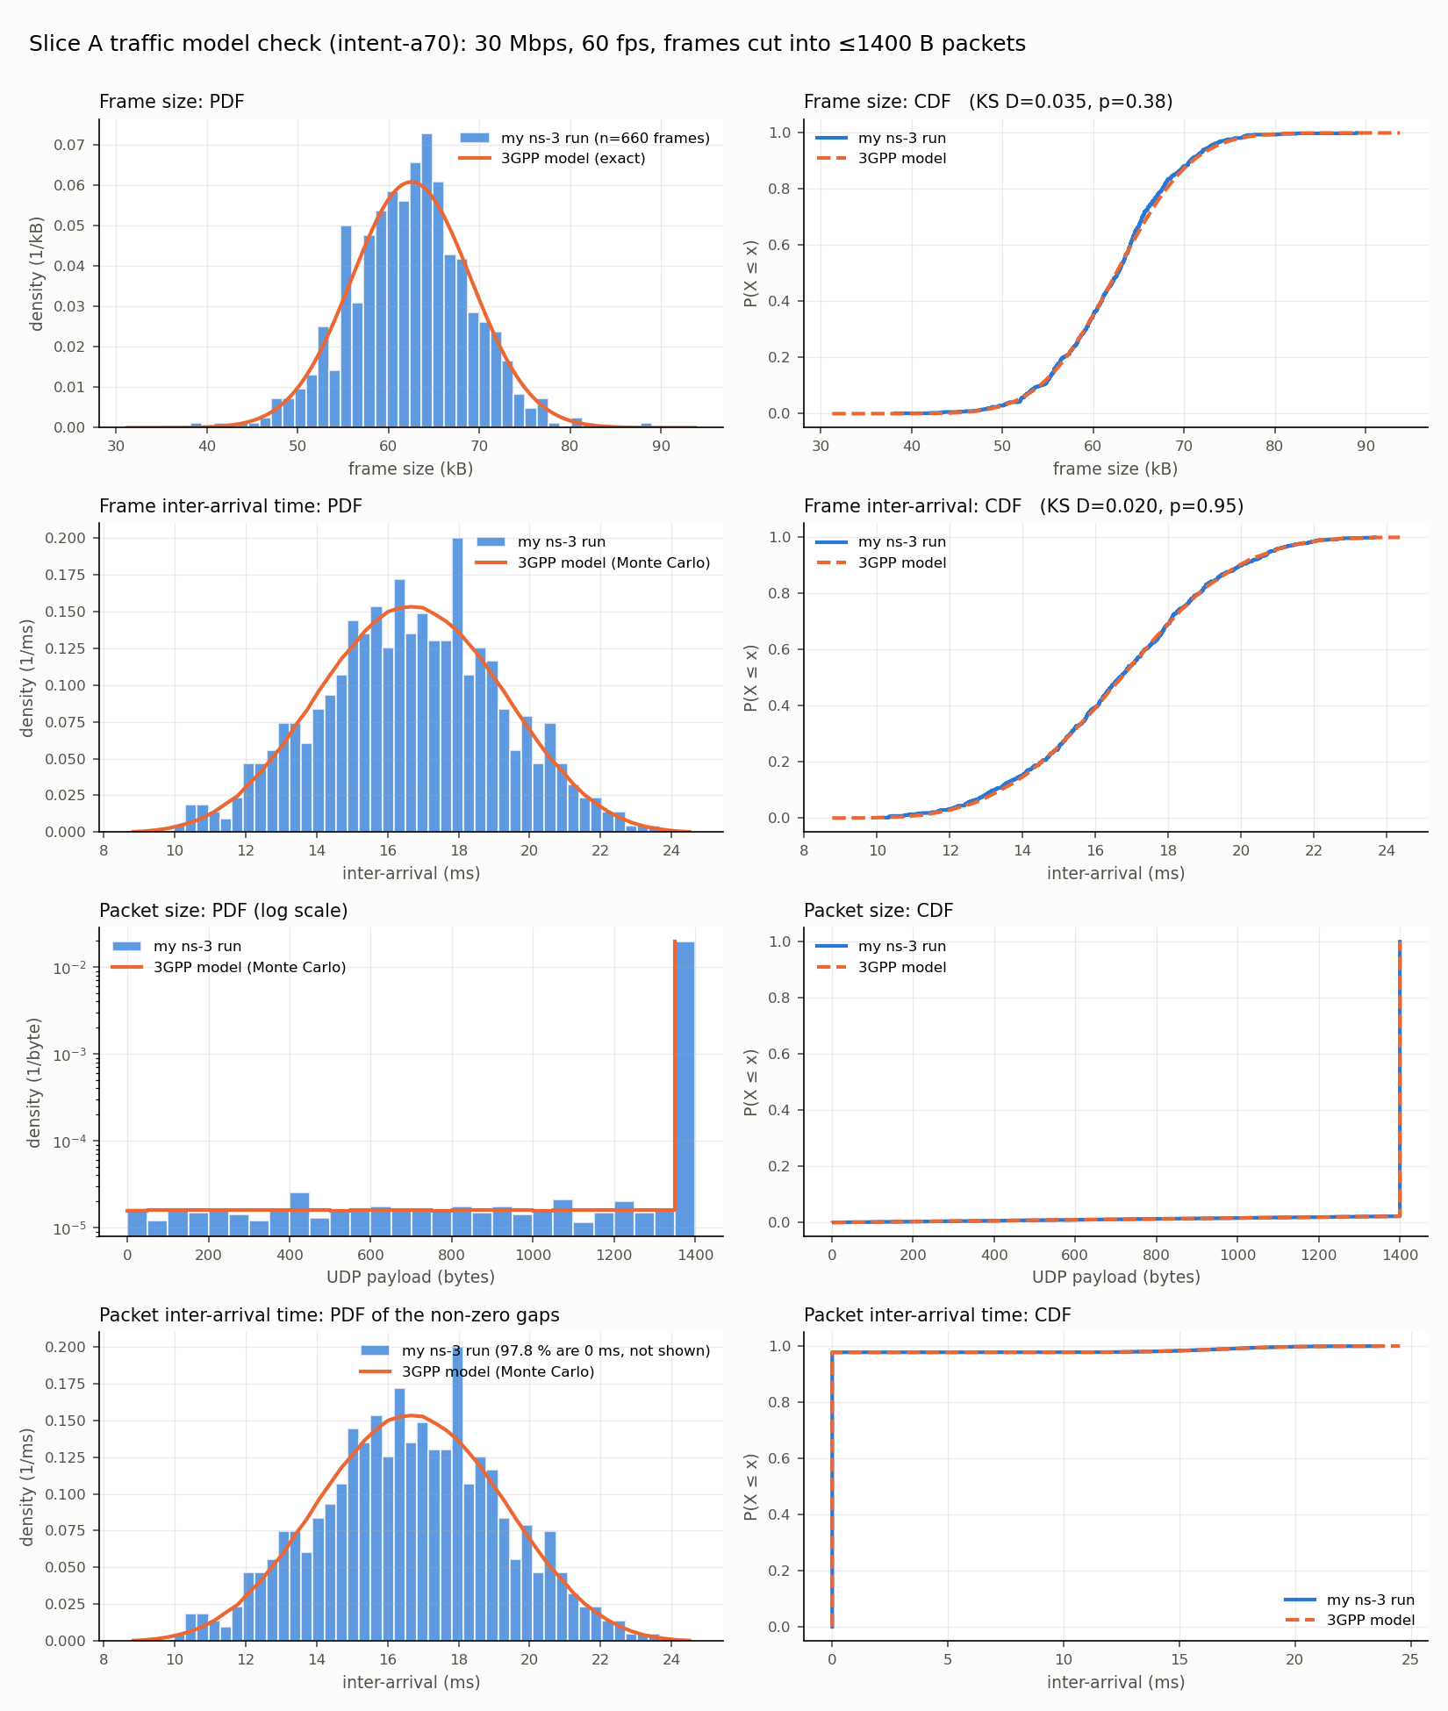
My traffic matches the 3GPP model
KS TEST AGAINST THE MODEL (660 FRAMES)
p = 0.38
frame size
p = 0.98
frame jitter
p = 0.95
frame inter-arrival
All p > 0.05: no evidence that my generator differs from the model.
Means: 62.3 vs 62.5 kB per frame, 16.66 vs 16.67 ms between frames.
Blue = my ns-3 run, orange = 3GPP model
Petrajoy Davidson | A2: ns-3 Setup & Traffic Model
7 / 10
Notes:
First, is my traffic really the 3GPP model?
Blue is my run, orange is the model. The top row is the frame size, PDF and CDF. The second row is the frame inter-arrival time. The bottom rows are the packet size and the packet inter-arrival time.
For the three random quantities I ran a Kolmogorov-Smirnov test against the model. Frame size: p equals 0.38. Jitter: 0.98. Frame inter-arrival: 0.95. All far above 0.05, so there is no evidence that my generator differs from the model. The means also match: 62.3 kilobytes against 62.5, and 16.66 milliseconds against 16.67.
The packet curves look strange, but they are expected: almost every packet is 1400 bytes with one smaller remainder per frame, and almost every gap is zero because the packets of a frame leave together.

Slide 8
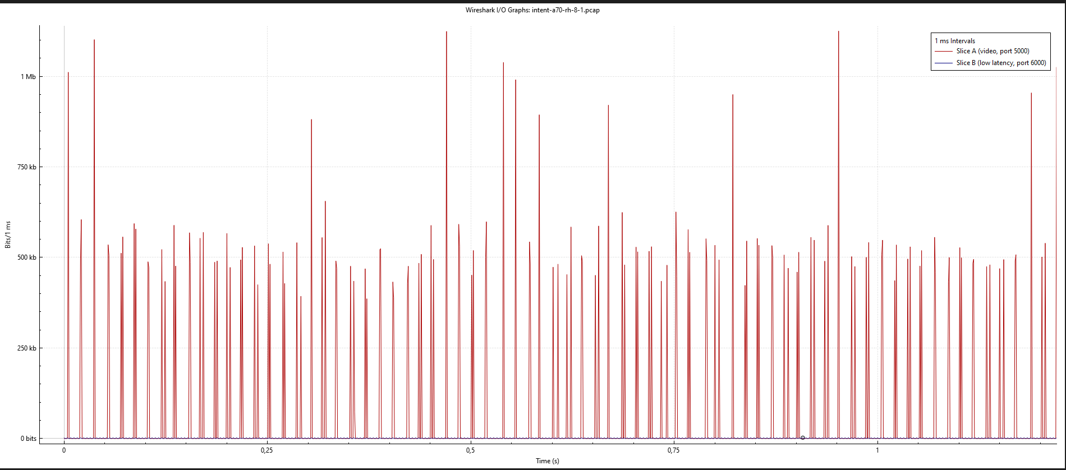
Proof on the wire
VIDEO PACKETS COUNTED
29 715
in all three sources:
Wireshark (PCAP)
29 715
FlowMonitor
29 715
my send log
29 715
Wireshark I/O graph, 1 ms bins, first 1.2 s: one spike per video frame (red), slice B flat (blue). A ~500 kbit spike is one 62.5 kB frame.
330 frames per UE, 43 to 53 packets each, 15.5 to 17.4 ms apart
Petrajoy Davidson | A2: ns-3 Setup & Traffic Model
8 / 10
Notes:
Second, is it really on the network? I captured the link from the server into the core and opened it in Wireshark.
The I/O graph shows one spike per video frame. Most spikes are about five hundred kilobits, which is exactly one frame of 62.5 kilobytes. The taller ones are two users' frames in the same millisecond. The flat line at the bottom is slice B.
And the three sources agree packet for packet: Wireshark, FlowMonitor, and my own send log all count 29 715 video packets.

Slide 9
Four intents accepted, one breaks slice B
Intent | Split A / B | Slice B load | B p95 delay | B loss | Slice B SLA
a70 | 70 / 30 MHz | 0.4 Mbps | 1.0 ms | 0.00 % | met
a90 | 90 / 10 MHz | 0.4 Mbps | 1.0 ms | 0.00 % | met
a70-heavyB | 70 / 30 MHz | 40 Mbps | 1.1 ms | 0.01 % | met
a90-heavyB | 90 / 10 MHz | 40 Mbps | 12.7 ms | 9.99 % | VIOLATED
SLICE B, a90-heavyB
12.7 ms
p95 delay vs 10 ms budget; 10 % of packets not delivered
Same 90 / 10 split: safe when slice B is light, harmful when it is heavy. The shares alone cannot tell.
All four passed the capacity-only check. Slice A is unchanged in all four (2 x 30 Mbps, 0 % loss).
Petrajoy Davidson | A2: ns-3 Setup & Traffic Model
9 / 10
Notes:
Now the main result. I enacted four intents. All four passed the capacity-only check.
With a seventy-thirty split and a light slice B, everything is fine. With ninety-ten and a light slice B, still fine: slice B only needs about half a megabit.
Then I made slice B heavier, forty megabits in total. At seventy-thirty it is still fine: one point one milliseconds at the ninety-fifth percentile.
But at ninety-ten with the heavy slice B, the ninety-fifth percentile delay is 12.7 milliseconds, above the ten-millisecond budget, and ten percent of its packets are not delivered. The SLA is violated, and the capacity check accepted it.
So the same split is safe or harmful depending on slice B's load. A check that only looks at the shares cannot see that.

Slide 10
Take-aways
1
ns-3.48 + 5G-LENA v5.1 runs on my VM; setup and what broke are documented
2
My XR video generator matches 3GPP TR 26.926: PDF/CDF, KS tests, Wireshark
3
The capacity-only check accepts an intent that breaks slice B's SLA; harm depends on the victim's load, not only the share
NEXT
A3
A4
Final
baseline paper on RAN slicing QoS
sweep share x slice B load, 10+ seeds, 95 % CI
QoS-aware check that rejects intents like a90-heavyB
Limits: one seed and 6 s per run; "loss" under overload is backlog left at the end of the run.
10 / 10
Notes:
Three take-aways.
One: ns-3.48 with 5G-LENA runs on my VM, and the setup is documented, including what broke.
Two: my XR video generator matches the 3GPP model, checked with PDFs, CDFs, KS tests, and Wireshark.
Three: the capacity-only check accepts an intent that breaks slice B's SLA, and whether an intent is harmful depends on the victim's load, not only on the share.
The limits: one seed and six seconds per run so far. Next, in A3 I pick the baseline paper. In A4 I sweep the share and the load with at least ten seeds. And for the final project, I build the QoS-aware check that should reject intents like the last one.
Thank you. I am happy to take questions.

