Slide 1
Domain Specific Languages
Java
Ruby
...
jPDL
BPEL
Pageflow
...
IoC-configs
Graph Oriented Programming
Hibernate
mappings
Programming
languages
Graph based execution languages
...

Slide 2
Executable software artifacts
Graph
Editor /
proj. view
Graph
Editor /
proj. view
Domain
model
(Java
class files)
Executable
Business
Processes
(jPDL XML files +
java classes)
XML Source
Editor
XML Source
Editor
Scripts
(ant scripts)
Pageflow
(webapp
configuration)
.
.
.
XML Source
Editor
Graph
Editor /
proj. view
XML Source
Editor

Slide 3
leavingTransitions
Node
Transition
destination
Execution
Node
node
Node
Execution
+execute(Execution e):void
event(String event) : void
Transition
+take(Execution e):void

Slide 4
Node
+execute(Execution e):void
StartState
Decision
Task
EndState
+execute(...)
+execute(...)
+execute(...)
+execute(...)
An example process language

Slide 5
startSale : StartState
e : Execution
(amount>5000) : Decision
yes
no
doubleCheck : Task
deliver : Task
end :
EndState

Slide 6
startSale : StartState
Hidden Action
When entering
Node ‘deliver’:
Call my Java
bean Deliveries.start
Hidden Action
When taking
transition ‘yes’:
Call my Java
bean MyStats.update
(amount>5000) : Decision
yes
no
doubleCheck : Task
deliver : Task
end :
EndState

Slide 7
: ProcessExecution
root : ExecutionPath
startSale : StartState
billing : ExecutionPath
shipping : ExecutionPath
: Fork
billing
shipping
sendBill : Task
getQuotes : Task
waitForMoney : Task
selectTransporter : Task

Slide 8
Programming
Languages
Libraries
& Utilities
BPM
Suites
Graph based languages /
Graph Oriented Programming
BPM Suites
Libraries
& Utilities
Product X
Product Y
Programming languages
Application
Domain

Slide 9
Service Orchestration Engine
(e.g. BPEL)
<svcD>
<callSvcA />
<callSvcB />
<callSvcC />
</svcD>
Enterprise Service Bus (ESB)
<XML />
<svcA />
<svcB />
<svcC />

Slide 10
execute
node
command
msg queue
command
executor
e : Execution
generatePdf

Slide 11

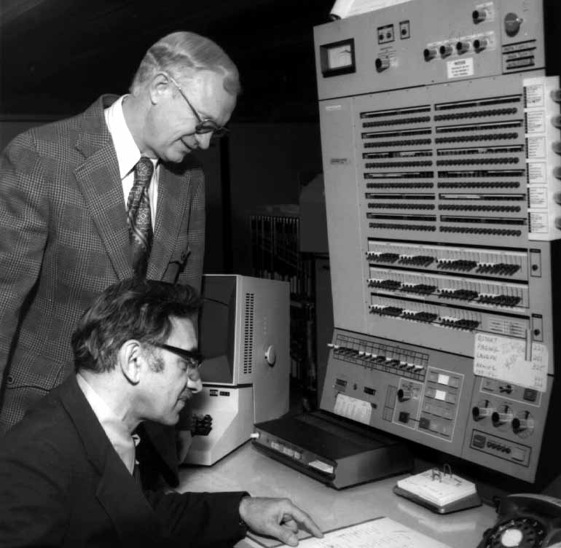
Process
Business
Analyst
BPM
System

Slide 12

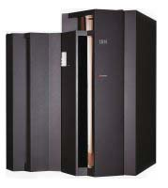
Process
Business
Analyst
Technical
Developer
tech {
<details />
}
BPM
System

