Slide 1
Fast Grid-Based Smoothing for SPH Fluid
Surface Reconstruction
student: Iohannes-Heorh Folbort

Slide 2
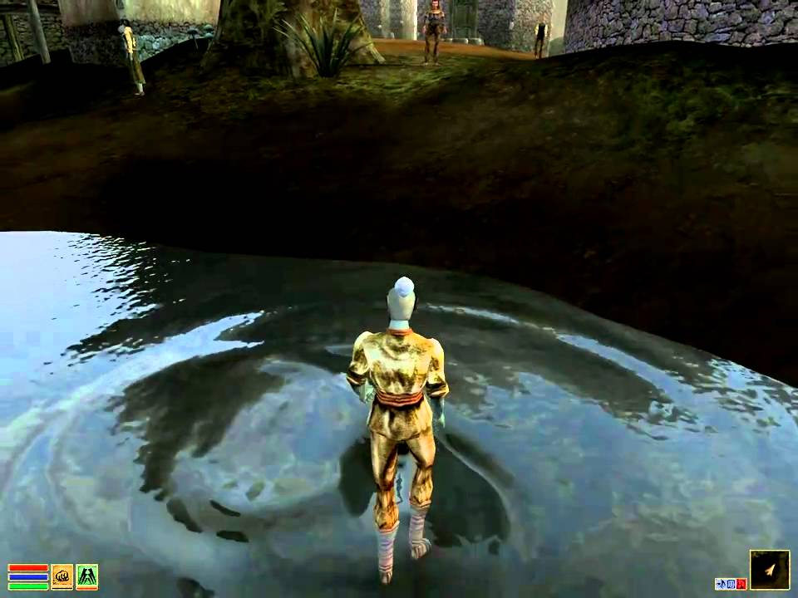

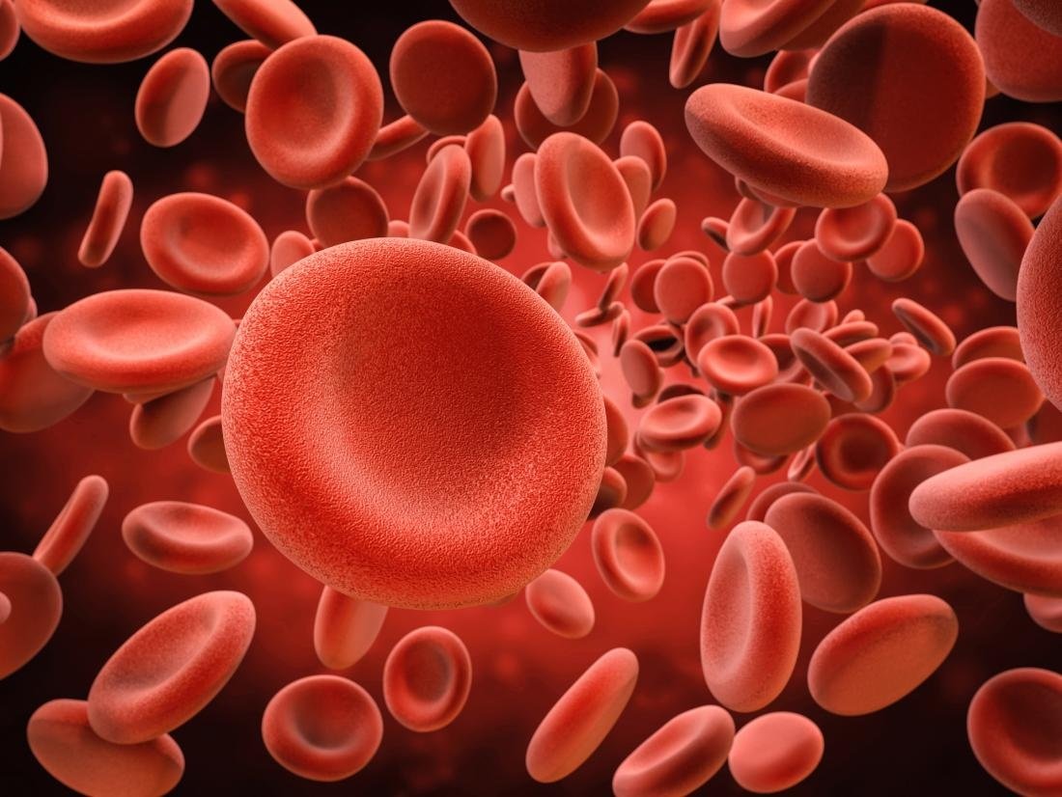
Introduction and Motivation

Slide 3
SPH fluids
Lagrangian methods are popular novadays due to simplicity and simulation possibilities
Use particles instead of fixed grid domain
Less prone to restrictions
Reconstructs realistic fluid behaviour
Can be applied in other fields (simulation of sand, smoke, multiphase fluids etc.)

Slide 4
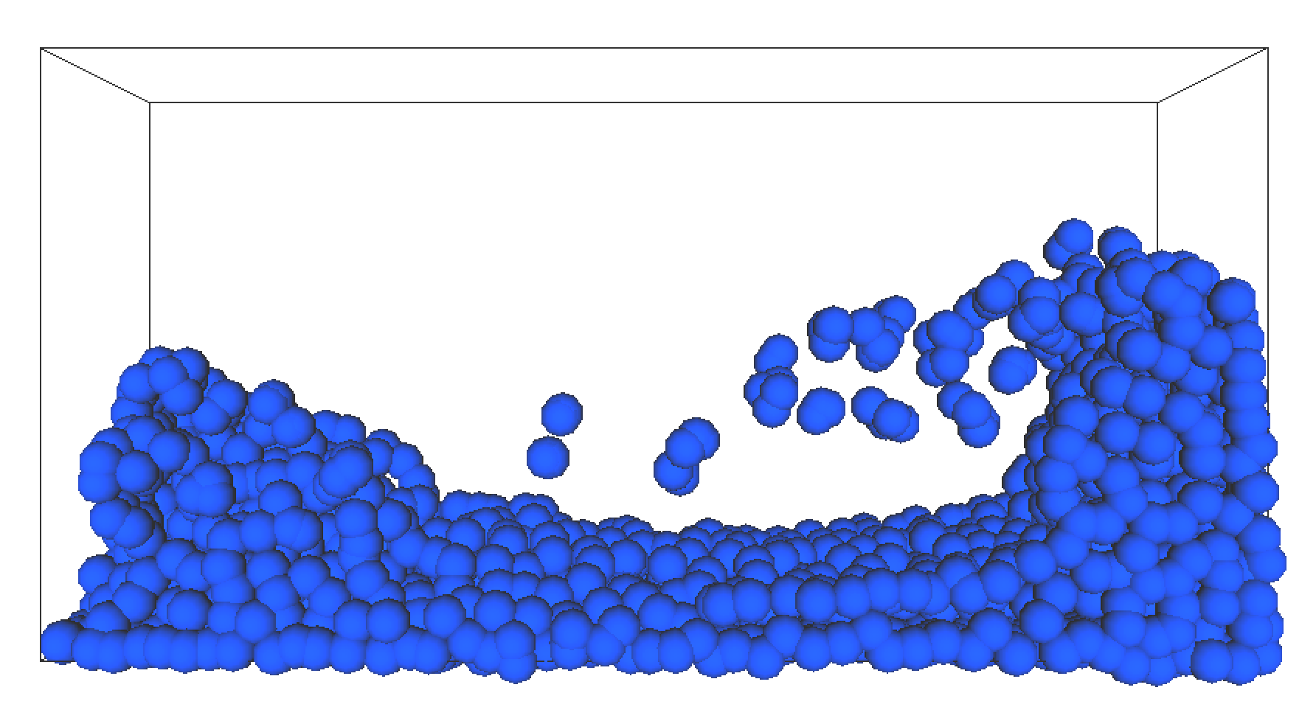
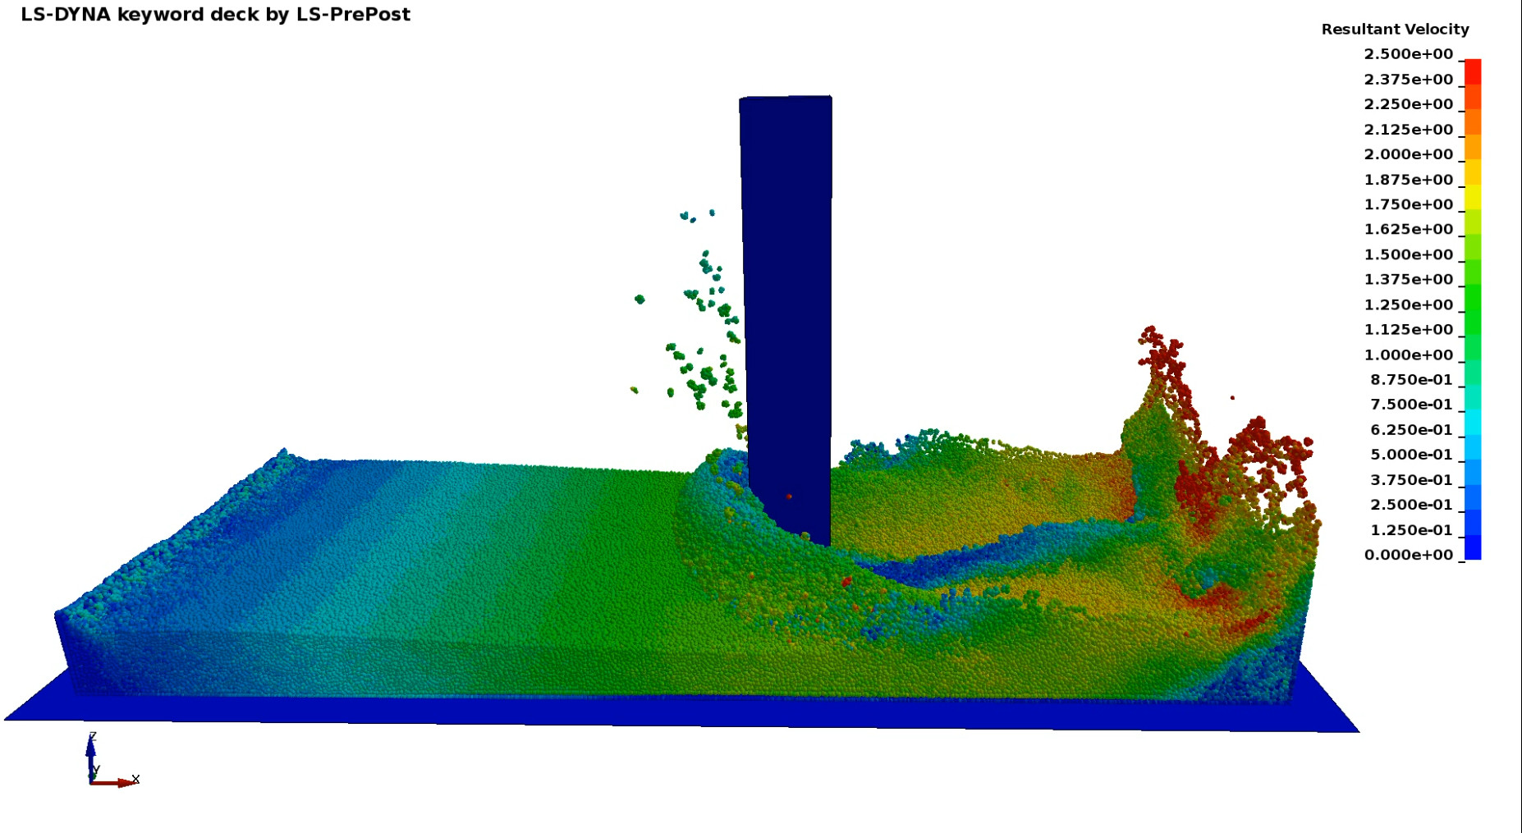
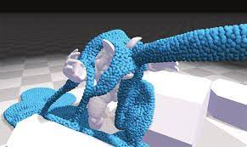
SPH fluids

Slide 5
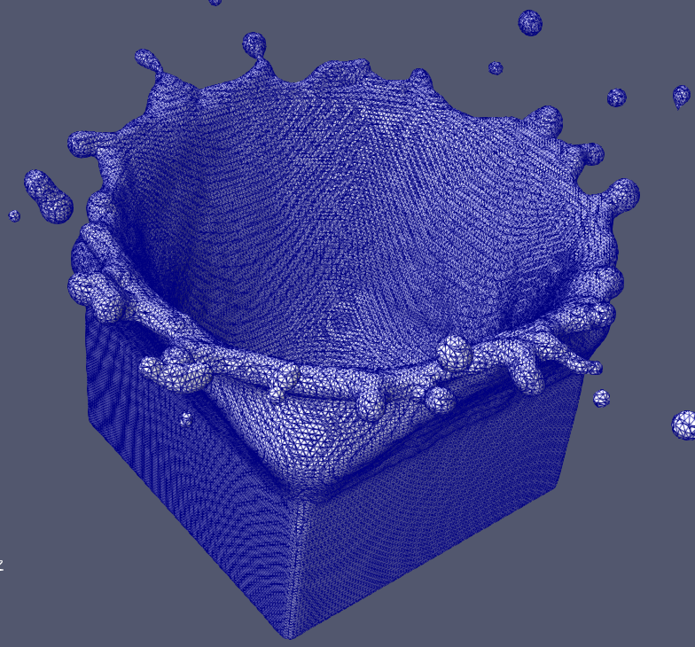
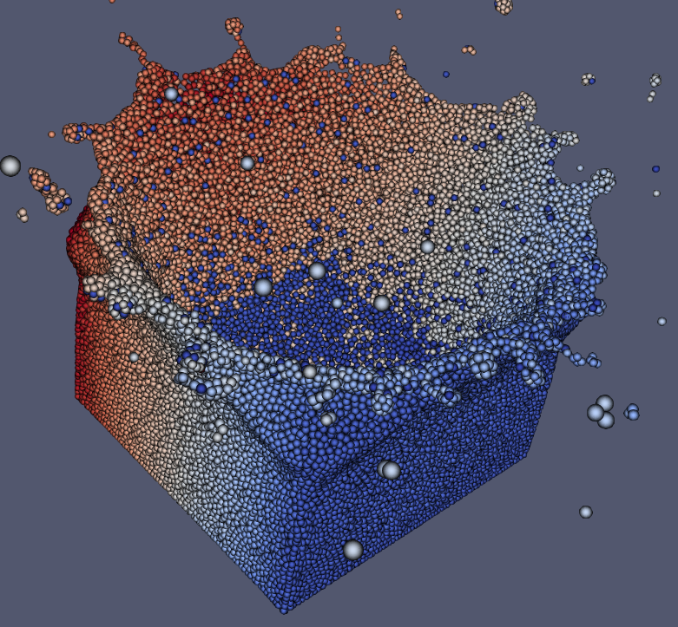
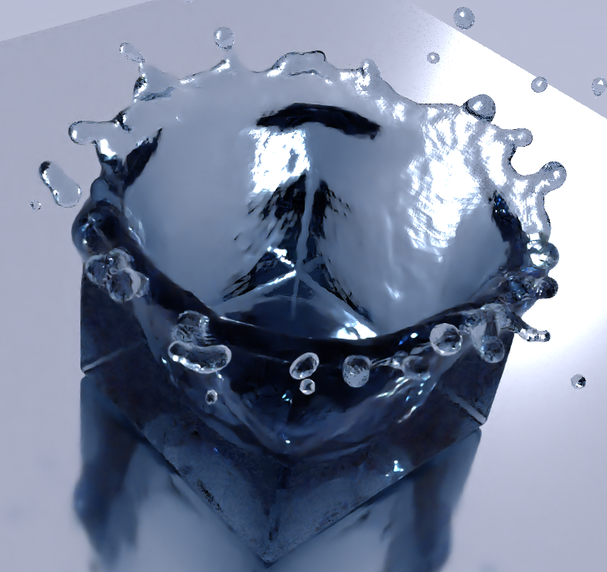

Surface extraction

Slide 6


Surface extraction hurdles
Expectations
Reality

Slide 7
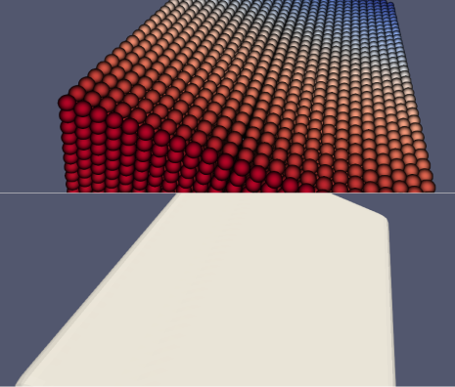
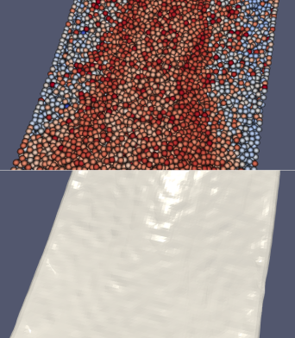
Surface extraction hurdles
Regular
Irregular

Slide 8

Surface extraction tradeoff
Fast & ugly
Slow & pretty

Slide 9

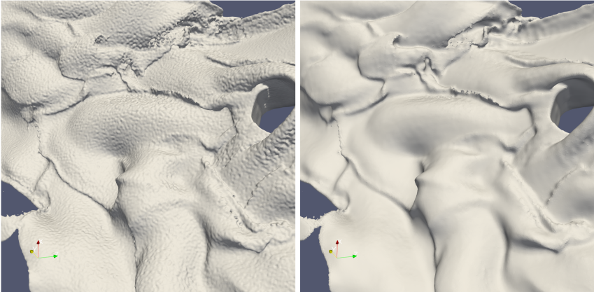
Smoothing surfaces
Before smoothing
After smoothing

Slide 10

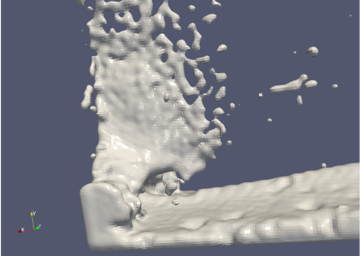
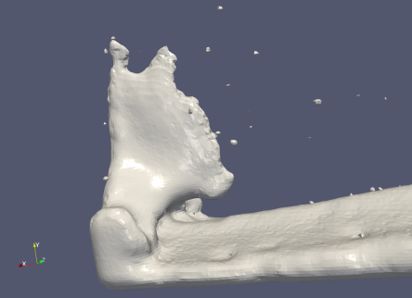
Smoothing surfaces
Before smoothing
After smoothing

Slide 11
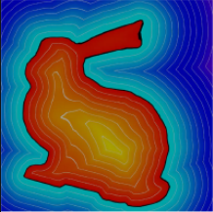
Fundamentals
Signed Distance Fields
  Determines fluid presence in a volume space
  Positive valued areas (red) are inside the fluid
  Negative areas (blue) are outside the fluid

Slide 12
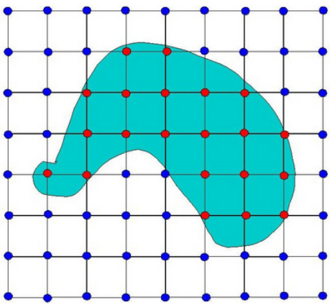

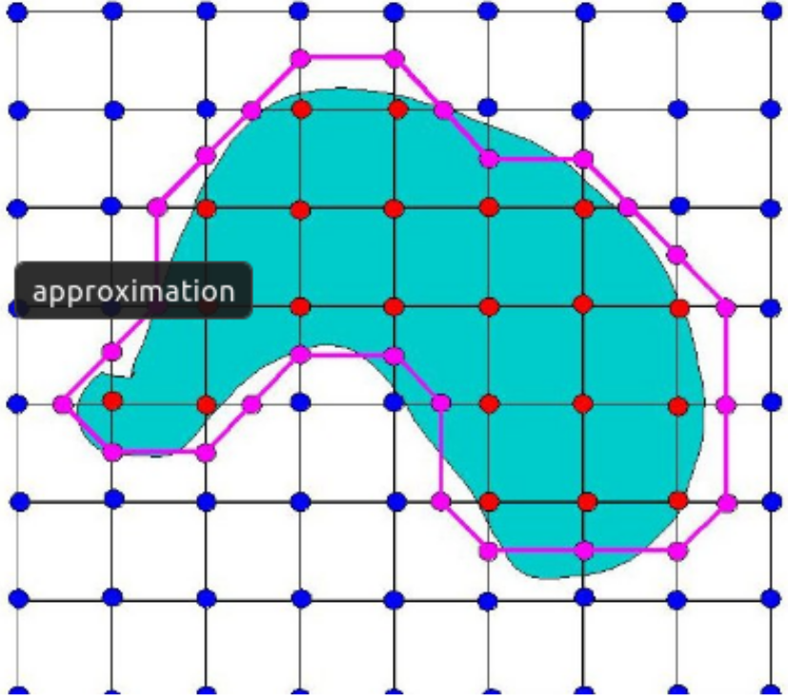
Fundamentals
Marching Cubes
  Detects 0-level intersection cells on a SDF grid.
  Computes triangular mesh vertices

Slide 13
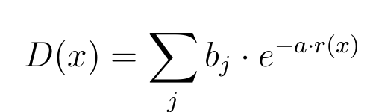

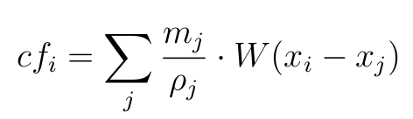

Related works
Blinn
Zhu&Bridson
Muller et.al.
Solenthaler et.al.

Slide 14
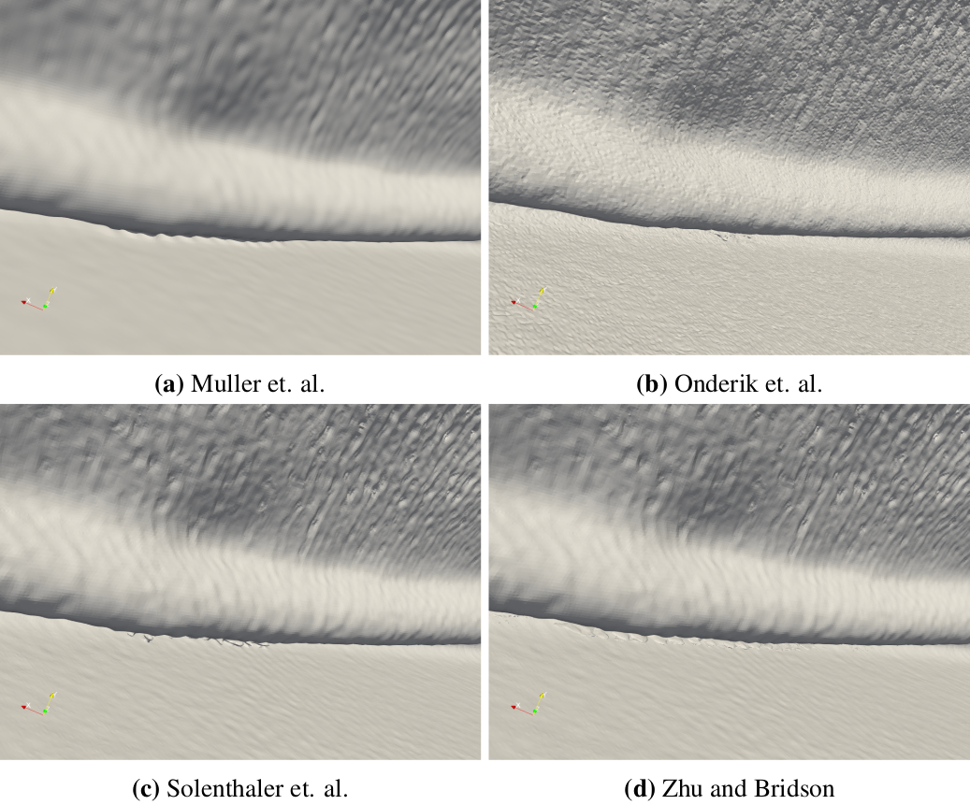
Related works

Slide 15
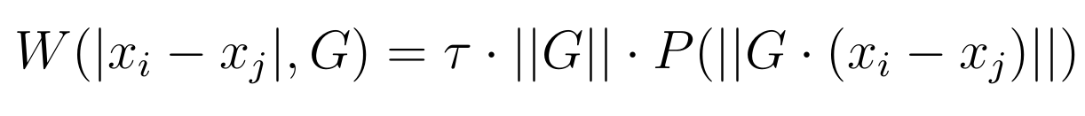
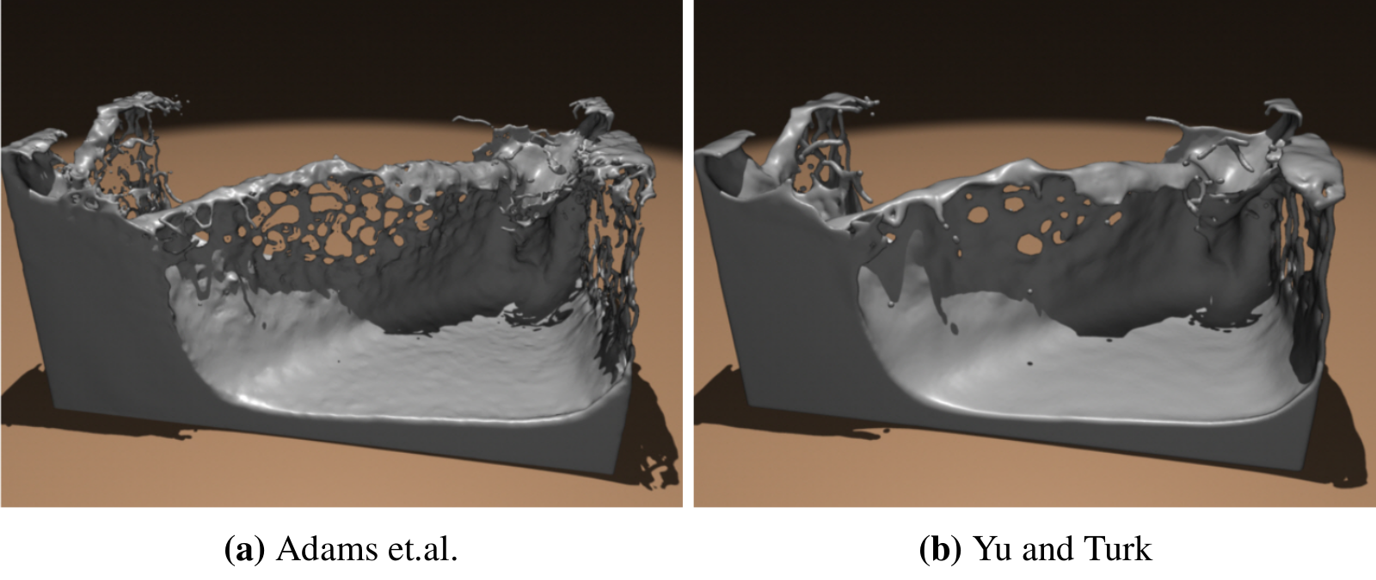
Anisotropic kernels

Slide 16


Our methods
Little overhead
Massively paralelisable
Configurable

