Slide 1
Deep Learning Lecture – 4 (RNN)
Sukho Lee(이석호)
Dongseo Univ.
@울산대학교 2018.1.15~16

Slide 2



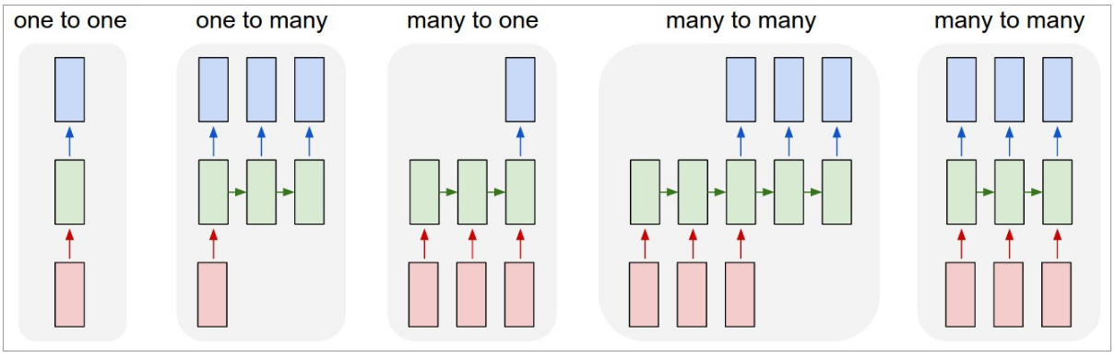
RNN model
Input vector
hidden layer
Output vector
Ex): input : image
Output : image
→image classification
Ex) input : image
Output : text
→ Image captioning
Ex) input : text
Output: T/F
True/False
determination
of text
Ex) input : text
output: text
Language translation,
chatbot
Ex) input : video frame
output: label for frame
→labeling of video frame
Adopted from the blog “The unreasonable effectiveness of RNN” (by Andrej Karpathy)

Slide 3
RNN model
“If training vanilla neural nets is optimization over functions, training recurrent nets is optimization over programs.”

Slide 4
RNN model
rnn = RNN()
y = rnn.step(x)
RNN api contains this step method.
But, there is a hidden state inside it.
Trough this hidden state the ouput becomes influenced not only by the current input x, but also on the past inputs.
class RNN:
# ...
def step(self, x):
# update the hidden state
self.h = np.tanh(np.dot(self.W_hh, self.h)
+ np.dot(self.W_xh, x))
# compute the output vector
y = np.dot(self.W_hy, self.h)
return y
Every time step function is called self.h gets
updated. It can be expressed by the following equation:
previous state
input
Current state: dependent on previous state and current input
output: dependent on current state.

Slide 5
RNN model (unrolled)
y1 = rnn1.step(x)
y = rnn2.step(y1)
0.5
0.3
-1.0
1.2
1.0
2.2
-3.0
4.1
0.50.3
-1.0
1.2
0.10.5
1.9
-1.1
1.0
0.3
0.1
0.3
-0.1
0.9
1.0
0.3
0.1
0.1
-0.5
-0.3
0
1
0
0
1
0
0
0
0
1
0
0
0
0
1
0

Slide 6
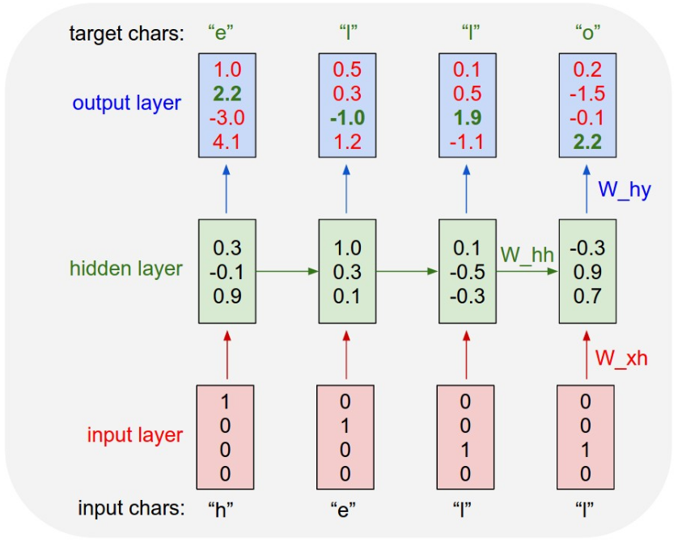
RNN model (unrolled)
Prob. That the next character is ‘h’
Prob. That the next character is ‘e’
Prob. That the next character is ‘l’
Prob. That the next character is ‘o’
1-of-k encoding

Slide 7
Tensorflow Practice -7

Slide 8
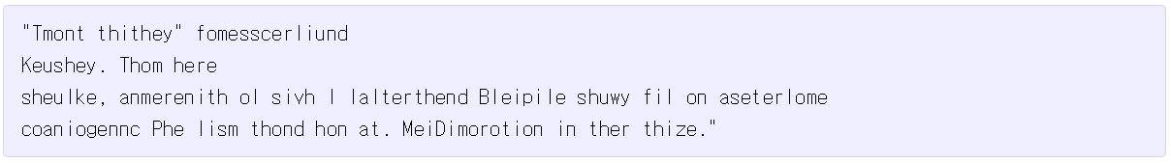
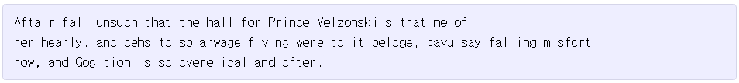
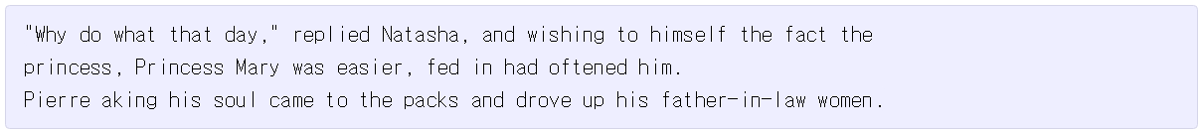
Ex)
After 100 epoch of LSTM training
After 300 epoch of LSTM training
After 500 epoch of LSTM training
After 700 epoch of LSTM training
After 2000 epoch of LSTM training

Slide 9
Ex)
PANDARUS:
Alas, I think he shall be come approached and the day
When little srain would be attain'd into being never fed,
And who is but a chain and subjects of his death,
I should not sleep.
Second Senator:
They are away this miseries, produced upon my soul,
Breaking and strongly should be buried, when I perish
The earth and thoughts of many states.
DUKE VINCENTIO:
Well, your wit is in the care of side and that.
Second Lord:
They would be ruled after this chamber, and
my fair nues begun out of the fact, to be conveyed,
Whose noble souls I'll have the heart of the wars.
Clown:
Come, sir, I will make did behold your worship.
VIOLA:
I'll drink it.

Slide 10
Ex)
<page>
<title>Antichrist</title>
<id>865</id>
<revision>
<id>15900676</id>
<timestamp>2002-08-03T18:14:12Z</timestamp>
<contributor>
<username>Paris</username>
<id>23</id>
</contributor>
<minor />
<comment>Automated conversion</comment>
<text xml:space="preserve">#REDIRECT [[Christianity]]</text>
</revision>
</page>

Slide 11
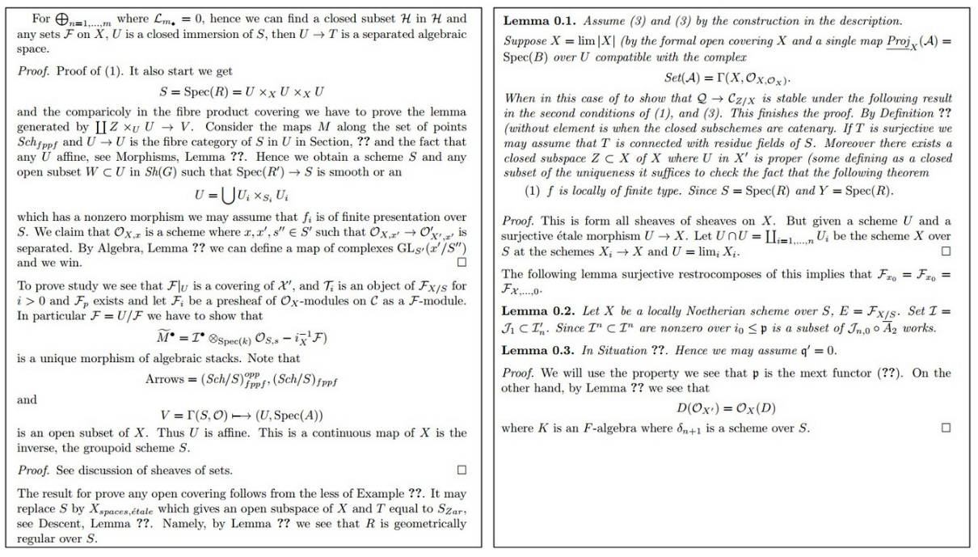
Ex)

Slide 12
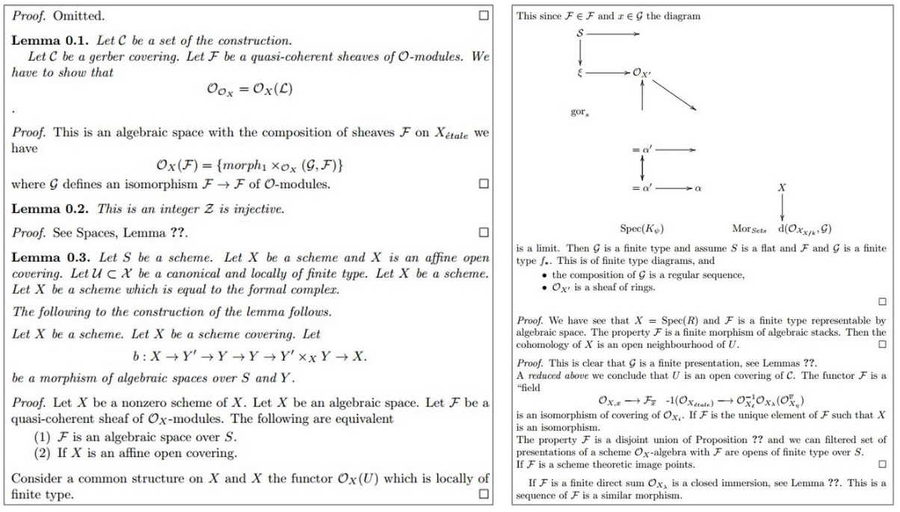
Ex)
다이어그램을 그릴 줄 안다

Slide 13
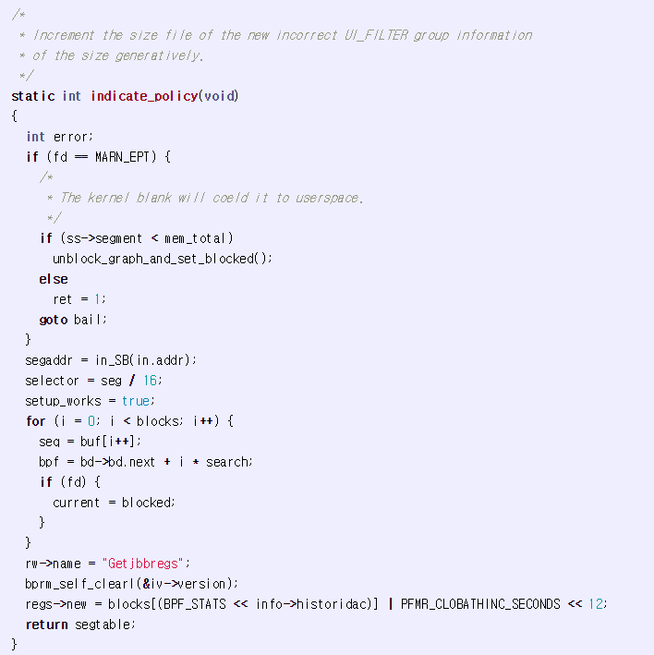
Ex)

Slide 14
Auto-Reply System
Are you visiting Vietnam for the new year? → Yes
Are you hanging out with us tonight? → No
Did you read the cool paper on ResNet? → Yes
…..

Slide 15
Bag-of-words method
Are you visiting Vietnam for the new year, Quoc?
[0, 0, 0, 0, 0, 0, 1, 0, 0, 0, 0,……...0, 0, 1, 0, 0, 0, 2]
“Bag of words”
representation
20,000 dimension
Are you visiting Vietnam for the new year, Quoc?
[0, 0, 0, 0, 0, 0, 1, 0, 0, 0, 0,……...0, 0, 1, 0, 0, 0, 2]
One-hot encoding
for 20,000 words
20,000 dimension
Are you visiting Vietnam for the new year, Quoc?
[0, 0, 0, 0, 0, 0, 1, 0, 0, 0, 0,……...0, 0, 1, 0, 0, 0, 2]
20,000 dimension
Are you visiting Vietnam for the new year, Quoc?
[0, 0, 0, 0, 0, 0, 1, 0, 0, 0, 0,……...0, 0, 1, 0, 0, 0, 2]
Words not beloning to the 20,000
words are encoded in the end
of the vector
20,000 dimension

Slide 16
Bag-of-words방법
Are you visiting Vietnam for the new year, Quoc? → Yes
[0, 0, 0, 0, 0, 0, 1, 0, 0, 0, 0,……...0, 0, 1, 0, 0, 0, 2] → 1
Are you hanging out with us tonight? → No
[0, 0, 0, 0, 0, 0, 1, 0, 0, 0, 0,……...1, 0, 0, 0, 0, 0, 0] → 0
Did you read the cool paper on ResNet? → Yes
[0, 0, 0, 0, 0, 0, 0, 0, 1, 0, 0,……...0, 0, 1, 0, 1, 0, 1] → 1

Slide 17
Bag-of-words method
Training:
For iteration 1,2,3,…..10000000
randomly choose an e-mail and its response
if response== Yes update and to increase
if response==No update and to increase
From: https://www.youtube.com/watch?v=G5RY_SUJih4&t=474s

Slide 18
Bag-of-words method
Training:
For iteration 1,2,3,…..10000000
randomly choose an e-mail and its response
if response== Yes update and by
if response==No update and by
From: https://www.youtube.com/watch?v=G5RY_SUJih4&t=474s

Slide 19
Bag-of-words method
Training:
“bag-of-words” representation don’t consider the order of words
Are you visiting Vietnam for the new year, Quoc?
[0, 0, 0, 0, 0, 0, 1, 0, 0, 0, 0,……...0, 0, 1, 0, 0, 0, 2]
20,000 dimension
From: https://www.youtube.com/watch?v=G5RY_SUJih4&t=474s

Slide 20
Sequence to sequence model
Are you visiting Vietnam for the new year , Quoc ?

Slide 21
Vector related to the word “Are” :
This vector is also being learned
Are you visiting Vietnam for the new year , Quoc ?
From: https://www.youtube.com/watch?v=G5RY_SUJih4&t=474s

Slide 22
Vector related to the word “you” :
This vector is also being learned
Are you visiting Vietnam for the new year , Quoc ?
From: https://www.youtube.com/watch?v=G5RY_SUJih4&t=474s

Slide 23
Vector related to the word “visiting” :
This vector is also being learned
Are you visiting Vietnam for the new year , Quoc ?
From: https://www.youtube.com/watch?v=G5RY_SUJih4&t=474s

Slide 24
For iteration 1,2,3,…..10000000
randomly choose an e-mail and its response
if response== Yes update and as follows:
Also update and as follows:
and every related word vectors (like ) have to be updated
From: https://www.youtube.com/watch?v=G5RY_SUJih4&t=474s

Slide 25
Are you visiting Vietnam for the new year, Quoc? → Yes, see you soon!
Are you hanging out with us tonight? → No, I’m too busy
Did you read the cool paper on ResNet? → Yes, it’s nice
Input and output have varying lengths
Ex: Auto-response, translation, sentence summary, Q&A, image caption….
From: https://www.youtube.com/watch?v=G5RY_SUJih4&t=474s

Slide 26
I’m fine thanks <end>
…
Hi how are you <end>
I’m fine thanks <end>
…
Hi how are you <end>
I’m fine thanks

Slide 27
I’m fine thanks <end>
…
Hi how are you <end>
I’m fine thanks
Encoder
Decoder

Slide 28
For iteration 1,2,3,…..10000000
randomnly choose an e-mail and its response
randomnly choose a word inside
Update all parameters in the encoder and decoder, such that the probability for
given
Update all related
From: https://www.youtube.com/watch?v=G5RY_SUJih4&t=474s

Slide 29
Testing(Prediction)
For incoming mail
Find which has the highest probability given
Find which has the highest probability given and
……
End when <end> appears.
Greedy Search Decoding
From: https://www.youtube.com/watch?v=G5RY_SUJih4&t=474s

Slide 30
Testing(Prediction)
For incoming mail
Find k candidates for given
Find k candidates for given and
……
End for each Beam when <end> appears.
The Beam with highest probability is chosen as the response.
Beam Search Decoding
From: https://www.youtube.com/watch?v=G5RY_SUJih4&t=474s

Slide 31
How
…
what
Hi
sure
<end>
입력 x
Yes
certainly
I
Please
I
see
come
Beam Search Decoding
From: https://www.youtube.com/watch?v=G5RY_SUJih4&t=474s

Slide 32
RNN with Attention
I’m
…
Hi how are you <end>
From: https://www.youtube.com/watch?v=G5RY_SUJih4&t=474s

Slide 33
RNN with Attention
fine
…
Hi how are you <end>
I’m
From: https://www.youtube.com/watch?v=G5RY_SUJih4&t=474s

Slide 34
RNN with Attention
Inner product
I’m
…
Hi how are you <end>
From: https://www.youtube.com/watch?v=G5RY_SUJih4&t=474s

Slide 35
RNN with Attention
(softmax)
I’m
…
Hi how are you <end>
From: https://www.youtube.com/watch?v=G5RY_SUJih4&t=474s

Slide 36
RNN with Attention
I’m
, ,… , ,
are learned in the training
stage.
…
Hi how are you <end>
From: https://www.youtube.com/watch?v=G5RY_SUJih4&t=474s
All implemented in TensorFlow’s seq2seq

Slide 37
RNN with Attention
Hola!
…
Hi how are you <end>
From: https://www.youtube.com/watch?v=G5RY_SUJih4&t=474s

Slide 38
RNN with Attention
Como
…
Hi how are you <end>
From: https://www.youtube.com/watch?v=G5RY_SUJih4&t=474s

