Slide 1
Deep Learning Lecture – 1 (Basics)
Sukho Lee(이석호)
Dongseo Univ.
@울산대학교 2018.1.15~16

Slide 2
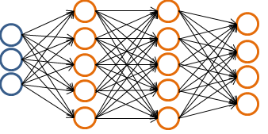
Deep Learning
Deep learning is a learning technique which
Learns through a deep neural network
# of layers <=3 → shallow network
# of layers >3 → deep network
Layer 1
Layer 4
Layer 2
Layer 3

Slide 3









Layer 1
Layer 2
Layer 1
Layer 2

Slide 4


Layer 1
Layer 2

Slide 5
Layer 1
Layer 2
Layer 3

Slide 6
Layer 1
Layer 2
Layer 3
If there is no non-linearity between the layers than the 3-layer network can be expressed by a
Single matrix. → The same as having only 2-layers with the weights in .

Slide 7
Layer 1
Layer 2
Layer 3
Neural Network can be seen as a mapping function between two vectors(tensors) .
The above network maps to .

Slide 8
Layer 1
Layer 2
Layer 3
Neural Network can be seen as a mapping function( ) between two vectors(tensors) and
In other words, the above network maps to .

Slide 9

Speech Recognition
Neural
Network
4.5
sampling
4.3
3.5
3.4
2.8
1.6
0.3
-0.8
-0.9
-0.4
-0.3
-0.6
-0.4
…
[3.4 4.3 4.5 3.5 2.8 -0.8 -0.9 0.3 -0.4 -0.6 -0.3 -0.4 1.6]
Tom
Becky
Robert
Charles

Slide 10

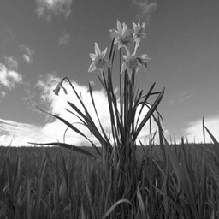
Image Recognition
125
11
99
243
10
81
A Digital Image is a 2-D Array of integer values
173
180
35

Slide 11
Image Recognition
x
15
10
0
0
0
0
0
0
0
0
193
255
0
0
0
0
0
0
120
130
0
0
30
30
30
200
200
210
120
5
u(x,y)=193
69
230
230
233
200
193
3
30
100
100
150
100
100
100
30
30
30
y
187
30
150
100
100
100
100
20
150
19
69

Slide 12
Image Recognition
15
10
0
0
0
0
0
0
0
0
0
0
120
15
10
0
130
0
0
0
0
0
0
0
0
0
0
0
0
0
120
130
0
0
…..
30
30
30
200
200
210
120
5
69
230
187
230
233
200
193
3
30
150
30
100
100
150
100
100
100
30
30
187
30
100
150
100
100
100
100
20
150
19
69
100
100
150
69

Slide 13
Image Recognition
15
Neural
Network
10
0
0
0
0
0
0
Cat
0
0
0
0
120
15
10
0
0
0
0
0
0
0
130
0
0
0
0
0
0
120
130
0
0
0
30
30
30
200
200
210
120
5
…..
69
230
230
233
200
193
3
187
30
30
100
100
150
100
100
100
30
30
187
30
150
150
100
100
100
100
20
150
19
69
100
100
100
150
69

Slide 14
Problem of Recognition ≈ Problem of Classification,
Problem of Regression
Voice Recognition : Problem of how to classify different voices
Image Recognition : Problem of how to classify objects in image
Given a vector what is the proper function which can approximate ?
Input
True Output
Estimated Output
voice1
tom
voice2
Becky

Slide 15
Deep Learning as a Universal Approximator
Data
Output
vector(or Tensor)
vector(or Tensor)
Deep Neural Network can be seen as a
Tensor-to-Tensor mapping function
Why is it called an Approximator? It tries to find a function which approximates the true value
It is called a Universal Approximator because it can approximate even in the case that the relation between and is highly non-linear.

Slide 16
Deep Learning as an automatic programming
Classic programming
Data
Computer
(Execution)
Output
Program
Machine Learning
Data
Computer
(Synthesis)
Program
Output
Why Machine Learning becomes important : difficult to write Program for difficult data

Slide 17


Deep Learning as a Universal Approximator
1
Data
0
…
0
0
Data
0
…
1

Slide 18
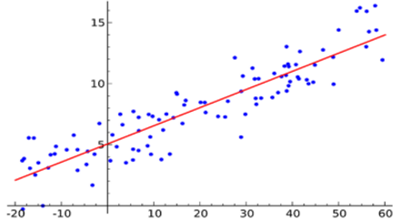
Simple Linear Regressor
Parameters are and
If the relation between and is simple, this relation can be modeled by a simple model,
and it is easy to obtain the parameters.

Slide 19

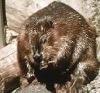
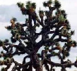




Deep Learning as a Universal Regressor
Highly non-linear
anchor
beaver
Joshua
tree
In the pixel space, the distance between the Beaver images can be more far than the distance between the Beaver and the Anchor images

Slide 20









Deep Learning as a Universal Regressor
Highly non-linear = neural network
anchor
beaver
Joshua
tree
The model can only represent a linear relationship.
In comparison, “neural network” can represent a highly non-linear relationship.
So it can be said that “neural network” has a greater representation power than

Slide 21
Learning (Training) : Supervised Learning
Tell the model that the output should be for as the input
Model(?)
…..
…..
input
output
Given a set of inputs and outputs data
train the model.
After training
train(learning)
Model(!)
Test data
The ouput may be

Slide 22
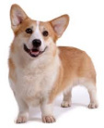


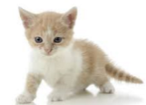
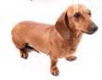



Learning (Training) : Supervised Learning
Tell the model that the output should be dog for as the input
Model(?)
…..
...
input
output
After training
Given a set of inputs and outputs data
train the model.
train(learning)
Model(!)
The output maybe: = cat
Test data

Slide 23
Design the Model
Design the model:
Define the form of the relation between input and output.
The form determines the exactness of the approximation to the true output
Model(?)
Model A
Model Z
……
are the parameters
are the parameters
Need at least 2 sets of data.
Need at least 3 sets of data

Slide 24

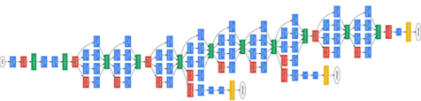
Design the Model
Design the model:
Define the form of the relation between input and output.
The form determines the exactness of the approximation to the true output
Deep Neural Network
Google Inception Model
VGG Model
……
Find the parameters (weight, bias)
for the Inception model
Error : 3.6%
Find the parameters (weight, bias)
for the VGG model
Error : 6.8%

Slide 25
Define the loss functon : Define what you want to decrease
Model
…..
True output
Current output
Different
Because the parameters are not right
Different

Slide 26
Define the loss functon : Define what you want to decrease
How to measure the difference
Different
Loss function has large value if the
Difference is large:
A measure on the Loss
True output
Current output
different
Want to change the parameters such that the difference decreases (such that decreases)
How?
Gradient Descent

Slide 27
Finding the parameters : gradient descent
When to use gradient descent:
If depends on find which decreases
A value
Can be a Scalar
a vector, or a Tensor

Slide 28
Gradient descent: is 1-D
The slope at :
If positive has to move left (-direction) for to decrease
If negative : has to move right (+direction) for to decrease
Small positive number : Learning rate

Slide 29
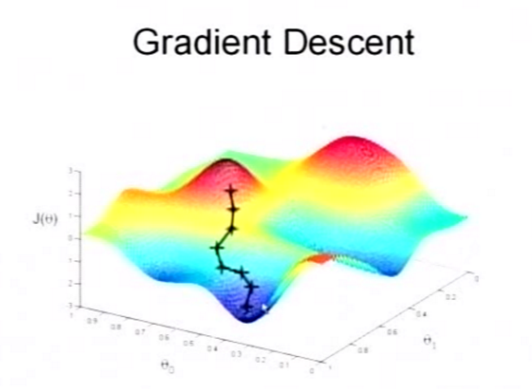
Gradient descent: is 2-D
: A value (height)
: A vector
: 2-D vector : (x,y) coordinates

Slide 30
Compute:
: n-dimension
: n-dimension
EX)

Slide 31
Define the loss functon : Define what you want to decrease
Model:

Slide 32
24
8
Has come closer to the true output 7
(than the former output of 11).

Slide 33
Tensorflow Practice-1 : Tensorflow Basic Usages
http://github.com/petrasuk/Day-1
Lab-1.ipynb

Slide 34
Tensorflow Practice-2 : Training practice-1
Tensorflow Basic Usages : http://github.com/petrasuk/Day-1
Lab-2.ipynb

Slide 35
Tensorflow Practice-3

Slide 36
Tensorflow Practice-3
Making the Training Data Set
import tensorflow as tf
import numpy as np
# Making 100 2-D x_data (float64 -> float32)
x_data = np.float32(np.random.rand(2, 100))
# Give labels to x_data by applying
# (W_true = [0.1, 0.2], b_true = 0.3)→ The true parameter values we want to find)
y_data = np.dot([0.100, 0.200], x_data) + 0.300
Code from: https://gist.github.com/haje01/202ac276bace4b25dd3f

Slide 37
Random
x_data
100
0.1 0.3 0.2 …… 0.4
0.49 0.41 0.04 … 0.46
=
[0.1, 0.2]
2
+
0.3 0.3 0.3 …… 0.3
W_true
0.9 0.4 0.1 …… 0.6
y_data
x_data
b_true
[0.1, 0.2]
0.1
0.49=
+0.3
0.9

Slide 38
Tensorflow Practice-3 : defining the model
Define a linear model with parameter W and b
# let b be 0
b = tf.Variable(tf.zeros([1]))
# W is a 1x2 weight variable (initialized with random values between -1~1)
W = tf.Variable(tf.random_uniform([1, 2], -1.0, 1.0))
# multiply W with x_data and add b
y = tf.matmul(W, x_data) + b
Code from: https://gist.github.com/haje01/202ac276bace4b25dd3f

Slide 39
Any random number
100
0.1 0.3 0.2 …… 0.4
0.1r1+0.9r2 …
=
[r1 r2]
2
+
0 0 0 …… 0
W
0.9 0.4 0.1 …… 0.6
b
y
x_data
[r1, r2]
0.1
0.1r1+0.9r2=
+0
0.9

Slide 40
100
0.1 0.3 0.2 …… 0.4
0.49 0.41 0.04 … 0.46
=
[0.1, 0.2]
2
+
0.3 0.3 0.3 …… 0.3
W_true
0.9 0.4 0.1 …… 0.6
y_data
x_data
b_true
[0.1, 0.2]
0.1
0.49=
+0.3
0.9
Given y_data , y , and x_data
Find W and b which reduces the difference between
y and y_data
[r1, r2]
0.1
0.1r1+0.9r2+b=
+b
0.9
100
0.1 0.3 0.2 …… 0.4
0.1r1+0.9r2+b …
=
[r1 r2]
2
+
0 0 0 …… 0
W
0.9 0.4 0.1 …… 0.6
b
y
x_data

Slide 41
Training the model
Gradient descent Method
# Define the loss function)
loss = tf.reduce_mean(tf.square(y - y_data))
# Set the gradient descent optimizer with alpha = 0.5
optimizer = tf.train.GradientDescentOptimizer(0.5)
# set the train operator which finds W and b which minimize the loss
train = optimizer.minimize(loss)
Code from https://gist.github.com/haje01/202ac276bace4b25dd3f

Slide 42
Training the model
Running the training session
# Define the operation which initializes all variables
init = tf.initialize_all_variables()
# Open and run the session
sess = tf.Session()
sess.run(init)
# Iterate 200 times the train operation
for step in range(200):
sess.run(train)
if step % 20 == 0:
print step, sess.run(W), sess.run(b)
Code from https://gist.github.com/haje01/202ac276bace4b25dd3f

Slide 43
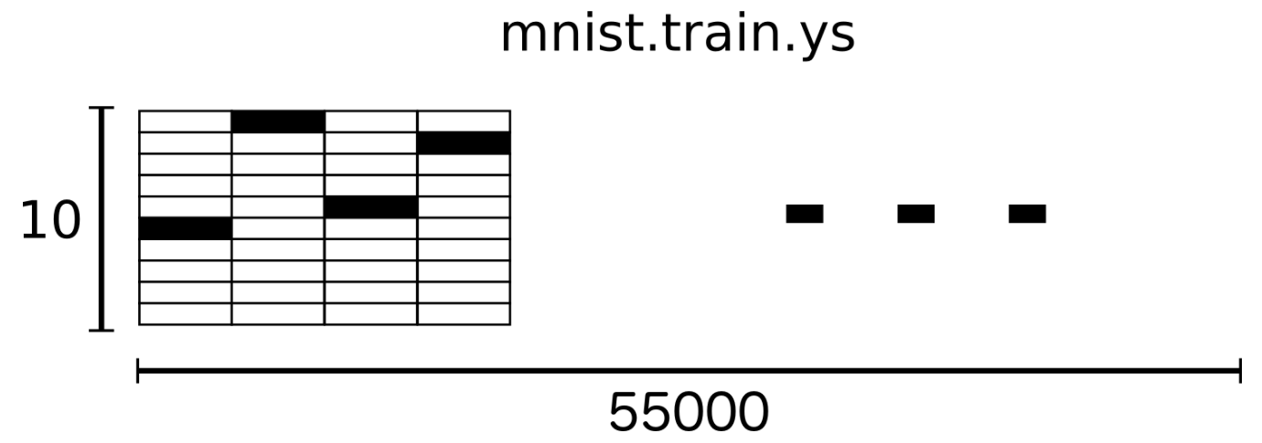
Tensorflow Practice-4
(Training with the MNIST data set)
MNIST label uses a One-Hot Encoding method.
The category corresponding to the number 5 is represented by [0, 0, 0, 0, 0, 1, 0, 0, 0, 0], and the category corresponding to the number 0 as [1, 0, 0, 0, 0, 0, 0, 0, 0, 0]
Code from https://gist.github.com/haje01/202ac276bace4b25dd3f

Slide 44
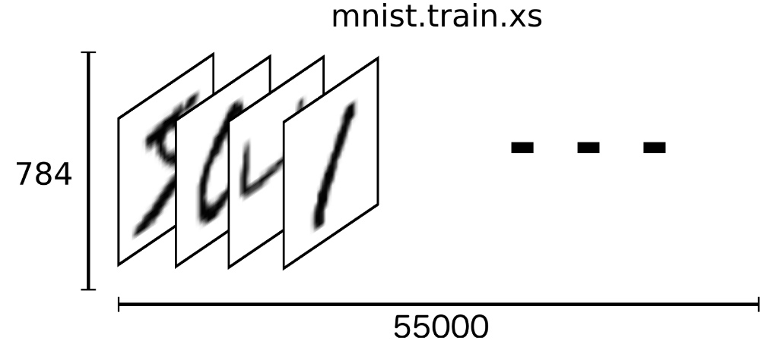
Tensorflow Practice-4
(Training with the MNIST data set)
MNIST has 55,000 training images + 10,000 test images + 5,000 validation images. Each image has a size of 28x28 which becomes a 784 dimensional vector if written in the 1-D vector form.
Code from https://gist.github.com/haje01/202ac276bace4b25dd3f

Slide 45
Tensorflow Practice-4
(Training with the MNIST data set)
x is a Placeholder for the 2D tensor, where the data will be stored. None means that the number of the row is not restricted.
The weights and the bias variables are filled with 0. The result of the training will be saved in these variables. W is of size [784, 10] to be multiplied to the 784 dimension image and to result in a 10 dimension vector. b is 10 dimensional vector.
import tensorflow as tf
# placeholder for the image data
x = tf.placeholder("float", [None, 784])
# weight and bias variables
W = tf.Variable(tf.zeros([784,10]))
b = tf.Variable(tf.zeros([10]))
Code from https://gist.github.com/haje01/202ac276bace4b25dd3f

Slide 46
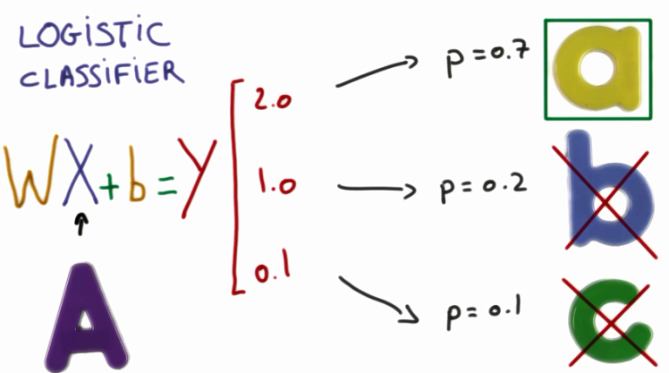
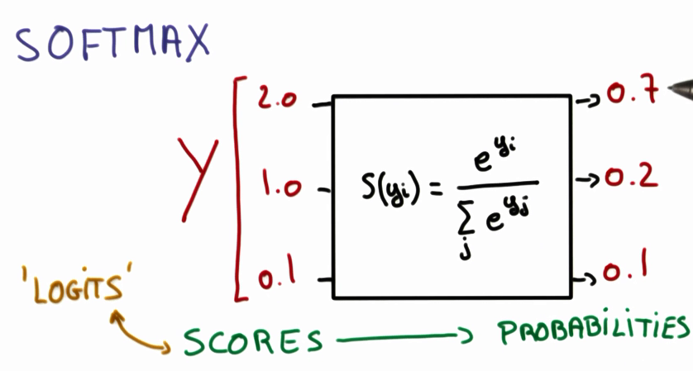
Softmax 함수

Slide 47
image1
1-hot encoding
for
or
same
image1
image2
image1
image2
1-hot encoding for
1-hot encoding for

Slide 48
one-hot coding
For image1
784
10
10
10
X
W
T
Y
image1
image2
784
….
softmax
None
=
None
None
image N

Slide 49
Tensorflow Practice-4
(Training with the MNIST data set)
# The model
y = tf.nn.softmax(tf.matmul(x,W) + b)
# The placeholder for the true label
y_ = tf.placeholder("float", [None,10])
y_ is filled with the true label. The loss function is taken as the Cross-Entropy.
# Loss function
cross_entropy = -tf.reduce_sum(y_*tf.log(y))
Code from https://gist.github.com/haje01/202ac276bace4b25dd3f

Slide 50
Tensorflow Practice-4
(Training with the MNIST data set)
The model is trained with the Backpropagation method.
The optimizer is a gradient descent optimizer with hyper-parameter(learning rate) of 0.01. Using this optimizer a learning operation which minimizes the loss is defined.
# learning operation
train_step = tf.train.GradientDescentOptimizer(0.01).minimize(cross_entropy)
# Initialize the variables
init = tf.initialize_all_variables()
sess = tf.Session()
sess.run(init)
Code from https://gist.github.com/haje01/202ac276bace4b25dd3f

Slide 51
Tensorflow Practice-4
(Training with the MNIST data set)
At training stage the training images and training labels are applied to the placeholders of the model via the parameters of the feed_dict. At every epoch only a small batch is used in the training. This kind of training is called Stochastic Training.
# For each epoch take 100 samples. The number of epochs is 1000.
for i in range(1000):
batch_xs, batch_ys = mnist.train.next_batch(100)
sess.run(train_step, feed_dict={x: batch_xs, y_: batch_ys})
Code from https://gist.github.com/haje01/202ac276bace4b25dd3f

Slide 52
Testing with the MNIST data set
At running time the test images and test labels are applied to the placeholders of the model via the parameters of the feed_dict.
The vector correct_prediction contains the value 1 for correct prediction, and 0 for false prediction. Taking the mean over all the elements in correct_prediction gives the accuracy.
# Rate of correct prediction.
correct_prediction = tf.equal(tf.argmax(y,1), tf.argmax(y_,1))
accuracy = tf.reduce_mean(tf.cast(correct_prediction, "float"))
print sess.run(accuracy, feed_dict={x: mnist.test.images, y_: mnist.test.labels})
Output: 0.9155
Code from https://gist.github.com/haje01/202ac276bace4b25dd3f

