Slide 1
Lab 9: I/O Redirection

Slide 2
What is a data stream?
A data stream is a sequence of encoded data which is transmitted or received between programs or computers

Slide 3
Examples Files on GitHub
We will be using the same files from Lab 7 and 8 to learn about input output redirection

Slide 4
Input and Output
Input and output is used to make programs work properly and see information
Three types of data streams:
  Stdin (0): standard input, defaulted to the keyboard
  Stdout (1): standard output, defaulted to the terminal screen
  Stderr (2): standard error, defaulted to the terminal

Slide 5
Redirecting Input
To change where the input comes from you would use the “<“
Best example:
  Wc < hello-utf.txt
  This outputs “1 45 288” instead of “1 45 288 hello-utf.txt”
  This is because when we redirect the input, we do not know the file name

Slide 6
Redirecting Output
To redirect output, you would use “>” symbol
Example:
  Sort random-passwords.txt > sorted-passwords.txt
  Instead of displaying the sorted words on the terminal, it will be saved in the file

Slide 7
Redirecting Error
If you want to redirect error, you would use “2>” symbol
Cd some_random_directory 2> error.log
If this directory does not exist, the error message will be saved in the error log, but if it successful, you will change directories

Slide 8
Piping
Piping is how you redirect the output of one command or program to be the input of another program
Sort words.txt | uniq –d
This will sort the words in the file, and then print out the duplicates

Slide 9
Command Chaining
In addition to redirecting the input and output to other files or commands, you can run commands only if some other command either failed or succeeded
Cd lab13 || echo “Failed”
This will only print out “Failed” on the terminal if you are not able to change into that directory
cd lab5 && echo “Success”
This will only print out “Success” on the terminal if you are able to change directories

Slide 10
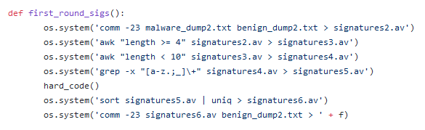
Real World Example
In Spring 2018, I was tasked with making an anti-virus which could detect malicious files
I used various filtering commands and several regex commands in order to filter out unnecessary inputs and keep the desired input.
Code:

