Slide 1
Lab 8: Regular Expressions
Enter the world of Black Magic

Slide 2
What is a regular expression?
A regular expression is a sequence of symbols and characters expressing a string or pattern to be searched for within a longer piece of text
Or in theory of computation terms: A regular expression is an algebraic formula whose value is a pattern consisting of a set of strings, called the language of the expression [This is the confusion definition that we don’t need to learn]

Slide 3
Examples Files on GitHub
We will be using the same files from Lab 7 to learn more about regex in this lab

Slide 4
Grep
Grep is the most common regex command used on the command line
Grep stands for global regular expression print
The syntax is grep [options] pattern [file]
In essence, you define a search pattern and a file and then the shell will read through the file to find instances of that pattern

Slide 5
Common Regex Syntax
The following are the various characters that are used in a regex:
. (dot) – a single character
? - preceding character matches zero or one times
* - preceding character matches zero or more times
+ - preceding character matches one or more times
[a-z] – character is included in the range of characters specified by the brackets
[^ a-z] – character is not one of those included in the brackets in that range
{n} – preceding character matches exactly n times
{n, m} – preceding character matches at least n times, but not more than m times
^ – matches at the beginning of the line
$ – matches at the end of the line

Slide 6
Grep Examples
grep ‘firefox’ ps-output.txt
grep ‘libreoffice’ ps-output.txt
grep ‘f.x’ period.txt
grep ‘…..’ period.txt
Grep -x ‘[a-z]\+’ random-passwords.txt
grep -x ‘[0-9]\+’ random-passwords.txt
grep ‘[a-c]\+’ random-passwords.txt
Grep ‘[T]$’ random-alphanumeric.txt
Grep ‘^y.*[0-9]’ random-alphanumeric.txt

Slide 7
Other Commands
There are other numerous commands that you can use other than grep to filter through files
Comm
Awk
Sed [this is very complicated]

Slide 8
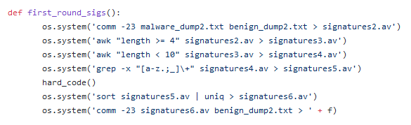
Real World Example
In Spring 2018, I was tasked with making an anti-virus which could detect malicious files
I used various filtering commands and several regex commands in order to filter out unnecessary inputs and keep the desired input.
Code:

