Slide 1
Lab 4: Introduction to Scripting

Slide 2
Source Code Available on Github
All the code that is written in this lab is available on my github:
https://github.com/petrauskasm/After-Hours-Command-Line-Basics

Slide 3



What is scripting?
Scripting is a program that automates the execution of tasks
Examples:
  creating 100 directories
  connecting to a server
Scripting Languages:
  Python
  Ruby
  Perl

Slide 4
Command Line Arguments
Most of the scripts that you will write will need some optional input from the user
These are called command line arguments
Examples:
  ./fibonacci 50
  ./client -p 29773 cbw.sh
  ./av-detect signatures.av malware_directory

Slide 5
Fibonacci Script in C
Goal: create a script in C that will calculate the nth fibonacci number, where n is number you give to the program

Slide 6
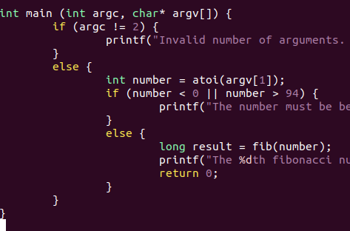
Main Function in C
We will be focusing on the code in the main function
argc is a variable that hold the number of arguments passed to the program
argv is a list of the argument
Converting the string to an integer
Letting the fib function do all the math

Slide 7
Compiling the C program
C is a compiled language, so we can't just run the code directly
You can compile it two ways
  gcc -o fibonacci fibonacci.c
  Makefile
A Makefile allows you to run the make command to compile the program instead of typing out gcc … over and over again

Slide 8

Contents of the Makefile
The following is the contents of the makefile for the fibonacci program:
Typing make fibonacci or make in the terminal will run gcc -o fibonacci fibonacci.c
Typing make clean will remove the the compiled program when you are done using it
It must be named Makefile

Slide 9
Scripting in Python
Scripting in Python or other scripting languages does not require for the code to be compiled
You just need the code and a couple other things
  Shebang statement
  main function

Slide 10
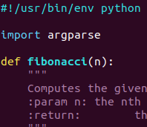
Shebang
Scripting languages require a shebang statement at the beginning of the file
This tells the system which language to interpret the rest of the file as
Usually in the form #! interpreter
Shebang for python

Slide 11

The main function
For a python script to run properly, a main function needs to be specified
The main function

Slide 12
Command Line Arguments in Python
There are a couple of libraries that you can import to parse command line arguments
  sys
  argparse
Sys is a basic library that will uses a similar method to the C programming language
Argparse has more options for interpreting command line arguments

Slide 13
Bash Scripting
All of the commands you have been entering on the command line are part of the Bash programming language
Examples:
  echo
  ls
  pwd
You can write a script to execute these commands

Slide 14
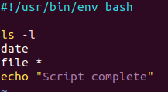
Bash Scripting Example
The following is a simple script written in bash
Shebang for bash
Some random bash commands

