Slide 1
Lab 2: Terminal Basics

Slide 2
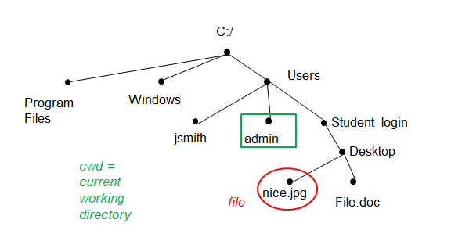
Directories and File Systems
Root directory – top most directory in a file system (“C:/“ for Windows, “/” for Unix/Mac)
Home directory – directory for a specific user in a file system (“C:/Users/<USERNAME>” for Windows “/home/<USERNAME>” for Unix/Mac

Slide 3
Filepaths
Two types:
  Absolute – always starts from the root directory
  Relative – starts from the current working directory

Slide 4
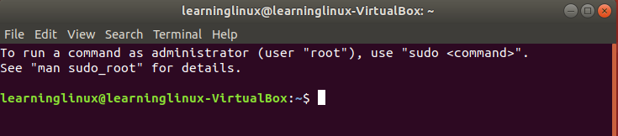
The Terminal
Here is a breakdown of what we see in the terminal when we start it up
learninglinux – username of the current person using the computer
learninglinux-VirtualBox – the name of the computer
~ represents the filepath of the home directory
$ prompt symbol

Slide 5
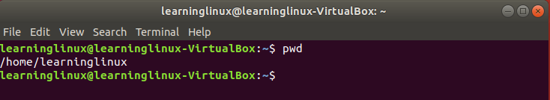
Print Working Directory (pwd)
The pwd command will print the filepath of your current working directory

Slide 6
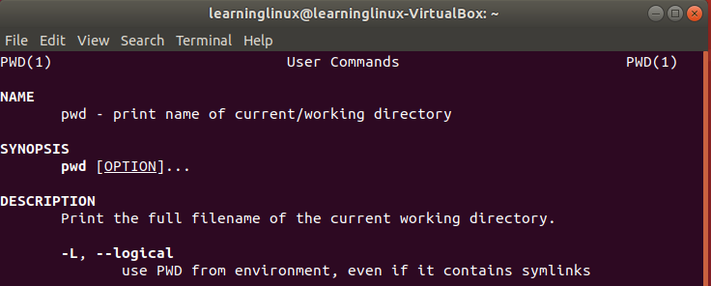
Manual Pages (man)
The man command will display information about the given command
The syntax is man [command]

Slide 7
Change Directory (cd)
The cd command allows you to move around the file system between all the different types of directories
By default, typing in cd in the terminal will take you back to your home directory

Slide 8
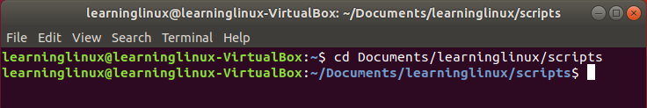
Change Directory (cd)
The syntax for this command is cd [directory]
To change to a different directory, you must specify which directory you want to go to
You must give an absolute filepath of relative filepath of the directory

Slide 9
List Segments (ls)
The ls command lets you view the files/directories in the current working directory
Two optional arguments you should know
  a – will show ALL the files in the current working directory, including hidden files
  l – will show the files with more specific information in long format

Slide 10
List Segments (ls)
Color | File Type
White | Regular Text File
Blue | Directory
Green | Executables or Scripts
Pink | Images
Cyan | Links (shortcuts)
Red | Archives

Slide 11
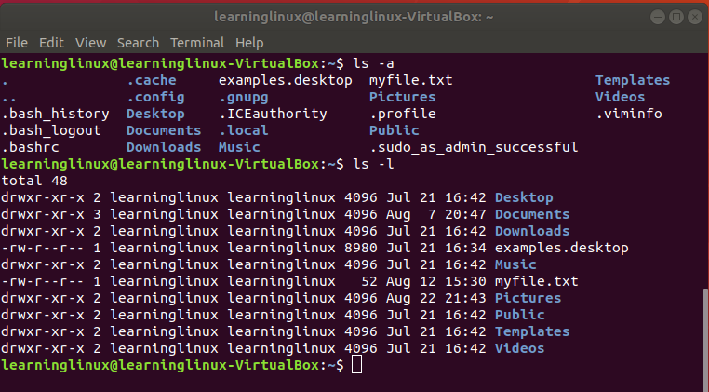
List Segments (ls)
The syntax is ls [options]

Slide 12
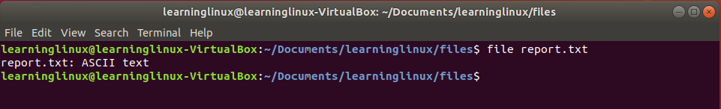
Making Files (touch, vim)
There are multiple ways to make a new file
touch [filename]
This will create a new text file by default with the name filename
vim [filename]
Use the file command to see the the type of file

Slide 13
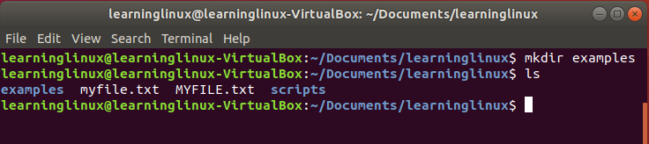
Making a Directory (mkdir)
To make a new directory use the command mkdir
The syntax is mkdir [directory name]

Slide 14
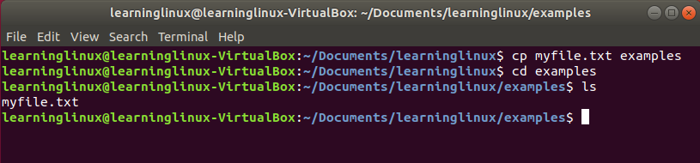
Copying Files (cp)
To copy a file from one directory to another, use the cp command
The syntax is cp [file] [destination]
This will copy a file from the source directory to the destination directory

Slide 15
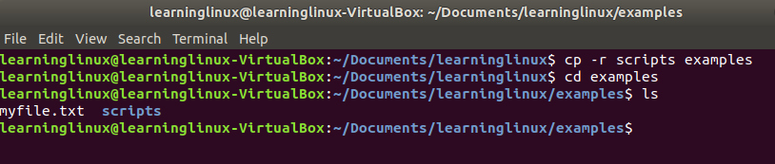
Copying Directories (cp)
To copy an entire directory, you can still use the cp command
The syntax is cp -r [directory] [destination]
The r is an optional argument that will let you copy directory contents recursively

Slide 16
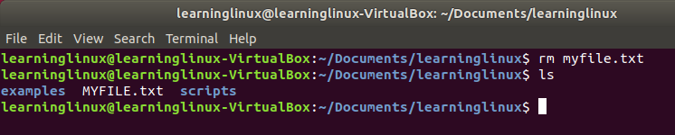
Removing Files (rm)
To remove or delete a file, use the rm command
The syntax is rm [filename]

Slide 17
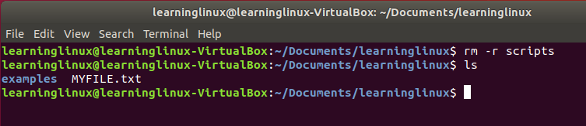
Removing Directories (rm)
To remove or delete an entire directory, you can still use the rm command
The syntax is rm -r [filename]
Like the cp command, the r is an optional argument that you need to specify to work on directories

Slide 18
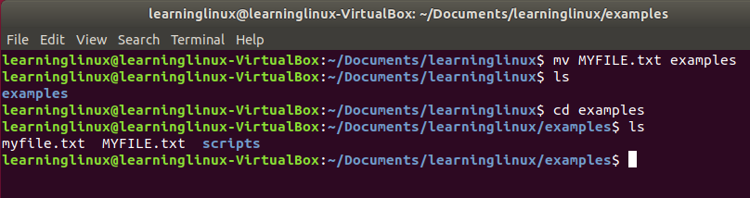
Moving Files (mv)
To move a file from one directory to another, use the mv command
The syntax is mv [filename] [destination]
This moves the file to the destination folder

Slide 19
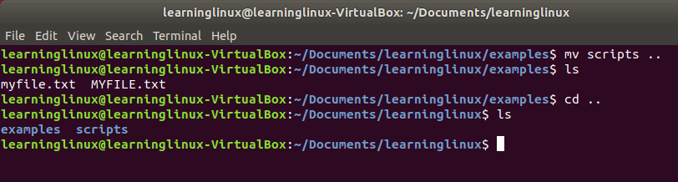
Moving Directories (mv)
To move an entire directory, you can still use the mv command
The syntax mv -r [directory] [destination]

Slide 20
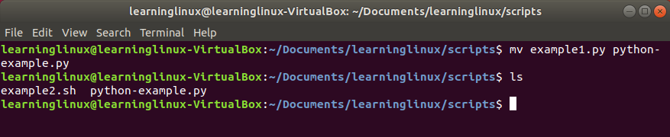
Renaming Files (mv)
To rename a file, you can also use the mv command
The syntax is mv [original filename] [new filename]

