Slide 1
Lab 1: Getting Started

Slide 2
Required Software
Linux ISO File
  Ubuntu (https://www.ubuntu.com/download/desktop)
Virtualization Software
  Oracle VirtualBox (http://www.virtualbox.org/wiki/Downloads)
  VMware Workstation (https://www.vmware.com/products/workstation-pro.html)

Slide 3

Intro & Goals
Prof.Christo Wilson
Martin Petrauskas
Goals of this “class” and the semester:
  Learn basic Linux commands
  Have confidence using the command line for every day use
  To be like a real hackerman
Website: https://cbw.sh/linuxbasics/index.html

Slide 4



Different Ways to Learn Linux
Install it as the host OS on your computer
For Windows users, Windows Subsystem for Linux (WSL) is a good option to run the bash terminal on your Windows machine
Virtual Machines – install Linux on a virtual machine, a computer within a computer

Slide 5


Different Ways to Learn Linux
For the Mac, you can use your default terminal with Homebrew
PuTTY, an SSH client for Windows users, so you can login to the CCIS Server from your laptop

Slide 6
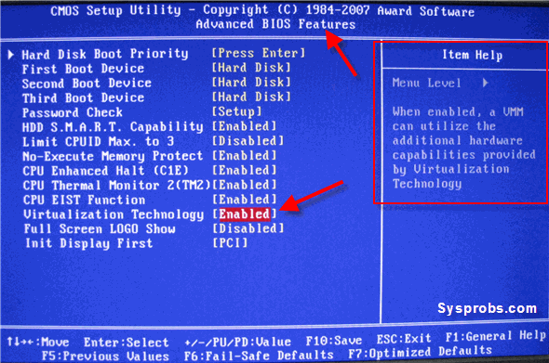
Making a VM and Installing Ubuntu
Follow along with me to create a Virtual Machine in VirtualBox

Slide 7
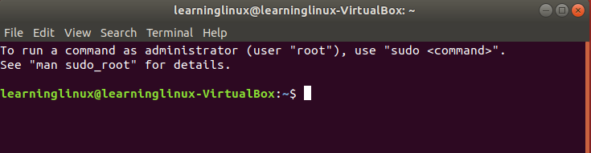
Starting the Terminal
Once you've logged in, right click anywhere on the screen and select “Start Terminal”
Or search the programs for “Terminal”

Slide 8





Installing Necessary Programs
We need to install some miscellaneous programs that you will need throughout the semester
We will install vim, emacs, pip, python, ruby, perl, and git
sudo apt-get install python-pip vim emacs ruby perl git

