Slide 1
Lab 3: File Permissions

Slide 2
What are files?
Files are bytes of data written on some computer resource
To see the contents of a file, use the cat command
The syntax is cat [filename]

Slide 3
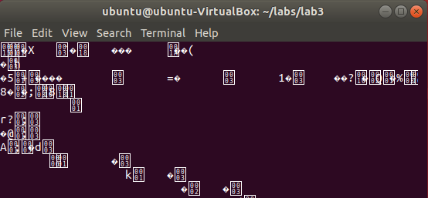
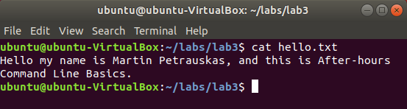
Text Files vs. Binary Files
There are two types of files
  Text: contain characters that can be read by humans
  Binary: contains characters and symbols that can only be read by computers
Output of: cat hello.txt
Output of: cat ssort

Slide 4
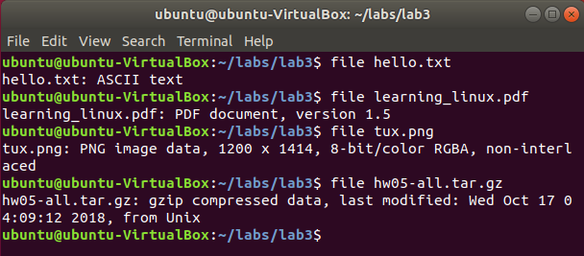
Determining File Type
Use the file command to determine what the contents of a file are
The syntax is file [filename]

Slide 5


File Extensions Don't Mean Anything
File extensions are just a convenience
They assist the user interface to decide which program should open a file
However, file extensions can be incorrect
This isn't an application
It's just a text file.

Slide 6
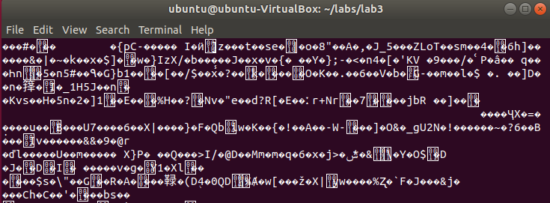
File Extensions Don't Mean Anything
Here are two files with the same content and different file extensions
Output of cat learning_linux.pdf
Output of cat learning_linux.txt
The output contains the same information, so the extension doesn't matter

Slide 7
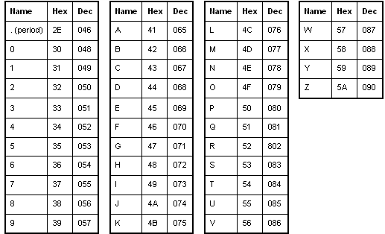
Character Encoding – ASCII
Way of transforming regular characters into binary for computers to read
ASCII (American Standard Code for Information Interchange)
Allows for 128 different characters to be encoded
Part of an ASCII Table

Slide 8
Character Encoding – UTF
Unicode Transformation Format
Allows for over 1 million different characters to be encoded
Unfortunately, emojis can now be encoded with UTF
UTF is backwards compatible with ASCII

Slide 9
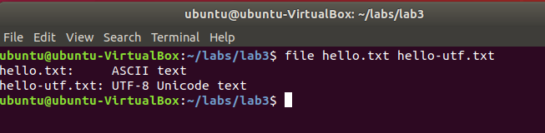
Character Encoding Example
Operating systems will distinguish between text files depending on their encoding

Slide 10
File Permissions – Background Info
Unix systems have three levels of permissions:
  Read – user can view file contents (4)
  Write – user can edit file (2)
  eXecute – user can run file as a program or script (1)
Users are split into three categories for permissions:
  User/owner – user who created the file (u)
  Group – group of users (g)
  Other – all the other users (o)

Slide 11

Reading File Permissions
How to read file permissions:
First character:
“-” (file) or
“d” (directory)
File Permissions for other users (o)
File Permissions for the user (u)
File Permissions for the group (g)

Slide 12
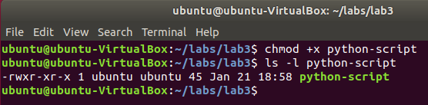
Changing File Permissions – Basic
Use the chmod command to change file permissions
The syntax is chmod [mode] [filename]
Execute permissions are given to all users

Slide 13
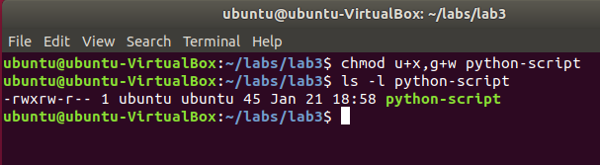
Changing File Permissions – Advanced
chmod u+x,g+w python-script
Give execute permissions to the owner and write permissions to the group

Slide 14
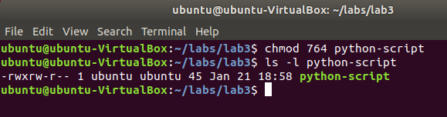
Changing File Permissions – Octal
We can use the octal number system to encode file permissions in numbers
chmod 764 python-script
Same thing as chmod u+x,g+w python-script
Useful website: https://chmod-calculator.com/
7 is for rwx, 6 is rw-, and 4 is r--.

