Slide 1
Lab 5: Complex Inputs

Slide 2
What is a complex input?
Something other than basic alphanumeric strings
Non-Complex Inputs:
Christo
pitbull
password123
somethingelse7
Complex Inputs:
$PATH
“Huh”
“Hello world\n”
\0
*.sh
?.py

Slide 3
Important Bash Complex Inputs
There are some special bash variables that you should take note of:
  $PATH
  $USER
  $HOME
  $SHELL
Use the echo command to see what these variables are

Slide 4
Whitespace
The most overlooked form of complex inputs
What is the difference between the following commands?
  mkdir resource files
  mkdir 'resource files'
The first will create two directories named “resource” and “files”
The second will create one directory named “resource files”
The same thing will happen for regular files

Slide 5
Quoting
Quoting is how you deal with anything that has spaces
Now you can run mkdir 'resource files' and it will create one directory
There are two types of quoting
  Strong quoting – uses single quotes
  Weak quoting – uses double quotes

Slide 6
Strong Quoting
Strong quoting makes use of the single quotes
This tells the shell to interpret everything it reads literally
echo '$HOME'
This outputs $HOME

Slide 7
Weak Quoting
Weak quoting makes use of double quotes
This tells the shell to interpret any variables or escape characters
echo “$HOME”
This outputs /home/ubuntu
The shell will see $HOME and interpret it and print out the home directory

Slide 8
Wildcards
There are three types of wildcards:
  * (asterisk)
  ? (question mark)
  [] (square brackets)

Slide 9

Hitchhiker's Guide to the Galaxy
A brief history before we get into the functionality of the asterisk
42: The answer to life, universe, everything
Anyone know why that is?
42 in binary is 00101010
00101010 in ASCII is the asterisk

Slide 10
Asterisk Wildcard
Since we now know the background history of the asterisk and why it is so important, we can discuss how it's used
The asterisk represents any number of characters
Try the command file * in any directory that has some files

Slide 11
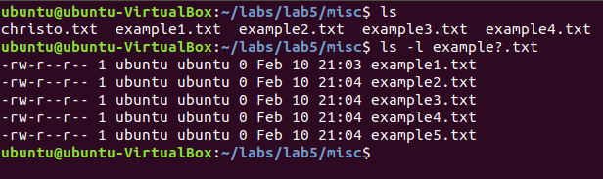
Question Mark Wildcard
Rather than representing multiple characters like the asterisk, the question mark will only represent one character
Run the command ls -l example?.txt

Slide 12

Square Brackets Wildcard
The square brackets wildcard offers some flexibility in which characters you'd like to substitute
With the square brackets, you can only substitute certain characters
Try the command file l[aeiou]st.txt
This will only return file names with the second character as a vowel and the other characters being fixed

Slide 13
Combining All the Wildcards
The wildcards can be combined with each other to give more flexibility in your searches
Examples:
  ls -l *.?? (this will search for any file which has a file extension which is two characters long)
  file [nmc]* (this will search for anything which starts with “n”, “m”, or “c”
There are endless ways to put together wildcards

Slide 14
Escape Characters
In the terminal, programming languages, etc. there are a set of characters that invoke a different interpretation of the character
Examples:
  \n
  \t
  \”

Slide 15
Escape Characters in Action
To see how escape characters affect basic strings, use the echo command with the -e argument
echo -e “Hello\nWorld”
echo -e “Hello\tWorld”
echo -e “Hello\vWorld”

