Slide 1
C#/.NET a rozdíl mezi javou
Petr Balat
Notes:
This template can be used as a starter file for presenting training materials in a group setting.
Sections
Right-click on a slide to add sections. Sections can help to organize your slides or facilitate collaboration between multiple authors.
Notes
Use the Notes section for delivery notes or to provide additional details for the audience. View these notes in Presentation View during your presentation.
Keep in mind the font size (important for accessibility, visibility, videotaping, and online production)
Coordinated colors
Pay particular attention to the graphs, charts, and text boxes.
Consider that attendees will print in black and white or grayscale. Run a test print to make sure your colors work when printed in pure black and white and grayscale.
Graphics, tables, and graphs
Keep it simple: If possible, use consistent, non-distracting styles and colors.
Label all graphs and tables.

Slide 2
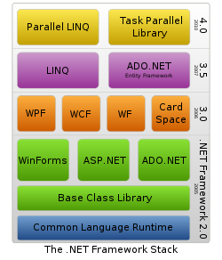
Obsah
Platforma
jazyk C#
.NET core Knihovny
Komunita
Notes:
Give a brief overview of the presentation. Describe the major focus of the presentation and why it is important.
Introduce each of the major topics.
To provide a road map for the audience, you can repeat this Overview slide throughout the presentation, highlighting the particular topic you will discuss next.

Slide 3
Platforma - zkratky
CIL (Common Intermediate Language) někdy jenom IL == byte code
CLR (Common Language Runtime) == jvm (java virtual machine)
ASP (Active server pages) == JSP , ASP.NET, ASP.NET MVC
WPF (Windows Presentation Foundation) klientské app
WCF (Windows Communication Foundation) = SOA
ADO.NET == jdbc
Silverlight – podmnozina .NET pro RIA aplikace jako flash
GAC (Global Assembly Cache) – repository knihoven
Notes:
Give a brief overview of the presentation. Describe the major focus of the presentation and why it is important.
Introduce each of the major topics.
To provide a road map for the audience, you can repeat this Overview slide throughout the presentation, highlighting the particular topic you will discuss next.

Slide 4
Assembly
(dll nebo exe) ~ jar + metadata
Version=10.0.0.0, Culture=neutral (x86 nebo x64), PublicKeyToken=hash cislo
Weakly Named Assemblies a Strongly Named Assemblies - podepsaný lze zadat do GAC (c:\Windows\Microsoft.NET\assembly\GAC_MSIL či GAC_32, GAC_64)
Pozor: pokud je závislost na dll Specific Version = true v runtime .NET nejdriv hleda v GAC a potom v adresari exe souboru či bin na webu !!! knihovny naistalovany pomoci nejakych instalatoru napr. mvc3 apod. a samozřejmě .NET core knihovny. Doporucuju vlastni knihovny nedavat do GAC.
kvalitní open dekompiler: ILSpy http://wiki.sharpdevelop.net/ILSpy.ashx
práce s GAC pomocí GACUTIL.exe
Assembly Names příklady:
http://msdn.microsoft.com/en-us/library/k8xx4k69(v=vs.71).aspx
http://nhforge.org/doc/nh/en/index.html#mapping
http://www.springframework.net/doc-latest/reference/html/objects.html#objects-configuration-metadata
Notes:
Give a brief overview of the presentation. Describe the major focus of the presentation and why it is important.
Introduce each of the major topics.
To provide a road map for the audience, you can repeat this Overview slide throughout the presentation, highlighting the particular topic you will discuss next.

Slide 5
Visual Studio
2010 premium, resharper 6, nuget
Ctr+space = code completion
Ctrl+shift+space = Smart code completion
Alt+Insert = Generate code
Ctrl+Shift+R = Refactor this
Ctrl+n = open type
Ctrl+Shift+n = go to file
Notes:
Give a brief overview of the presentation. Describe the major focus of the presentation and why it is important.
Introduce each of the major topics.
To provide a road map for the audience, you can repeat this Overview slide throughout the presentation, highlighting the particular topic you will discuss next.

Slide 6
Modifikátory
Navíc internal pro viditelnost v rámci Assembly. Lze u assembly definovat friendly pro jiné assembly [assembly: InternalsVisibleTo(„nazev assembly")]
default modifikátor pro třídu je internal, metody a fieldy private. Private je pro namespace == package.
Notes:
Give a brief overview of the presentation. Describe the major focus of the presentation and why it is important.
Introduce each of the major topics.
To provide a road map for the audience, you can repeat this Overview slide throughout the presentation, highlighting the particular topic you will discuss next.

Slide 7
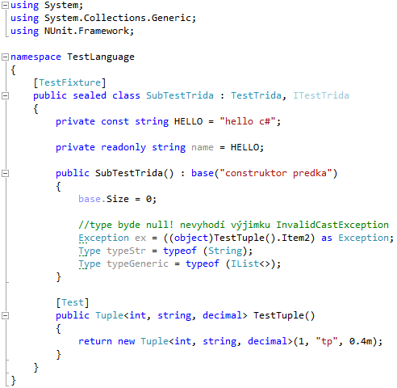
Klíčová slova
extend a implementation == : první trida
super == base
final class == sealed class
final field == readonly field
package == namespace
pouziti s using System.Collections;
const – nelze menit v runtime
pretypovani jako v jave plus as
typeof(Trida) místo Trida.class a typeof(GenerickaTrida<>)
Tuple<,,,>
anotace == atribut viz CommentAttribute.cs potom se pouzije jako [Comment]
object initializer, dynamic, a anonymní třída – příklad
region a preprocesor – příklad
partial – pouze rozdělení tříd/metod do více souboru
var – pouze bere typ z prave strany vyrazu a to jiz v dobe prekladu
Notes:
Give a brief overview of the presentation. Describe the major focus of the presentation and why it is important.
Introduce each of the major topics.
To provide a road map for the audience, you can repeat this Overview slide throughout the presentation, highlighting the particular topic you will discuss next.

Slide 8
Virtual metody
Defaultně NEjsou metody virtuální jako v jave
nutnost psát virtual a override
Klíčové slovo new -> příklad TestTrida
default parametry
Notes:
Give a brief overview of the presentation. Describe the major focus of the presentation and why it is important.
Introduce each of the major topics.
To provide a road map for the audience, you can repeat this Overview slide throughout the presentation, highlighting the particular topic you will discuss next.

Slide 9
Property
Místo get a set metod
V set máme klíčové slovo value
set { field = value;}
Od C# 3 automatický { get; set; }
V runtime jsou to metody takze zvazit zda mají být virtualní
Příklad TestTrida.cs
Notes:
Give a brief overview of the presentation. Describe the major focus of the presentation and why it is important.
Introduce each of the major topics.
To provide a road map for the audience, you can repeat this Overview slide throughout the presentation, highlighting the particular topic you will discuss next.

Slide 10
struct a class
class stejny jako v jave referenční typ
struct je hodnotový typ kopírují se hodnoty
enum je též hodnotový typ – workaround pro dalsi obsah jsou atributy
Příklad TestStruct.cs
Notes:
Give a brief overview of the presentation. Describe the major focus of the presentation and why it is important.
Introduce each of the major topics.
To provide a road map for the audience, you can repeat this Overview slide throughout the presentation, highlighting the particular topic you will discuss next.

Slide 11
Nullable<>
Pokud chceme použít null u hodnotových typů
int? promena = null; // doporučovaný zápis
Nullable<int> promena = null;
?? Operator
Příklad TestNullable.cs
Notes:
Give a brief overview of the presentation. Describe the major focus of the presentation and why it is important.
Introduce each of the major topics.
To provide a road map for the audience, you can repeat this Overview slide throughout the presentation, highlighting the particular topic you will discuss next.

Slide 12
Implementace rozhrani + static class
Stejný jako v javy
plus explicitni implementace rozhrani
static class není to samé co v javě! Příklad i se statickou extension metodou pozor na chovani NullReferenceException
Notes:
Give a brief overview of the presentation. Describe the major focus of the presentation and why it is important.
Introduce each of the major topics.
To provide a road map for the audience, you can repeat this Overview slide throughout the presentation, highlighting the particular topic you will discuss next.

Slide 13
Přetížení operátorů
Příklad TestOperator.cs
Nejdou přetížit operátory:
=, ., ?:, ->, new, is, sizeof, typeof
http://msdn.microsoft.com/en-us/library/8edha89s(v=vs.71).aspx
Notes:
Give a brief overview of the presentation. Describe the major focus of the presentation and why it is important.
Introduce each of the major topics.
To provide a road map for the audience, you can repeat this Overview slide throughout the presentation, highlighting the particular topic you will discuss next.

Slide 14
Generiky, kovariance a kontravariance
Uchovává se typ generiky IList<string> != IList<int>
Klíčová slova where : , new() struct class
Lze použít instanceof T
V runtime GetType().ToString() == IList`1[System.String]
interface IEnumerable<out T> { }
IEnumerable<AbstractPerson> p = new List<Person>();
interface IComparer<in T> {}
Compare(Shape a, Shape b) kde Circle : Shape
new SortedSet<Circle>(new ShapeAreaComparer())
TestGeneric
Notes:
Give a brief overview of the presentation. Describe the major focus of the presentation and why it is important.
Introduce each of the major topics.
To provide a road map for the audience, you can repeat this Overview slide throughout the presentation, highlighting the particular topic you will discuss next.

Slide 15
Destruktur, using a IDispose
Chování destruktoru jako v jave finalize ale je zaručeno že se volá vždy při uvolňování.
Idispose je pro explicitní uvolnování unmanaged zdroju např, souborů, connections apod.
Místo try finaly -> používat using
Příklad. TestDispose
Notes:
Give a brief overview of the presentation. Describe the major focus of the presentation and why it is important.
Introduce each of the major topics.
To provide a road map for the audience, you can repeat this Overview slide throughout the presentation, highlighting the particular topic you will discuss next.

Slide 16
Exception
Podobně jako v javě ale neexistují checked výjimky
Dědí se po System.Exception
NullPointerException==NullReferenceException
ClassCastException== InvalidCastException
…
Notes:
Give a brief overview of the presentation. Describe the major focus of the presentation and why it is important.
Introduce each of the major topics.
To provide a road map for the audience, you can repeat this Overview slide throughout the presentation, highlighting the particular topic you will discuss next.

Slide 17
yield return a yield break
Místo psaní implementace IEnumerable. Řeší překladač v těle metody.
yield return vrací další prvek.
Yield break - už není dostupný další.
Př: Místo vracení již naplněné kolekce prvku (čas. náročnost) vracíme postupně
Pozor při znovu zavolaní metody se znova provede telo metody
-> jiz spocitane pouzit ToArray nebo ToList apod.
Příklad TestEnumerable.cs
http://msdn.microsoft.com/cs-cz/library/9k7k7cf0.aspx
Notes:
Give a brief overview of the presentation. Describe the major focus of the presentation and why it is important.
Introduce each of the major topics.
To provide a road map for the audience, you can repeat this Overview slide throughout the presentation, highlighting the particular topic you will discuss next.

Slide 18
Eventy, delagaty a closure
Delegaty jsou reference na metody
Příklad TestClosures.cs
Pozor na memory leaks u event => pouzit WeakEventManager
Predefinovane delegaty void Action<,,> a Func<,,> kde poslední typ musí metoda vracet
Notes:
Give a brief overview of the presentation. Describe the major focus of the presentation and why it is important.
Introduce each of the major topics.
To provide a road map for the audience, you can repeat this Overview slide throughout the presentation, highlighting the particular topic you will discuss next.

Slide 19


linq a Expression
Je rozhodně skvělá věc ☺
Přidává funkcionální styl programování
Deklarativní dotazy nad různými zdroji dat (LINQ to Objects, XML, nad SQL DB, parallel linq)
Notes:
Give a brief overview of the presentation. Describe the major focus of the presentation and why it is important.
Introduce each of the major topics.
To provide a road map for the audience, you can repeat this Overview slide throughout the presentation, highlighting the particular topic you will discuss next.

Slide 20
linq a Expression
Pokud se pouzije System.Linq.Expresion<>
Nekompiluje se ale naparsuje a vytvoří strom (expression tree)
Používá se potom v linq providerech např. Nhibernate linq
Notes:
Give a brief overview of the presentation. Describe the major focus of the presentation and why it is important.
Introduce each of the major topics.
To provide a road map for the audience, you can repeat this Overview slide throughout the presentation, highlighting the particular topic you will discuss next.

Slide 21
Native features
unchecked {}
[extern]
Pointry
Příklad TestPtr.cs
Notes:
Give a brief overview of the presentation. Describe the major focus of the presentation and why it is important.
Introduce each of the major topics.
To provide a road map for the audience, you can repeat this Overview slide throughout the presentation, highlighting the particular topic you will discuss next.

Slide 22
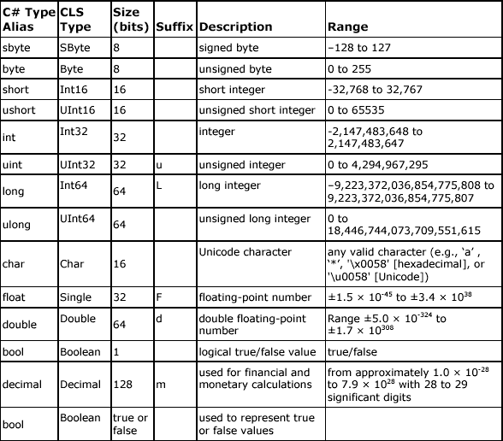
Typy
Pro typ peníze používat decimal
Notes:
Give a brief overview of the presentation. Describe the major focus of the presentation and why it is important.
Introduce each of the major topics.
To provide a road map for the audience, you can repeat this Overview slide throughout the presentation, highlighting the particular topic you will discuss next.

Slide 23
Konvence
konvence interface začíná I viz IList a implementace List
nazvy metod z pascal konvence (hlavni designer c# :-)) první Velke pismeno viz ToString() jinak stejny jako u javy
Notes:
Give a brief overview of the presentation. Describe the major focus of the presentation and why it is important.
Introduce each of the major topics.
To provide a road map for the audience, you can repeat this Overview slide throughout the presentation, highlighting the particular topic you will discuss next.

Slide 24
Object a ValueType
Class dědí po Object
Struct dědí po ValueType (neexistuje metoda GetType(), destruktor a static metody Equals
)
string je alias k System.String je vždy immutable tzn. muze se pouzivat ==
@ verbatim string
ToString() pozor double apod závislý na local nastavení počítače -> doporucuju si napsat extension static metody MoneyToString() apod. viz priklad TestToStringCulture.cs
Notes:
Give a brief overview of the presentation. Describe the major focus of the presentation and why it is important.
Introduce each of the major topics.
To provide a road map for the audience, you can repeat this Overview slide throughout the presentation, highlighting the particular topic you will discuss next.

Slide 25
Kolekce
Kolekce ze dvou namespace System.Collections a System.Collections.Generic
pouzivat misto ICollection nebo IList IEnumerable<>
Místo mapy je IDictionary<,>
Do kolekce lze vkladat struct tzn. int apod.
C5 library http://www.itu.dk/research/c5/
Notes:
Give a brief overview of the presentation. Describe the major focus of the presentation and why it is important.
Introduce each of the major topics.
To provide a road map for the audience, you can repeat this Overview slide throughout the presentation, highlighting the particular topic you will discuss next.

Slide 26
Zajímavé třídy
System.Lazy<>(Func<T> valueFactory, bool isThreadSafe)
new Lazy(() => new TestTrida());
System.Convert pro převod do int, double apod
System.Threading.Tasks pro práci s vlákny
System.Text.StringBuilder
System.Numerics.BigInteger (assembly System.Numerics)
Notes:
Give a brief overview of the presentation. Describe the major focus of the presentation and why it is important.
Introduce each of the major topics.
To provide a road map for the audience, you can repeat this Overview slide throughout the presentation, highlighting the particular topic you will discuss next.

Slide 27
Komunita
www.codeplex.com
code.google.com
www.github.com
wug.cz/zaznamy
www.mstv.cz
Notes:
Give a brief overview of the presentation. Describe the major focus of the presentation and why it is important.
Introduce each of the major topics.
To provide a road map for the audience, you can repeat this Overview slide throughout the presentation, highlighting the particular topic you will discuss next.

Slide 28


Otázky?
určitě se zeptejte. celý příštý týden jsem na dovolené :-)

