Slide 1
An In-Depth Look at JFR in GraalVM Native Image
Robert Toyonaga

Slide 2
Today’s Topics
Section 1: High-level JFR Native Image
A quick JFR refresher
GraalVM/Native Image Intro
How (and why) is Native Image JFR different than OpenJDK?
Current state of support for JFR in GraalVM Native Image
Section 2: Low-level JFR Native Image
Events
Chunk files
In-flight buffers
Constant pools
Chunk rotations

Slide 3
JDK Flight Recorder (JFR) Refresher
A monitoring/profiling tool built into the JVM
Event-based
Low overhead
Gain insight into threads, monitors, CPU profiling, allocations, GC …

Slide 4


What is GraalVM Native Image?
Create AOT compiled binaries from Java apps
Faster start-up
Uses less resources
javac
Graal native-image
executable
Compile your java program into bytecode.
Use the GraalVM native-image tool to build the binary.
Execute the binary.

Slide 5
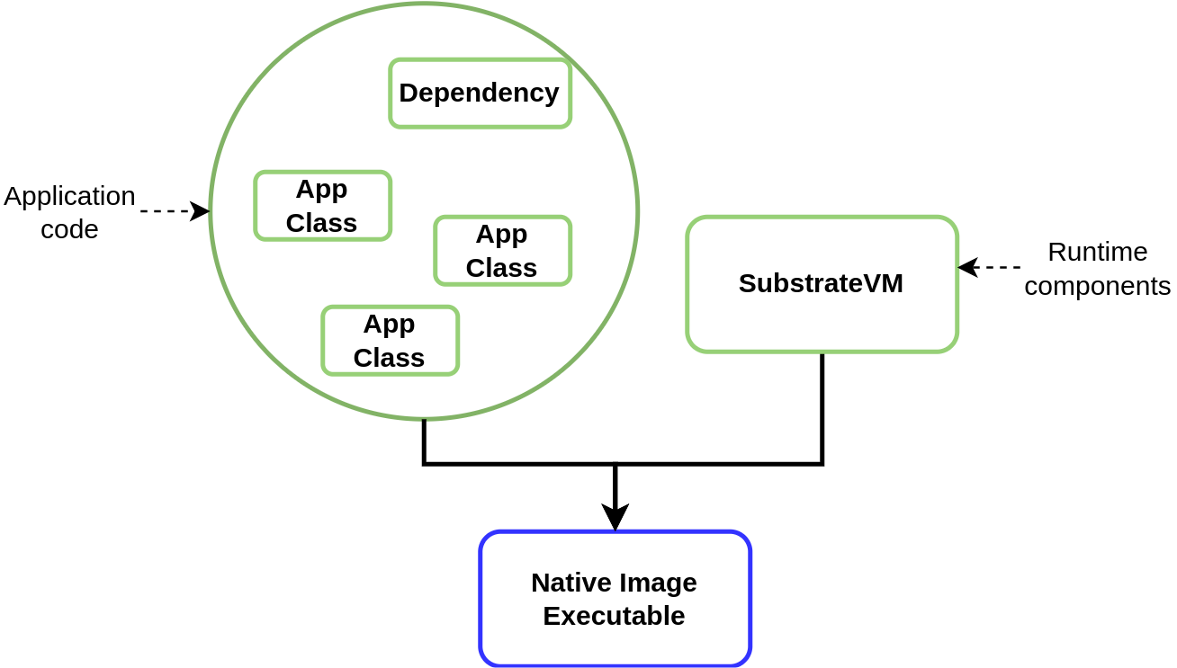
Why is Native Image JFR different than OpenJDK?

Slide 6
Current State of JFR Support in Native Image
Start/Stop recording
Events
Threads, monitor, allocation, GC, safepoint …
Dump snapshots to disk
Custom Event API
Stack traces (and method profiling)
Event streaming
Remote JMX connection to FlightRecorderMXBean

Slide 7
Basic Building and Running with JFR
Buildtime
native-image --enable-monitoring=jfr JavaApplication
Runtime
./javaapplication -XX:StartFlightRecording=filename=recording.jfr

Slide 8
Current Limitations
Not all events are implemented
Events implemented through bytecode instrumentation
New JDK events (@deprecated etc.)
Event streaming doesn’t support stack traces yet
In review: Leak profiling (OldObjectSample event)
In review: Continuous allocation profiling
In progress: Native Memory Tracking

Slide 9
Section 2: Deep Dive Into JFR
Events
Chunk files
In-flight buffers
Constant pools
Chunk rotations

Slide 10
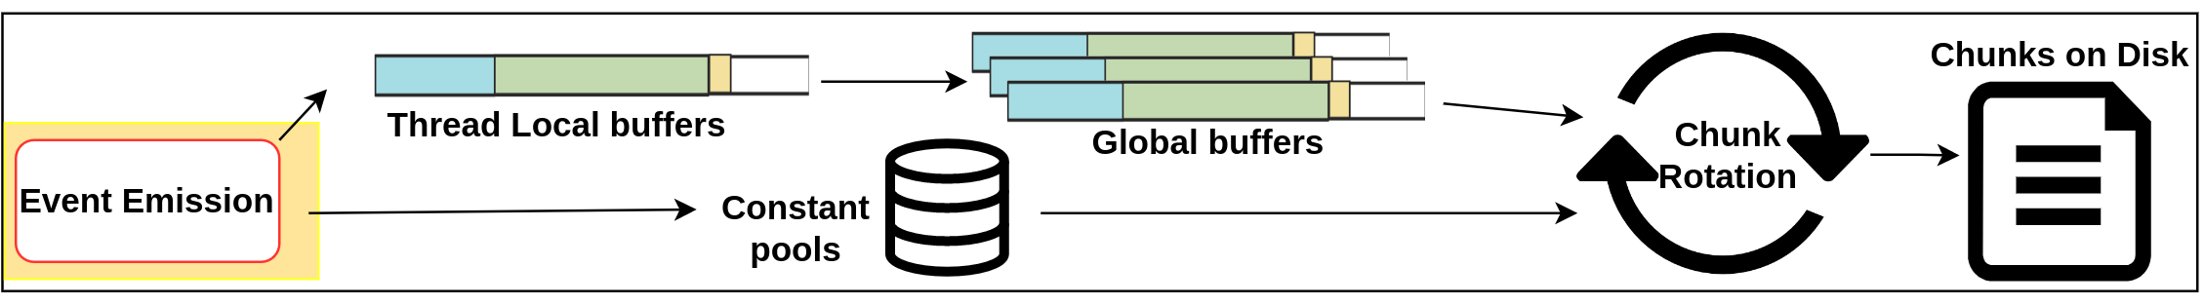
Roadmap

Slide 11
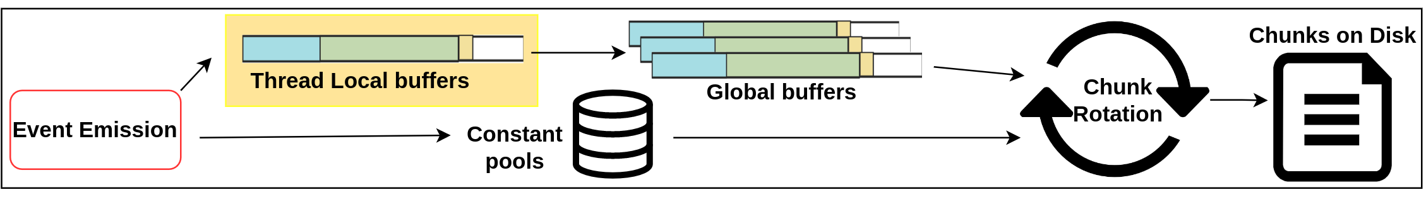
Roadmap

Slide 12
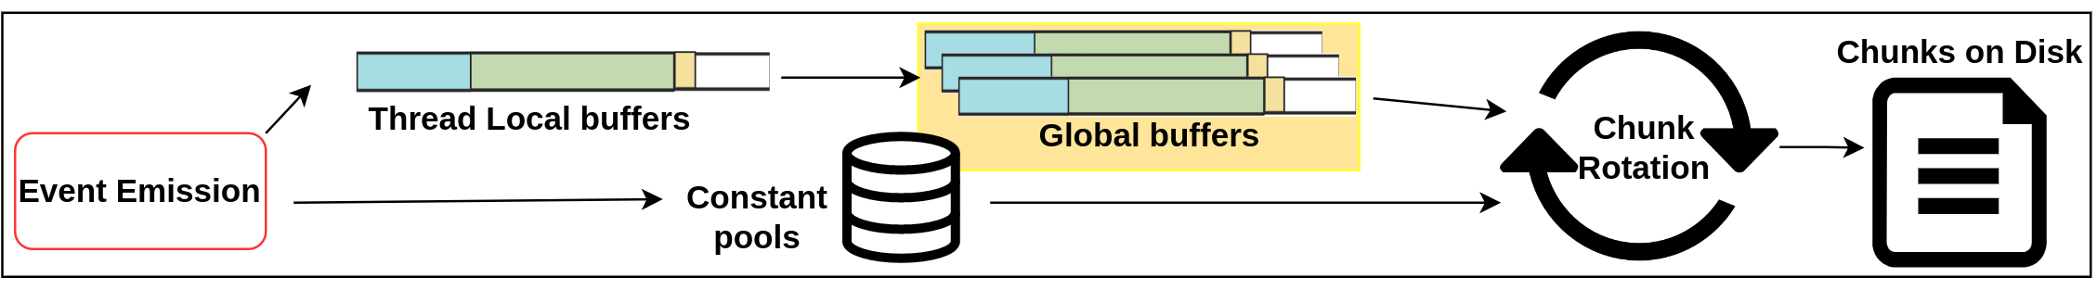
Roadmap

Slide 13
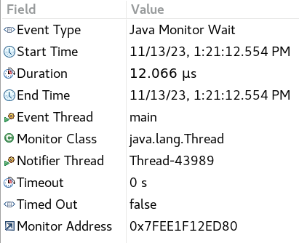
Events

Slide 14
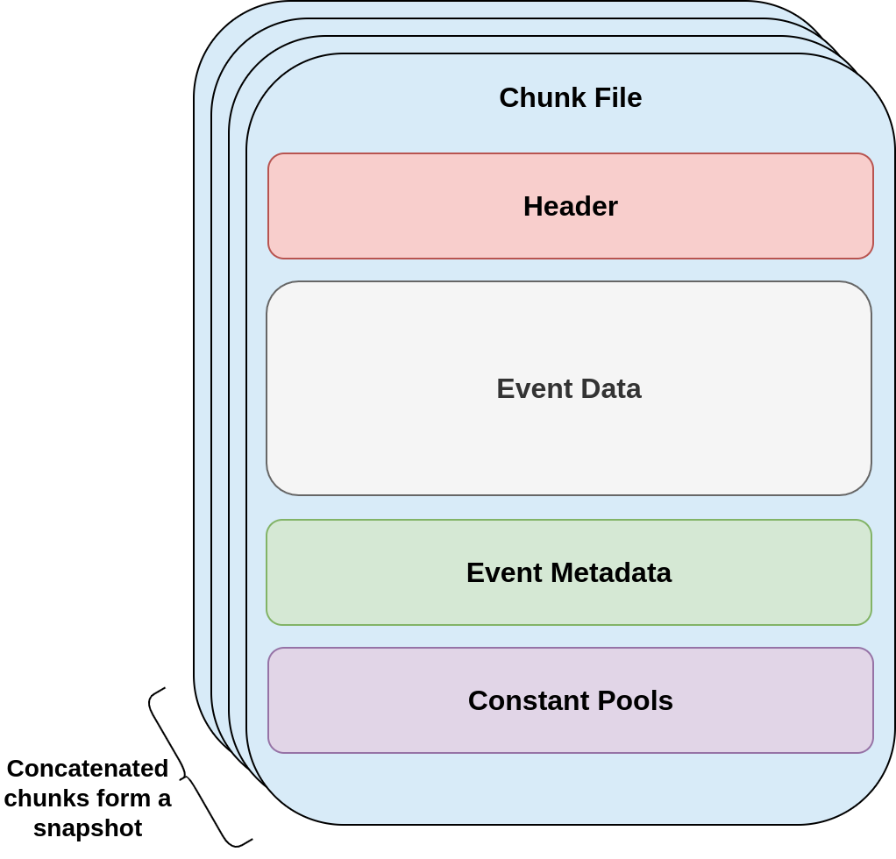
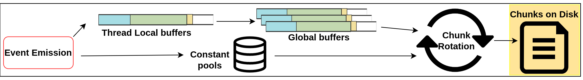
Chunk Files
Each chunk is self-contained and independent
Events in “Event Data” reference data in “Event Metadata” and “Constant Pools”

Slide 15
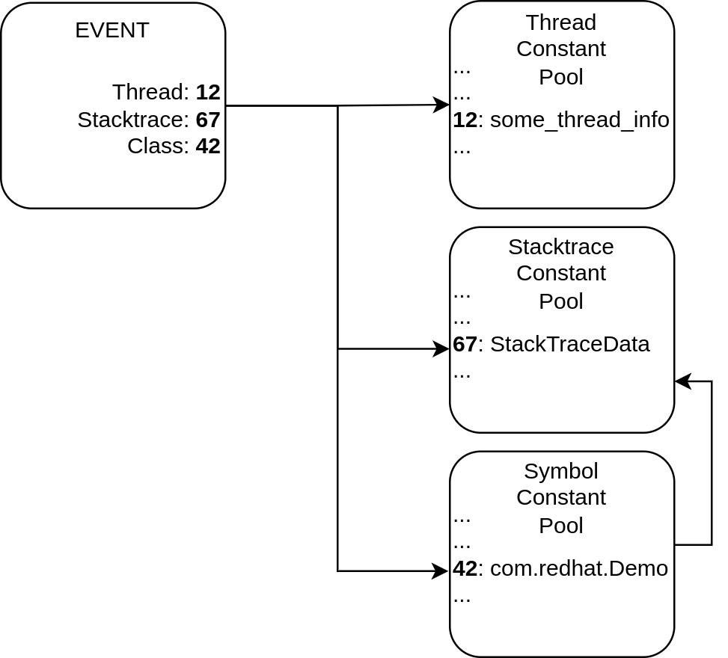
Referencing using JFR IDs
Constants are only recorded once per chunk
Allows for compactness of data (both in-flight and on-disk)

Slide 16
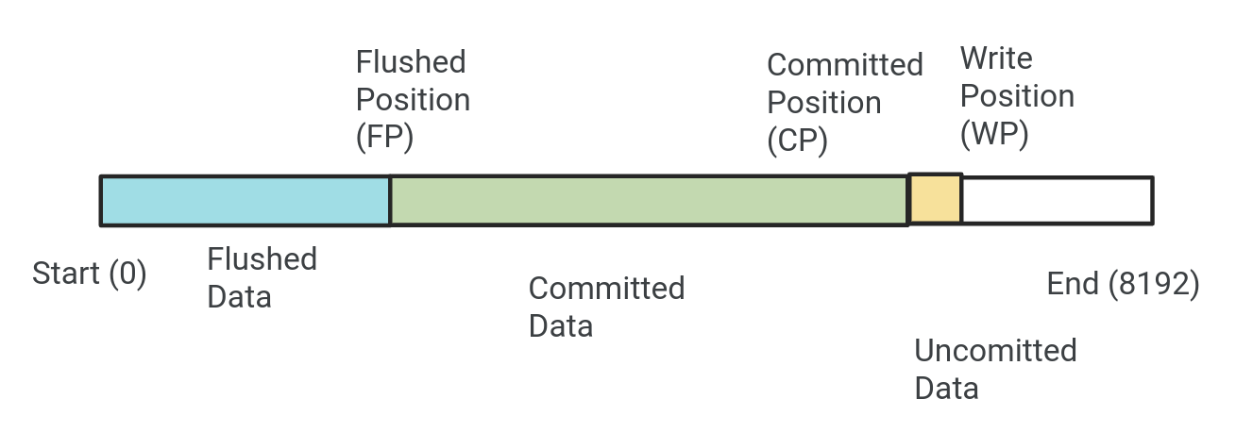
In-Flight Buffers: Thread Local Buffers
Holds “in-flight” event data
Allows for concurrent read/writes

Slide 17
In-Flight Buffers: Global Buffers
A collection of shared buffers structured identical to thread-local buffers
Provides additional flexible storage
Global buffers eventually are flushed to disk

Slide 18
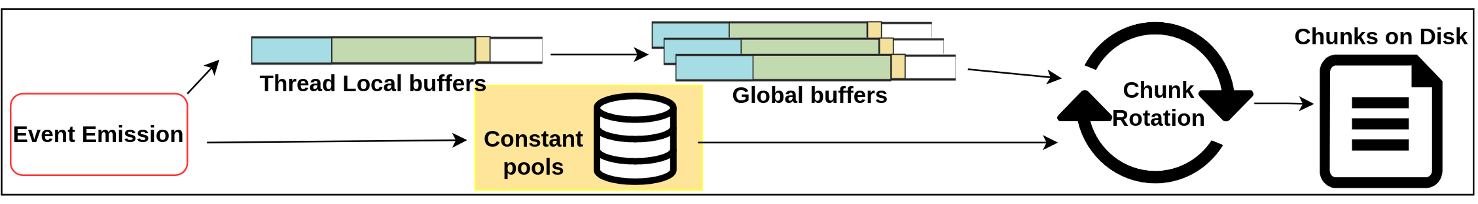
Constant Pools
Allows for compactness of event data through deduplication of constants
Various pools:
Class
Package
Classloader
Method
Stacktrace
Thread

Slide 19
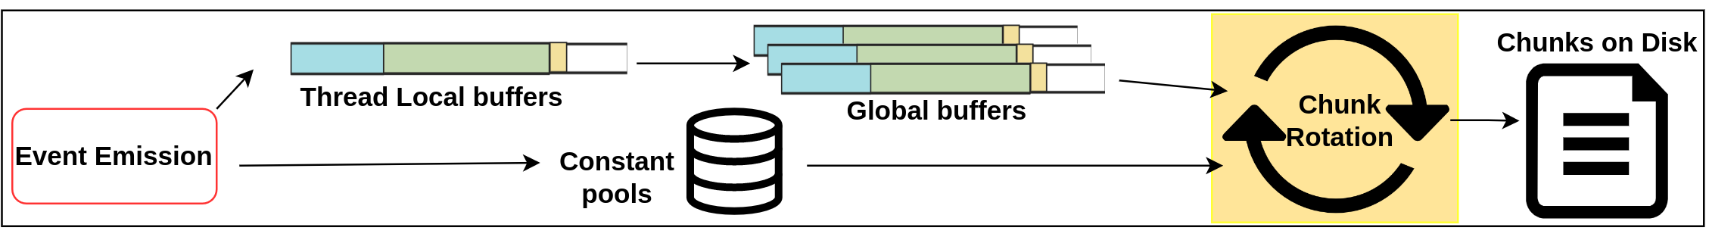
Chunk Rotation
After enough data has been generated, a rotation is requested
Purpose:
Persist in-flight data to disk
Prevent any single chunk file from growing too large
A safepoint is required

Slide 20
Chunk Rotation: Order of Operations
Epoch 1
Enqueue safepoint operation
Safepoint
Write local buffers to disk
Write global buffers to disk
Epoch 2
Write constant pools to disk
Close old chunk / Open new chunk

Slide 21
Chunk Rotation: Uninterruptible
Can safepointing for chunk rotation interrupt event emission (separating event and constant data)?
Begin event emission
Record event data to thread-local buffers
What if a chunk rotation safepoint happens here?
Epoch 1
Epoch 2
Record constant data to constant pools

Slide 22
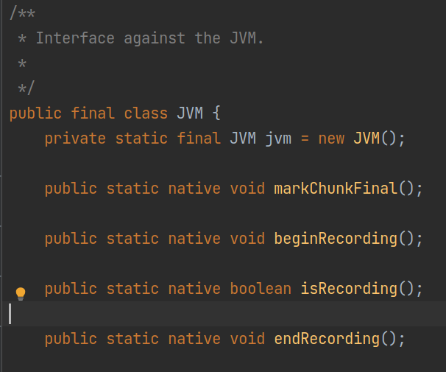
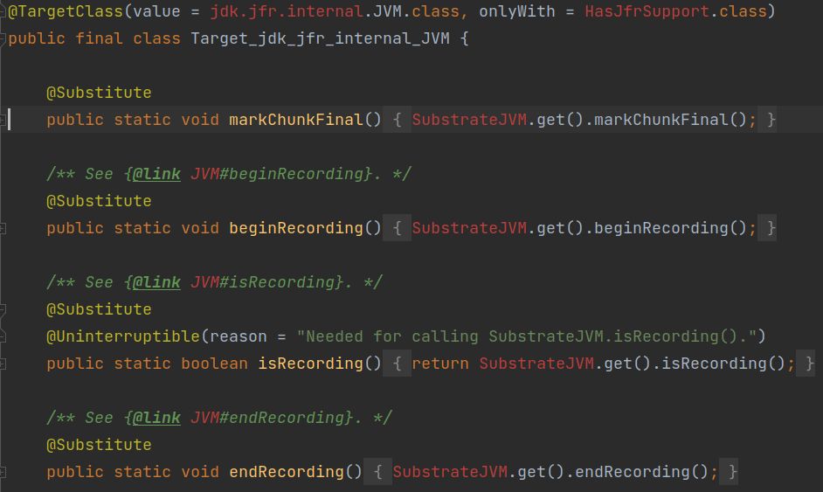
Substitutions
OpenJDK JFR calls from java into Hotspot via JNI. We must redirect those calls to our own underlying implementation.

Slide 23
Links for Further Reading
List of supported events
Article highlighting support in GraalVM for JDK20
Native JFR walkthrough with Quarkus
Official GraalVM JFR docs (though a bit outdated)
Podcast: Using Native Image JFR with Quarkus

Slide 24
Questions?
Thank you for listening

