Slide 1
Measuring the Gravitational Acceleration using Raspberry Pi

Slide 2
Motivation
Passion for Physics
Perfect fit for what I study at the Faculty of Automation and Computer Science
Good opportunity to apply what I have been studying:
Programming
Electronics
Data acquisition, handling and processing
Automation

Slide 3
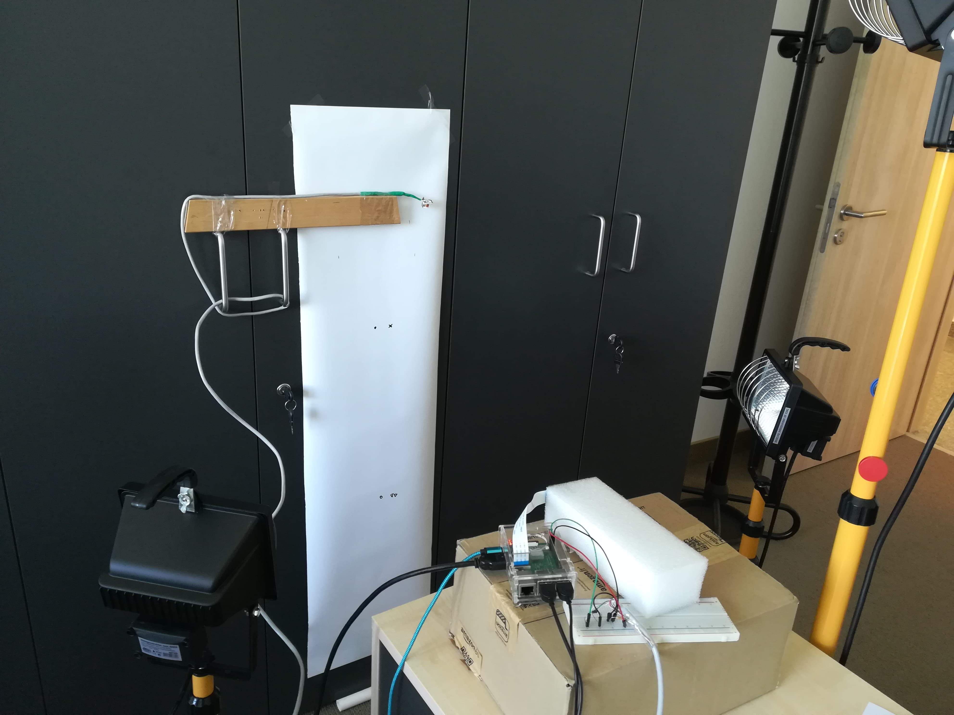
Experimental Setup

Slide 4
How does the Object-Detection program work?
Python + OpenCV (Open Computer Vision)
Checks all the frames captured with the camera for pixels that have the HSV values in between a given range
Masks these pixels, applies a threshold using Otsu’s Binarization Method
Calculates and outputs the coordinates of the geometrical center of the object
A plotting application gives the final result, based on the output of this program

Slide 5
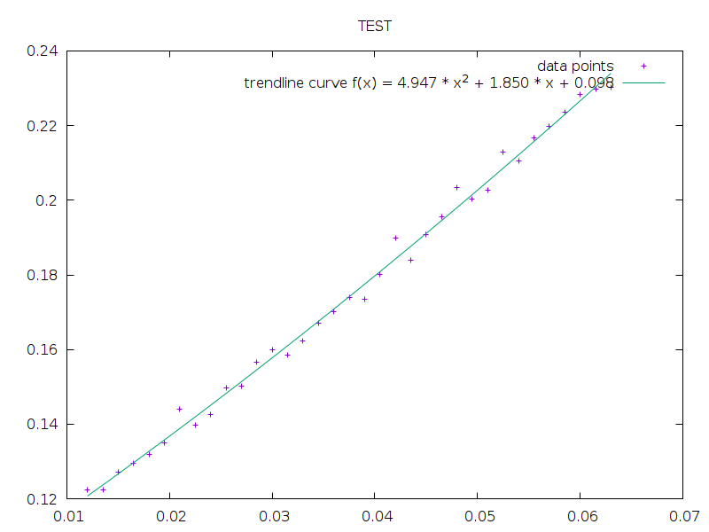
Results

Slide 6
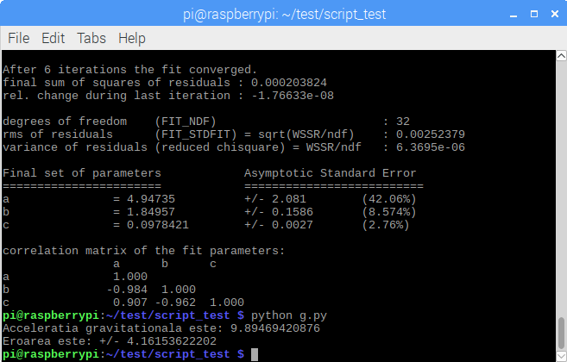
Results

Slide 7
What skills did I improve?
Python
Linux
Bash
Electronics
Tackling a big project

Slide 8
What did I learn?
Computer Vision, applied with OpenCV
Automation with Raspberry Pi
Data acquisition
Working with a relatively big pack of data
That you can do a lot of things if you knew where to find out about them
Example: Otsu’s Binarization Method

Slide 9
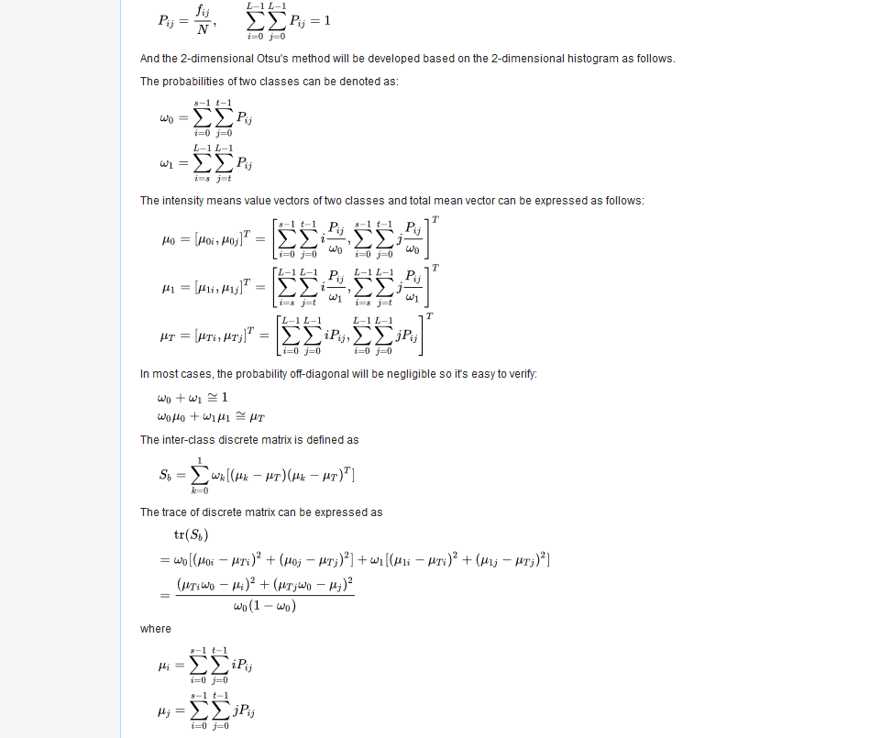
Otsu’s Binarization Method - Math

Slide 10
Otsu’s Binarization Method - Python

Slide 11
What did I discover?
I would really love a career as a Research Scientist

Slide 12
Thank you for your attention!

