Slide 1

AI CLINICAL DOCUMENTATION · DIAGNOSTIC ACCURACY · CLAIMS PROTECTION
MedScribe AI
Focus on Patients. We Handle the Rest.
F STATION· 2026
1 / 16

Slide 2
Physicians lose billions to wrong codes.
We make that impossible.
MedScribe AI enforces diagnostic protocols and insurance billing criteria in real time — reducing claim denials,
protecting physician revenue and giving doctors back the hours that paperwork stole.
$125B
86%
5–10%
€1M
Annual US physician
revenue lost to billing errors
Claim denials
are preventable
Romanian CASA invoices
rejected per Traian, psychiatrist
F/ai revenue target
within 6 months
US United States
UK United Kingdom
FR France
DE Germany
RO Romania

Slide 3
THE PROBLEM
Documentation waste is visible.
Diagnostic errors are invisible. Both cost a fortune.
Physicians lose hours to paperwork — and they lose revenue to the wrong codes, wrong criteria, and missing documentation.
Traian (psychiatrist, Romania): "If you make one error in a prescription, you pay for the entire prescription. Every error in a sick note = €5,000 fine."
DOCUMENTATION BURDEN
DIAGNOSTIC & BILLING ERRORS
49%
of workday lost to documentation (AMA/Dartmouth)
$125B
lost annually by US physicians from coding errors (AAPC/AHLA industry estimates · Change Healthcare Revenue Cycle Index)
2 hrs
per day recoverable per physician
86%
of claim denials are preventable — wrong codes, missing criteria
8+ hrs/wk
of "pajama time" completing notes after hours
80%
of medical bills contain at least one coding error
37%
of consultation time spent staring at a screen
5–10%
of CNAS invoices rejected in Romania (Traian, psychiatrist)
"There are 15,000 free transcription tools. The selling point is diagnostic accuracy — if it gets the diagnosis right, treatment will be right too." — Traian, psychiatrist

Slide 4
DIAGNOSTIC ACCURACY CRISIS
Wrong diagnosis = wrong treatment = denied claim.
Time criteria: the most violated — and most expensive — errors.
SOURCE: Transcript — Traian, Senior Psychiatrist, Romania · 5 March 2026
"For GAD you need 6 months. If you say 1 month, you don't meet the criteria — the diagnostic is wrong, the billing code is wrong, the claim is denied."
⏱ Time Criteria Failures
📋 Severity & DSM/ICD Criteria
💊 Protocol & Prescription Errors
GAD requires 6 months of anxiety — AI flagged 1-month case as GAD
Major depression: symptoms must persist daily for 2+ weeks
Schizophrenia: hallucinations must persist 6+ months outside affective episodes
First psychotic episode ≠ schizophrenia if <6 months — separate billing code
Panic disorder: criteria require recurrent episodes + persistent concern
GAD: requires ≥3 somatic + ≥3 psychological symptoms — AI missed this
ICD-10 vs ICD-11 used differently per country — Romania on ICD-10
F41.3 (mixed anxiety) ≠ F41.1 (GAD) — wrong code = claim rejection
Traian: "I'd go with F41.3 mixed anxiety disorder, not GAD — the time criterion wasn't met"
DSM-5 / CANMAT guidelines ignored by generic AI systems
Gabapentin: only prescribable on 2 codes, List A only (Romania COCA norms)
SSRIs for panic disorder in women ≠ GAD treatment — different drug class
CANMAT/Maudsley guidelines: structured by evidence level per diagnosis
Prescribing outside protocol = claim rejected + full prescription repayment
"We need filters on therapeutic protocols" — Traian, re: prescription validation

Slide 5
INSURANCE CLAIMS CRISIS
France: our primary market. The others are expansion.
FR
France
PRIMARY MARKET
EXPANSION MARKETS
ICD-10 · CCAM · CNAM · Carte Vitale
UK
United Kingdom
NHS coding backlog
SNOMED CT · OPCS-4
CNAM Audit
2023 Law
Station F
OPCS-4.10 errors reduce PbR tariff. Private sector (AXA, Bupa) = direct billing impact per error.
CCAM code unjustified → instant audit trigger
Health Modernization Act mandates certified billing software
Home market — CNAM & hospital groups accessible from campus
DE
Germany
>20% OPS rejection
Mandatory compliance window
ICD-10-GM · OPS · GKV/PKV
French Health Modernization Act (2023) requires certified billing software for all private clinics — this is an access mandate, not a nice-to-have.
Dual GKV/PKV system — different documentation logic per patient. Quarterly billing or claims forfeit.
CCAM miscoding = CNAM audit
RO
Romania
5–10% CASA rejection
A clinical act code unsupported by documentation triggers an automatic CNAM audit. No warning, no grace period. One error = full review.
ICD-10 · COCA · SIUI
"One prescription error = repay entire prescription." — Traian. €5K fine per sick note error.
Carte Vitale integration
Claims window 2 years, but front-end coding errors cause instant rejection before the Carte Vitale window even opens.
US
United States
$125B/yr losses
Our go-to-market anchor
ICD-10-CM · CPT · CMS
50 private clinics × €70/mo = €3.5K MRR by Month 2. Station F gives direct access to CNAM contacts and French hospital group leadership.
Medicare Advantage: 15.7% initial denials, 57% overturned on appeal. 487 new codes in FY2026.

Slide 6
THE SOLUTION
Three intervention points. One platform. Every market.
MedScribe AI operates at the three critical moments where documentation errors become denied claims — enforcing
the right protocol, in the right language, for the right insurance system.
01
02
03
Diagnostic Criteria
Enforcement
Procedure Code
Validation
Billing-Ready
Documentation
Before any code is assigned, MedScribe AI validates that documented evidence meets the diagnostic criteria — time thresholds, severity markers, differential exclusions. GAD requires 6 months. Major depression requires 2 weeks. MedScribe AI checks both.
MedScribe AI cross-validates procedure codes against documented clinical justification. Germany's OPS codes — >20% rejection rate — are validated before submission. OPCS-4 (UK), CCAM (France), COCA protocols (Romania): same logic, market-specific rules.
MedScribe AI generates insurance-ready notes satisfying payer requirements per market — Medicare in the US, NHS PbR in the UK, CNAM in France, GKV/PKV in Germany, CASA/CNAS in Romania. Audit trail included. Prescription protocol compliance enforced.
ICD-10-CM (US) · SNOMED CT (UK) · ICD-10 + CCAM (FR) · ICD-10-GM (DE) · ICD-10 + COCA (RO)
CPT / ICD-10-PCS (US) · OPCS-4.10 (UK) · CCAM / NGAP (FR) · OPS (DE) · SIUI / CNAS (RO)
Medicare / Medicaid · NHS + AXA/Bupa · CNAM / Carte Vitale · GKV + PKV (GOÄ) · CNAS + CASA

Slide 7
PROTOCOL COVERAGE MATRIX
What MedScribe AI enforces — by market, by layer.
Built (MVP)
In Progress (Q2 2026)
Planned (Q3 2026+)
Protocol Layer | FR France | RO Romania | UK United Kingdom | DE Germany | US United States
Transcription & Notes | Built FR/multilingual ASR | Built RO language + SIUI-ready | Built EN + multilingual | Built DE language support | Built EN / telehealth
Diagnostic Coding | In Progress ICD-10 + CCAM mapping | In Progress ICD-10 + COCA norms | Planned Q3 SNOMED CT + ICD-10 | Planned Q3 ICD-10-GM validation | Planned Q4 ICD-10-CM + CPT
Diagnostic Criteria Validation | In Progress DSM-5 / ICD-10 time + severity criteria | In Progress Validated with psychiatrists | Planned Q3 NICE / Maudsley criteria | Planned Q3 S3 Guidelines | Planned Q4 DSM-5 / CANMAT
Insurance Billing Compliance | Planned Q3 CNAM / Carte Vitale integration | Planned Q3 COCA + SIUI / CNAS integration | Planned Q4 OPCS-4 / PbR tariff | Planned Q4 OPS / GKV/PKV | Planned 2027 CPT / prior auth / CMS
Primary Denial Trigger | CCAM not justified by clinical note | Outside COCA protocol; sick note error (€5K fine) | OPCS-4 error reduces PbR tariff | ICD-10-GM qualifier missing; OPS >20% rejection | Prior auth missing; code specificity insufficient

Slide 8
TECHNOLOGY
Three intelligent layers. All running simultaneously.
LAYER 1
LAYER 2
LAYER 3
Transcription
Translation
Clinical Copilot
⚡ Deepgram Nova-3 Medical
⚡ Google Cloud / Azure
⚡ Anthropic Claude / GPT-4o
⚡ 3.45% WER
⚡ Medical glossaries
⚡ Live differential Dx
⚡ Multilingual streaming
⚡ Real-time overlay
⚡ Diagnostic criteria validation
⚡ Speaker diarization
⚡ <500ms latency
⚡ Protocol compliance
⚡ <500ms latency
⚡ Full RTL support
⚡ Safety alerts
MedScribe AI adds a 4th layer competitors lack: Protocol & Criteria Validation — enforcing DSM-5/ICD-10 time criteria, COCA norms, CANMAT/Maudsley treatment protocols before any code is assigned or any claim is submitted.

Slide 9
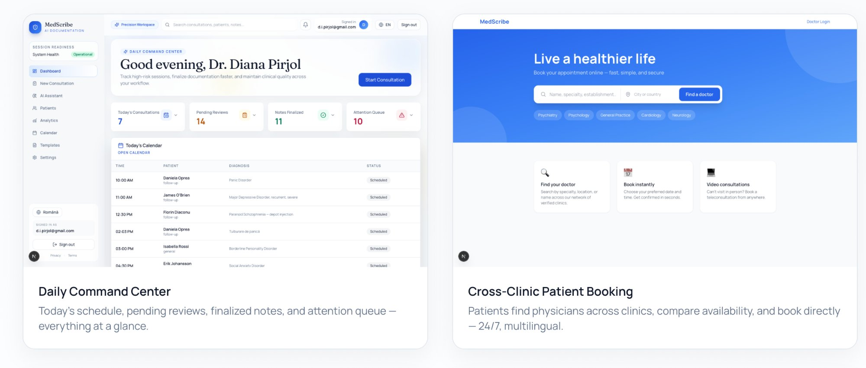
THE PRODUCT
Built and Working Today

Slide 10
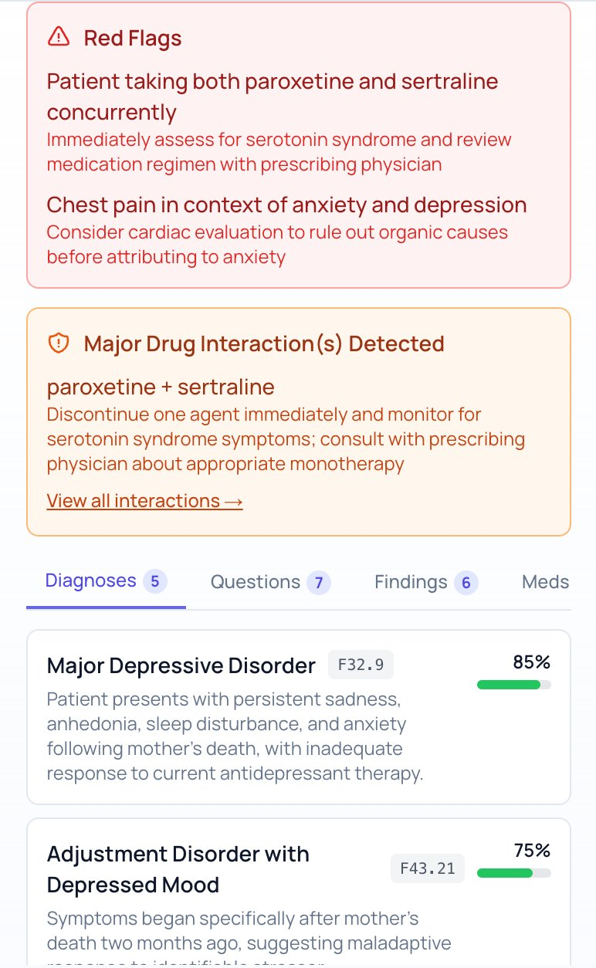
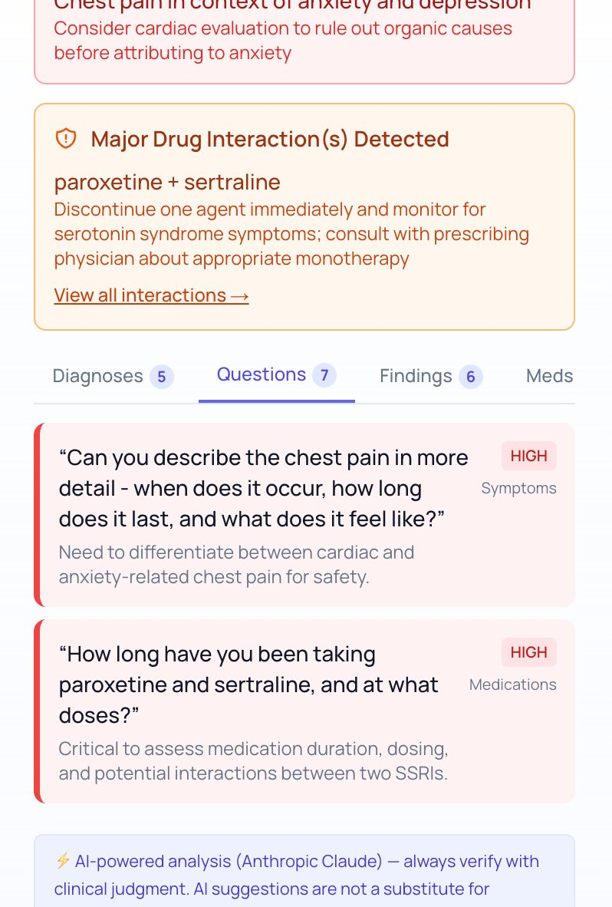
LIVE CLINICAL COPILOT
AI Thinks During the Consultation
Live safety alerts, drug interactions, and differential diagnoses — even in complex mental health cases.
Safety Alerts & Differential Dx
AI-Suggested Questions
Red flags, drug interactions (serotonin syndrome), and ranked diagnoses with ICD codes — surfaced live.
Prioritized clinical questions with reasoning — nothing missed, even in complex mental health cases.

Slide 11
LIVE CLINICAL COPILOT
AI thinks during the consultation — not after.
Diagnostic criteria enforced in real time, not discovered at claim submission.
LIVE CONSULTATION — AI COPILOT OUTPUT
[Aim] Criteria-Aware AI
Patient: "I've been anxious for about a month, having trouble sleeping.."
MedScribe AI knows that GAD = 6 months, that depression requires 2-week daily symptoms, that first psychosis ≠ schizophrenia. Generic AI systems do not.
Patient: "My mother had depression after grandma died, but overall no [family history]."
⚠ CRITERIA ALERT
GAD (F41.1) requires ≥6 months. Only 1 month reported — criterion NOT met.
[Chart] Real-time vs Post-hoc
Competitors analyze after the consultation. MedScribe AI delivers evolving insights while the patient is still in the room — errors caught before they become claims.
✓ SUGGESTED CODE
F41.3 Mixed anxiety and depressive disorder — better fit for current symptom duration.
? MISSING CRITERIA
Confirm: muscle tension, irritability, restlessness, excessive fatigue — 3 somatic + 3 psychological required.
[Lock] Protocol Compliance
✓ FOLLOW-UP Qs
Prescription validation against COCA (Romania), NICE/Maudsley (UK), CANMAT (Canada/EU). Wrong prescription = full repayment. MedScribe AI prevents this.
Check TSH, B1, B6, B12 to exclude organic causes. Caffeine intake? Sleep architecture?

Slide 12
MARKET OPPORTUNITY
$27B+ Global Market by 2033 — No dominant player outside the US.
Market | Key Driver | Pricing (validated) | Path to €1M
FR France (Priority) | 2023 Modernization Act mandates certified billing software | €70/mo · private clinics | 50 clinics · 2 months
UK United Kingdom | NHS coding backlog; private AXA/Bupa billing accuracy | £60–80/mo · private sector | 60 providers · 3 months
DE Germany | OPS >20% rejection rate; GKV/PKV dual system burden | €80–100/mo · OPS moat | 60 providers · 4 months
RO Romania (Traian insights) | CASA 5–10% rejection; COCA protocol enforcement; SIUI integration | €40–60/mo · CMIs | 100 CMIs · 5 months
US United States | $125B billing losses; prior auth; Medicare Advantage 11–17% denials | $99–199/mo · specialty | Scale from EU base
TAM
SAM
$27B+
SOM
$16B+
$5–10M
Private clinics FR/RO
Year 1–3 realistic
with solo founder
Outpatient, specialty
& mental health
across 5 markets
Global AI clinical
documentation by 2033
(28.4% CAGR)

Slide 13
COMPETITIVE ADVANTAGE
Why MedScribe AI wins — where every other tool stops.
1
Diagnostic Criteria
Enforcement
2
Insurance Protocol
Compliance
3
Real-time — Not
Post-hoc Analysis
The only platform that validates ICD-10/DSM time criteria before assigning a code. GAD requires 6 months — MedScribe AI checks. Others don't.
COCA (Romania), CCAM (France), OPS (Germany), OPCS-4 (UK), CPT (US) — validation rules per market, per payer. Not a generic scribe.
MedScribe AI thinks during the consultation. Competitors process after. Errors caught at 0 cost, not discovered at claim denial.
4
Full Patient Journey
Ownership
5
Multi-Market
Protocol Engine
6
European Launchpad
from Station F
Booking → consultation → referral → billing → continuity. No competitor covers the full cycle across 5 markets simultaneously.
US/UK/FR/DE/RO from a single platform. Different coding systems, same AI engine — localized to each insurance architecture.
Paris base → CNAM, hospital groups, GDPR-compliant architecture. F/ai partner network (Anthropic, Microsoft, Mistral) for AI infrastructure.

Slide 14
See How MedScribe AI Stacks Up
FEATURE COMPARISON
Yes
Partial
No
Capability
MedScribe AI
Heidi
Freed
Nabla
Nuance DAX
DeepScribe
CORE DOCUMENTATION
Real-time ambient transcription
✓
✓
✓
✓
✓
✓
AI clinical note generation (SOAP, CHEDDAR etc.)
✓
✓
✓
✓
✓
✓
Source-traceable notes (cite exact quote per claim)
✓
×
×
×
×
Specialty-specific note templates (20+ specialties)
✓
✓
✓
✓
✓
✓
Referral letters auto-generated from transcript
✓
✓
×
×
✓
×
After-visit / patient-facing summaries
✓
✓
✓
×
✓
×
Pre-charting & visit prep (prior visit summary, chat)
✓
✓
×
×
×
CLINICAL INTELLIGENCE
Live Clinical Copilot (during visit)
✓
×
×
×
Clinical evidence / guidelines at point of care
✓
✓
×
×
✓
×
AI-suggested follow-up questions (live)
✓
×
×
×
×
×
Evolving differential diagnosis (live)
✓
×
×
×
×
×
Safety alerts & drug interaction checking
✓
×
×
✓
×
HCC risk / value-based care coding support
✓
×
×
✓
✓
Human QA review layer
×
×
DIAGNOSTIC ACCURACY (MedScribe AI moat)
ICD-10 / CPT auto-coding
✓
✓
✓
✓
✓
Diagnostic time criteria enforcement (DSM/ICD)
✓
×
×
×
×
×
Severity & symptom count validation (GAD, MDD, etc.)
✓
×
×
×
×
×
Multi-standard coding (ICD-10-GM, SNOMED CT, CCAM)
✓
×
×
×
×
Procedure code validation (OPCS-4, OPS, CCAM)
✓
×
×
×
×
×
CLAIMS PROTECTION (MedScribe AI moat)
Insurance billing validation per payer/market
✓
×
×
×
×
COCA / CNAM / GKV / SIUI protocol compliance
✓
×
×
×
×
×
Prescription protocol enforcement (CANMAT / Maudsley)
✓
×
×
×
×
×
Claim denial prevention with audit trail
✓
×
×
×
×
MULTILINGUAL & PATIENT JOURNEY
Live multilingual translation (patient ↔ clinician)
✓
×
×
×
×
×
Transcription in 14+ languages
✓
✓
×
×
AI patient comms & follow-up automation
✓
✓
×
×
×
Full patient journey (booking → billing → continuity)
✓
×
×
×
×
Cross-clinic physician discovery & booking
✓
×
×
×
×
×
Practice analytics & reporting
✓
×
×
×
✓
×
Sources: Heidi (heidihealth.com, Evidence launch Feb 2026), Freed (getfreed.ai, Feb 2026), Nuance DAX / Dragon Copilot (Microsoft, Feb 2026), DeepScribe (deepscribe.ai, KLAS 2025). Nabla (nabla.com, 2026). MedScribe AI data from product roadmap.
On-premise / private cloud deployment
HIPAA compliant (SOC 2 / BAA)
GDPR native (EU data residency)
SIUI / CNAS integration (Romania)

Slide 15
BUSINESS MODEL
SaaS per-clinician licensing — revenue starts Day 1 with Starter and Professional.
MOST POPULAR
Starter
Available now
Professional
Available now
Enterprise
€49–99
€149–199
Custom pricing
annual contract
/clinician/month
/clinician/month
Aspirational — post traction
✓ Live transcription
✓ Everything in Starter
→ On-premise deployment
✓ 2 languages
✓ Unlimited languages
→ SSO / SAML
✓ SOAP notes
✓ Live translation
→ Custom glossaries
✓ PDF export
✓ Clinical Copilot
→ SIUI/CNAM/GKV integration
✓ Diagnostic criteria alerts
✓ Protocol compliance engine
→ SLA guarantee
✓ Email support
✓ EMR integration
✓ Priority support
F/ai Revenue Path: France 50 clinics × €70 = €3.5K MRR (Mo.2) → +UK 60 × £70 → +Germany 60 × €80 → +Romania 100 CMIs × €50 → 250+ providers = €1M ARR at Month 6 Deal Day

Slide 16
PRODUCT ROADMAP
Path to market — and to €1M ARR by F/ai Deal Day.
Done
In Progress
Planned
Planned
Q1 2026
Q2 2026
Q3 2026
(F/ai Sep)
Q4 2026
(Deal Day)
Foundation
Intelligence
Claims Protection
Scale
✓ ASR integration
✓ Live Clinical Copilot
→ Insurance code validation per market
→ On-premise deployment
✓ Multilingual transcription
✓ Real-time translation
→ SIUI / CNAM / GKV billing integration
→ Specialty models (psychiatry, cardiology)
✓ Basic SOAP notes
✓ Diagnostic criteria engine (ICD-10/DSM)
→ Prescription protocol enforcement
→ API marketplace
✓ Demo mode
✓ Patient summaries
→ Audit trail per payer requirement
→ Institutional learning
✓ Source traceability
→ Protocol compliance (COCA/CCAM)
→ EMR / FHIR integration
→ Hospital group enterprise deals

Slide 17
TRACTION & VALIDATION
Early validation from practicing physicians — not desk research.
KEY VALIDATION SESSION
Traian — Senior Psychiatrist, 10+ years · Romania · 5 March 2026
"There are 15,000 free transcription tools. The selling point is diagnostic accuracy — if it gets the diagnosis right, treatment will be right too. That's the differentiator."
VALIDATED ✓
GAPS IDENTIFIED (Roadmap Input)
Diagnostic accuracy is the #1 selling point — not transcription
Transcription lag under fast speech (anxious patients speak quickly)
ICD/DSM time criteria (6-month rule for GAD) are routinely missed by AI
AI not enforcing ICD-10 time criteria — must be hard-wired
Prescription protocol errors cost physicians the entire prescription value
SIUI / CNAS integration: prescription reporting and claim sync
Sick note errors: €5,000 fine per error (CNAS enforcement)
COCA protocol filters: prescription must match exact approved indication
Maudsley & CANMAT as the gold-standard clinical protocol references
Environmental microphone needed for clinical ambient capture
Private clinics & CMIs are the right first target — admin-heavy, fee-at-risk
Traian offered to continue as clinical advisor (monthly sessions)
1
Clinical advisor sessions completed
12+
Physician markets consulted (RO · UK · IL · AU)
MVP
Live product — full patient journey built
LOI
Pursuing: Traian (RO) & 2 private clinics

Slide 18







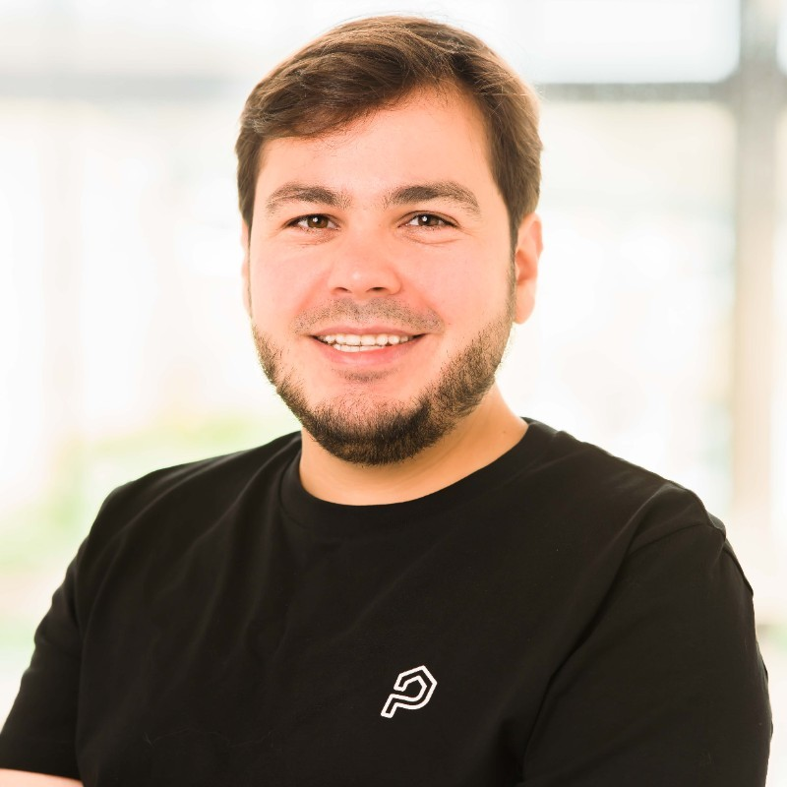




TEAM & HIRING PLAN
Who's building MedScribe AI — and who we're hiring first.
CURRENT TEAM
D
Diana Pirjol, MBA, MSc
FOCUS
Co-Founder & CEO
Vision · product strategy · clinical validation · fundraising · market entry. Life-science and healthcare
Gates Cambridge · Fulbright · AstraZeneca (4 ventures) · EU Innovation Council Expert · $20M World Bank Trust Fund portfolio
S
Ștefan Boronea
FOCUS
Co-Founder & CTO
Technical architecture · AI/ML infrastructure · product development · security & compliance. AI/ Deep tech
Entrepreneur First alumni (London). Co-founded Proportunity — ML-driven real estate (9+ yrs). Former Security Team Lead at Booking.com (3 yrs). IEEE & ACM member.
HIRING PLAN — with F/ai funding
#1 PRIORITY
Immediately — pre-close
#2 PRIORITY
Month 2–3 post-funding
#3 PRIORITY
Month 3–4 post-funding
Clinical Co-Founder / CMO
Senior Full-Stack Engineer
Clinical Ops / Customer Success
Physician with digital health experience · protocol validation · equity partner
EHR/FHIR integration experience · SIUI/CNAM API knowledge a plus
Healthcare background · French or Romanian market · clinic onboarding experience

Slide 19
STATION F · F/ai ALIGNMENT
Built for F/ai. Designed to reach €1M in 6 months.
✓ AI-native with strong technical foundations
F/ai PARTNER RELEVANCE
Diagnostic criteria enforcement engine trained on ICD-10/DSM/COCA/CCAM validation rules — the AI is the moat, not a wrapper on a transcription API.
· Anthropic — AI safety & clinical compliance
· Microsoft Azure — HIPAA/GDPR-eligible cloud
✓ Clear path to €1M revenue in 6 months
· Mistral AI — French language sovereignty
France (CNAM compliance urgency post-2023 law) → UK private clinics → Germany OPS moat → Romania CMIs. 250 providers × €70 avg = €1M ARR at Deal Day.
· AWS — HIPAA-eligible infrastructure
· Hugging Face — open-source medical models
✓ Build globally competitive companies from Europe
· Sequoia / General Catalyst / Kima — investor access
Paris base → CNAM + French hospital group access. 5-market protocol engine from day one. EU-first architecture with US scale pathway.
DEAL DAY TARGET — APRIL 2027
MedScribe AI's F/ai Deal Day partnership target: Ramsay Santé or Elsan (French hospital groups) + a Romanian private clinic chain. Both represent the home-market institutional validation that unlocks UK/DE/US scale.
✓ Product ready for commercialisation
MVP validated with practicing physicians. Traian session (March 2026) identified and prioritised the diagnostic accuracy + claims protection roadmap.

Slide 20
THE ASK
What we need from Station F F/ai.
MedScribe AI is at a critical inflection point: product validated, technology proven, founder-market fit established. F/ai will accelerate our path from MVP to €1M ARR.
[Brain] Mentorship & Network
[Money] Funding & Resources
Access to healthcare industry mentors, hospital CIOs, and clinical champions. Psychiatry + cardiology specialist advisors for protocol engine refinement (Traian identified this gap directly).
Seed capital for cloud infrastructure, ASR/LLM API costs during pilot phase, and go-to-market in France, UK, Germany, Romania. Compute credits via F/ai partner network (AWS, Azure, Anthropic).
[Hospital] Customer Introductions
[Map] Go-to-Market Strategy
Warm introductions to French private hospital groups (Ramsay Santé, Elsan), UK private clinics, German specialist practices, and Romanian clinic chains. Deal Day as commercial activation moment.
Guidance on enterprise sales cycles in healthcare, regulatory navigation (HIPAA/GDPR/DSPT/CNAM), insurance system integration priorities, and pricing optimisation per market.

Slide 21
MedScribe AI
I lighten your burden. In every language. In every system.
US ICD-10-CM
UK SNOMED CT
FR CCAM/CNAM
DE ICD-10-GM/OPS
RO COCA/SIUI
AI Clinical Copilot · Diagnostic Accuracy · Claims Protection
medscribe.ai · diana@medscribe.ai · Station F F/ai · Sep–Dec 2026
"Medicine will absolutely be assisted by AI in the coming years. But we must ensure it gets the differential diagnosis right. Get that right — and the treatment recommendations will be right too."
— Traian, Psychiatrist · Romania · 5 March 2026

