Slide 1





MedScribe AI
INCUBATION
PROGRAM
APPLICATION
Focus on Patients.
We Handle the Rest.
Diana Pirjol, MBA, MSc
Founder & CEO
The full patient journey — from booking to referral — powered by
multilingual AI. Real-time transcription, translation, and live
clinical decision support.
2026
Live Copilot
2 hrs/day saved
HIPAA & GDPR
Multilingual
1 / 16

Slide 2




THE PROBLEM
We cannot train enough physicians
to meet demand.
Physicians spend 49% of their workday on documentation — nearly double the 27% spent on patients. The WHO projects a 10M health worker shortfall by 2030. In multilingual hospitals, documentation errors compound clinical risk.
49%
10M
40%
2×
of workday lost
to documentation
health worker
shortfall by 2030
mental health
professional burnout
more errors in cross-
language consultations
No solution covers the full patient cycle or spans multiple languages simultaneously.
2 / 16
Sources: ¹ Sinsky et al., Annals of Internal Medicine, 2016 (AMA/Dartmouth-Hitchcock). ² Boniol et al., BMJ Global Health, 2022; WHO Global Strategy on HRH: Workforce 2030. ³ O'Connor et al., European Psychiatry, 2018 — meta-analysis of 62 studies, 33 countries (n=9,409). ⁴ Based on multilingual hospital documentation error analysis.

Slide 3




THE SOLUTION
The Full Patient Journey — One Platform
Every competitor stops at the consultation. MedScribe AI owns the entire cycle.
1
→
2
→
3
→
4
→
5
Booking
Pre-Visit
Consultation
Post-Visit
Continuity
Live Transcription
Instant Translation
Clinical Copilot
Smart Notes
Word-by-word with speaker identification across any language
Real-time overlay so every participant understands every word
AI suggests follow-up questions and evolving differential Dx — live
Source-traceable SOAP notes — every sentence linked to what was said
3 / 16

Slide 4

TECHNOLOGY
Three Intelligent Layers, Real Time
All layers run simultaneously. The doctor sees transcription, translation, and AI suggestions updating in real time — no waiting.
LAYER 1
LAYER 2
LAYER 3
Transcription
Translation
Clinical Copilot
⚡
Deepgram Nova-3 Medical
⚡
Google Cloud / Azure
⚡
Claude / GPT-4o
⚡
3.45% WER
⚡
Medical glossaries
⚡
Live differential Dx
⚡
Multilingual streaming
⚡
<500ms latency
⚡
Follow-up questions
⚡
Speaker diarization
⚡
Cached for speed
⚡
Safety alerts
Sources: WER benchmarks from Deepgram Nova-3 Medical documentation. Translation latency based on Google Cloud Translation API & Azure Cognitive Services specifications. LLM capabilities per Anthropic Claude and OpenAI GPT-4o technical reports.
4 / 16

Slide 5
THE DIFFERENTIATOR
AI Thinks During the Consultation
Competitors analyze after. MedScribe AI delivers evolving insights while the patient is still in the room.
Live Clinical Copilot
Intelligent SOAP Notes
96% traceability score
Suggested Questions
"Have you experienced blurred vision?"
S
Headaches for 1 week, worse in mornings.
Discontinued Amlodipine 5mg 3 days ago.
"Any family history of hypertension?"
"Why did you stop taking the medicine?"
O
BP: 160/95 mmHg. Dizziness,
blurred vision.
Evolving Differential Dx
HIGH
Hypertensive urgency
A
Hypertensive urgency secondary
to medication non-adherence.
MOD
Hypertensive emergency
Restart Amlodipine 5mg. Order BMP,
fundoscopy. Follow-up 48h.
📋 Patient summary auto-generated in patient's language · 6th-grade reading level · Full RTL support
Clinical Flags
P
BP 160/95 — medication non-adherence
Consider urgent fundoscopy
5 / 16

Slide 6
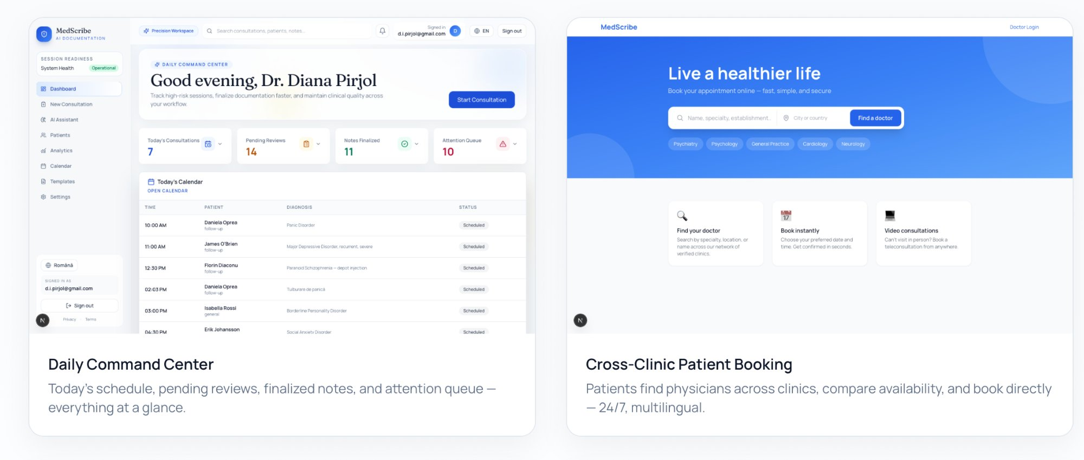
THE PRODUCT
Built and Working Today
6 / 16

Slide 7
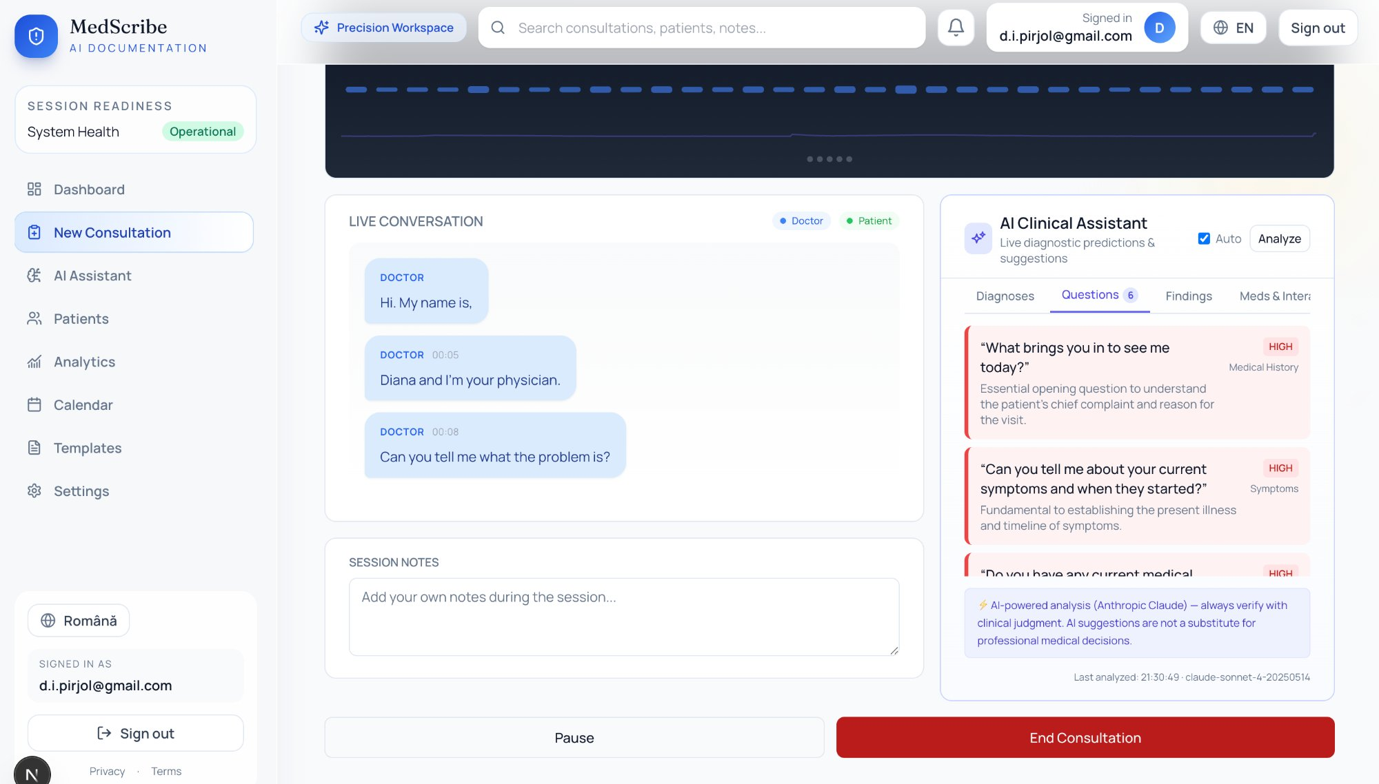
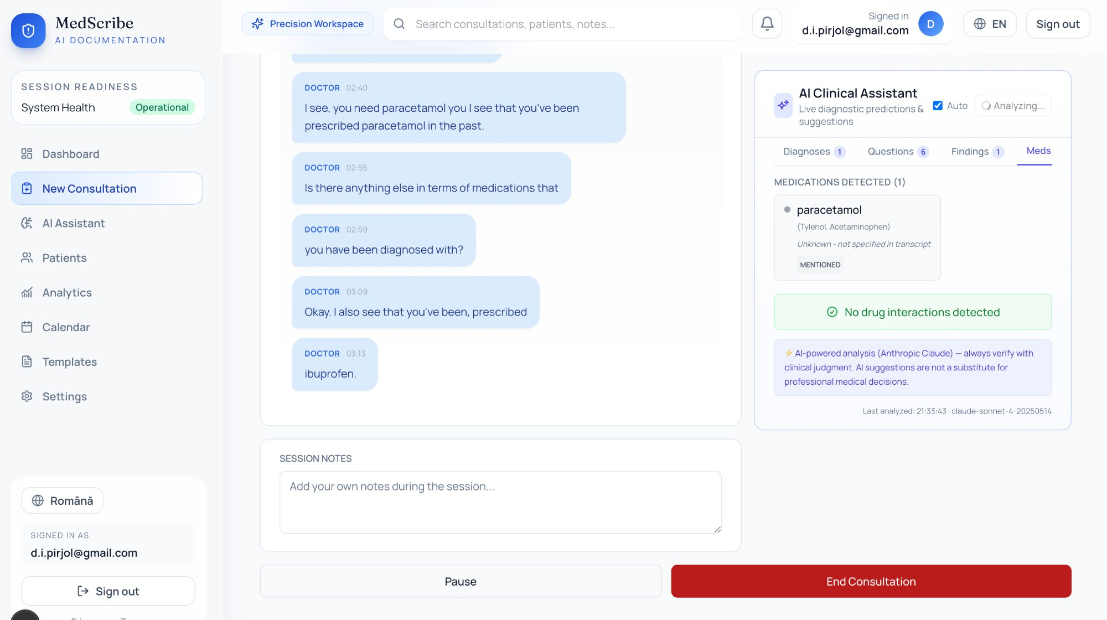
LIVE CLINICAL COPILOT
AI Thinks During the Consultation
AI-Suggested Questions
Medication & Interaction Tracking
Prioritized clinical questions surface in real time as the doctor speaks — nothing missed.
Medications detected from conversation. Drug interactions checked automatically — zero manual entry.
Powered by Anthropic Claude · Real-time streaming via Deepgram Nova-3 Medical
7 / 16

Slide 8
PROVEN IMPACT
Numbers That Matter
FOR CLINICIANS
2 hrs/day
30-sec
37%
8+ hrs/wk
Reclaimed from
documentation
Patient prep replaces
15-20 min chart review
Less screen time —
look at the patient
Of 'pajama time'
eliminated
FOR CLINICS & PRACTICES
10 hrs/wk
10-20%
15-25%+
New revenue
Per provider regained in
manual-doc settings
More patients seen
per provider
Revenue uplift from
throughput & coding
Longitudinal data for
clinical trials & RWE
Sources: Projected impact based on clinical AI scribe benchmarks. Sinsky et al. (AMA, 2016); Tai-Seale et al., Health Affairs, 2017; Tierney et al., JAMIA, 2024. Revenue uplift estimates per McKinsey & Co. healthcare practice.
8 / 16

Slide 9
MARKET OPPORTUNITY
$27B+ Global Market by 2033
10M health workers short by 2030 and half of clinician capacity lost to documentation — clinical AI is no longer optional.
TAM
SAM
SOM
$27B+
$16B+
$500M
Global AI clinical
documentation by 2033
(28.4% CAGR)
Outpatient, specialty
& mental health
Private multi-specialty
& mental health globally
Target Regions
Europe
GCC
Asia
Africa
Latin America
United States
Sources: TAM: Grand View Research, AI in Healthcare Market Report, 2033 (38.9% CAGR); Market.us AI in Medicine Report, 2033 (27.6% CAGR). SAM/SOM: Company estimates based on outpatient specialty & mental health addressable segments. WHO Global Health Expenditure Database.
9 / 16

Slide 10
COMPETITIVE ADVANTAGE
Why MedScribe AI Wins
1
Full Patient Journey
2
Built for Mental Health
3
Live Clinical Copilot
Booking → consultation → referral → continuity. Competitors stop at the consultation.
Zero in-session documentation. Clinicians fully present. Post-session notes generated instantly.
AI thinks during the consultation — differential Dx, safety alerts, questions. Competitors analyze after.
4
Source-Traceable Notes
5
Multilingual Native
6
Cross-Clinic Booking
96% traceability. Click any sentence → exact transcript moment. Evidence-linked audio trail.
Live transcription & translation. <500ms latency. Medical glossaries. Full RTL support.
Patients discover, compare, and book across clinics. Built-in analytics. No competitor touches the patient.
10 / 16

Slide 11
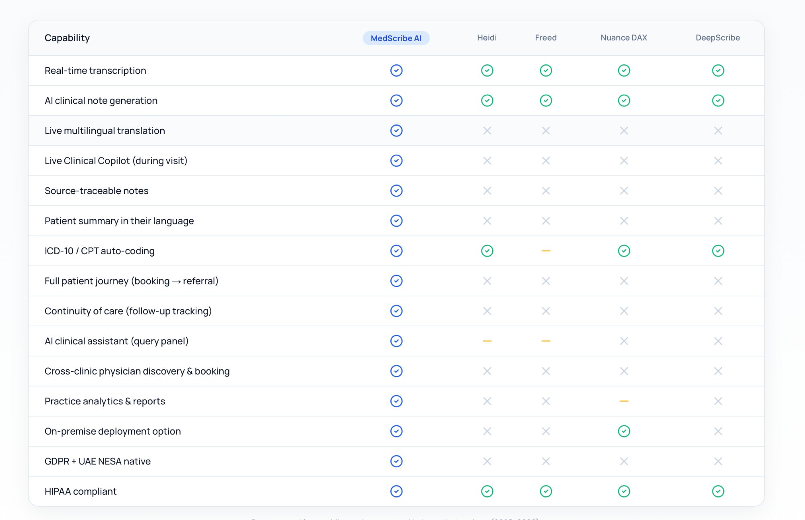
FEATURE COMPARISON
See How MedScribe AI Stacks Up
11 / 16
Source: Company websites and product documentation (2025–2026).

Slide 12
BUSINESS MODEL
SaaS Per-Clinician Licensing
Predictable, scalable revenue with enterprise tiers for larger deployments.
Starter
MOST POPULAR
Enterprise
Professional
$99
$199
Custom
/clinician/month
/clinician/month
annual contract
✓ Live transcription
✓ Everything in Starter
✓ Everything in Professional
✓ 2 languages
✓ Unlimited languages
✓ On-premise deployment
✓ SOAP notes
✓ Live translation
✓ SSO / SAML
✓ PDF export
✓ Clinical Copilot
✓ Custom glossaries
✓ Email support
✓ EMR integration
✓ Dedicated success manager
✓ Priority support
✓ SLA guarantee
12 / 16

Slide 13
PRODUCT ROADMAP
Path to Market
Q1 2026
Q2 2026
Q3 2026
Q4 2026
Foundation
Intelligence
Enterprise
Scale
COMPLETED
IN PROGRESS
PLANNED
VISION
✓ ASR integration
✓ Live Clinical Copilot
✓ EMR / FHIR integration
✓ Specialty models
✓ Multilingual transcription
✓ Real-time translation
✓ On-premise deployment
✓ Institutional learning
✓ Basic SOAP notes
✓ Source traceability
✓ Admin dashboard
✓ API marketplace
✓ Demo mode
✓ Patient summaries
✓ SSO / SAML
✓ Regional expansion
13 / 16

Slide 14








THE FOUNDER
Diana Pirjol, MBA, MSc
Founder & CEO
Gates Cambridge Scholar
Fulbright Scholar
Executive MBA
Evaluated 100+ healthcare ventures across 8 markets. Built 4 ventures from concept to market at AstraZeneca. None solved the full patient journey — so I built MedScribe AI and validated the product end to end with practicing physicians.
I know what gets funded
Built inside Big Pharma
$20M World Bank portfolio. EU Innovation Council Expert — 55+ proposals. $77.8M health program.
4 ventures at AstraZeneca. Restructuring at Sandoz/Novartis HQ. 12 pharma cos at IQVIA.
I can build the product
Network to sell it
Medical Sciences. MSc Cambridge (Gates Scholar). MBA. Maths & programming background.
AstraZeneca, Novartis, Sanofi, Pfizer, MSD, Medtronic, 8+ more. €1.5M grants. 140+ experts.
14 / 16

Slide 15




THE ASK
What We Need From the Incubator
MedScribe AI is at a critical inflection point: product validated, technology proven, founder-market fit established. The incubation program will accelerate our path from MVP to market.
Mentorship & Network
Funding & Resources
Access to healthcare industry mentors, hospital CIOs, and clinical champions who can open doors for pilot programs and early adoption.
Seed capital to fund cloud infrastructure, ASR/LLM API costs during pilot phase, and initial go-to-market activities in target markets.
Customer Introductions
Go-to-Market Strategy
Warm introductions to private hospital groups, mental health clinics, and multi-specialty practices in the GCC, Europe, and US.
Guidance on enterprise sales cycles in healthcare, regulatory navigation (HIPAA/GDPR/NESA), and pricing optimization.
15 / 16

Slide 16
MedScribe AI
LET'S
BUILD
THIS
The future of clinical documentation is
multilingual, intelligent, and real-time.
MedScribe AI saves clinicians 2 hours per day, covers the
full patient journey, and addresses a $27B+ market that no
competitor fully serves. The workforce is shrinking.
Demand is rising. We are the only lever.
Confidential · 2026
diana@medscribe.ai
Diana Pirjol, MBA, MSc — Founder & CEO
16 / 16

